Slide 1
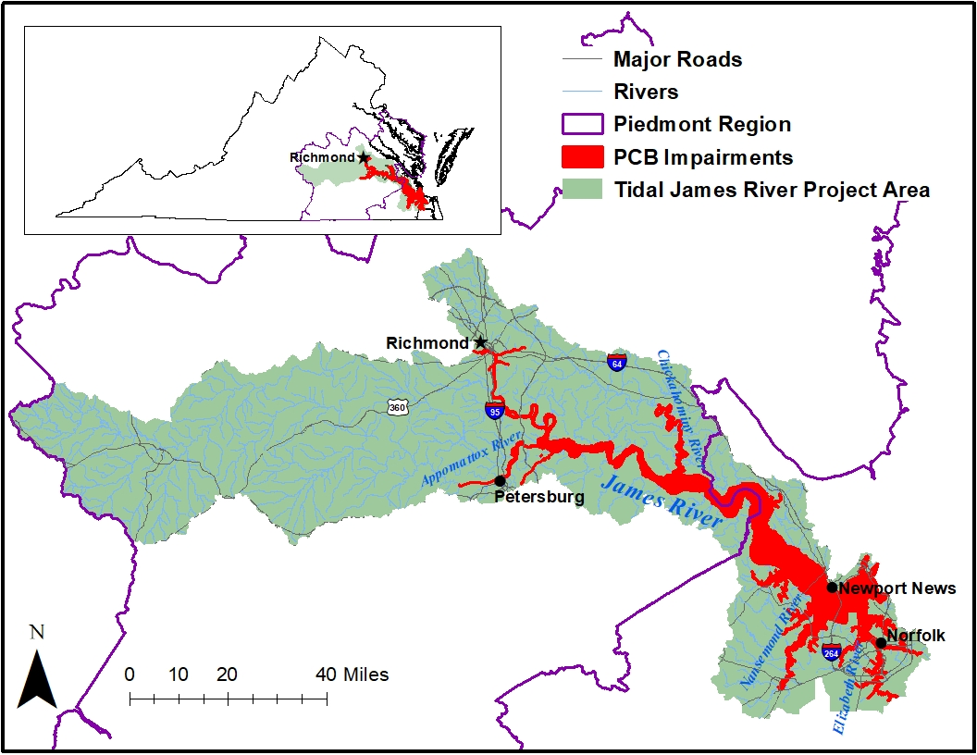
Tidal James River, Elizabeth River, and Tidal Tributaries PCB Study Area
Welcome! Please enter your name and affiliation in the chat box
For Technical Support call 804.527.5029

Slide 2
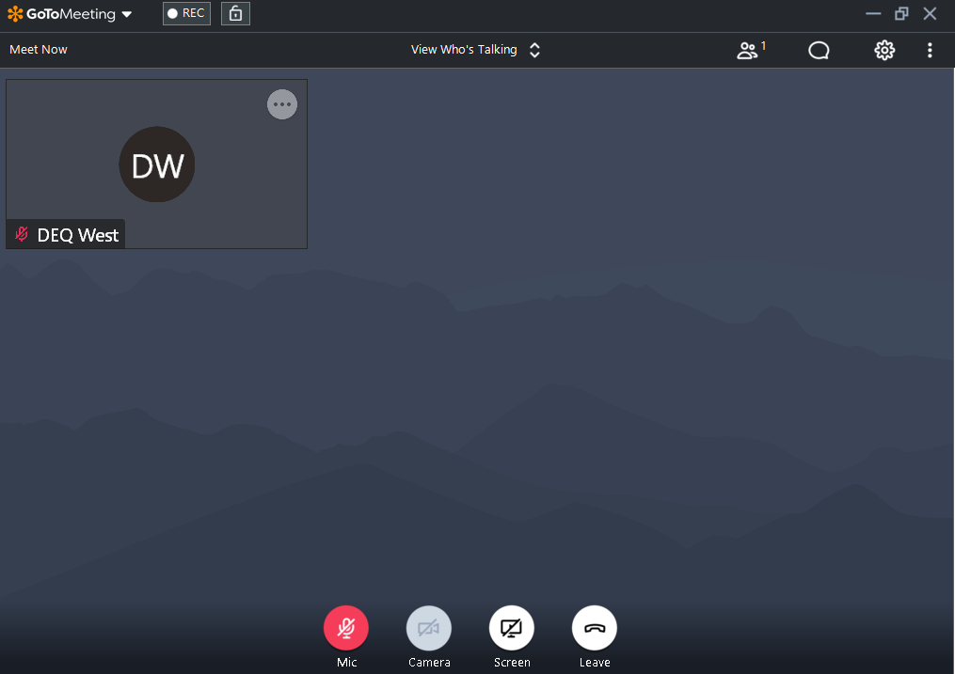
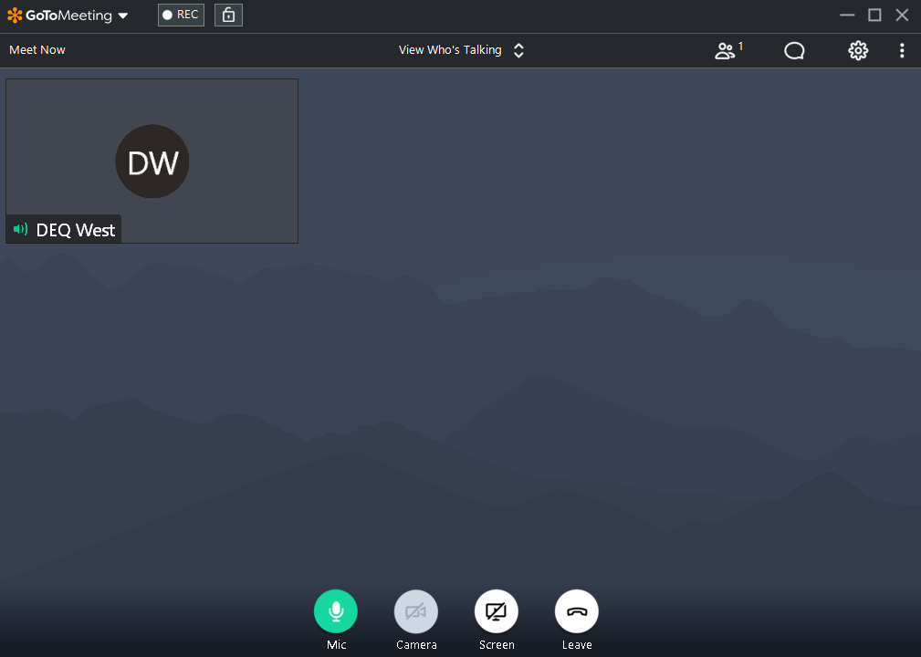
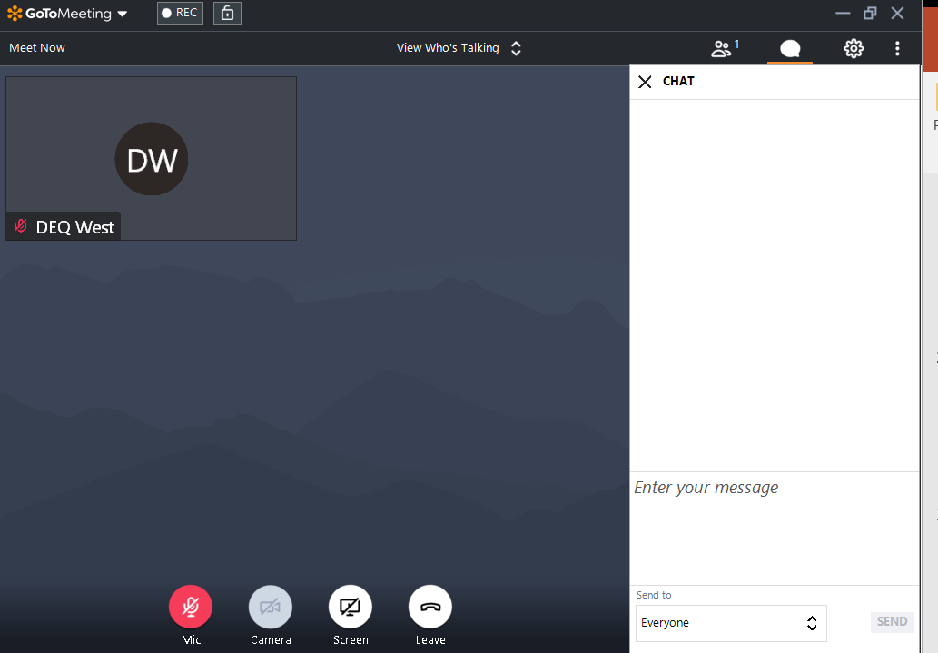
Getting Familiar with GoToMeeting
For technical support issues call: 804-527-5029

Slide 3




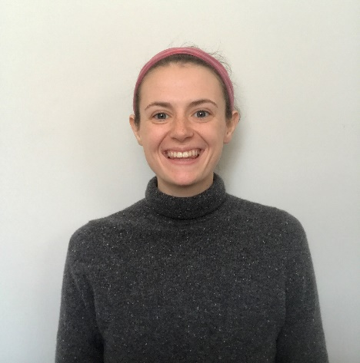
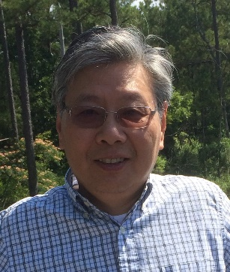

Introductions
Mark Richards
DEQ Central Office
Jen Rogers
Piedmont Regional Office
Kelley West
Piedmont Regional Office
Paige Haley
Tidewater Regional Office
Dr. Jian Shen
Res. Prof. of Marine Science
Notes:
Intro Myself
Jen P, planning Team Lead at Piedmont and is serving as technical support for this meeting
Rob Breeding from CO on questions
Warren Smigo and Mike Shaver- our Piedmont Regional Biologists- they are the ones out collecting bugs and providing tons of data for the study. They are on the call tonight to help with questions as they are the experts when it comes to all things biology- They also provided many of the photos for this presentation
We also are teaming with Katie Shoemaker at Wetland Studies and Solutions, Inc and Dr. Robert Brandt from JMU who are the contractors working on this project.
Also want to acknowledge Matt Carter, Garth Jenkins and Andrew Kirk on the water monitoring crew who help collect lots of data for use in this project

Slide 4
Tidal James River, Elizabeth River, and Tidal Tributaries PCB Water Quality (TMDL) Study:
Technical Advisory Subcommittee Meeting (Piedmont Regional Office)
Mark Richards & Jen Rogers
March 25, 2021

Slide 5
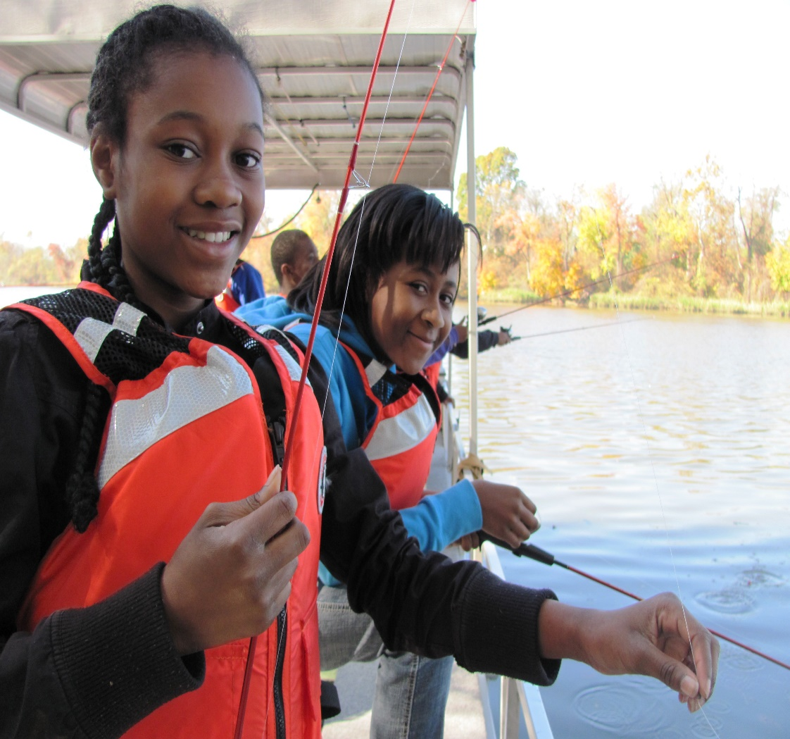

Meeting Agenda
Meeting objective and Technical Advisory Committee’s Role
TMDL Development Process
Overview of the TMDL Sources
PCB Fate and Transport Model - VIMS
Point Source Load Calculations
TMDL Endpoint
Source: James River Association
For Technical Support call 804.527.5029

Slide 6
Meeting Objective and Technical Advisory Subcommittee Role
For Technical Support call 804.527.5029

Slide 7

Role of Technical Advisory Subcommittee Members
To play an advisory role on technical aspects of the TMDL to:
  Keep the TMDL:
    Realistic
    Reasonable
    Reflective of local conditions
Examples of things TAC members have influence over:
  Model assumptions (hydrology condition used for TMDL)
  Identification of missing sources
  TMDL site-specific endpoint concentrations
  Allocations of the TMDL to the different sources
Notes:
RECORD

Slide 8
Technical Advisory Subcommittee
Due to spatial size of watershed, the Technical Advisory Committee is split into two Subcommittees
  Piedmont Regional area (meeting March 25th)
  Tidewater Regional area (meeting March 30th)
If a decision is made at one of the tidal James River Subcommittee meetings, a follow-up TAC meeting will be held to ensure collective awareness.
Every effort will be made to keep the meetings consistent.
For Technical Support call 804.527.5029

Slide 9
Overview of TMDL Development Process
For Technical Support call 804.527.5029

Slide 10
Continuous Planning Process
For Technical Support call 804.527.5029
Monitoring
VPDES Permit Limits
Water
Quality Standards
Assessment
Implementation Plan
Integrated Report
Public
Participation
TMDLs
Public
Participation
EPA

Slide 11
VA Water Quality Criterion –Total PCBs
Agency | Fish Tissue Threshold (ng/g or ppb) | WQC (pg/L or ppq)
VDH | 100 (Fish Consumption Advisory) | - -
DEQ | 18 (Screening Value) | 640
DEQ’s Water Quality Assessment (Integrated Report)
  VDH - Consumption Advisory = impairment
  DEQ - two or more fish samples exceed screening value at a site or two water samples exceed criterion at a site = impairment
  From: DEQ’s 2022 (Draft) Water Quality Assessment Guidance Manual
For Technical Support call 804.527.5029

Slide 12
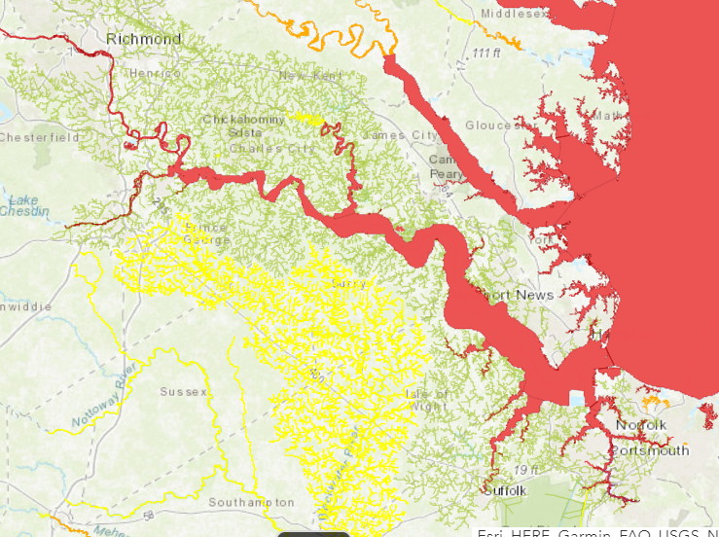
Problem Identification - VDH Fish Consumption Advisory
For Technical Support call 804.527.5029
River basin | Water-body | Section | Locality | Contam-inants | Fish species | Advisory description
James River | James River | From I-95 James River Bridge in Richmond to Hampton Roads Bridge Tunnel, including tidal portions of tributaries | Richmond City, Henrico Co., Chesterfield Co., Charles City Co., Hopewell City, Colonial Heights City, Petersburg City, Dinwiddie Co., Prince George Co., Surry Co., James City Co., New Kent Co., Isle of Wight Co., Newport News City, Suffolk City, Portsmouth City, Hampton City, Norfolk City, Chesapeake City, Virginia Beach City | PCBs | Gizzard Shad, Carp, Blue Catfish ≥32 inches, Flathead Catfish ≥32 inches | Do Not Eat
James River | James River | Same | Same | PCBs | Blue Catfish <32 inches, Flathead Catfish <32 inches, Channel Catfish, White Catfish, Largemouth Bass, Bluegill Sunfish, American Eel, Quillback Carpsucker, Smallmouth Bass, Creek Chub, Yellow Bullhead Catfish, White Perch, Striped Bass, Bluefish, Croaker, Spot, Blueback Herring, Hickory Shad | ≤ 2 meals/month
Does not apply to swimming
http://www.vdh.virginia.gov/environmental-health/public-health-toxicology/fish-consumption-advisory/

Slide 13
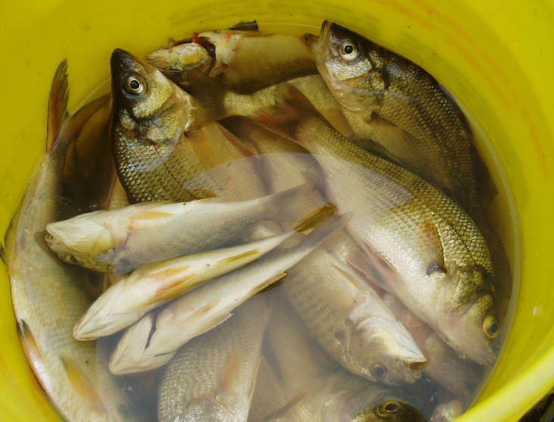
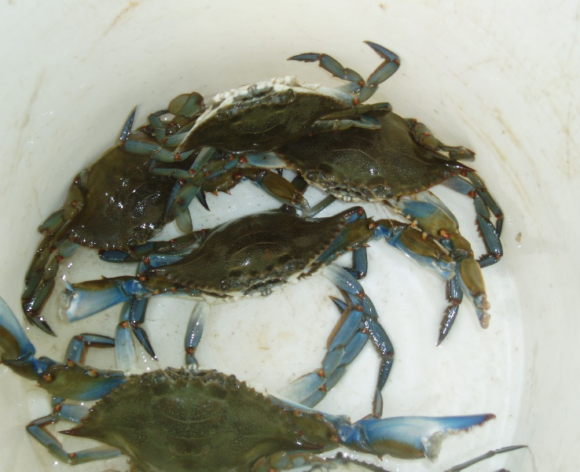
Problem Identification
PCB Impairments Included in 305(b)/303 (d) Integrated Report
For technical support issues call: 540-562-6718
Affected Water Body | Listing Year | Square Miles
Upper James River & Tributaries (tidal fresh) | 2002, 2006, 2008, 2012 | 34.2
Middle James River & Tributaries (Oligohaline) | 2004 and 2006 | 53.8
Lower James River & Tributaries (Mesohaline) | 2004 & 2006 | 143.1
Elizabeth River & Watershed | 2004 & 2006 | 17.0
*Does not affect swimming
Source: Rick Browder, DEQ

Slide 14
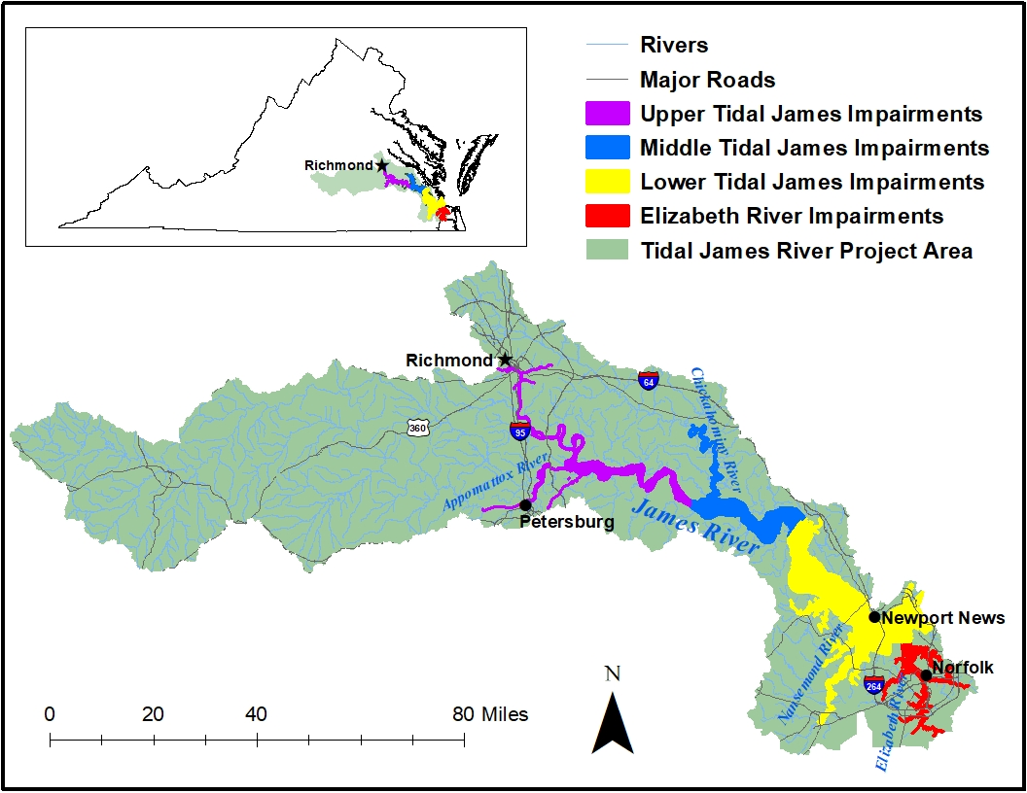
Tidal James River Impaired Watershed
For Technical Support call 804.527.5029

Slide 15
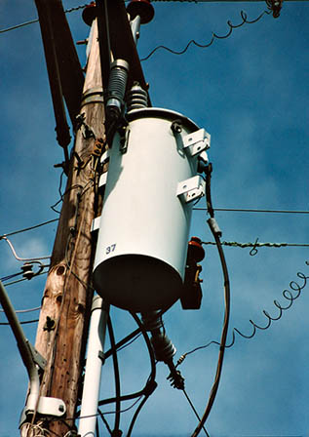
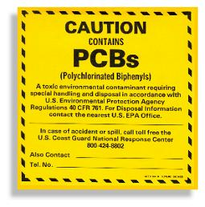
Contaminant of Interest - PCBs
Legacy Contaminant
  Estimated that > 1.5 Billion lbs. manufactured in the U.S. until 1977
Characteristics
  Very stable and heat resistant
  Persistent in the environment
Common uses:
  Transformers, capacitors, hydraulic fluids, circuit breakers, PVC Products, carbonless copy paper, caulking material, paints, and more!
For Technical Support call 804.527.5029

Slide 16
Total Maximum Daily Load (TMDL)
TMDL = WLA + LA + MOS
Where:
WLA = Waste Load Allocation
LA = Load Allocation
MOS = Margin of Safety
Goal = Reduce existing PCB load to restore the fish consumption use
Pollutant Load
TMDL End Point
Pollution Budget
Addresses different pollution categories
PCB TMDL - Multi-media approach
  Air, Land, Water
Margin of Safety
Load Allocations (WLA + LA)
TMDL
Existing Load
Allocated Load
For restoration the waterbody must meet two thresholds: 1) Numeric WQC [or site specific value] and 2) fish tissue threshold
For Technical Support call 804.527.5029

Slide 17

The TMDL Process
For Technical Support call 804.527.5029
Fish Consumption Advisory
Identify Problem
Low Level PCB
Analysis
In Process
Source Assessment
Identify sources
Estimate source loading
To be Completed
Link Sources to Targets
Assess linkages
Estimate total loading capacity
TMDL Allocations
Reduce loads from point sources
Divide remaining loads among
sources
To be Completed
TMDL = Sum of WLA + Sum of LA + MOS
Notes:
These components are not necessarily sequential steps, but are a guide and framework for TMDL development.
(1) Problem Identification: define key factors and background information for a listed waterbody that describe the nature and impairment. This is the guiding factor in development of the TMDL.
(2) Develop Numeric Targets: measurable indicators and target values that can be used to evaluate attainment of water quality standards in the listed waterbody.
(3) Source Assessment: identify sources of loading for bacteria
(4) Link Targets and Sources: this is necessary in order to develop the TMDL since the linkage defines the cause-and-effect relationship between the pollutant sources and the in-stream pollutant response and allows for an estimation of loading capacity. This relationship can vary seasonally, especially for nonpoint sources that are highly dependent on precipitation.
(5) Load Allocations: pollutant loadings that will not exceed the loading capacity and will lead to attainment of the water quality standard can be determined based on the target/source linkage. The loadings may be distributed or allocated among the significant sources.
(6) Follow-up Monitoring: An ongoing monitoring plan should be included to determine whether the TMDL has resulted in attaining water quality standards and to support any required revisions to the TMDL.

Slide 18
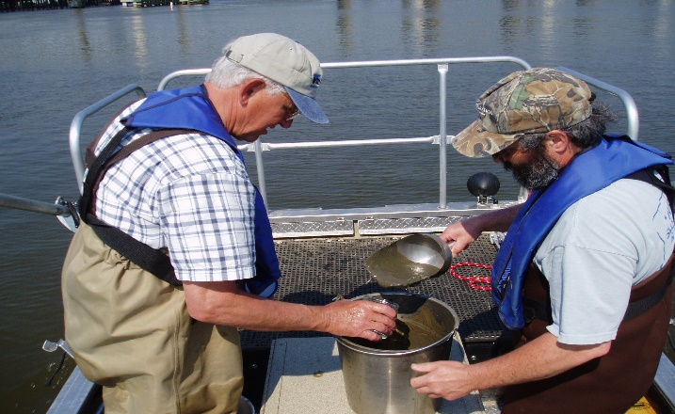
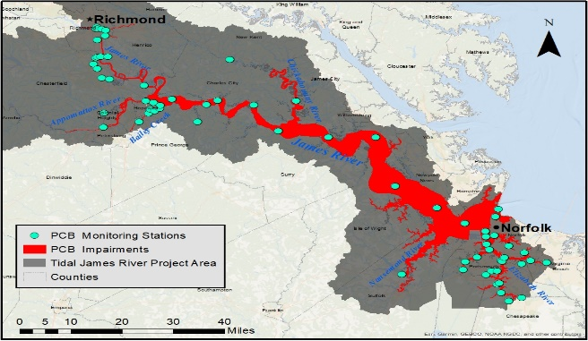
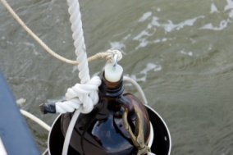
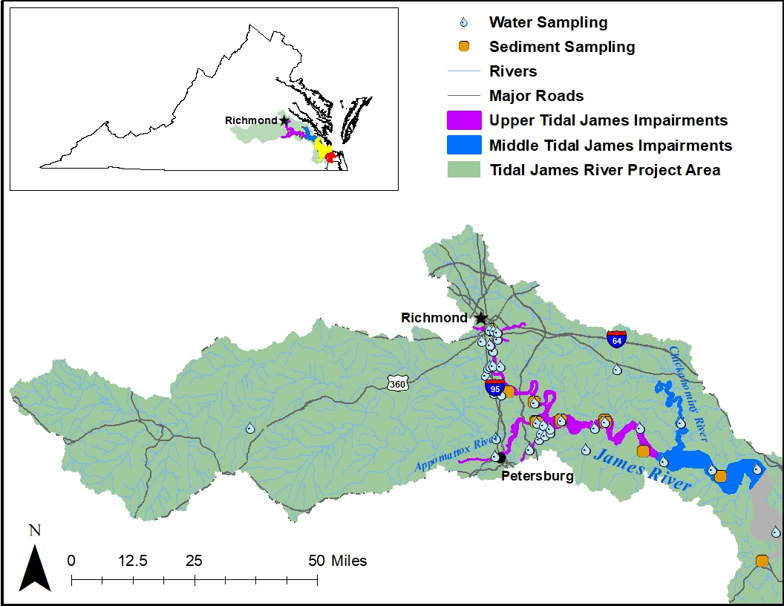
DEQ’s TMDL Sampling Approach
2009-2012, 2016, 2020
Source identification
TMDL model support
    Calibration/validation
2009-2012, 2016, 2020
water column, sediment
    Water column grab samples: High and Base Flow (n >260)
    Sediment samples as needed
For Technical Support call 804.527.5029

Slide 19
Sources Considered in the PCB TMDL Development Study
For Technical Support call 804.527.5029

Slide 20
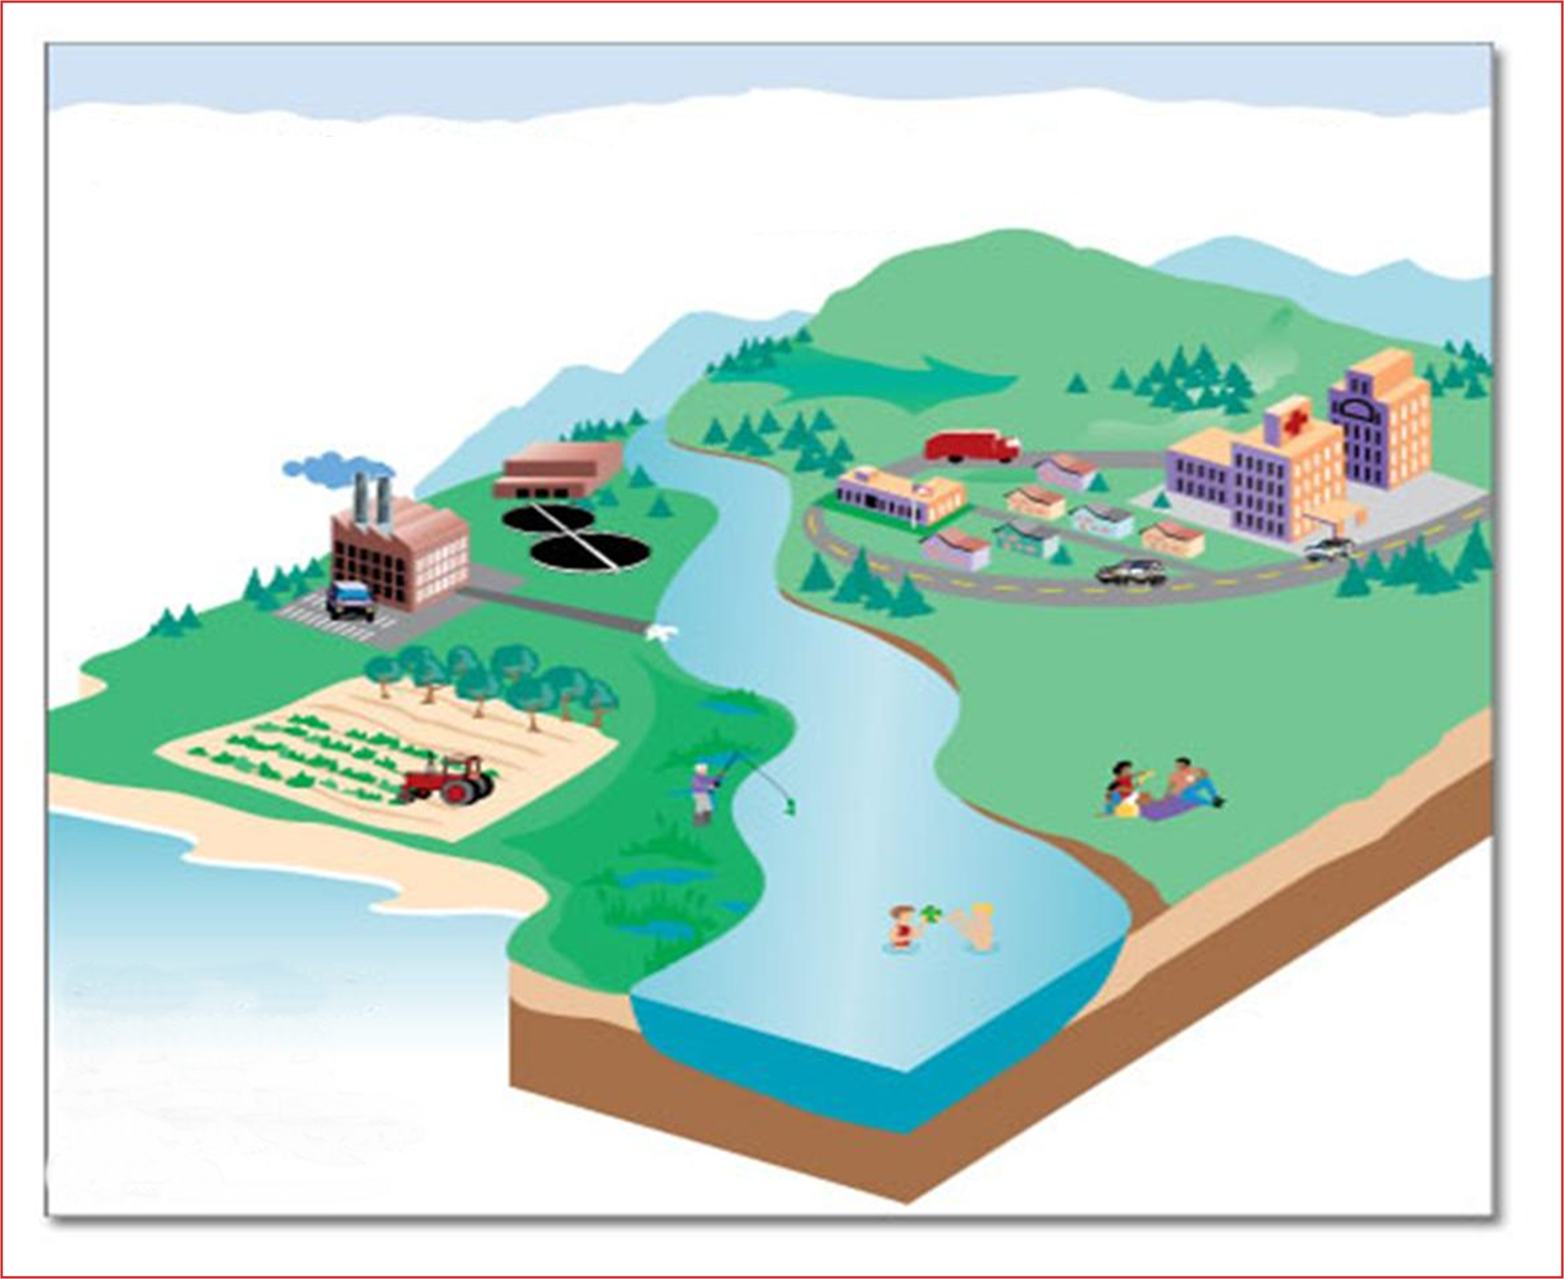

Sources considered in PCB TMDL
Wet Deposition
2
Dry Deposition
Air Emissions
Non-point source
Runoff
4
1
3
MS4 SW Runoff
Point Source Effluent
Contaminated Sites
PCB
PCB
5
Non-point source
Runoff
Requires Multi-Media Approach
(land, water, air)
PCB
6
PCB Contaminated
Sediment
PCB
PCB

Slide 21
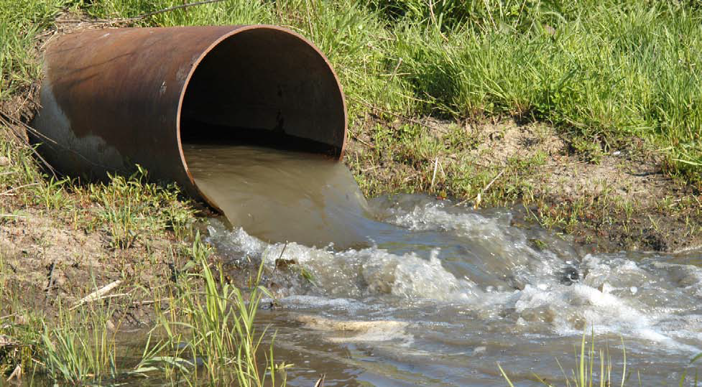
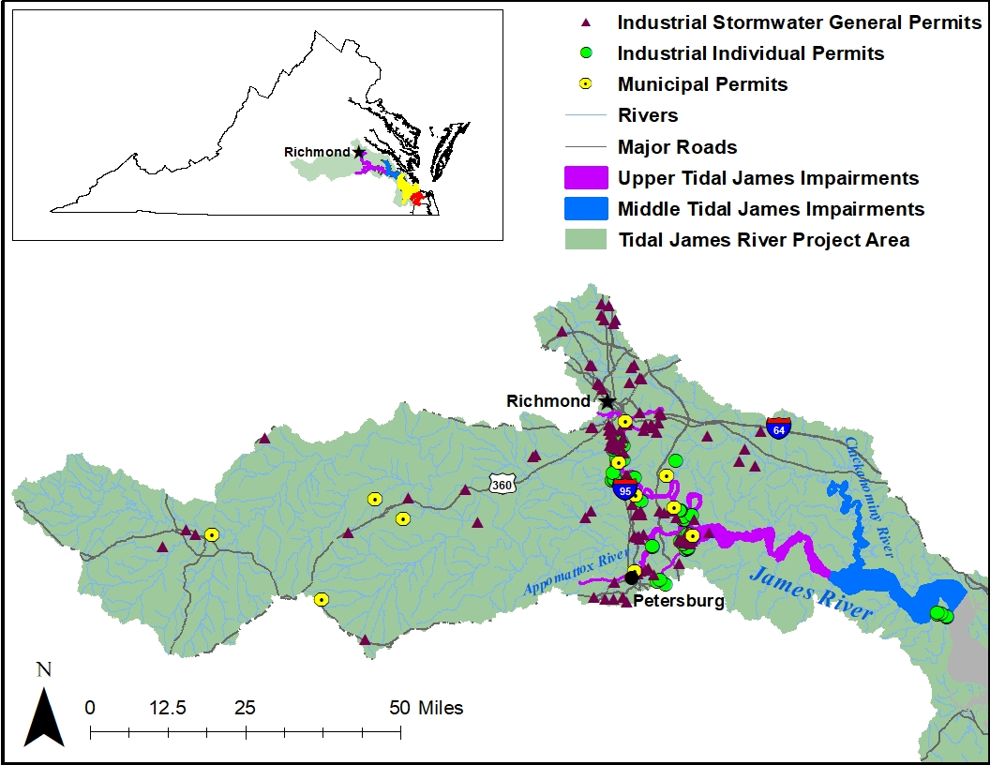
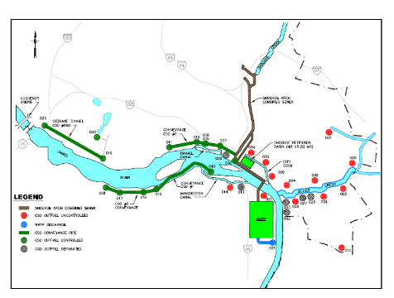
TMDL Source Category – Point Sources
VPDES Permitted facilities
  Municipal WWTP (11)
  Industrial sources (136)
    Selected based on Standard Industrial Classification (SIC)
      Individual Industrial Facilities
      Industrial Storm Water General Permitted Facilities
  Municipal Separate Storm Sewer System (MS4; 15)
  Combined Sewer Overflow (CSO)
    Richmond
For Technical Support call 804.527.5029

Slide 22
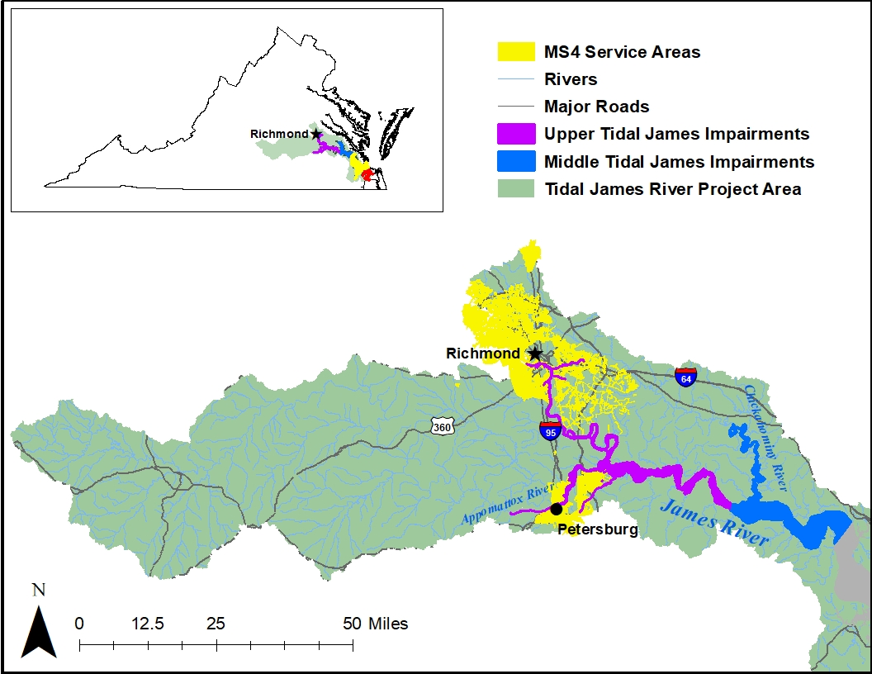
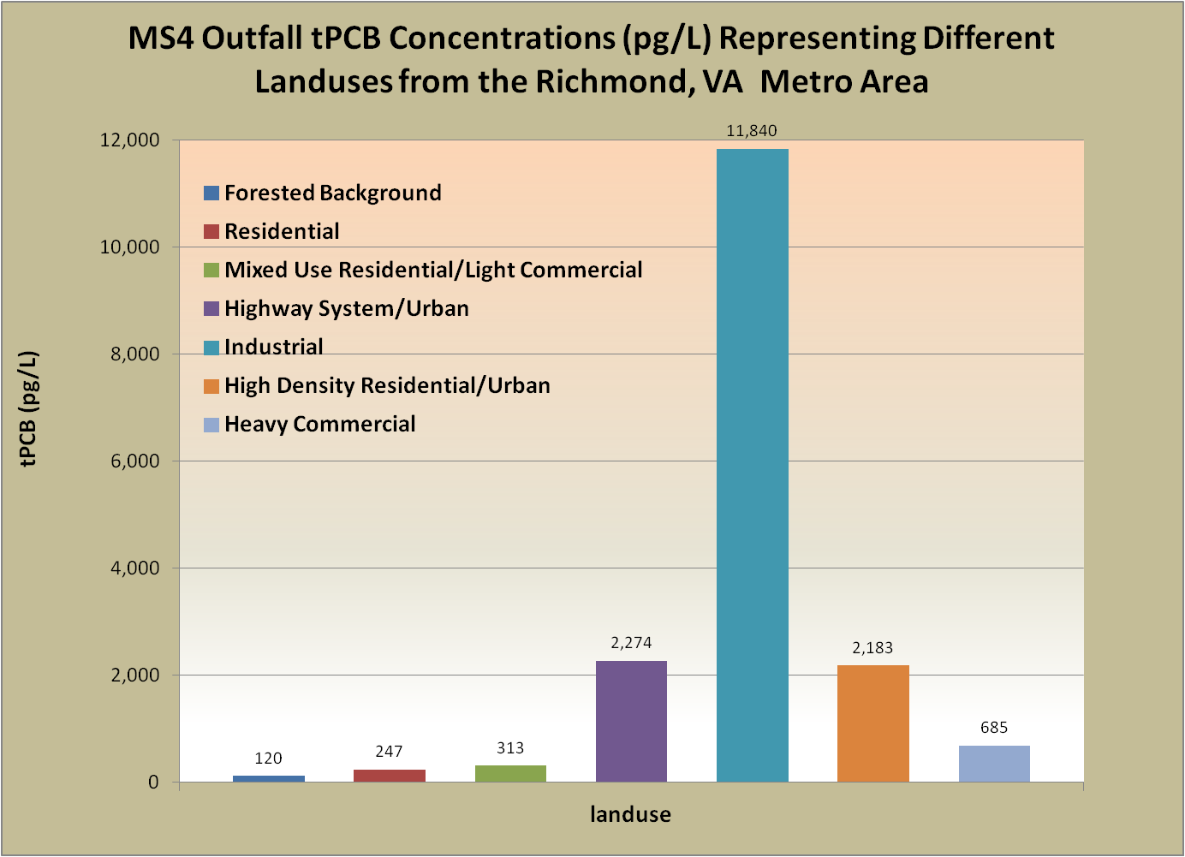
TMDL Source Category – MS4s
Upper and Middle Tidal James River (Piedmont Region)
MS4s | Projected PCB Baseline Load (g/yr) | Projected WLA (g/yr)
2 (Phase I – Large) 13 (Phase II - Small) VDOT | TBD | TBD
Lower James River and Elizabeth River Watershed (Tidewater Region)
MS4s | Projected PCB Baseline Load (g/yr) | Projected WLA (g/yr)
6 (Phase I – Large) 17 (Phase II – Small) VDOT | TBD | TBD
Non-MS4
For Technical Support call 804.527.5029

Slide 23
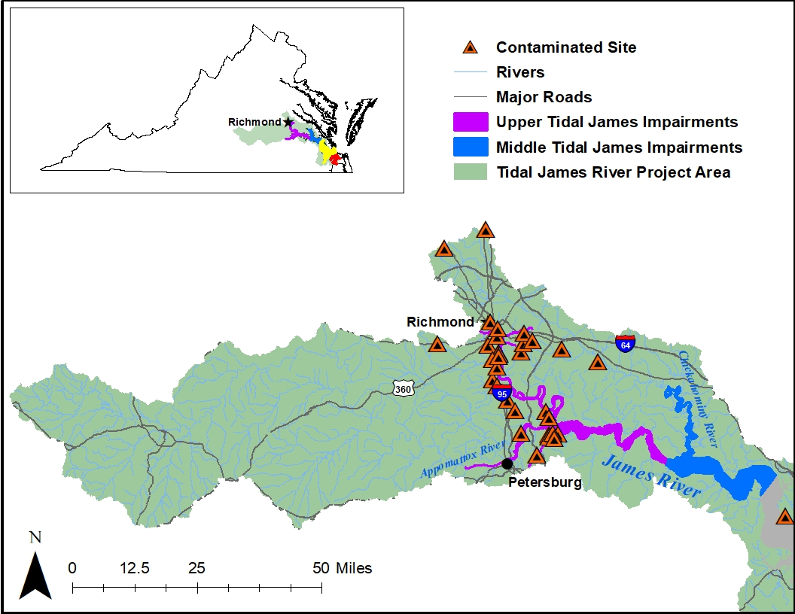
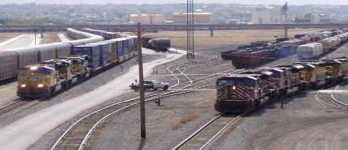
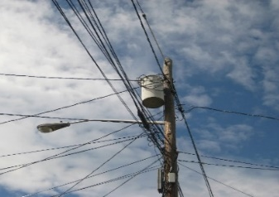
TMDL Source Category - Contaminated Sites
TSCA-PCB Clean-up Sites (0)
RCRA Corrective Action (16)
CERCLA (3)
Voluntary Remediation/Brownsfield (3)
Landfills
Rail Yards/Spurs
Miscellaneous spill sites
  Pollution Response (PREP)
Electric Utility Transformer Pads
https://commons.wikimedia.org/w/index.php?curid=6092689
For Technical Support call 804.527.5029
https://commons.wikimedia.org/w/index.php?curid=17503186

Slide 24
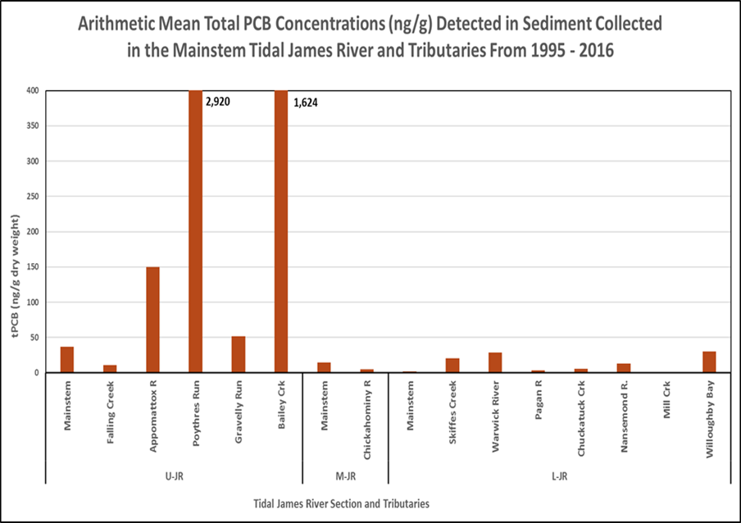
TMDL Source Categories
For technical support issues call: 540-562-6718
Atmospheric Deposition (example)
Contaminated Sediment
Modes of Deposition
Wet = 4.5 – 12% of total
Rodenburg (Totten), L. A. et al., 2007. Rutgers University
24

Slide 25
PCB TMDL Fate and Transport Model
For Technical Support call 804.527.5029

Slide 26

James River PCB TMDL Study
Jian Shen
Virginia Institute of Marine Science
March 25, 2021

Slide 27
Outline
PCB Transport Processes
Estuarine Model
Loading estimation
Preliminary model results
TMDL Study

Slide 28
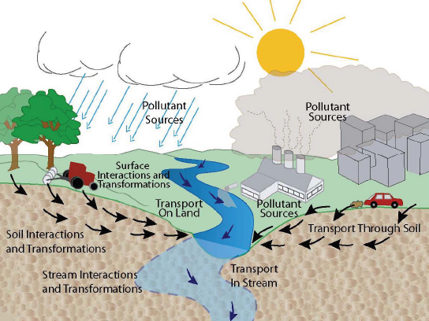
PCB Transport Processes in Watershed

Slide 29
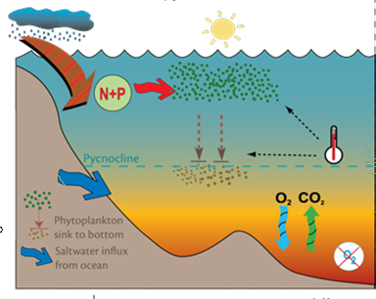
PCB Transport Processes in Estuary
Atmospheric
deposition
Air-sea
exchange
Runoff
Discharge
PCB
Sorbed to
POC & algae
Transport downstream
Sorbed
to DOC
Sorption/desorption
Dissolved
Settling and
Resuspension
Transport
Upstream due to stratification
Ground
water
Diffusion
Burial

Slide 30
Estuarine Model
Precipitation
Atmospheric exchange
Water
Watershed model
Nonpoint
sources
Point sources
Water column model
Loading
Biochemical Reaction
Transport in & out
Determine Loading reduction based WQS
Sediment model
TMDL

Slide 31
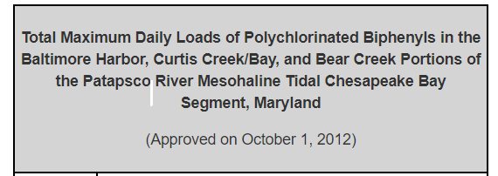
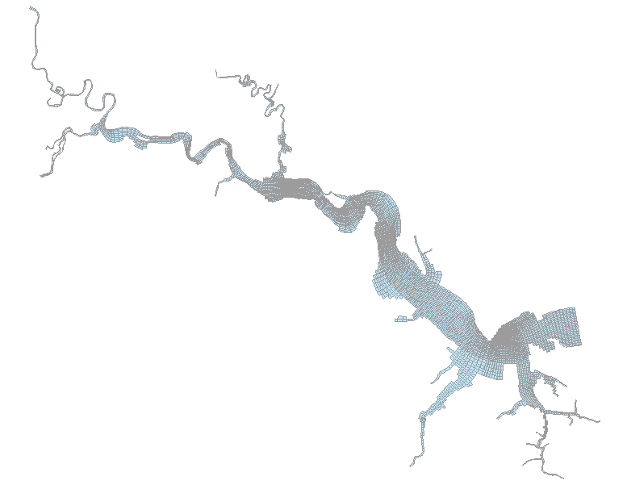
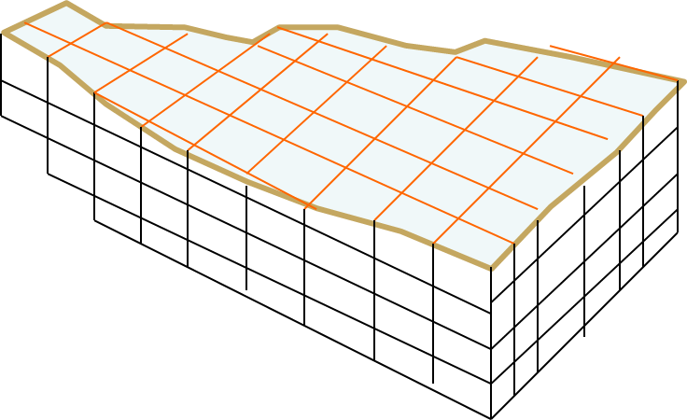

Estuarine Model (biochemical processes)
It is a organic carbon-based (sorption/desorption) modeling framework
It couples water column and the bottom sediment
It models exchanges of PCB between Bay water and atmosphere

Slide 32
Estuarine Model Elements
Tide, Temperature, Salinity, TSS, Meteorological forcing (wind, atm. pressure, dry & wet temperature, cloud cover, solar radiation)
Dynamic
Model
Surface elevation
Current
Temperature
Salinity
Suspended sediment
Loading
ATM
Loading
Bay
POC bound
Algae bound PCB
Water column
Particulate organic carbon
Water column
Dissolved PCB
PCB
Model
DOC bound PCB
Algal particulate organic carbon
Dissolved carbon
Carbon
Model
POC sorbed
PCB
DOC sorbed
PCB
Dissolved PCB
Particulate organic carbon
Dissolved carbon
Burial
Sediment
Sediment

Slide 33
PCB Model Sorption Processes
v
v = PCB concentration on the solid / carbon (ng/g)
Cd =dissolved concentration (ng/L)
C_{d}
Equilibrium model assumes:
Algae
Particulate carbon
The relationships between total PCB, dissolved PCB, particulate carbon bound PCB, algal bound PCB, and dissolved carbon bound PCB are:
PCB
Dissolved PCB
Dissolved carbon
f_{x} = fraction of each component
C = total PCB
Partition coefficient differs for different homolog

Slide 34
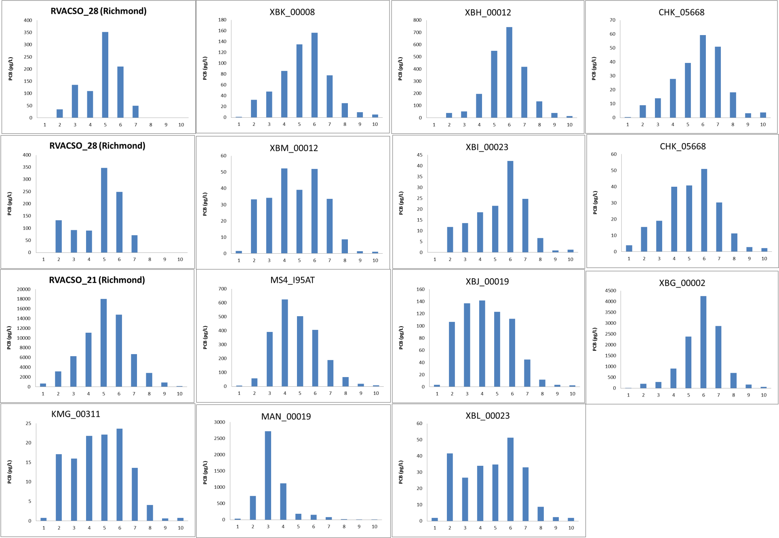
Storm Water Measurements

Slide 35
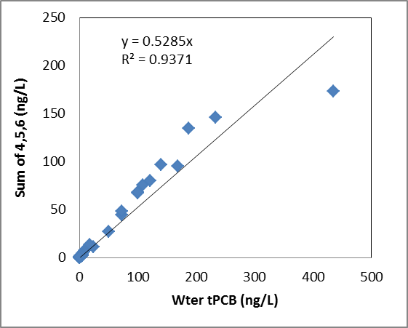
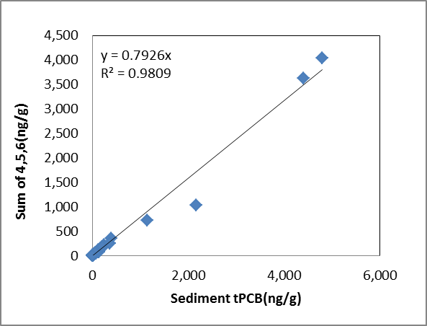
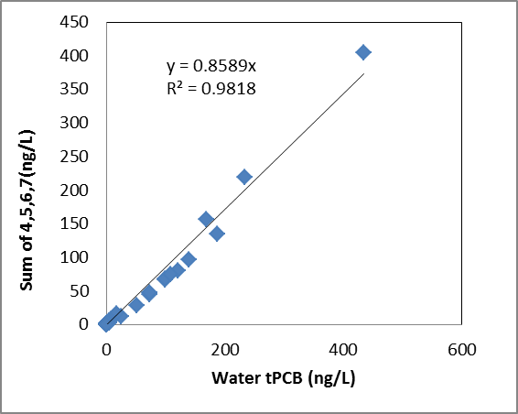
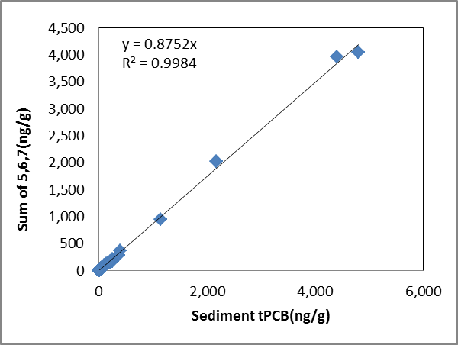
Simulate PCB based on Selected Homologs
Water tPCB (ng/L)

Slide 36
Loading estimation
Upstream loading
Atmospheric deposition
Lateral loading
Contaminated sites
Point source/MS4
CSOs

Slide 37
Atmospheric Deposition
The measured atmospheric deposition on the watersheds in the Chesapeake Bay ranges from 1.6 and 16.3 μg/m²/year (CBP, 1999)
Total PCB wet and dry depositions were 1.1 and 1.0 kg/year, respectively for the James River below the fall line (CBP, 1999).
The estimated total PCB atmospheric deposition rate is 3.08 (μg/m²/year).
An approximate 1-2% deposited PCB on watershed will discharge to the estuary (Totten et al. 2006, Delaware River )
The estimated loading is about 569 g/yr (assuming 2% runoff) below the fall line
Direct PCB deposition on the surface of Estuary is about 1,056 g/year
Current net transport between atmosphere and water is out (loss PCB to atmosphere)
  Total PCB gaseous concentrations is about 330 pg/m³ (0.3 pg/l). Mean PCB concentration is about 15,560 pg/l

Slide 38
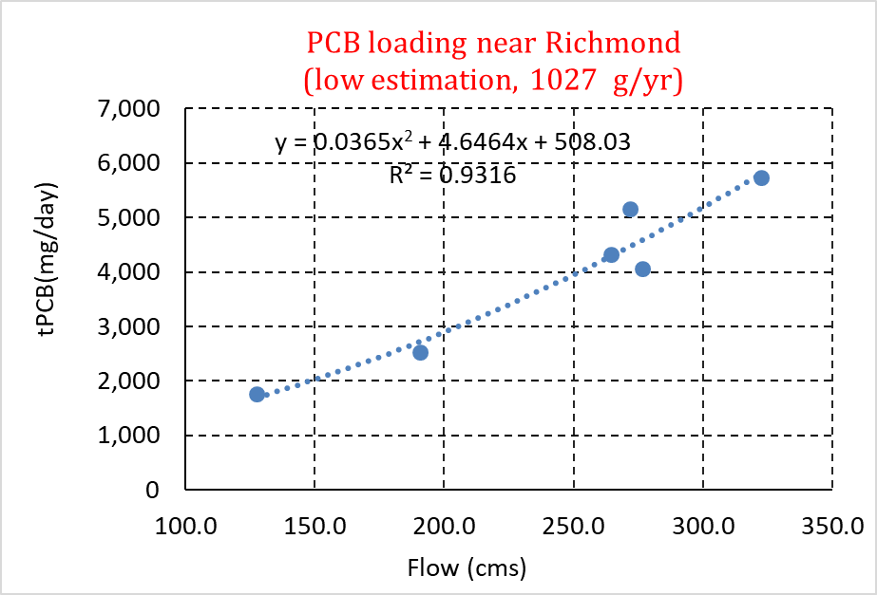
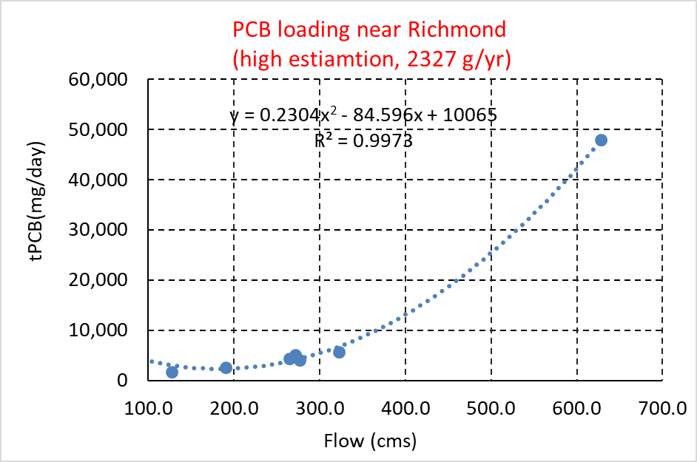
Upstream Loading Estimation
Assuming atmospheric deposition rate is 3.08 ug/m²/year, 2% runoff, the estimated loading are 1,051 g/year
Regression estimation are 1,027 (low) and 2,327 (high) g/year, respectively from 2005-2014. Model input using high estimation based on regression

Slide 39
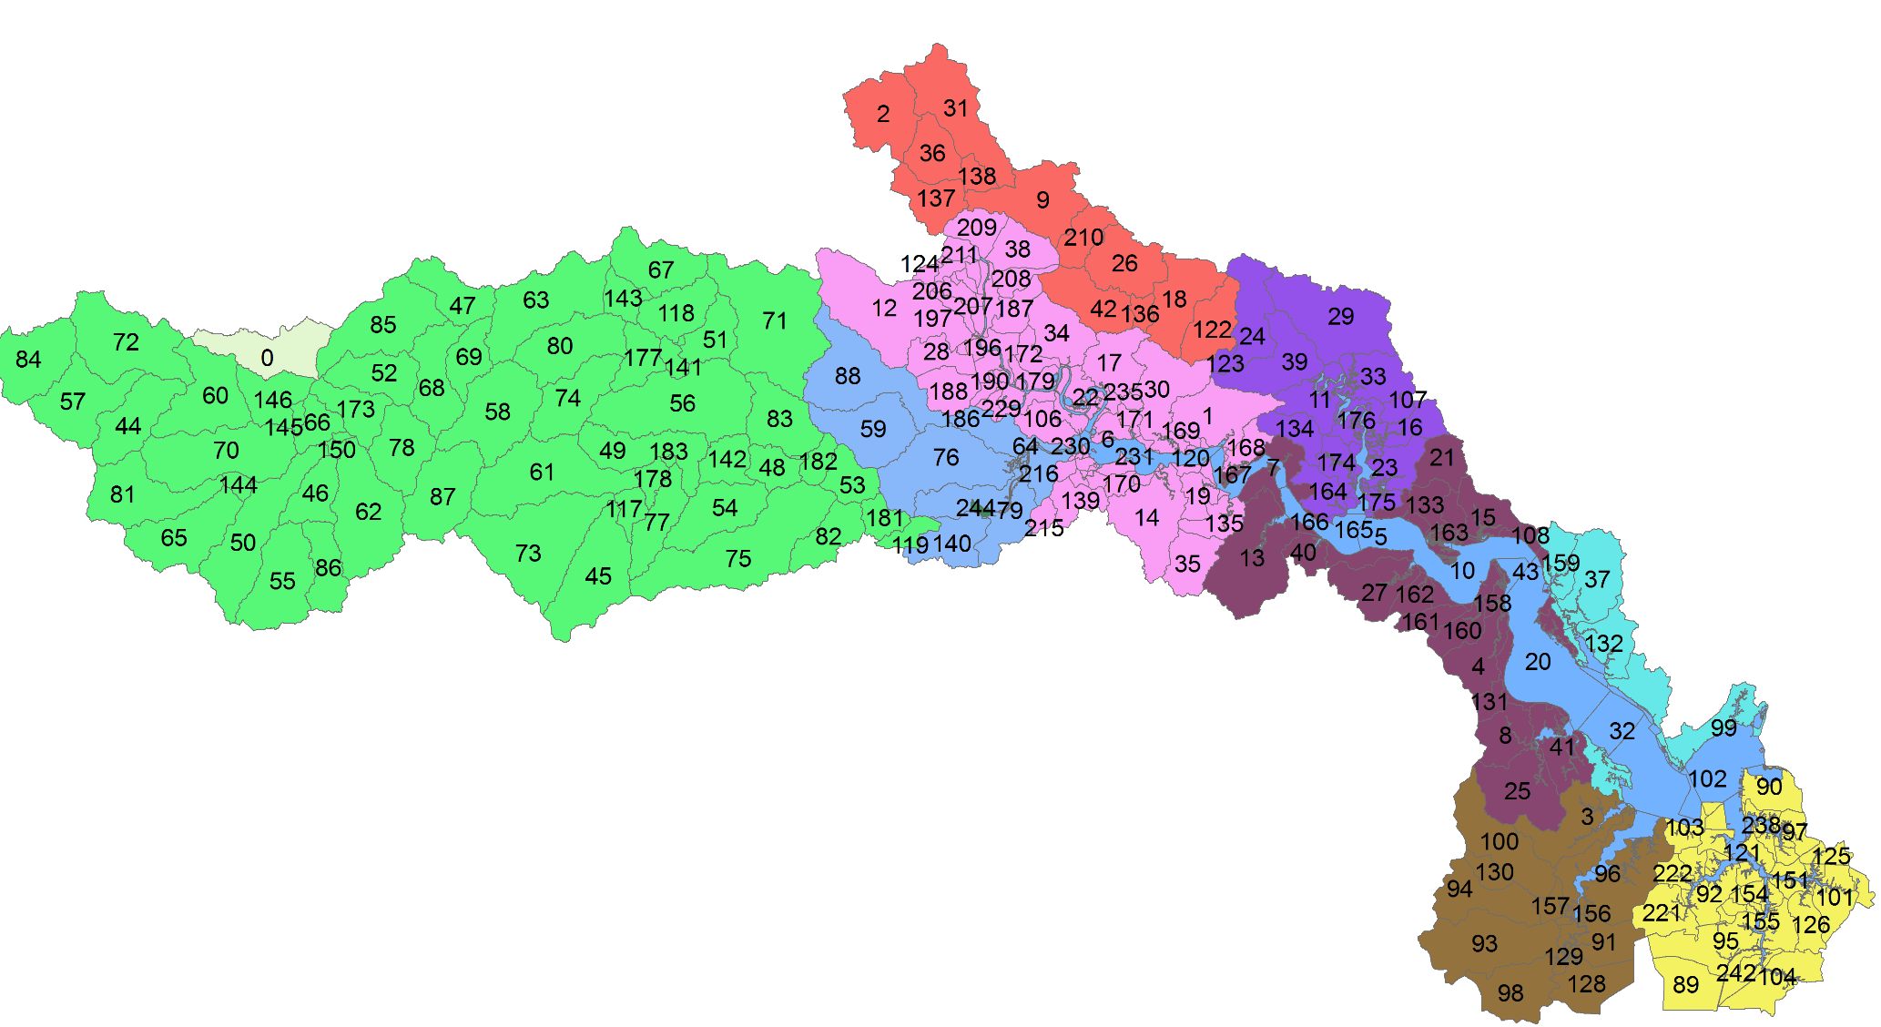
Watershed Model Approach
The watershed model will be used to simulate non-point sources loadings based on land uses below fall-line
Watershed is divided into multiple segments
Major pollutant sources
  Contamination sites
  MS4/Storm water
  Background source (land use)

Slide 40
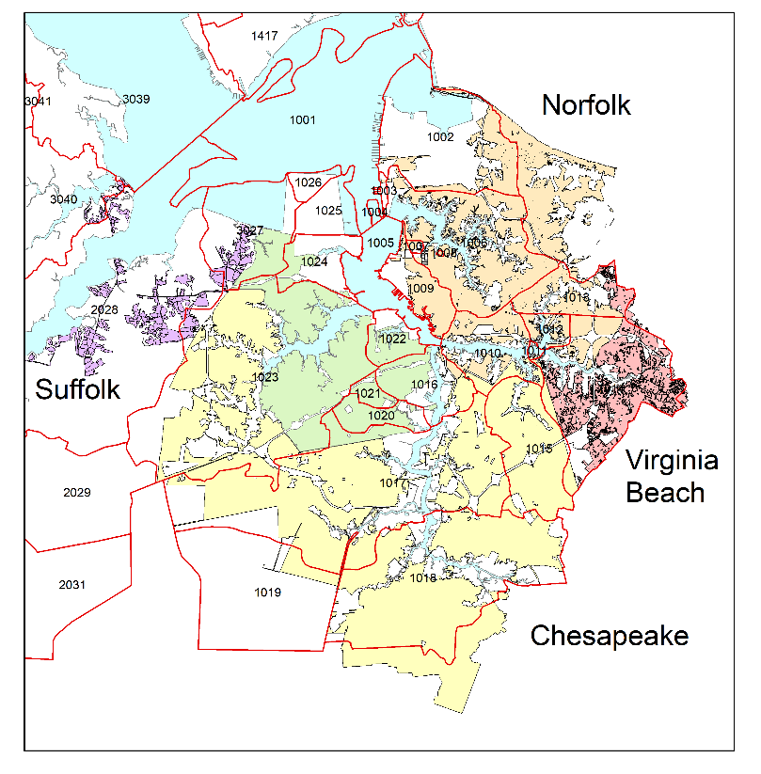
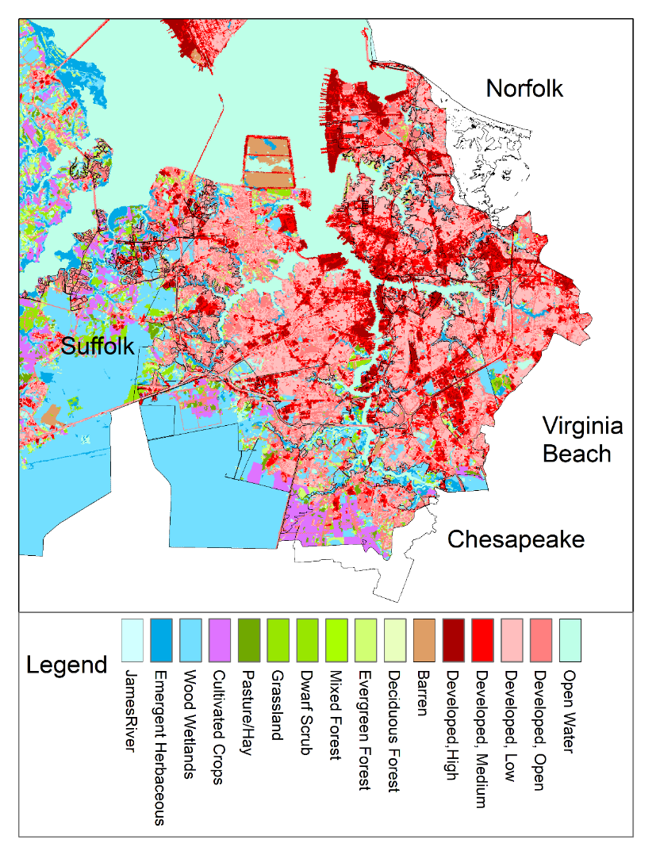
Watershed model: Using land use

Slide 41
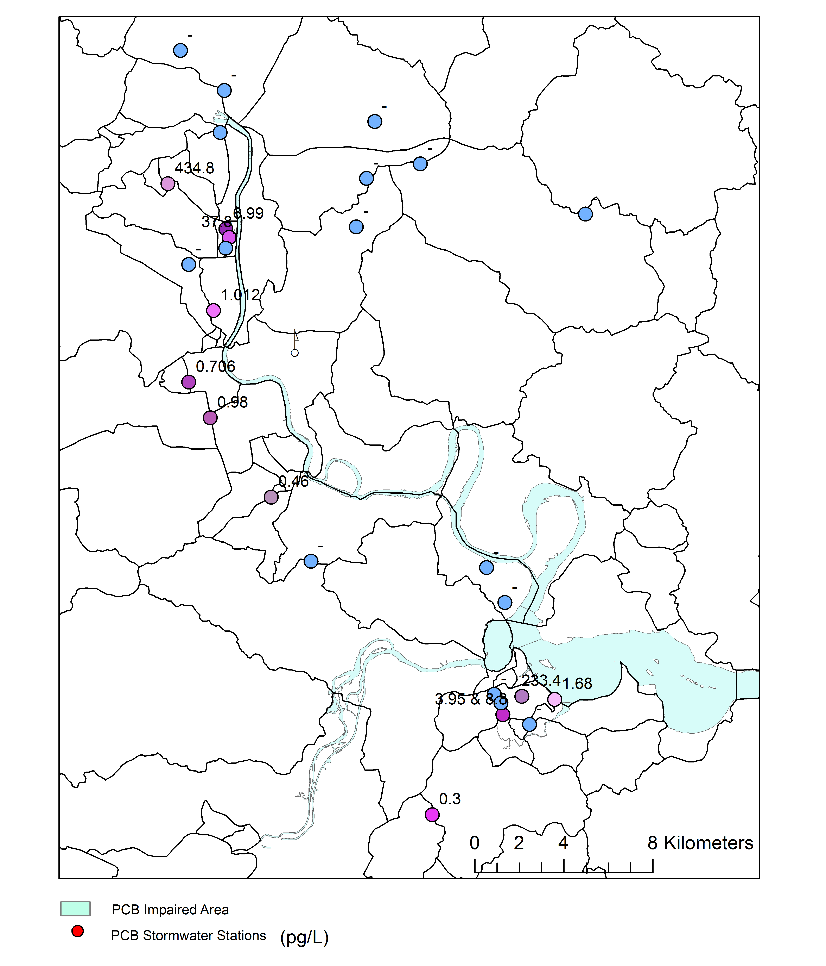
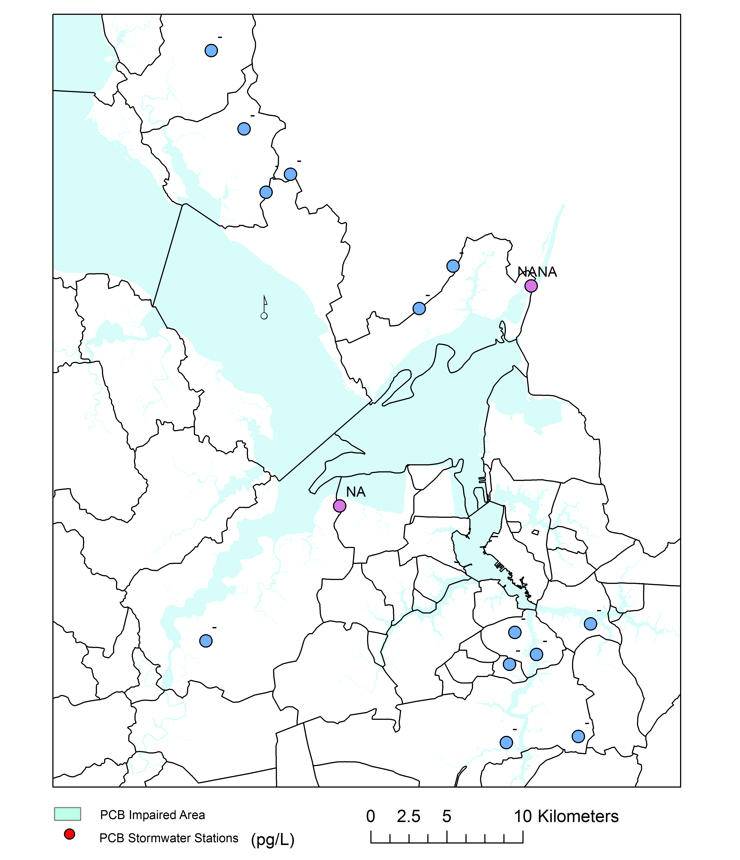
Contaminated and Remediated Sites
11 sites have PCB concentration (total 48)
Using watershed modeled flow and area, the loading can be estimated assuming PCB concentration is constant
For sites without concentration, mean concentration will be used
Estimated loads are 19.3 and 983 g/year using median and mean concentrations, respectively
Final loading will be adjusted based watershed model and observations

Slide 42
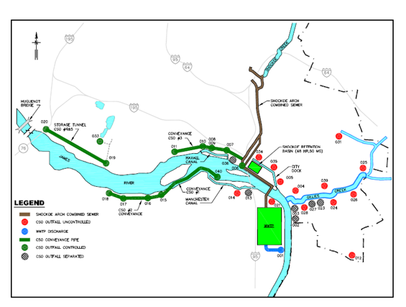
CSOs (Richmond)
938 pg/L
64,367 pg/L
Loadings Derivation Current Condition
  Utilize monthly average flows (10 yr. period) and mean PCB concentration is 11,906.7 pg/L.

Slide 43
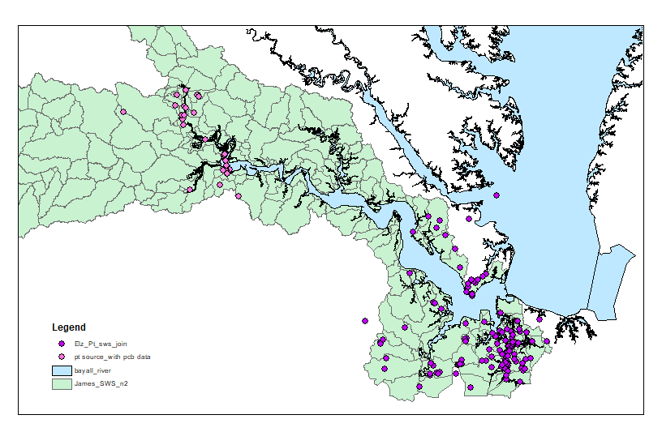
Watershed model: Point Sources
Upper JR for PRO mtg ~ 145 facilities; Lower JR and Eliz River ~ 177 facilities
Combined point source
(~322)
Loading is estimated based on drainage area, measured flow and typical concentration

Slide 44

MS4 Loading Estimation
Use watershed model to simulate loadings from urban land uses
Adjust loading based on observations for different land uses

Slide 45
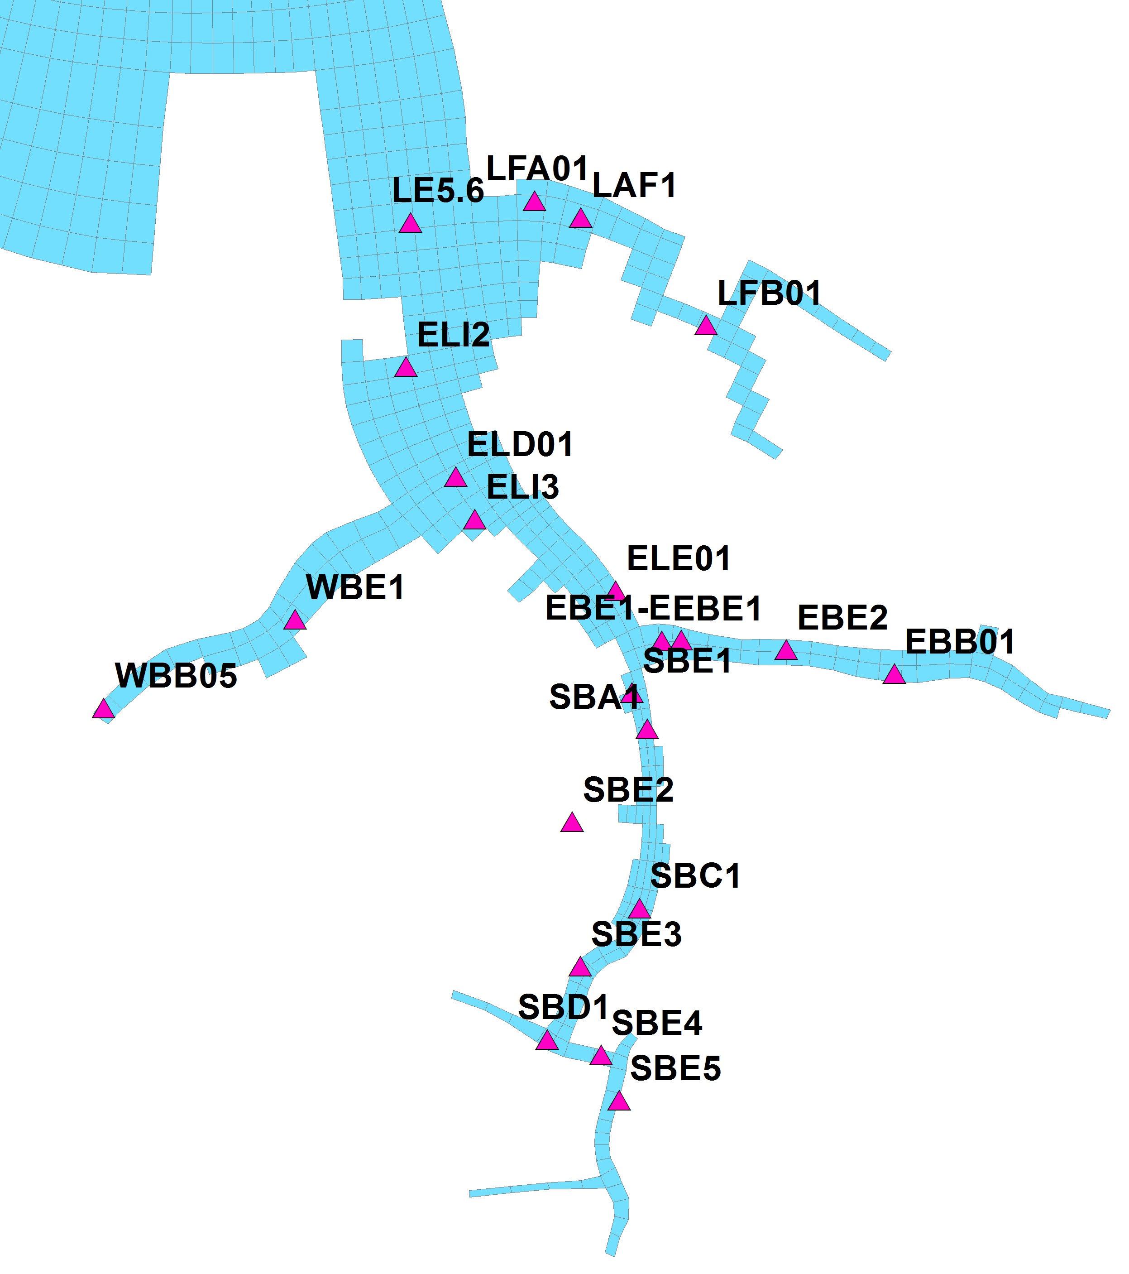
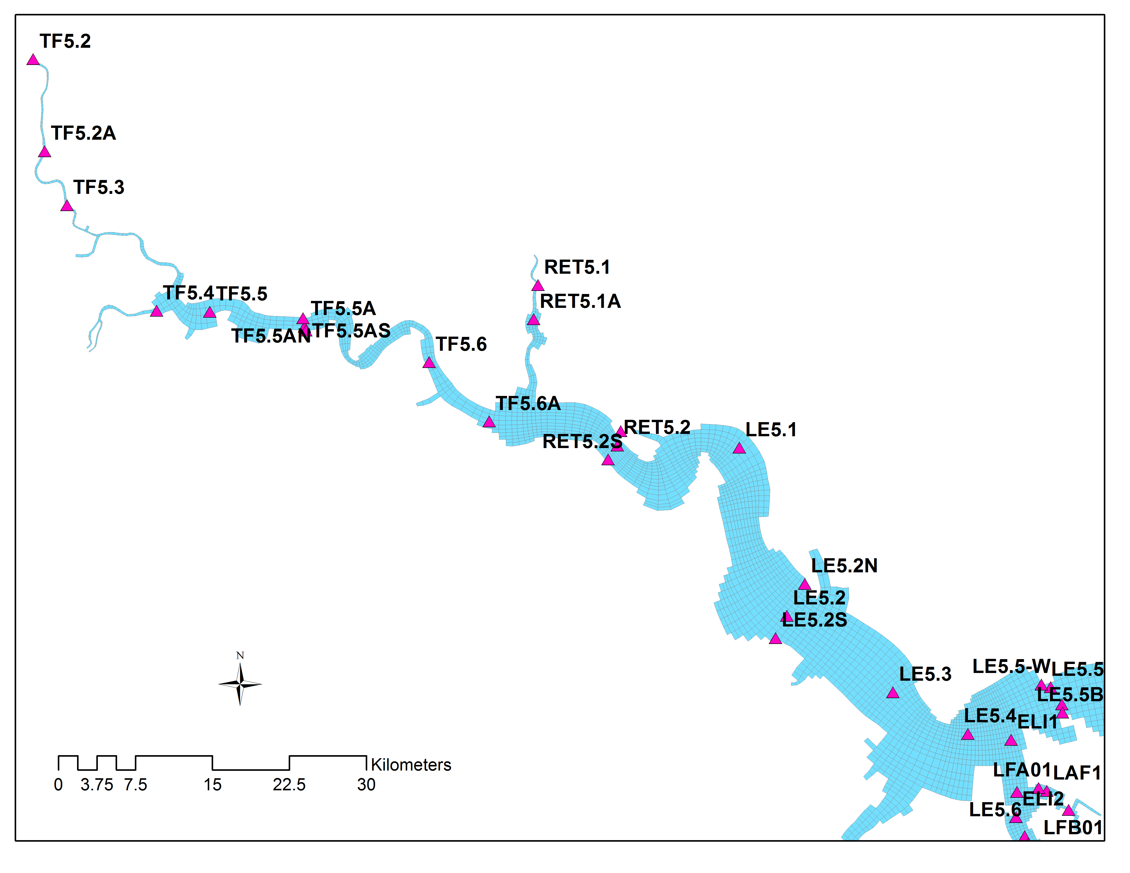
Preliminary model results
Location of Observations for model calibration

Slide 46
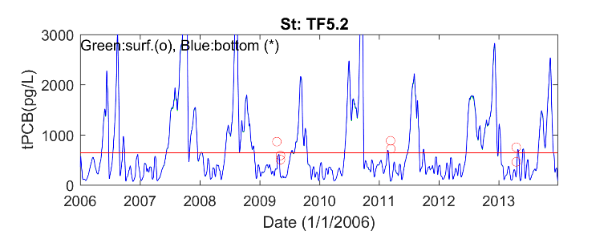
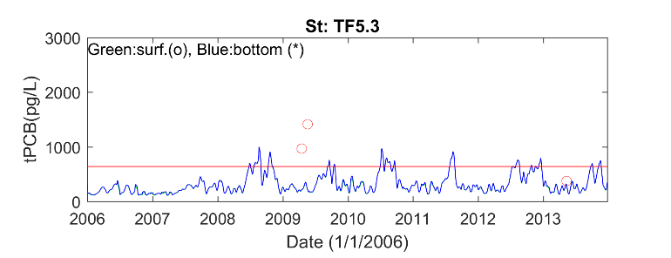










Preliminary model results: Example

Slide 47

PCB budget
Combine model simulations and loading estimation to estimate the PCB budget and determine load reduction
Shen et al., 2012

Slide 48
TMDL Study
Use water quality standards (WQS) to conduct TMDL with target source reduction (point, nonpoint, MS4, contaminated sites etc)
Large portion of PCB is from the bottom sediment deposition. It will take time for the water quality condition of the estuary to meet the WQS
TMDL simulation
  Using representative flows (high, mean, low) to run model for a sufficient time (advantage: including resuspension, deposition processes)
  Using harmonic flow (advantage: mean condition)
Mean tPCB in Baltimore harbor
(Shen et al. 2012)

Slide 49

Flow Distribution
Harmonic flow (2010)
Select 3-year flow

Slide 50


Proposed Procedure for Loading Allocation
Allocate loads (WLA (MS4) and LA) for each jurisdiction
  City, county, federal land, VDOT, and other specific units (e.g. university)
  WLA for point source is estimated based on permitting
The regulated area for each jurisdiction is determined by the GIS layer for each city, or county, or federal land
  Regulated area includes both pervious and impervious lands
  VDOT is excluded from City/County GIS layer
  Federal lands are excluded from City/County GIS layer
Estimate loading for each Jurisdiction
  Option I:
    Compute the percentage of regulated area to total jurisdiction area for each modeled sub-watershed
    Use the percentage to partition the total loading for each sub-watershed
    Sum loads for all sub-watershed
  Option II:
    Same as option I, but estimate loading based on land use and partition the loading based on percentage of the land use for each jurisdiction area
    This method is more difficult, but it does not provide better estimation as we don’t have very good data set to calibrate loading for each land use

Slide 51

Climate Change Consideration
Sea-level rise (0.22 cm, and 0.86 psu) at James River mouth
Increase of salinity intrusion
Change in estuarine circulation
Changes in discharge
Change in residence time
Increase temperature (~0.9-1.2 C)
Increase growth rate
Increase respiration rate
Change in grazing
Transport processes

Slide 52

Temperature Effect on Growth and Respiration Rates
Testing cases
Reduced respiration
Revised curve for diatom
Use 2 curves for summer green
Use Eppley curve
Change grazing
Respiration rate changes faster than growth rate when temperature increase.
The temperature increases in summer due to climate change ranges from 1-2 Cº, and the growth rate does not increase fast enough and Chl-a could decrease.
If a high growth rate is used, the model calibration is not satisfactory in the James River

Slide 53


Evaluation Impact due to Transport or Temperature
Change in transport
Change in temperature
Blue lines are current condition and red lines are under changed condition

Slide 54
Climate Change Consideration
Minor changes in Chl a and organic carbon
Increase depth (volume increase will reduce concentration)
Increase salinity and gravitational circulations
It is not expected Climate change will impact on PCB TMDL significantly
Model simulation of algae and carbon for James River Chl a project provides all the dynamics and organic carbon results. We can conduct similar simulations if it is needed.

Slide 55
VPDES Load Calculations
For Technical Support call 804.527.5029

Slide 56
General Approach to Point Source Loads
Applicable to:
  Municipal Wastewater Treatment Plants
  Industrial Stormwater General Permits
  Industrial Individual Permits
Existing loads and wasteload allocations (WLAs) are calculated on a spreadsheet outside of the TMDL model
  Integrated into the TMDL model
Calculated in a standard fashion for all PCB TMDLs
  Provides for consistency and certainty
  Clearly communicates the assumptions of the TMDL WLA
Load = concentration * flow

Slide 57
PCB Concentrations Used for Establishing Point Source Loads
“Existing Condition” load
  Preference to use Permittee generated PCB data
    Corrected in accordance with TMDL GM 14-2004
  In lieu of available PCB data, default concentration used
    Derived from statewide PCB data using Standard Industrial Classification (SIC)
Waste Load Allocation (WLA)
  Utilize TMDL endpoint PCB concentration
    Applicable sub-watershed
For Technical Support call 804.527.5029

Slide 58
Point Source Flow Matrix
Wastewater Type |  | PCB Conc. and Discharge Flow (Used for Calculation of Baseline Loads & WLAs)
Municipal |  | Design Flow (Used for WLA)
 |  | Eight Years Monthly Ave Flow (Used for Baseline Load)
* Industrial Storm Water General Permits (ISWGPs) |  | Flow calculated from inputs including industrial activity acreage and impervious acreage acreage
*Individual Industrial | Process Water | Baseline Load uses Mean of DMR monthly average flow WLA = Mean of DMR daily max flow
 | Comingled (process water can’t be separately measured from SW)
 | Storm Water | Acreage applicable to outfall drainage area (industrial activity acreage and impervious acreage)
*A single baseline load and WLA is calculated from each applicable facility regardless of the number of outfalls.
For Technical Support call 804.527.5029

Slide 59
TMDL Endpoints
For Technical Support call 804.527.5029

Slide 60

State Water Quality Standards Has Two Values
TMDL has two endpoints
 | Fish Tissue Threshold (ppb) | WQC (ppq)
VDH | 100 (Fish Consumption Advisory) | - -
DEQ | 18 (Screening Value) | 640
DEQ’s Water Quality Assessment (Integrated Report)
  VDH - Consumption Advisory = impairment
  DEQ - two or more fish samples exceed screening value at a site or two water samples exceed criterion at a site = impairment
TMDL must be consistent with the WQS, not the VDH threshold
Notes:
VDH value also contains Exposure Duration Factor in the numerator = Life expectancy/expected time lived in a single location
Consumption rate
DEQ = 22 g/day
Updated by EPA in 2015 based on the Exposure Factors 2011 handbook.
90th percentile consumption rate of fish from inland and nearshore waters for adults 21 year and older (2003-2010)
VDH = 15 g/day
(227 g/meal) 2 meals a month 30 days in a month

Slide 61
Narrative WQS

Slide 62

VA Water Quality Criterion
VA PCB criterion and Fish Screening Values based on EPA guidelines
Fish Screening Value basis of criterion
  Water concentration translated using a Bioconcentration Factor (BCF)
    Lab derived translator developed in the early 80’s
    Assumes fish only obtain PCBs through gills from the water column (ratio of PCB conc. in fish to that in water)
      What about other exposure pathways?

Slide 63


Biannual Water Quality Assessment Guidance
Guidance memo developed for each Assessment Cycle
  Appendix E-1 Contains Fish Tissue Values for Non-Carcinogen and Carcinogen Criterion Based Tissue Values (TV)
  2016 (GM No. 16-2005) – 9/6/2016
  2018 (GM No. 16-2005) – 3/5/2018
  2020 (GM No. 19-2001) – 7/12/2019
    [footnote] These fish tissue values have been calculated based on the Water Quality Standards that are associated with the latest Triennial Review criteria proposals as adopted by the State Water Control Board in October 2008.
  2022 (GM No. XXX ) –
  Undergoing final internal (DEQ) review
    Public noticed January 19th – February 18th (2021)
Forthcoming Triennial Review
  From 0.00064 ug/L to 0.00058 ug/L
PCB Total/congeners | 1336-36-3 |  | 20
PCB Total/congeners | 1336-36-3 |  | 20 18

Slide 64
PCBs and Water Partitioning
K_{ow} values of PCB homolog groups
Homolog | Midpoint K_{ow}
Mono+Di | 47,315
Tri | 266,073
Tetra | 1,011,579
Penta | 3,349,654
Hexa | 5,370,318
Hepta | 17,179,084
Octa | 39,810,717
Nona | 82,224,265
Deca | 151,356,125
More Hydrophobic i.e., less Dissolved

Slide 65


Bio magnification
Biomagnification
PCBs
H₂O
x1000
x100
x10
x2
Concentration (parts per trillion)
0.001
1
1,000
10,000
20,000

Slide 66
PCB Endpoints
Bioaccumulation and Bioconcentration Concepts
  Bioaccumulation refers to “the uptake and retention of a chemical by an aquatic organism from all surrounding media (e.g., water, food, sediment).”
  Bioconcentration refers to “the uptake and retention of a chemical by an aquatic organism from water only.”
“For some chemicals (e.g., highly persistent and hydrophobic), the magnitude of bioaccumulation by aquatic organisms can be substantially greater than the magnitude of bioconcentration.”
“…EPA encourages States and authorized Tribes to derive BAFs that are specific to certain regions or waterbodies, where appropriate.”

Slide 67

Average Fish Tissue Concentration vs. Average Water Concentrations
Quadrant | Water | Fish
A | Fail | Pass
B | Fail | Fail
C | Pass | Pass
D | Pass | Fail
A
B
A
B
Average H₂O tPCB (pg/L)
C
D
C
D

Slide 68

Bioaccumulation Factors (BAFs)
EPA Method (EPA-822-03-030, 2003)
Utilize site specific data (i.e., water data) to reflect exposure of fish and their food
  Pathways of PCB exposure includes through gills, from food, and indirect ingestion of contaminated sediment
More realistic
Precedent (PCB TMDLs)
  Potomac River
  Roanoke River
  Levisa Fork
  New River

Slide 69
BAF Process in a Nutshell
Within the home range of a fish species
Within a TMDL watershed
For each fish species: Ratio of Water PCBs and Fish Tissue PCBs
For each fish species: Normalized for freely dissolved PCBs and fish tissue lipid content
For each fish species: The median of home range values
For each fish species: Normalized by median fish lipid content and freely dissolved PCBs
BAF values are calculated for each fish species in a TMDL watershed
The TMDL endpoint is based on some average of selected fish species BAF values
For each fish species: Normalized values divided by fish tissue threshold value
(18 ppb)

Slide 70
BAF Endpoint Selection
BAFs are calculated for each fish species in the four TMDL watershed sections
  Upper tidal JR, middle tidal JR, lower tidal JR, and Elizabeth River
  If select a site-specific endpoint, would be based on recreational/commercial interest, fish advisory, or as an example, use arithmetic mean of species
Upstream reductions from the James, Jackson, Maury River PCB TMDL will likely impact the fall-line load in upper tidal JR
  Different modeled scenarios can be run to assist with endpoint selection
DEQ exploring a draft endpoint revision based on comments received
  Appropriate fish cutoff (year fish collected)
  Changes in analytical methods

Slide 71
Anticipated TAC Meeting Timeline
Sources and Endpoints
Draft TMDL Allocations
Draft TMDL Report
1st Technical Advisory Subcommittee Meeting
(Mar. ’21)
2nd Technical Advisory Subcommittee Meeting
(Summer ’21)
3rd Technical Advisory Subcommittee Meeting
(Winter ’21)
2021 2022
1st Public Meeting
(Feb. ‘21)
Final Public Meeting
(Winter ‘22)
For Technical Support call 804.527.5029

Slide 72

Next Steps
Public comment responses
TAC contact list
Watershed Modeling
  Throughout 2021
Anticipated future TAC meetings
  TAC 2 - Summer 2021
  TAC 3 - Winter 2021
Meeting Feedback
  Virtual Meeting Comment Form
Overall: Mark.Richards@DEQ.Virginia.gov
Piedmont: Jennifer.Rogers@DEQ.Virginia.gov
For technical support issues call: 804-527-5029

