Slide 2
The Virginia Environmental Excellence Program - Reporting System
Tutorial
Disclaimer:
Some of the content may not be in an accessible format pursuant to Section 508 of the federal Rehabilitation Act of 1973, as amended (29 U.S.C. § 794 (d)). Please contact Keith Boisvert, Keith.Boisvert@DEQ.Virginia.gov or Morgan Goodman, Morgan.Goodman@DEQ.Virginia.gov if you need assistance.
Office of Pollution Prevention
VEEP EMS Track Annual Reporting
February, 2021

Slide 3
myDEQ Portal
VEEP Annual EMS Track reports are submitted through the myDEQ portal https://portal.deq.virginia.gov/
myDEQ portal is part of DEQ’s technology plan. The portal will allow DEQ to receive & share data with the regulated community and citizens.

Slide 4
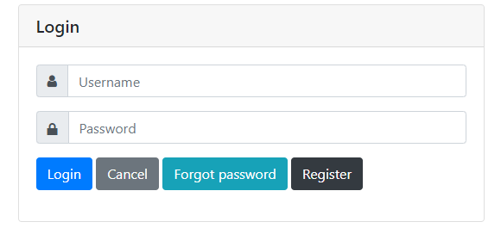
Registering for Access
“In order to submit your annual report you must first register for access to DEQ’s reporting portal https://portal.deq.virginia.gov/
If you have previously registered for access you do no need to register again.

Slide 5
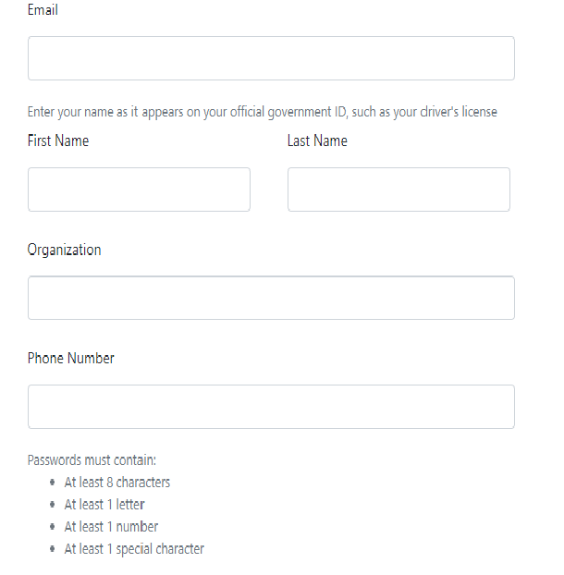
Registration continued
On the registration page you will need to submit some preliminary information and then submit the form. An automated email will be sent to you so that you can validate your email address. You only have 30 minutes to validate.
You will need to provide:
  Valid E-mail
  First and last name
  Organization name
  Phone number
  Password
  Confirm password

Slide 6
Log in
Once you validate your email address. You can log in to the portal using your email address and password. You will not have to reregister for access to the Portal from year to year.

Slide 7
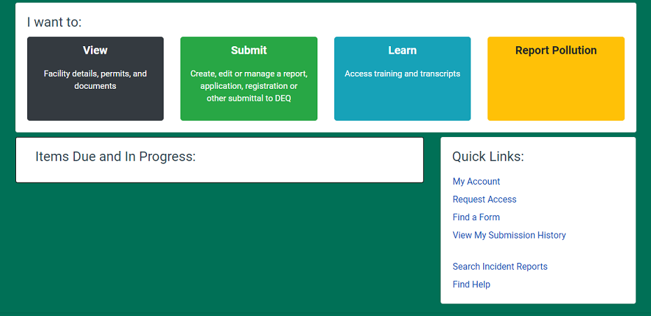
Portal Dashboard
After logging in you will see the DEQ Portal Dashboard.
‘Request Access’ to the VEEP Membership report you wish to edit and submit.

Slide 8
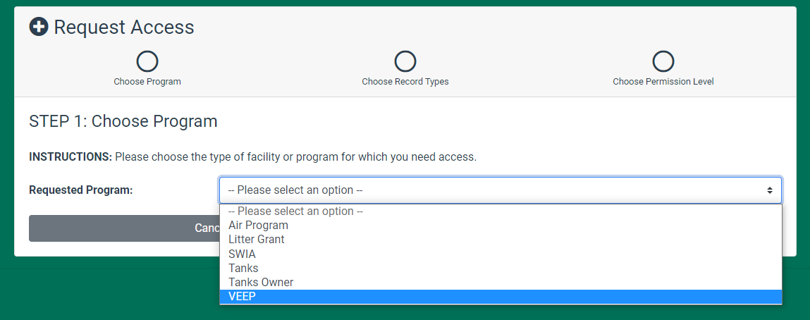
Request Access to VEEP Report
Go to the drop down list, select VEEP and hit ‘next’.

Slide 9
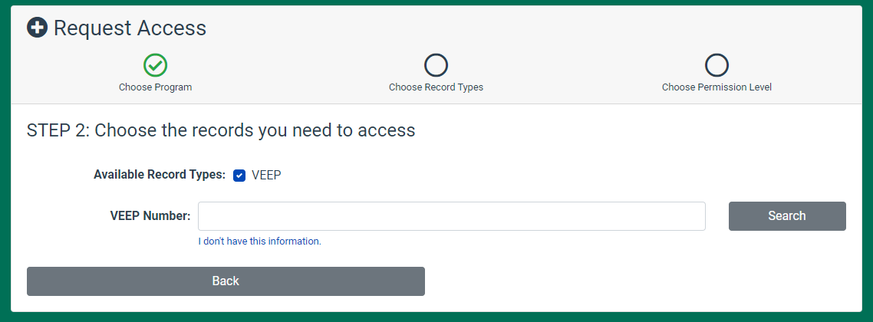
Request Access to VEEP Report Continued
In order to request access to your VEEP report you must know your VEEP Membership #. This can be found on your most recent VEEP acceptance letter. Contact Keith Boisvert, Keith.Boisvert@DEQ.Virginia.gov or Morgan Goodman, Morgan.Goodman@DEQ.Virginia.gov if you need assistance finding your VEEP #.
Once you have the number, enter it and hit ‘Search’. Note: The system only allows you to request access to one report at a time.

Slide 10
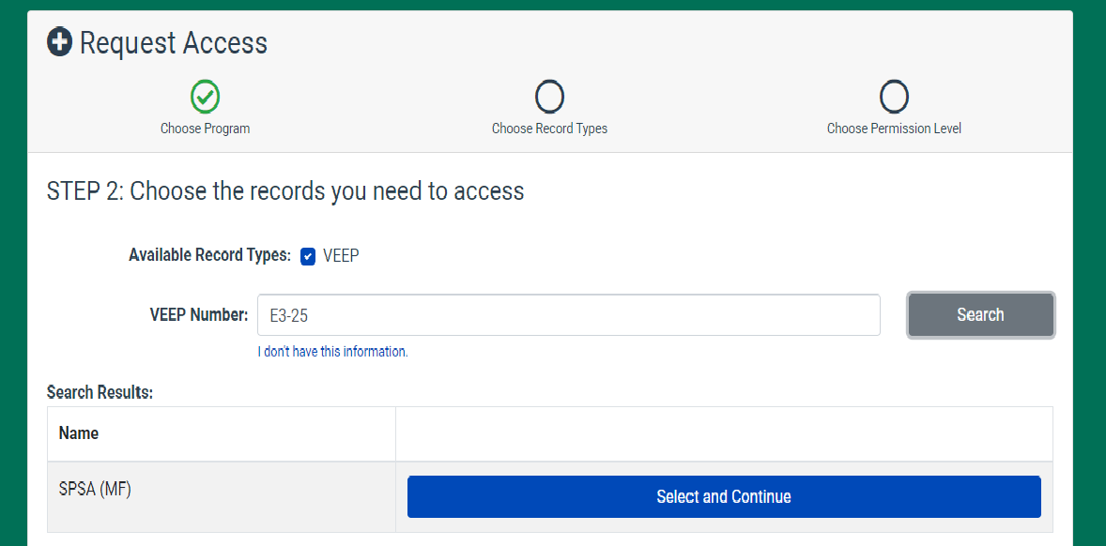
Request Access to VEEP Report Continued
The correct VEEP Membership # will generate your VEEP Membership name. If the resulting name is accurate, hit ‘Select and Continue’
.
E3-123
.
Company XYZ

Slide 11
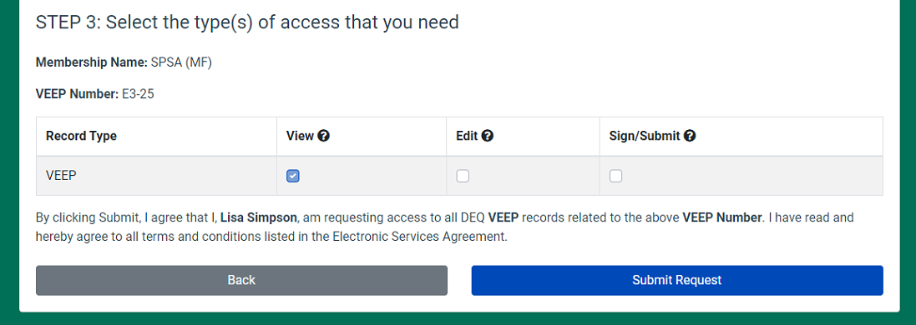
Request Access to VEEP Report Continued
Be sure to assign yourself all access to your report
(View, Edit and Sign/Submit)
.
Company XYZ
.
E3-123

Slide 12
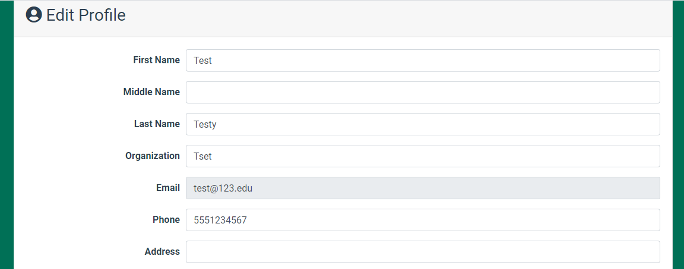
Edit Profile
On the next page you will be asked to make some basic additions to your Profile.

Slide 13
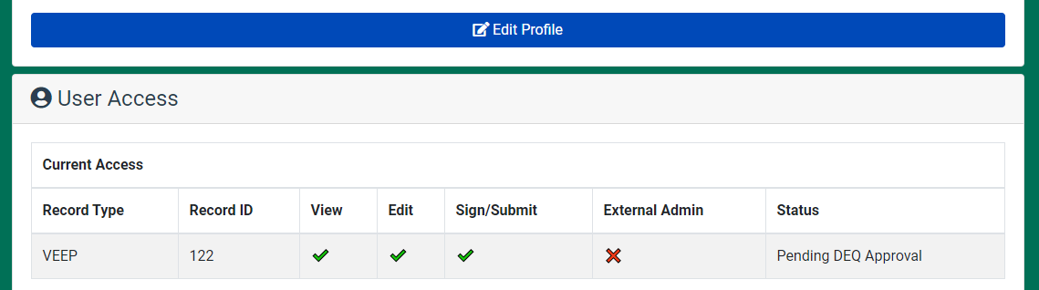
Edit Profile Continued
When your Profile is complete, at the bottom of the page you will see the status of you ‘User Access’ which will be ‘Pending DEQ Approval’.
NOTE: ‘External Admin’ is not available for VEEP. It is not needed.
On the upper right of this screen (not shown) is the ‘Home’ button, allowing you to return to the Dashboard or log out while you await the approval of your access request.

Slide 14
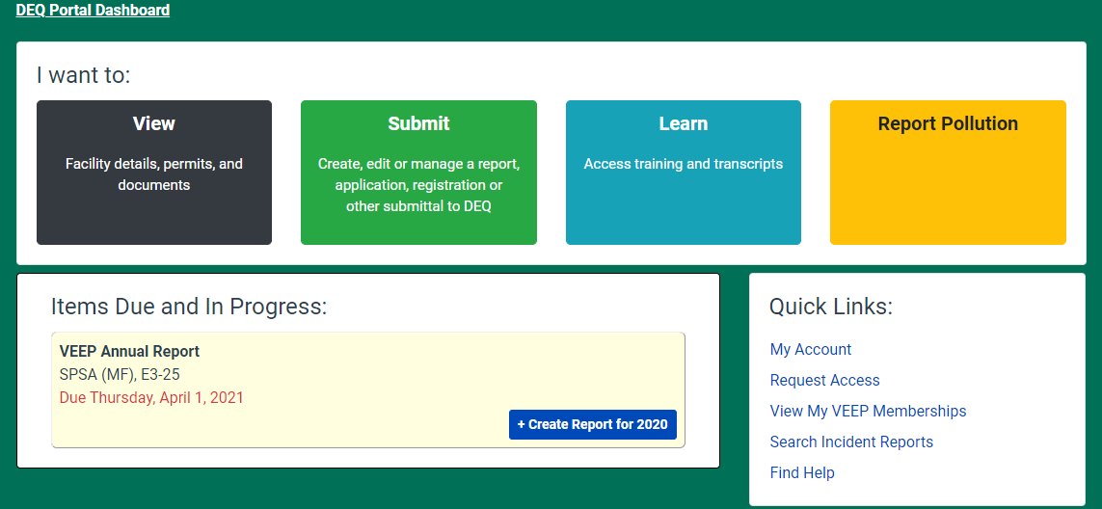
Portal Dashboard w/ VEEP Report Access
You will get an email when access to your report has been approved. Log back in to https://portal.deq.virginia.gov/ and you will see your VEEP report or reports.
Click on the ‘Create Report’ button, to start filling out the report.
Company XYZ, E3-123

Slide 15
NOTE
The preceding slides represent an update to changes made to the myDEQ Portal VEEP registration process and changes to the layout of the Portal dashboard.
The following slides provide an explanation of the VEEP reporting process. To avoid replicating this guidance annually, DEQ is using sample slides from 2019 reporting.

Slide 16
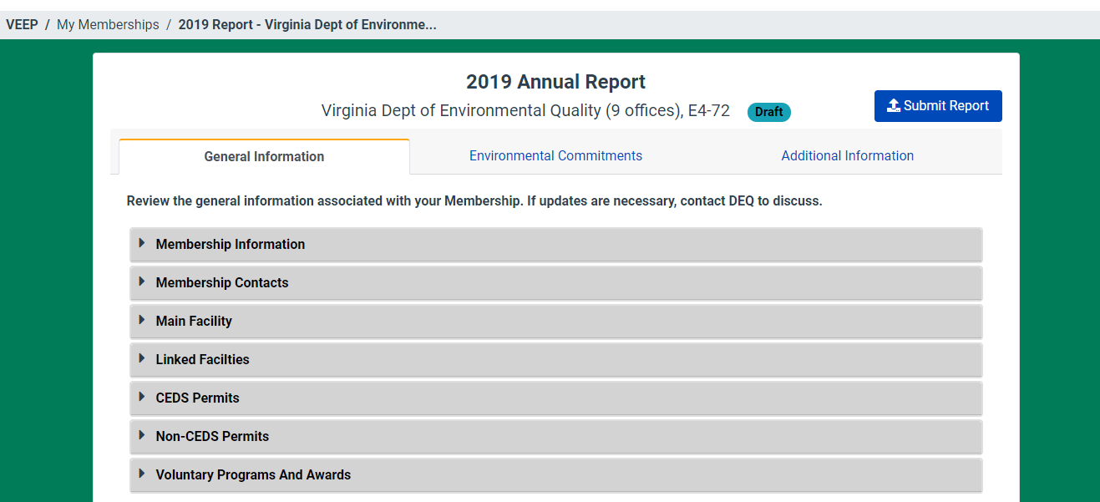
Creating a Report - General Information 1
This tab takes you to the numerical reporting commitment section.
This tab that takes you to the narrative reporting questions.
‘General Information’ items can be opened and reviewed, but not edited. If changes need to be made or you have questions contact Keith Boisvert, Keith.Boisvert@DEQ.Virginia.gov or Morgan Goodman Morgan.Goodman@DEQ.Virginia.gov

Slide 17
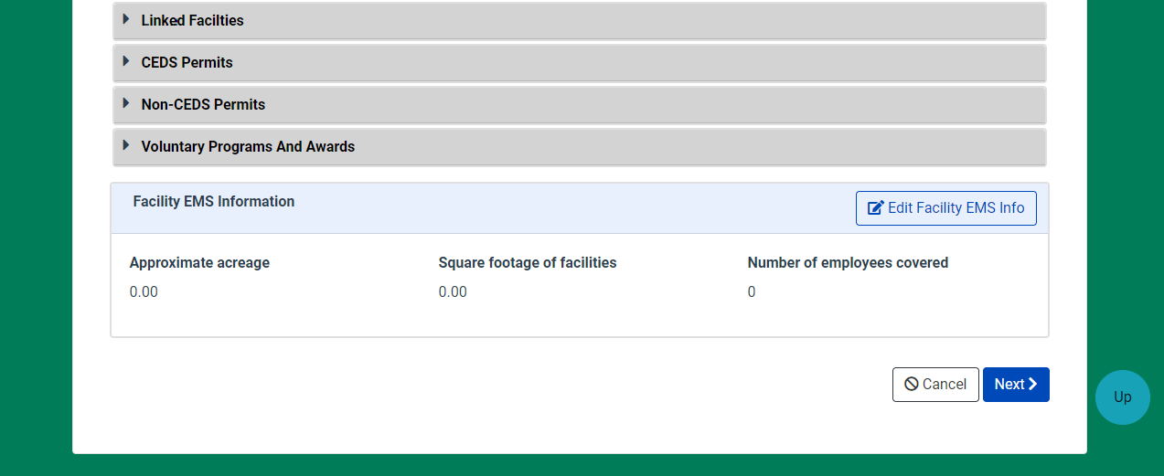
Creating a Report – General Information
Add any environmental voluntary programs and/ or awards pertinent to the membership.
This is the only information that can be updated on the ‘General Information’ tab. This information is available in the previous year’s report.

Slide 18
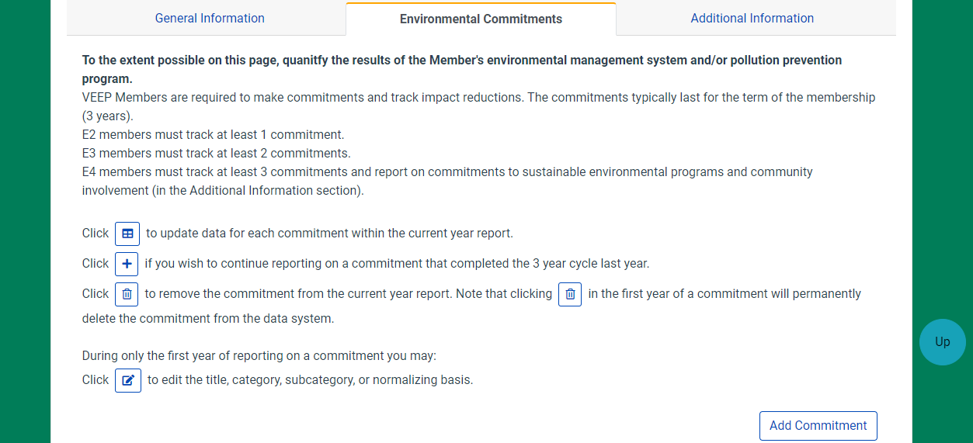
Environmental Commitment Reporting
The ‘+’ is used when a commitment has run its three year cycle and you wish to continue to report on that commitment for another three year cycle.

Slide 19
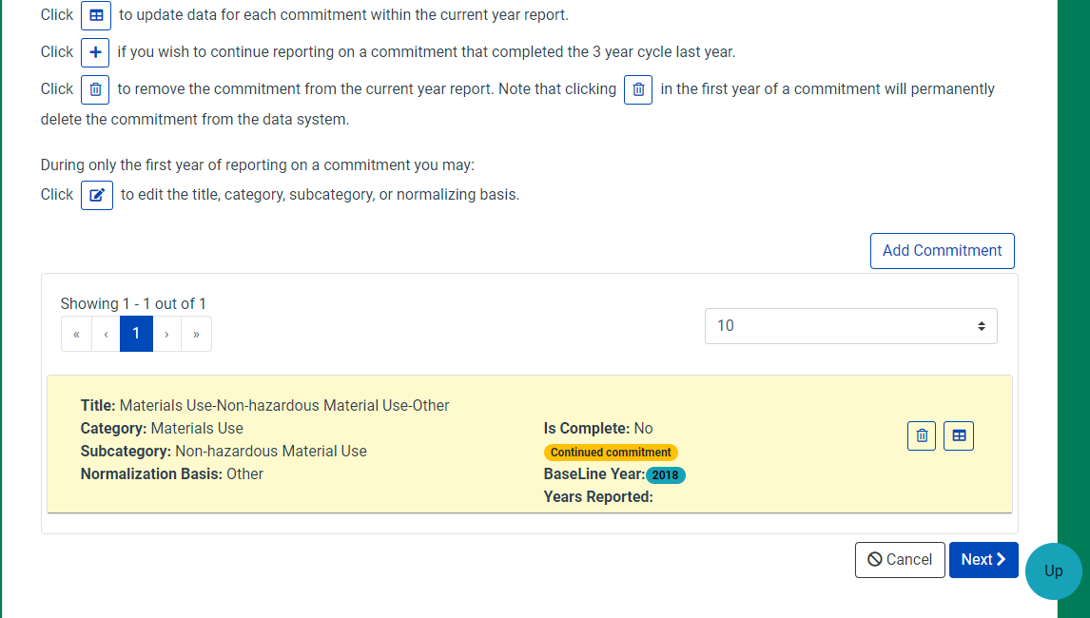
Environmental Commitment Reporting –
Add a New Commitment
If you wish to add a new reporting commitment.

Slide 20
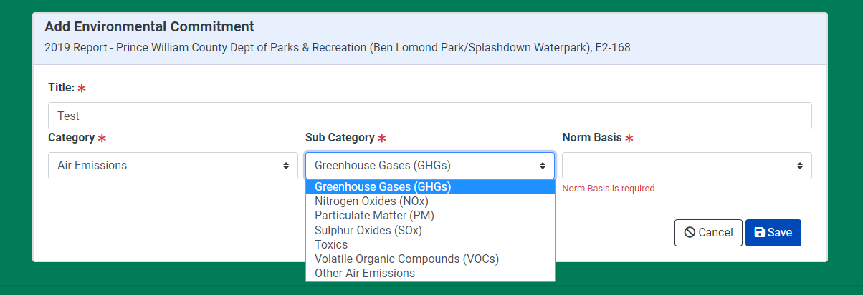
Environmental Commitment Reporting –
Add a New Commitment
Name your new ‘Environmental Commitment’.
Choose the ‘Category’, ‘Sub Category’ and ‘Normalizing Basis’ from the drop down lists and hit ‘Save’.

Slide 21
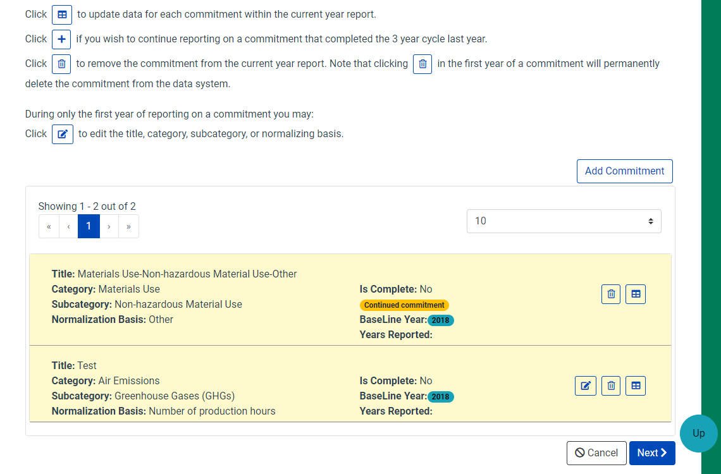
Environmental Commitment Reporting –
Add a New Commitment
The new reporting commitment appears with the other reporting commitments.

Slide 22
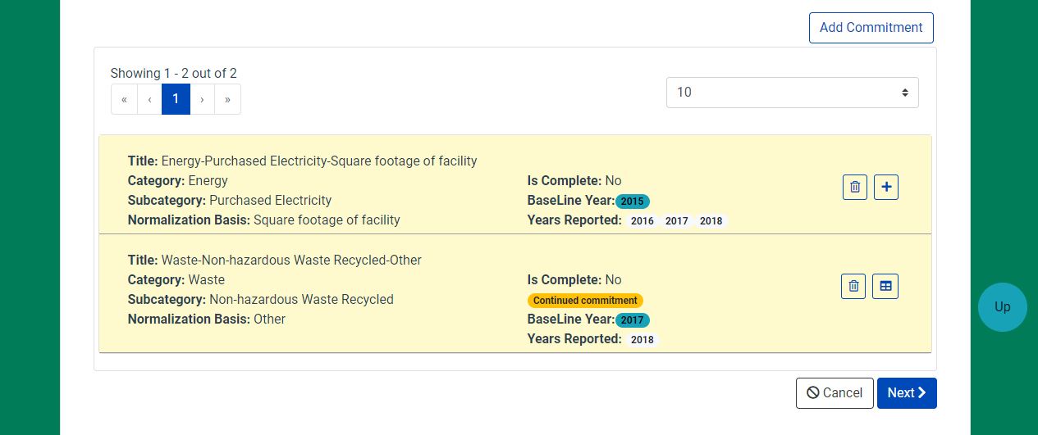
Environmental Commitment Reporting Update
Each reporting commitment tells you how many years have been reported.
‘Continued Commitment’ means that the reporting commitment has been reported on in a previous 3 year cycle.

Slide 23
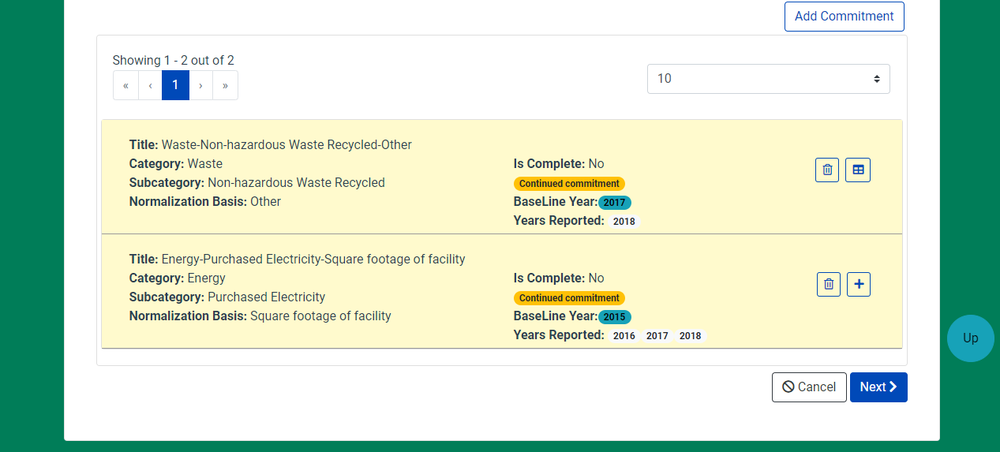
Environmental Commitment Reporting Update
The table symbol allows a reporter to update a report.
The ‘+’ allows for an established reporting commitment to continue to be reported on for another 3 year cycle.

Slide 24
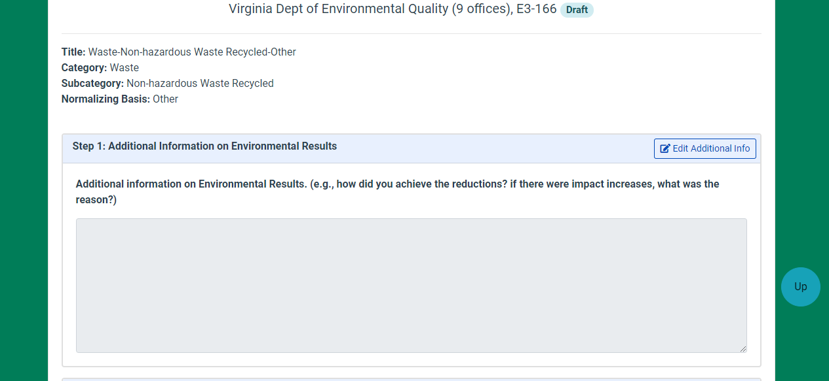
Environmental Commitment Reporting Update
To update the information and/or populate this area with your previous year’s explanation click on ‘Edit Additional Info’.
A brief description of the environmental commitment is required.

Slide 25
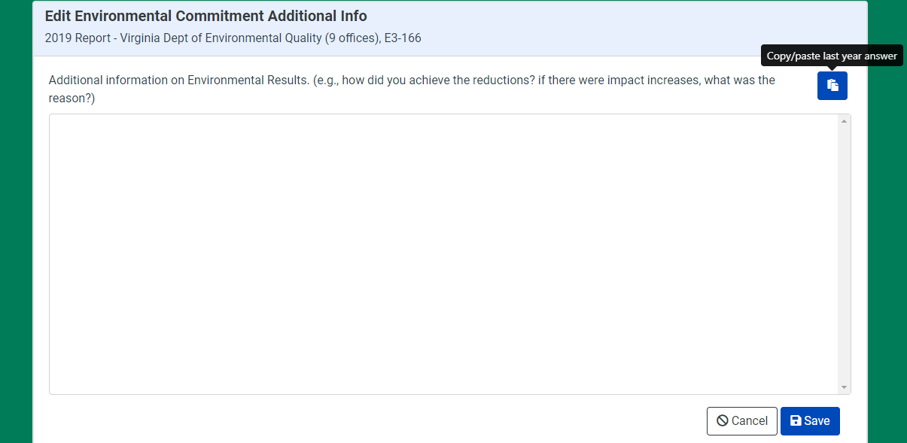
Environmental Commitment Reporting
One you click on the ‘Edit Additional Info’ button, you have the opportunity to use the previous year’s description

Slide 26
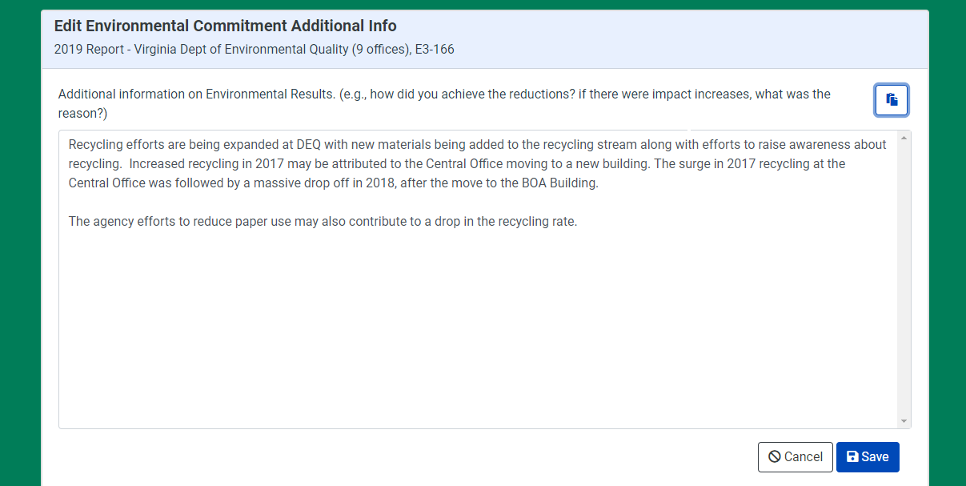
Environmental Commitment Reporting Update
The previous year’s answer will populate unless you are reporting on the first year of new 3 year cycle.
As you complete a question hit ‘Save’ and move on.

Slide 27
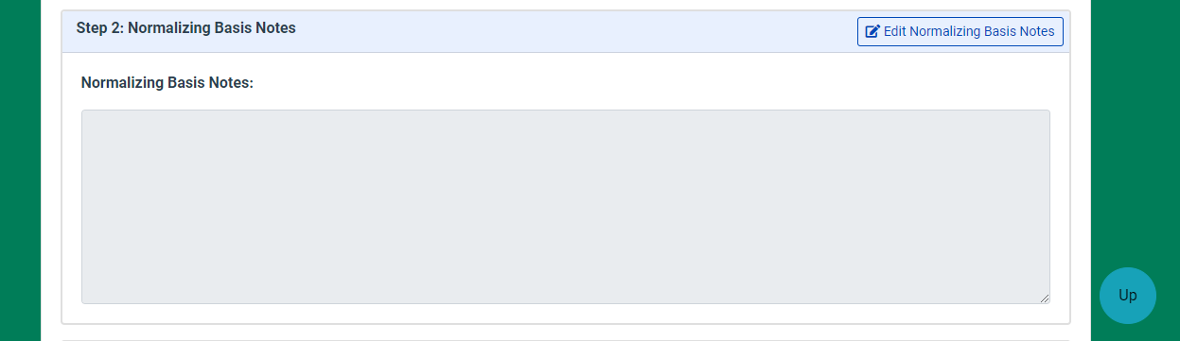
Environmental Commitment Reporting Update
The process for importing the previous year’s narrative is the same for the ‘Normalizing Basis’ and ‘Cost Savings Information’.

Slide 28
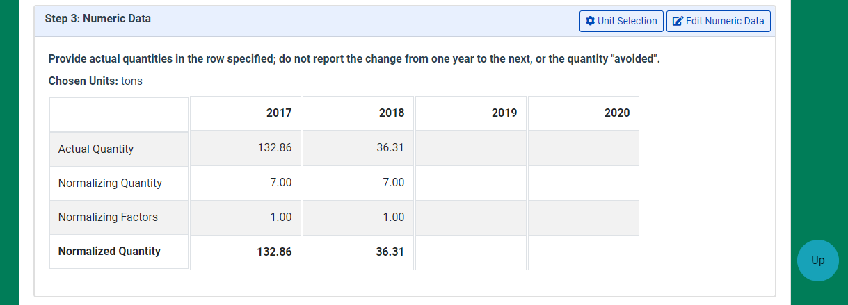
Environmental Commitment Reporting Update
‘Unit Selection’ allows you to change the units that you are reporting.

Slide 29
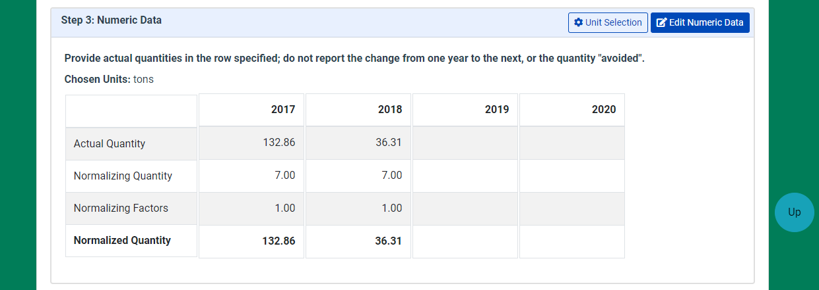
Environmental Commitment Reporting
‘Edit Numeric Data’ allows you to enter numerical data for the current reporting year.

Slide 30
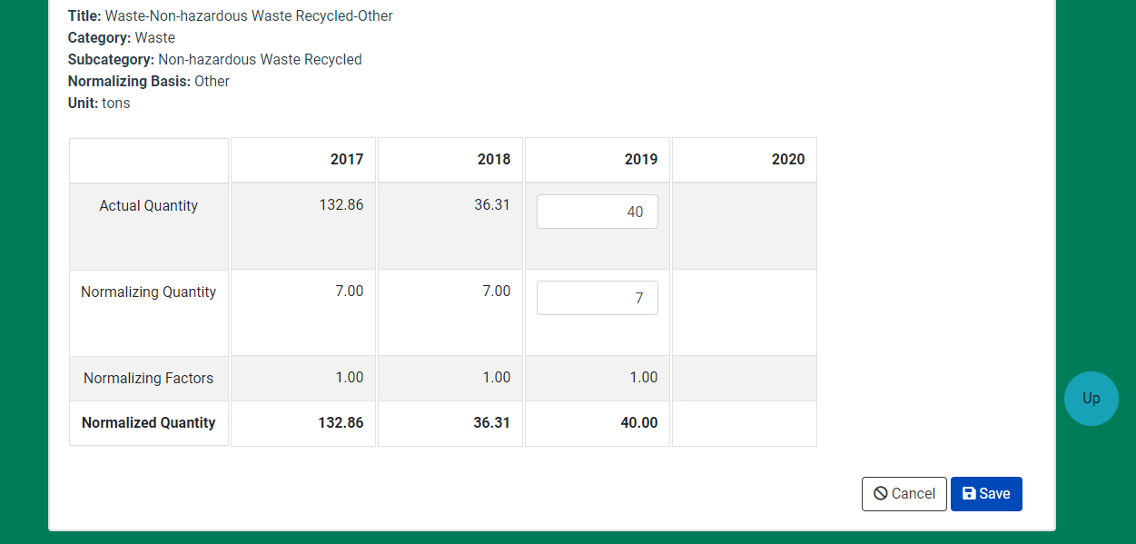
Environmental Commitment Reporting Update
Add your ‘Actual’ and ‘Normalizing’ numbers.
Click anywhere on the page and the Normalized quantities are calculated for you.
Don’t forget to Save.

Slide 31
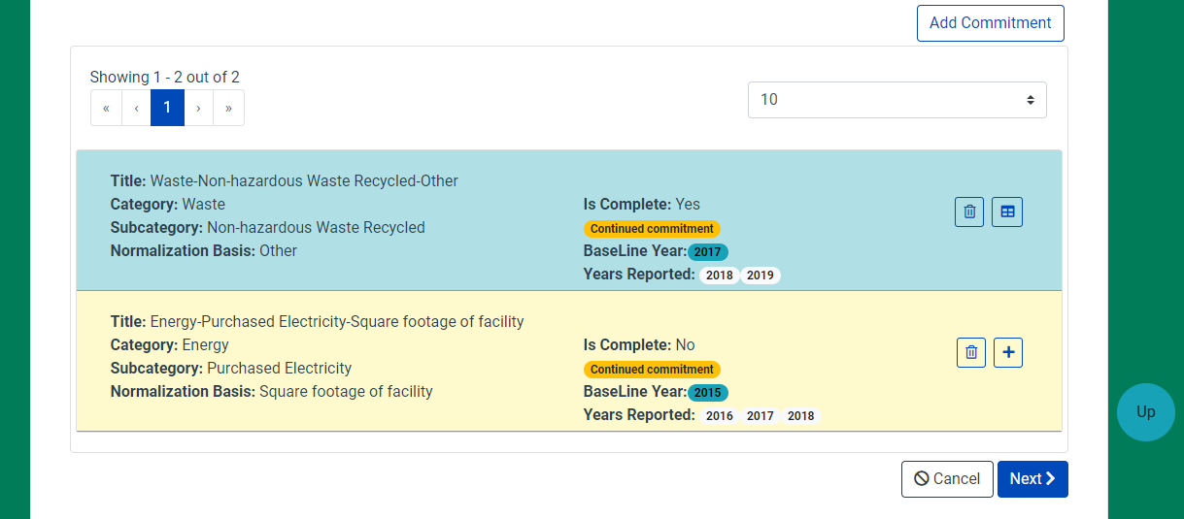
Environmental Commitment Reporting Update
A completed reporting commitment changes to blue.

Slide 32
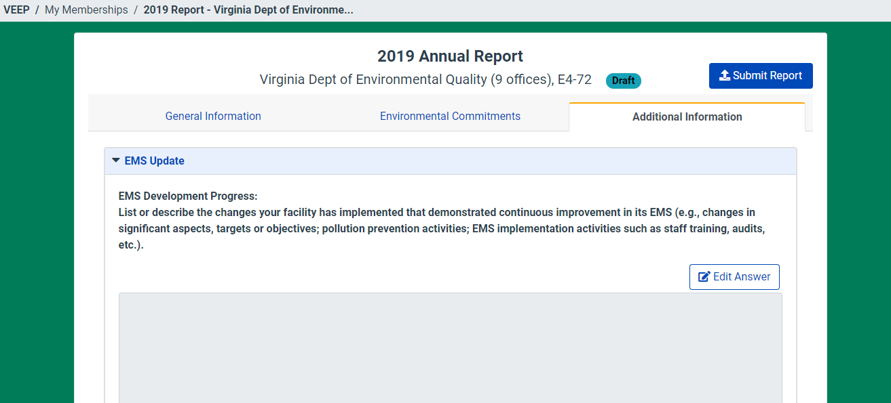
Additional Information
‘Additional Information’ is a series of narrative questions that need to be answered. All questions in the report need to be answered to submit the report. The only exception is the narrative reporting question available to E4 Members
Unlike in the ‘Environmental Commitments’ section, the questions in the ‘Additional Information’ section won’t populate with the previous year’s answer.

Slide 33
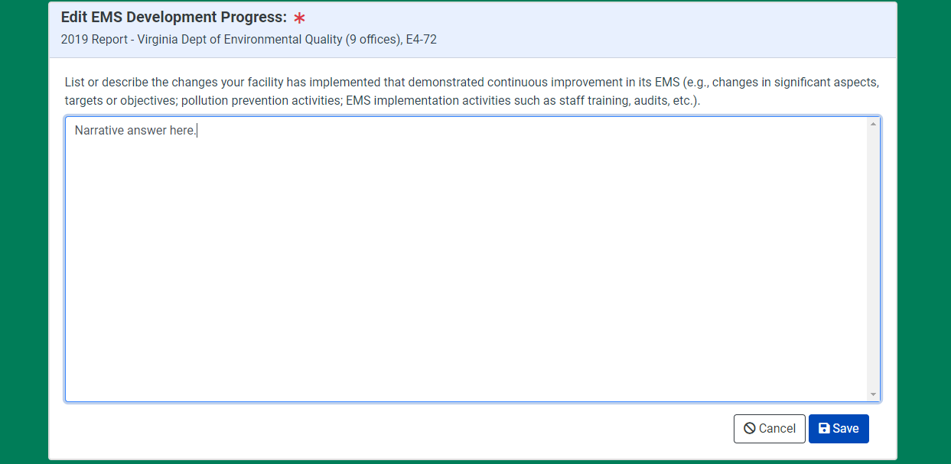
Additional Information
Once you answer a question, save and go on to the next question.

Slide 34
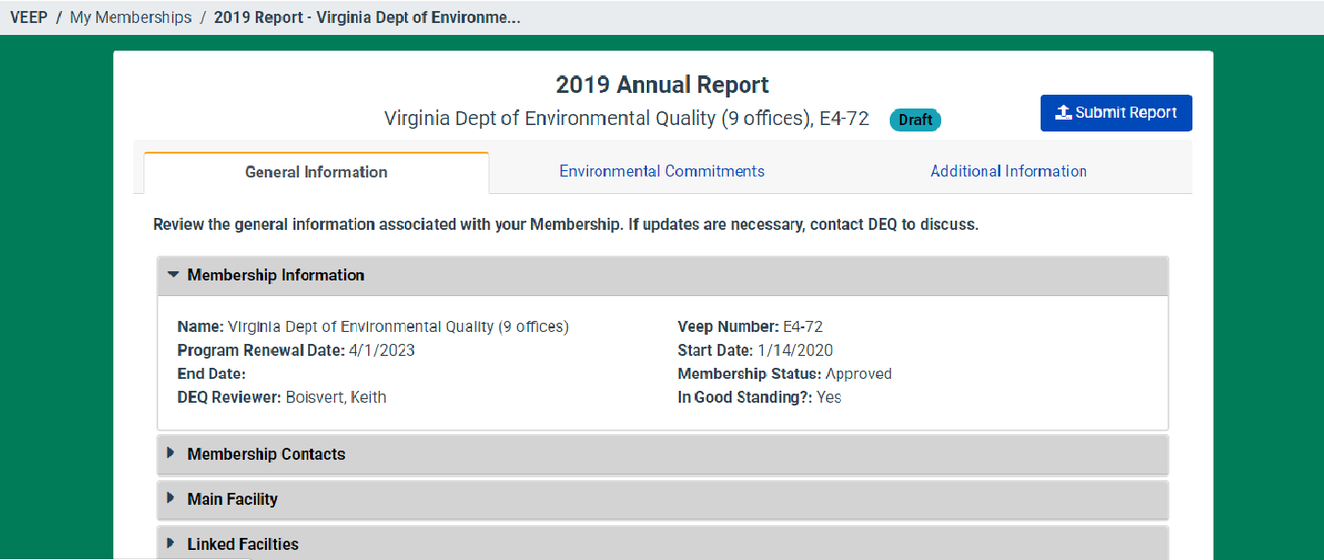
Submit Report
When your report is complete you can click on ‘Submit Report’
If your report is incomplete you will get an error message telling you what you need to fix. Fix the problems and try the ‘Submit Report’ button again.
Once your report is complete and submitted you will get an email confirmation.

Slide 35
Report Review
DEQ staff will review submitted reports.
If a completed report needs to be updated you will be contacted and asked to make updates or provide more information.
Once a report has been reviewed and approved by DEQ staff you will be notified via email.

Slide 36
Questions?
Keith Boisvert
Keith.Boisvert@DEQ.Virginia.gov
(804) 698-4225
Or
Morgan Goodman
Morgan.Goodman@DEQ.Virginia.gov
(804) 698-4122

