Slide 1
Modeling PCBs
Mountain Run PCB TMDL TAC Meeting
January 12, 2021

Slide 2
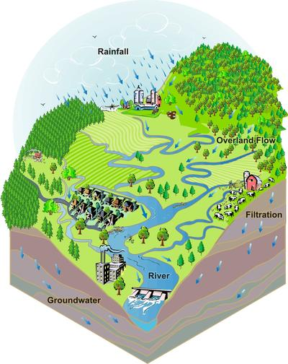
What is a model?
For technical support: 703-583-3906
A computational representation of a watershed used to simulate pollutant fate and transport.
Agricultural
Residential
Commercial
http://prairierivers.org/what-is-a-watershed/

Slide 3
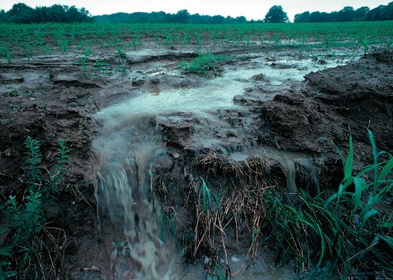
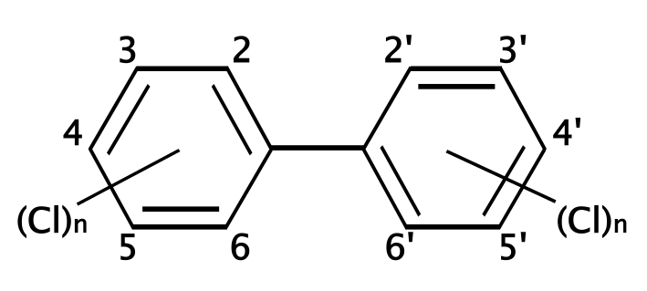
Model Process
PCB model consists of
3 major components:
  Hydrology
  Sediment
  PCB fate and transport
Results calibrated against observed data:
  USGS stream flow data
  Suspended sediment concentration data
  PCB concentration data
http://prairierivers.org/what-is-a-watershed/
https://upload.wikimedia.org/wikipedia/commons/thumb/4/49/Polychlorinated_biphenyl_structure.svg/2000px-Polychlorinated_biphenyl_structure.svg.png
https://photogallery.sc.egov.usda.gov/
netpub/server.np
3
Notes:
Hydrology is the critical foundation for the modeling process
Sediment is a function of the hydrology (runoff and in-stream scouring/deposition)
Sediment is the main transport mechanism of PCBs
Model PCBs after modeling the sediment
It is a multi-step process in which each subsequent step builds off the results of the previous

Slide 4
How is the model used?
1. Watershed inputs are used to develop model.
Watershed
Inputs
1
4

Slide 5

How is the model used?
Watershed inputs are used to develop model.
Model simulates watershed processes (flow, pollutant fate and transport).
Watershed
Inputs
1
2
Model Outputs
Computer
Model
5

Slide 6
How is the model used?
1. Watershed inputs are used to develop model.
2. Model simulates watershed processes (flow, pollutant fate and transport).
3. Model is calibrated to observed data.
3
Adjust Calibration Parameters
No
Watershed
Inputs
1
2
Model Outputs
Match Observed Data?
Yes
Computer
Model
6

Slide 7
How is the model used?
1. Watershed inputs are used to develop model.
2. Model simulates watershed processes (flow, pollutant fate and transport).
3. Model is calibrated to observed data.
4. Calibrated PCB outputs are compared with TMDL endpoints.
3
Adjust Calibration Results
No
Watershed
Inputs
4
1
2
Model Outputs
Match Observed Data?
Yes
PCB Outputs Compared w/ Endpoints
Computer
Model
7

Slide 8
How is the model used?
1. Watershed inputs are used to develop model.
2. Model simulates watershed processes (flow, pollutant fate and transport).
3. Model is calibrated to observed data.
4. Calibrated PCB outputs are compared with TMDL endpoints.
3
Adjust Calibration Results
No
Watershed
Inputs
4
1
2
Model Outputs
Match Observed Data?
Yes
Meet TMDL Endpoints?
Yes
Computer
Model
No
Revise Pollutant Reduction Scenarios
Until No Exceedance of TMDL Endpoints
5
5. Model allows evaluation of multiple pollution reduction scenarios.
8

Slide 9

How is the model used?
1. Watershed inputs are used to develop model.
2. Model simulates watershed processes (flow, pollutant fate and transport).
3. Model is calibrated to observed data.
4. Calibrated PCB outputs are compared with TMDL endpoints.
3
Adjust Calibration Results
No
Watershed
Inputs
4
6
1
2
Model Outputs
Match Observed Data?
Yes
Meet TMDL Endpoints?
Yes
Computer
Model
TMDL
Complete
No
Revise Pollutant Reduction Scenarios
Until No Exceedance of TMDL Endpoints
5
5. Model allows evaluation of multiple pollution reduction scenarios.
6. Stakeholders select acceptable reduction scenario to achieve TMDL.
9

Slide 10
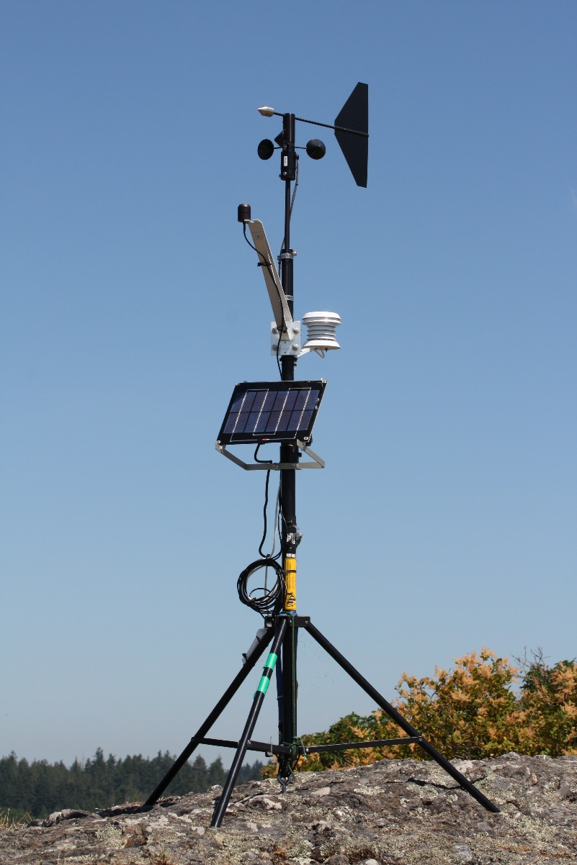
Model Inputs
Watershed Inputs
  Meteorological Data
https://commons.wikimedia.org/wiki/File:Weather_vane_2748.JPG
10

Slide 11
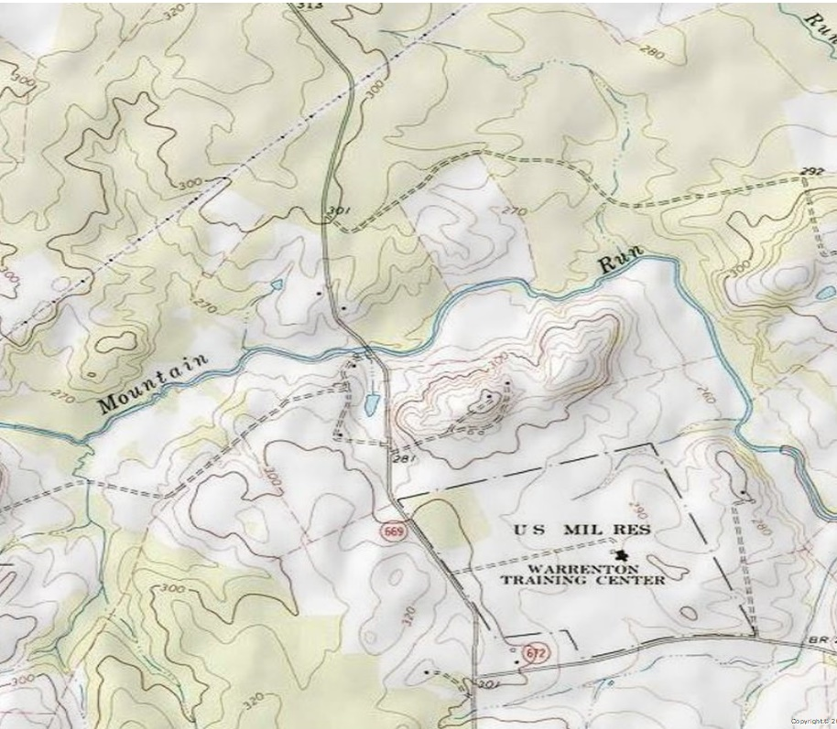
Model Inputs
Watershed Inputs
  Meteorological Data
  Watershed Topography
http://topomaps.usgs.gov/drg/
Topo maps, Digital Elevation Models (DEMs)
11

Slide 12
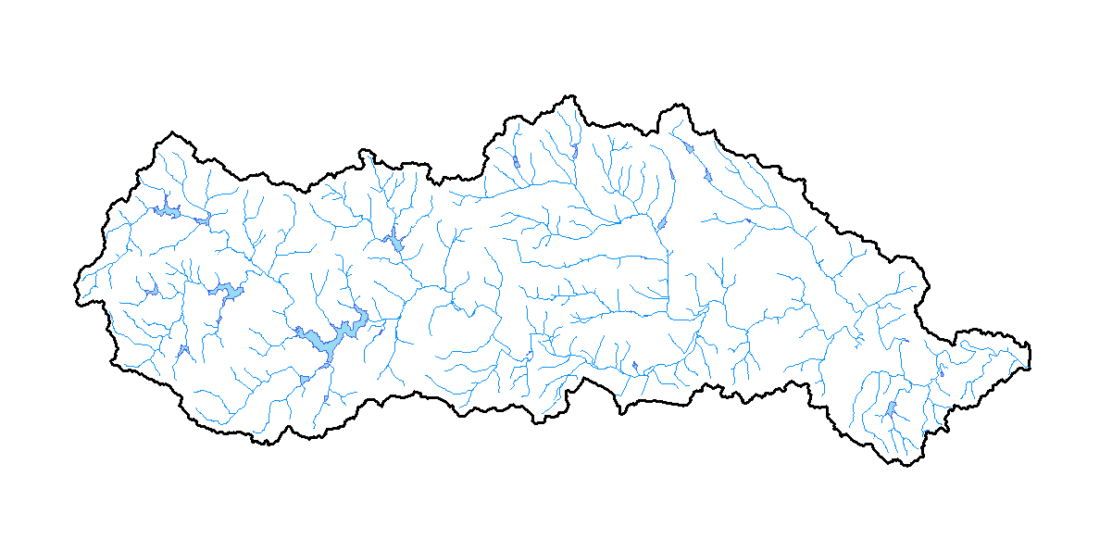
Model Inputs
Watershed Inputs
  Meteorological Data
  Watershed Topography
  Stream Networks
National Hydrography Dataset (NHD)
12

Slide 13
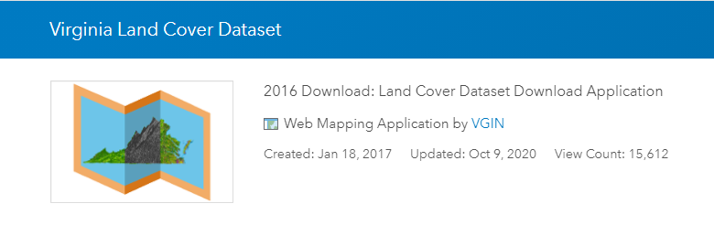
Model Inputs
Watershed Inputs
  Meteorological Data
  Watershed Topography
  Stream Networks
  Land Use
http://www. https://vgin.maps.arcgis.com/
13

Slide 14
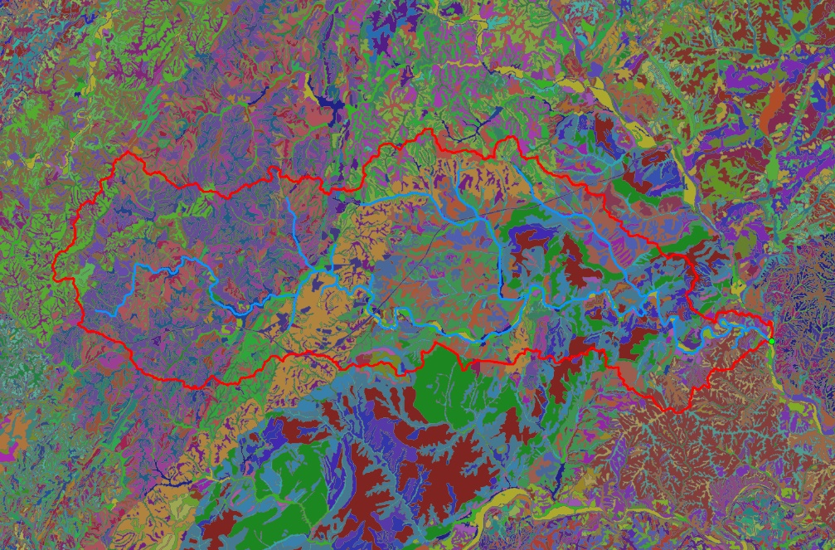
Model Inputs
Watershed Inputs
  Meteorological Data
  Watershed Topography
  Stream Networks
  Land Use
  Soil Types
SSURGO Data, USDA-NRCS
14

Slide 15
Potential PCB Sources

Slide 16
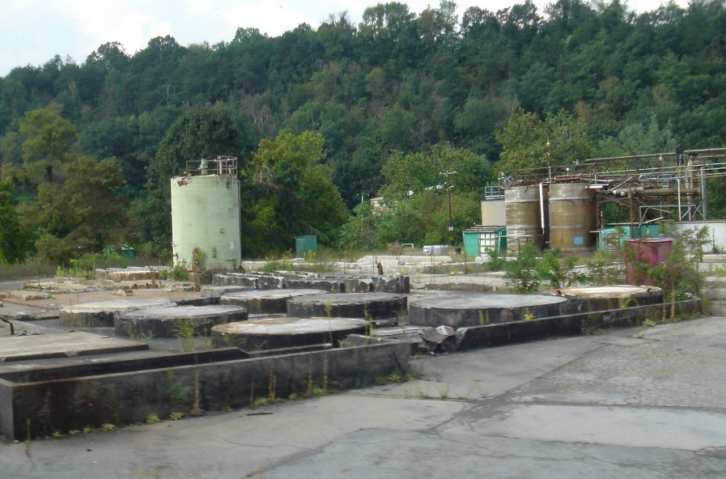
Contaminated Sites
Former Manufacturing Facilities
http://www.panoramio.com/photo/96185658
Former Manufacturing Facility
16

Slide 17
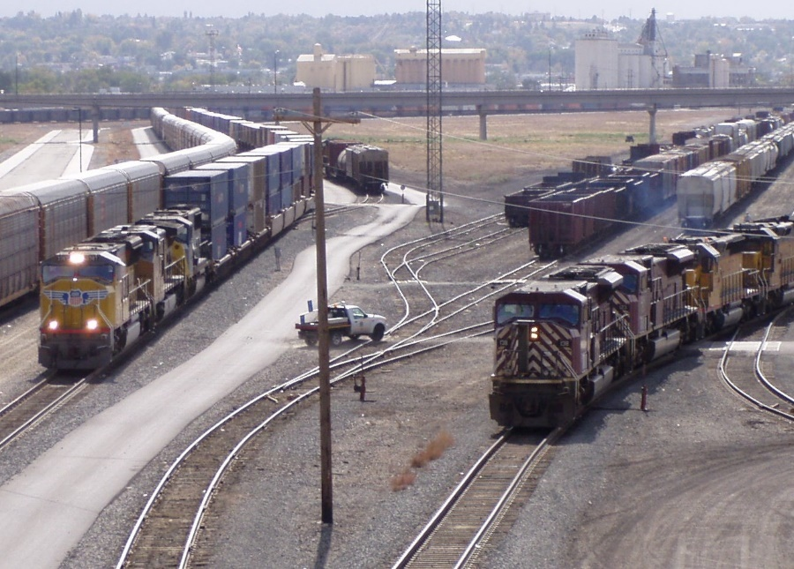
Contaminated Sites
Former Manufacturing Facilities
Rail Yards
Electrical Substations
Soils have been exposed to PCBs
  PCBs attach to the soil particles and wash off during precipitation events
Modeled as nonpoint sources – diffuse sources (no clearly defined outlet)
https://commons.wikimedia.org/w/index.php?curid=6092689
Active Rail Yard
17

Slide 18
PCB Oil Spills
Acute events in which PCBs are released into the environment
May enter stream/river directly or may be spilled onto land surface
Modeled as single event at specific date and time
Event details available in Pollution Response Program (PReP) database (Source: Virginia DEQ)
https://upload.wikimedia.org/wikipedia/commons/thumb/4/49/Polychlorinated_biphenyl_structure.svg/2000px-Polychlorinated_biphenyl_structure.svg.png
18

Slide 19
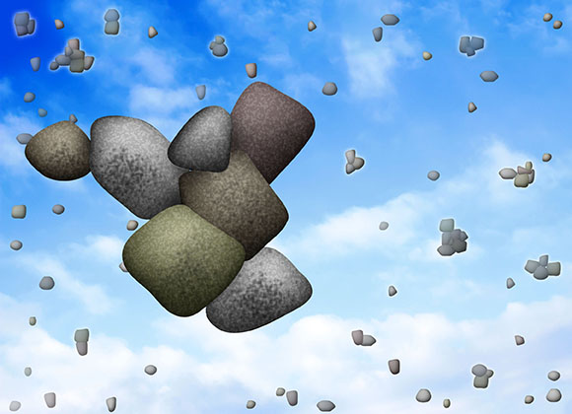
Atmospheric Deposition
PCBs are present in the atmosphere in small concentrations
They settle out from the atmosphere and are deposited on the land
Modeled as a daily load of PCBs, applied to entire watershed surface area at a constant rate (1.6 μg/m²)
Considered a legacy source
http://www.pnnl.gov/science/images/highlights/atmospheric/atmosParticleWeightGain_580px.jpg
19
Notes:
The atmospheric deposition rate is an adopted value from the Chesapeake Bay Program Atmospheric Deposition Study. The rate from the Chesapeake Bay study is used in the Lewis Creek because no local data is available. 1.6 ug/m^2/yr
The deposition is in the form of wet deposition or dry aerosol deposition. Gas exchange is also a factor (was a factor for Chesapeake Bay in which there was a net loss of PCBs to atmosphere.) but in the Lewis Creek watershed there isn’t as much surface area for PCBs to exchange and volatilize into the air.

Slide 20
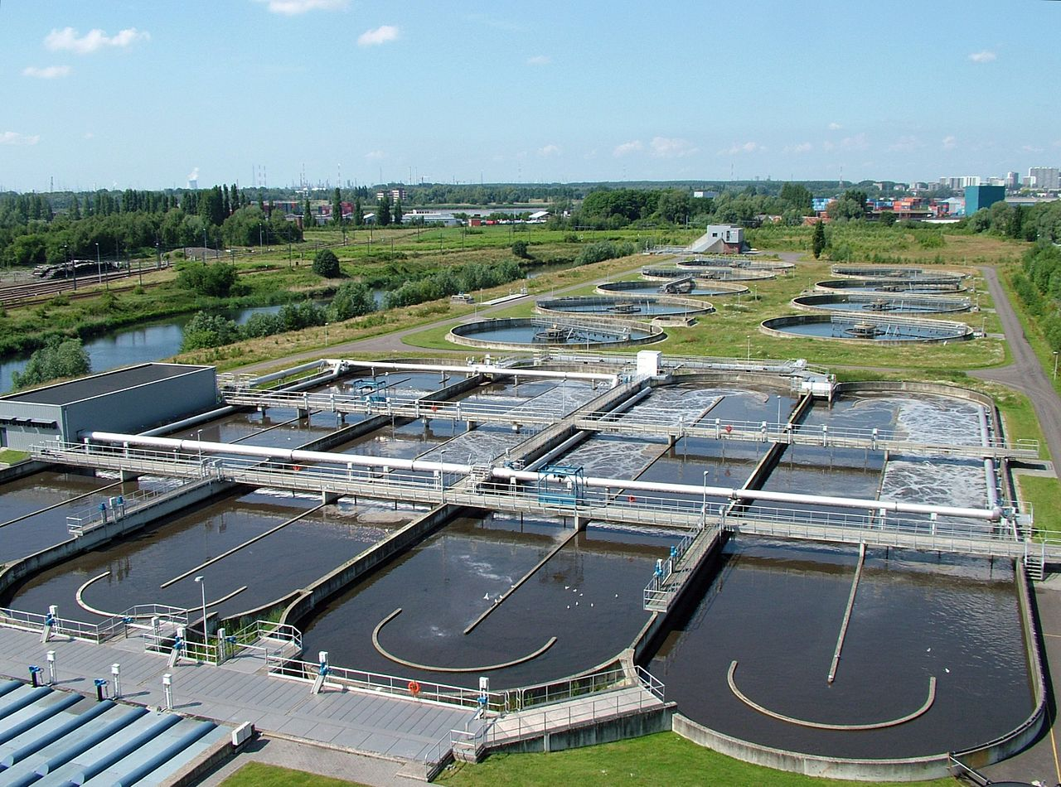
Permitted Sources
  Municipal Wastewater Treatment Plants
  Industrial Stormwater General Permitted Facilities
  Industrial Facilities
Modeled as point sources – sources with a defined outlet
Wastewater Treatment Plant
20

Slide 21
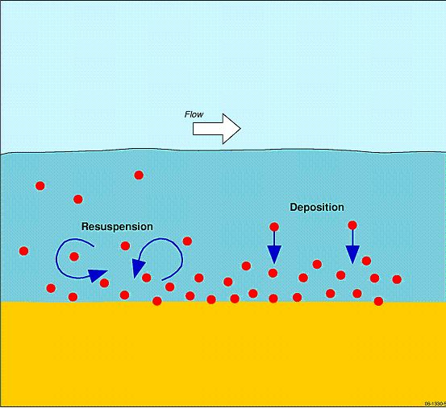
In-Stream Sediment
PCBs that have attached to sediment and washed off the land surface may settle to the streambed and persist in the environment
If the sediment is disturbed, the PCBs can be released into the water column
Modeled as an initial concentration of PCBs attached to in-stream sediment
Considered a legacy source
http://www.ozcoasts.gov.au/glossary/images/resuspension.jpg
In-stream sediment resuspension and deposition
21
Notes:
PCBs are hydrophobic and tend to attach to sediment

Slide 22
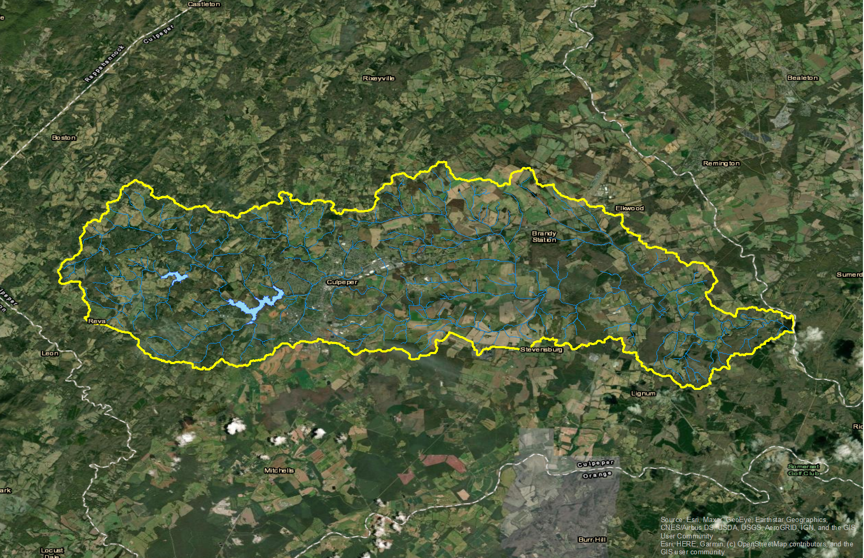
Mountain Run Watershed
22

Slide 23
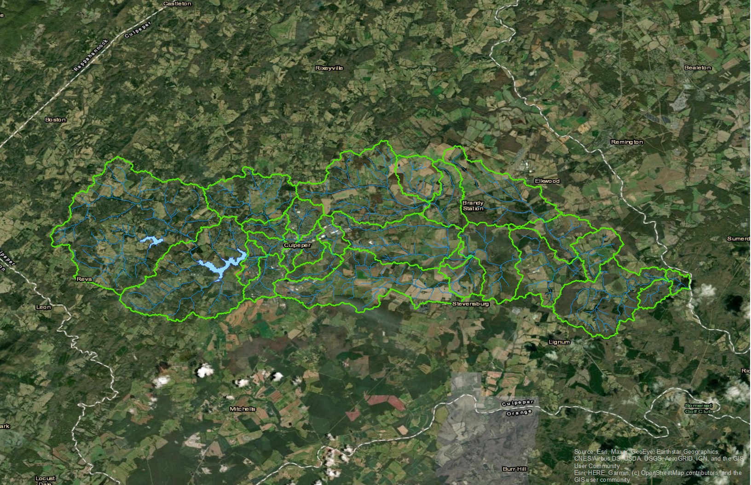
Mountain Run Sub-Watersheds
Stony Creek
Lower New
River
Lower New
River
Walker Creek
Peak
Creek
Reed Creek
Upper New
River
23

Slide 24
Hydrology Model
Simulates the watershed water balance
Meteorology (precipitation and evapotranspiration) is the driving force
Accounts for:
  Spring flow
  Major withdrawals (municipal water supply and industrial cooling water)
  Major discharges (water treatment plants, industry)
USGS data used for calibration
http://prairierivers.org/what-is-a-watershed/
24
Notes:
Following 3 slides are optional and can be reviewed if the attendees want more information on how the model works

Slide 25
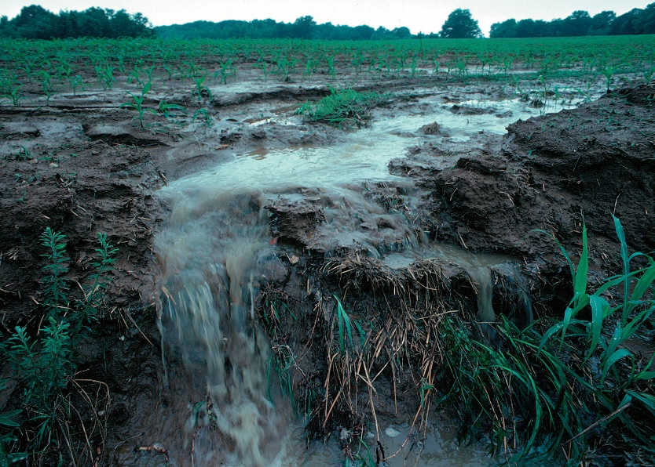
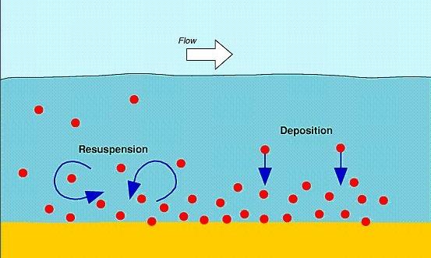
Sediment Model
PCBs typically enter waterways attached to sediment particles
To simulate PCB fate and transport, erosion and sediment transport are modeled.
  Sediment detachment and washoff from land surfaces
  Scouring and deposition in reaches
Simulated total suspended solids (TSS) concentrations calibrated against observed suspended sediment concentration (SSC) data
https://photogallery.sc.egov.usda.gov/netpub/server.np
Soil detachment and washoff (erosion)
http://www.ozcoasts.gov.au/glossary/images/resuspension.jpg
In-stream sediment resuspension and deposition
25

Slide 26
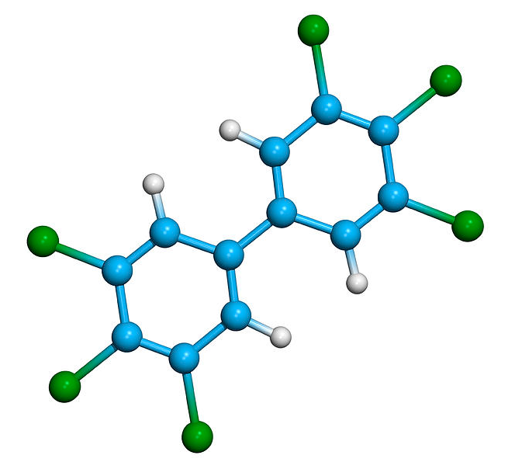
PCB Fate and Transport Model
Simulates the fate and transport of PCBs through the watershed
Adsorption and desorption coefficients are used to model how sediment-attached PCBs enter the water column
Calibrated against PCB water column sampling data
Used for pollution allocation scenarios to reduce pollutant sources and meet endpoint goals
https://upload.wikimedia.org/wikipedia/commons/thumb/4/49/Polychlorinated_biphenyl_structure.svg/2000px-Polychlorinated_biphenyl_structure.svg.png
http://images.fineartamerica.com/images-medium-large/polychlorinated-biphenyl-molecule-dr-tim-evans.jpg
PCB molecules
26
Notes:
If discussing this slide, then state that the sources of PCB in the model are what is noted above

