Slide 1
Modeling PCBs
Mountain Run PCB TMDL Public Meeting
January 13, 2021

Slide 2
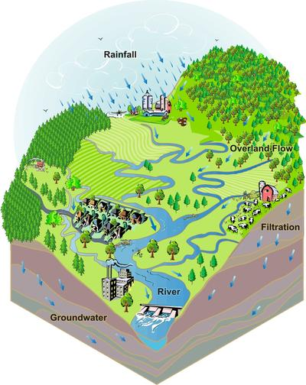
What is a model?
For technical support: 703-583-3906
A computational representation of a watershed used to simulate pollutant fate and transport.
Agricultural
Residential
Commercial
http://prairierivers.org/what-is-a-watershed/

Slide 3
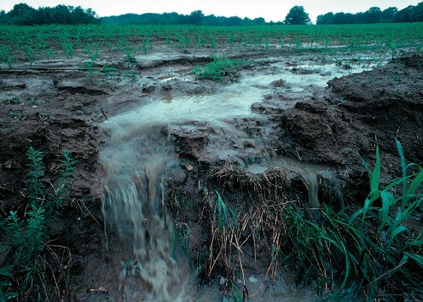
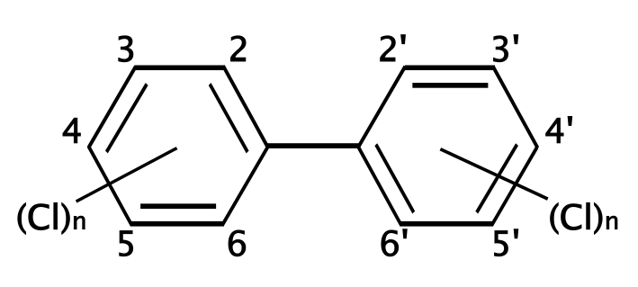
Model Process
PCB model consists of
3 major components:
  Hydrology
  Sediment
  PCB fate and transport
Results calibrated against observed data:
  USGS stream flow data
  Suspended sediment concentration data
  PCB concentration data
http://prairierivers.org/what-is-a-watershed/
https://upload.wikimedia.org/wikipedia/commons/thumb/4/49/Polychlorinated_biphenyl_structure.svg/2000px-Polychlorinated_biphenyl_structure.svg.png
https://photogallery.sc.egov.usda.gov/
netpub/server.np
3
Notes:
Hydrology is the critical foundation for the modeling process
Sediment is a function of the hydrology (runoff and in-stream scouring/deposition)
Sediment is the main transport mechanism of PCBs
Model PCBs after modeling the sediment
It is a multi-step process in which each subsequent step builds off the results of the previous

Slide 4
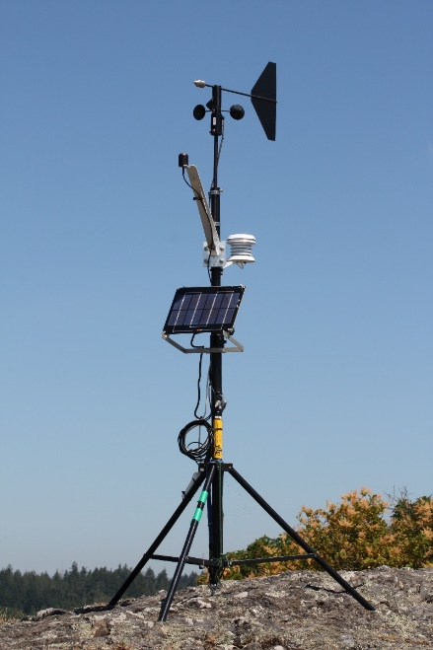
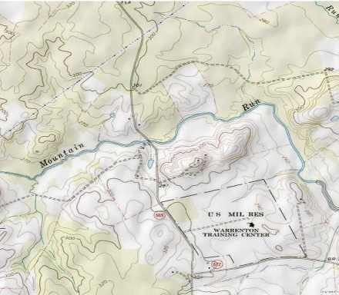
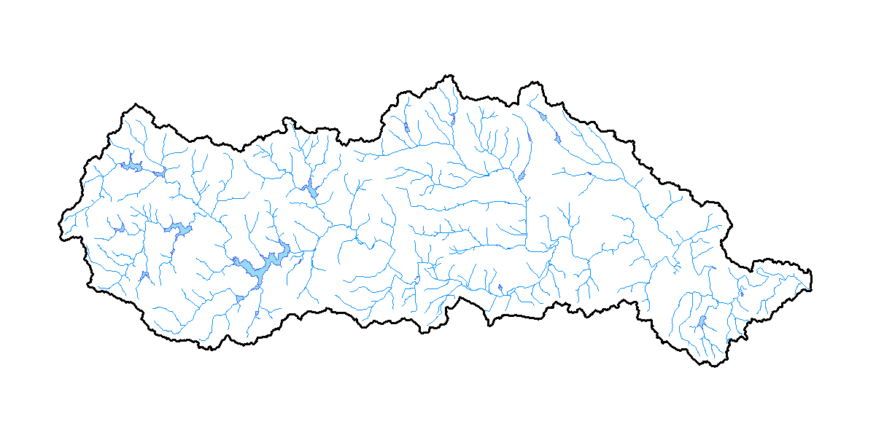
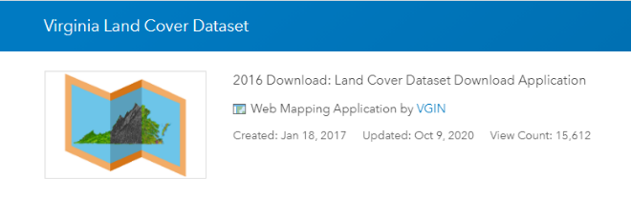
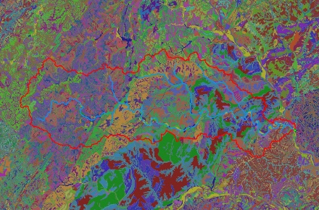
Model Inputs
Watershed Inputs
  Meteorological Data
  Watershed Topography
  Stream Networks
  Land Use
  Soil Types
Topo maps, Digital Elevation Models (DEMs)
https://commons.wikimedia.org/wiki/File:Weather_vane_2748.JPG
National Hydrography Dataset (NHD)
http://www. https://vgin.maps.arcgis.com/
SSURGO Data, USDA-NRCS
4

Slide 5
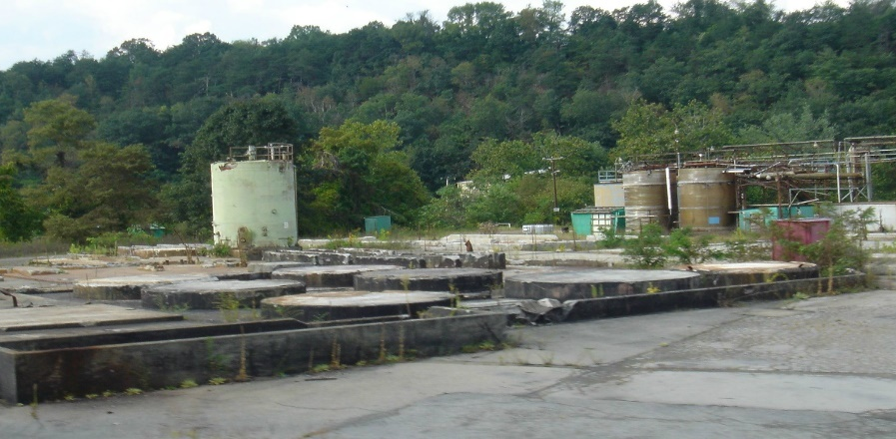
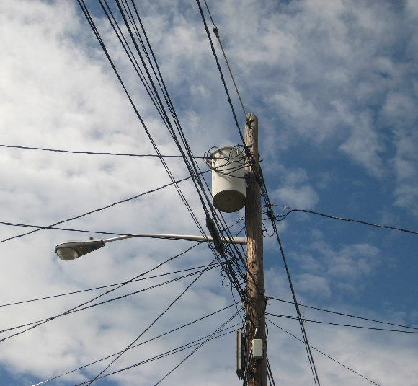
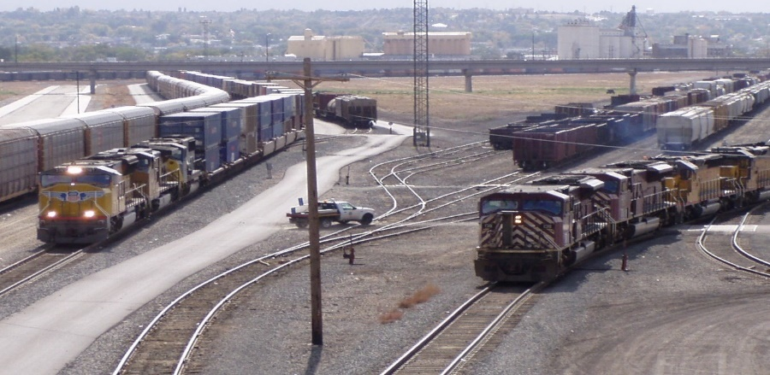
Potential PCB Sources
Contaminated Sites
PCB Oil Spills
Permitted Sources
Atmospheric Deposition
In-Stream Sediment
http://www.panoramio.com/photo/96185658
https://commons.wikimedia.org/w/index.php?curid=6092689
https://commons.wikimedia.org/w/index.php?curid=17503186
5

Slide 6
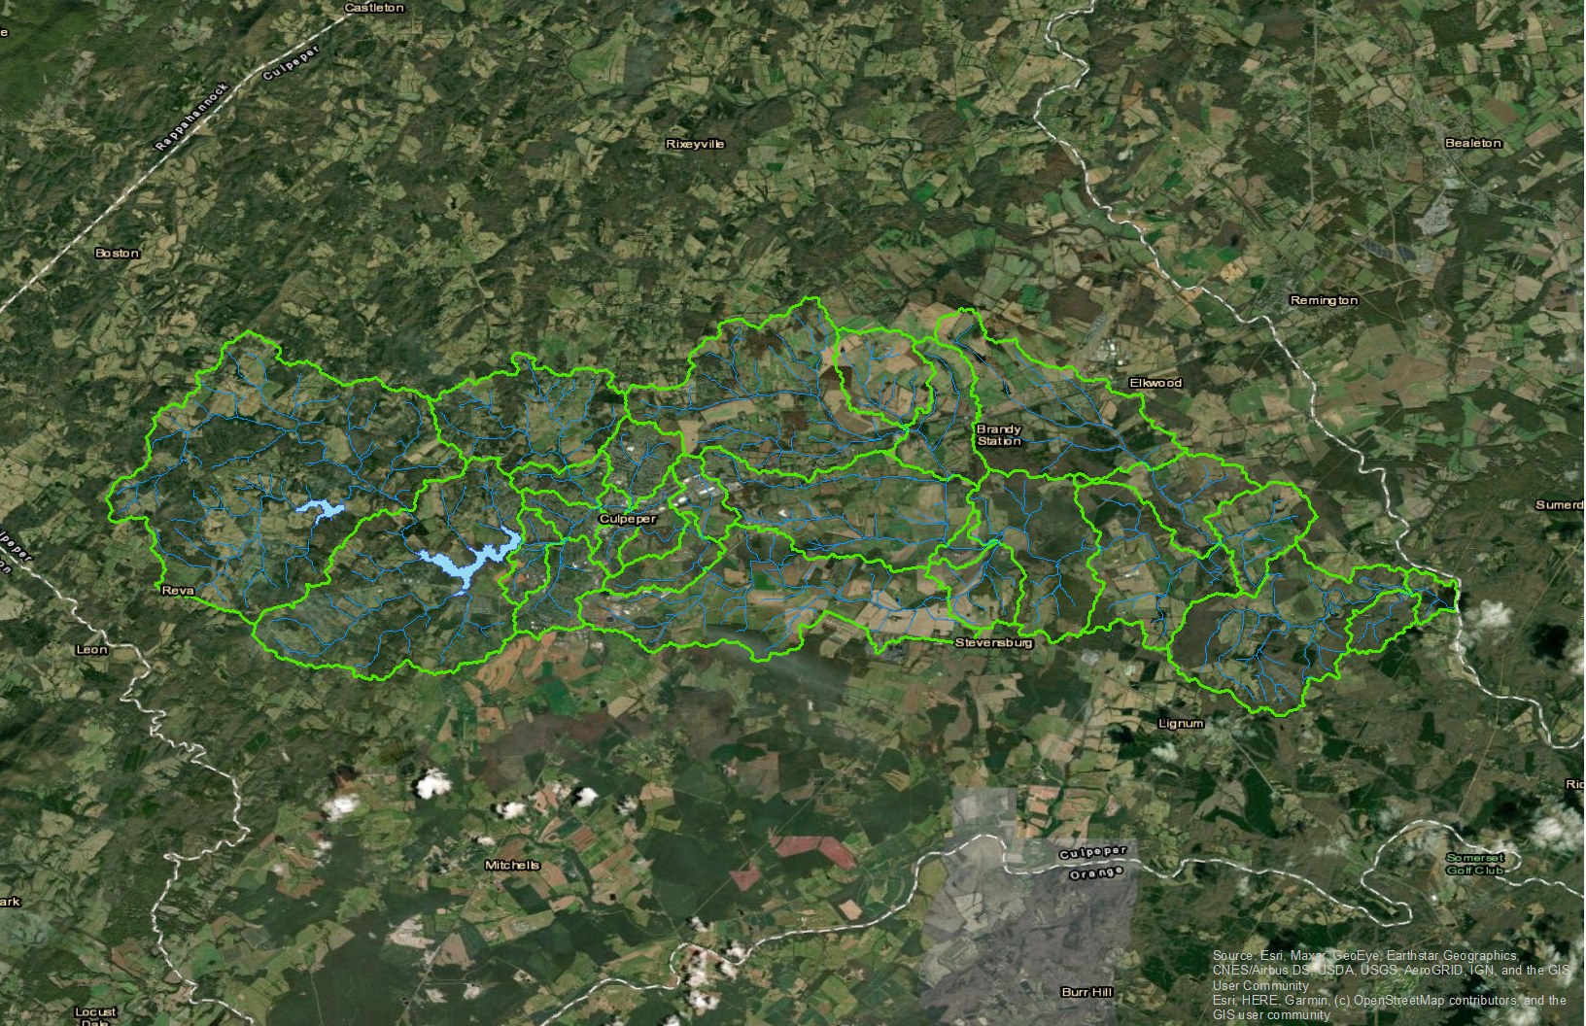
Mountain Run Sub-Watersheds
Stony Creek
Lower New
River
Lower New
River
Walker Creek
Peak
Creek
Reed Creek
Upper New
River
6

