Slide 1
Tidal James River, Elizabeth River, and Tidal Tributaries PCB Water Quality (TMDL) Study:
Public Meeting
Mark Richards & Paige Haley
January 26, 2021

Slide 2
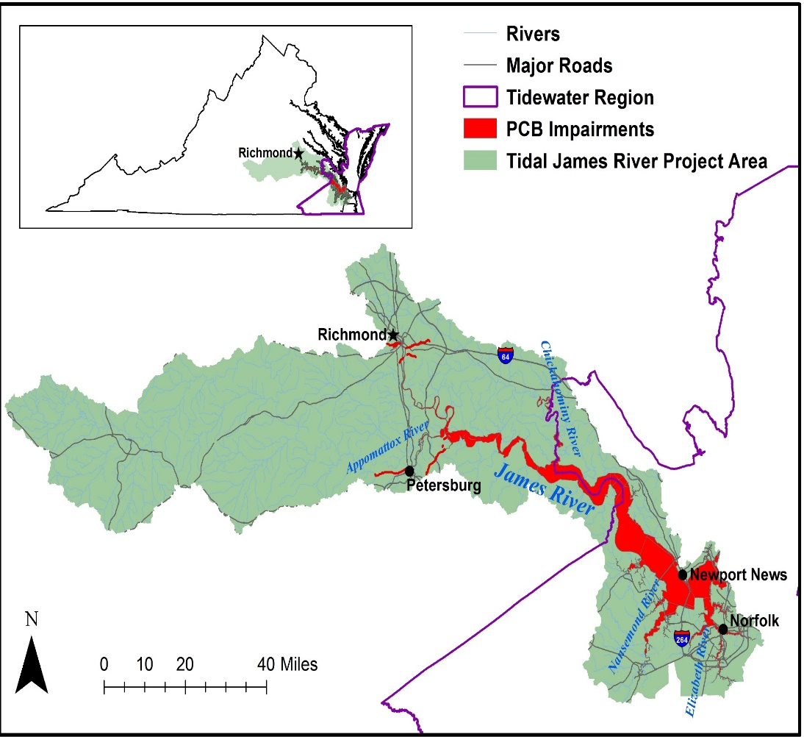

Agenda
Welcome and Introductions
  Meeting Objectives
Overview of Water Quality Planning
Background PCB Information
Water Quality Impairment of the tidal James River watershed
Overview of the tidal James River watershed PCB TMDL
Next Steps
For Technical Support call 757.518.2153

Slide 3
Overview of Water Quality Planning

Slide 4
Water Quality Standards
Designated Uses
  All waters are designated for recreation, aquatic life, fish consumption, and wildlife
  Other uses applied locally as applicable (shellfish [tidal], public water supply, Chesapeake Bay, etc.)
Criteria
  To protect and maintain designated uses
  Numeric or narrative
Anti-degradation
  Protects and maintains existing water quality from being degraded

Slide 5
Continuous Planning Process
For Technical Support call 757.518.2153
Monitoring
VPDES Permit Limits
Water
Quality Standards
Assessment
Implementation Plan
Integrated Report
Public
Participation
TMDLs
Public
Participation
EPA

Slide 6
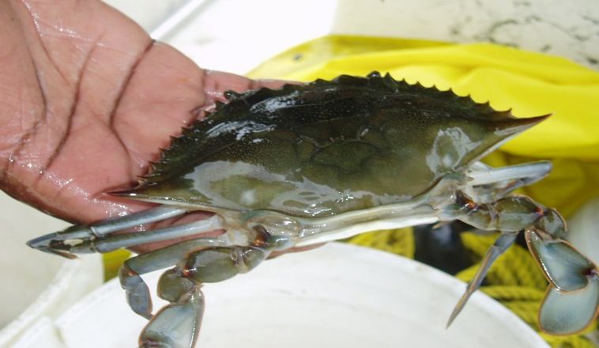
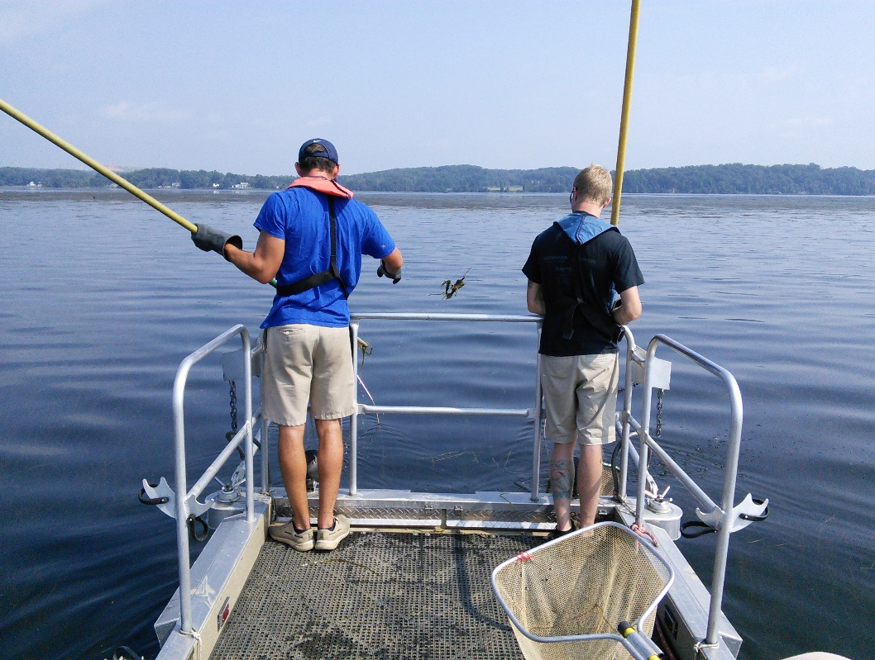
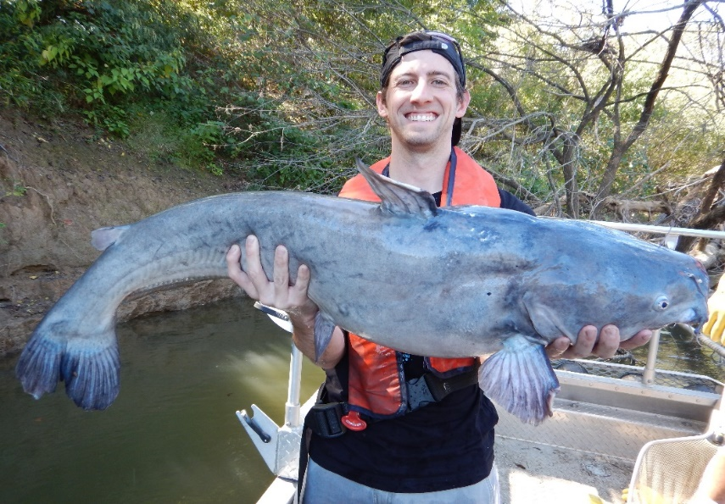
DEQ Fish Tissue Monitoring
Monitor to assess the “Fishable” Goal of the Clean Water Act - 305(b)
Target contaminants that accumulate in tissue
    “Lipophilic” or Fat loving
      PCBs, Pesticides, etc.
    Mercury
Compare to trigger values (protect human health)
    Listed on “dirty waters” / 303(d) report if exceeds

Slide 7
VA Water Quality Criterion –Total PCBs
Agency | Fish Tissue Threshold (ng/g or ppb) | WQC (pg/L or ppq)
VDH | 100 (Fish Consumption Advisory) | - -
DEQ | 18 (Screening Value) | 640
DEQ’s Water Quality Assessment (Integrated Report)
  VDH - Consumption Advisory = impairment
  DEQ - two or more fish samples exceed screening value at a site or two water samples exceed criterion at a site = impairment
  From: DEQ’s 2022 (Draft) Water Quality Assessment Guidance Manual

Slide 8
Total Maximum Daily Load (TMDL)
TMDL = WLA + LA + MOS
Where:
WLA = Waste Load Allocation
LA = Load Allocation
MOS = Margin of Safety
Goal = Reduce existing PCB load to restore the fish consumption use
Pollutant Load
TMDL End Point
Pollution Budget
Addresses different pollution categories
PCB TMDL - Multi-media approach
  Air, Land, Water
Margin of Safety
Load Allocations (WLA + LA)
TMDL
Existing Load
Allocated Load
For restoration the waterbody must meet two thresholds: 1) Numeric WQC [or site specific value] and 2) fish tissue threshold

Slide 9

The TMDL Process
Fish Consumption Advisory
Identify Problem
Low Level PCB
Analysis
In Process
Source Assessment
Identify sources
Estimate source loading
To be Completed
Link Sources to Targets
Assess linkages
Estimate total loading capacity
TMDL Allocations
Reduce loads from point sources
Divide remaining loads among
sources
To be Completed
TMDL = Sum of WLA + Sum of LA + MOS
Notes:
These components are not necessarily sequential steps, but are a guide and framework for TMDL development.
(1) Problem Identification: define key factors and background information for a listed waterbody that describe the nature and impairment. This is the guiding factor in development of the TMDL.
(2) Develop Numeric Targets: measurable indicators and target values that can be used to evaluate attainment of water quality standards in the listed waterbody.
(3) Source Assessment: identify sources of loading for bacteria
(4) Link Targets and Sources: this is necessary in order to develop the TMDL since the linkage defines the cause-and-effect relationship between the pollutant sources and the in-stream pollutant response and allows for an estimation of loading capacity. This relationship can vary seasonally, especially for nonpoint sources that are highly dependent on precipitation.
(5) Load Allocations: pollutant loadings that will not exceed the loading capacity and will lead to attainment of the water quality standard can be determined based on the target/source linkage. The loadings may be distributed or allocated among the significant sources.
(6) Follow-up Monitoring: An ongoing monitoring plan should be included to determine whether the TMDL has resulted in attaining water quality standards and to support any required revisions to the TMDL.

Slide 10
PCB Background Information
For Technical Support call 757.518.2153

Slide 11

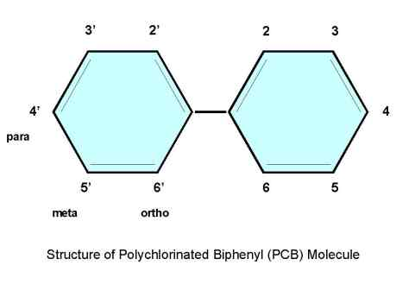
Background: PCBs
Biphenyl molecule (1-10 chlorine atoms)
209 distinct PCB Compounds
Regulated by DEQ as Total PCB (tPCB) = 209 compounds summed
Referred to as PCB Aroclors (Monsanto tradename) = mixture of PCB compounds
  Examples 1248, 1254, 1260
For Technical Support call 757.518.2153

Slide 12
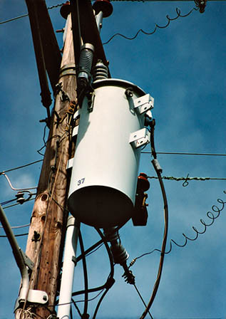
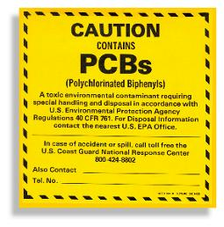
Background: PCBs
Legacy Contaminant
  Estimated that > 1.5 Billion lbs. manufactured in the U.S. until 1977
Characteristics
  Very stable and heat resistant
  Persistent in the environment
Common uses:
  Transformers, capacitors, hydraulic fluids, circuit breakers, PVC Products, carbonless copy paper, caulking material, paints, and more!
For Technical Support call 757.518.2153

Slide 13
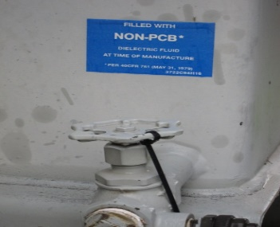
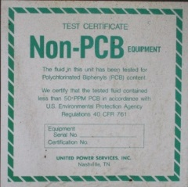
Toxics Substances Control Act (TSCA)
1976 Law regulates PCBs
  Bans the manufacture, processing, use and distribution in commerce
  Non-PCB Transformer defined as containing < 50 ppm PCB
  Inadvertent manufacture of PCBs – products up to 50 ppm allowed to leave site as long as annual average is < 25 ppm
    Unintentional by-products of manufacturing processes
50 ppm compared to DEQ’s WQC - 6.4 X 10⁻⁷ ppm (0.00000064)
For Technical Support call 757.518.2153
Notes:
Banned in 1979
PCB Regulations: Part 761 in Title 40 of the Code of Federal Regulations
https://www.epa.gov/pcbs/learn-about-polychlorinated-biphenyls-pcbs
Has list of federal notices
6 Sept 2012: changes made so that PCB regs matched RCRA regs (40 CFR 262, 263, 264)
TSCA Cleanup level of 1 ppm
9VAC20-81-630: wastes containing PCBs (effective 2011)

Slide 14
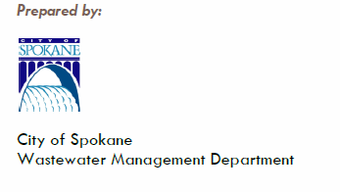

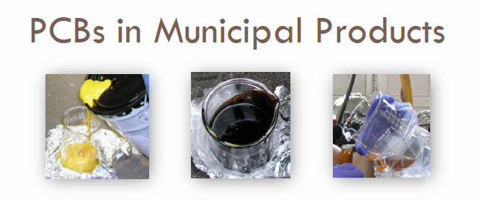
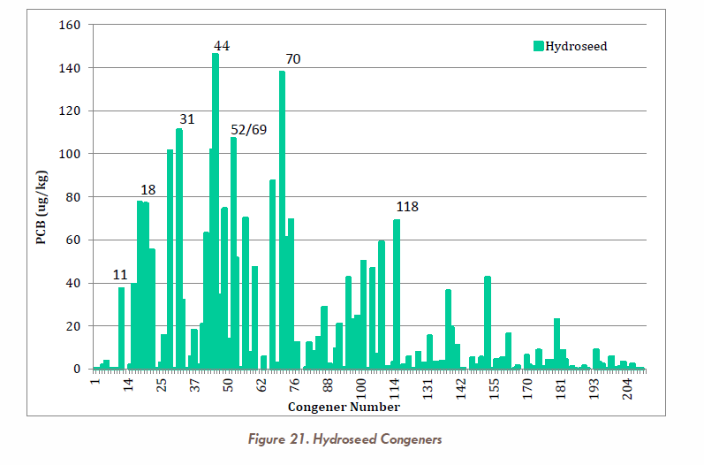
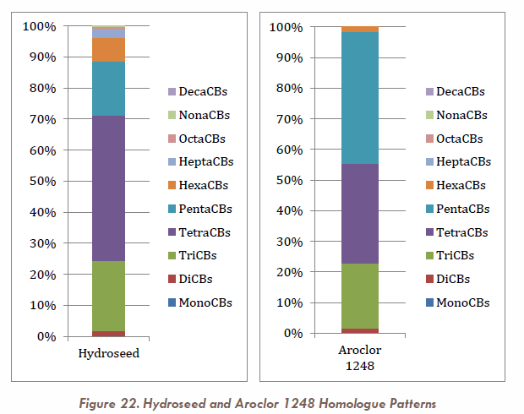
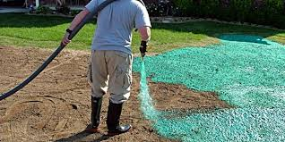
PCBs in Municipal Products
March 2015
Examples of other products tested
  Pennzoil SAE5W-30
  Valvoline Full Synthetic
  Road paint

Slide 15
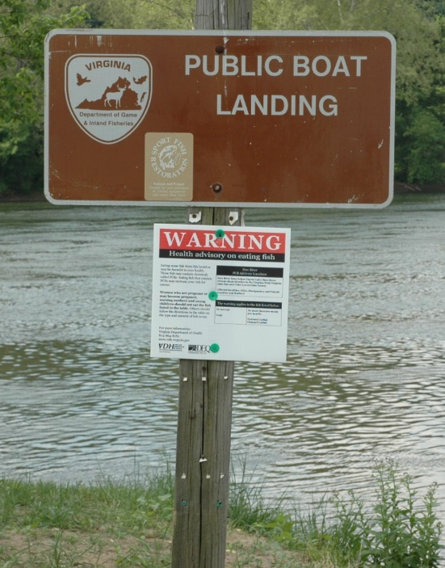
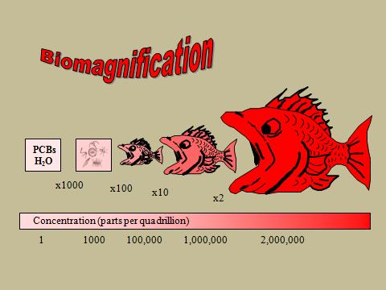
Why PCBs Continue to be an Issue
Fish impairments based on human health concerns
  Fish consumption significant exposure pathway
    Suspected carcinogen (EPA)
      International Agency on Research for Cancer (WHO) upgraded to carcinogen
    Immunotoxicity, reproduction and
    development , hepatotoxicity (liver), etc.
Persistent, bioaccumulates at a low conc. (ppq or pg/L) & biomagnifies
Confirmed on-going releases
For Technical Support call 757.518.2153

Slide 16
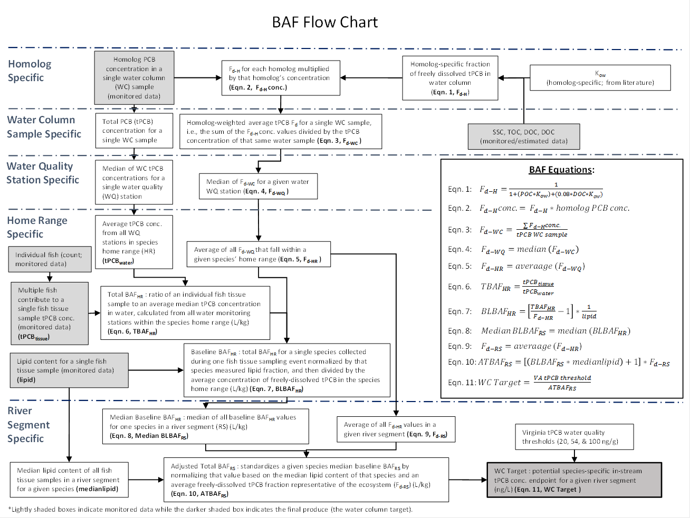
Site Specific PCB Endpoint
Explore the use of a site-specific Bioaccumulation Factor (BAF) endpoints
  Considers multiple exposure pathways
    Other pathways include sediment ingestion and Biomagnification
  Used in other VA PCB TMDLs - Potomac River, Roanoke River, New River and Levisa Fork
Existing WQC only considers a single exposure pathway (through fish gills)
1) Numeric water based value and 2) fish tissue concentration must be met for successful restoration
  Narrative WQS (i.e., control of toxic substances including those that bioaccumulate)
EPA Method (EPA-822-03-030, 2003)
For Technical Support call 757.518.2153

Slide 17
Tidal James River, Elizabeth River, and Tidal Tributaries Water Quality Impairment
For Technical Support call 757.518.2153

Slide 18
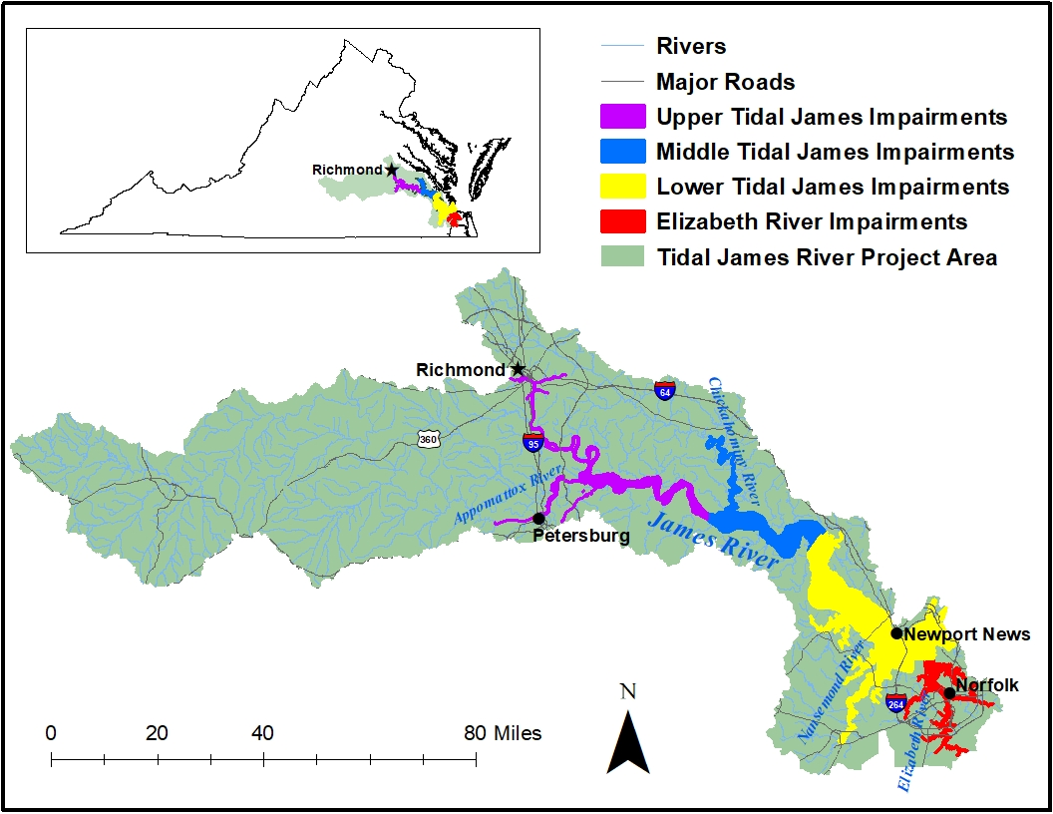
Tidal James River Watershed
For Technical Support call 757.518.2153

Slide 19
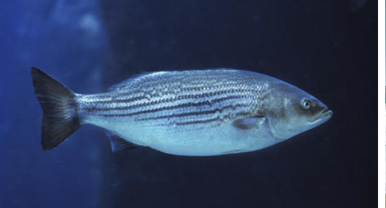
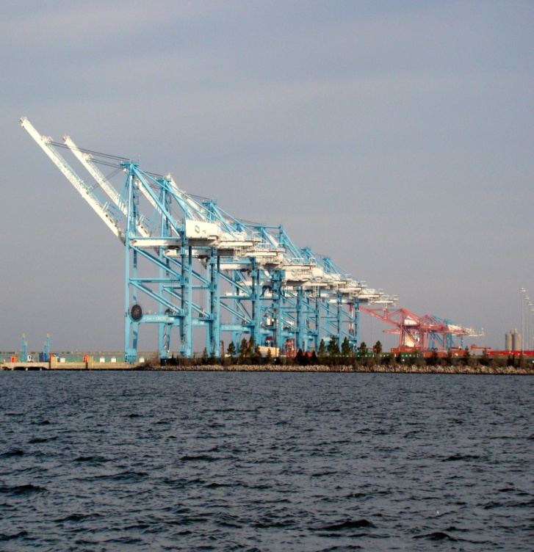
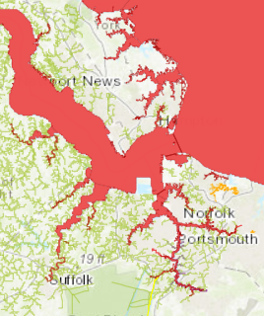
James and Elizabeth River Watershed PCB Impairment Timeline
1993,1998, & 2000-2001: DEQ monitors fish tissue
2002: VA Department of Health issues fish consumption advisory for numerous species
2003: DEQ performed a source investigation in the upper tidal James River
2005, 2012 & 2016: DEQ completes additional fish tissue monitoring
2009-2020: DEQ performs water and sediment monitoring for PCB water quality study; initiated meetings
https://www.alamy.com/stock-photo/striped-bass.html
http://www.vdh.virginia.gov/environmental-health/public-health-toxicology/fish-consumption-advisory

Slide 20
Problem Identification - VDH Fish Consumption Advisory
River basin | Water-body | Section | Locality | Contam-inants | Fish species | Advisory description
James River | James River | From I-95 James River Bridge in Richmond to Hampton Roads Bridge Tunnel, including tidal portions of tributaries | Richmond City, Henrico Co., Chesterfield Co., Charles City Co., Hopewell City, Colonial Heights City, Petersburg City, Dinwiddie Co., Prince George Co., Surry Co., James City Co., New Kent Co., Isle of Wight Co., Newport News City, Suffolk City, Portsmouth City, Hampton City, Norfolk City, Chesapeake City, Virginia Beach City | PCBs | Gizzard Shad, Carp, Blue Catfish ≥32 inches, Flathead Catfish ≥32 inches Blue Catfish <32 inches, Flathead Catfish <32 inches, Channel Catfish, White Catfish, Largemouth Bass, Bluegill Sunfish, American Eel, Quillback Carpsucker, Smallmouth Bass, Creek Chub, Yellow Bullhead Catfish, White Perch, Striped Bass, Bluefish, Croaker, Spot, Blueback Herring, Hickory Shad | Do Not Eat ≤ 2 meals/month
James River | Mill Creek | Entire Creek | City of Hampton | PCBs | Gizzard Shad | ≤ 2 meals/month
James River | Southern Branch | Southern Branch, including tributaries | Portsmouth City, Chesapeake City, Norfolk City | PCBs, Dioxin | Blue Crab | Do not eat crab's hepatopancreas ("mustard"). Crab meat is ok to eat.
http://www.vdh.virginia.gov/environmental-health/public-health-toxicology/fish-consumption-advisory/
Does not apply to swimming

Slide 21
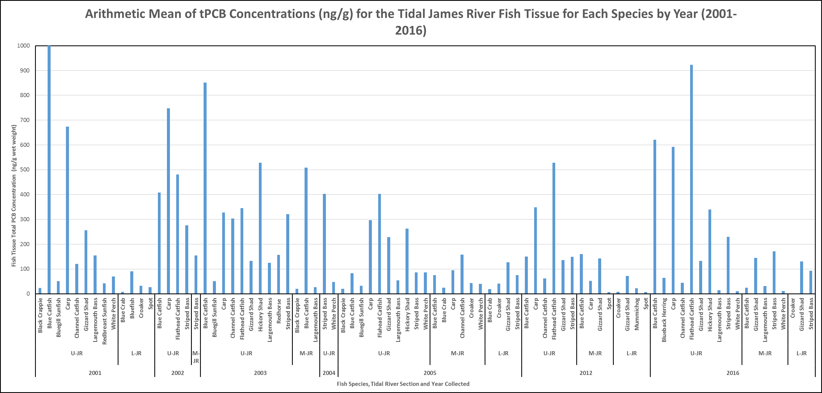
Tidal JR Fish Specis by year
2,024.9 ng/g
DEQ’s Screening Value
VDH Threshold

Slide 22
Arithmetic Mean of tPCB Concentrations (ng/g) for the Lower James River Consumption Advisory Species by Year (1993-2016)
Lower JR segment begins east of Hog Island Wildlife Management Area
VDH Threshold

Slide 23
tPCB conc. for consumption advisory fish in Elizabeth River watershed

Slide 24
Arithmetic Mean of tPCB Concentrations (ng/g) for Gizzard Shad in the Elizabeth River Watershed by Year (1998-2016) and Waterbody

Slide 25
Arithmetic Mean of tPCB Concentrations (ng/g) for Gizzard Shad in the Elizabeth River Watershed by Year (1998-2016) and Waterbody

Slide 26
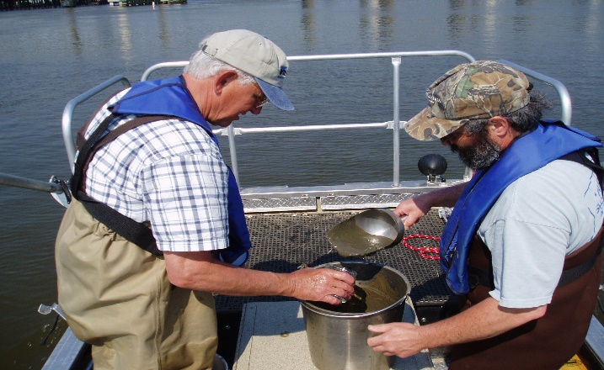
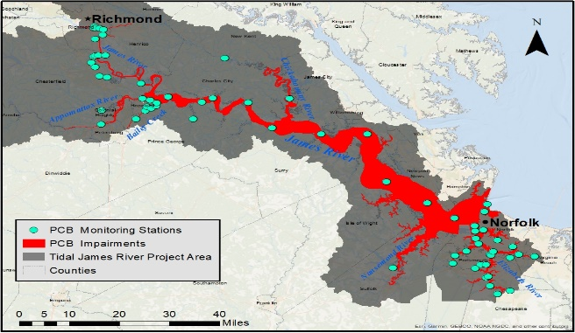
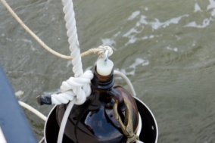
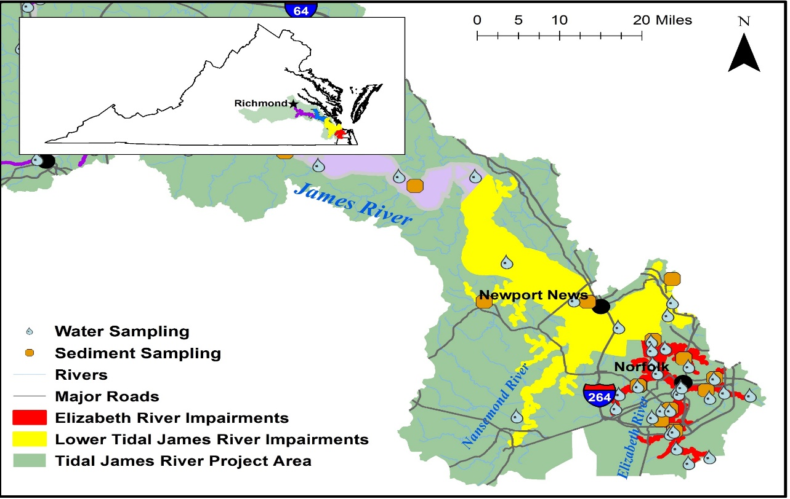
DEQ TMDL Sampling Approach
Source identification
TMDL model support
    Calibration/validation
2009-2012, 2016, 2020
Water column, sediment
    Water column grab samples: High and Base Flow (n >260)
    Sediment samples as needed

Slide 27

Graph showing water data
Upper JR

Slide 28
Arithmetic Mean of tPCB Concentrations (pg/L) in Water Samples Collected During Dry and Wet Weather from the Elizabeth River Watershed (2009-2020)
30,434
34,327

Slide 29
Arithmetic Mean of tPCB Concentrations (pg/L) in Water Samples Collected During Dry and Wet Weather from Tributaries in the Elizabeth River Watershed (2009-2020)
55,907
5,351
16,294
DEQ’s WQC

Slide 30
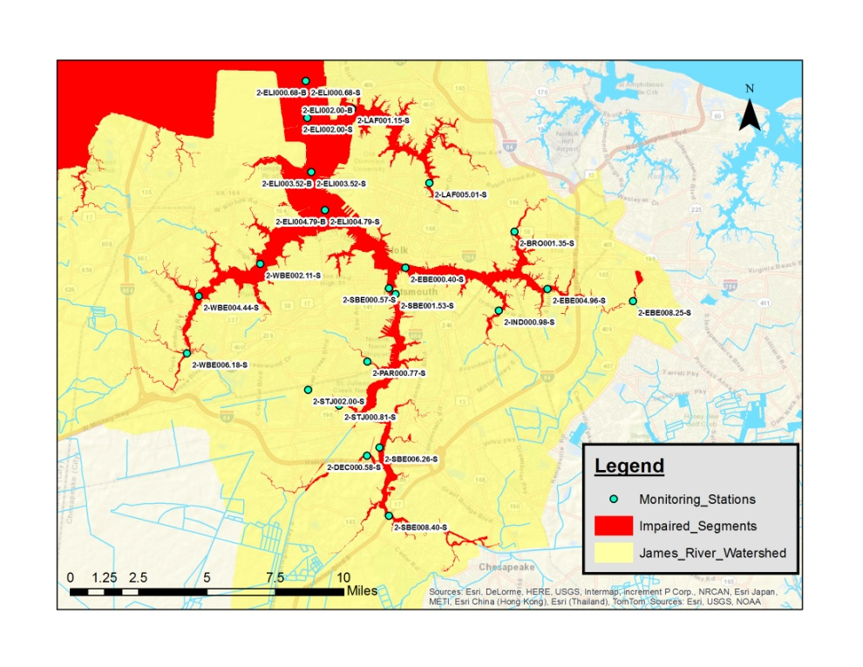
Monthly PCB concentrations at RM 4.79

Slide 31
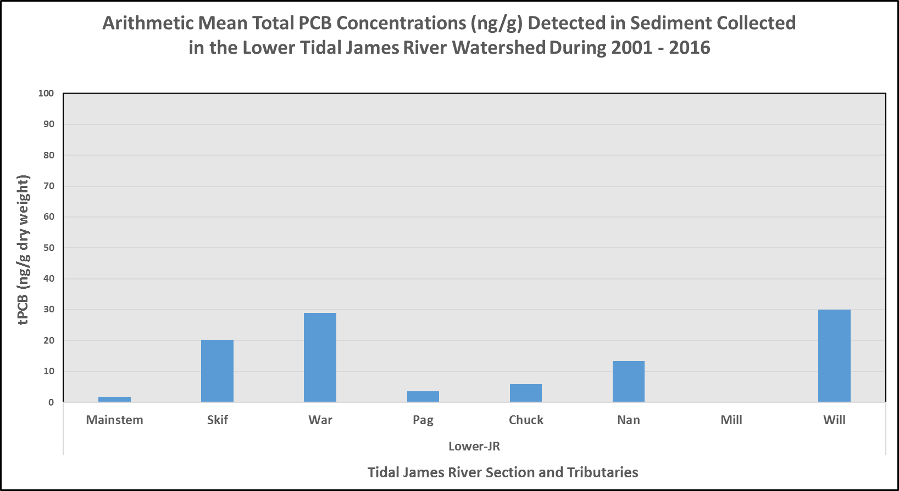
Graph os sediment in the James River
L-JR = Lower James River
Skif = Skiffes Creek
War = Warick River
Pag = Pagan River
Chuck = Chuckatuck Creek
Nan = Nansemond Creek
Mill = Mill Creek
Will = Willoughby Bay
For Technical Support call 757.518.2153

Slide 32
Mean Total PCB Concentrations (ng/g) Detected in Sediment Collected in the Elizabeth River Watershed During 2001-2016
n = 2
SB = Southern Branch ER
DC = Deep Creek
SJ = St. Juliens Creek
PC = Paradise Creek
EB = Eastern Branch ER
BC = Broad Creek
WB = Western Branch ER
ER = Mainstem ER
LR = Lafayette River
n = 8
n = 4

Slide 33
Tidal James River, Elizabeth River, and Tidal Tributaries PCB TMDL

Slide 34
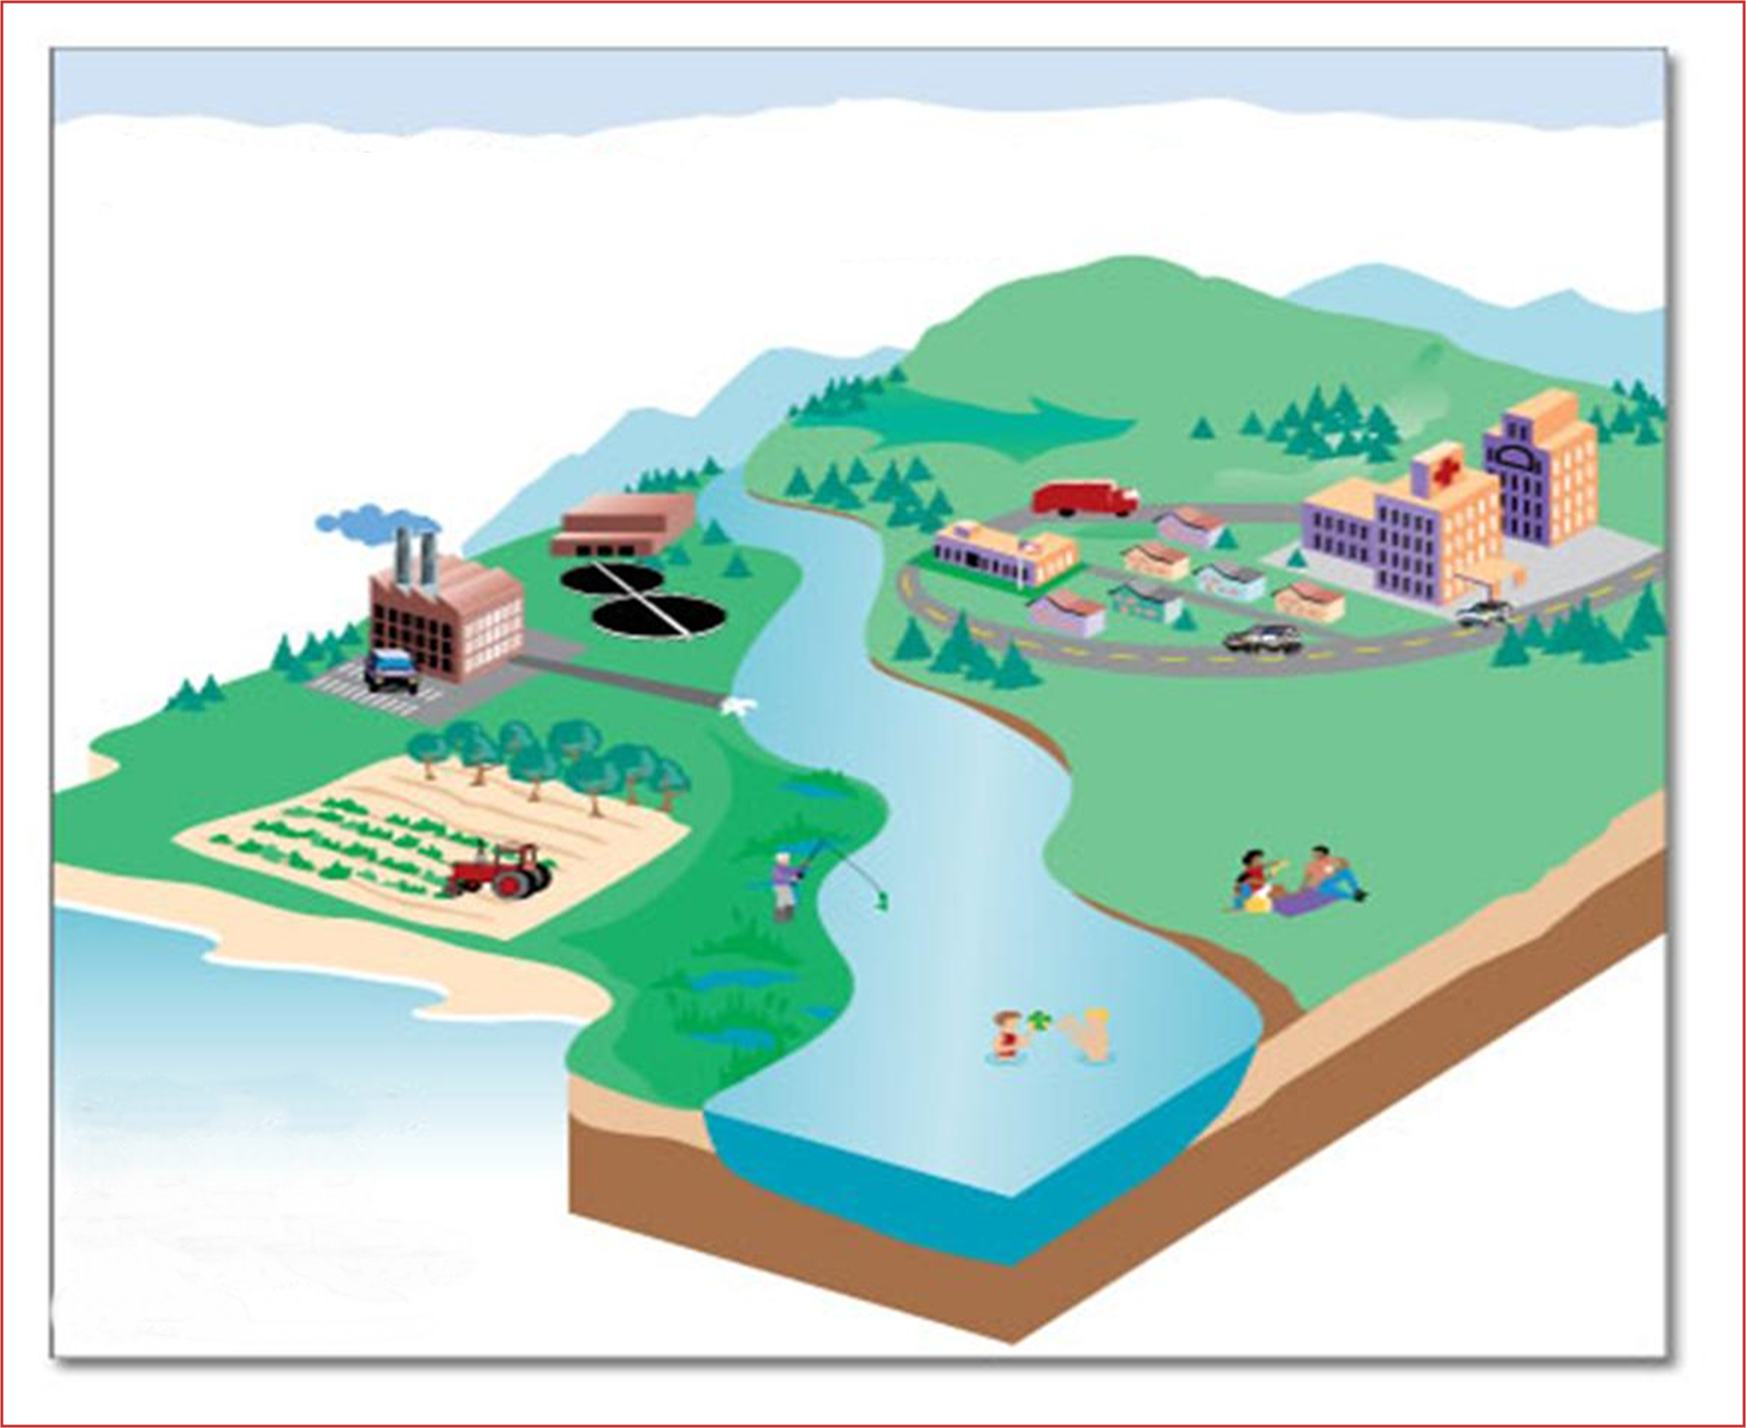

Sources considered in PCB TMDL
Wet Deposition
2
Dry Deposition
Air Emissions
Non-point source
Runoff
4
1
3
MS4 SW Runoff
Point Source Effluent
Contaminated Sites
PCB
PCB
5
Non-point source
Runoff
Requires Multi-Media Approach
(land, water, air)
PCB
6
PCB Contaminated
Sediment
PCB
PCB

Slide 35
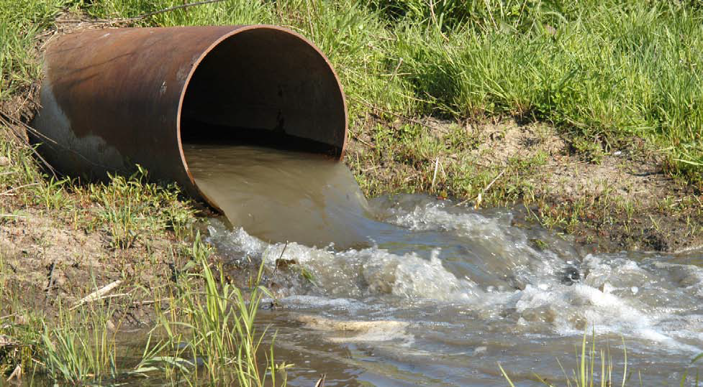
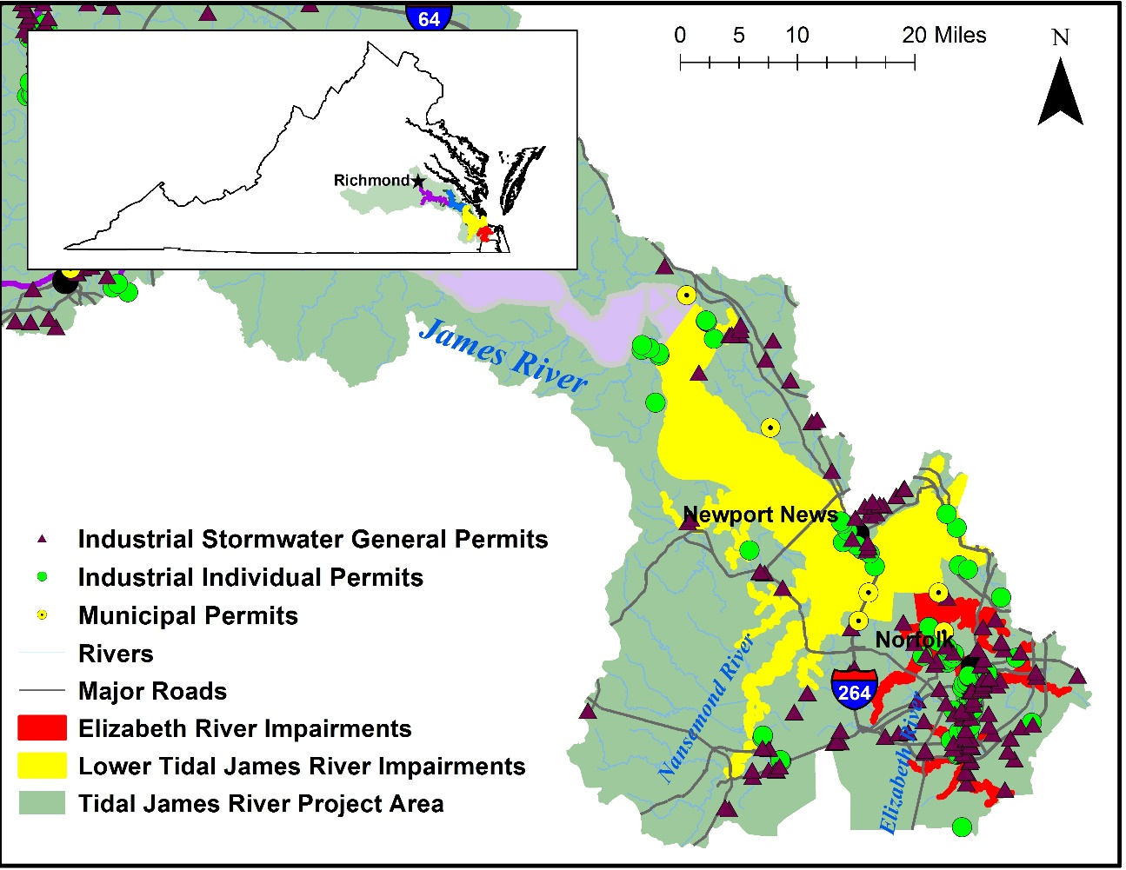
TMDL Source Category – Point Sources
VPDES Permitted facilities
  Municipal WWTP
  Industrial sources
    Selected based on Standard Industrial Classification (SIC)
      Individual Industrial Facilities
      Industrial Storm Water General Permitted Facilities
  Municipal Separate Storm Sewer System (MS4)
  Combined Sewer Overflow (CSO)
    Richmond

Slide 36
TMDL Source Category – Point Sources
Upper and Middle Tidal James River (Piedmont Region)
Facility Type | # Permitted Facilities | Projected PCB Baseline Load (g/yr) | Projected WLA (g/yr)
Municipality | 11 | TBD | TBD
Industrial IP | 22 | TBD | TBD
Indus. SW GP | 112 | TBD | TBD
Lower James River and Elizabeth River Watershed (Tidewater Region)
Facility Type | # Permitted Facilities | Projected PCB Baseline Load (g/yr) | Projected WLA (g/yr)
Municipality | 6 | TBD | TBD
Industrial IP | 44 | TBD | TBD
Indus. SW GP | 127 | TBD | TBD
TBD = To Be Determined

Slide 37
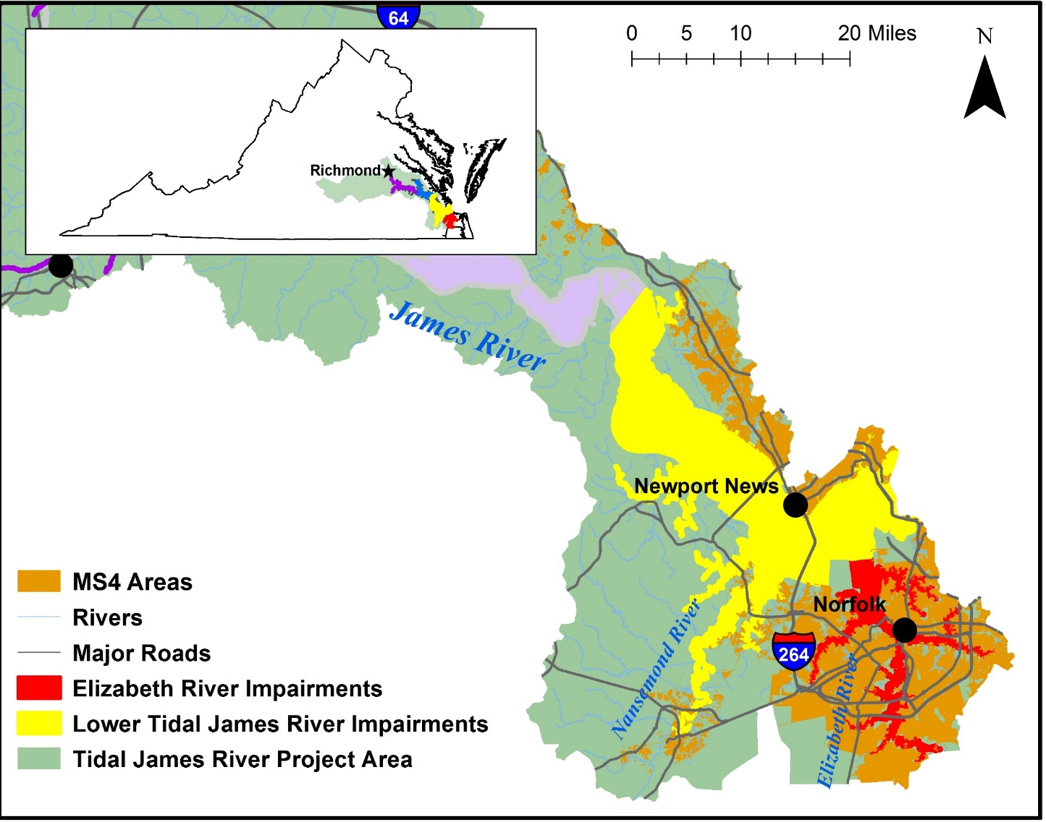
TMDL Source Category – MS4s
Upper and Middle Tidal James River (Piedmont Region)
MS4s | Projected PCB Baseline Load (g/yr) | Projected WLA (g/yr)
2 (Phase I – Large) 13 (Phase II - Small) VDOT | TBD | TBD
Lower James River and Elizabeth River Watershed (Tidewater Region)
MS4s | Projected PCB Baseline Load (g/yr) | Projected WLA (g/yr)
6 (Phase I – Large) 17 (Phase II – Small) VDOT | TBD | TBD
For Technical Support call 757.518.2153

Slide 38
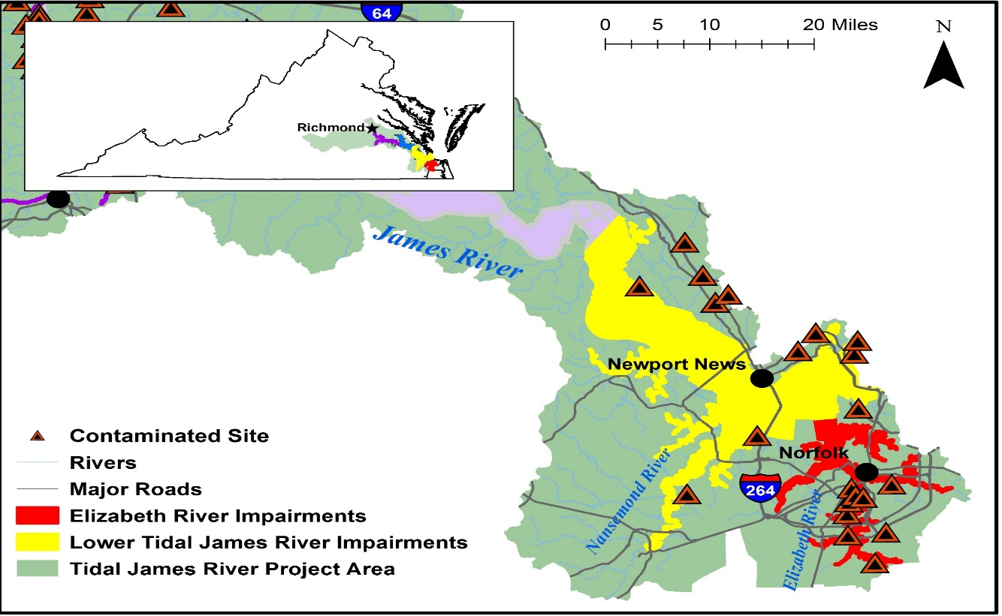
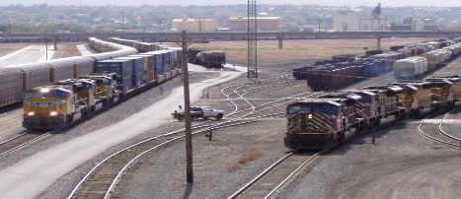
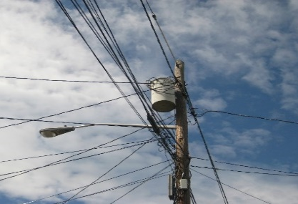
TMDL Source Category - Contaminated Sites
TSCA (PCB Clean-up Sites)
RCRA Corrective Action Facilities
CERCLA
Voluntary Remediation Sites
Landfills
Rail Yards/Spurs
Miscellaneous spill sites
  Pollution Response (PREP)
Electric Utility Transformer Pads
https://commons.wikimedia.org/w/index.php?curid=6092689
https://commons.wikimedia.org/w/index.php?curid=17503186

Slide 39
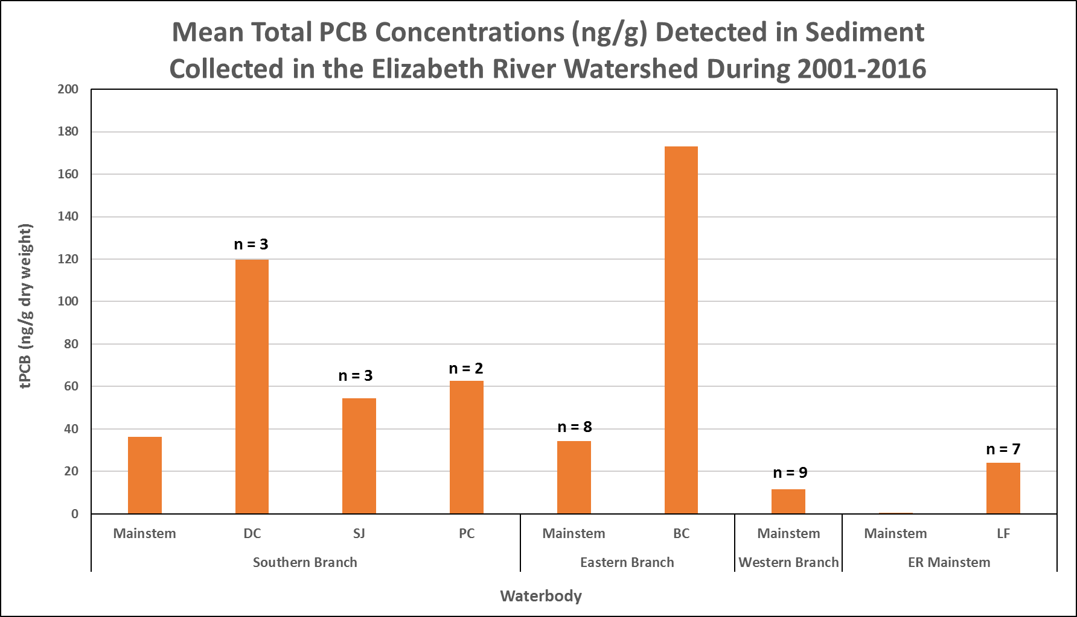
TMDL Source Categories
Atmospheric Deposition (example)
Contaminated Sediment
Modes of Deposition
Wet = 4.5 – 12% of total
Rodenburg (Totten), L. A. et al., 2007. Rutgers University
For Technical Support call 757.518.2153

Slide 40
Implementation Process
Implementation Process
Point sources
WLA---- PMP
Nonpoint sources
Source “Fingerprinting”
Detect “uncharacterized sources”
Investigation
of Hotspots
Deliberate Monitoring
Funding

Slide 41
VPDES Point Sources
Pollutant Minimization Plan
If existing (baseline) condition > WLA
Pollutant Minimization Plan
Submitted and Approved
Backtrack/Source ID
Adaptive Implementation
Re-evaluate baseline load
Remediation
/BMPs

Slide 42
TMDL - Contaminated Sites
RCRA Corrective Action, TSCA, CERCLA
Clean-up standards for land based contaminated sites have no relationship to PCB water quality criterion
  The PCB clean-up level of 1 mg/kg is not adequate to protect the fish consumption use
What about PCB contaminated drainage that leaves the site?
  Contamination occurs when stormwater comes into contact with PCB contaminated soils (< 1 mg/kg) and migrates off-site (e.g., MS4, direct drainage to waterbody, etc.)
For Technical Support call 757.518.2153

Slide 43
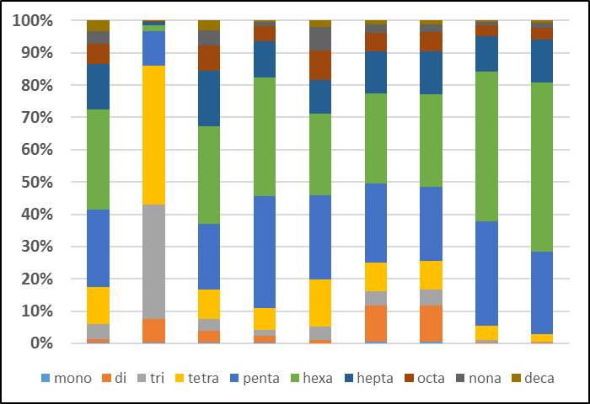
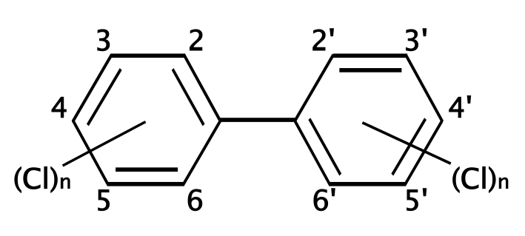


Point Source/Nonpoint Source:
“Fingerprinting”
Objective: To identify a specific pattern or “fingerprint” of congeners that could be indicative of a pollution source
1. # of fingerprints in the system
2. Chemical composition in each fingerprint
3. contribution of each fingerprint in each sample

Slide 44
Timeline - Tidal James & Elizabeth Rivers PCB TMDL Development

Slide 45

Next Steps
Public Comment Period
  January 27th – February 26th
  Send Comments to:
  Paige Haley
  5636 Southern Blvd
  Virginia Beach, VA 23462
  Mary.Haley@deq.virginia.gov
DEQ will hold two Technical Advisory Committee meetings
  March 25th – Focus will be on areas of the Upper and Middle Tidal James River
    If interested in participating as a member, Contact Jennifer.Rogers@deq.virginia.gov
  March 30th - Focus will be on the Lower James and Elizabeth Rivers
    If interested in participating as a member, Contact Mary.Haley@deq.virginia.gov
Mark.Richards@deq.virginia.gov
Mary.Haley@deq.virginia.gov
For Technical Support call 757.518.2153

Slide 46
Extra Slides

Slide 47


VDH Threshold
In 2012 increased fish tissue PCB threshold from 50 ppb to 100 ppb
  Designed to protect public health when contamination has been identified.
  Risk Assessment calc. designed for known contamination in a finite geographical area (e.g., Superfund site).
VDH Changes -
- Increased body weight from 70 kg to 80 kg (176 lbs)
Changed life expectancy inc. from 70 yrs to 78 yrs & from 30 yrs
to 32 yrs a person would live in the same residence
- Decreased from four meals/month to two
Note: VDH is not required to go through administrative regulatory process to change threshold(s)

Slide 48
VA Water Quality Criterion
VA PCB criterion based on EPA guidelines
Fish Screening Value basis of criterion
  Water concentration translated using a Bioconcentration Factor (BCF)
    Lab derived translator developed in the early 80’s
    Assumes fish only obtain PCBs through gills from the water column (ratio of PCB conc. in fish to that in water)
Update: 80 kg (176)
( = 2 meals/month)
Update: 22 g/d (1.5 lbs)
a

