Slide 1
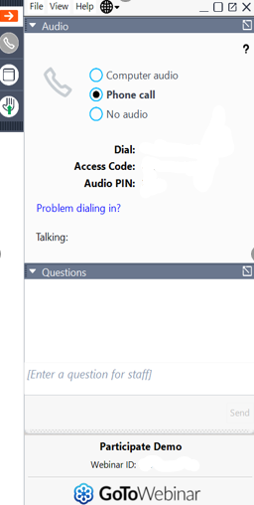



PC/Laptop View
James and Elizabeth River PCB TMDL Public Meeting
Mobile Devices View
Android
Minimize the control panel➔
or maximize the control panel
Raise or lower your hand ➔
Enter Questions ⬆
⬆ Click 3 dots to open Audio Options
Select audio method
Raise ⬆ Lower Hand
*Phone call provides better quality audio
Raise ⬇ Lower Hand
iPhone
Enter questions then click send ➔
For Technical Support call 804.527.5029
Audio Options ⬆
Enter ⬆ Questions

Slide 2
Tidal James River, Elizabeth River, and Tidal Tributaries PCB Water Quality (TMDL) Study:
Public Meeting
Mark Richards & Jen Rogers
January 28, 2021

Slide 3




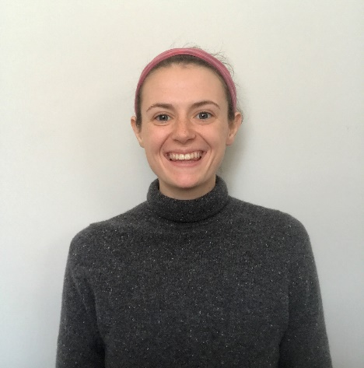
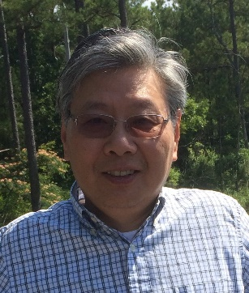

Introductions
Mark Richards
CO TMDL Team Lead
Jen Rogers
PRO TMDL Coordinator
Kelley West
PRO Environmental
Planner
Paige Haley
TMDL Coordinator
Dr. Jian Shen
Res. Prof. of Marine Science
Notes:
Intro Myself
Jen P, planning Team Lead at Piedmont and is serving as technical support for this meeting
Rob Breeding from CO on questions
Warren Smigo and Mike Shaver- our Piedmont Regional Biologists- they are the ones out collecting bugs and providing tons of data for the study. They are on the call tonight to help with questions as they are the experts when it comes to all things biology- They also provided many of the photos for this presentation
We also are teaming with Katie Shoemaker at Wetland Studies and Solutions, Inc and Dr. Robert Brandt from JMU who are the contractors working on this project.
Also want to acknowledge Matt Carter, Garth Jenkins and Andrew Kirk on the water monitoring crew who help collect lots of data for use in this project

Slide 4
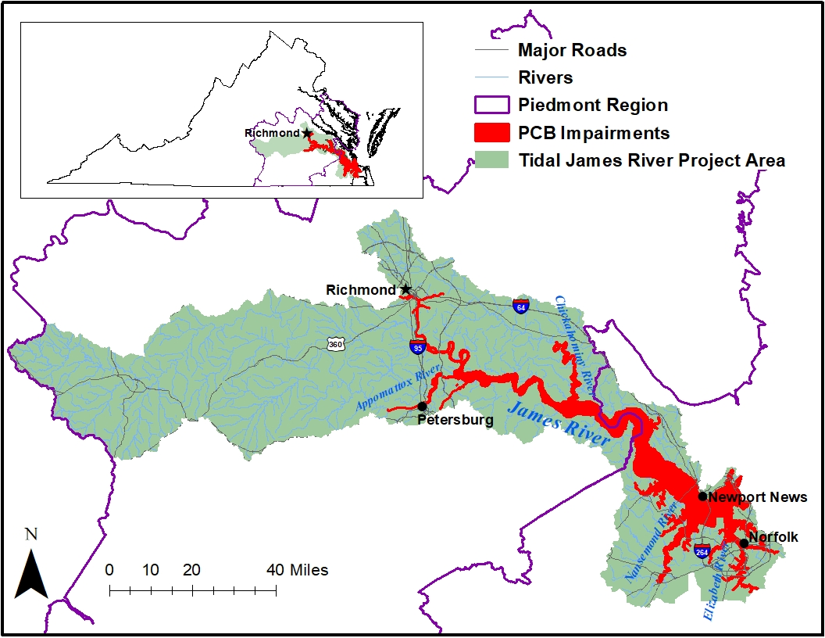

Agenda
Welcome and Introductions
  Meeting Objectives
Overview of Water Quality Planning
Background PCB Information
Water Quality Impairment of the tidal James River watershed
Overview of the tidal James River watershed PCB TMDL
Next Steps
For Technical Support call 804.527.5029

Slide 5
Overview of Water Quality Planning
For Technical Support call 804.527.5029

Slide 6
Water Quality Standards
Designated Uses
  All waters are designated for recreation, aquatic life, fish consumption, and wildlife
  Other uses applied locally as applicable (shellfish [tidal], public water supply, Chesapeake Bay, etc.)
Criteria
  To protect and maintain designated uses
  Numeric or narrative
Anti-degradation
  Protects and maintains existing water quality from being degraded
For Technical Support call 804.527.5029

Slide 7
Continuous Planning Process
For Technical Support call 804.527.5029
Monitoring
VPDES Permit Limits
Water
Quality Standards
Assessment
Implementation Plan
Integrated Report
Public
Participation
TMDLs
Public
Participation
EPA

Slide 8
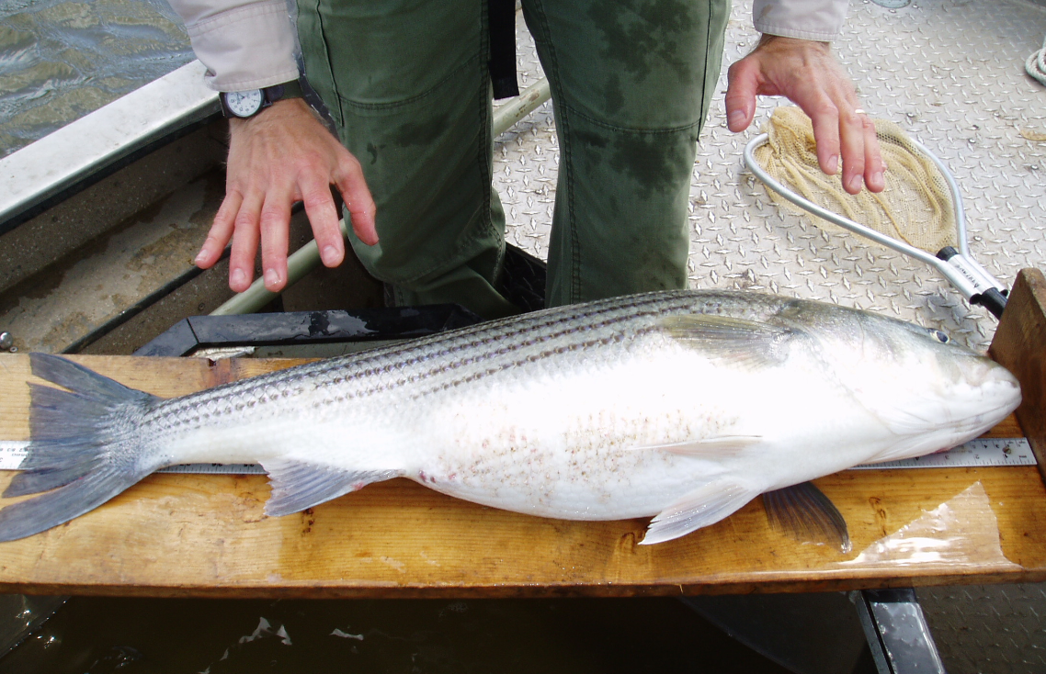
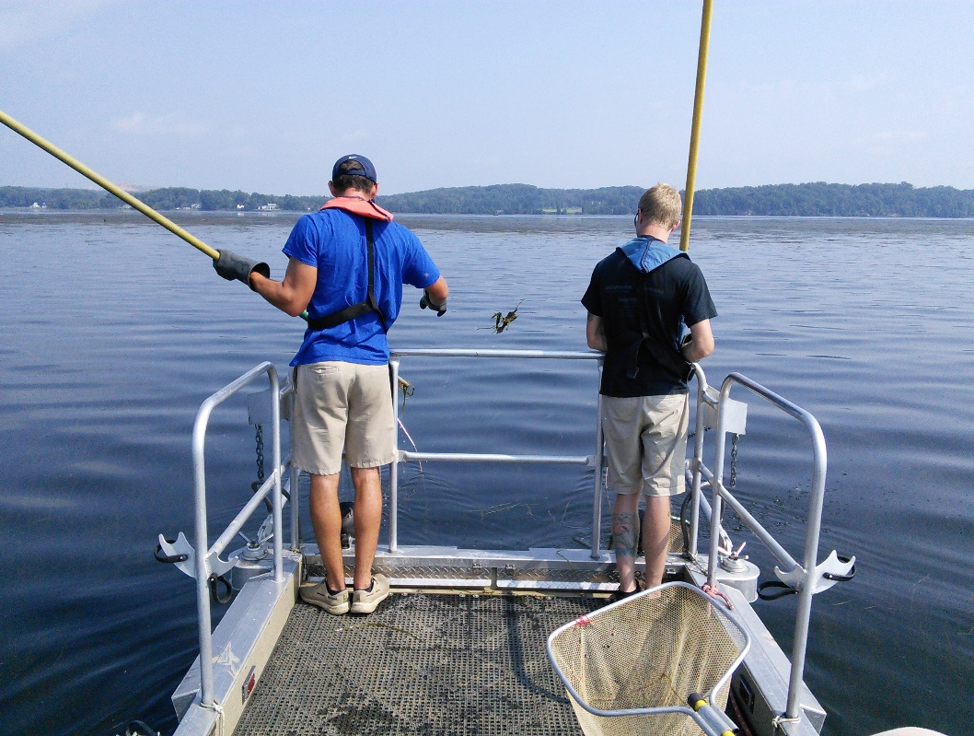
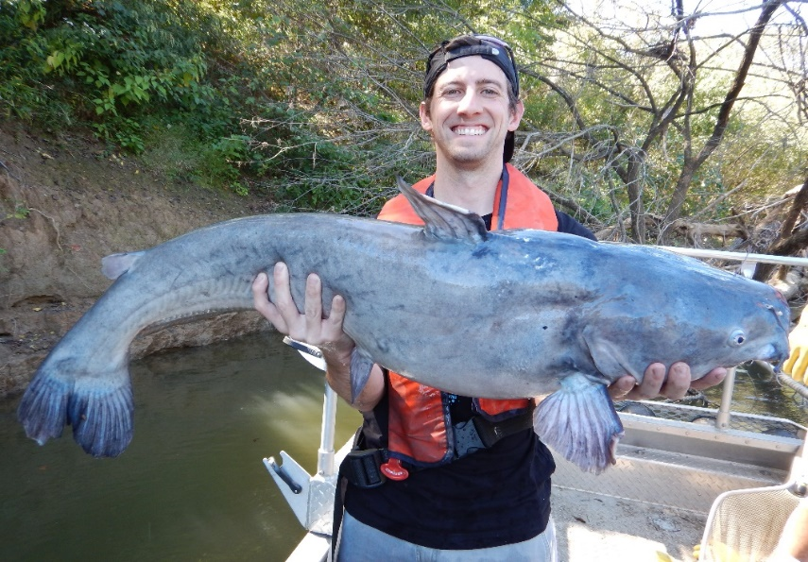
DEQ Fish Tissue Monitoring
Monitor to assess the “Fishable” Goal of the Clean Water Act - 305(b)
Target contaminants that accumulate in tissue
    “Lipophilic” or Fat loving
      PCBs, Pesticides, etc.
    Mercury
Compare to trigger values (protect human health)
    Listed on “dirty waters” / 303(d) report if exceeds
For Technical Support call 804.527.5029

Slide 9
VA Water Quality Criterion –Total PCBs
Agency | Fish Tissue Threshold (ng/g or ppb) | WQC (pg/L or ppq)
VDH | 100 (Fish Consumption Advisory) | - -
DEQ | 18 (Screening Value) | 640
DEQ’s Water Quality Assessment (Integrated Report)
  VDH - Consumption Advisory = impairment
  DEQ - two or more fish samples exceed screening value at a site or two water samples exceed criterion at a site = impairment
  From: DEQ’s 2022 (Draft) Water Quality Assessment Guidance Manual
For Technical Support call 804.527.5029

Slide 10
Total Maximum Daily Load (TMDL)
TMDL = WLA + LA + MOS
Where:
WLA = Waste Load Allocation
LA = Load Allocation
MOS = Margin of Safety
Goal = Reduce existing PCB load to restore the fish consumption use
Pollutant Load
TMDL End Point
Pollution Budget
Addresses different pollution categories
PCB TMDL - Multi-media approach
  Air, Land, Water
Margin of Safety
Load Allocations (WLA + LA)
TMDL
Existing Load
Allocated Load
For restoration the waterbody must meet two thresholds: 1) Numeric WQC [or site specific value] and 2) fish tissue threshold
For Technical Support call 804.527.5029

Slide 11

The TMDL Process
Fish Consumption Advisory
Identify Problem
Low Level PCB
Analysis
In Process
Source Assessment
Identify sources
Estimate source loading
To be Completed
Link Sources to Targets
Assess linkages
Estimate total loading capacity
TMDL Allocations
Reduce loads from point sources
Divide remaining loads among
sources
To be Completed
TMDL = Sum of WLA + Sum of LA + MOS
For Technical Support call 804.527.5029
Notes:
These components are not necessarily sequential steps, but are a guide and framework for TMDL development.
(1) Problem Identification: define key factors and background information for a listed waterbody that describe the nature and impairment. This is the guiding factor in development of the TMDL.
(2) Develop Numeric Targets: measurable indicators and target values that can be used to evaluate attainment of water quality standards in the listed waterbody.
(3) Source Assessment: identify sources of loading for bacteria
(4) Link Targets and Sources: this is necessary in order to develop the TMDL since the linkage defines the cause-and-effect relationship between the pollutant sources and the in-stream pollutant response and allows for an estimation of loading capacity. This relationship can vary seasonally, especially for nonpoint sources that are highly dependent on precipitation.
(5) Load Allocations: pollutant loadings that will not exceed the loading capacity and will lead to attainment of the water quality standard can be determined based on the target/source linkage. The loadings may be distributed or allocated among the significant sources.
(6) Follow-up Monitoring: An ongoing monitoring plan should be included to determine whether the TMDL has resulted in attaining water quality standards and to support any required revisions to the TMDL.

Slide 12
PCB Background Information
For Technical Support call 804.527.5029

Slide 13

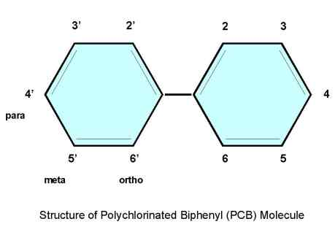
Background: PCBs
Biphenyl molecule (1-10 chlorine atoms)
209 distinct PCB Compounds
Regulated by DEQ as Total PCB (tPCB) = 209 compounds summed
Referred to as PCB Aroclors (Monsanto tradename) = mixture of PCB compounds
  Examples 1248, 1254, 1260
For Technical Support call 804.527.5029

Slide 14
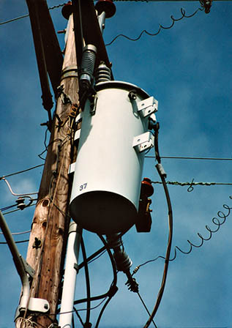
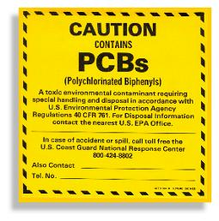
Background: PCBs
Legacy Contaminant
  Estimated that > 1.5 Billion lbs. manufactured in the U.S. until 1977
Characteristics
  Very stable and heat resistant
  Persistent in the environment
Common uses:
  Transformers, capacitors, hydraulic fluids, circuit breakers, PVC Products, carbonless copy paper, caulking material, paints, and more!
For Technical Support call 804.527.5029

Slide 15
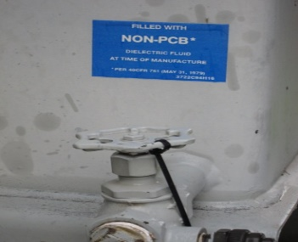
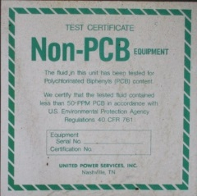
Toxics Substances Control Act (TSCA)
1976 Law regulates PCBs
  Bans the manufacture, processing, use and distribution in commerce
  Non-PCB Transformer defined as containing < 50 ppm PCB
  Inadvertent manufacture of PCBs – products up to 50 ppm allowed to leave site as long as annual average is < 25 ppm
    Unintentional by-products of manufacturing processes
50 ppm compared to DEQ’s WQC - 6.4 X 10⁻⁷ ppm (0.00000064)
For Technical Support call 804.527.5029
Notes:
Banned in 1979
PCB Regulations: Part 761 in Title 40 of the Code of Federal Regulations
https://www.epa.gov/pcbs/learn-about-polychlorinated-biphenyls-pcbs
Has list of federal notices
6 Sept 2012: changes made so that PCB regs matched RCRA regs (40 CFR 262, 263, 264)
TSCA Cleanup level of 1 ppm
9VAC20-81-630: wastes containing PCBs (effective 2011)

Slide 16
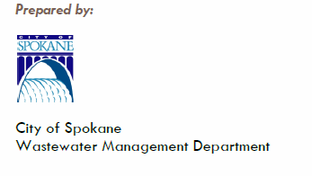

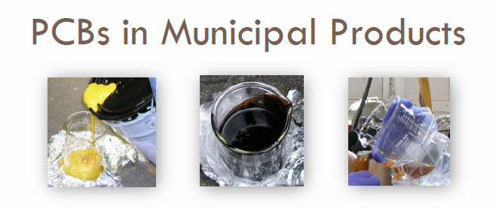
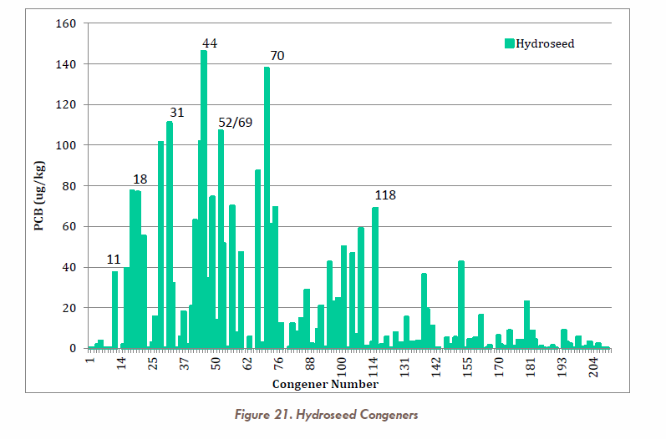
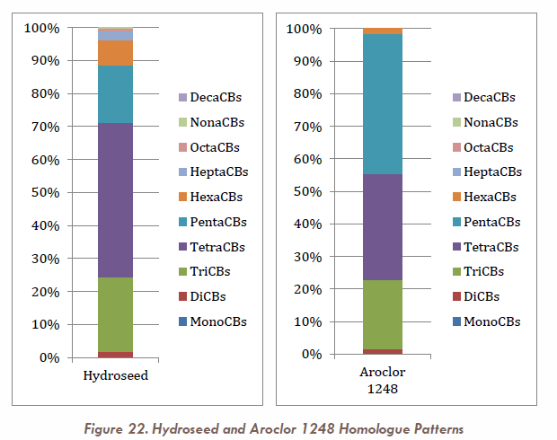
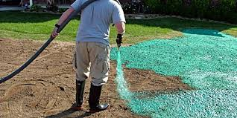
PCBs in Municipal Products
March 2015
Examples of other products tested
  Pennzoil SAE5W-30
  Valvoline Full Synthetic
  Road paint
For Technical Support call 804.527.5029

Slide 17
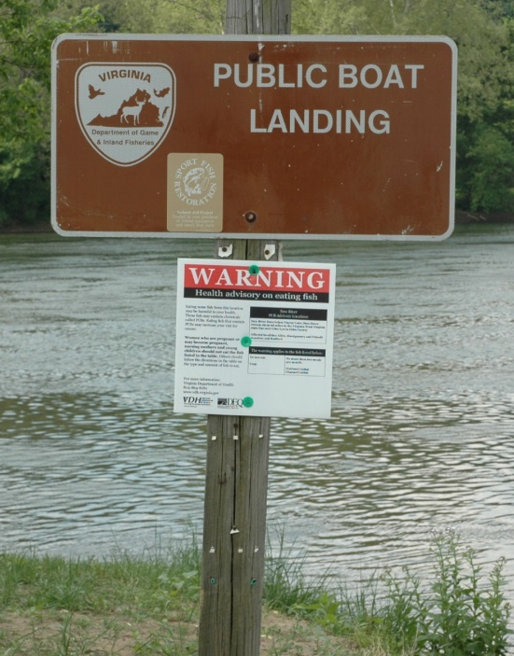
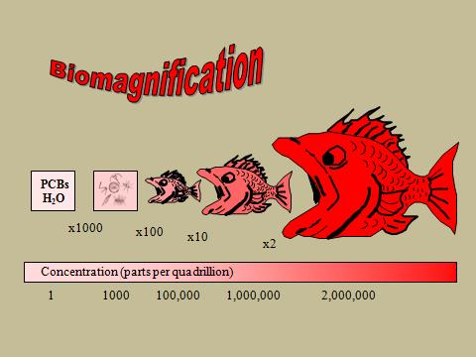
Why PCBs Continue to be an Issue
Fish impairments based on human health concerns
  Fish consumption significant exposure pathway
    Suspected carcinogen (EPA)
      Designated a carcinogen by the International Agency on Research for Cancer (WHO)
    Immunotoxicity, reproduction and
    development , hepatotoxicity (liver), etc.
Persistent, bioaccumulates at a low conc. (ppq or pg/L) & biomagnifies
Confirmed on-going releases
For Technical Support call 804.527.5029

Slide 18
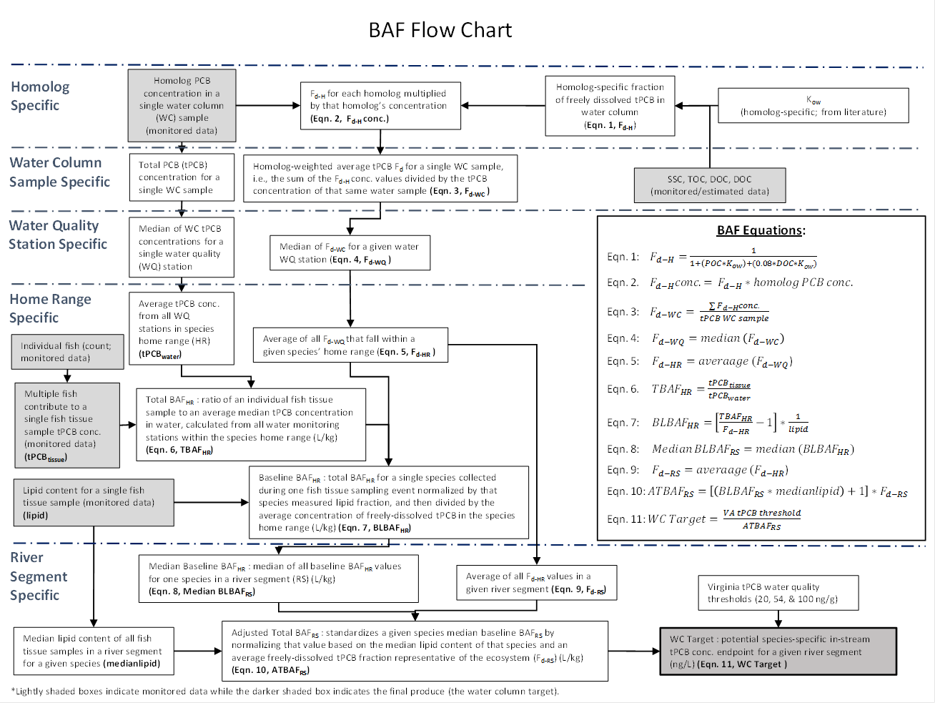
Site Specific PCB Endpoint
Explore the use of site-specific Bioaccumulation Factor (BAF) endpoints
  Considers multiple exposure pathways
    Other pathways include sediment ingestion and Biomagnification
  Used in other VA PCB TMDLs - Potomac River, Roanoke River, New River and Levisa Fork
Existing WQC only considers a single exposure pathway (through fish gills)
1) Numeric water based value and 2) fish tissue concentration must be met for successful restoration
  Narrative WQS (i.e., control of toxic substances including those that bioaccumulate)
EPA Method (EPA-822-03-030, 2003)
For Technical Support call 804.527.5029

Slide 19
Tidal James River, Elizabeth River, and Tidal Tributaries Water Quality Impairment
For Technical Support call 804.527.5029

Slide 20
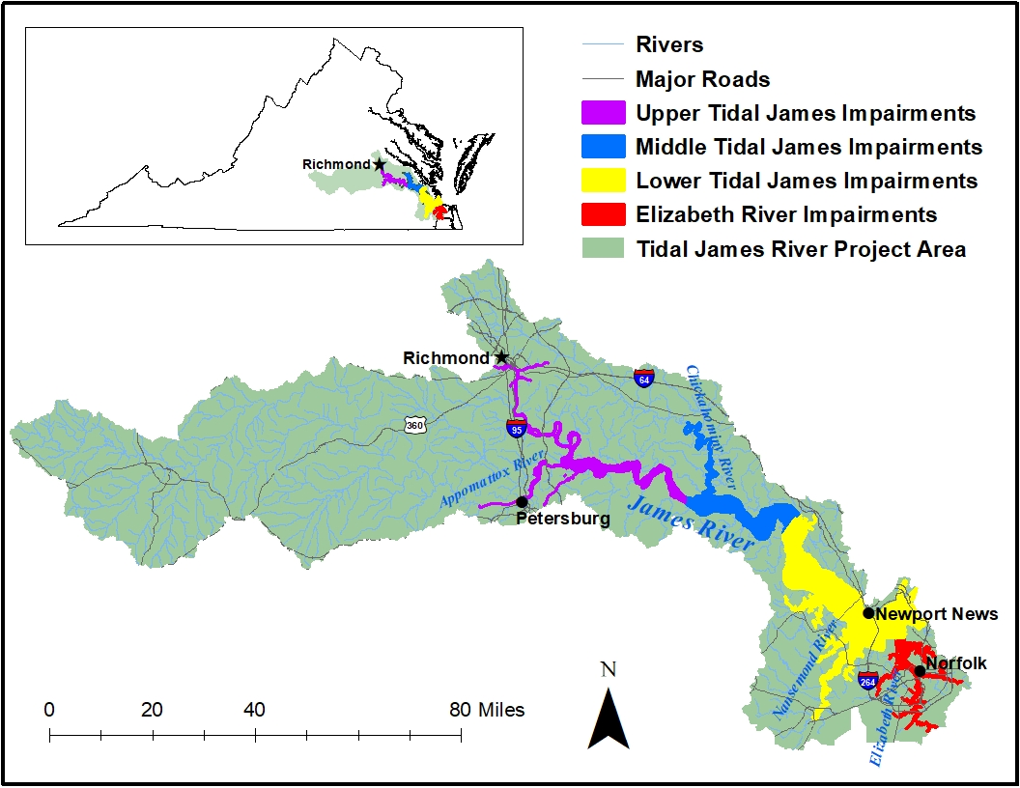
Tidal James River Watershed
For Technical Support call 804.527.5029

Slide 21
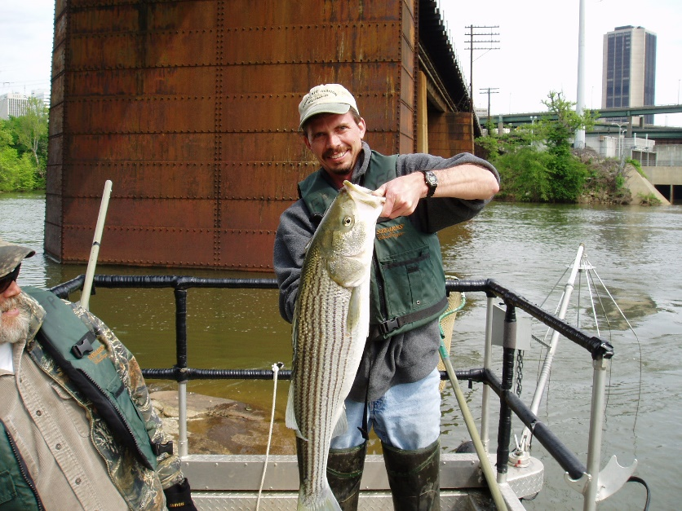
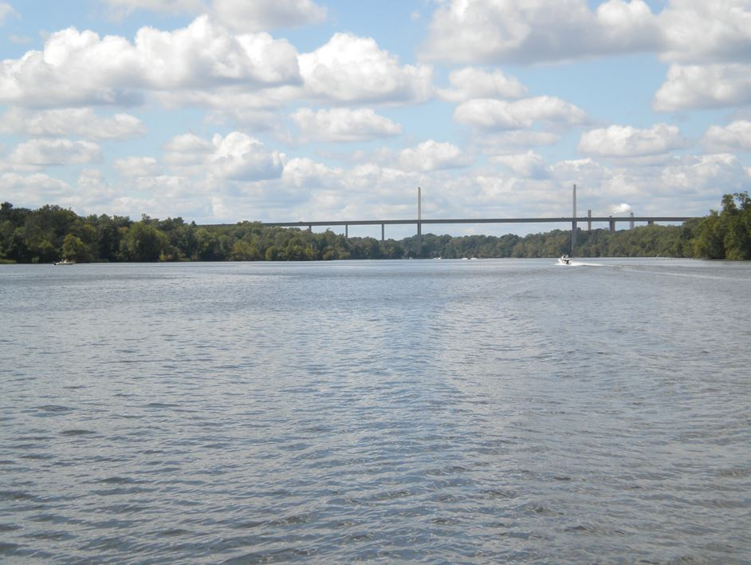
James and Elizabeth River Watershed PCB Impairment Timeline
1993,1998, & 2000-2001: DEQ monitors fish tissue
2002: VA Department of Health issues fish consumption advisory for numerous species
2003: DEQ performed a source investigation in the upper tidal James River
2005, 2012 & 2016: DEQ completes additional fish tissue monitoring
2009-2020: DEQ performs water and sediment monitoring for PCB water quality study; initiated meetings
https://www.alamy.com/stock-photo/striped-bass.html
For Technical Support call 804.527.5029

Slide 22
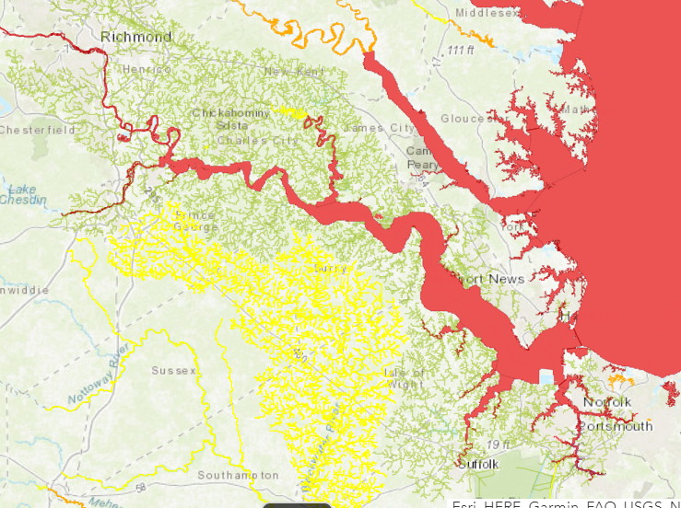
Problem Identification - VDH Fish Consumption Advisory
For Technical Support call 804.527.5029
River basin | Water-body | Section | Locality | Contam-inants | Fish species | Advisory description
James River | James River | From I-95 James River Bridge in Richmond to Hampton Roads Bridge Tunnel, including tidal portions of tributaries | Richmond City, Henrico Co., Chesterfield Co., Charles City Co., Hopewell City, Colonial Heights City, Petersburg City, Dinwiddie Co., Prince George Co., Surry Co., James City Co., New Kent Co., Isle of Wight Co., Newport News City, Suffolk City, Portsmouth City, Hampton City, Norfolk City, Chesapeake City, Virginia Beach City | PCBs | Gizzard Shad, Carp, Blue Catfish ≥32 inches, Flathead Catfish ≥32 inches | Do Not Eat
James River | James River | Same | Same | PCBs | Blue Catfish <32 inches, Flathead Catfish <32 inches, Channel Catfish, White Catfish, Largemouth Bass, Bluegill Sunfish, American Eel, Quillback Carpsucker, Smallmouth Bass, Creek Chub, Yellow Bullhead Catfish, White Perch, Striped Bass, Bluefish, Croaker, Spot, Blueback Herring, Hickory Shad | ≤ 2 meals/month
Does not apply to swimming
http://www.vdh.virginia.gov/environmental-health/public-health-toxicology/fish-consumption-advisory/

Slide 23
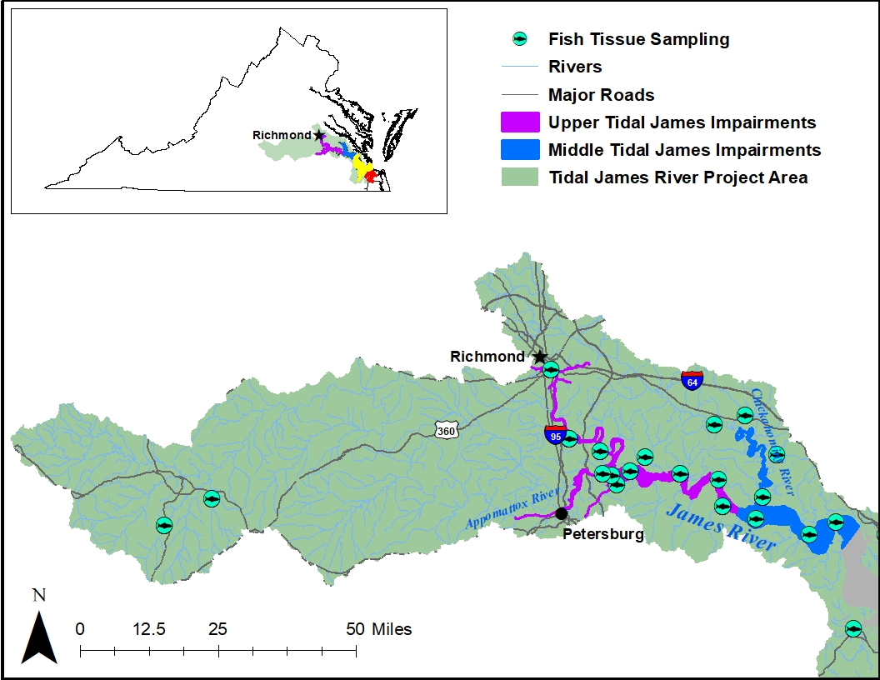
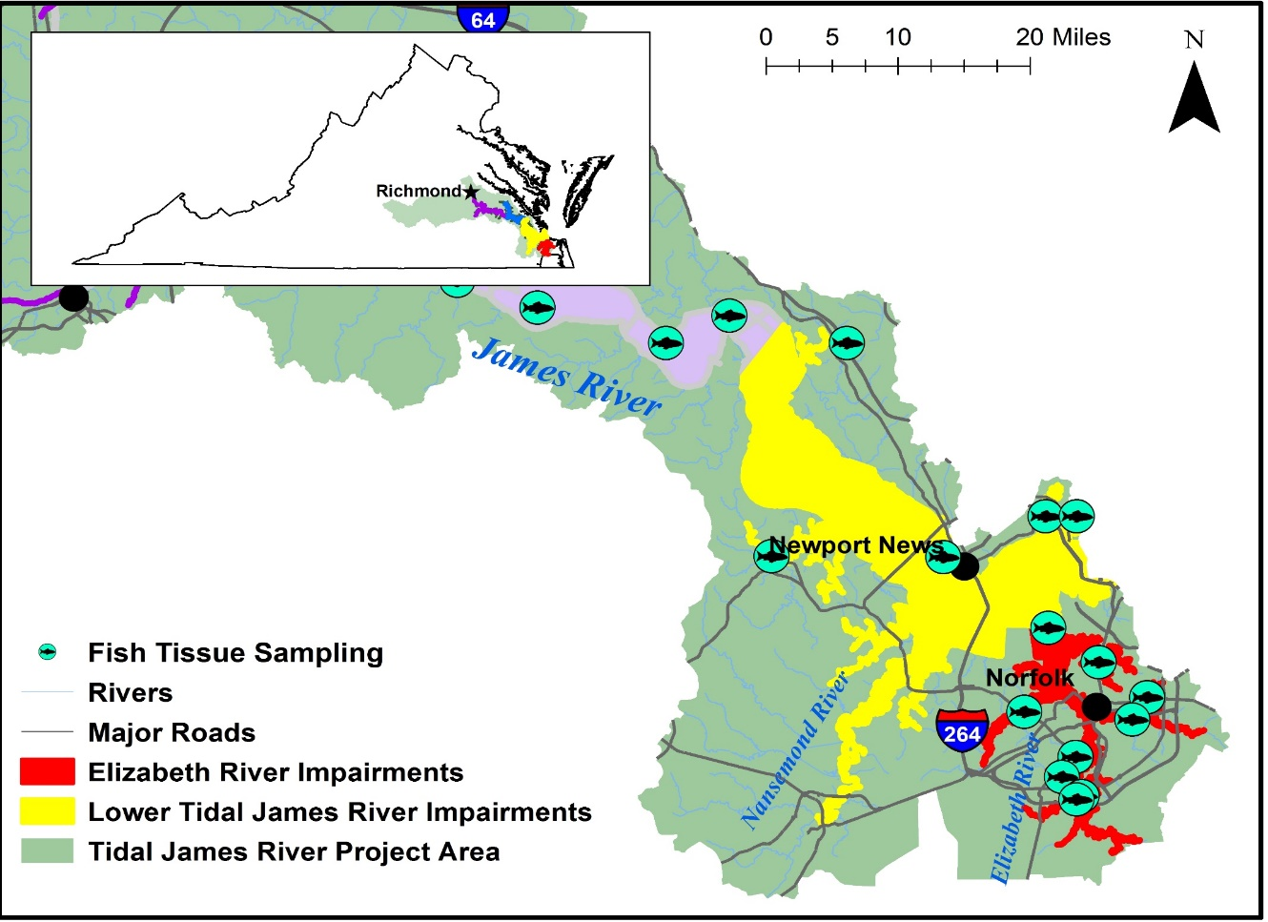
Fish Monitoring Stations in the Tidal James River Watershed
Upper and Middle Tidal James River
Lower Tidal James River & Elizabeth River
For Technical Support call 804.527.5029

Slide 24
Place Map here
2,024.80

Slide 25
Fish Tissue graph for the Middle JR
For Technical Support call 804.527.5029

Slide 26
Arithmetic Mean of tPCB Concentrations (ng/g) for the Lower James River Consumption Advisory Species by Year (1993-2016)
Lower JR segment begins east of Hog Island Wildlife Management Area
VDH Threshold

Slide 27
JR Tributaries Fish Tissue Data
1,012
App = Appamatox River
Bailey = Baily Crk/Bay
Chk = Chickahominy River
Poyth = Poythrus Run
For Technical Support call 804.527.5029

Slide 28
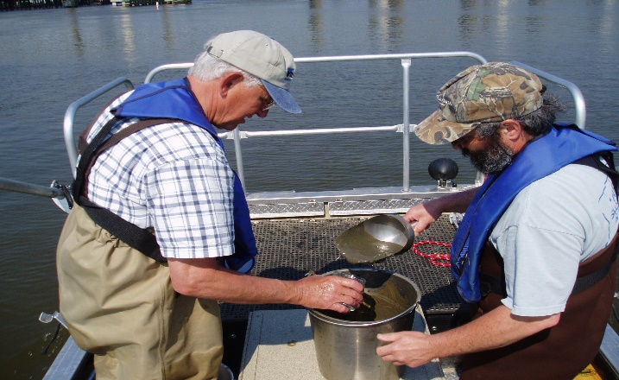
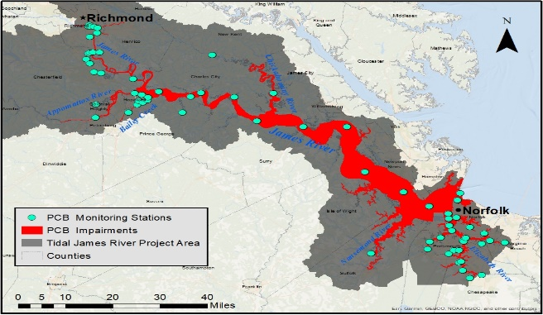
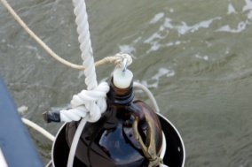
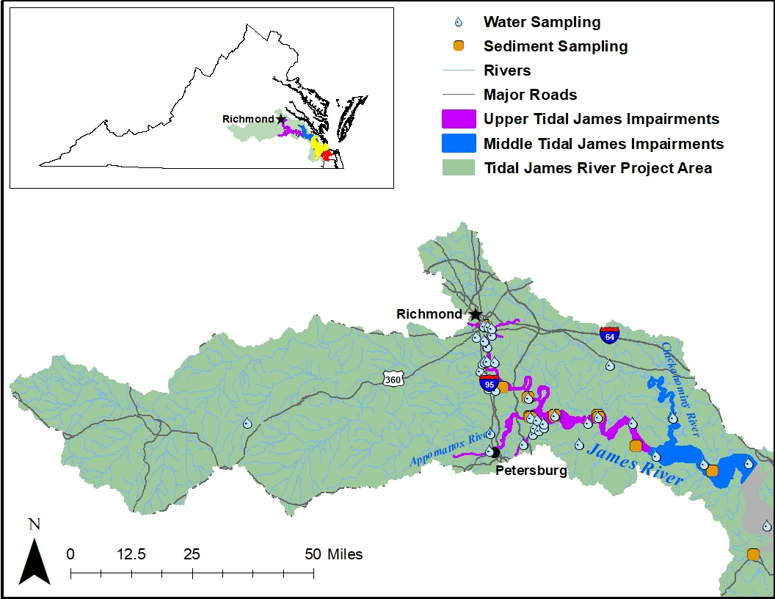
DEQ’s TMDL Sampling Approach
2009-2012, 2016, 2020
Source identification
TMDL model support
    Calibration/validation
2009-2012, 2016, 2020
water column, sediment
    Water column grab samples: High and Base Flow (n >260)
    Sediment samples as needed
For Technical Support call 804.527.5029

Slide 29

Graph showing water data
Upper JR
For Technical Support call 804.527.5029

Slide 30
Water tPCB conc. graph for tidal tributaries
234,484
168,667
n = 5
n = 3
n = 2
n = 2
n > 1 Represents a mean conc.
For Technical Support call 804.527.5029

Slide 31
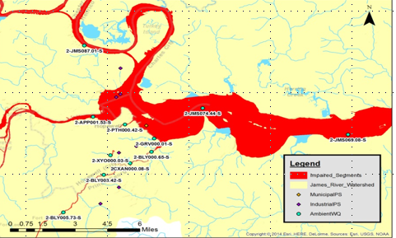
Placeholder Monthly PCB concentrations at HopewellRM
For Technical Support call 804.527.5029

Slide 32
Sediment Data graph
For Technical Support call 804.527.5029

Slide 33
Tidal James River, Elizabeth River, and Tidal Tributaries PCB TMDL
For Technical Support call 804.527.5029

Slide 34
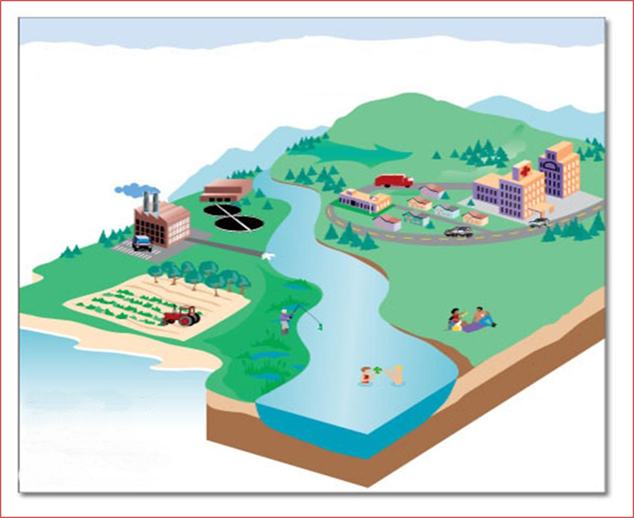

Sources considered in PCB TMDL
Wet Deposition
2
Dry Deposition
Air Emissions
Non-point source
Runoff
4
1
3
MS4 SW Runoff
Point Source Effluent
Contaminated Sites
PCB
PCB
5
Non-point source
Runoff
Requires Multi-Media Approach
(land, water, air)
PCB
6
PCB Contaminated
Sediment
PCB
PCB
For Technical Support call 804.527.5029

Slide 35
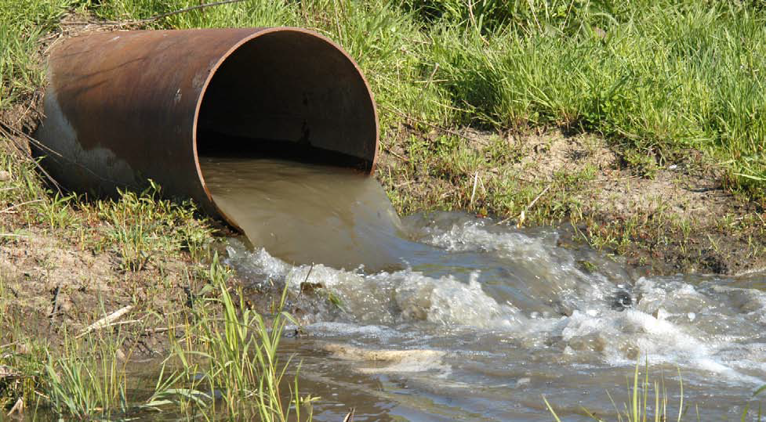
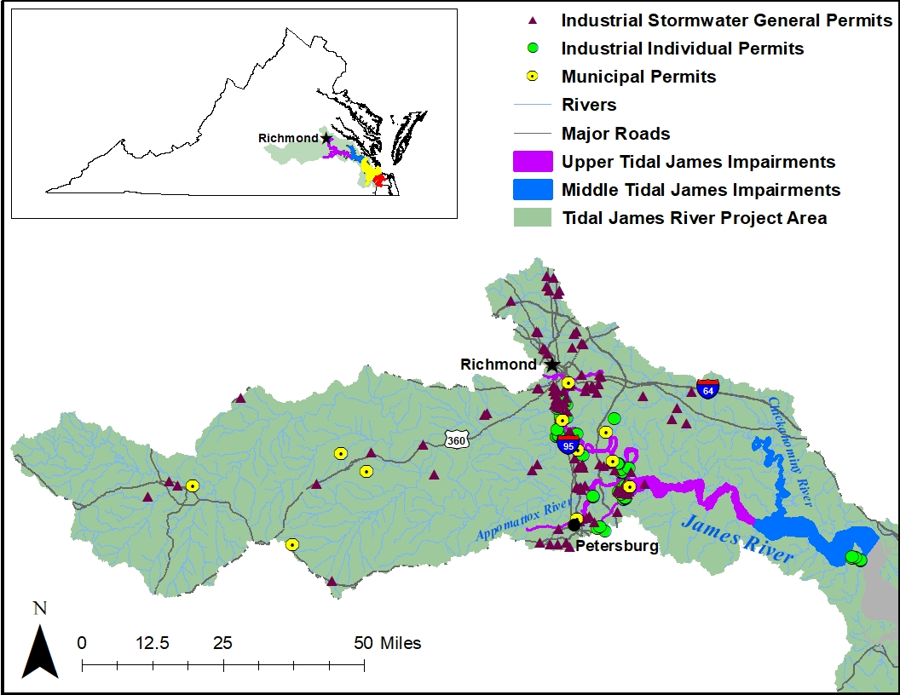
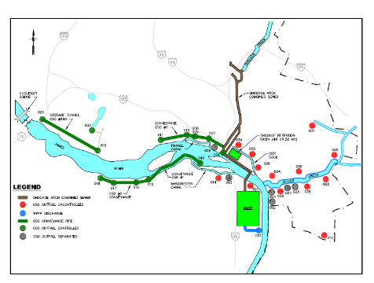
TMDL Source Category – Point Sources
VPDES Permitted facilities
  Municipal WWTP
  Industrial sources
    Selected based on Standard Industrial Classification (SIC)
      Individual Industrial Facilities
      Industrial Storm Water General Permitted Facilities
  Municipal Separate Storm Sewer System (MS4)
  Combined Sewer Overflow (CSO)
    Richmond
For Technical Support call 804.527.5029

Slide 36
TMDL Source Category – Point Sources
Upper and Middle Tidal James River (Piedmont Region)
Facility Type | # Permitted Facilities | Projected PCB Baseline Load (g/yr) | Projected WLA (g/yr)
Municipality | 11 | TBD | TBD
Industrial IP | 22 | TBD | TBD
Indus. SW GP | 112 | TBD | TBD
Lower James River and Elizabeth River Watershed (Tidewater Region)
Facility Type | # Permitted Facilities | Projected PCB Baseline Load (g/yr) | Projected WLA (g/yr)
Municipality | 6 | TBD | TBD
Industrial IP | 44 | TBD | TBD
Indus. SW GP | 127 | TBD | TBD
TBD = To Be Determined
For Technical Support call 804.527.5029

Slide 37
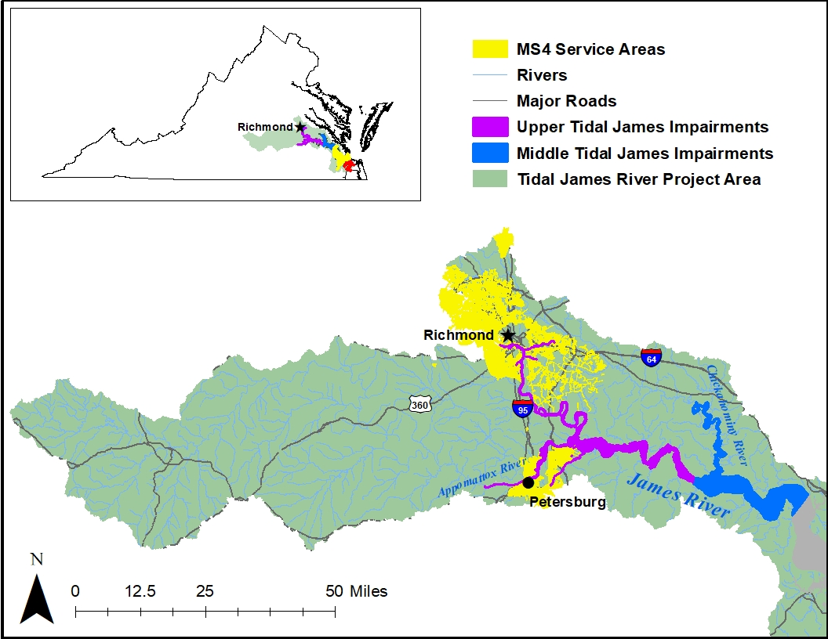
TMDL Source Category – MS4s
Upper and Middle Tidal James River (Piedmont Region)
MS4s | Projected PCB Baseline Load (g/yr) | Projected WLA (g/yr)
2 (Phase I – Large) 13 (Phase II - Small) VDOT | TBD | TBD
Lower James River and Elizabeth River Watershed (Tidewater Region)
MS4s | Projected PCB Baseline Load (g/yr) | Projected WLA (g/yr)
6 (Phase I – Large) 17 (Phase II – Small) VDOT | TBD | TBD
For Technical Support call 804.527.5029

Slide 38
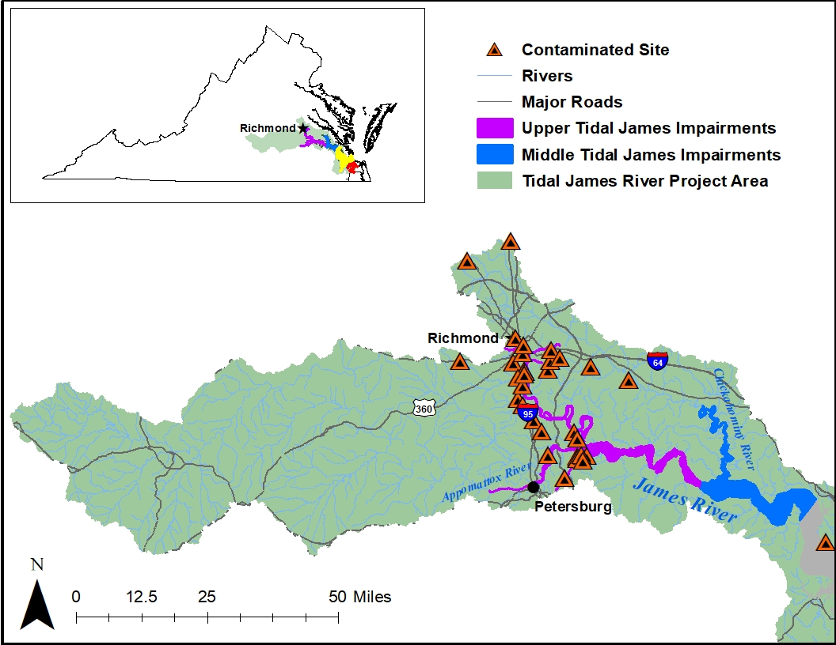
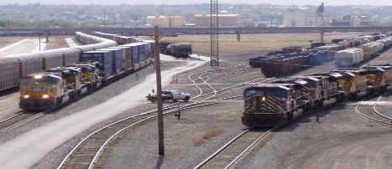
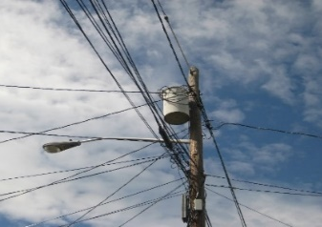
TMDL Source Category - Contaminated Sites
TSCA (PCB Clean-up Sites)
RCRA Corrective Action Facilities
CERCLA
Voluntary Remediation/Brownsfield
Landfills
Rail Yards/Spurs
Miscellaneous spill sites
  Pollution Response (PREP)
Electric Utility Transformer Pads
https://commons.wikimedia.org/w/index.php?curid=6092689
For Technical Support call 804.527.5029
https://commons.wikimedia.org/w/index.php?curid=17503186

Slide 39
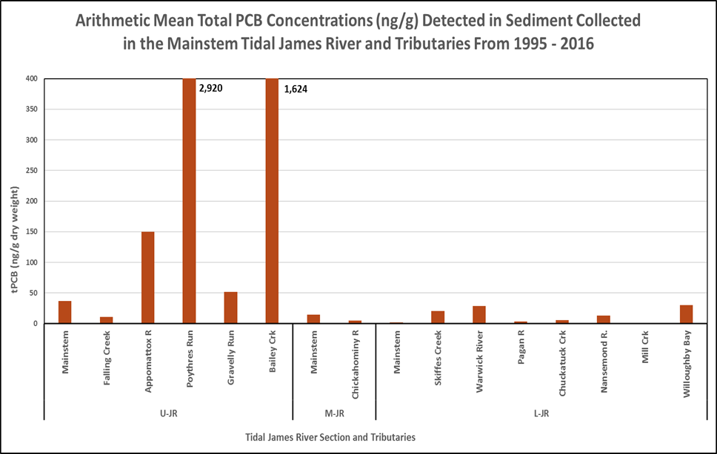
TMDL Source Categories
Atmospheric Deposition (example)
Contaminated Sediment
Modes of Deposition
Wet = 4.5 – 12% of total
Rodenburg (Totten), L. A. et al., 2007. Rutgers University
For Technical Support call 804.527.5029

Slide 40
Implementation Process
Implementation Process
Point sources
WLA---- PMP
Nonpoint sources
Source “Fingerprinting”
Detect “uncharacterized sources”
Investigation
of Contaminated Sites & Hotspots
Deliberate Monitoring
Funding
For Technical Support call 804.527.5029

Slide 41
VPDES Point Sources
Pollutant Minimization Plan
If existing (baseline) condition > WLA
Pollutant Minimization Plan
Submitted and Approved
Backtrack/Source ID
Adaptive Implementation
Re-evaluate baseline load
Remediation
/BMPs
For Technical Support call 804.527.5029

Slide 42
TMDL - Contaminated Sites
RCRA Corrective Action, TSCA, CERCLA
Clean-up standards for land based contaminated sites have no relationship to PCB water quality criterion
  The PCB clean-up level of 1 mg/kg is not adequate to protect the fish consumption use
What about PCB contaminated drainage that leaves the site?
  Contamination occurs when stormwater comes into contact with PCB contaminated soils (< 1 mg/kg) and migrates off-site (e.g., MS4, direct drainage to waterbody, etc.)
For Technical Support call 804.527.5029

Slide 43
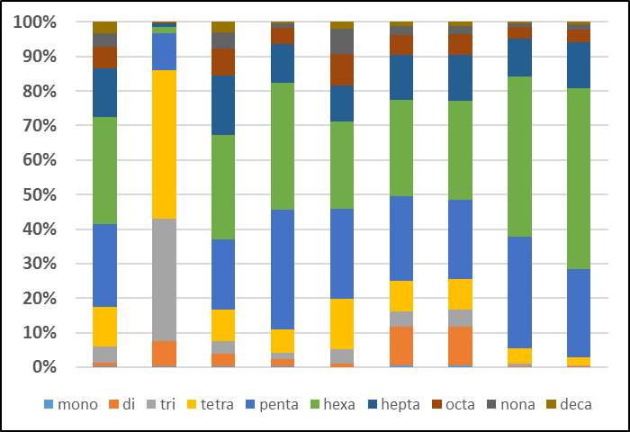
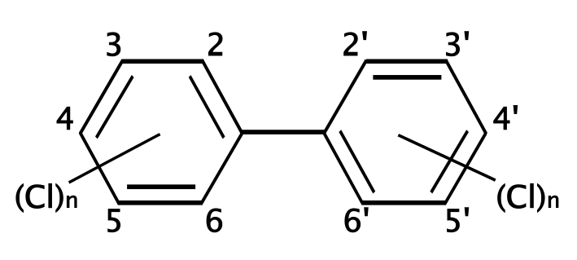


Point Source/Nonpoint Source:
“Fingerprinting”
For Technical Support call 804.527.5029
Objective: To identify a specific pattern or “fingerprint” of congeners that could be indicative of a pollution source
1. # of fingerprints in the system
2. Chemical composition in each fingerprint
3. contribution of each fingerprint in each sample

Slide 44
Timeline - Tidal James & Elizabeth Rivers PCB TMDL Development
For Technical Support call 804.527.5029

Slide 45

Next Steps
Public Comment Period
  January 29th – March 1st
  Send Comments to:
  Jen Rogers
  4949-A Cox Road
  Glen Allen, VA 23060
  Jennifer.Rogers@deq.virginia.gov
DEQ will hold two Technical Advisory Committee meetings
  March 25th – Focus will be on areas of the Upper and Middle Tidal James River
    If interested in participating as a member, Contact Jennifer.Rogers@deq.virginia.gov
  March 30th - Focus will be on the Lower James and Elizabeth Rivers
    If interested in participating as a member, Contact Mary.Haley@deq.virginia.gov
Mark.Richards@deq.virginia.gov
Jennifer.Rogers@deq.virginia.gov
For Technical Support call 804.527.5029

