Slide 1

techfortroops.org
501c-3 (IRS 47-1465185)

Slide 2
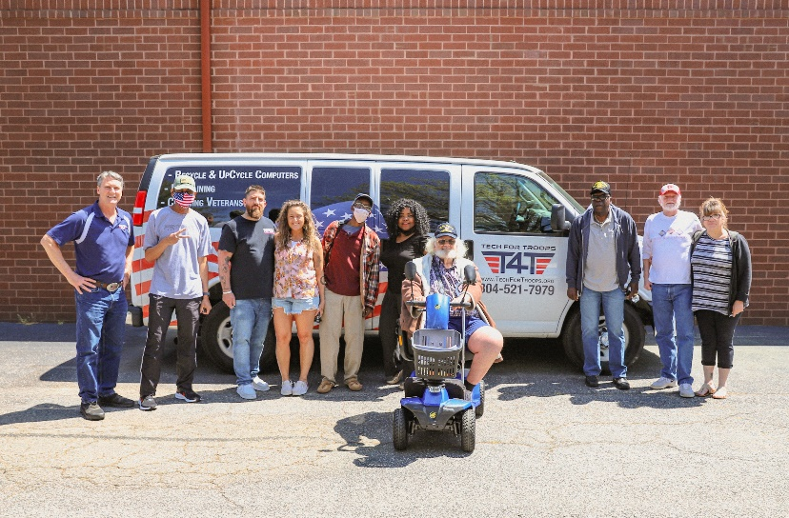
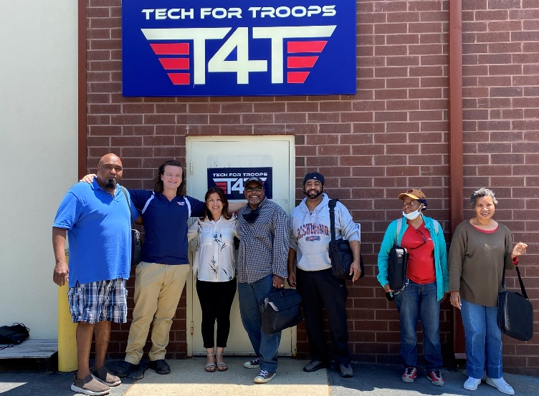
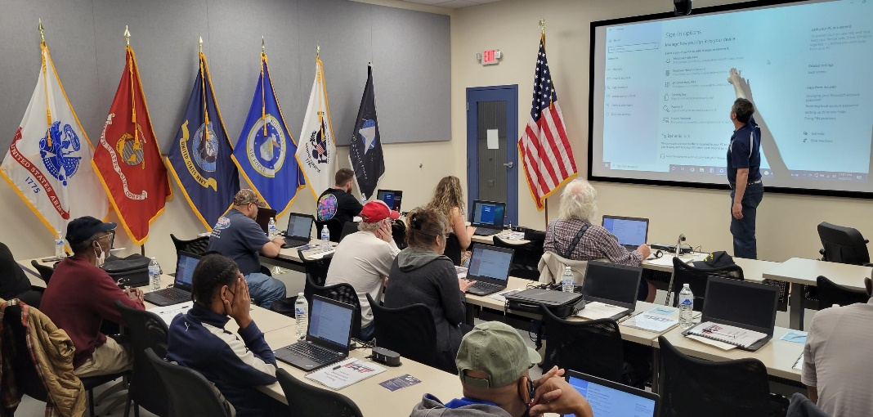

Improving the Military Community and their families lives, One computer at a time
Mission: Turning donations into Training, Education, and Technology for Veterans and their families in need.
Many Veterans face two significant barriers when competing in the modern workforce: lack of a computer and lack of skills needed to effectively use that computer.
Tech For Troops supports Veterans by collecting used technology that would otherwise end up in
landfills, refurbishing laptops
and providing training to Active Duty, the Veterans and their families.

Slide 3
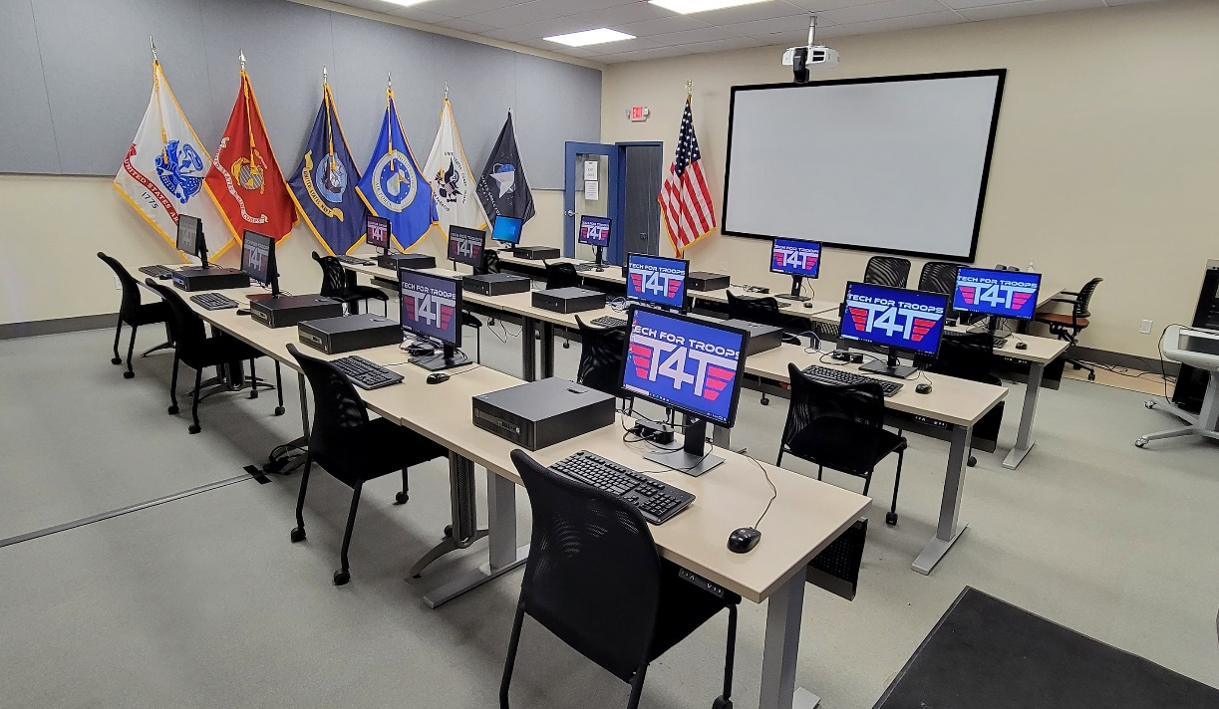

Who are we?
T4T gifts free/low cost refurbished computers to in need Active Duty, Veterans, spouses and the 3rd grade through college aged children of the Military Community
  We ship computers nationwide
100% Complete Data Destruction
“Aiming For Zero” Suicide Prevention
  Saved 16 lives in 18 months
Workforce Development Program
  In person and online
  5,000+ free online classes
Hire Veterans and provide them IT technical
training
Reuse or Recycle electronics with a R2 certified
company – almost 800,000 pounds in 2024
Recycle Your Tech. Renew A Veteran's Life.

Slide 4
The Pyramid
Aiming For Zero
Recycling
Veteran Education
Data Security

Slide 5
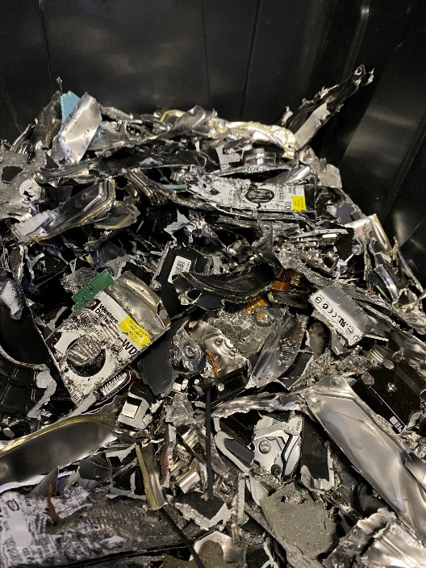
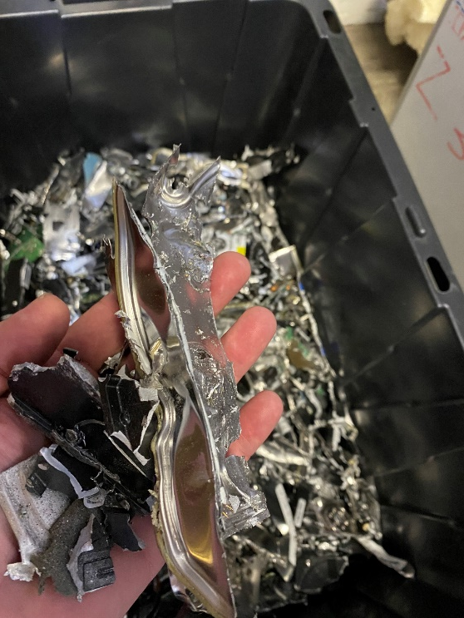

Guaranteed Data Destruction
Forensically certified for data destruction
Store hard drives in a secure room under lock and key
with camera surveillance (14 security cameras)
Every sector of a hard drive is overwritten using
a destructive “write”
Any drive that fails wiping is destroyed by shredding
For a fee, T4T provides a Certificate of Destruction

Slide 6
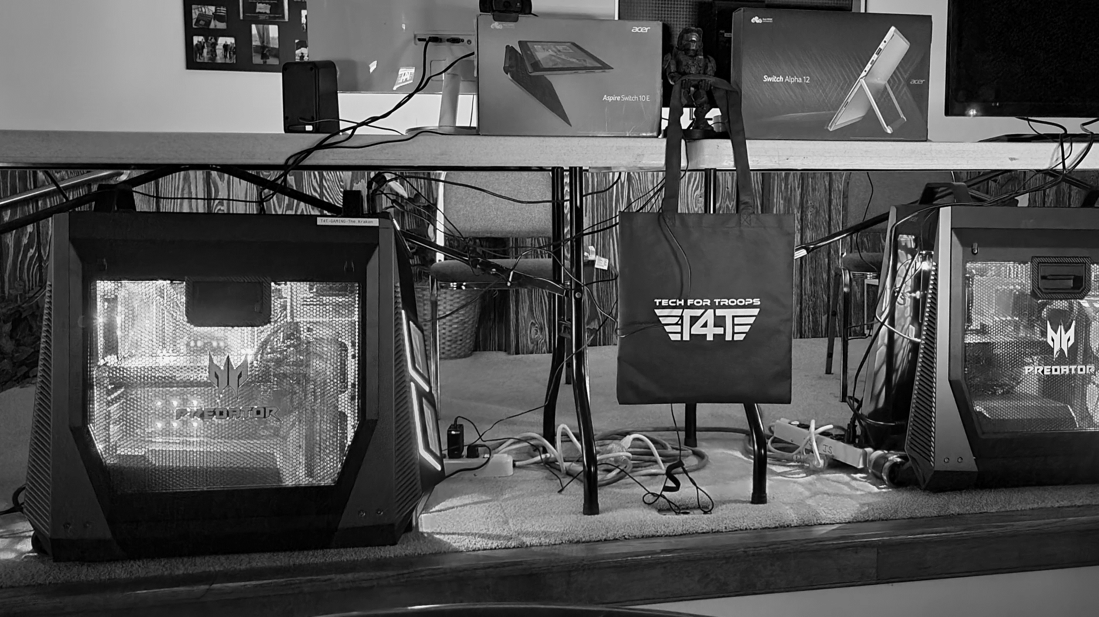
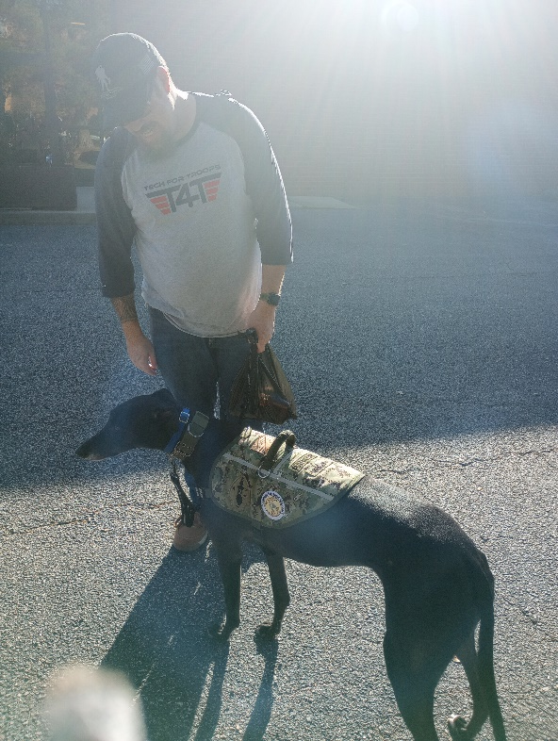

Beyond being used to heal & offer hope, gaming is an easily learned tool for Veteran engagement.
Game Corps:
Aiming For Zero
GameMaster Jason and General Hawk, his service dog/Mascot of T4T.
Impacting suicide in the Military Community
The Future of Veteran Communication
Using Discord and Twitch, Game Corps “Aiming For Zero” has impacted Active Duty, Veterans and families lives across the USA.

Slide 7

Can you effect Change?
“Hey dude – what’s up w/ you?”
T4T Game Corps has saved 21 lives in the past 26 months and have affected countless more.
The number isn’t ZERO yet – which means – we’re just getting started – and we need YOUR help.
*Veterans typically listen to other Veterans.
“Eudemonic Lifestyle” is found when the subject leads a virtuous life and has negative feelings assuaged because their endeavors are fulfilling not just financially and practically – but emotionally and spiritually.
Mental Health facilities are asking for our help for Veterans in patient service.
- What can you do to help us help our brothers and sisters?

Slide 8
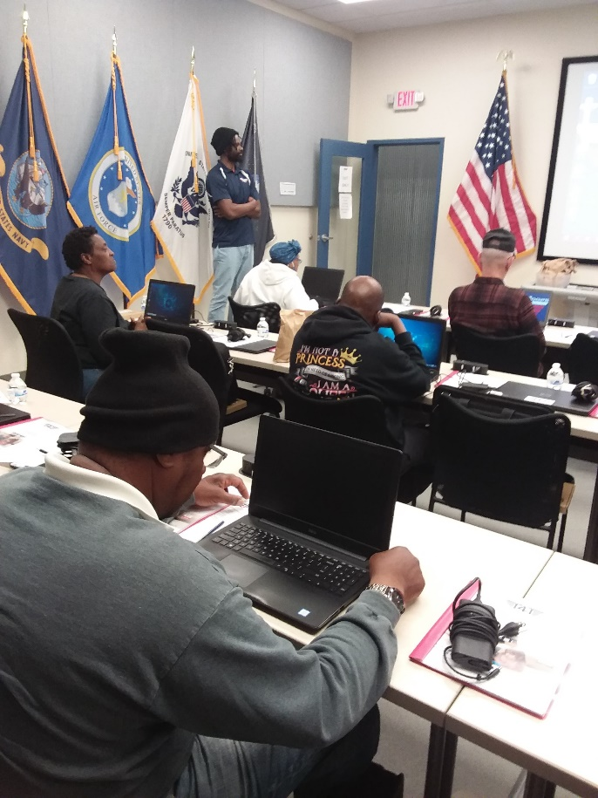
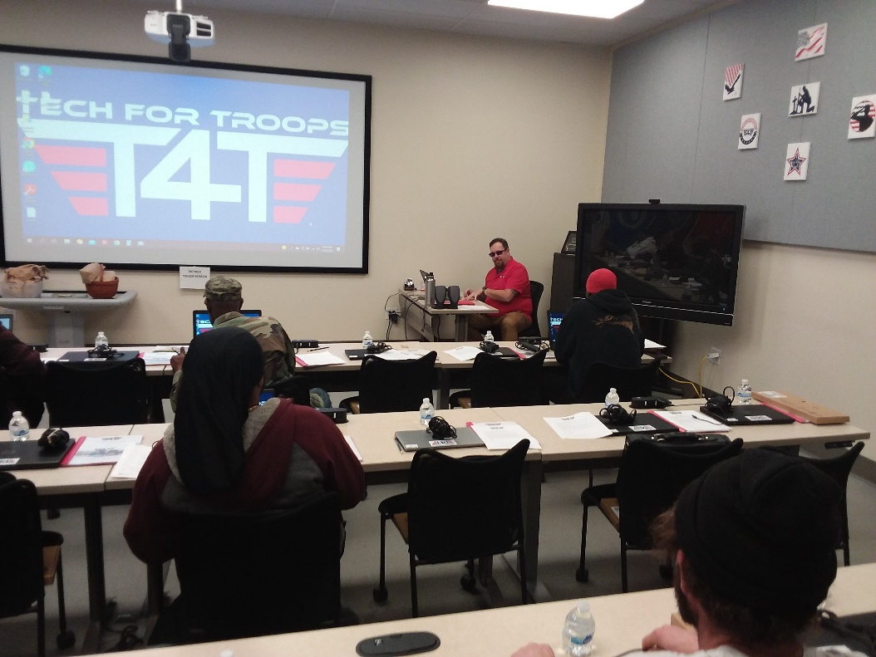
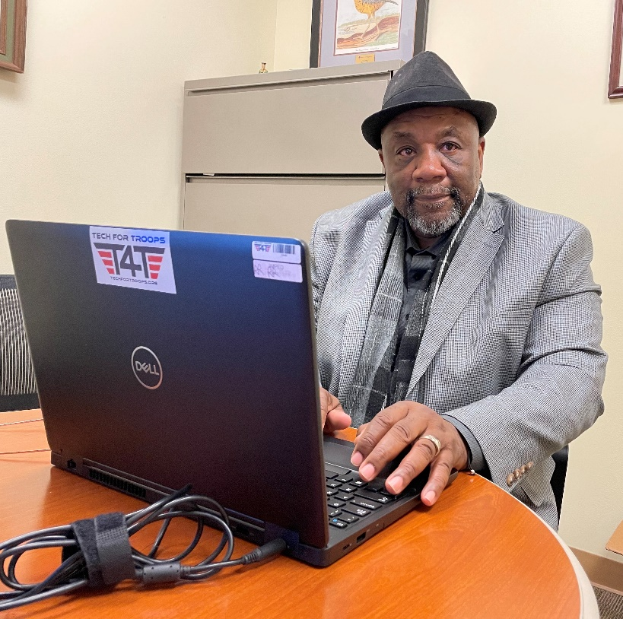

Veteran Improvement By Education Program (VIBE)
Veterans who became proficient on a computer

Slide 9
Veteran Homelessness - VA
March 14, 2024:
The Department of Veterans Affairs plans to move more than 41,000 homeless veterans into permanent housing in 2024 and conduct outreach with up to 40,000 veterans living in cars, parks or on the streets.
Question is: What good is it if the Vet moves into an apt and has no way to apply for a job? Or doesn’t know how to use a computer?
And – This is going to get worse –
A January 25 report from Harvard’s Joint Center for Housing Studies estimated that over 650,000 Americans experienced homelessness in 2023—up almost 50% from 2015. Costs of renting and home ownership have skyrocketed while wages largely stagnate. The Harvard report found that half of U.S. households are “cost-burdened” (meaning that 30-50% of monthly income goes to housing), and 12 million people are “severely cost-burdened.” These Americans stand one accident, health setback, or employment disruption away from eviction.

Slide 10
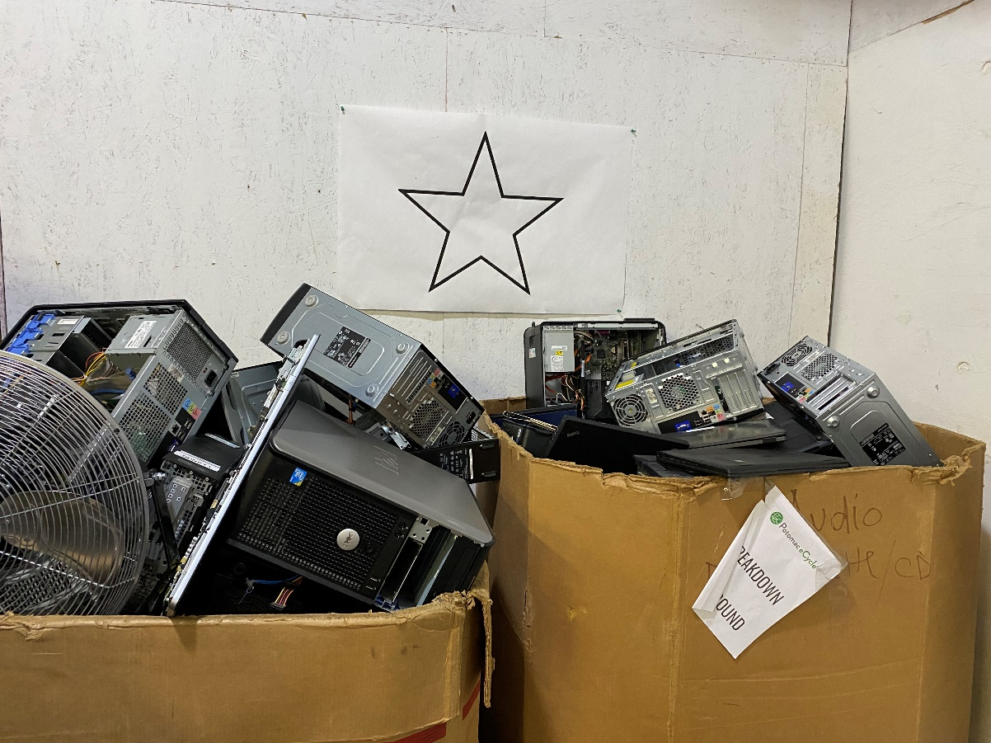
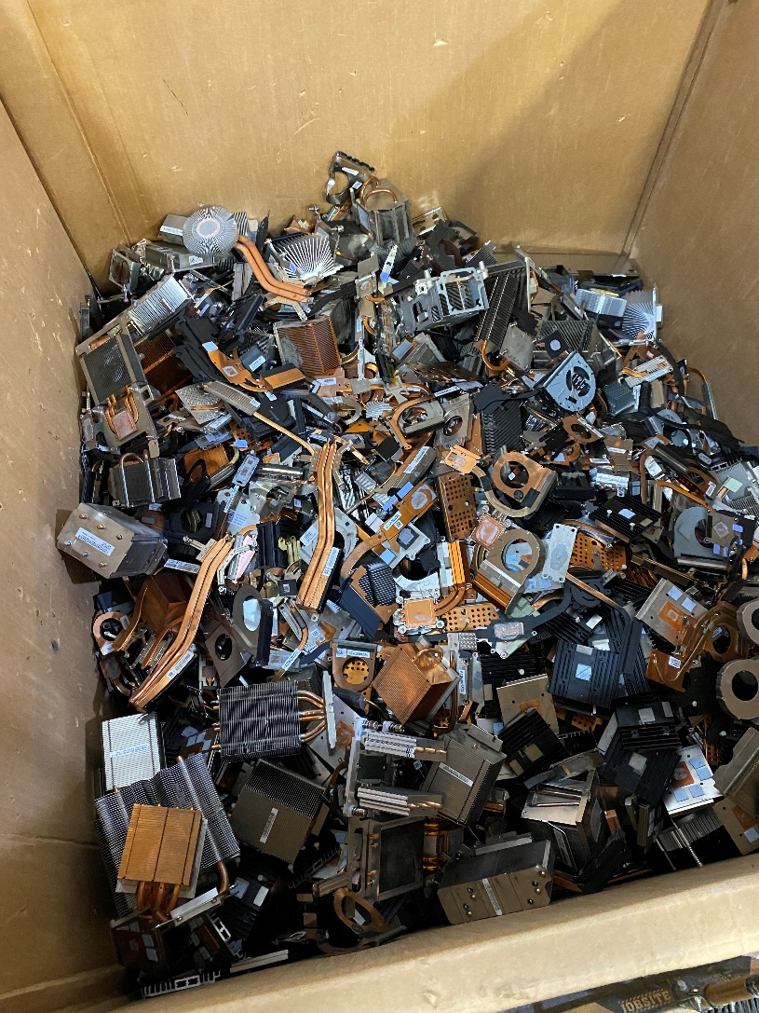
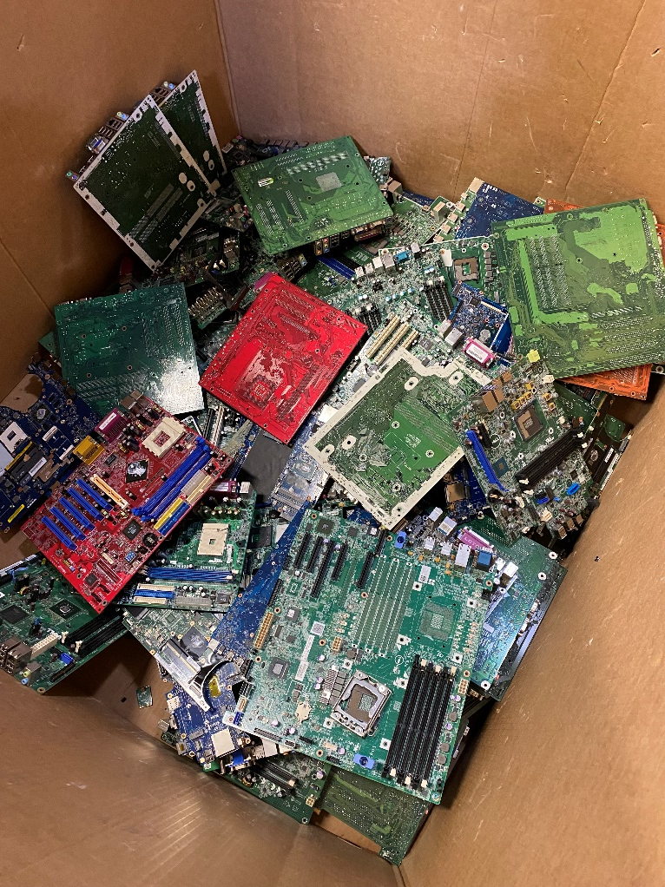

Responsibly Recycling Electronic waste
Over 1.5 million tons in 10 years

Slide 11

Circular Economy Sustainability Model
T4T is a market leader in environmental sustainability and supporting Corporate Social Responsibility (CSR) plus economic development
Carbon neutral and more earth friendly by responsibly reusing and recycling thereby eliminating equipment going to the landfill
Promote socially and environmentally responsible corporate recycling
Our R2 Certified recycling partner does NOT ship e-waste overseas
Your company may already have CSR program/sustainability efforts
  CSR is positive in the eyes of the public
  There’s no downside to your reputation or company interests
Corporations partnering with T4T is a win-win-win (You & the Military Community & T4T)
Newest Program - T4T is a founding member of the RVA Circular City Initiative
Notes:
One laptop = 414 pounds of CO2
Year 2021
303 laptops put back into service
Carbon offset of 125,442 pounds

Slide 12
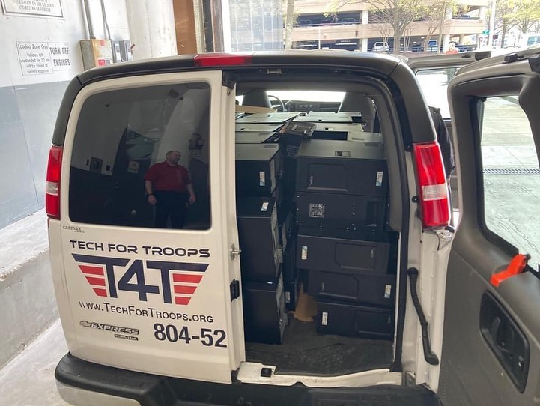
Reducing your Carbon Footprint
Working hard to reduce manufacturing/energy usage/CO2
2023 - 7,248 Tons of Carbon
2024 – 12,271 Tons of Carbon
was offset by T4T
Every item T4T repurposes or responsibly
recycles keeps that much Gold, Silver,
carbon and hazardous materials out of
the landfill
Cool van being used for a pick up

Slide 13
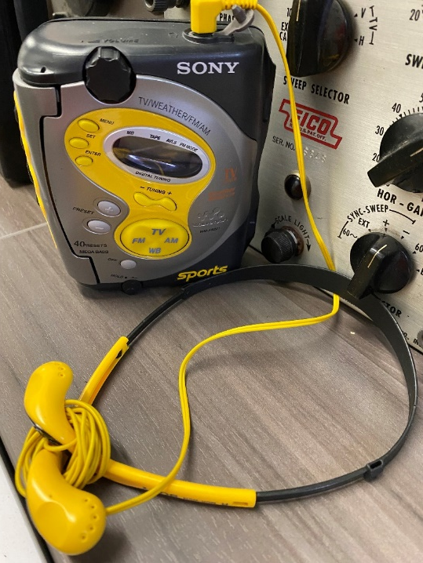
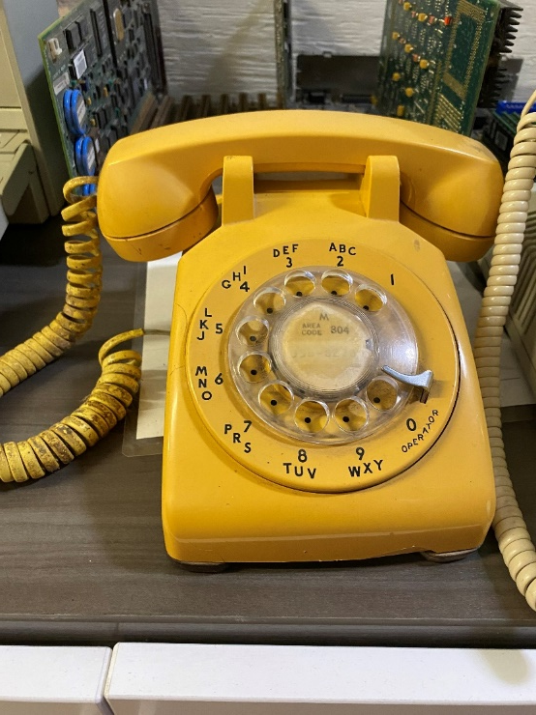
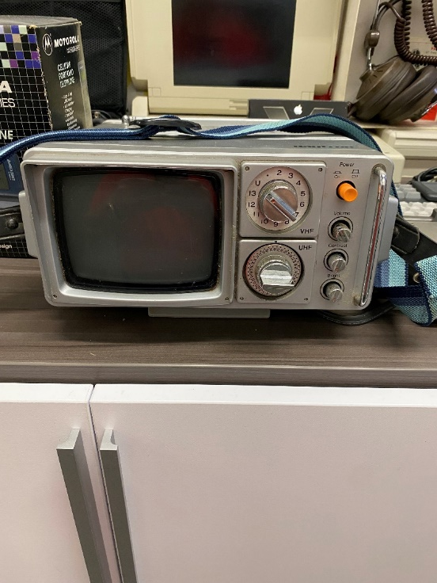
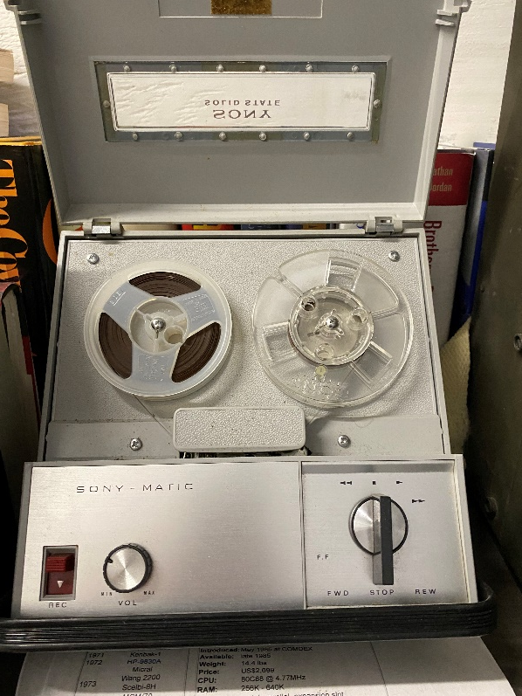
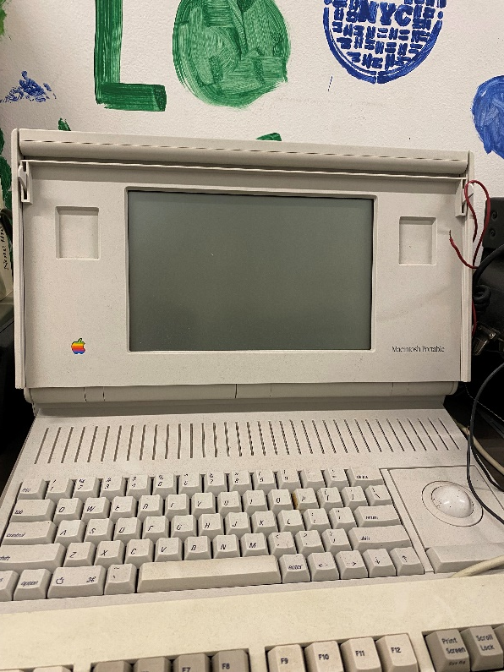
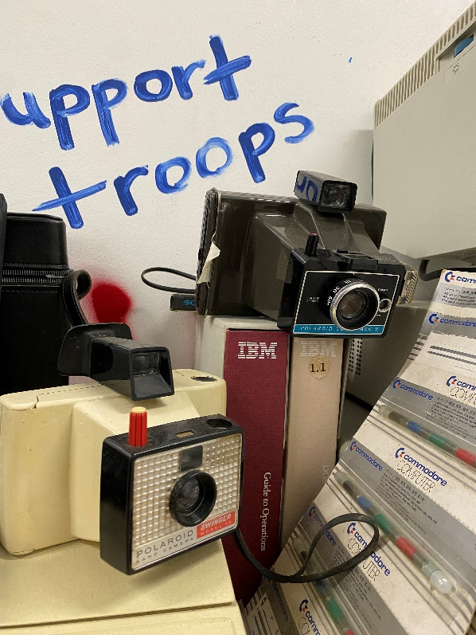

Museum Pieces

Slide 14
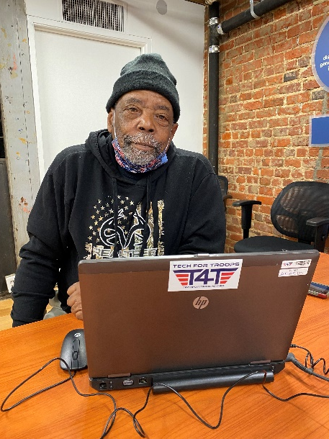
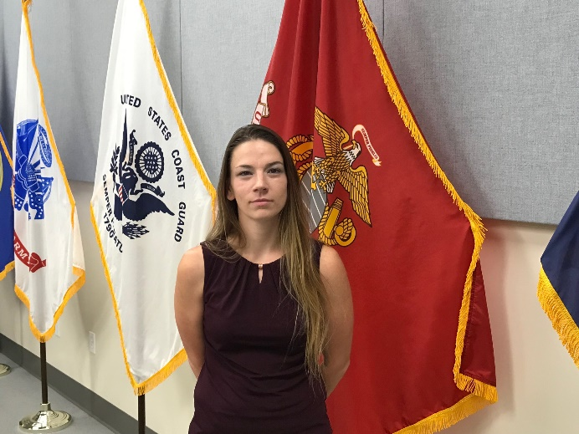
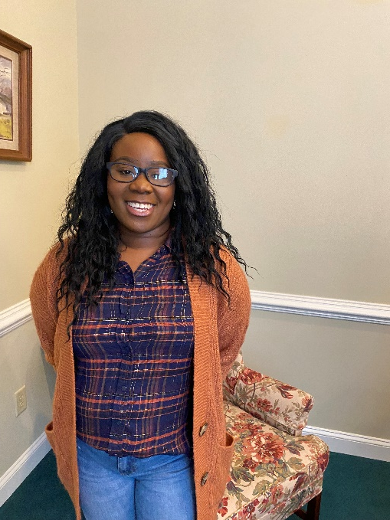
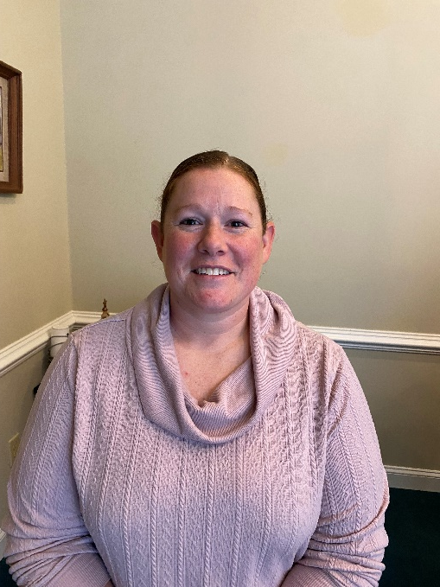
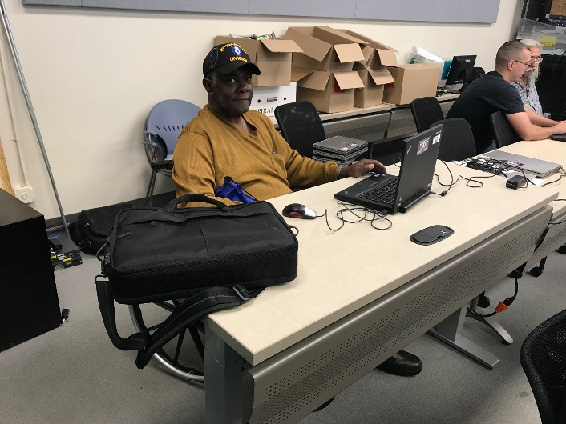
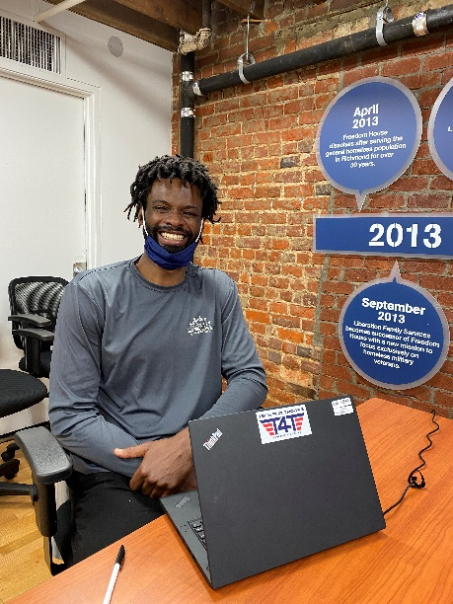
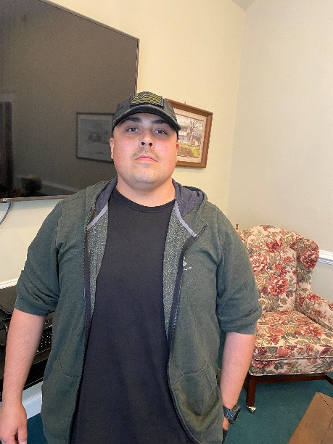

T4T needs your help to elevate our patriots – they are you, as we are them
Who T4T serves –
Our brothers and sisters in need

Slide 15
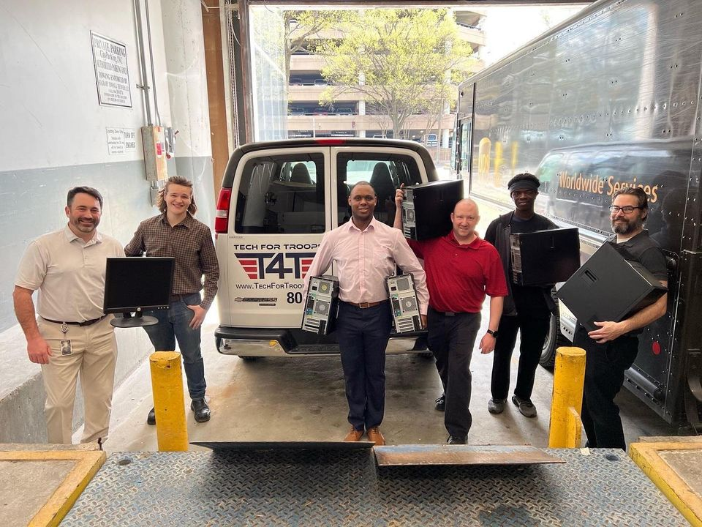

Our request of you
Foundation and Corporate grants
Introductions to family/friends
  Influencers
  Foundations
  CEO/CIO/CISO’s
All Corporate equipment donations
  Servers, routers, switches too!
Financial donations
  Corporate Matching dollar donations
  Kroger - krogercommunityrewards.com
  search for Tech For Troops or # RA828
Support individual programs – Education, Aiming For Zero, Recycling
Volunteer! (in person or remote)
SPREAD THE WORD!

Slide 16


T4T is actively looking for sponsors and competitors

Slide 17
Information
Current Address
4840 Waller Rd Richmond, VA 23230
Just off of Staples Mill/64 on the Broad St side (big T4T sign over our door)
What we can accept
Can accept - Partial list: Laptops, Desktops, Wiring, Servers, Routers, Switches, Hard drives, Cameras, Cell phones, Game boxes, Stereos, and more
For a fee – we can accept Fax Machines, TVs, CRT Monitors, Printers

Slide 18

Social Media
All of T4T’s social media can be
accessed via one (1) link
https://linktr.ee/techfortroops

Slide 19

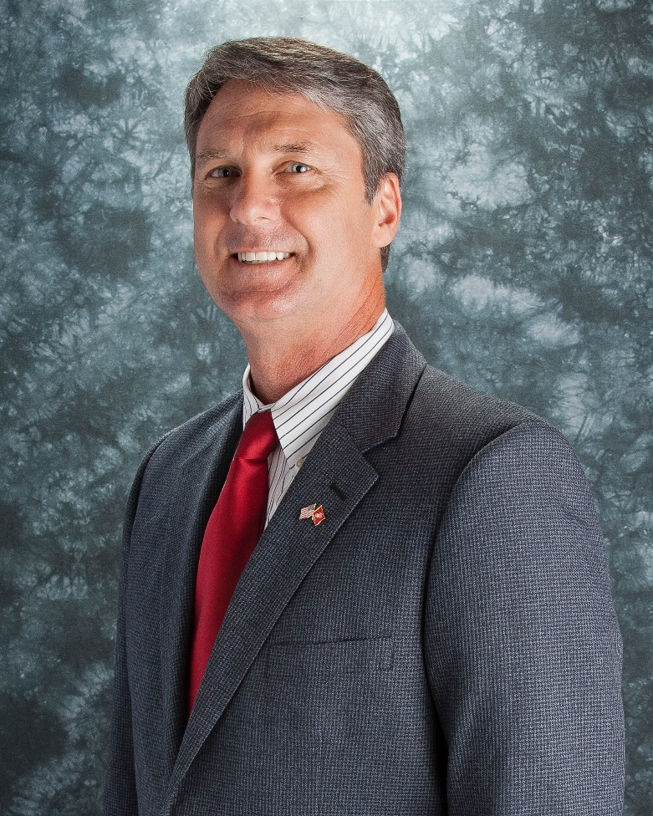
Questions?
Mark Casper,
President & CEO
mcasper@techfortroops.org
www.techfortroops.org

Slide 20
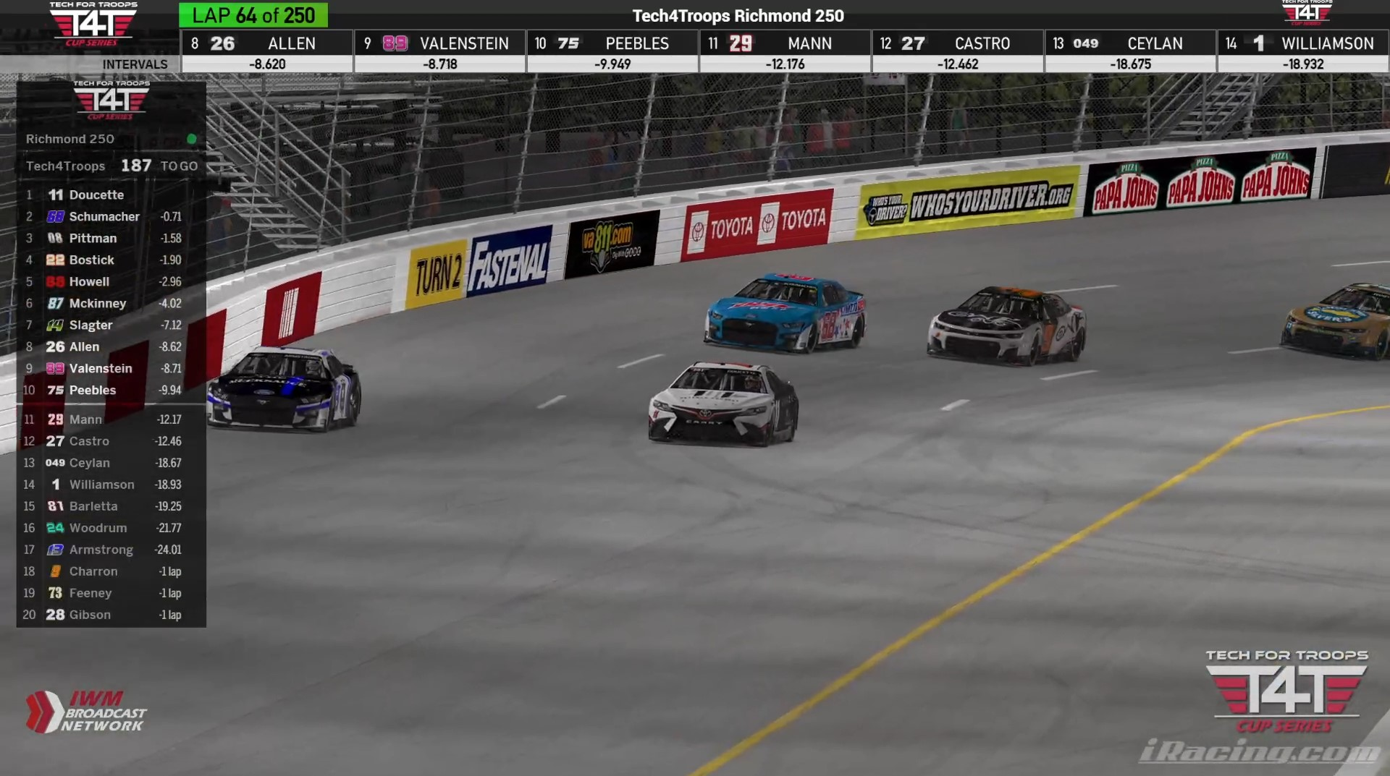



Tech4Troops Cup Series in partnership with The IWM Broadcast Network
Sponsor needed

