Slide 1
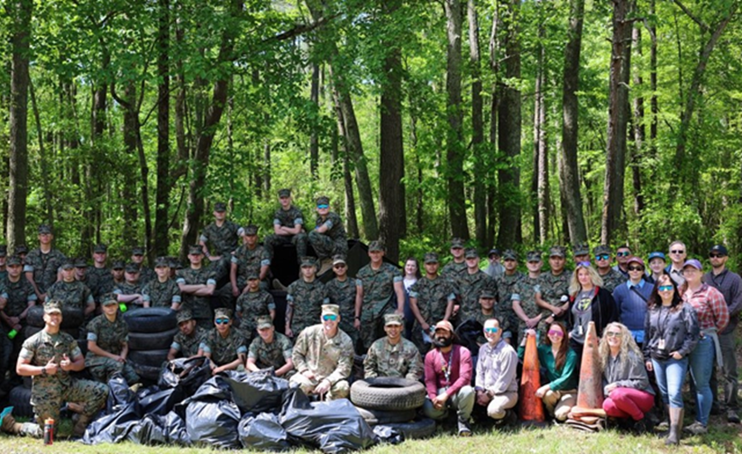
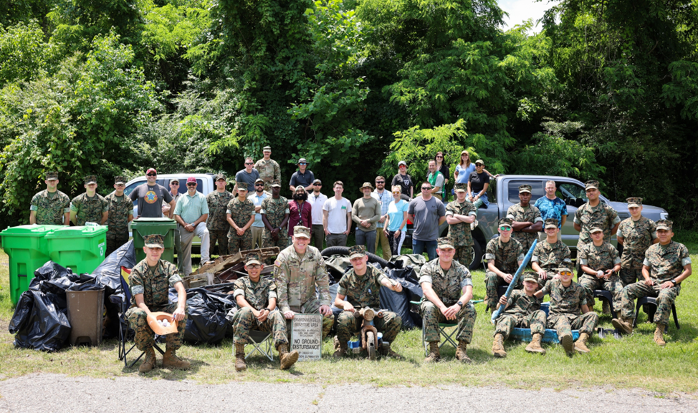
Increasing Our Diversion at Fort Lee
In 1998, the Department of Defense set a solid waste diversion goal of 40% or greater through Executive Order 13101, entitled “Greening the Government Through Waste Prevention, Recycling, and Federal Acquisition”
The target date was 2005 however, the DoD met that goal by 2001
By 2006, the Army specifically achieved a 43% diversion rate on municipal solid waste and a 72% diversion rate on construction & demolition debris (59% overall)
Every installation is different and correspondingly presents their own unique challenges to reaching the targeted diversion rate
Fort Lee has taken it a step further and established our own Qualified Recycling Program that allows us to sell scrap materials to aid in funding environmental projects on the installation

Slide 2
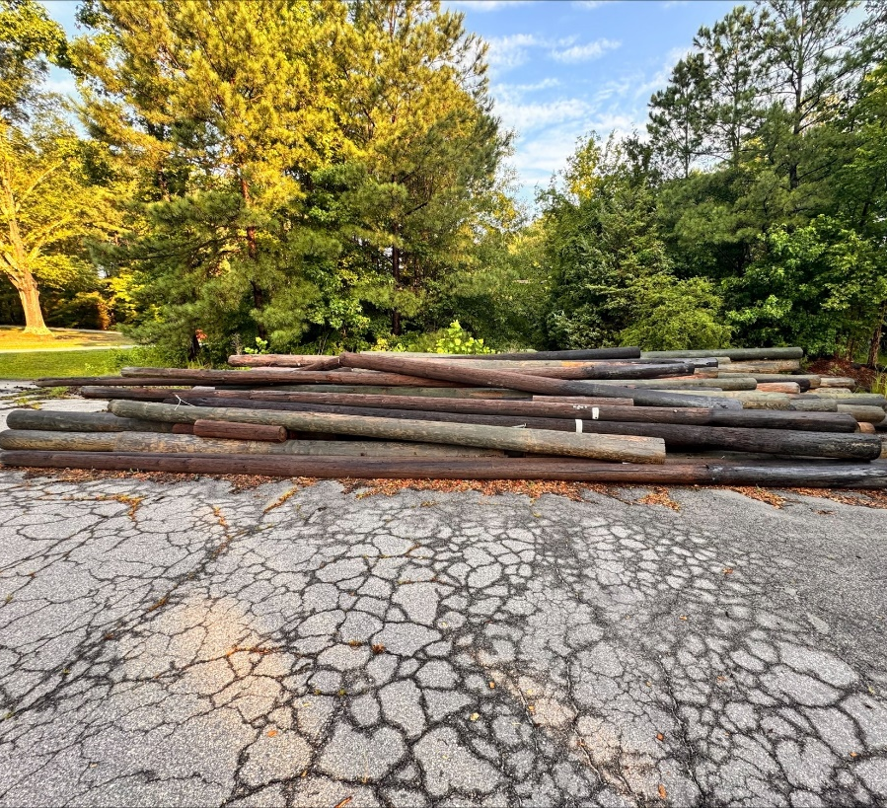
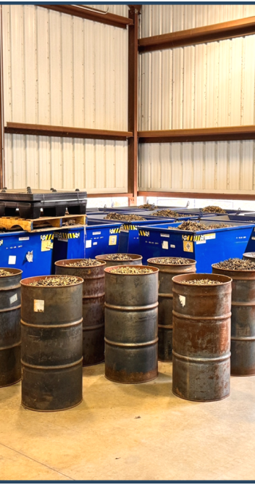
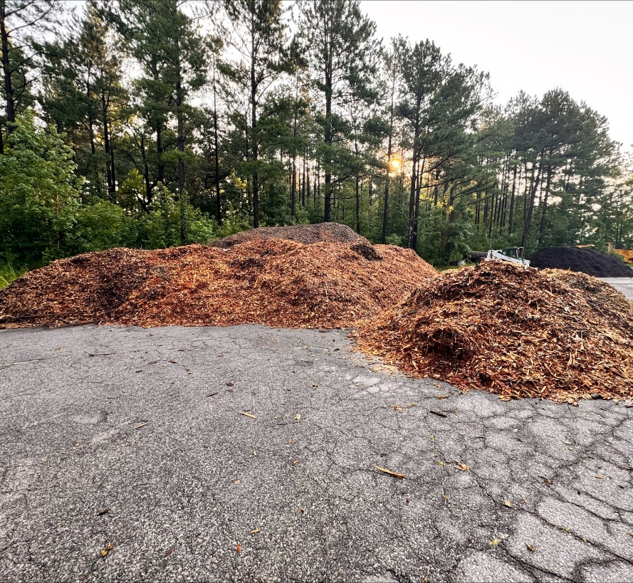
Overview
At Fort Lee we use a mix of traditional and innovative methods to reach our target goals
Traditional Recycling
  Cardboard
  Batteries
  Metals
  Fuel and Oil
  Wood
Innovative
  Food waste composting
  Brass
  Trees, Leaves, and telephone poles
  Spot sales
  Reutilization and Donations
  Standard Operating Procedures and Contracted Management

Slide 3
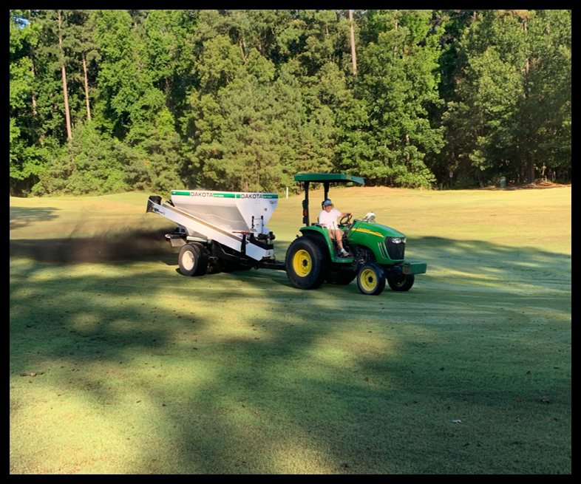
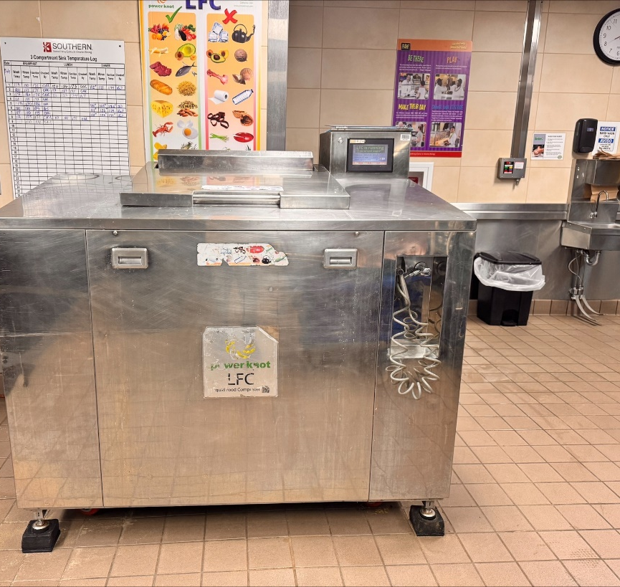
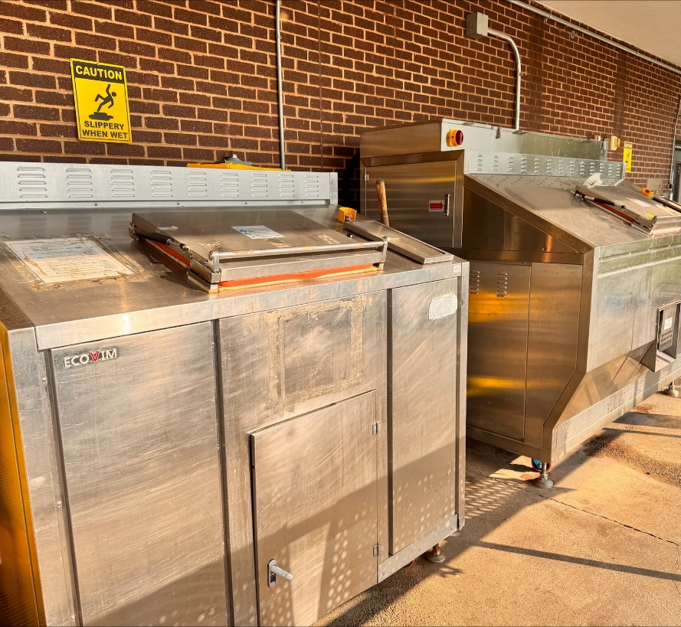
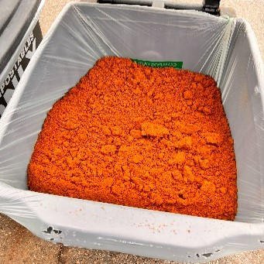
How We Innovate
Food Waste
  Around 5 million meals a month with on average 1lb of waste generated from every meal, we generate a lot of food waste
  By utilizing dehydrators and digestors we can reduce that food weight by 90% and prep the waste for more efficient composting
  We partner with McGill Compost (Wavery, VA) who properly composts the waste and then returns the mix to be used on the installation as a soil amendment replacing chemical fertilizers
  566 tons FY 25 so far
Brass
  Through standard training operations we generate a lot of brass bullet casings
  We process about 20 tons of the rounds a year to render them inert and unable to be reloaded and then sell that material to fund other environmental projects on base

Slide 4
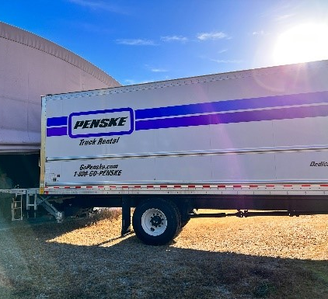
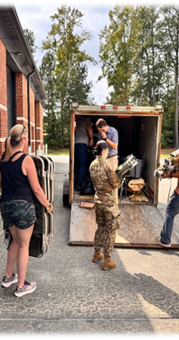
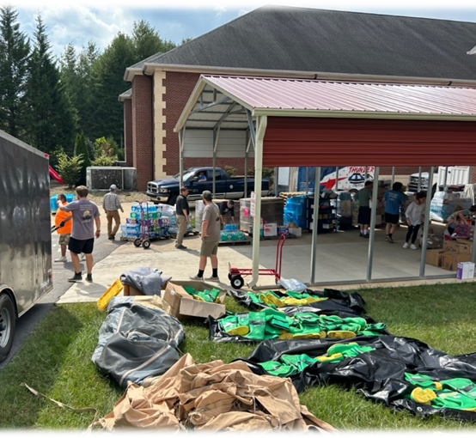
How We Innovate: Continued
Trees, Leaves, and Telephone Poles
  Throughout the year we regularly clean up dying or hazardous trees, leaves and yard waste, as well as removing damaged or concerning telephone poles
  That material is chipped and used to resurface our maneuver training roads
  This helps to both eliminate dust and particulates on these unpaved surfaces but also allows us purposefully utilize material that would otherwise be considered waste
Reutilization and Donation
  Once the Army’s considerations with a piece of equipment or supplies have been addressed, if items are unable to be reused on the installation, we work to partner with local nonprofits, tribal organizations, school systems, and religious groups to ensure that usable materials are given a second life
Standard Operating Procedures and Contract Management
  One of the less labor intensive but more efficient ways to ensure diversion is to work the language in to our mission operations and contract language for work on base
  FY24 we were able to recycle 100% of our construction & demolition debris!

Slide 5
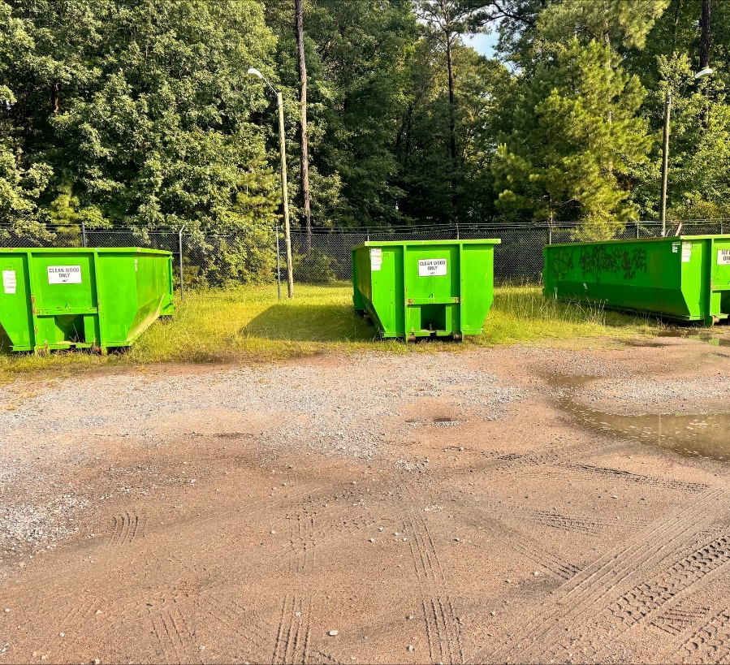
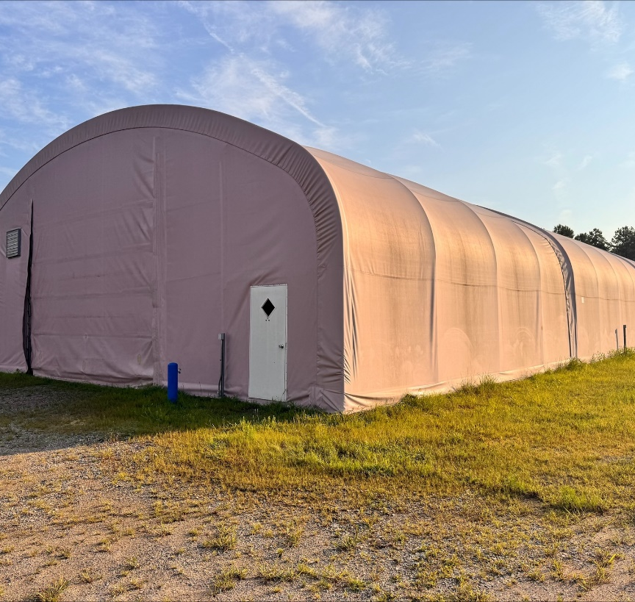
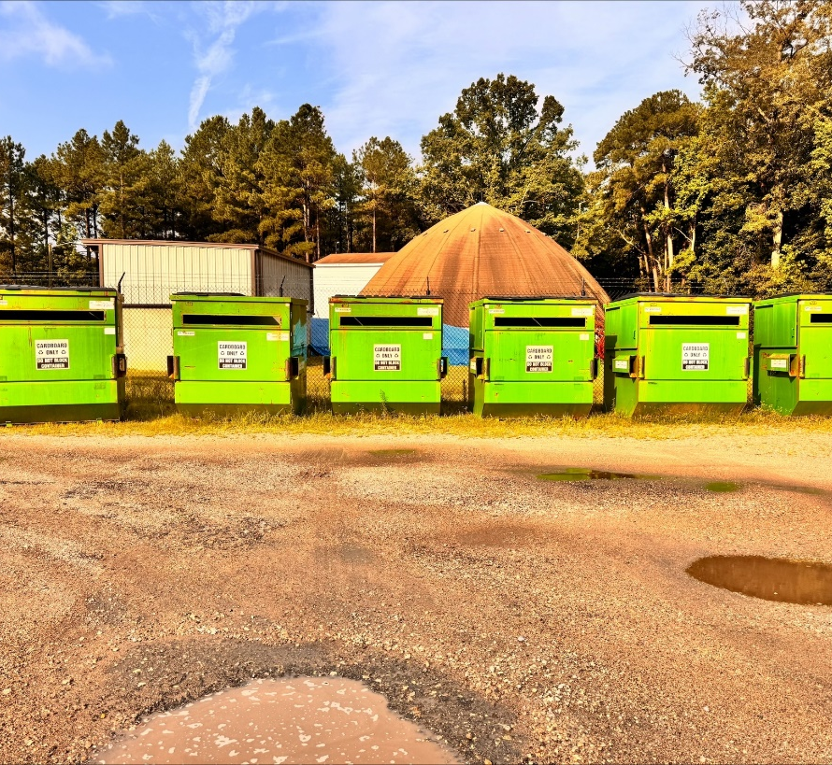
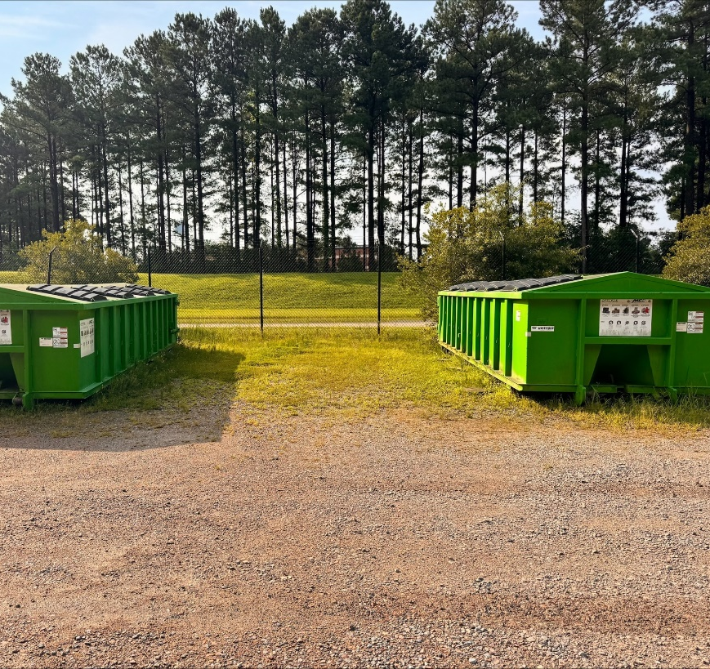
Path Moving Forward
Material Recycling Facility
  To increase both how much recyclables we capture as well as to increase the profitability of the respective commodities we have been working to establish our own processing area
  While our vision is to capture all potentially recyclable materials from our waste streams, we will initially start out focusing on cardboard and white paper
R3 Facility
  The Reuse, Recycle, Reinvest facility has been established within the same footprint
  Made up of dedicated staff that help to coordinate the transfer, sale, or disposal of any usable items as well as any previously unidentified recyclable or profitable waste streams
  A recent example would be the sale and recycling of over a ton of used toner cartridges but can include anything from furniture to hand sanitizer

Slide 6


Thank you!
Questions or concerns?
We are always looking for new partners, processes, and technologies! Please connect with us to discuss further.
Chubs Maharaj
Recycling & Outreach Manager
chabinath.g.maharaj.ctr@army.mil
(804) 573-5023
Alan Mills
Chief Environmental Management Division
james.a.mills80.civ@army.mil
(804) 734-3560

