Slide 1



ENERGY Saving Performance Contracting (ESPC)
Virginia Energy Management Program
Mason Trimble
804-382-4217
Mason.Trimble@energy.virginia.gov

Slide 2
Terminology
  BOE: Back of Envelope
  ECM: Energy Conservation Measure
  EE: Energy Efficiency
  ESCO: Energy Savings Company/Contractor
  ESPC: Energy Savings Performance Contracting
  IGA: Investment Grade Audit
  M&V: Measurement & Verification
  MOU: Memorandum of Understanding
  RFP: Request for Proposal
  RFQ: Request for Qualifications
Energy Saving Performance Contracting

Slide 3
What is ESPC?
Energy Savings Performance Contracting
(ESPC):
The use of guaranteed savings from the maintenance and operations budget (utilities) as capital to make needed upgrades and modernizations to a facility, financed over a specified period of time.
Budget neutral approach
Implement facility upgrades
Using guaranteed savings
Energy Saving Performance Contracting

Slide 4
Components of a Project
Virginia Department of Energy
Since 2002, Virginia Energy’s ESPC program has worked with sate agencies and other public bodies to enter contracts with energy service companies to significantly reduce energy costs.
Program Support
Free Project Support:
Comprehensive guidance and assistance on all relevant or related matters.
Document Templates:
Pre-developed forms provided to streamline every step.
Program Enforcement
(Code of VA § 45.2-1702):
Project guarantees, performance validation, stipulated financing parameters.
COVA ESPC program is designed for Virginia Energy to assist you throughout the entire process. When you have questions, we have answers!
Energy Saving Performance Contracting

Slide 5
Virginia ESPC pROGRAM
The Energy Savings Contractor
(ESCO)
A company that provides a broad range of energy solutions, including design, implementation of energy savings projects, retrofitting, energy conservation, energy infrastructure, power generation, energy supply and risk management.
ABM Building Service, LLC
Ameresco, Inc.
CEG Solutions
Centrica Business Solutions
CMTA Energy Solutions, Inc.
D E Kirby, Inc.
Energy Systems Group LLC
ENGIE
Honeywell Building Solutions
Johnson Controls, Inc.
McClure Company
McKinstry Essention LLC
Noresco, LLC
Schneider Electric
Siemens Industry, Inc.
Southland Energy
The Efficiency Network (TEN)
Trane U.S., Inc.
Wendel Energy Services, LLC
An ESCO will be your long-term partner in the design, construction and verification of your project!
Energy Saving Performance Contracting

Slide 6
Phases of a Project
PhaseS OF A PROJECT
Phase One: Feasibility
Consultation with Virginia Energy
Gather Pertinent Data
Establish Viable Project
Phase Three: Investment Grade Audit
MOU Awarded
Final Audit + Negotiations
Virginia Energy Review
DGS Review (21-days)
Contract Finalization
Approval Letter
Phase Two: Back of Envelope
RFQ ESCOs (Min. 5)
Kick-off Meeting
Facility Audit
Proposal Submission
MOU Negotiation
Phase Four: Contract & Construction
Internal Reviews/Approvals
Notice to Proceed
Construction
Phase Five: Measurement & Verification
Data Storage – ePB
Annual Reconciliation
Energy Saving Performance Contracting

Slide 7
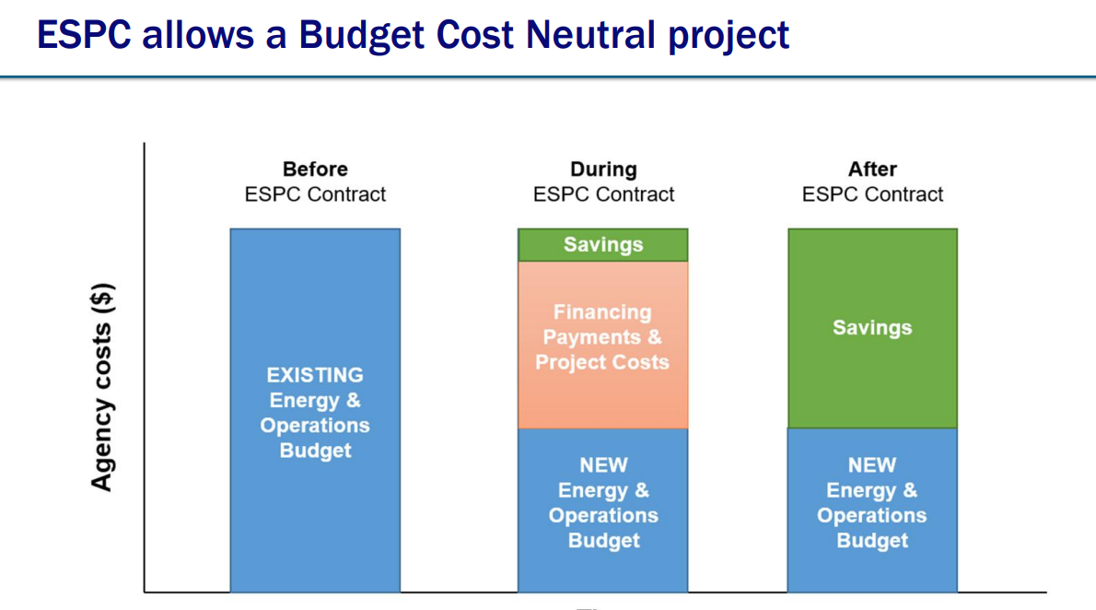
Financing a project?
Energy Saving Performance Contracting

Slide 8
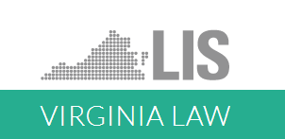
State Program Review
State program review
Project Budget Neutral or Positive
Truncated Procurement
Pre-qualified Contractors
Detailed Audits
Performance Guaranteed
Comprehensive Support
Article 2. Energy and Operational Efficiency Performance-Based Contracting Act
§ 45.2-1702 Definitions
§ 45.2-1703 Energy performance-based contract procedures; required contract provisions
§ 45.2-1704 Application of article
§ 2.2-4303.01 High-risk contracts; definition; review
Treasury Funding for State Agencies
§ 2.2-2417 Approval of financial terms of certain contracts; using agencies to procure certain financial services through Treasury Board.
Energy Saving Performance Contracting

Slide 9
END
Energy Saving Performance Contracting

