Slide 1
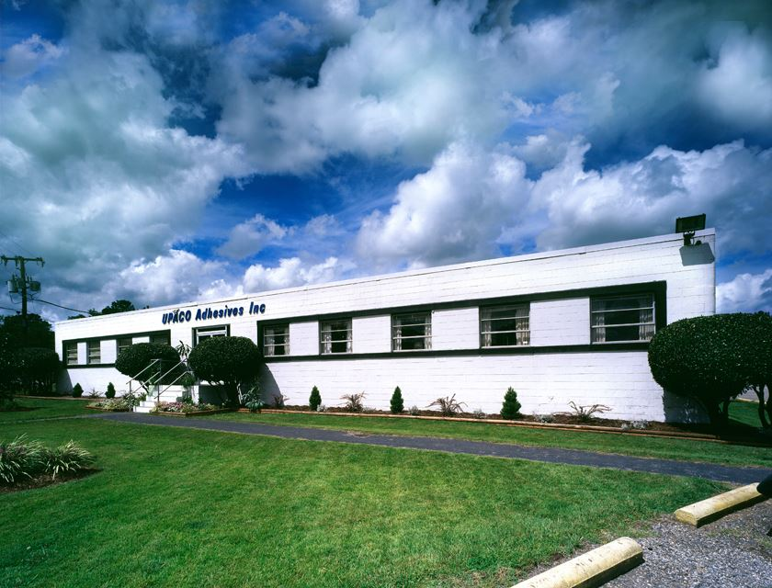
Pollution Prevention at Worthen Industries:
A Path to Sustainable Success
VADEQ VEEP Workshop July 2025
Notes:
Good afternoon. My name is David Marshall, and this is my colleague Shaye Hardner, and we are here today to talk about pollution prevention efforts at Worthen Industries, and our organization’s commitment to reducing our environmental impact through practical, forward-thinking strategies. From minimizing waste to improving energy efficiency and expanding our use of renewable energy, we are continuously working toward a more sustainable future.

Slide 2
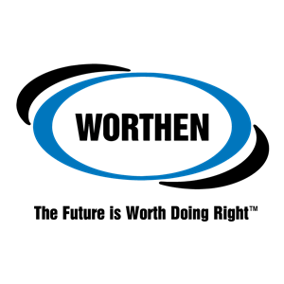
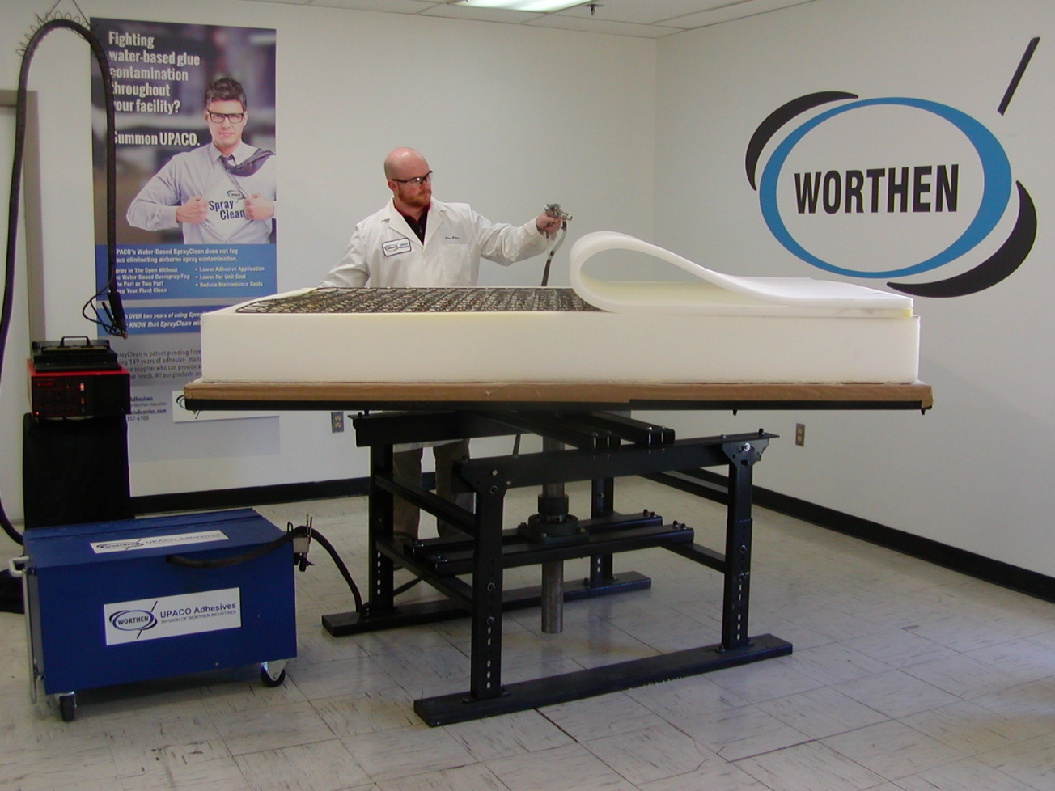
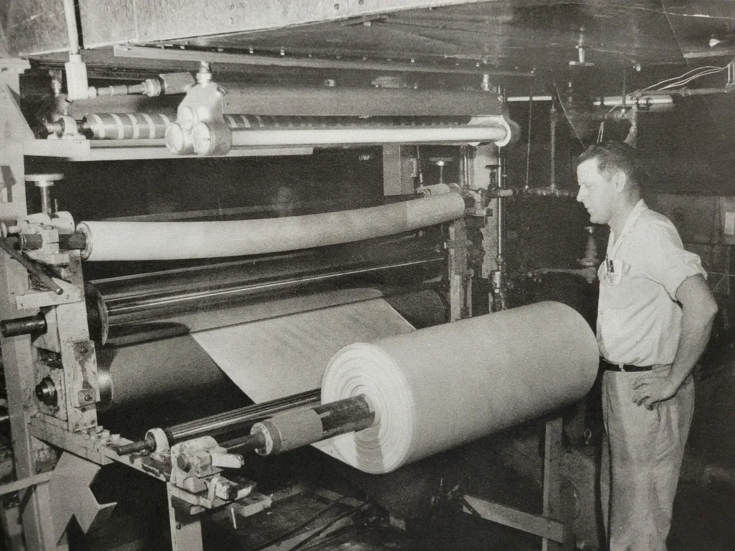
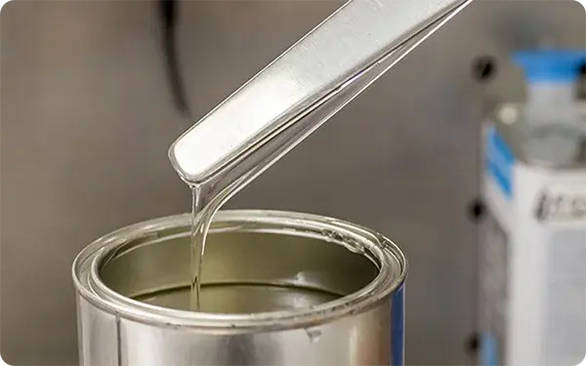
Introduction to Worthen Industries
A family owned and operated business
Over 150 years of servicing our customers
Our Mission: to deliver industry-leading solutions through sustainable innovation
Notes:
Shaye:

Slide 3
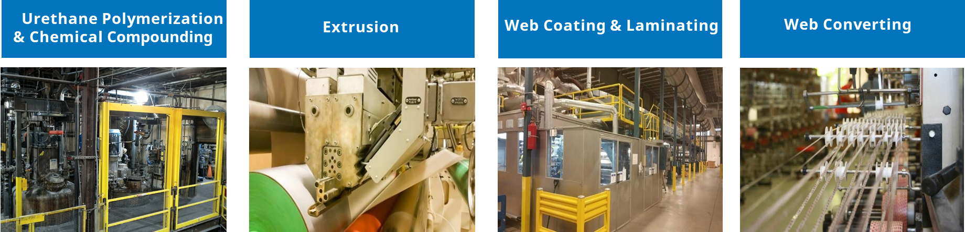
Introduction to Worthen Industries
What we do:
Industries we serve:
Furniture and mattresses
Medical
Building and construction
Footwear and apparel
Textiles
Performance tapes
Industrial
Packaging and laminating
Aerospace
Automotive
Commercial printing
Labels
Flexible ducting
Military
Solar
Notes:
Shaye:

Slide 4
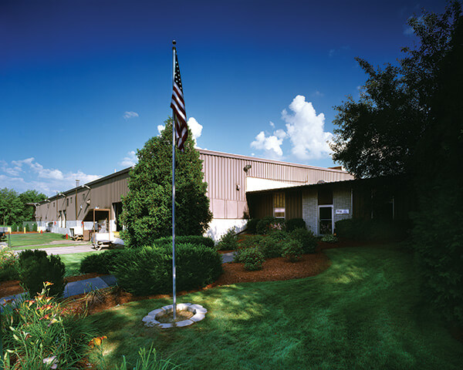
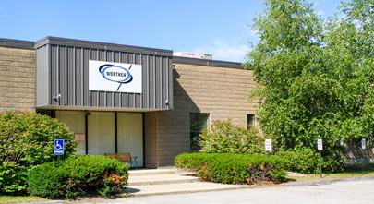
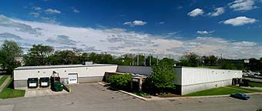
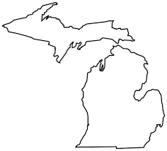
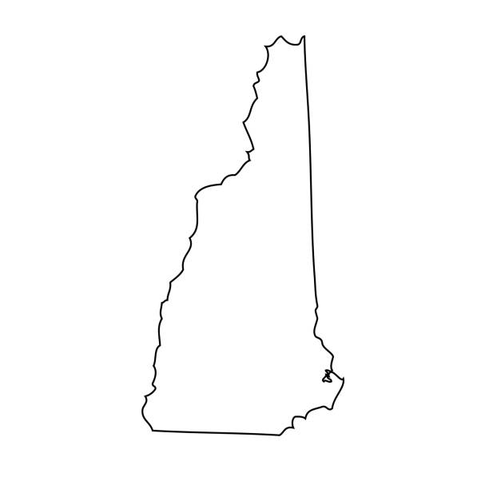
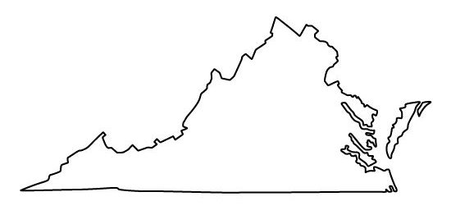
Richmond,
Virginia
Nashua,
New Hampshire
Grand Rapids,
Michigan
Notes:
Shaye: Headquartered in New Hampshire, Worthen Industries operates additional facilities in Michigan, and here in Richmond, Virginia. Our expansive footprint allows us to efficiently serve our customers while embracing our core values of safety, sustainability, and quality.
With 12 distinct business we are equipped to address a wide array of needs across various industries, including foam fabricating (furniture/mattresses), laminating, packaging, and footwear. Our commitment to sustainability is evident in every aspect of our operations, from design and production to distribution.

Slide 5
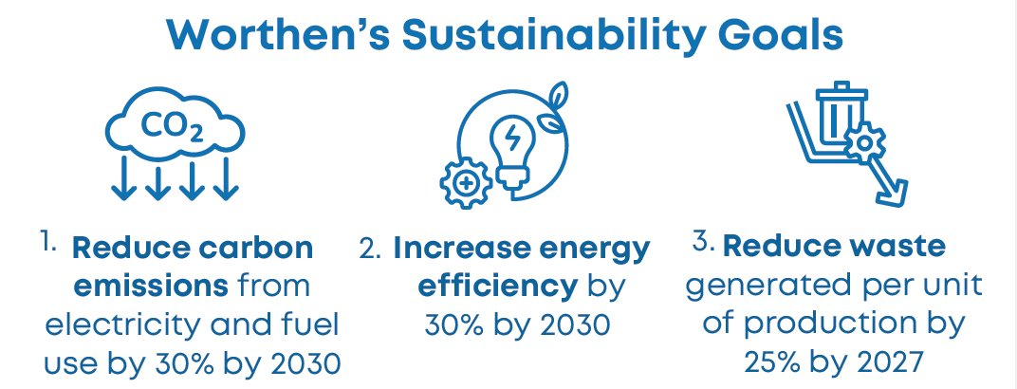
Worthen Industries’ Sustainability Initiatives
BECAUSE THE FUTURE IS WORTH DOING RIGHT
Worthen Industries is committed to operating in a sustainable manner that protects our workers’ health, safety, and well-being; and the environment; and the communities in which we operate, and to working with our customers to develop more sustainable solutions.
Sustainability Initiatives Focus On:
Climate impacts and carbon footprint
Energy efficiency
Waste Management, reduction, and repurposing
Green chemistry and responsible manufacturing
Notes:
This is a content slide option with a title field and a text/image field with logo in the lower right (1/3)

Slide 6
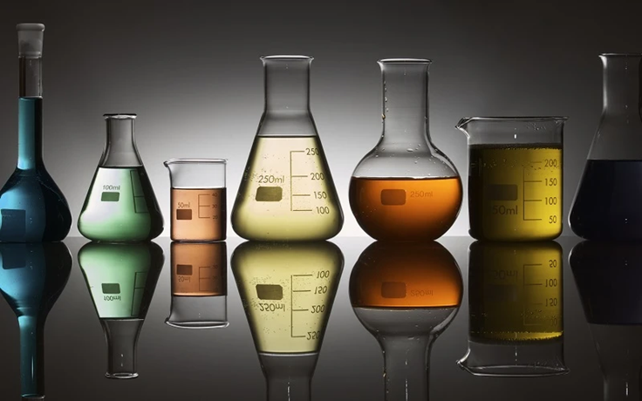
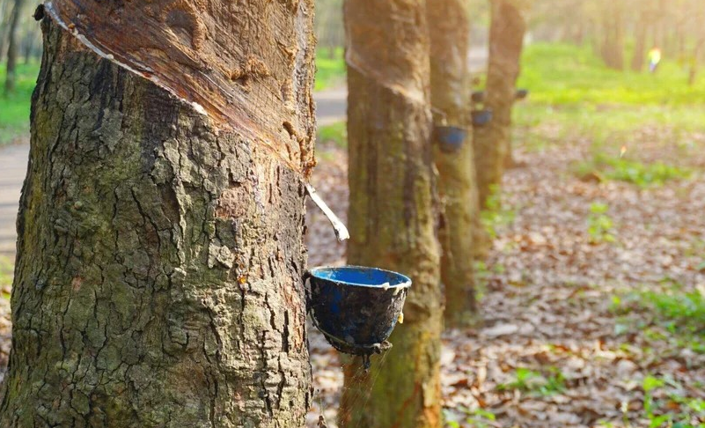
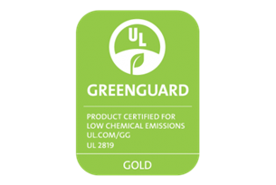
Green Chemistry
Our R&D teams continually work to develop products that:
Have lower to no solvent and/or VOC content
Are bio-based
Contain recycled content
Are biodegradable
And benefit our customers by:
Decreasing the carbon footprint of final product
Facilitating recycling/composting of final product
Improving processing efficiency and employee health and safety
We offer some products that are certified to bluesign®, Global Recycled Standard, OKEO-TEX® STANDARD 100, or UL GREENGUARD Gold.
Notes:
Richmond main BUs – Foam Fabricating Adhesives and Paper Converting and Packaging Adhesives
Offer water-based adhesives
Benefits:
Don't need fume hoods so decreased need for compressed air and don't lose building heat or conditioned air
Increased transfer efficiency so less wasted adhesive
Better for worker health
Incorporating biobased content - natural rubber and rosin ester
VOC-free solvent-based adhesives
Airlessly atomized spray technology
Benefits:
Less overspray and increased transfer efficiency so less wasted adhesive
Better for worker health
GreenGuard is a certification that a product meets strict chemical and VOC emissions requirements to help ensure indoor air quality

Slide 7
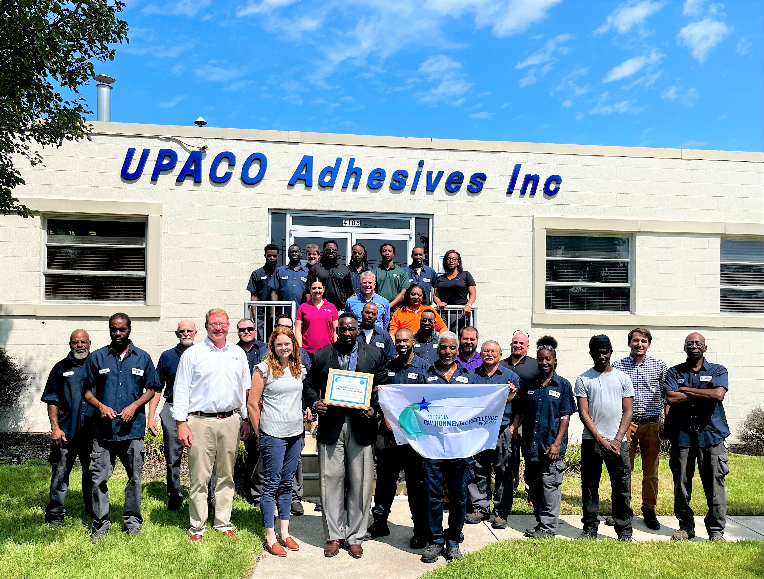
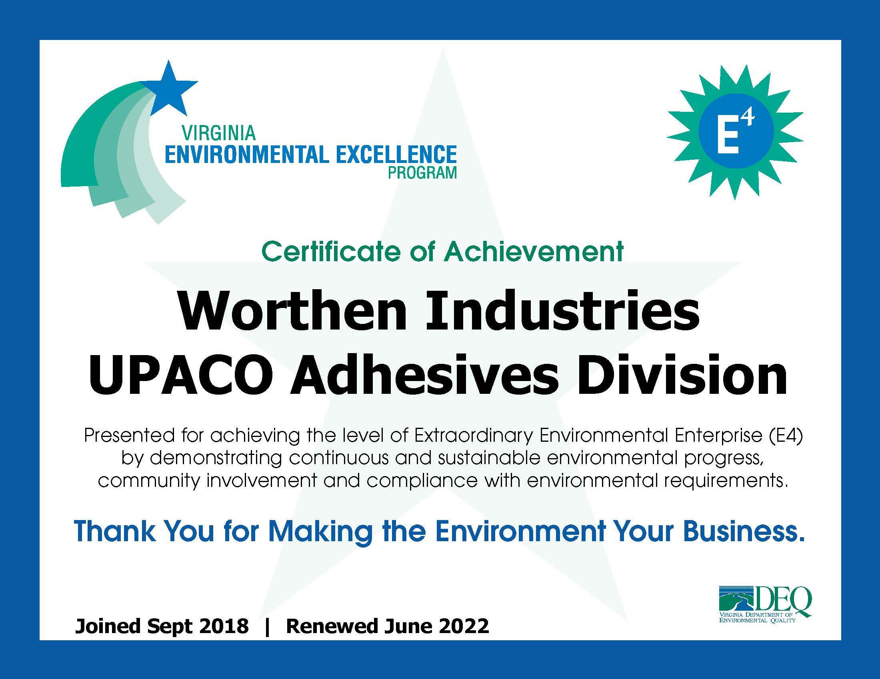
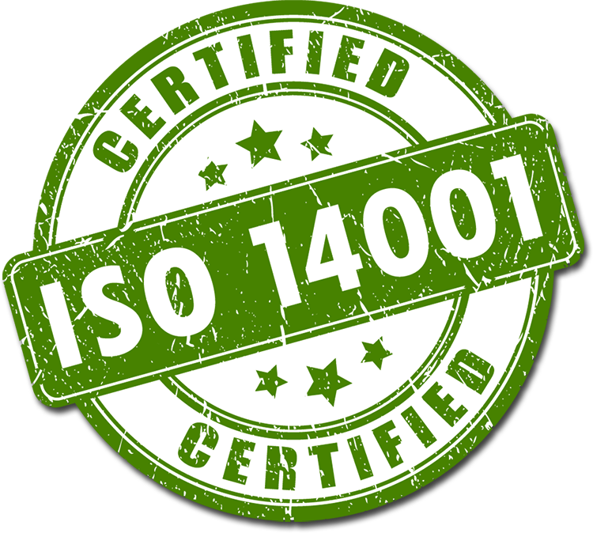
Pollution Prevention – Regulatory Compliance
VEEP member since 2018
E4 since 2022
Notes:
Dave: At Worthen Industries, we are committed to environmental responsibility, particularly at our Richmond, Virginia facility. We have integrated pollution prevention and regulatory compliance into the fabric of our operations. Our Richmond facility is ISO 14001 certified, demonstrating our dedication to maintaining an effective environmental management system. Additionally, as an E4 level member of the Virginia Environmental Excellence Program, we are recognized for our leadership in environmental performance and sustainability. These certifications reflect our ongoing commitment to minimizing our environmental impact and driving continuous improvement.

Slide 8
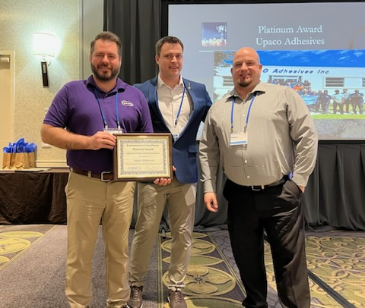
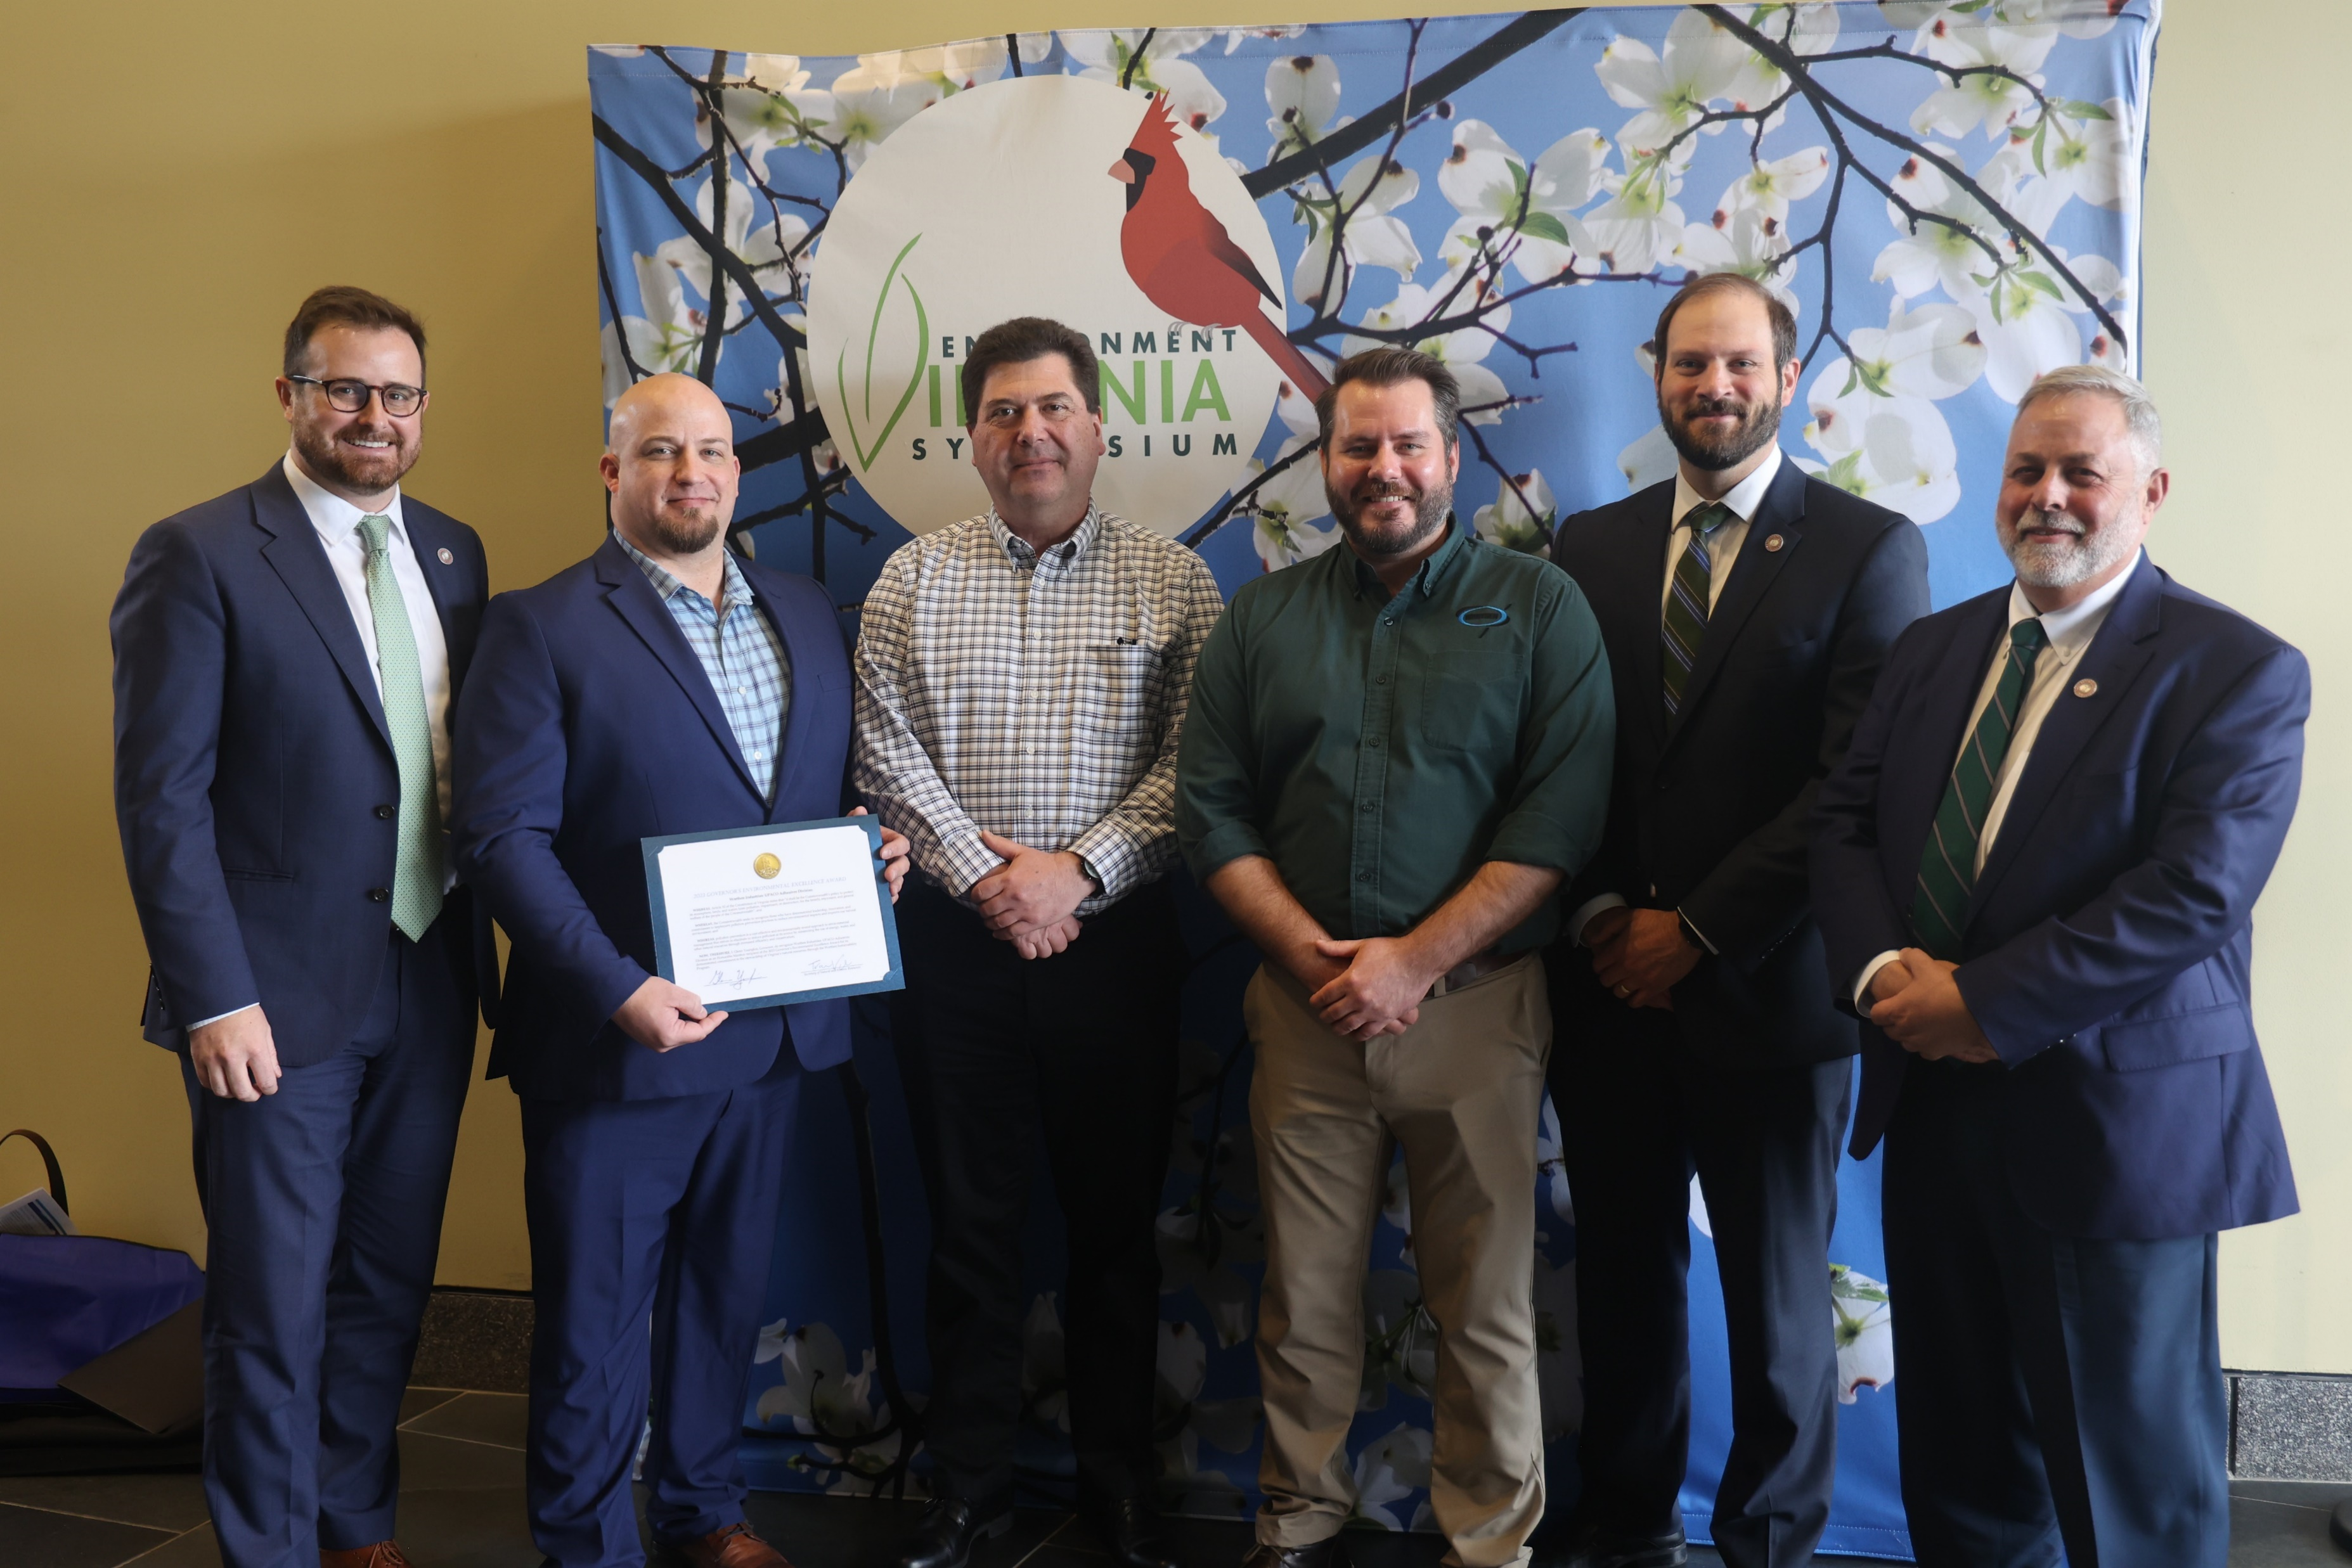
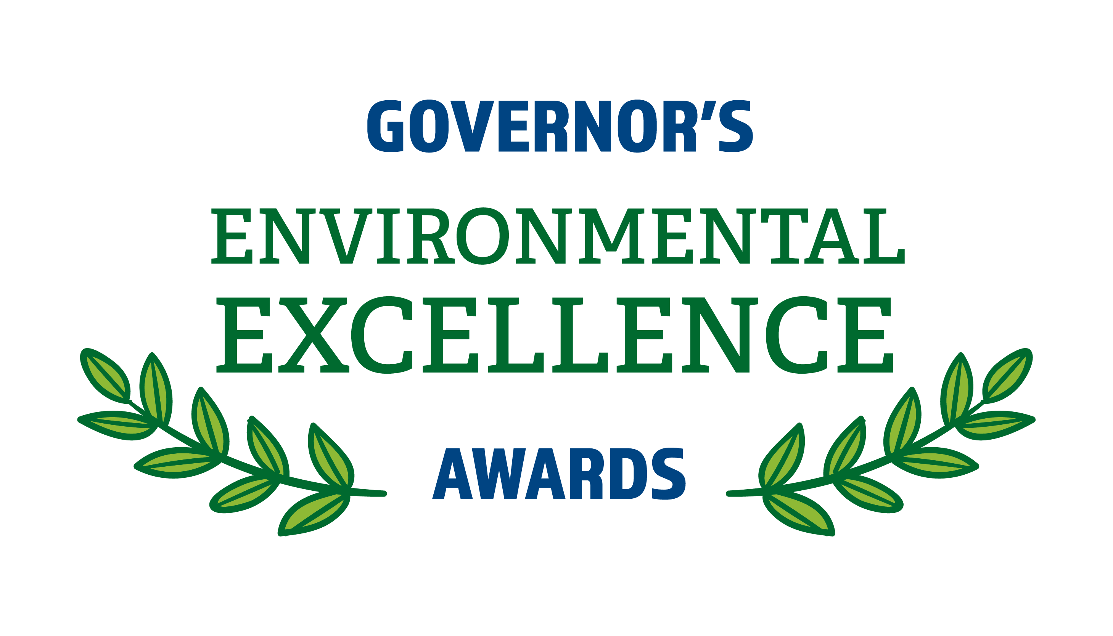
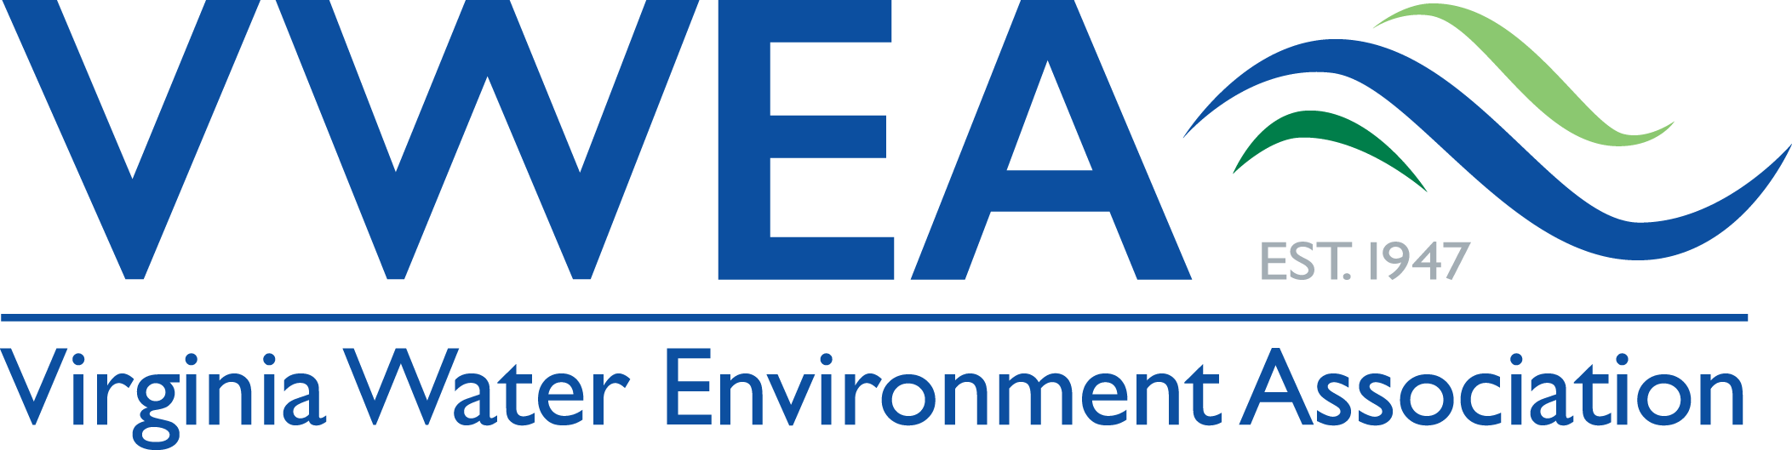
Pollution Prevention - Site Recognition
Awards in 2022
Platinum Level Award from
VWEA for 12 years of clean
Water compliance.
GEEA for Sustainability &
Pollution Prevention
Programs.
Notes:
Dave: In 2022, our efforts were formally recognized with several prestigious awards. The Virginia Water Environment Association honored us for 12 years of compliance, a testament to our sustained commitment to water quality. We also received an Honorable Mention for the Virginia Governor’s Environmental Excellence Award, recognizing our Sustainability Program and Pollution Prevention initiatives. These accolades reinforce the hard work of our team and our focus on making a lasting positive impact on the environment.
Looking forward, we are committed to further strengthening our environmental initiatives. Our goals include continuing to improve energy efficiency, conserve resources, and reduce waste through innovative technologies and proactive practices. At the heart of this effort is our commitment to transparency, accountability, and collaboration with stakeholders and regulatory agencies. As we continue to lead by example, we will ensure that our environmental strategy remains aligned with our long-term vision of sustainability.

Slide 9
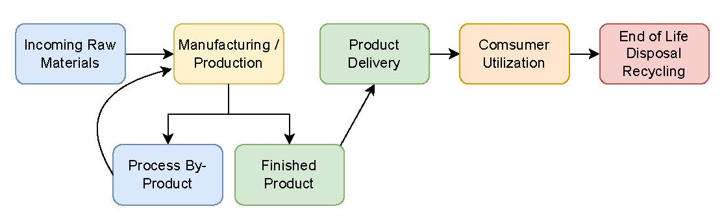
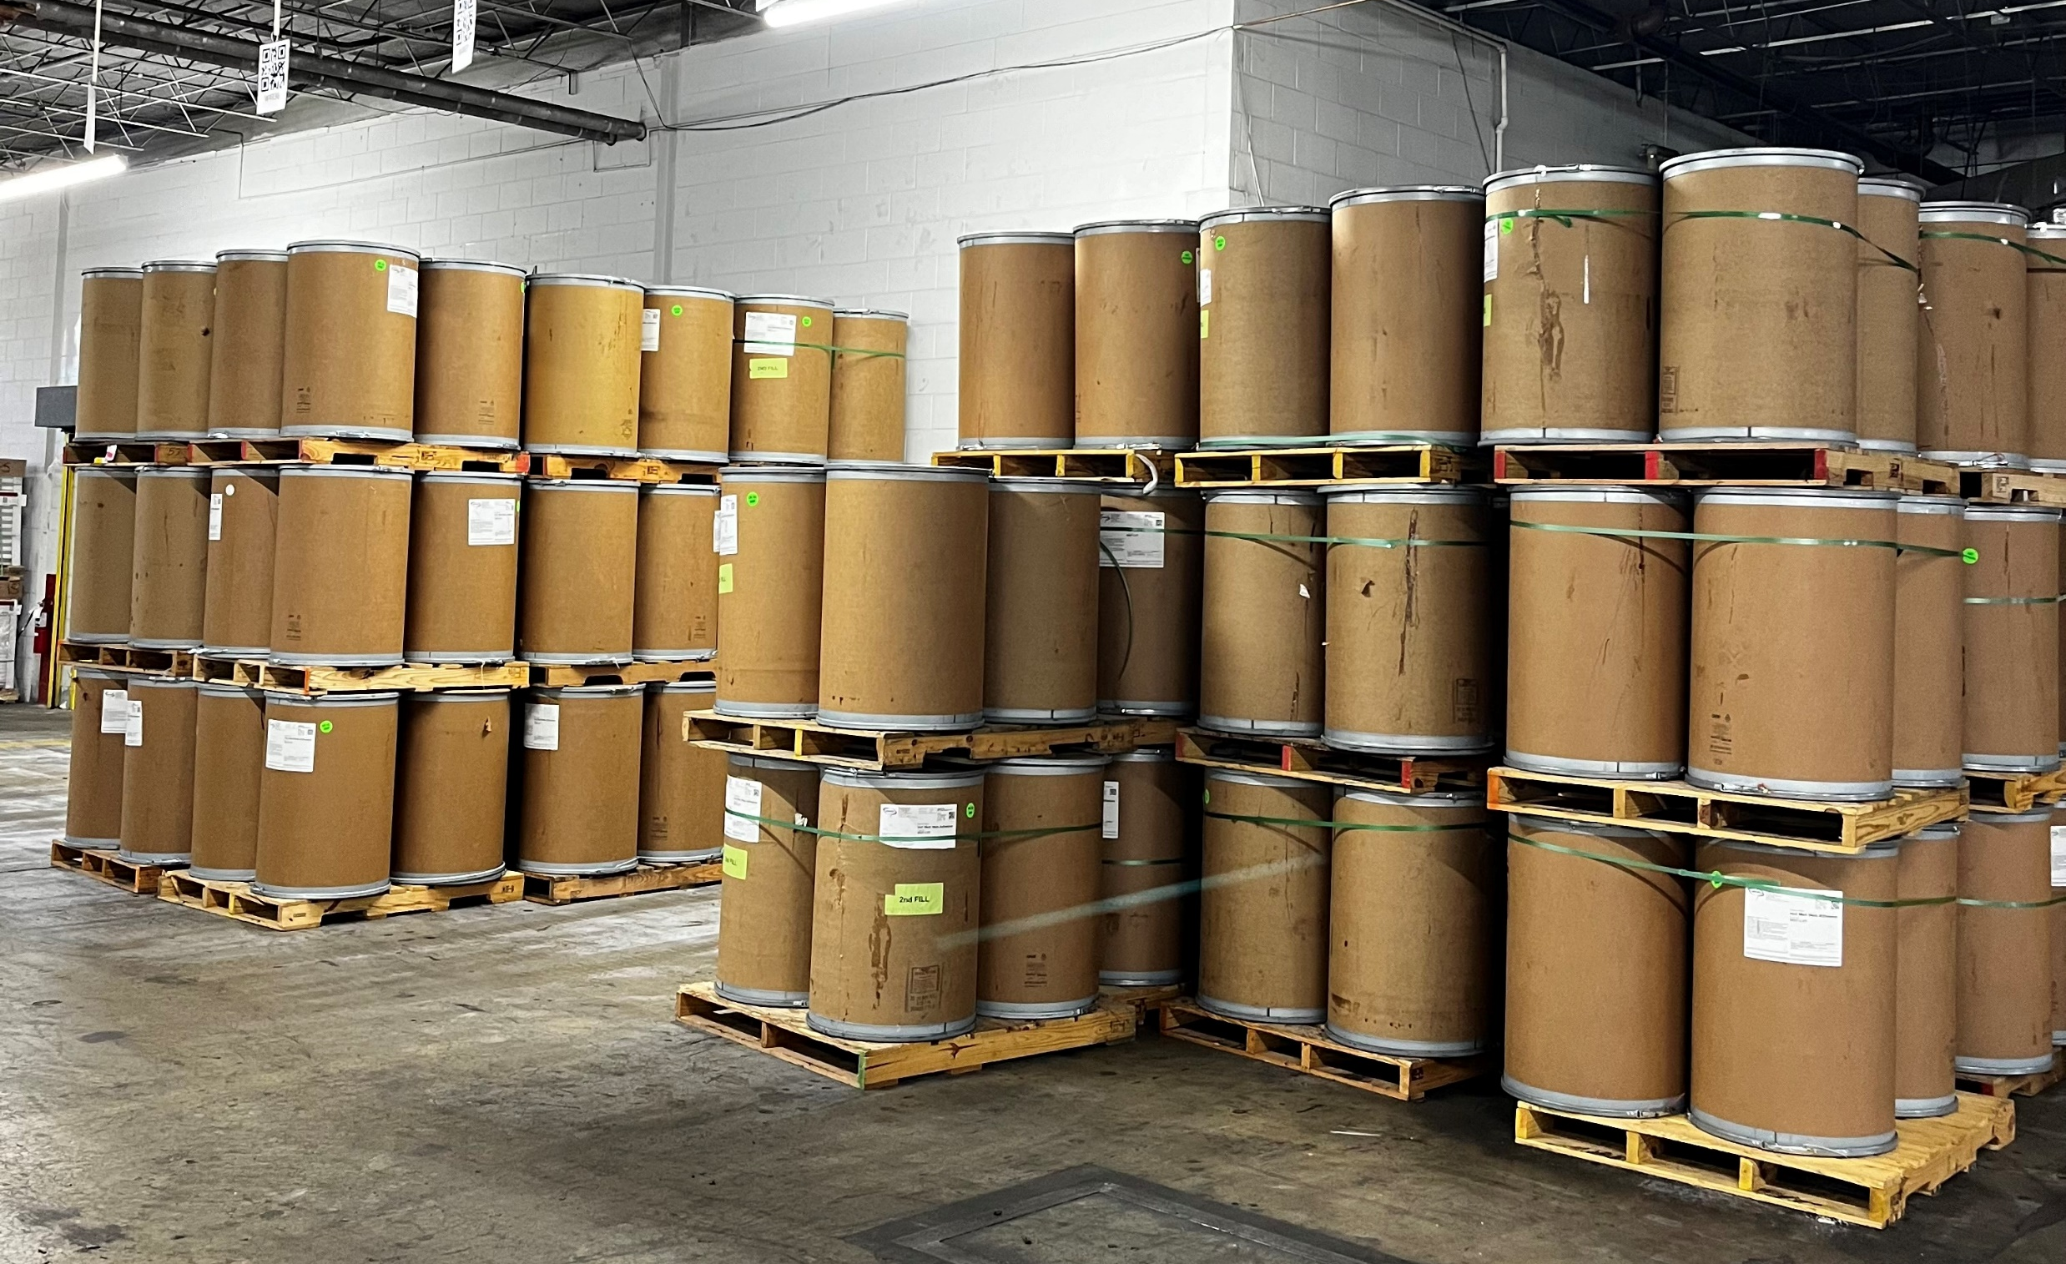
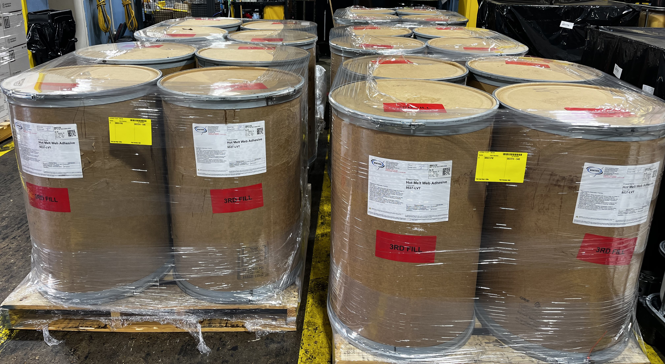
Pollution Prevention – Waste Reduction
Utilize like-chemistry to reduce process waste
Developing methods to safely and effectively reuse single-use containers
Notes:
Dave: A major focus of our Pollution prevention efforts is centered on strategic process improvements that reduce by-product generation and minimize waste at the source. One of the key initiatives involves the reuse of process wash materials, which were traditionally discarded. By utilizing like-product chemistry, these materials are now reutilized back into production, conserving resources, reducing disposal needs, and lowering overall environmental impact. This not only enhances efficiency but also supports our broader sustainability objectives by cutting down on chemical and water usage.
Another area of focus is optimizing the use of packaging containers. Through the development of improved handling and filling processes, we have significantly increased the reuse and lifecycle of packaging materials. By extending the utility of each container, we minimize the volume of single-use materials entering the waste stream. This initiative supports material conservation and reduces the environmental footprint of our packaging operations, aligning with our commitment to sustainable resource management.
In parallel, we have adopted a comprehensive approach to responsible waste management, emphasizing diversion of process waste from landfills. Non-reusable waste is sent to certified waste-to-energy facilities, where it is safely converted into usable energy rather than contributing to landfill volume. This practice plays a critical role in our commitment to achieving a zero-landfill goal. By integrating these pollution prevention strategies across our operations, we continue to move closer to a circular model of production that prioritizes resource efficiency and environmental responsibility.

Slide 10
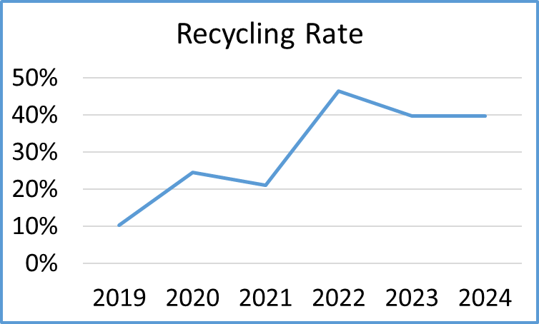
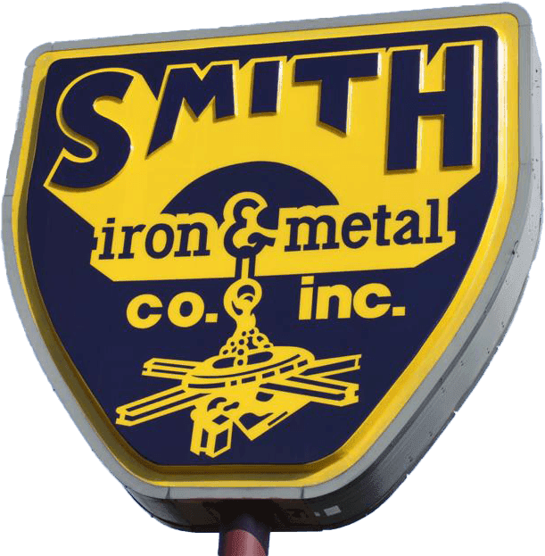

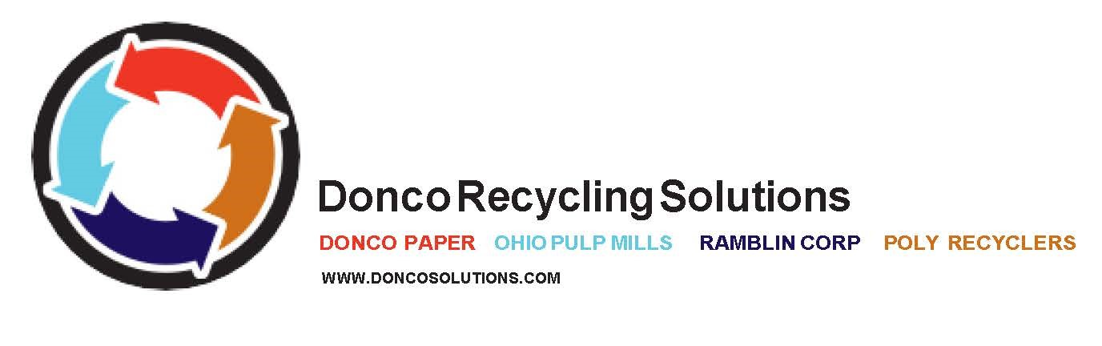
Pollution Prevention – Recycling Partnerships
Recycling Partnerships for
Plastic Films
Scrap Metal
Off-Spec Products
Notes:
Dave: As part of our ongoing commitment to pollution prevention and sustainability, we have expanded our waste minimization efforts through strategic recycling partnerships with industry-leading organizations. These collaborations allow us to responsibly divert waste materials from landfills and reintroduce them into the production cycle, furthering our goal of achieving a circular economy. By identifying valuable waste streams and aligning with capable recycling partners, we are maximizing resource recovery and minimizing environmental impact.
One key partnership is with International Paper, through which we recycle plastic films commonly used in packaging and shipping. These materials, once considered waste, are now collected and recycled, reducing the impact on local landfills. We also work closely with Smith Iron & Metal to manage and recycle scrap metal generated from our manufacturing processes. This ensures that valuable metals are recovered efficiently and redirected into the metal supply chain, conserving raw materials and energy.
Additionally, our collaboration with DONCO Recycling Solutions addresses the challenge of off-spec adhesives, which were previously difficult to repurpose. Through this partnership, these materials are now collected and processed into alternative fuel sources or components for industrial applications. Together, these recycling initiatives represent a critical part of our broader pollution prevention strategy, reinforcing our commitment to sustainable operations and responsible resource management.
These important partnerships have allowed for our organization to keep over 18 tons of plastic and 70 tons of metals out of our landfills, and for the repurposing of over 15 tons of off-spec adhesive.

Slide 11

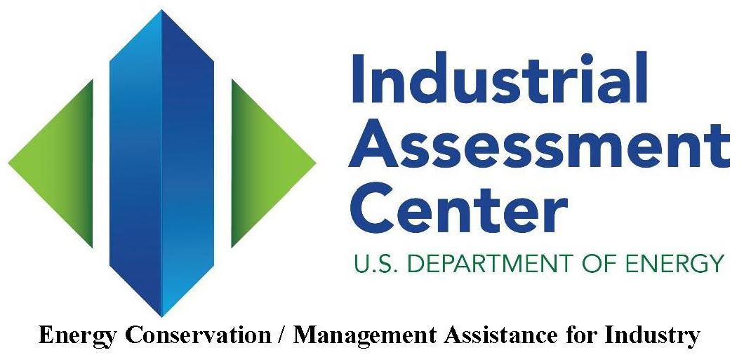

Pollution Prevention – Identifying Opportunities
2018 – Energy survey conducted by USDOE
through NCS
2024 – Building Efficiency Survey through
Dominion Power
Notes:
Dave: Identifying opportunities to reduce energy consumption has been a critical component of our sustainability strategy. To support this effort, we have utilized formal energy efficiency surveys to evaluate our operations and pinpoint areas for improvement. The first comprehensive energy survey was conducted in 2018 by North Carolina State University in partnership with the United States Department of Energy. This assessment provided valuable insight into our energy use patterns and outlined a series of actionable recommendations aimed at improving system efficiencies across our facility.
Building upon the findings from 2018, a second survey was completed in 2024 through Dominion Energy’s Energy Conservation Program. This assessment, conducted by Michaels Energy, offered a refreshed and in-depth analysis of our operations, considering recent technological advancements and evolving industry best practices. The survey emphasized both short- and long-term strategies for reducing energy consumption, including optimizing lighting systems, modernizing HVAC units, and implementing control systems that adjust power usage based on real-time demand.
These surveys have been instrumental in helping us identify and prioritize a wide range of energy reduction projects. From upgrading process equipment and replacing outdated support systems to improving building insulation and enhancing automation capabilities, we now have a clear roadmap for making strategic investments in energy efficiency. By implementing these improvements, we aim to reduce our environmental footprint, lower operational costs, and ensure long-term sustainability while continuing to meet the performance expectations of our customers.

Slide 12
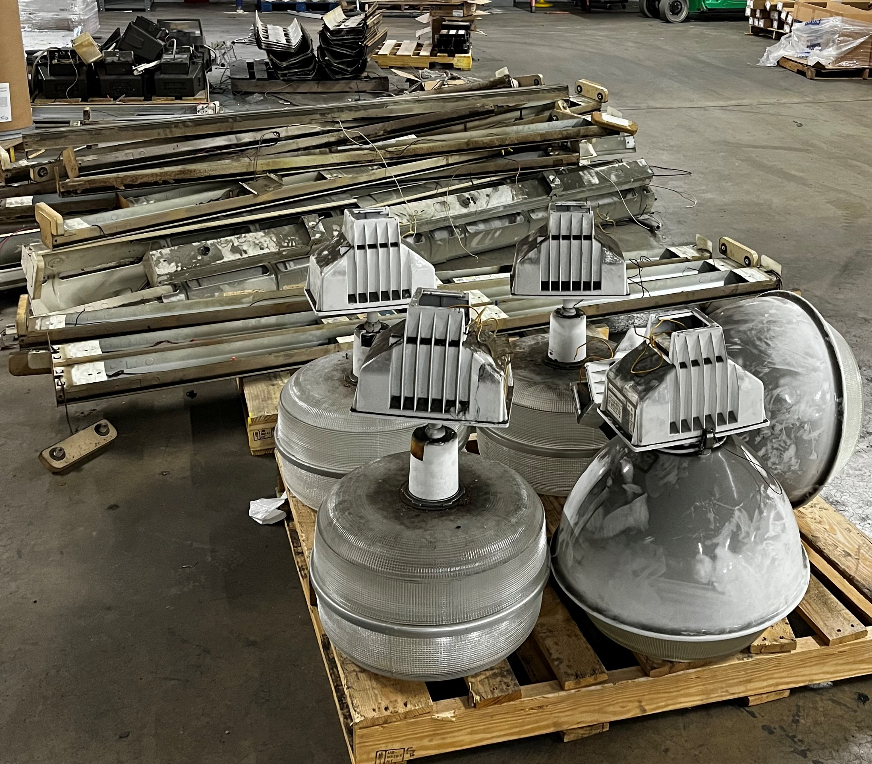
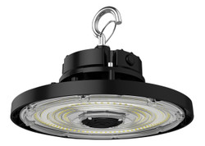
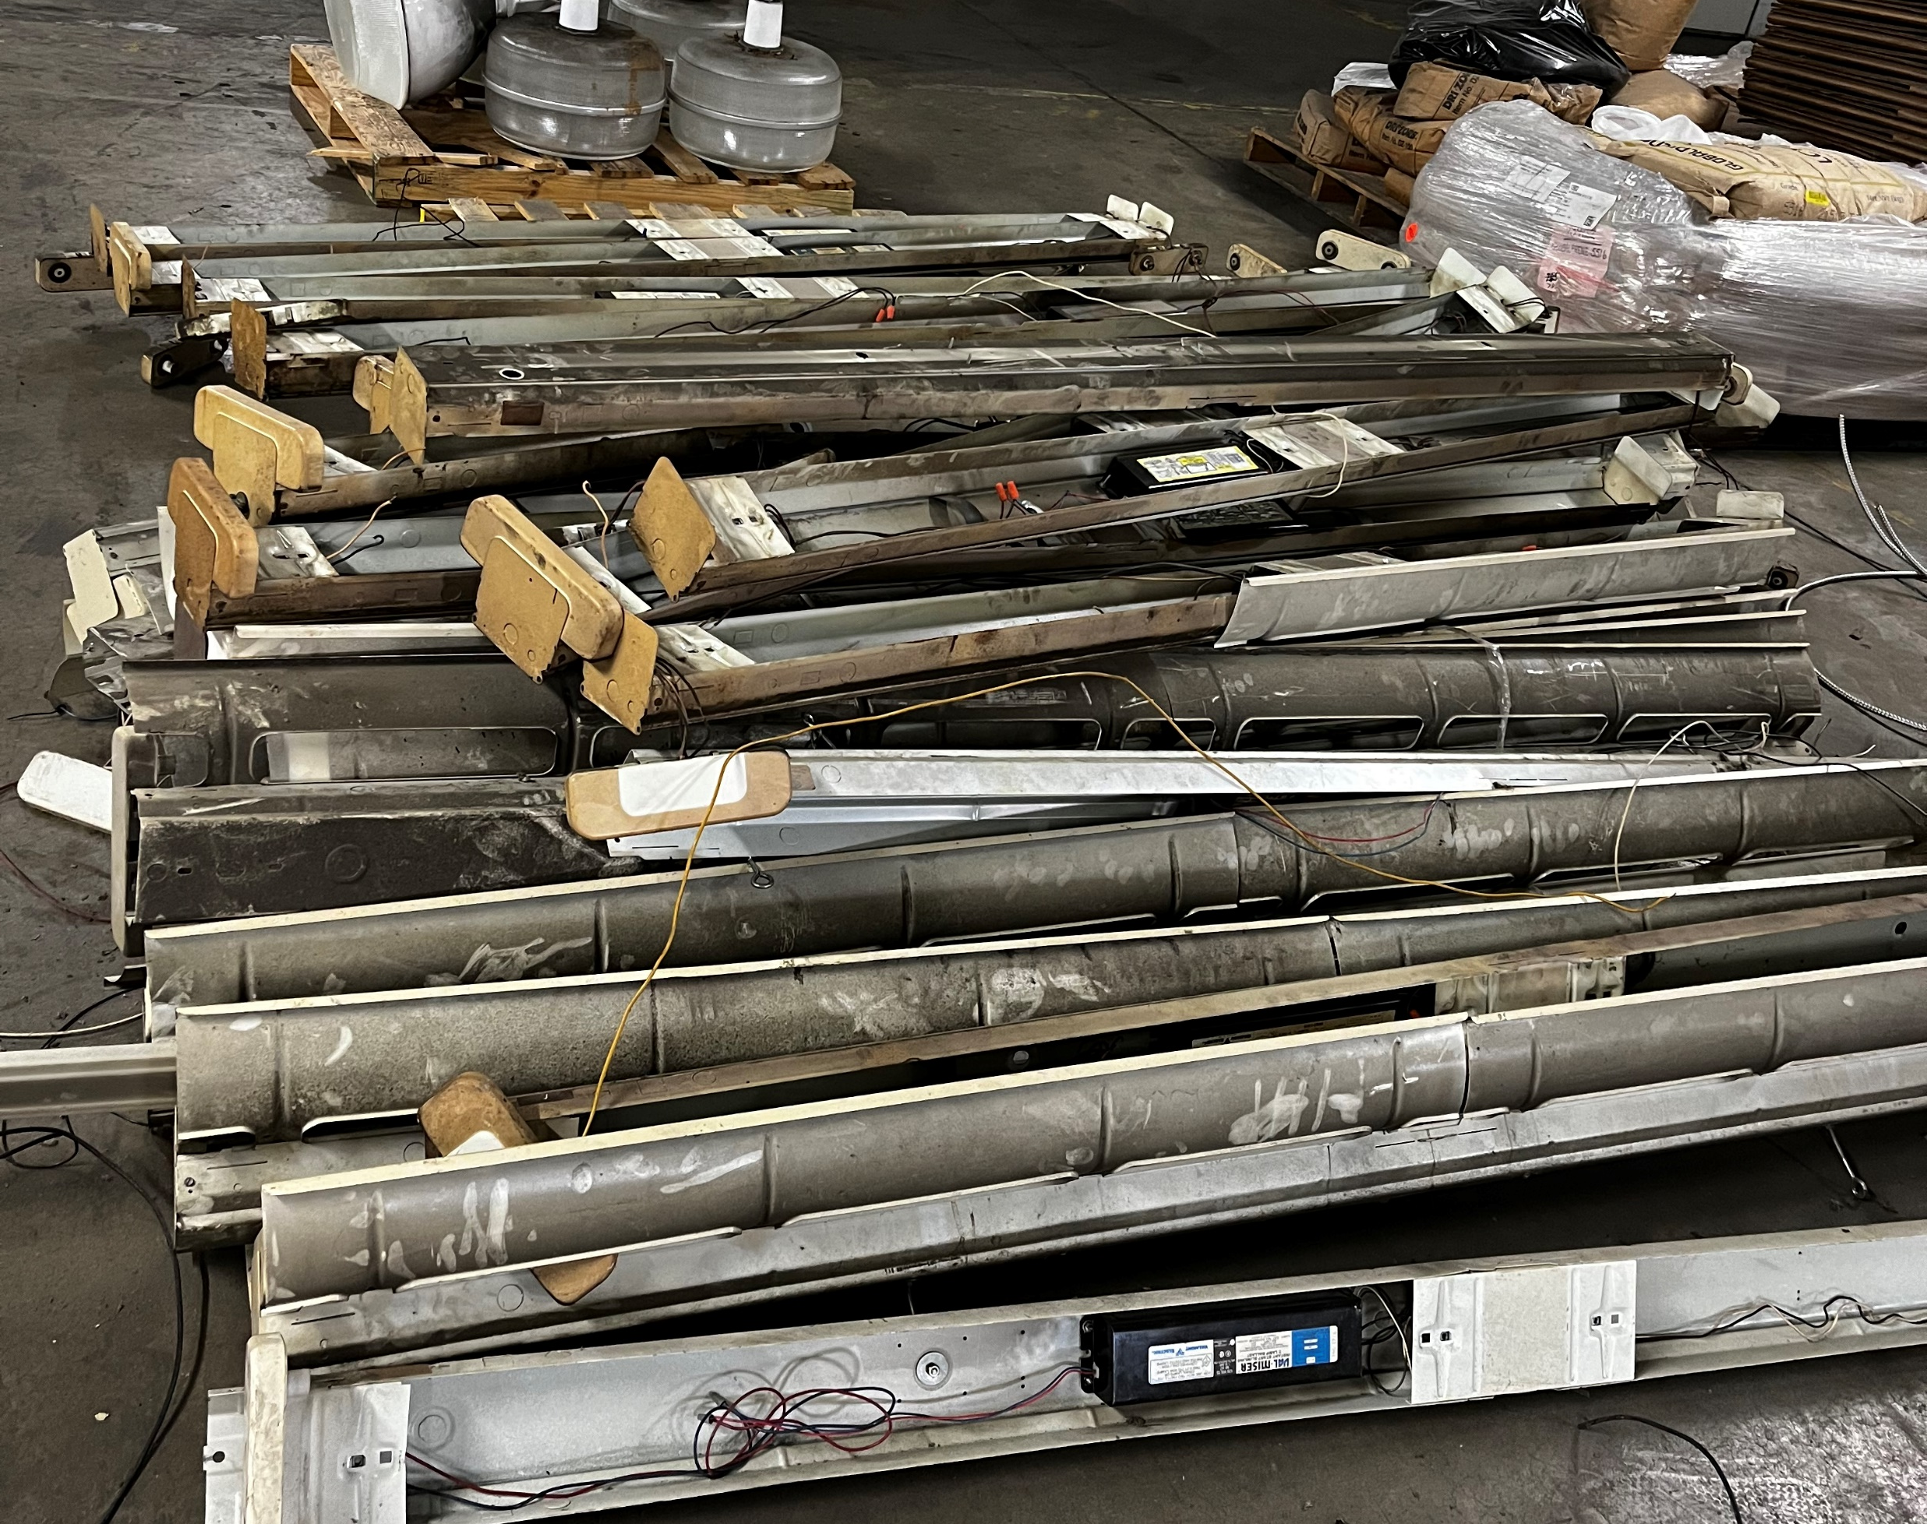

Pollution Prevention – Energy Efficiency
Facility Upgrades:
Fluorescent to LED
Photo Sensors
Motion Sensors
Notes:
Dave: A component of our commitment to pollution prevention is energy efficiency. We have undertaken a comprehensive facilities upgrade with a lighting fixture replacement. This initiative involved replacing over 380 outdated fluorescent lighting fixtures with high-efficiency LED fixtures throughout both the interior and exterior of the building. This lighting system was integrated with photo and motion sensors to minimize the usage when not needed, thus further minimizing energy consumption.

Slide 13
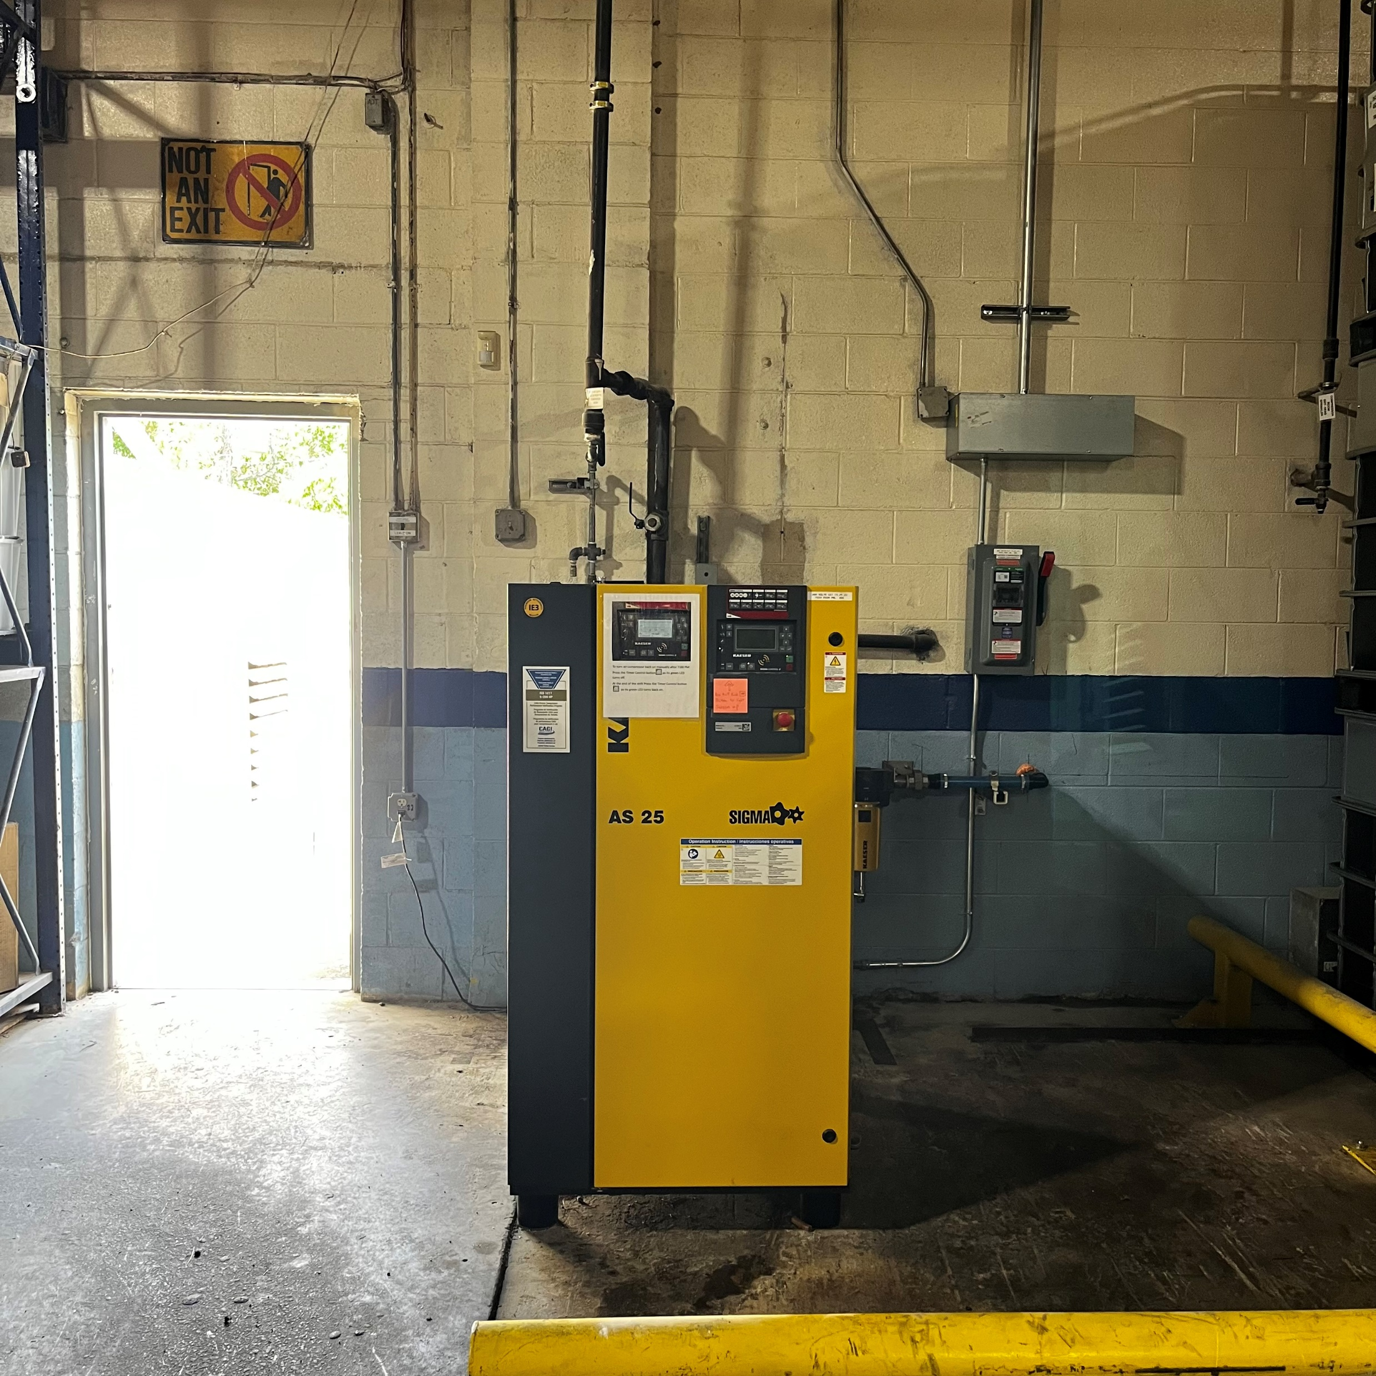
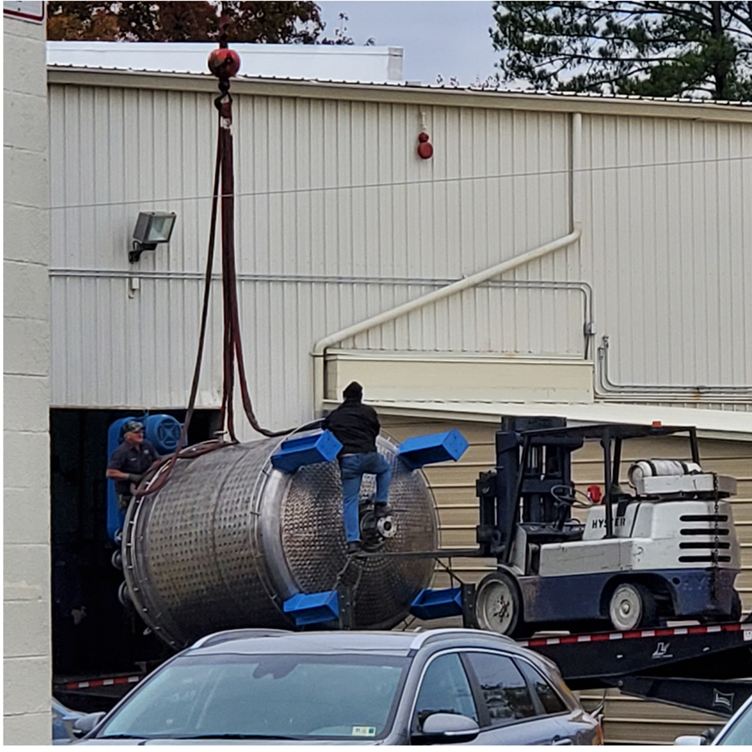
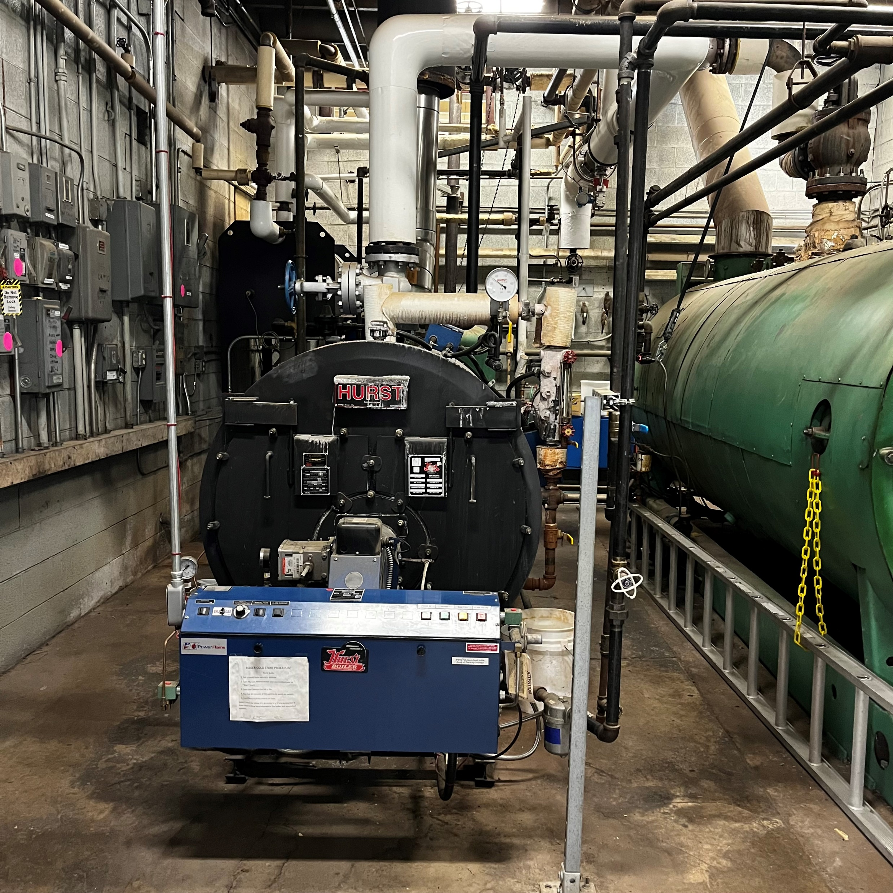
Pollution Prevention – Energy Efficiency
Upgrades to process equipment allows for greater production capacity
while using less energy
2024 – Compressor Upgrade
2021 – Mixing Vessel Upgrade
2019 – Boiler Upgrade
Notes:
Dave: Additional energy efficiency initiatives our organization has been making are significant investments in energy-efficient process equipment to reduce overall energy consumption and environmental impact. Example of these key upgrades include replacing our original boiler and compressor, both having older 50-hp motors, with newer 25-horsepower units. These transitions not only minimize energy waste associated with oversizing but also enhances system performance and reduces greenhouse gas emissions associated with steam generation.
Another major advancement in our energy efficiency efforts is the installation of a new Cowles mixing vessel, which features a modern, energy-efficient motor. This upgrade has enabled us to increase production output while consuming less electricity, representing a significant improvement in process efficiency. By optimizing both the mechanical and operational aspects of the mixing process, we can meet customer demand more sustainably and support our broader pollution prevention and energy conservation goals.

Slide 14
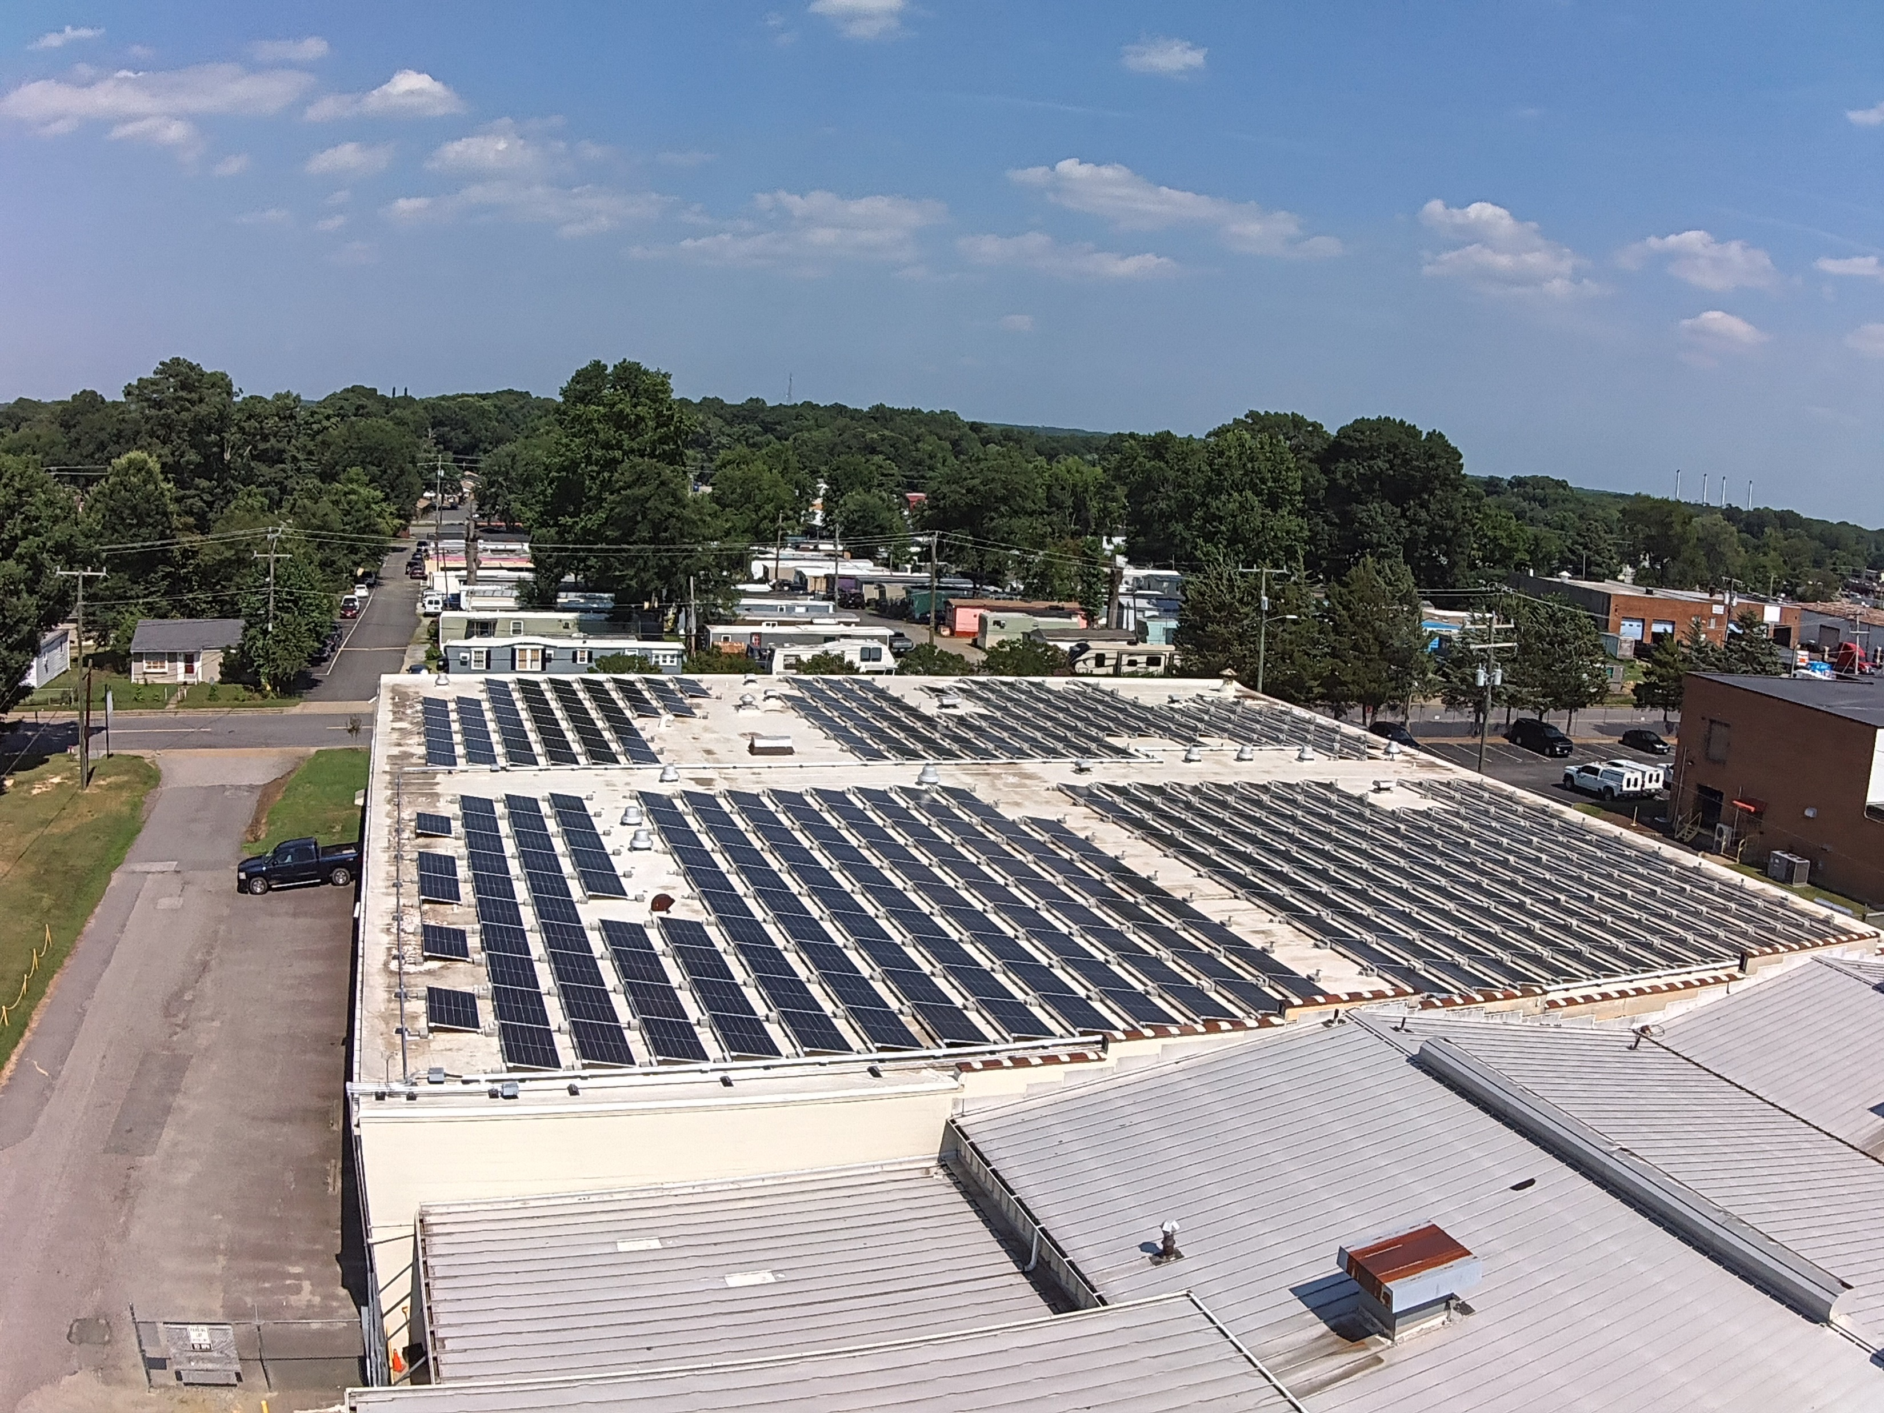
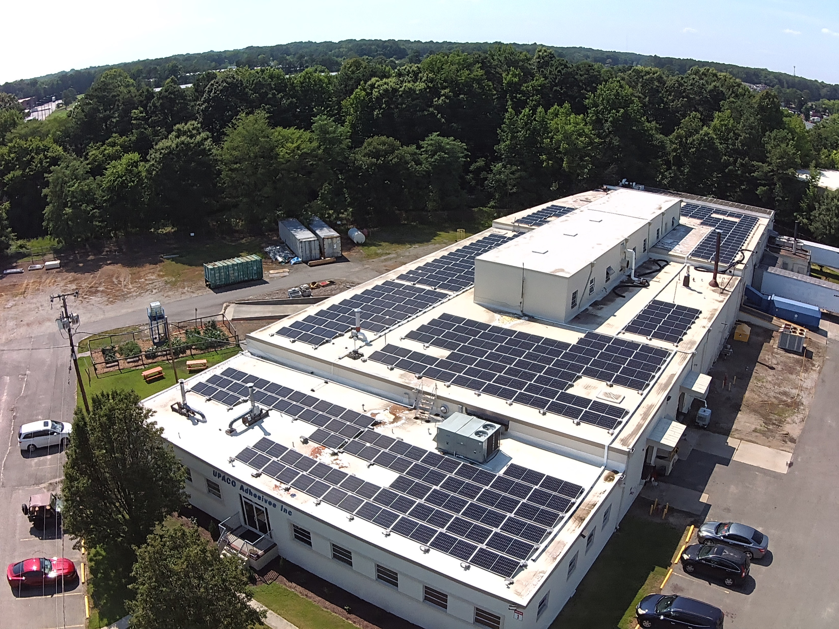
Pollution Prevention – Renewable Energy
Installation of 361 kW Solar Array with 683 panels
Estimated to provide ~70% of facility
power needs
Net metering to put excess power generated
back into the grid
Notes:
Dave: To further enhance sustainability and reduce reliance on nonrenewable energy sources, a solar array consisting of over 600 photovoltaic panels was recently installed and commissioned at our facility. This large-scale solar installation is strategically positioned to maximize sunlight exposure and is designed to generate enough electricity to meet approximately 60 to 70 percent of the facility’s total energy requirements. The project included comprehensive planning, structural assessments, electrical integration, and final commissioning to ensure optimal performance and long-term reliability.
The system is equipped with net metering capabilities, allowing excess power generated during periods of low demand to be fed back into the local power grid. This not only increases the overall efficiency of the system but also provides environmental and economic benefits by offsetting fossil fuel-based energy consumption. By leveraging solar power and contributing clean energy to the grid, the facility significantly reduces its carbon footprint and energy costs, supporting long-term goals for pollution prevention and operational sustainability.

Slide 15
Pollution Prevention – In Summary
Pollution Prevention at Worthen Industries in Richmond,
Virginia accomplishments:
Waste Reduction
  Process efficiency, material use, recycling partnerships
Energy Efficiency
  Equipment and facilities upgrades
Renewable Energy
  Net metering solar power
Looking to the future…
Notes:
Dave: Our pollution prevention efforts reflect a comprehensive approach to sustainability, focusing on waste reduction, energy efficiency, and the integration of renewable energy. By minimizing waste through material reuse, improved process management, and container recycling, we significantly reduce our environmental footprint. Energy efficiency initiatives, including equipment upgrades and lighting improvements, further enhance our operational sustainability while lowering overall energy consumption. The addition of a solar array to supplement our power needs with clean, renewable energy underscores our commitment to long-term environmental stewardship. Looking ahead, we remain dedicated to continuous improvement by regularly evaluating our operations, pursuing new technologies, and identifying additional opportunities to reduce our environmental impact.

Slide 16
4105 Castlewood Rd.
Richmond, Va. 23234
(804) 275-9231
1-800-WORTHEN
dmarshall@worthenind.com
Notes:
Thank you for your time.

