Slide 1
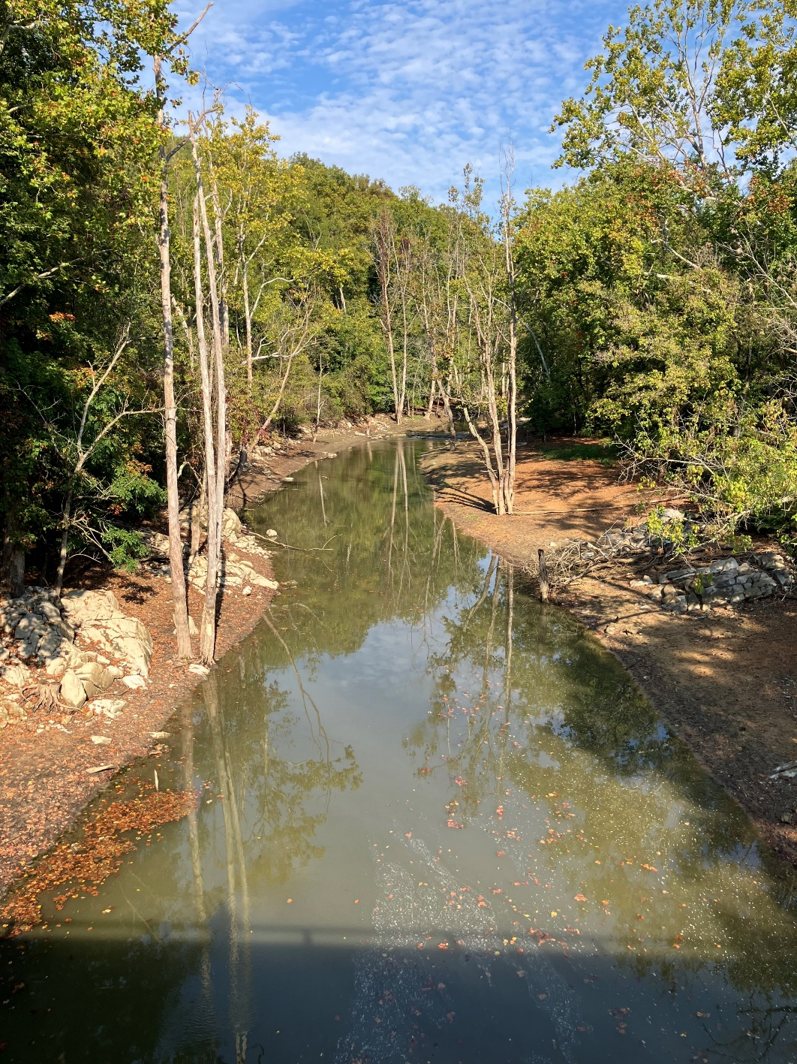
Wolf Creek Watershed
Clean Up Study
Second Community Engagement Meeting
Landon Jenkins
TMDL Coordinator, SWRO Regional Office
June 25, 2025

Slide 2
Goals for our meeting
Share what we know about Wolf creek:
Summarize monitoring data, discuss pollutants
Explain the process of developing a watershed model
Explain how goals are set for reducing pollutants
Answer your questions about this effort

Slide 3
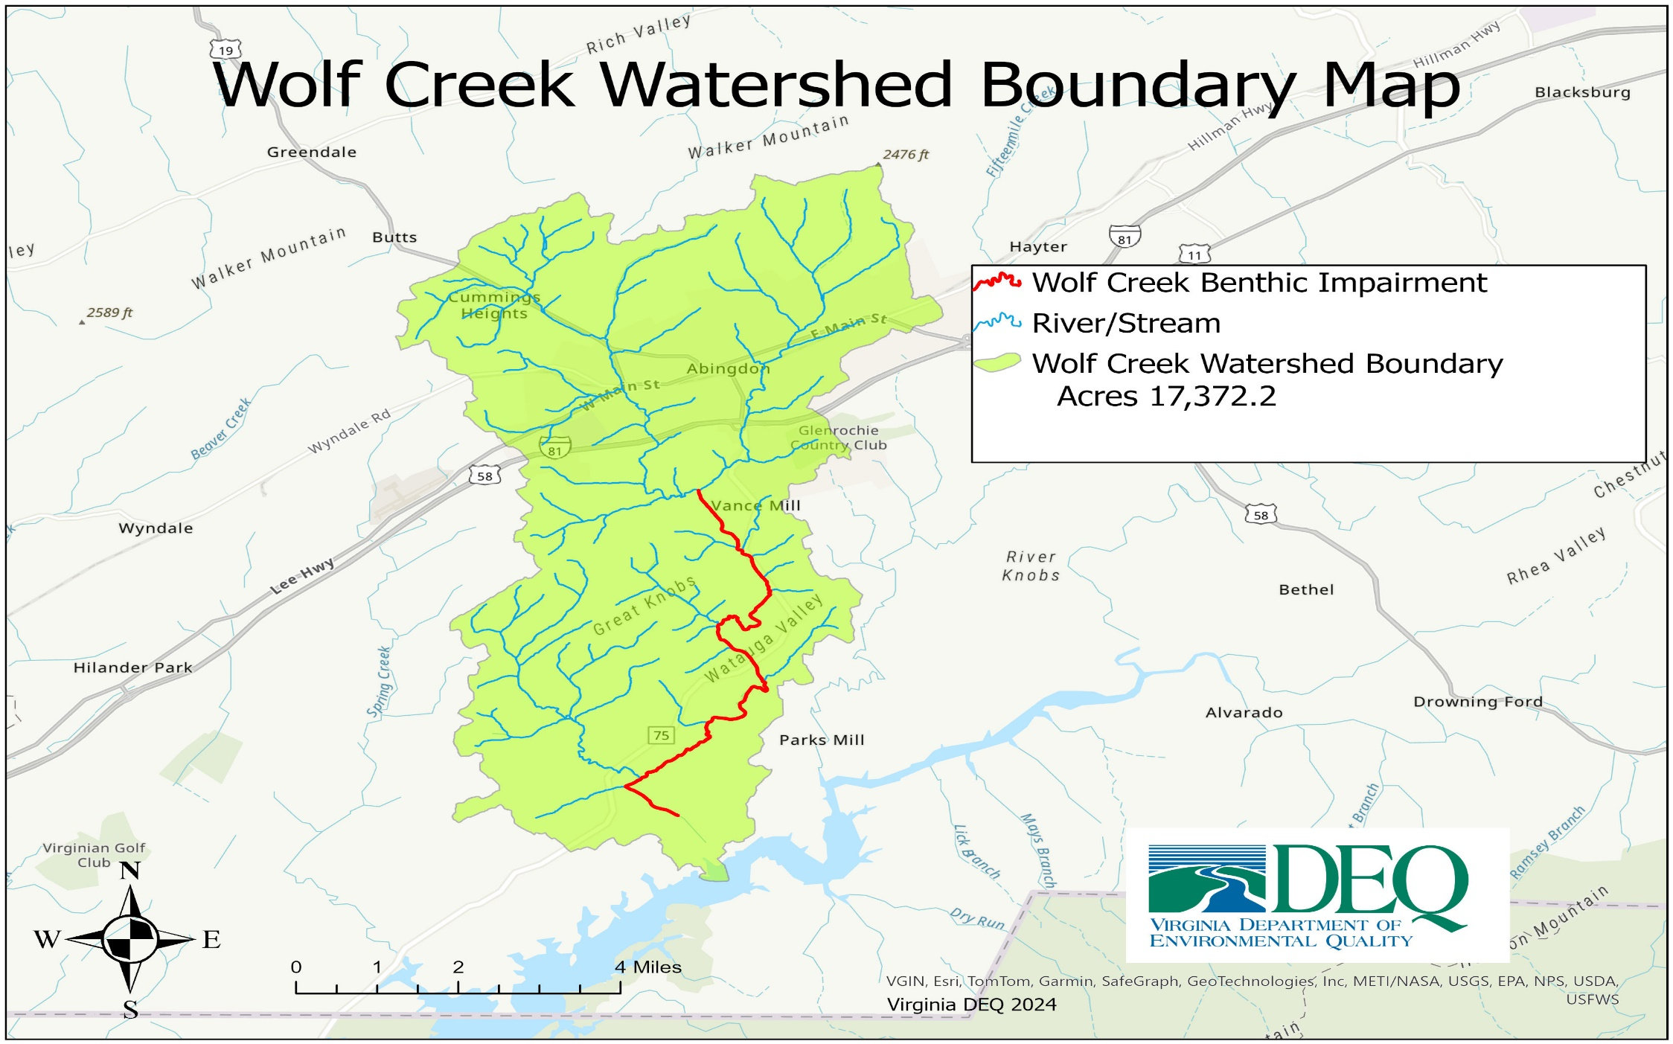

Slide 4
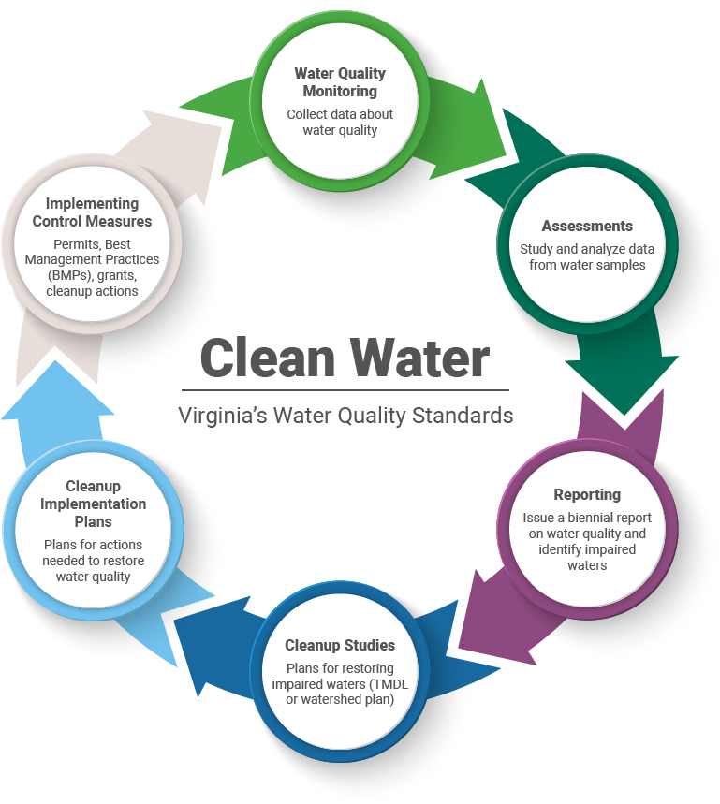

Slide 5

Why a study?
Photo: Jan Hamrsky: lifeinfreshwater.net
Water quality standards designate six uses for surface waters in Virginia. These include:
  Aquatic life
  Fish consumption
  Public water supplies (where applicable)
  Recreation (swimming)
  Shellfishing
  Wildlife

Slide 6
Aquatic Life Designated Use
What does this mean?
All waters should support “the propagation and growth of a balanced, indigenous population of aquatic life”
Benthic impairments, result from violations of the general standard narrative that “waters should be free from substances that are harmful to aquatic life”
Monitor benthic macroinvertebrates (the bugs on the stream bottom) to determine if the standard is met

Slide 7

Why should we care about bugs?
Consume algae and organic matter → nutrient cycling
Aquatic food chain
Our “canary in the coal mine”
Chemical monitoring =
a snapshot in time
  Long lived
  Relatively immobile

Slide 8

Determining a biological impairment
DEQ biological monitoring data (spring and fall)
VA Stream Condition Index is our barometer
  Diversity, pollution tolerance, feeding group
  Target score of ≥60

Slide 9

Sensitive to pollution: Mayflies
Sensitive to pollution: Mayflies
Photo: Jan Hamrsky: lifeinfreshwater.net

Slide 10

Caddisflies
Sensitive to pollution: Caddisflies
Photo: Jan Hamrsky: lifeinfreshwater.net

Slide 11
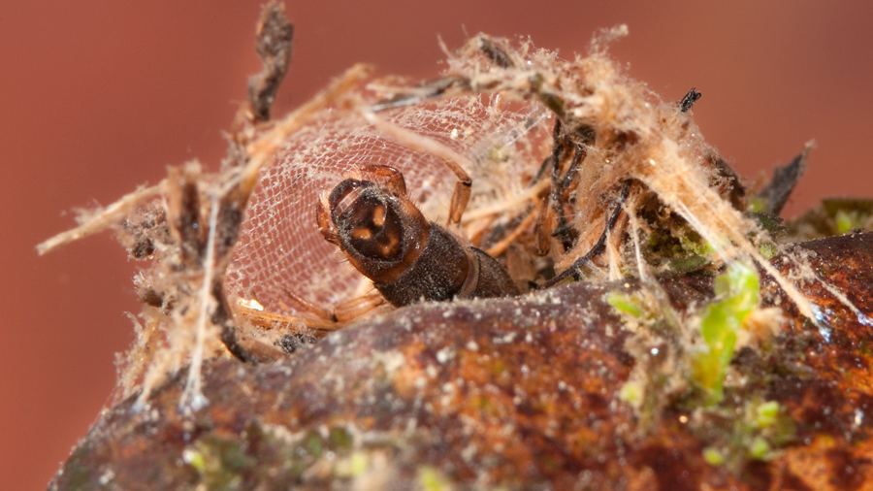
Net spinning caddisfly
Photo: Jan Hamrsky: lifeinfreshwater.net

Slide 12

Moderately Sensitive: Dragonflies
Photo: Jan Hamrsky: lifeinfreshwater.net

Slide 13

Insensitive to Pollution: Blackflies
Photo: Jan Hamrsky: lifeinfreshwater.net

Slide 14
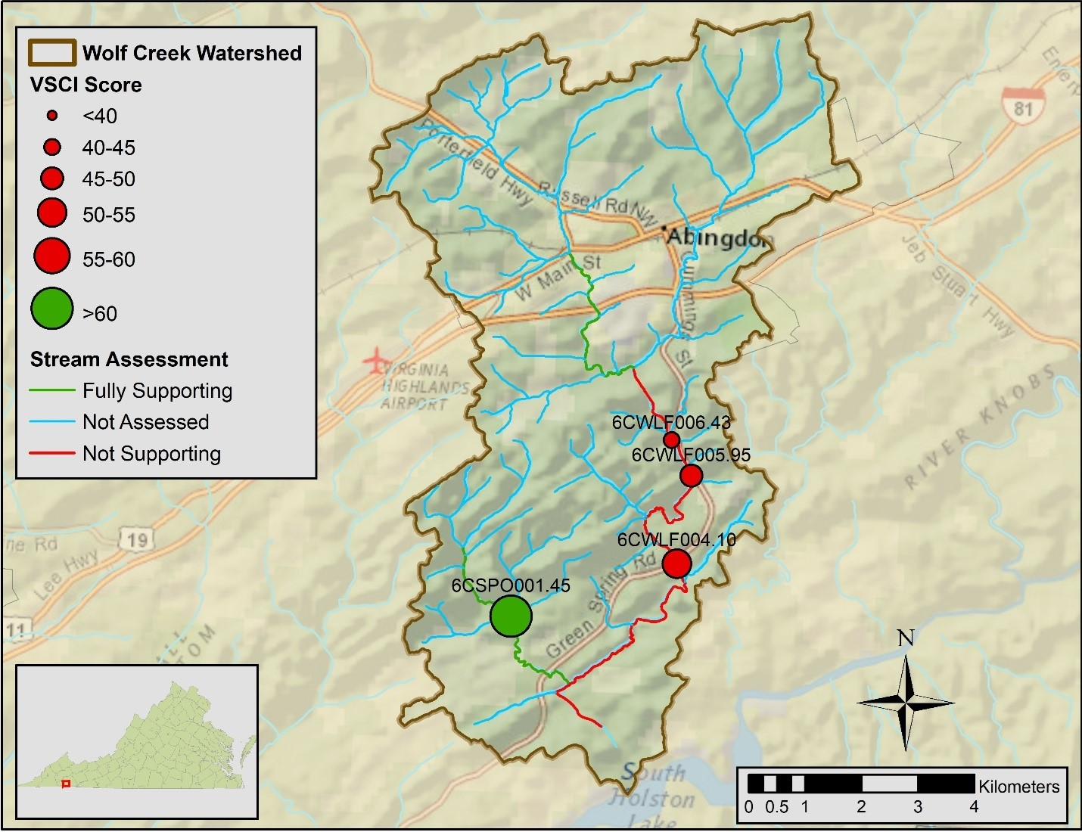
Wolf Creek Benthic Monitoring Stations
Notes:
Extrapolation, assumes due to no land changes the lower segment will also be impaired

Slide 15







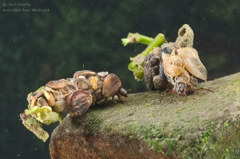
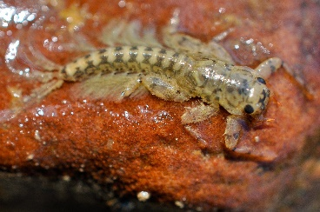
Virginia Stream Condition Index
60
40
20
Photos: Jan Hamrsky: lifeinfreshwater.net

Slide 16
The Benthic Stressor Analysis
The Virginia Department of Environmental Quality (VDEQ) contracted Wetland Studies and Solutions, Inc. and James Madison University (JMU) to conduct a stressor identification analysis for benthic impairments in Wolf Creek in Washington County, VA. Wolf Creek drains most of the Town of Abingdon, Virginia, flows south, and empties into South Holston Lake

Slide 17
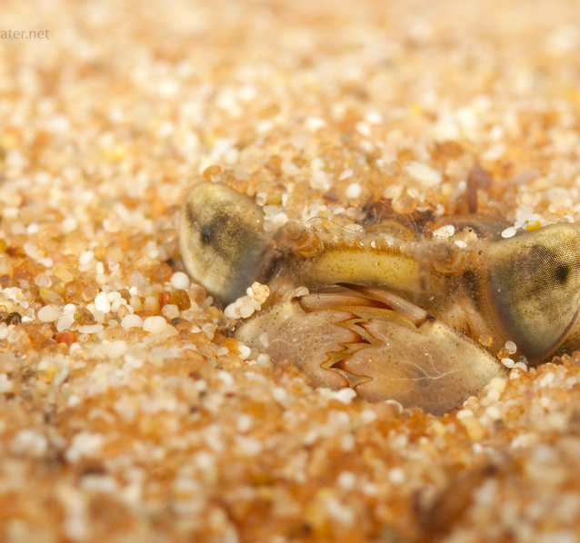
Biological Impairments
Determining the Cause…
How the benthic stressor analysis works
  Evaluation of monitoring data
  Comparison with healthy reference watershed data and stressor thresholds
  Weight of evidence approach-evaluates all data
  Identification of most likely stressor(s)
Photo: Jan Hamsky; www.lifeinfreshwater.net
Notes:
Weight of Evidence approach evaluates all available information on potential candidate stressors by listing potential candidate stressors identified from the listing information, monitoring data, scientific literature and historic information

Slide 18
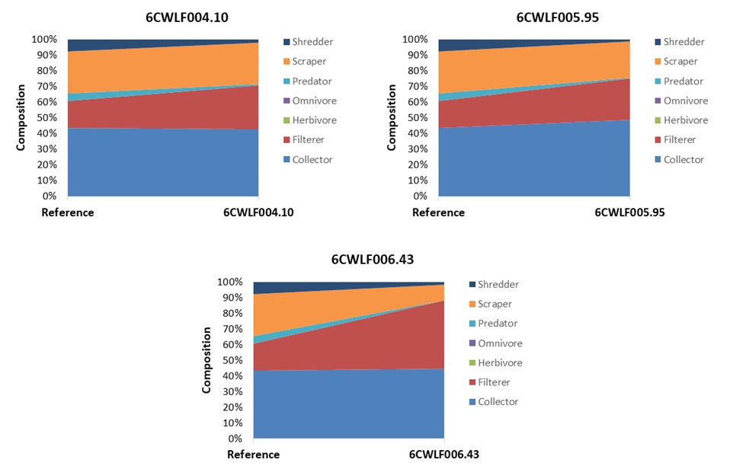
Evidence Of Sediment As A Stressor With an Increase in Filterers
Notes:
This shift in functional feeding group points to an increase in suspended sediment and organic matter. As particulate matter in the water column increases, more food is available for filtering organisms and that feeding niche expands

Slide 19






What is a TMDL?
A Total Maximum Daily Load is the maximum amount of a pollutant that a waterbody can receive and still meet water quality standards.

Slide 20
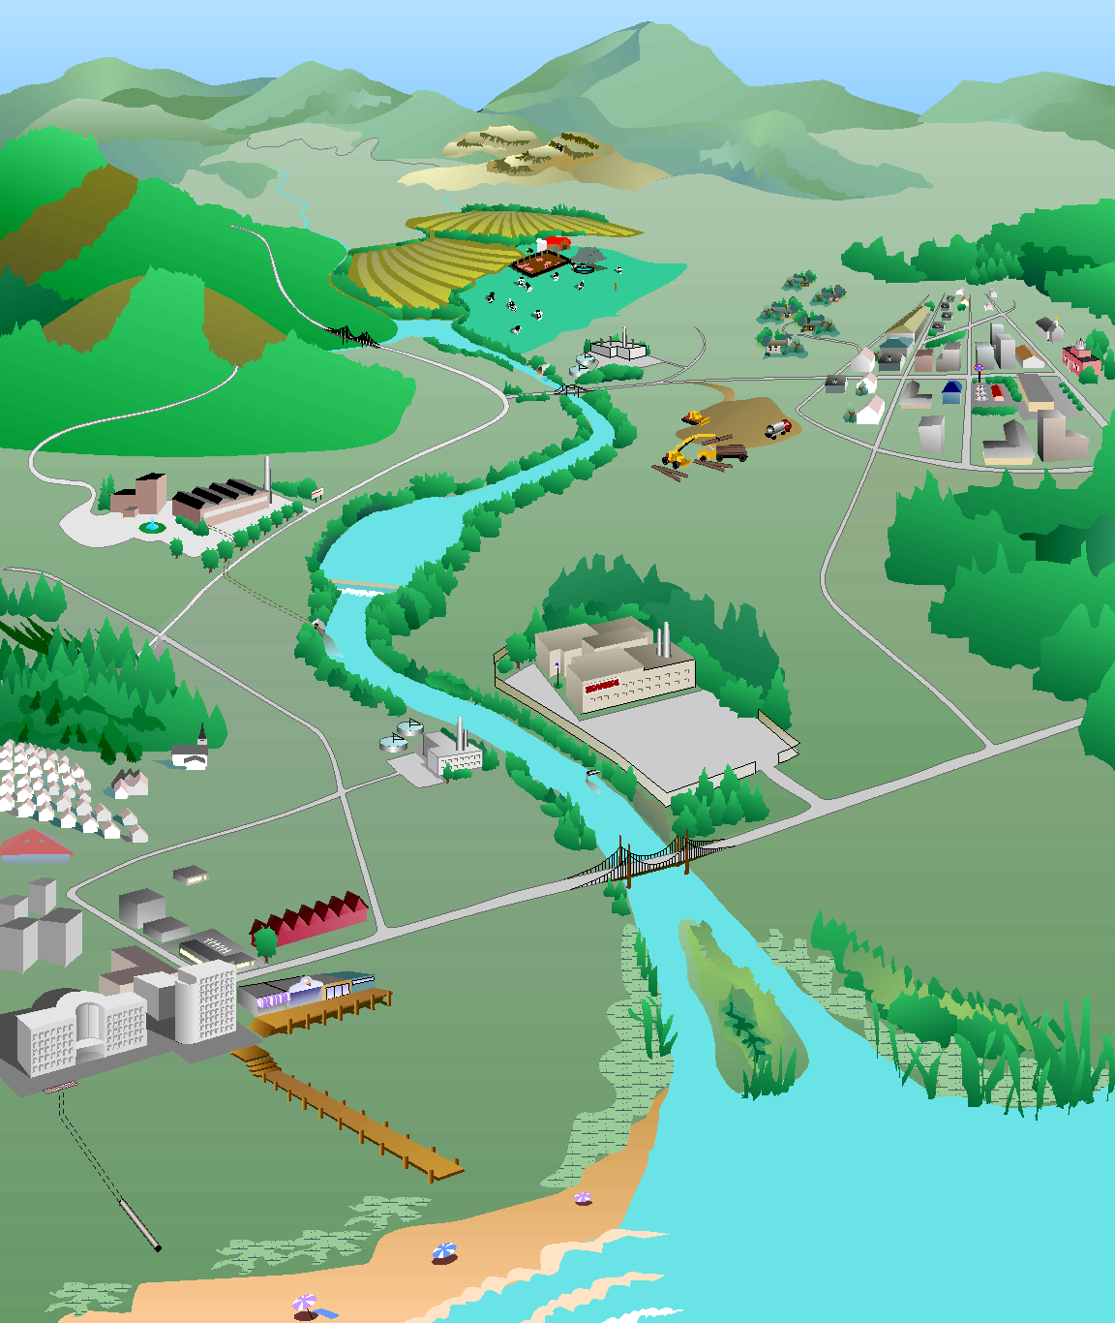
How do we develop a TMDL?
What’s the magic number…
Identify sources of sediment
Model their path to the stream
Determine reductions needed from each source to restore aquatic life
Forest:
0% reduction
Forest:
1 ton/yr
Cropland:
30% reduction
Cropland:
10 tons/yr
Residential:
50% reduction
Residential:
4 tons/yr
Pasture:
40% reduction
Pasture:
12 tons/yr
Urban:
75% reduction
Urban:
8 tons/yr
Impaired stream
Sediment load = 37 tons/yr
TMDL
Sediment load = 19 tons/yr
Point sources:
2 tons/yr
Point sources:
0% reduction
Diagram: Adapted from the Center for TMDL and Watershed Studies at Virginia Tech

Slide 21
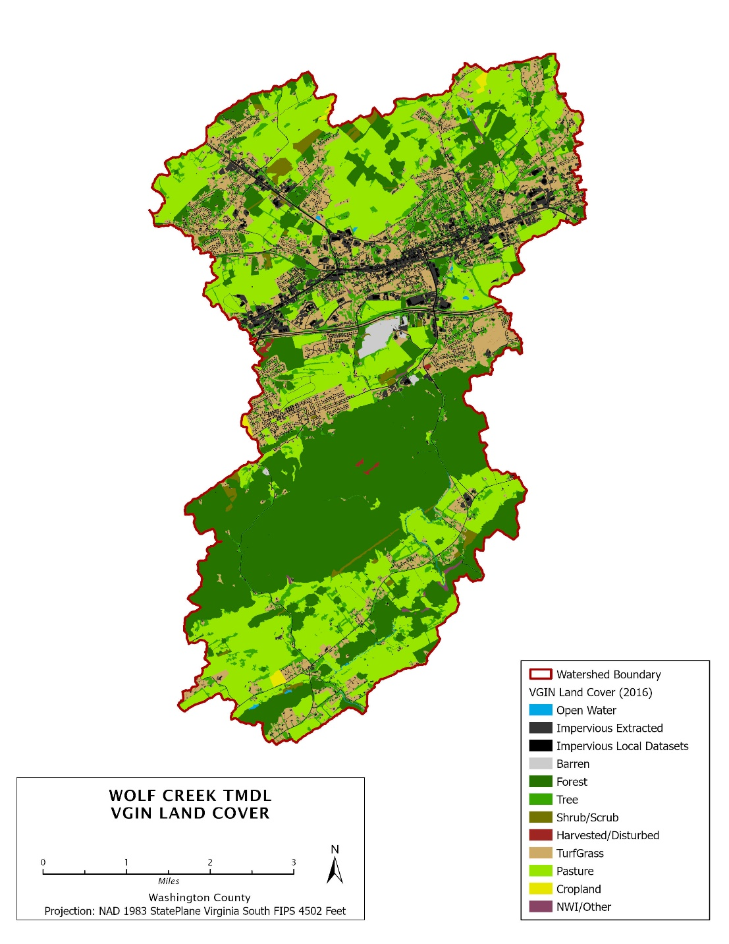
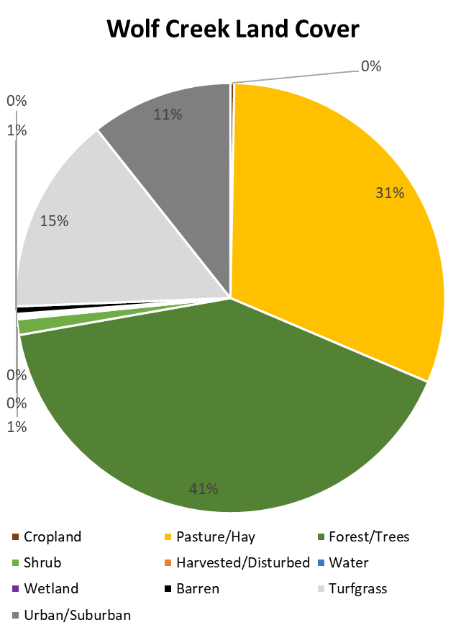
Land Cover Wolf Creek
Land Cover Category | Wolf Creek Watershed
 | Acres | %
Cropland | 48 | 0.3%
Hay | 2198 | 13.2%
Pasture | 2994 | 17.9%
Forest | 5160 | 30.9%
Trees | 1661 | 10.0%
Shrub | 196 | 1.2%
Harvested/Disturbed | 17 | 0.1%
Water | 23 | 0.1%
Wetland | 28 | 0.2%
Barren | 93 | 0.6%
Turfgrass | 2495 | 14.9%
Developed, pervious | 329 | 2.0%
Developed, impervious | 1452 | 8.7%
Total | 16,696 | 100.0%
Notes:
78.69 acres are barren which appears to be a quarry so it has been removed from the landcover to help account for it being in a permit

Slide 22
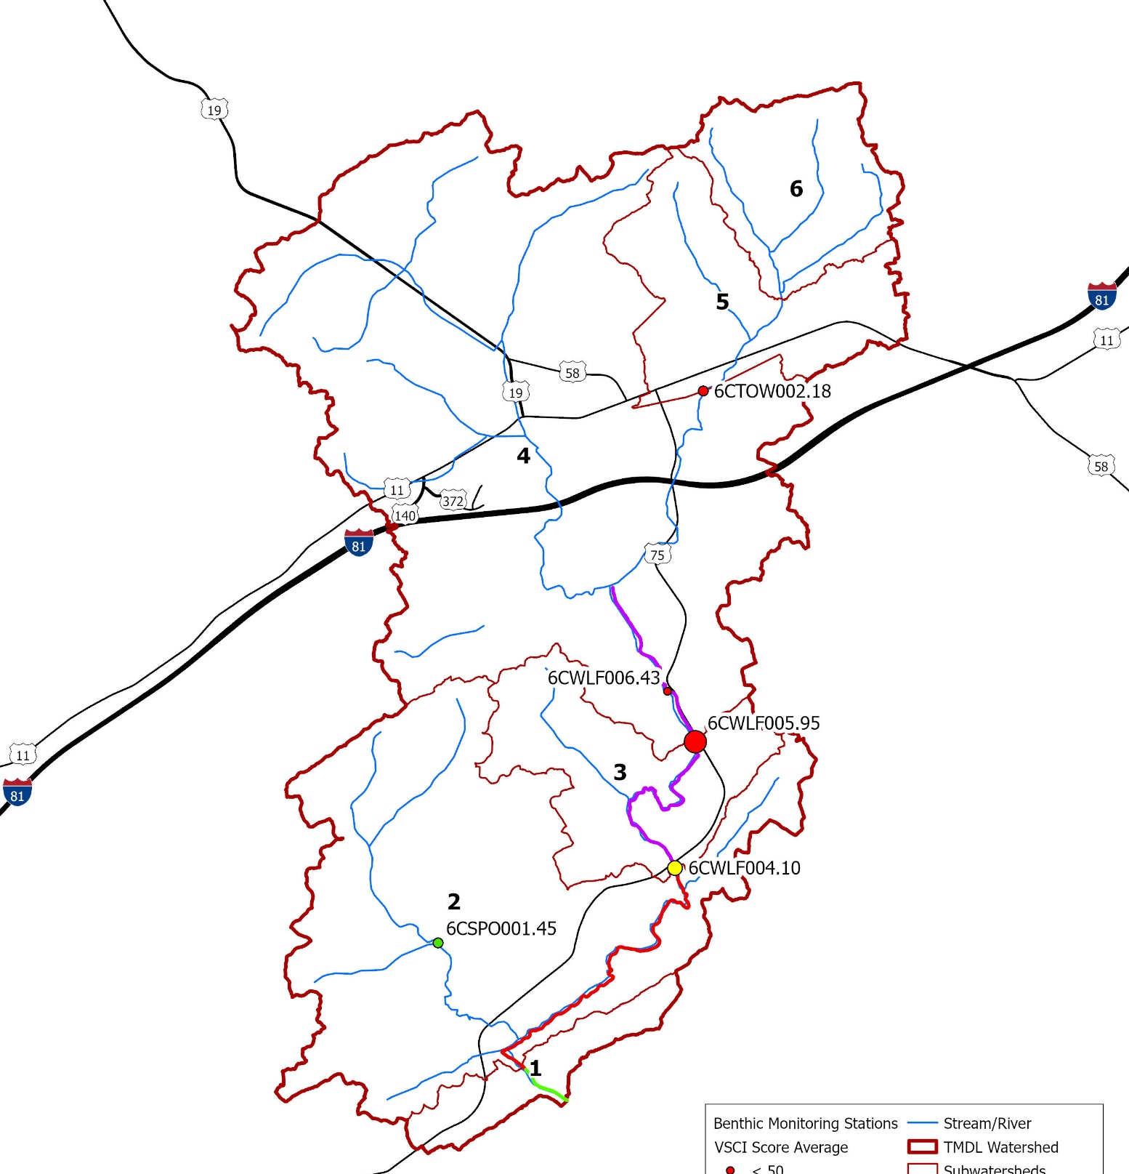

Upper Wolf Creek
Lower Wolf Creek

Slide 23
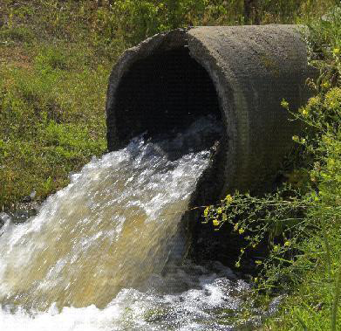
Identify point sources
Permitted dischargers
  Variety of permits spread across the Wolf Creek Watershed
Permit Type | Number of Permits
VPDES IP | 1
VPDES ISW | 1
VPDES Concrete | 1
PWTP | 1
Domestic Sewer | 3
NMMM | 1

Slide 24
Update Since Last Meeting:
Point Sources
MS4 Permits
Construction General Permits

Slide 25
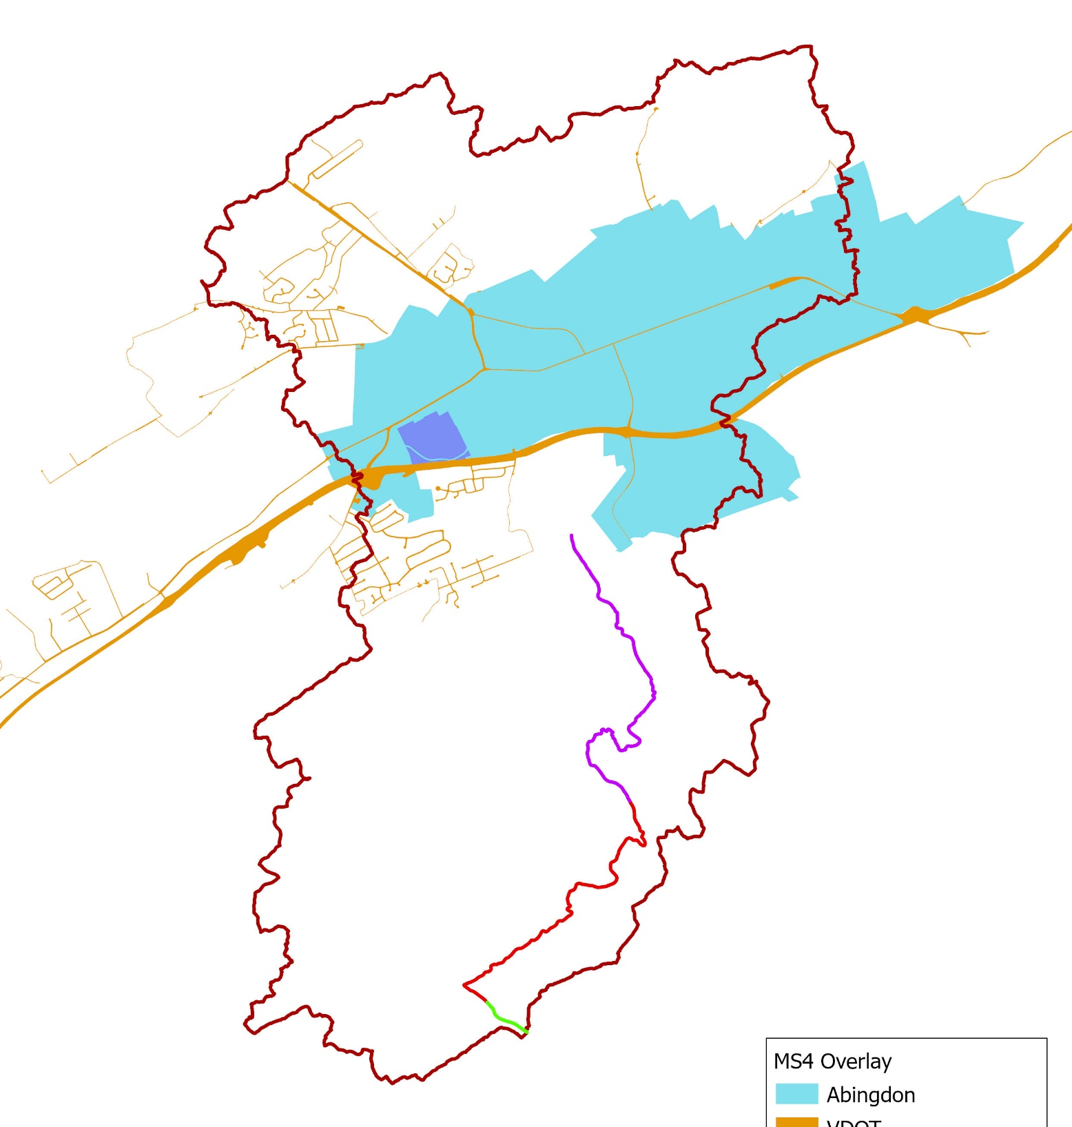
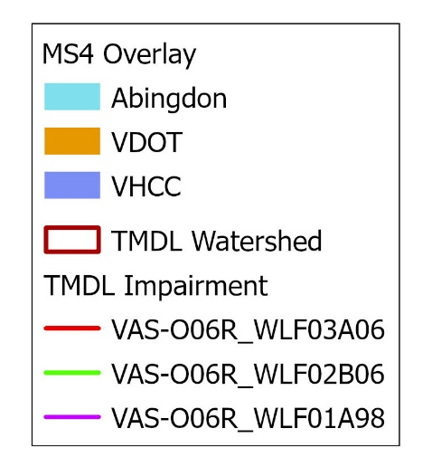
Municipal Separate Storm Sewer (MS4) Permits
Loads based on area and land cover
Aggregated vs. disaggregated allocations
Permit No | Permitted Entity
VAR040137 | Town of Abingdon
VAR092975 | VDOT
VAR040138 | VHCC

Slide 26
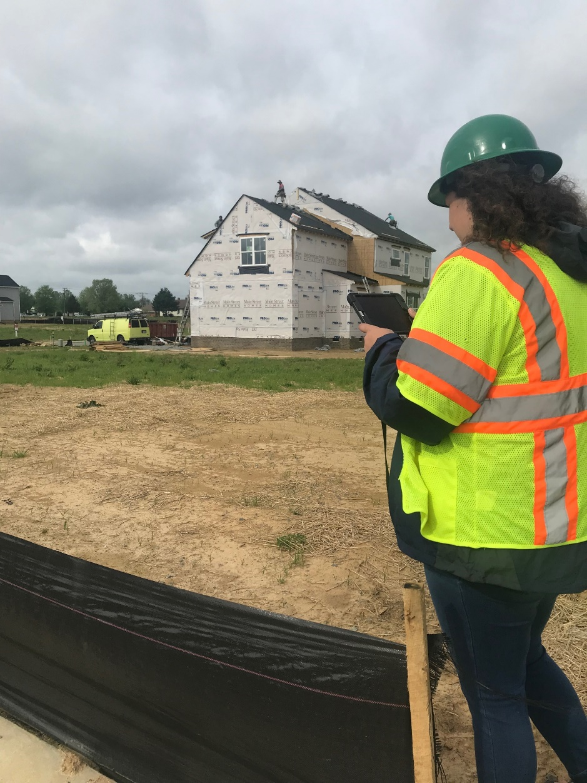
Construction General Permits
WLA based on average disturbed area of active construction permits
  Active permits in upper watershed, but none in lower portion of watershed
  Apply same ratio of CGP load-to-target load for lower and upper watershed
  0.4% of TMDL pollutant load set aside for CGP
Erosion and sediment control measures
  85% sediment removal

Slide 27
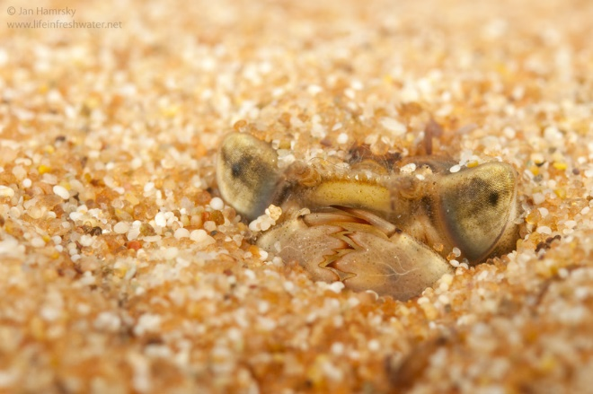
Q&A Session #1
Any questions so far?
Aggregate vs disaggregate MS4 allocations?
Photo: Jan Hamrsky: lifeinfreshwater.net

Slide 28
TMDL Equation
WLA
LA
MOS
TMDL
WLA= Wasteload Allocation
  Permitted/Point Source
LA= Load Allocation
  Nonpoint Source
MOS= Margin of Safety
  Extra load to account for uncertainty
Notes:
Permitted sources in lynch Creek= zero, Reed Creek= has 1 permit (dischargers)

Slide 29

TMDL Reductions Need a Target to Shoot For
Some pollutants have numerical criteria in regulations to set acceptable levels (e.g. bacteria counts)
Other pollutants are expected to vary among ‘healthy’ watersheds, so there is no set regulatory threshold (e.g. sediment)

Slide 30

Developing a Pollutant Target
Two main methods:
  Reference Watershed
    Find one, nearby, similar, but healthy watershed and see what the pollutant levels are there
    Straightforward method
    Hard to find ideal reference watershed
  All-Forested Load Multiplier
    Use many other watersheds - both healthy and impaired - to develop a target load
    Used in Virginia since 2014
    More rigorous result (less likely to overshoot)
    More effort and time

Slide 31
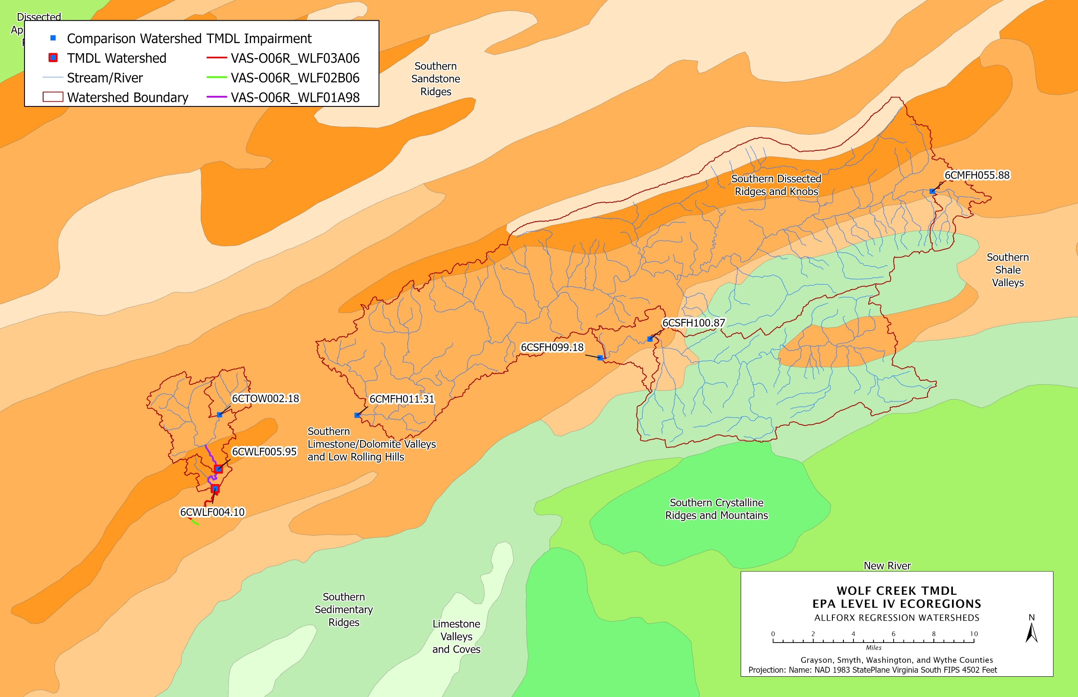

Slide 32
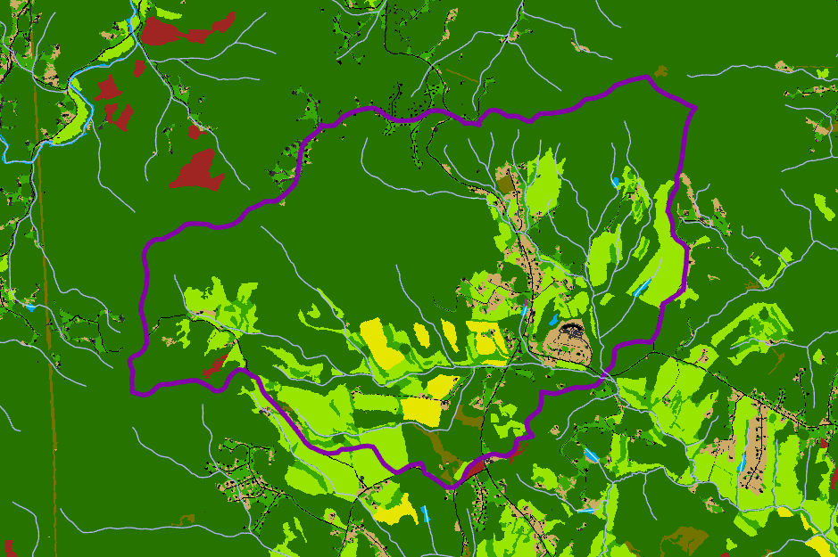
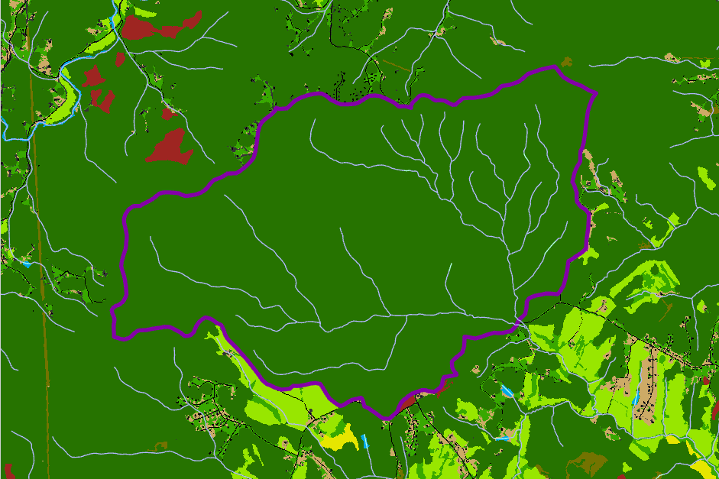
Developing a Pollutant Target: AllForX Methodology Example
Existing Sediment Load: 500,000 lb/yr vs. All Forested Sediment Load: 50,000 lb/yr
All-Forest Multiplier (AllForX) 500,000 / 50,000 = 10

Slide 33
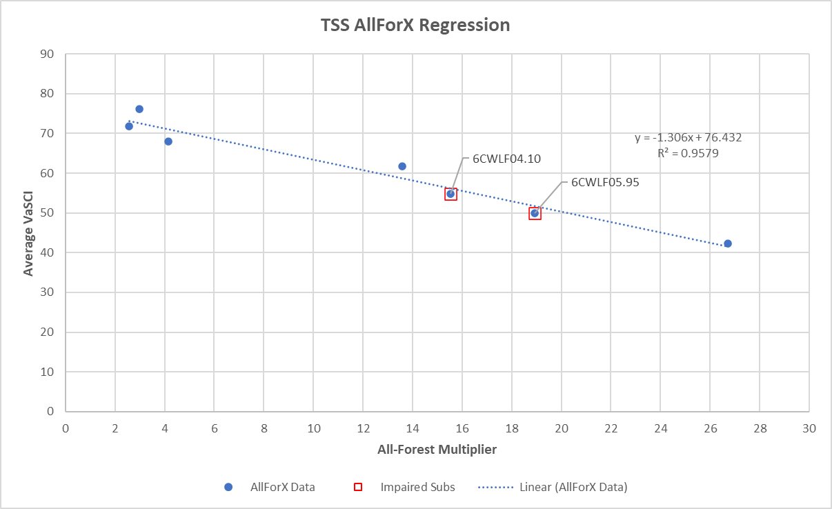
Developing a Pollutant Target: AllForX Methodology
Unimpaired Streams
Impaired Streams
Notes:
RENAME?

Slide 34
Developing a Pollutant Target: AllForX Methodology
Existing Sediment Load: 3,396,220 lb/yr
All Forested Sediment Load: 218,509 lb/yr
All-Forest Multiplier (AllForX) 3,396,220 / 218,509 = 15.54
Regression Results: VaSCI (average) = 60 -> Threshold AllForX = 12.58
To Obtain Target Loading:
(All Forested Sediment Load) x (Threshold AllForX)
218,509 lb/yr x 12.58 = 2,748,843 lb/yr
Reduction needed: 3,396,220 – 2,748,843 = 647,377 lb/yr

Slide 35
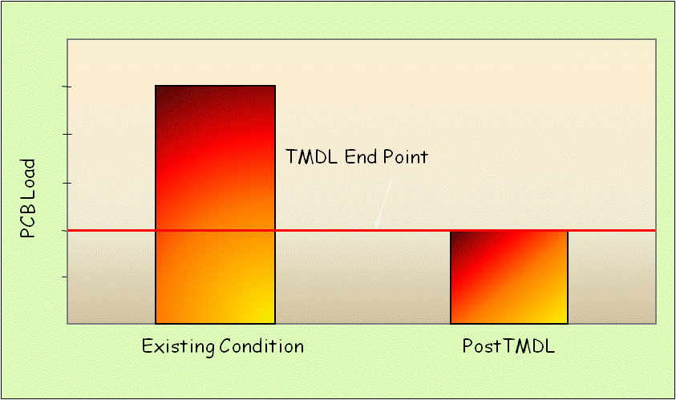
Balancing the “Pollution Pie”
Sediment Load

Slide 36
Upper Wolf Creek
Lower Wolf Creek

Slide 37
Upper Wolf Creek Sediment TMDL Target of: 2,748,843 lb/yr |  | Scenario 1 |  | Scenario 2 |  | Scenario 3
Source | Existing | Red. | Allocation | Red. | Allocation | Red. | Allocation
 | TSS (lb/yr) | % | TSS (lb/yr) | % | TSS (lb/yr) | % | TSS (lb/yr)
Cropland | 20,996 | 45.9 | 11,359 | 68 | 6,719 | 30 | 14,697
Hay | 46,980 | 45.9 | 25,416 | 68 | 15,034 | 30 | 32,886
Pasture | 1,039,493 | 45.9 | 562,366 | 68 | 332,638 | 30 | 727,645
Forest | 103,384 | - | 103,384 | - | 103,384 | - | 103,384
Trees | 86,853 | - | 86,853 | - | 86,853 | - | 86,853
Shrub | 12,462 | - | 12,462 | - | 12,462 | - | 12,462
Harvested | 3,337 | - | 3,337 | - | 3,337 | - | 3,337
Wetland | 858 | - | 858 | - | 858 | - | 858
Barren | 31,690 |  | 17,144 | - | 20,947 | - | 12,137
Turfgrass | 33,501 | 45.9 | 18,124 | 33.9 | 22,144 | 61.7 | 12,831
Developed Pervious | 5,288 | 45.9 | 2,861 | 33.9 | 3,496 | 61.7 | 2,025
Developed Impervious | 267,385 | 45.9 | 144,655 | 33.9 | 176,741 | 61.7 | 102,408
Streambank Erosion | 465,861 | 45.9 | 252,031 | 33.9 | 307,934 | 30 | 326,103
Abingdon MS4 | 1,075,421 | 45.9 | 581,803 | 33.9 | 710,853 | 61.7 | 411,886
VDOT MS4 | 140,314 | 45.9 | 75,910 | 33.9 | 92,748 | 61.7 | 53,740
VHCC MS4 | 27,621 | 45.9 | 14,943 | 33.9 | 18,257 | 61.7 | 10,579
Construction Permits | 10,500 | - | 10,500 | - | 10,500 | - | 10,500
ISW Permits | 563 | - | 789 | - | 789 | - | 789
VPDES Permits | 12,326 | - | 452,285 | - | 452,285 | - | 452,285
Concrete Products Permits | 46 | - | 46 | - | 46 | - | 46
Domestic Sewage Permits | 183 | - | 183 | - | 183 | - | 183
NMMM Permits | 26,648 | - | 39,790 | - | 39,790 | - | 39,790
MOS (10%) | - | - | 274,884 | - | 274,884 | - | 274,884
Future Growth (2%) | - | - | 54,977 | - | 54,977 | - | 54,977
TOTAL | 3,411,710 |  | 2,746,960 |  | 2,747,859 |  | 2,747,285
 | 0% red. |  | 19.5% red. |  | 19.5% red. |  | 19.5% red.

Slide 38
Lower Wolf Creek Sediment TMDL Target of 3,367,440 lb/yr |  | Scenario 0 |  | Scenario 1 |  | Scenario 2 |  | Scenario 3
 |  | Meets Upper Wolf Creek Target Only |  | Meets Lower Wolf Creek Target, Exceeds Upper Wolf Creek Target
Source | Existing | Red. | Allocation | Red. | Allocation | Red. | Allocation | Red. | Allocation
 | TSS (lb/yr) | % | TSS (lb/yr) | % | TSS (lb/yr) | % | TSS (lb/yr) | % | TSS (lb/yr)
Cropland | 11,861 | 45.9 | 6,417 | 53.2 | 5,551 | 70 | 3,558 | 40.5 | 7,057
Hay | 40,134 | 45.9 | 21,713 | 53.2 | 18,783 | 70 | 12,040 | 40.5 | 23,880
Pasture | 801,656 | 45.9 | 433,696 | 53.2 | 375,175 | 70 | 240,497 | 40.5 | 476,986
Forest | 180,555 | - | 180,555 | - | 180,555 | - | 180,555 | - | 180,555
Trees | 66,465 | - | 66,465 | - | 66,465 | - | 66,465 | - | 66,465
Shrub | 24,821 | - | 24,821 | - | 24,821 | - | 24,821 | - | 24,821
Wetland | 1,330 | - | 1,330 | - | 1,330 | - | 1,330 | - | 1,330
Barren | 126,344 | 45.9 | 68,352 | 53.2 | 59,129 | 38.6 | 77,575 | 70.3 | 37,524
Turfgrass | 12,048 | 45.9 | 6,518 | 53.2 | 5,638 | 38.6 | 7,398 | 70.3 | 3,578
Developed Pervious | 2,123 | 45.9 | 1,148 | 53.2 | 993 | 38.6 | 1,303 | 70.3 | 630
Developed Impervious | 70,231 | 45.9 | 37,995 | 53.2 | 32,868 | 38.6 | 43,122 | 70.3 | 20,858
Streambank Erosion | 1,258 | 45.9 | 680 | 53.2 | 589 | 38.6 | 772 | 40.5 | 748
Upper Wolf Creek (excluding MOS and FG) | 3,411,710 | - | 2,417,098 | - | 2,186,816 | - | 2,299,635 | - | 2,116,240
Construction Permits | - | - | 2,474 | - | 2,474 | - | 2,474 | - | 2,474
Domestic Sewage Permits | 91 | - | 91 | - | 91 | - | 91 | - | 91
MOS (10%) | - | - | 336,743 | - | 336,743 | - | 336,743 | - | 336,743
Future Growth (2%) | - | - | 67,349 | - | 67,349 | - | 67,349 | - | 67,349
TOTAL | 4,750,627 |  | 3,673,445 |  | 3,365,370 |  | 3,365,728 |  | 3,367,329
 | 0% red. |  | 22.7% red. |  | 29.2% red. |  | 29.2% red. |  | 29.1% red.

Slide 39
Upper Wolf Creek Utilizing Lower Wolf Creek Scenarios |  | Scenario 0 |  | Scenario 1 |  | Scenario 2 |  | Scenario 3
 |  | Meets Upper Wolf Creek Target Only |  | Meets Lower Wolf Creek Target, Exceeds Upper Wolf Creek Target
Source | Existing | Red. | Allocation | Red. | Allocation | Red. | Allocation | Red. | Allocation
 | TSS (lb/yr) | % | TSS (lb/yr) | % | TSS (lb/yr) | % | TSS (lb/yr) | % | TSS (lb/yr)
Cropland | 20,996 | 45.9 | 11,359 | 53.2 | 9,826 | 70 | 6,299 | 40.5 | 12,492
Hay | 46,980 | 45.9 | 25,416 | 53.2 | 21,987 | 70 | 14,094 | 40.5 | 27,953
Pasture | 1,039,493 | 45.9 | 562,366 | 53.2 | 486,483 | 70 | 311,848 | 40.5 | 618,498
Forest | 103,384 | - | 103,384 | - | 103,384 | - | 103,384 | - | 103,384
Trees | 86,853 | - | 86,853 | - | 86,853 | - | 86,853 | - | 86,853
Shrub | 12,462 | - | 12,462 | - | 12,462 | - | 12,462 | - | 12,462
Harvested | 3,337 | - | 3,337 | - | 3,337 | - | 3,337 | - | 3,337
Wetland | 858 | - | 858 | - | 858 | - | 858 | - | 858
Barren | 31,690 | - | 17,144 | - | 14,831 | - | 19,457 | - | 9,412
Turfgrass | 33,501 | 45.9 | 18,124 | 53.2 | 15,678 | 38.6 | 20,570 | 70.3 | 9,950
Developed Pervious | 5,288 | 45.9 | 2,861 | 53.2 | 2,475 | 38.6 | 3,247 | 70.3 | 1,571
Developed Impervious | 267,385 | 45.9 | 144,655 | 53.2 | 125,136 | 38.6 | 164,174 | 70.3 | 79,413
Streambank Erosion | 465,861 | 45.9 | 252,031 | 53.2 | 218,023 | 38.6 | 286,038 | 40.5 | 277,187
Abingdon MS4 | 1,075,421 | 45.9 | 581,803 | 53.2 | 503,297 | 38.6 | 660,309 | 70.3 | 319,400
VDOT MS4 | 140,314 | 45.9 | 75,910 | 53.2 | 65,667 | 38.6 | 86,153 | 70.3 | 41,673
VHCC MS4 | 27,621 | 45.9 | 14,943 | 53.2 | 12,927 | 38.6 | 16,959 | 70.3 | 8,203
Construction Permits | 10,500 | - | 10,500 | - | 10,500 | - | 10,500 | - | 10,500
ISW Permits | 563 | - | 789 | - | 789 | - | 789 | - | 789
VPDES Permits | 12,326 | - | 452,285 | - | 452,285 | - | 452,285 | - | 452,285
Concrete Products Permits | 46 | - | 46 | - | 46 | - | 46 | - | 46
Domestic Sewage Permits | 183 | - | 183 | - | 183 | - | 183 | - | 183
NMMM Permits | 26,648 | - | 39,790 | - | 39,790 | - | 39,790 | - | 39,790
MOS (10%) | - | - | 274,884 | - | 274,884 | - | 274,884 | - | 274,884
Future Growth (2%) | - | - | 54,977 | - | 54,977 | - | 54,977 | - | 54,977
TOTAL | 3,411,710 |  | 2,746,960 |  | 2,516,678 |  | 2,629,496 |  | 2,446,100
 | 0% red. |  | 19.5% red. |  | 26.2% red. |  | 22.9% red. |  | 28.3% red.

Slide 40

Q&A Session #2
Photo: Jan Hamrsky: lifeinfreshwater.net
Which scenario do you think makes the most sense for each watershed?
Other considerations?

Slide 41
Continuous WQ Planning Process: Implementation Plan
IP Report Content
Pollutant reduction needs
  Review TMDL studies, and factor in changes since TMDLs
  Land Use and Population changes
Best Management Practices
  Stakeholder input on practices most applicable locally
  Quantify Implementation actions
  Assess costs and benefits of actions
Implementation Plan Strategies
  Measurable goals/milestones
  Stakeholders’ roles
  Integrate with other plans
  Identify potential funding sources

Slide 42
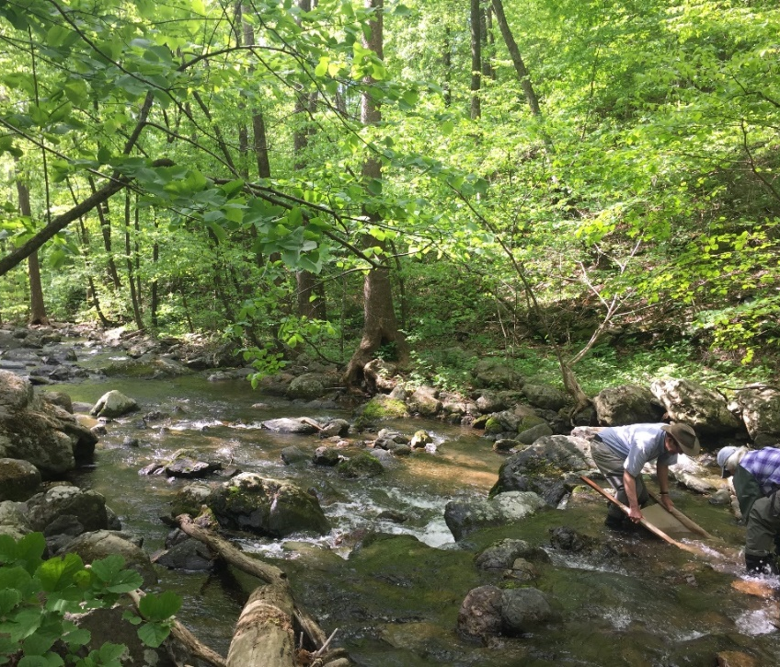
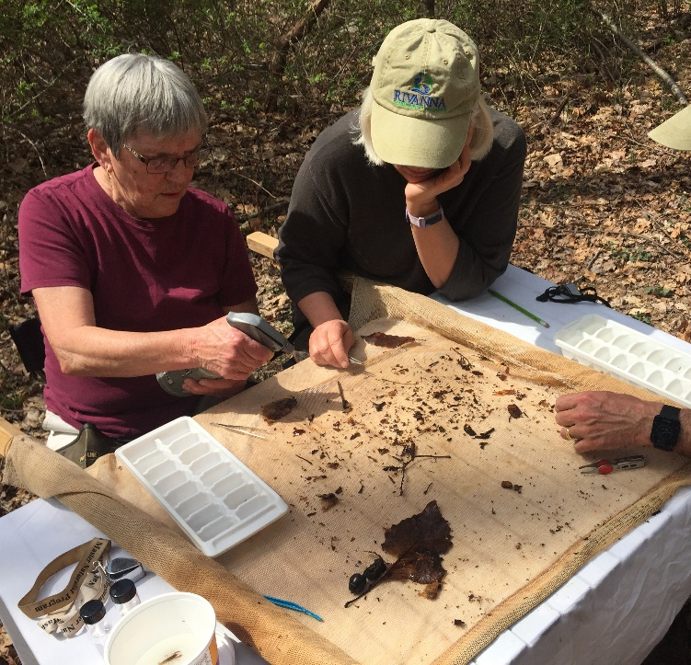
How can you get involved?
We need to hear from you!!!
Participate in Community Engagement Meetings
  Represents the local community
  Provides feedback on
    Land use
    Pollutant sources
    Key stakeholders and community meetings

Slide 43
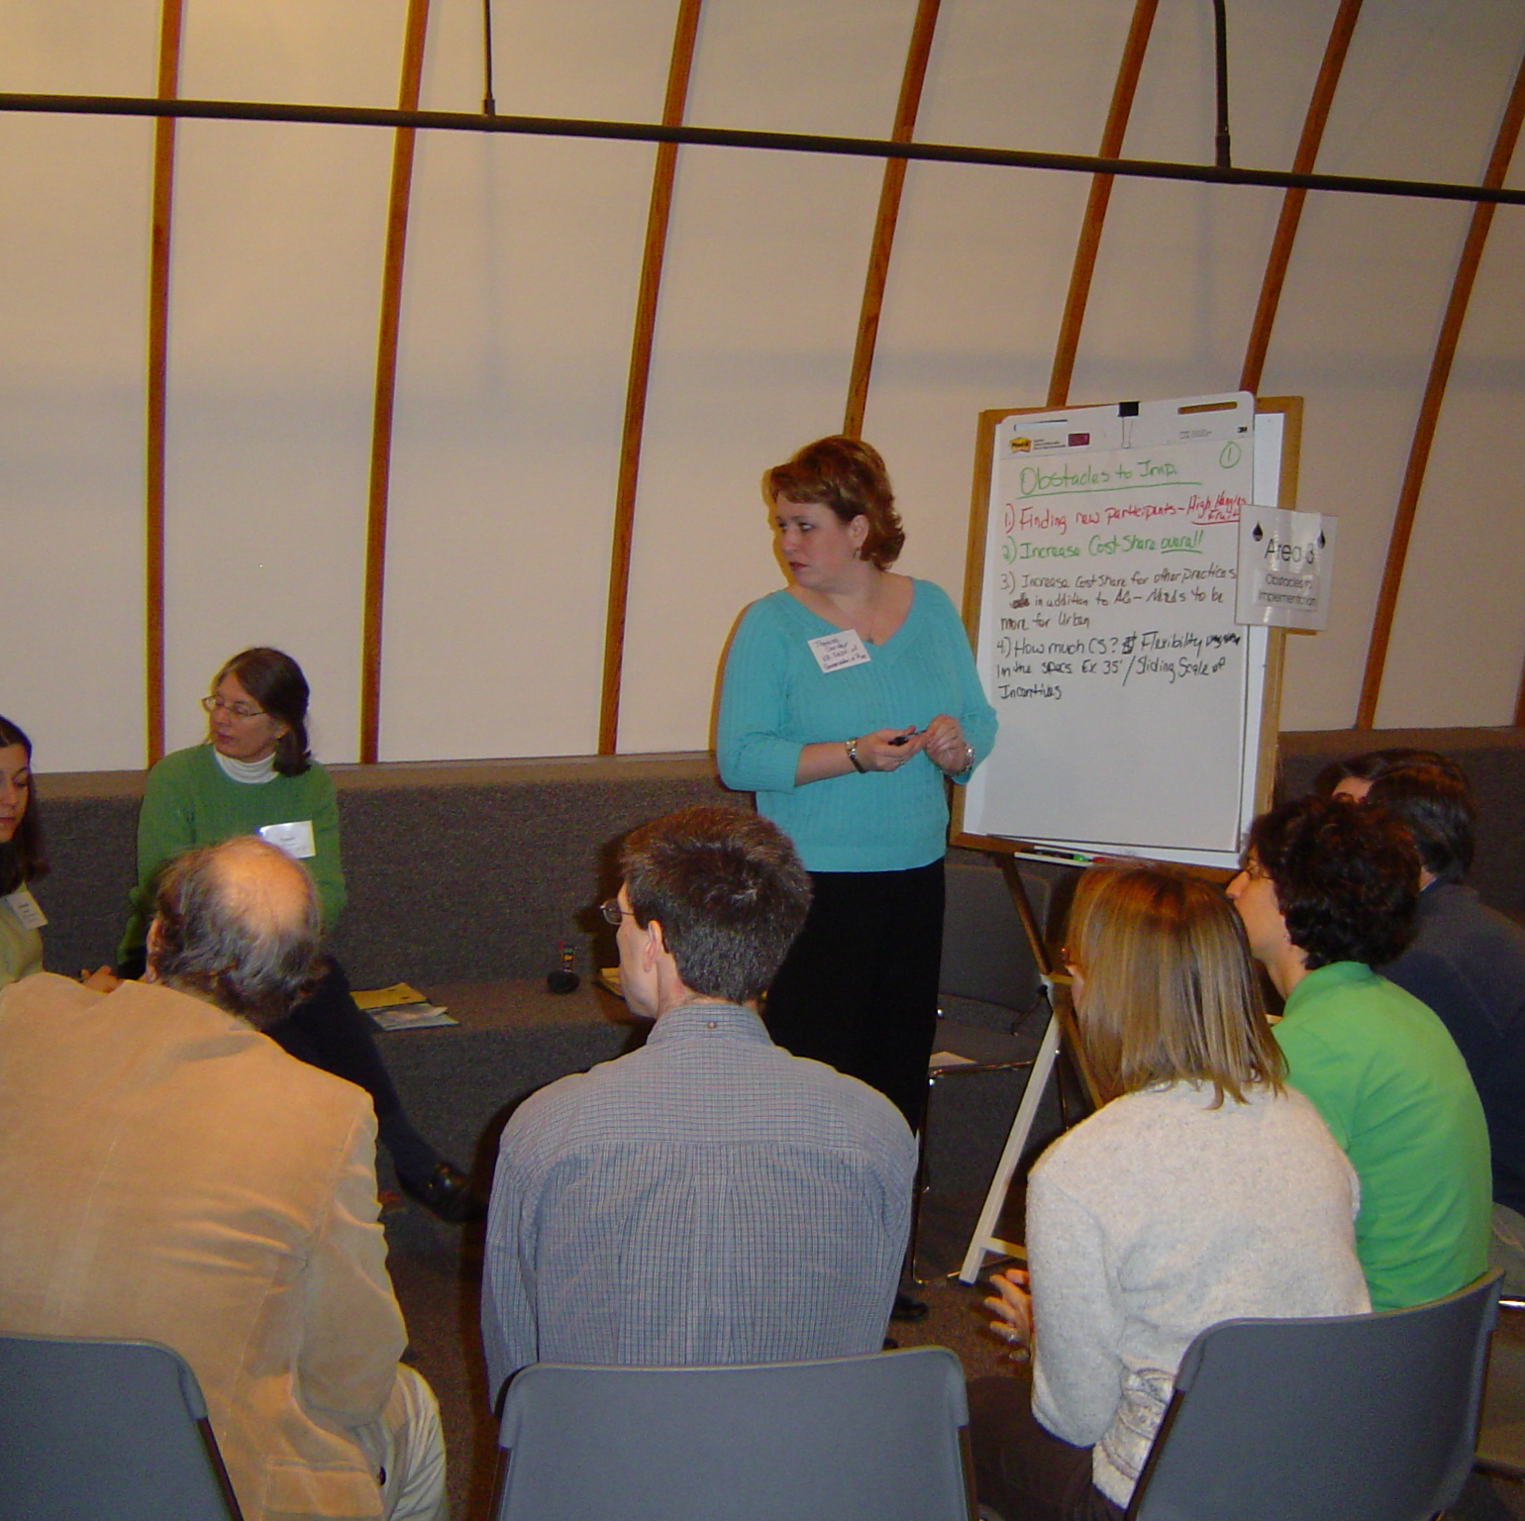
Develop draft report
Join us for the final public meeting
Draft final report presented them and open to public comment
Time preference??
Location preference??
What’s Next?

Slide 44
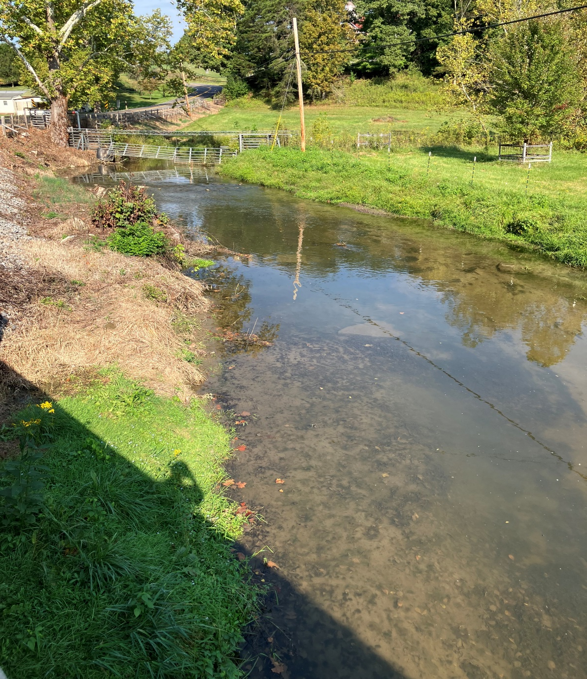
Questions & Comments
Send comments to:
Landon Jenkins
355 A Deadmore St SW
Abingdon, VA 24210
landon.jenkins@deq.virginia.gov

