Slide 1
Horsepen Creek, Little Roanoke Creek, and unnamed tributary to Spencer Creek Water Quality Study
A restoration plan for three watersheds in Charlotte County
Aerin Portner and Kim Romero
TMDL Coordinator & TMDL NPS Coordinator
June 25, 2025

Slide 2
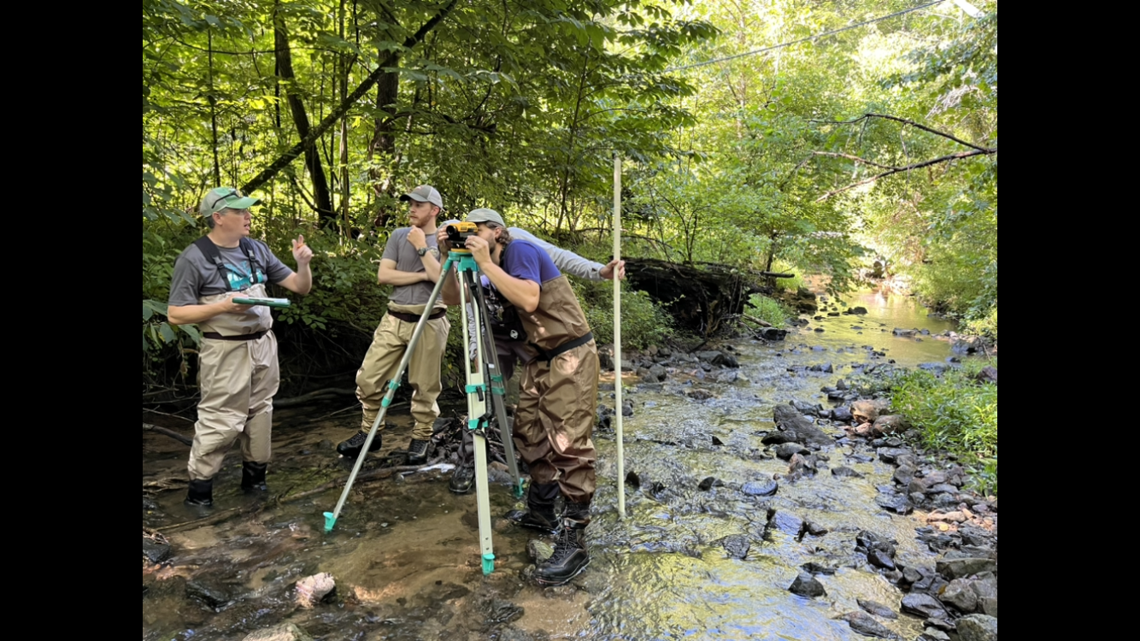
Our goals for today…
Introduce Advance Restoration Plans (ARPs)
  Discuss the similarities and differences with Total Maximum Daily Load (TMDL) studies and Implementation Plans
Discuss how to implement this plan
  Discuss sources and reductions
  Discuss best management practices
  Gage community preferences within the plan
Receive community feedback – We want to hear from you!

Slide 3
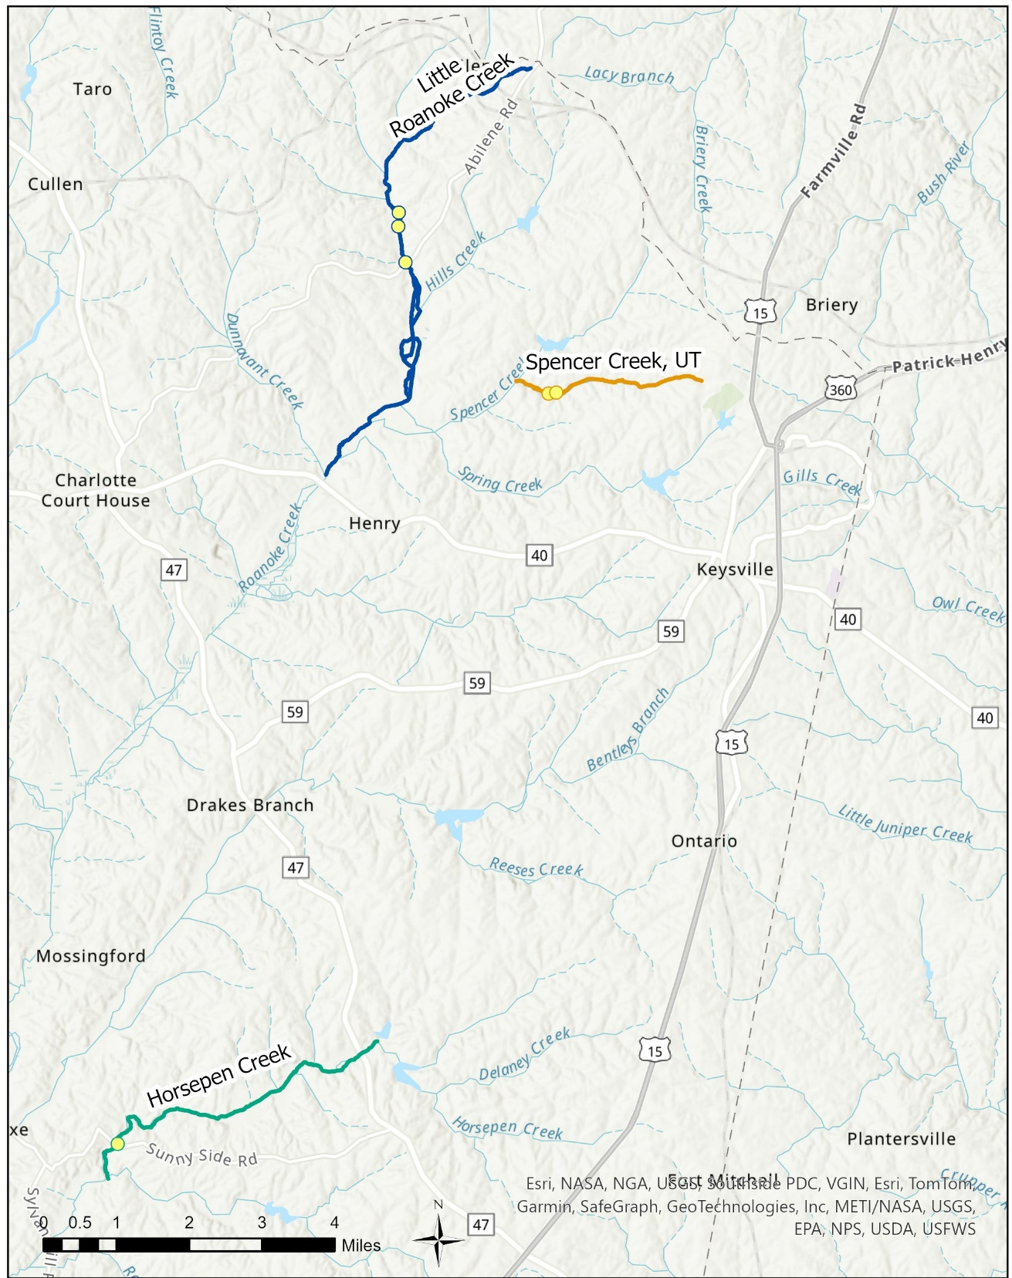

Slide 4
Likely Stressors Leading to Stream Impairment
Horsepen Creek:
Most Probable: Phosphorus
Possible Contributors: Sediment, Dissolved Oxygen, Physical Habitat
Little Roanoke Creek:
Most Probable: Sediment and Dissolved Oxygen
Possible Contributors: Phosphorus
Unnamed Tributary to Spencer Creek:
Most Probable: Sediment
Possible Contributors: Physical Habitat and Phosphorus

Slide 5
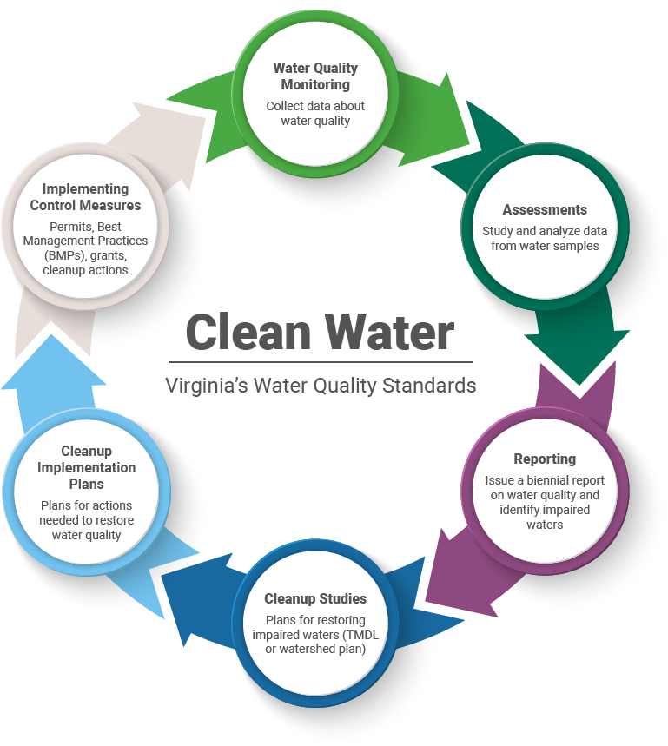

Virginia’s Water Quality Process
Advanced Restoration Plan
(ARP)

Slide 6
Advanced Restoration Plan (ARP)
An advance restoration plan (ARP) is a near-term plan, or description of actions, with a schedule and milestones, that is more immediately beneficial or practicable to achieving water quality standards (WQS).
When the ARP activities restore the applicable water quality standards, the waterbody can be delisted, which eliminates the need for a TMDL
ARPs are not a regulatory action. There are only considerations and not “requirements” in developing the plan.
Notes:
Essentially combining TMDL and IP.

Slide 7
ARP components
Similar basic process to TMDL
  Calculation of TMDL, Allocation of pollutants and various sources
  Implementation Plan- planning out BMPs that would help achieve the water quality goals and lead to possible 319(h) funding

Slide 8
ARP and NPS Watershed Based Plans (IP)
Many ARPs either were developed from existing WBPs or developed concurrently as WBP
ARPs focus on primarily nonpoint source based impairments so they tend to have overlaps in development and consideration with watershed based plans
For the 303(d) program, the primary consideration is to ensure that the ARP clearly demonstrates that the activities will restore the impaired WQS not just improve water quality
Like IP, partnerships and interested/involved stakeholders are essential to ARP development, implementation, and success.

Slide 9

So, what will restoration look like?

Slide 10


The Model & Reductions
Adjust
Calibration
Parameters
No
Watershed
Inputs
Model Outputs
Match Observed Data?
Yes
Meet TMDL Endpoints?
Yes
Computer Model
TMDL
Complete
No
Revise Pollutant Reduction
Scenarios Until We Meet
TMDL Endpoints

Slide 11
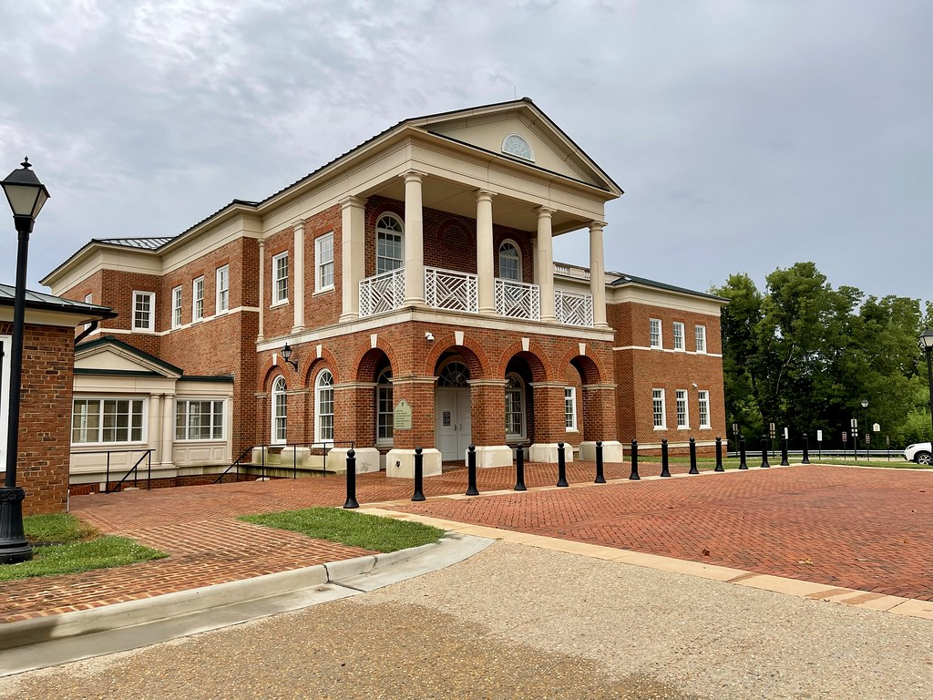
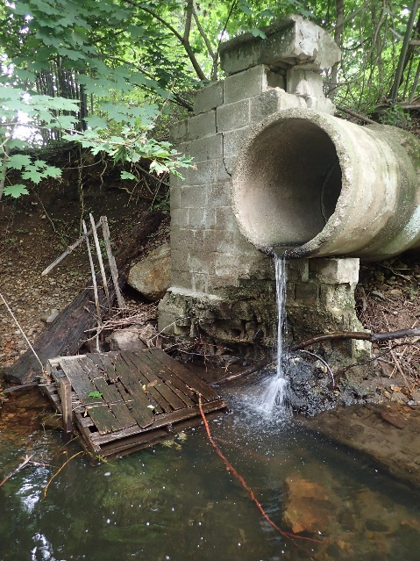
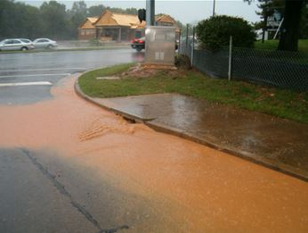
The Equation of the Pollution Load
WLA
LA
Wasteload Allocation
Permitted/Point Sources
MOS
TMDL
Load Allocation
Non-point Sources
Margin of Safety
Extra load to account for uncertainty
Total Maximum Daily Load

Slide 12
Horsepen Creek Watershed
We need to reduce total phosphorus loads from across the landscape by 38%.

Slide 13
How would you like that 38% distributed?
Reductions need to include:
10% margin of safety
1% future growth
Permitted Sources
Non-point sources
Land Use/Source | Phosphorus Load lbs/year | % Reduction | % Reduction
Cropland | 2,556 | 38
Pasture | 2,618 | 38
Hay | 2,362 | 38
Forest | 887
Harvested Forest | 244 | 38
Developed/Residential | 7,071 | 38
Channel Erosion | 158 | 38
Total Load | 15,896 | 10,193
Target Load | 10,305

Slide 14
Little Roanoke Creek Watershed (includes UT to Spencer Creek)
We need to reduce sediment loads from across the landscape by 74%.

Slide 15
How would you like that 74% distributed?
Reductions need to include:
10% margin of safety
2% future growth
Permitted Sources
Non-point sources
Land Use/Source | Phosphorus Load tons/year | % Reduction | % Reduction
Cropland | 1,652 | 74
Pasture | 296 | 74
Hay | 2,079 | 74
Forest | 579
Harvested Forest | 626 | 74
Developed/Residential | 1,611 | 74
Channel Erosion | 315 | 74
Total Load | 7,158 | 2,289
Target Load | 2,338
*The UT to Spencer Creek contributes 6% of this total load of sediment. It alone will require 68% to meet it’s own goals.

Slide 16
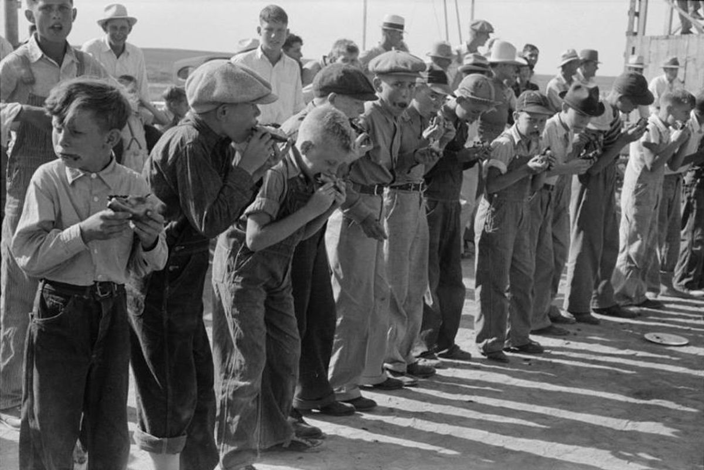
How do we implement these reductions?

Slide 17
Virginia’s Water Quality Process
Advanced Restoration Plan
(ARP)

Slide 18

What is a Clean Up Plan/Implementation Plan (IP)?
What the plan is….
A document that details actions/strategies to achieve load reductions for nonpoint source pollutants as defined by the TMDL/ outlined in an ARP
Consists of 9 elements
    Causes/ Sources of Pollution Identified
    Expected Load Reductions for Solutions Identifies
    Nonpoint Source Management Measures Identified
    Technical and Financial Assistance
    Education and Outreach
    Implementation Schedule
    Milestones Identified
    Load Reduction Evaluation Criteria’s
    Monitoring
Tells us “how” to improve water quality
for nonpoint sources
18
Notes:
Required by Virginia’s 1997 Water Quality Monitoring, Information and Restoration Act (WQMIRA)
- A TMDL Implementation Plan is a document that details the actions and strategies needed to achieve load reductions for nonpoint source pollutants that the TMDL identified.
Aspects of an IP include:
A review of the TMDL and any updates that are necessary
Corrective actions needed to improve water quality. This could be BMPs, education and outreach, incentives, etc.… things to help up reach our goals
A cost–benefit analysis to assess the cost of implementation. To compare the cost-effectiveness of various practices and evaluate their environmental benefits to determine the best practices needed to reach our goals.
Measurable goals and timeline: Implementation works best with a targeted, staged approach. Directing initial efforts where the biggest impacts can be made with the least effort so that money, time, and resources are spent efficiently. Initial implementation efforts will focus on these more cost-effective BMPs and educational programs. Upon completion of this first phase, water quality will be re-assessed to determine if water quality standards were attained. If these standards are still not being met, we move onto phase 2 where additional actions, usually more expensive and extensive, are taken. The purpose of this phased approach is to define a clear set of output and outcome goals, as well as an ambitiously realistic schedule for the restoration of a watershed. These phased approaches are usually on a 5 -15 year timeframe.
Achieving the goals of IP plans are dependent on strong participation by many environmental conservation organizations, area landowners, and community members. DEQ staff will work with the local communities and partners to promote and monitor implementation efforts and evaluate progress. Public participation is a vital part in the development and continuation of an IP.
Implementation plans also identify potential sources of funding to help in the clean-up efforts. Funds are often available in the form of cost-share programs, which share the cost of improvements with the landowner. Potential sources of funding include USEPA Section 319 funding for Virginia’s Nonpoint Source Management Program, the USDA’s Conservation Reserve Enhancement Program (CREP) and its Environmental Quality Incentive Program (EQIP), the Virginia State Revolving Loan Program, and the Virginia Water Quality Improvement Fund. The Virginia Guidance Manual for Total Maximum Daily Load Implementation Plans (VADEQ, 2017) contains information on a variety of funding sources, as well as government agencies that might support implementation efforts and suggestions for integrating TMDL implementation with other watershed planning efforts
Completely voluntary
Flexibility, specific to the community
IP stage is all voluntary

Slide 19
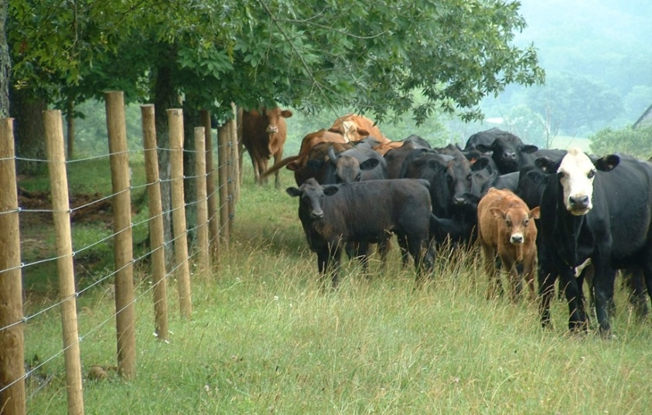
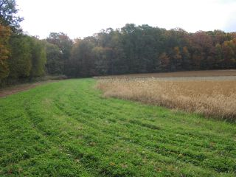
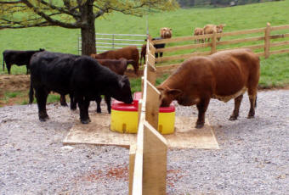
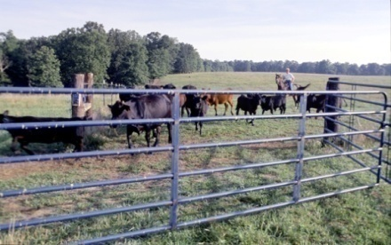
Potential Agricultural Control Measures
Livestock Exclusion Fencing
Vegetation Cover
19
Water Trough
Rotational Grazing
Notes:
Fence out cattle from streams and provide alternative water sources
Implement conservation tillage practices on cropland
Conduct stream bank restoration projects in areas where banks are actively eroding
Leave a band of 35 – 100 ft along the stream natural so that it buffers or filters out sediment from farm or residential land (a riparian buffer)
Expand street sweeping programs in urban areas
Reduce runoff by increasing green spaces and reducing hardened spaces (asphalt or concrete)

Slide 20
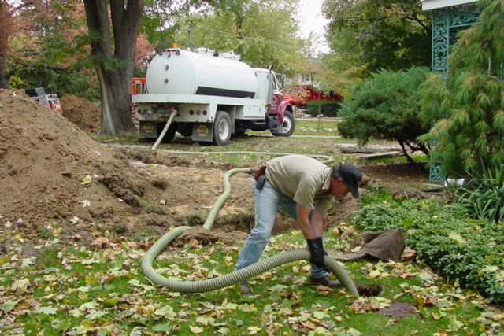
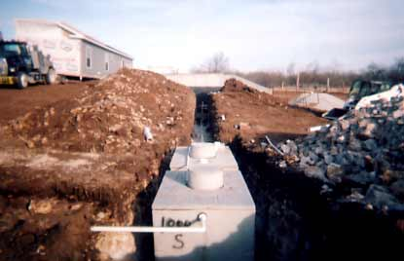
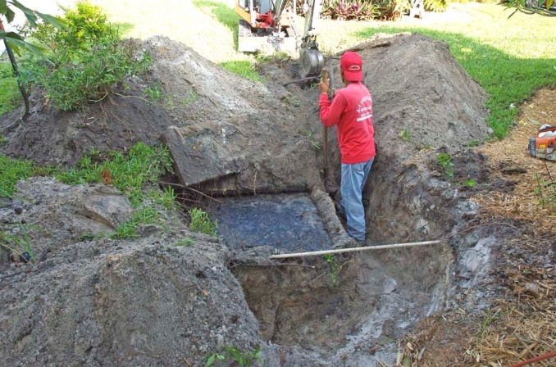
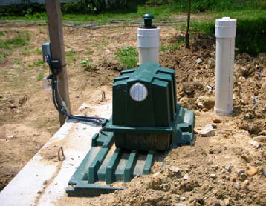
Potential Residential Control Measures
Conventional Septic System Replacement
Septic System Pump out
Septic System Replacement
Septic System Pump-out
Septic System Repair
Alternative On-site Sewage
Disposal System
Alternative On-site Sewage Disposal System
20
Septic System Repair
Notes:
Fence out cattle from streams and provide alternative water sources
Implement conservation tillage practices on cropland
Conduct stream bank restoration projects in areas where banks are actively eroding
Leave a band of 35 – 100 ft along the stream natural so that it buffers or filters out sediment from farm or residential land (a riparian buffer)
Expand street sweeping programs in urban areas
Reduce runoff by increasing green spaces and reducing hardened spaces (asphalt or concrete)
**Mention bacteria IP

Slide 21
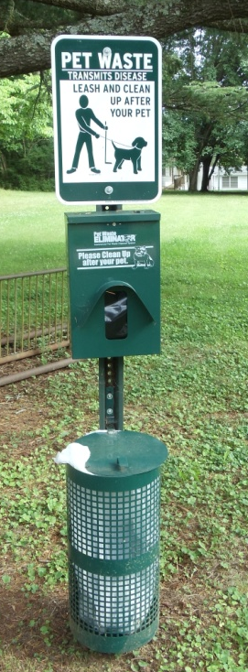
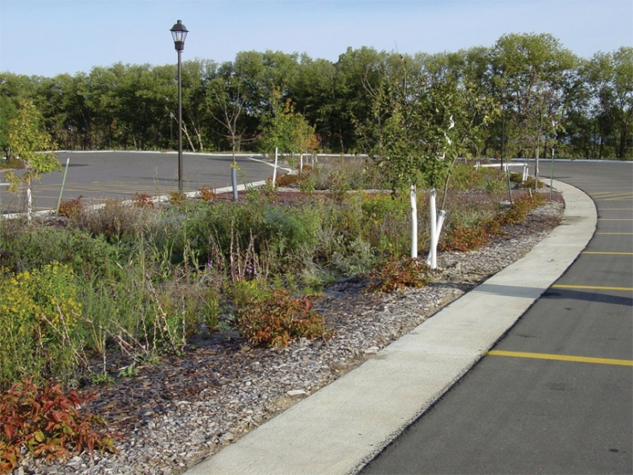
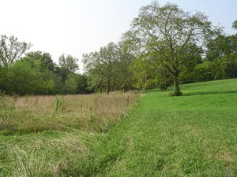
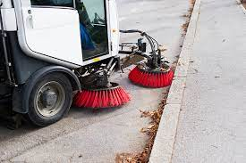
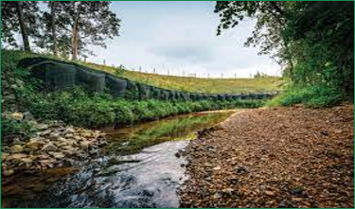
Pet Waste and Stormwater Control Measures
Bio Retention (Rain Garden)
Vegetated Buffers
Vegetated Buffer
Pet Waste Station
Pet Waste Station
Street Sweeping
Streambank Stabilization
21
Bioretention (rain garden)

Slide 22
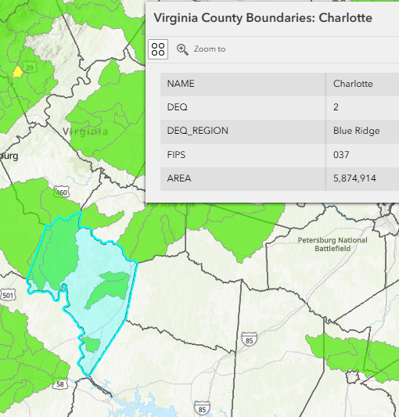
How to Implement an Advanced Restoration Plan (ARP)
Section 319(h) NPS Implementation Program Request for Applications (RFA)​
  What is 319(h) funding?​
    EPA awards 319(h) funds (Clean Water Act) to states, territories, and tribes to implement TMDL Implementation Plans.​
  Who can apply?​
    Local governments, county health departments, SWCDs, Virginia institutes of higher education, Planning District Commissions, Regional Commissions, nonprofits, and other agencies/departments of the Commonwealth.
    ​
  What can you apply for?​
    BMPs (agricultural, residential septic, pet waste, urban)​
    Education and Outreach​
    Water Quality Monitoring​
  Where can you work?​
    In an approved TMDL Implementation Plan or ARP
Virginia DEQ Environmental Data Mapper

Slide 23

What is your role in developing the Plan?
IPs are only as good as the information received/assessed
Provide comments/feedback on:
  What are the needs/interests in the area?
  Is it realistic?
  Are there particular management strategies that will work well in this area?
  Types of BMP practices
  Failing septic systems and straight pipes
  Livestock, wildlife and pet population estimates
  Recommend outreach activities & funding sources
  Identify potential partner organizations
23
Notes:
Join the Planning Process! (Time commitment: 1-2 meetings and review draft plan)
Provide input based on local interest/need
Share ideas to maximize landowner participation
Review draft of the Clean Up Plan
Plan for the final public meeting

Slide 24
Residential Overview
  Within the Horsepen Creek watershed, estimated totals (US Census 2020 + carrier data + USACE):
Estimated Population | Total Septic Systems | Houses with Failing Septic Systems | Houses with Straight Pipes
 |  | 10% of households | 1% of households
3,582 | 1,665 | 166 | 8
  Do these estimates seem correct?
Notes:
Assume 10% failing and 1% straight pipe until check with VDH

Slide 25
What changes have you seen in the watersheds?
  What is the current trend in housing within all three of the watersheds? Are new homes being built, or is the housing stock aging?
  Is there plan for future expansion of sewer coverage in the watershed?
  For Horsepen Creek- Is there any information regarding straight pipes in the watershed?

Slide 26
Sediment Practices in the past five years:
Practice Type | Program Year | Practice Code | Practice Description | Practice Lifespan
Livestock exclusion | 2021 | SL-6W | Stream Exclusion with Wide Width Buffer and Grazing Land Management | 15
 | 2022 | CCI-SL-6W | Stream Exclusion with Wide Width Buffer - Maintenance Practice | 5
 | 2022 | SL-6W | Stream Exclusion with Wide Width Buffer and Grazing Land Management | 15
 | 2022 | SL-6W | Stream Exclusion with Wide Width Buffer and Grazing Land Management | 15
 | 2022 | SL-6W | Stream Exclusion with Wide Width Buffer and Grazing Land Management | 15
 | 2022 | SL-6W | Stream Exclusion with Wide Width Buffer and Grazing Land Management | 15
 | 2023 | SL-6W | Stream Exclusion with Wide Width Buffer and Grazing Land Management | 15
 | 2024 | SL-6W | Stream Exclusion with Wide Width Buffer and Grazing Land Management | 15
 | 2024 | SL-6W | Stream Exclusion with Wide Width Buffer and Grazing Land Management | 15
 | 2024 | SL-6W | Stream Exclusion with Wide Width Buffer and Grazing Land Management | 15
Pasture Practice | 2021 | SL-11 | Permanent vegetative cover on critical areas | 5
 | 2022 | SL-11 | Permanent vegetative cover on critical areas | 5
Cropland Practices | 2020 | SL-8B | Small Grain and Mixed Cover Crop for Nutrient Management and Residue Management | 1
 | 2021 | SL-8B | Small Grain and Mixed Cover Crop for Nutrient Management and Residue Management | 1
 | 2022 | SL-1 | Long Term Vegetative Cover on Cropland | 15
 | 2022 | SL-8 | Protective cover for specialty crops | 1
 | 2022 | SL-8B | Small Grain and Mixed Cover Crop for Nutrient Management and Residue Management | 1
 | 2023 | SL-8 | Protective cover for specialty crops | 1
 | 2023 | SL-8B | Small Grain and Mixed Cover Crop for Nutrient Management and Residue Management | 1
 | 2023 | SL-8B | Small Grain and Mixed Cover Crop for Nutrient Management and Residue Management | 1
 | 2024 | SL-8B | Small Grain and Mixed Cover Crop for Nutrient Management and Residue Management | 1
 | 2024 | SL-8B | Small Grain and Mixed Cover Crop for Nutrient Management and Residue Management | 1
 | 2024 | SL-8B | Small Grain and Mixed Cover Crop for Nutrient Management and Residue Management | 1
Common BMPs:
SL-6W
SL-11
SL-8
SL-8B
SL-1
Note: These practices will also reduce TP in Horsepen.
Notes:
BMPs will be counted towards modeling for reductions

Slide 27
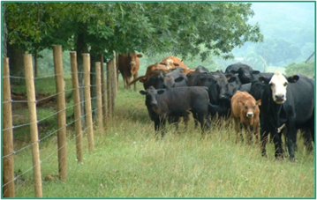
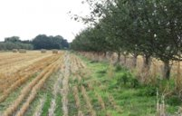
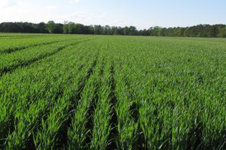
Potential Sediment Practices:
Agricultural
Practice type | Practice description
Livestock exclusion | Livestock exclusion with narrow buffer and grazing mgmt. (SL-6)
 | Livestock exclusion with wide buffer and grazing mgmt. (SL-6W)
Pasture practices | Permanent vegetative cover on critical areas (SL-11)
 | Afforestation of erodible pasture (FR-1)
Cropland practices | Long term vegetative cover on cropland (SL-1)
 | Continuous no-till (SL-15B)
 | Cover crop (SL-8B, SL-8B)
Livestock Exclusion Fencing
Afforestation of erodible pasture
Cover Crops

Slide 28
What needs to be done to address Agricultural sources of Sediment?
  What is the level of interest in installing best management practices (BMPs)? What % are interested in 10-, 25-, 35-, 50-foot buffers? What types of practices do they prefer?
  What are the BMPs on the list that are likely to generate the most interest? Least interest?
  Are there any BMPs of interest that you are not seeing on our list?
  Is there interest in rotational grazing systems? Other pasture management practices?
  Is there interest in converting poor pasture or erodible cropland to forest?

Slide 29
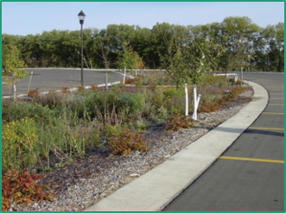
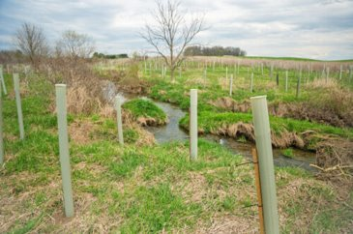
Potential Best Management Practices:
Urban/Residential
Practice Type | Sediment reduction | Phosphorous reduction
Bioretention filters | 55% - 95%* | 55% - 90%*
Bioswales | 55% - 95%* | 75%
Dry swales | 0% | 52% - 76%*
Detention basin retrofit | Varies by nature of retrofit | Varies by nature of retrofit
Pervious pavement | 55% - 80%* | 20% - 85%*
Streamside buffer: grass/shrub | 48%, LU Change | 36%, LU Change
Streamside buffer: forested | 48%, LU Change | 36%, LU Change
Streambank stabilization | 44.88 lbs/ft/yr | 0.068 lbs/ft/yr
Bio Retention (Rain Garden)
Forest Riparian Buffer
*- Efficiencies varies based upon design specifications

Slide 30
What needs to be done to address Urban/Residential sources of Sediment?
  What is the level of interest in installing these best management practices (BMPs)?
  What are the BMPs on the list that are likely to generate the most interest? Least interest?
  Are there any BMPs of interest that you are not seeing on our list?

Slide 31

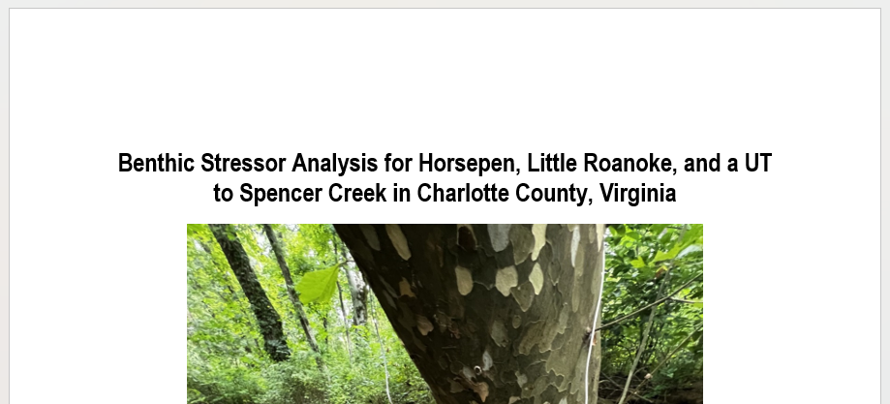
What happens next…
Access all materials on our website
https://www.deq.virginia.gov/our-programs/water/water-quality/tmdl-development/tmdls-under-development
June 25, 2025
March 5, 2025
EPA and SWCB Approval
Completed Benthic Stressor Analysis
First Public Meeting
Public Comment Period
TMDL Development/
Community Engagement Meetings
Final Public Meeting
Public Comment Period
January 15, 2025
Opportunity for you to participate

Slide 32
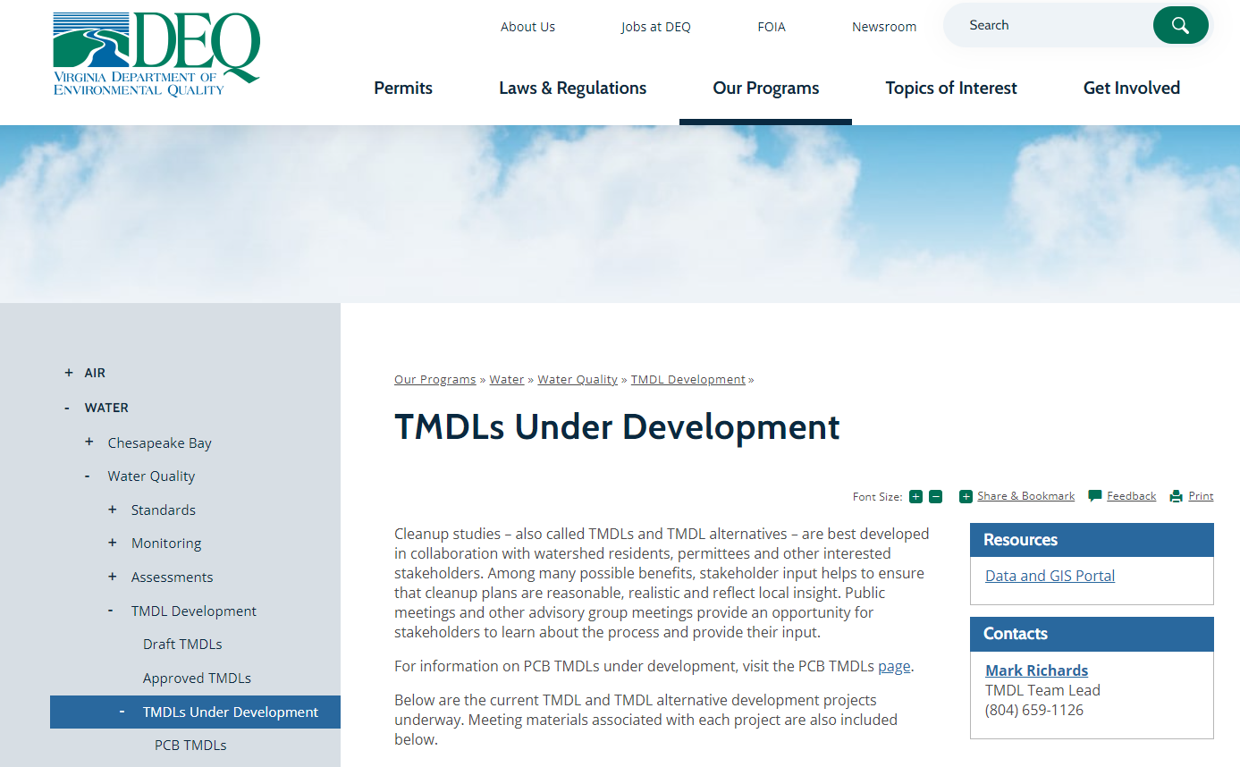
To learn more, visit DEQ’s website: https://www.deq.virginia.gov/our-programs/water/water-quality/tmdl-development
THANK YOU FOR YOUR ATTENDANCE!!!
Comments, Thoughts, & Questions
+ ARPs
Also see our IP page
Notes:
12 people
Water bottles
Cookies

