Slide 1
Horsepen Creek, Little Roanoke Creek, and unnamed tributary to Spencer Creek TMDL Study
A water quality study for watersheds in Charlotte County
Aerin Doughty
TMDL Coordinator
January 15, 2025

Slide 2
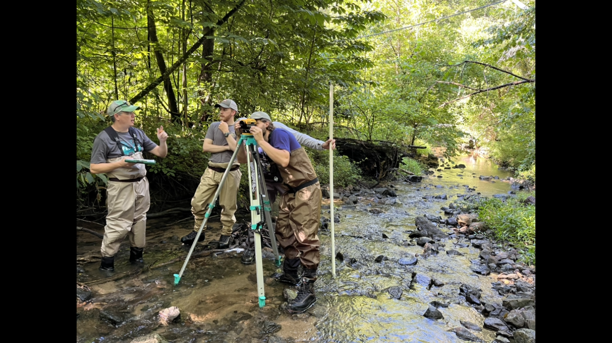
Our goals for today…
Share DEQ’s water quality improvement process
  Provide information on the streams of interest
  Define Total Maximum Daily Loads (TMDL)
  Discuss the stressor identification process
  Explore next steps and opportunities for engagement
Receive community feedback – I want to hear from you!

Slide 3
Agenda
Background and TMDL Development
  Virginia Stream Condition Index
  Impairments
  TMDL
Benthic Stressor Analysis Overview
  Monitoring/Data
  Approach
  Conclusions
Wrap-up and Next Steps by DEQ Staff
  Public Comment Period
  Engagement
  Study/Modeling/Implementation
Questions

Slide 4
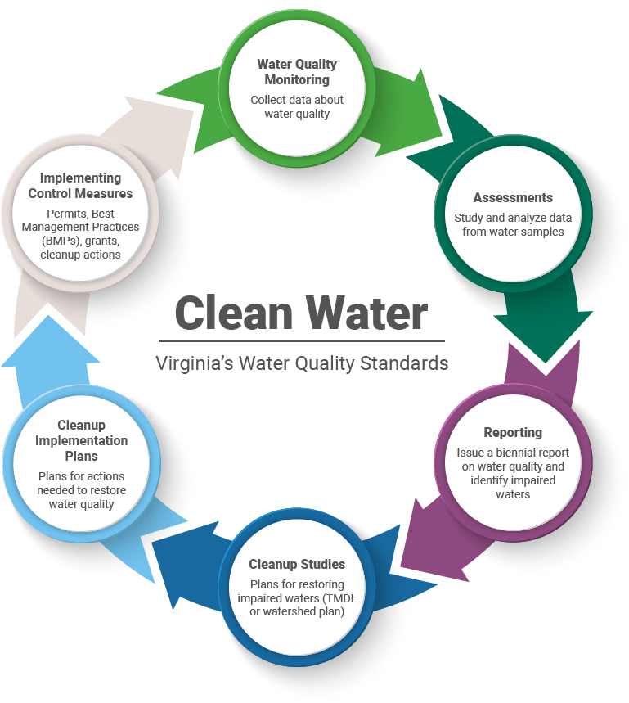
Virginia’s Water Quality Process

Slide 5
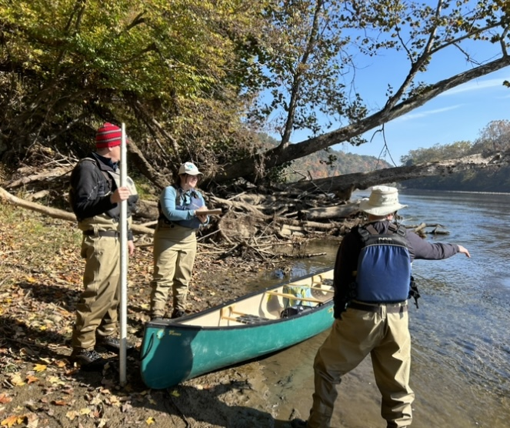
Background: Clean Water Act
The Clean Water Act requires that all waters meet water quality standards that promote healthy water use.
To meet the goals of the Clean Water Act, Virginia established water quality standards.

Slide 6
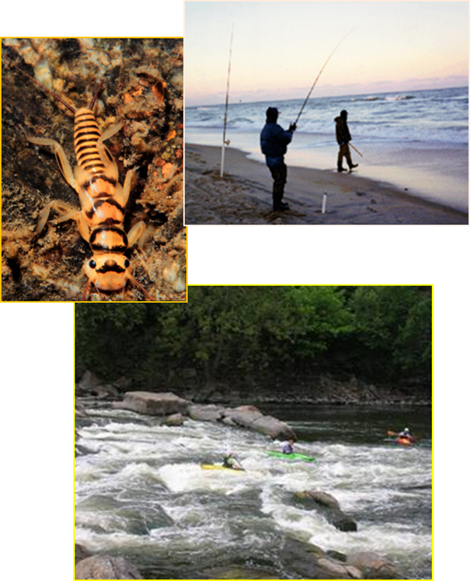
Virginia’s Water Quality Standards
Water quality standards protect these six designated uses:
  aquatic life
  wildlife
  fishing
  shellfish
  swimming
  drinking water

Slide 7
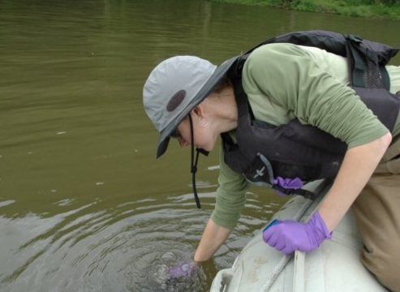
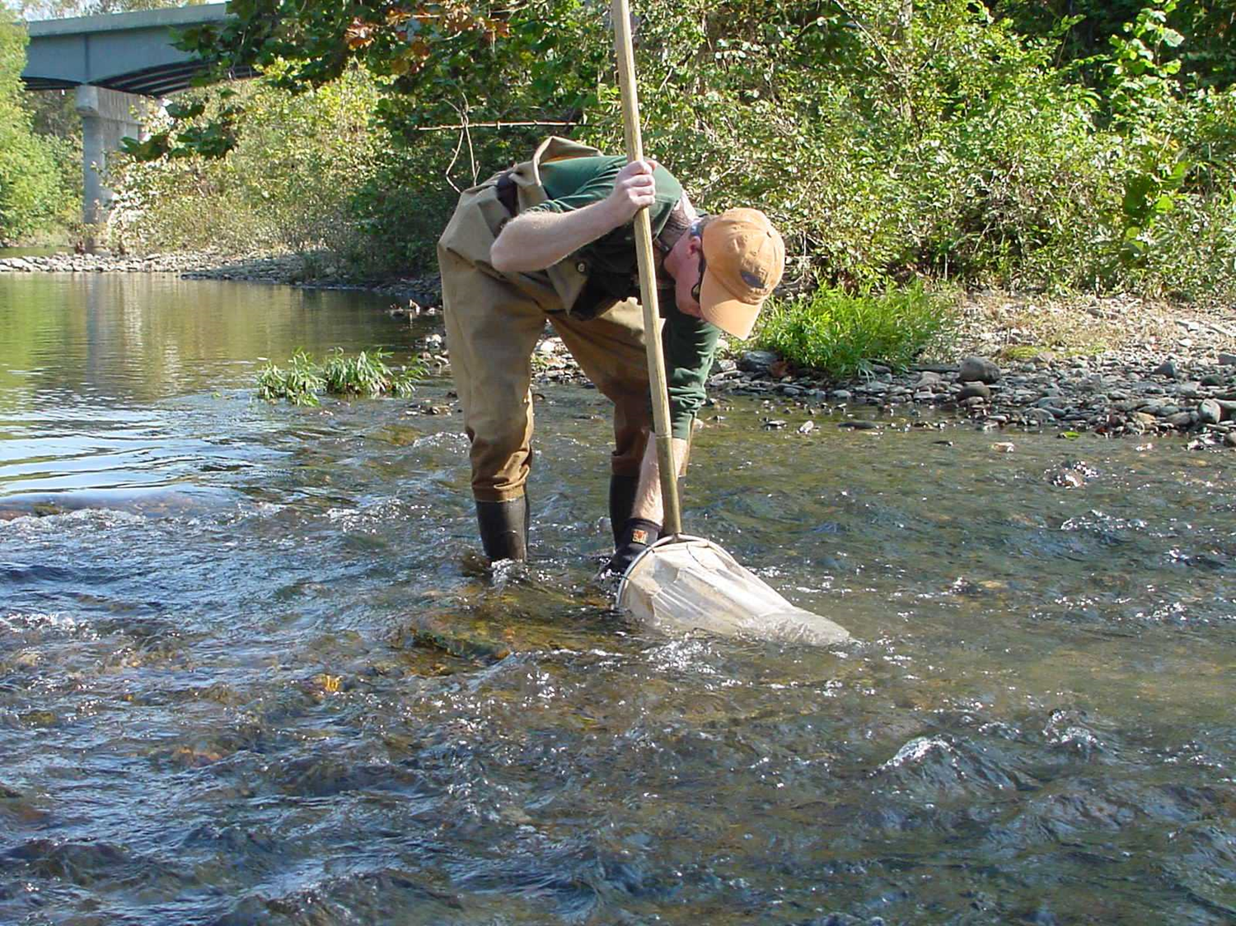
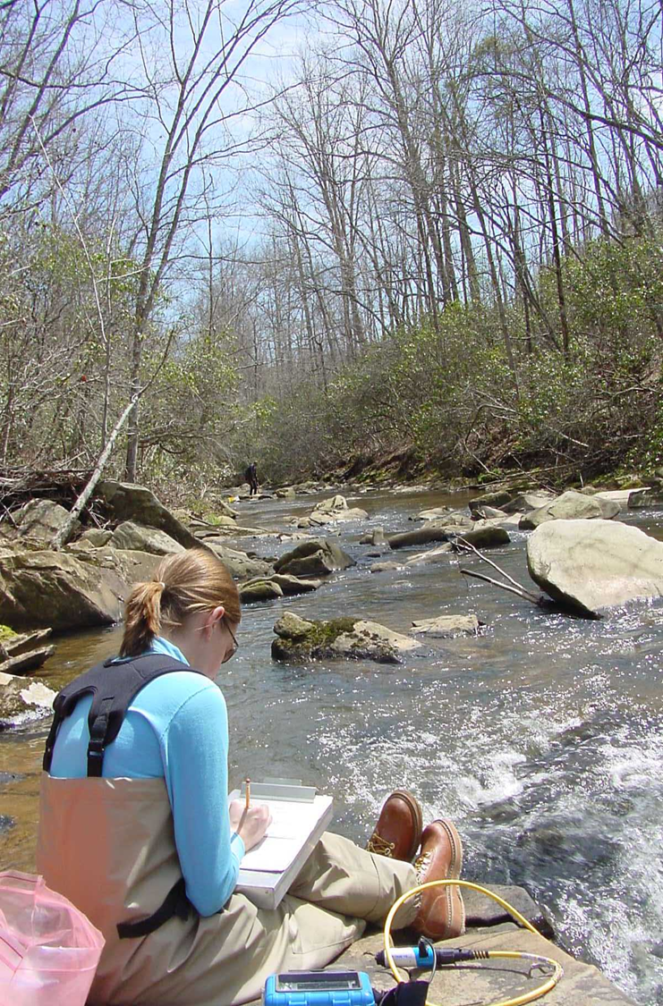
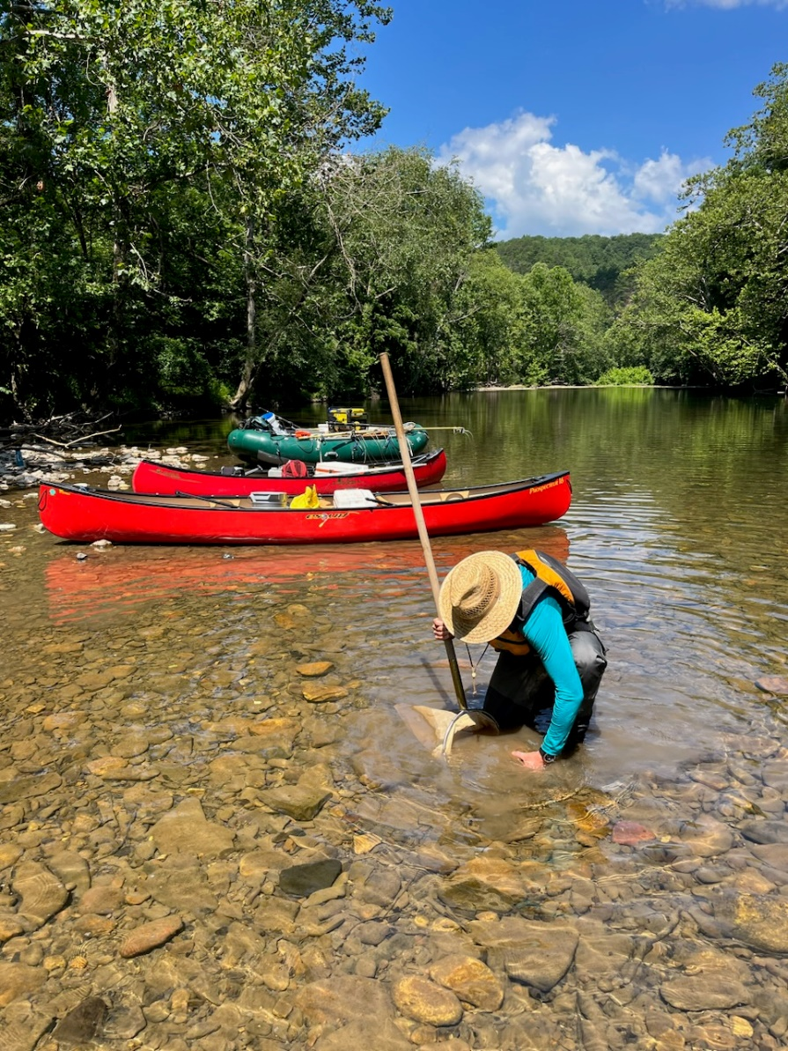
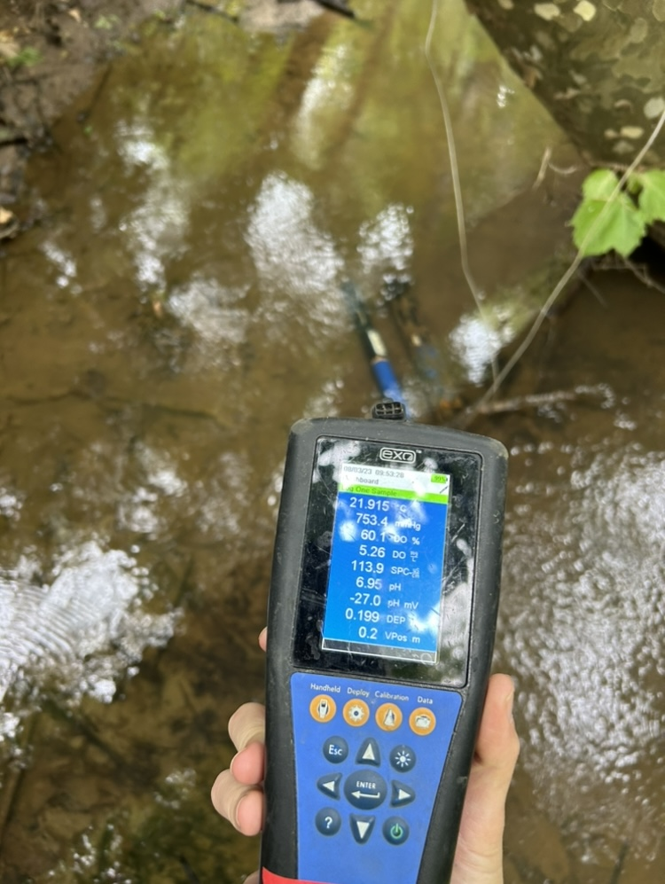

Slide 8
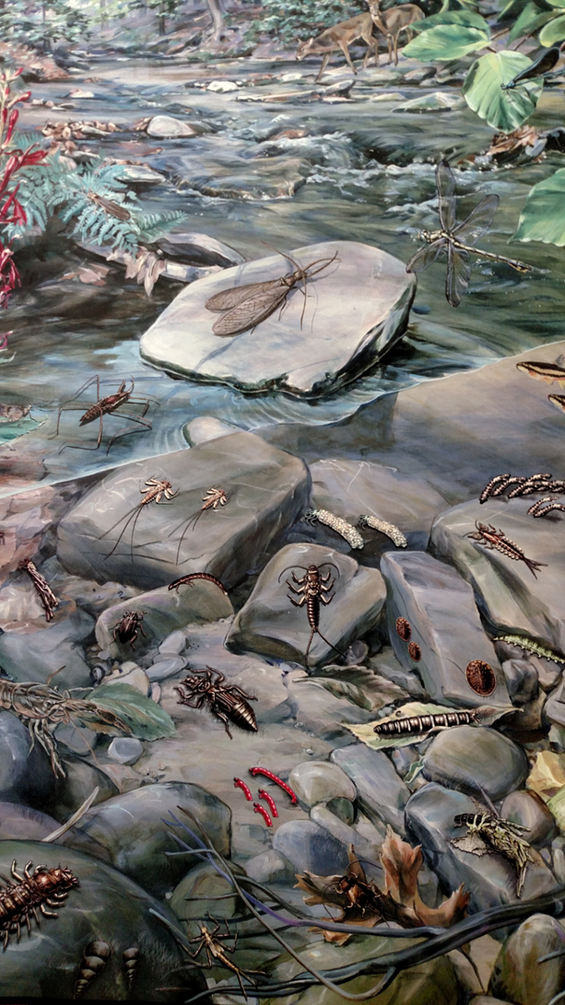
Why Benthic Macroinvertebrates?
Biological Indicators
Vary in their sensitivity to or tolerance of pollution
  Known pollution tolerance values (0-10)
  Respond to changes in water quality
Widespread, found in all aquatic environments
Limited mobility; spend 1-3 years in the water as larvae or nymphs
Biological monitoring gives a longer-term picture of water quality

Slide 9
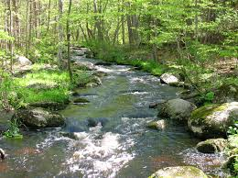

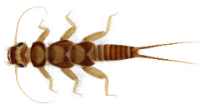
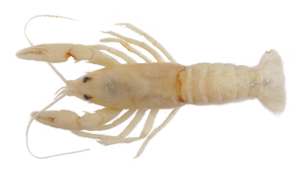
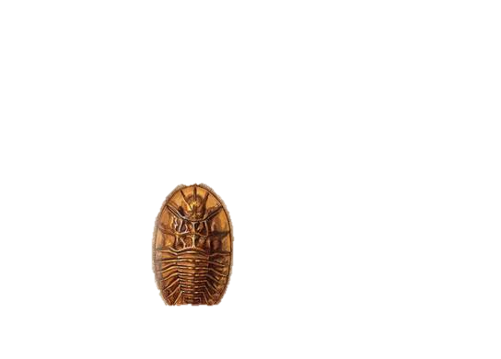


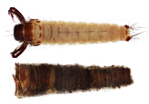
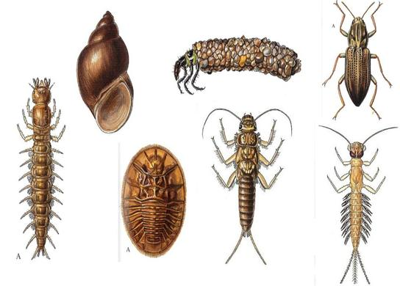

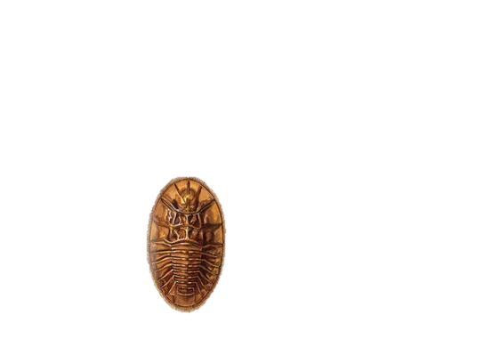
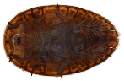
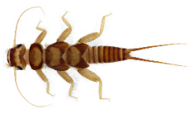
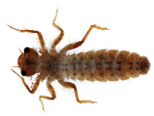


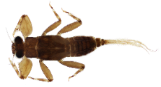

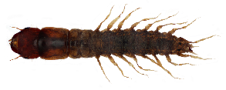

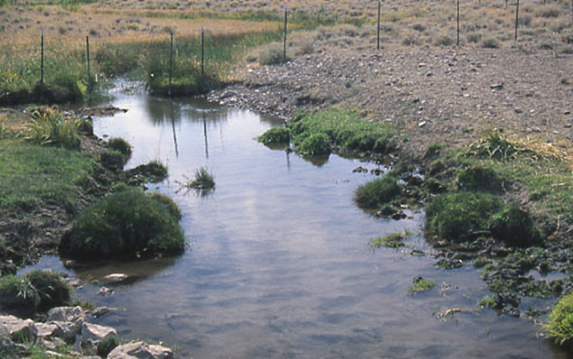






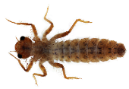


Aquatic life impairments are visible and quantifiable.

Slide 10
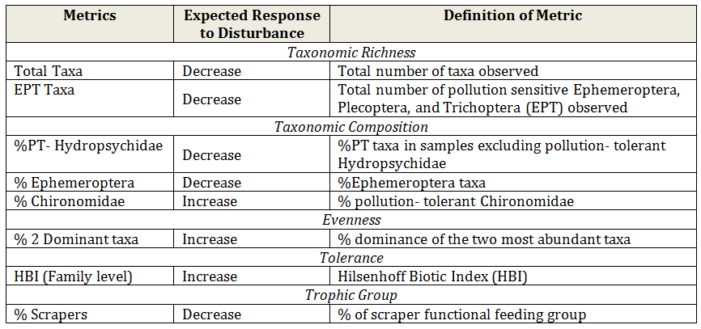
Virginia Stream Condition Index (VSCI)
Benthic macroinvertebrates are collected, sorted, and identified
Each sample produces a score that is driven primarily by the types and diversity of organisms found
Pollution sensitivity affects the score

Slide 11
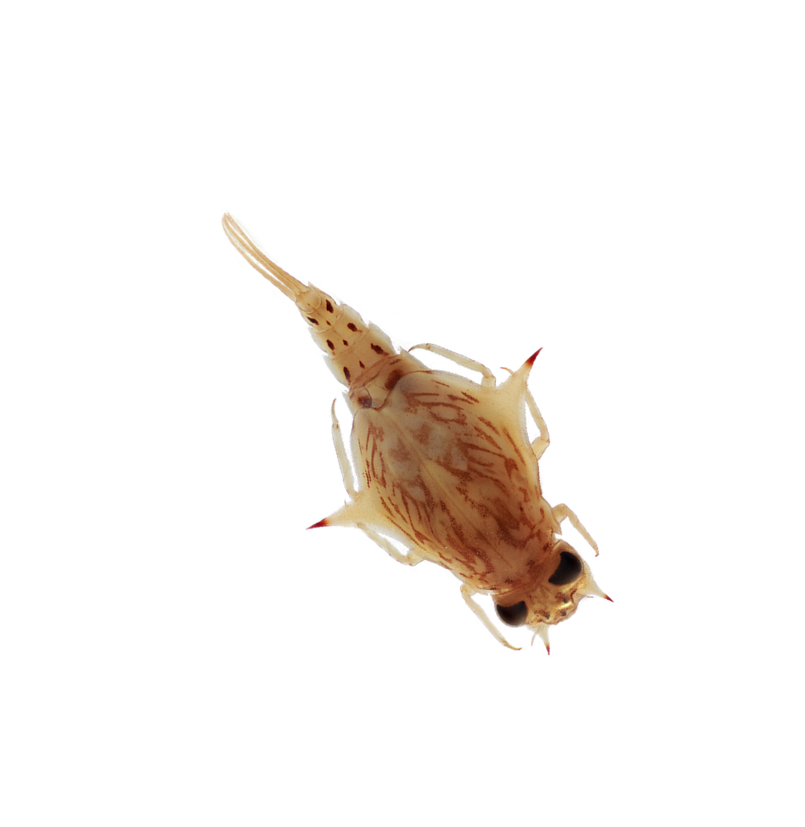
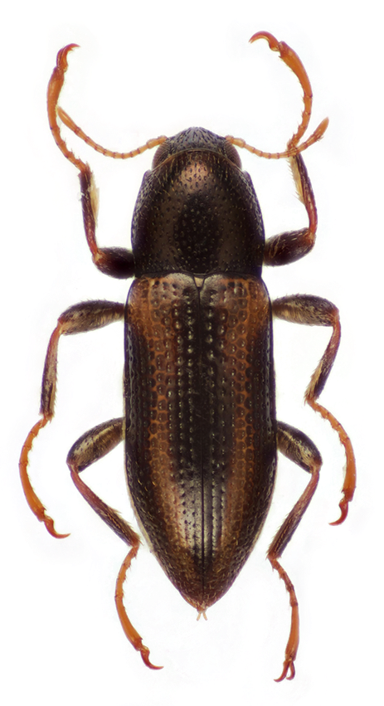

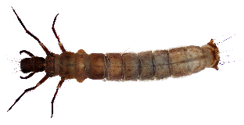
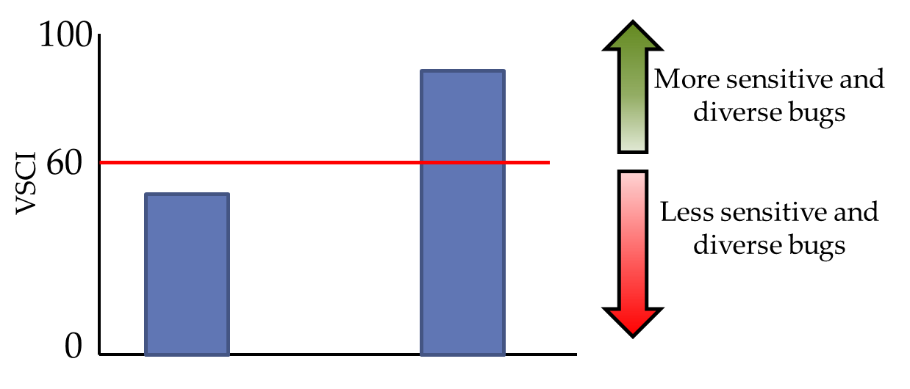
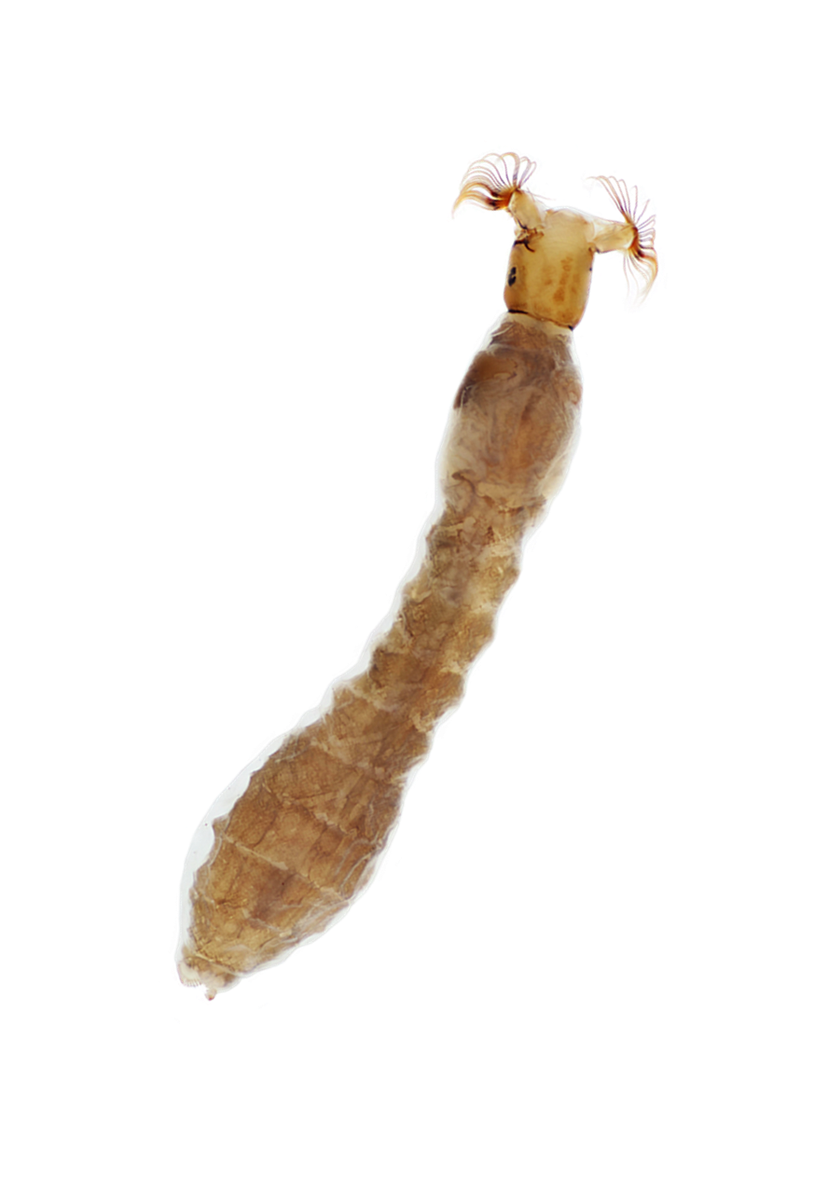
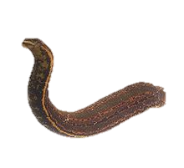
Virginia Stream Condition Index (VSCI)
VSCI scores tell us that there is an impairment but not what the pollutant is…

Slide 12
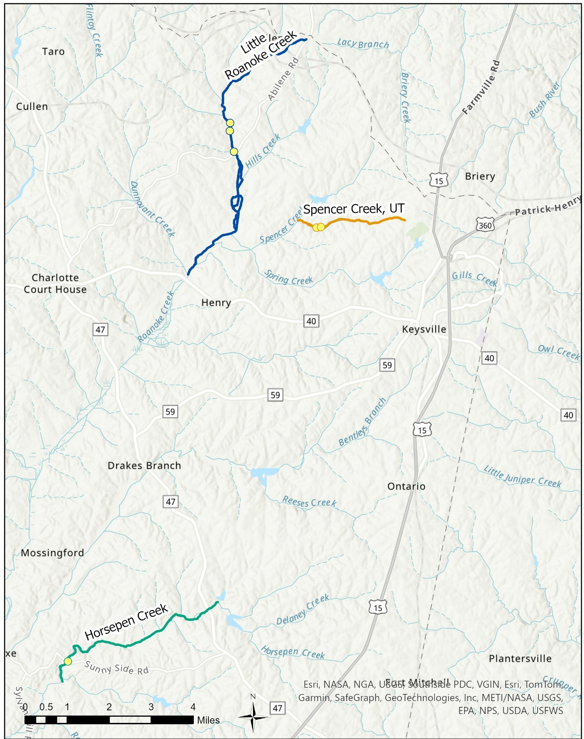

Slide 13
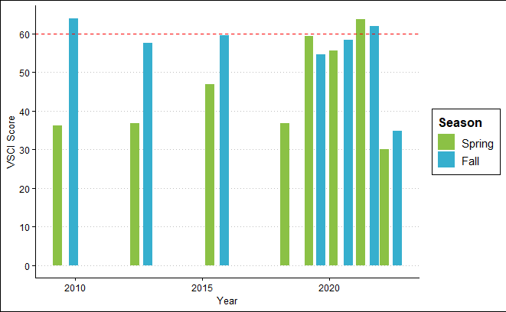
Horsepen Creek Biomonitoring Data
Station: 4AHEN004.27
Low VSCI scores are driven by % Mayflies, % Stoneflies and Caddisflies, and % Scrapers

Slide 14
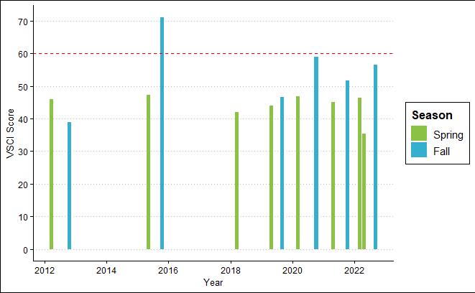
Little Roanoke Creek
Stations: 4ALRO010.18, 4ALRO010.68, 4ALRO010.88
Low VSCI scores are driven by % Mayflies, % Stoneflies and Caddisflies, and % Scrapers

Slide 15
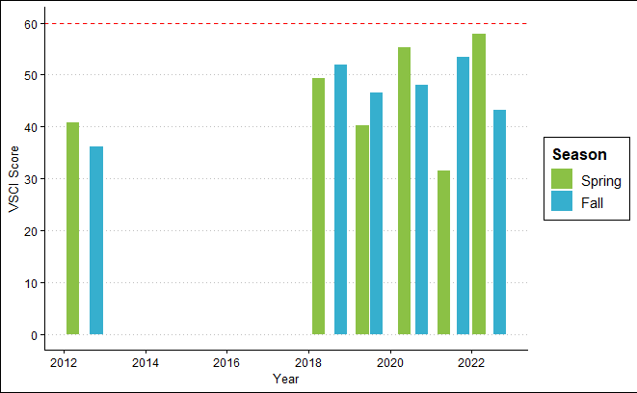
Unnamed tributary to Spencer Creek
Stations: 4AXVO000.50, 4AXVO000.60
Low VSCI scores are driven by % Mayflies, % Stoneflies and Caddisflies, and % Scrapers

Slide 16
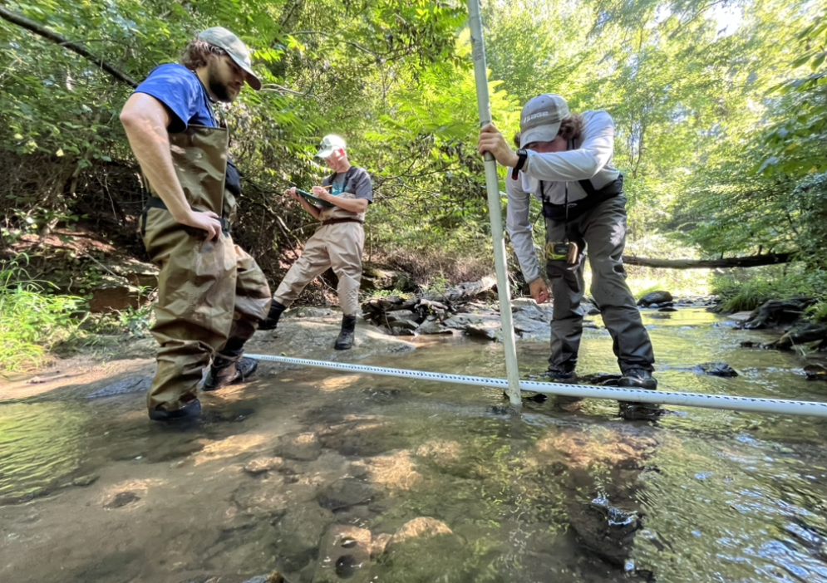
What is a TMDL?
A Total Maximum Daily Load (TMDL) is the maximum amount of a pollutant that a waterbody can receive and still meet water quality standards.
A TMDL includes:
  Identifying sources of pollution causing impairments
    Aquatic Life Impairment
  Modeling their path to the stream
  Determining the reductions needed from each source to meet the standard

Slide 17
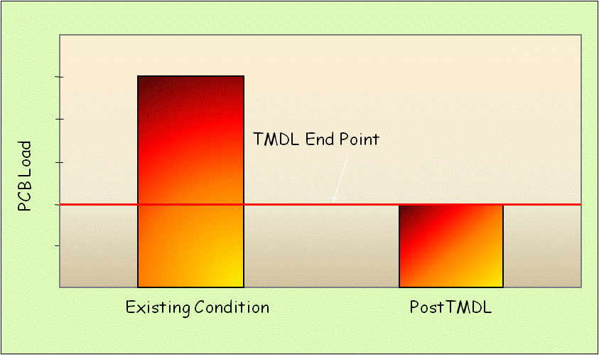
TMDL? A kind of “Pollution Diet”
TMDL Endpoint
Pollutant load in the stream currently
Pollutant load the stream can accept and meet WQS

Slide 18
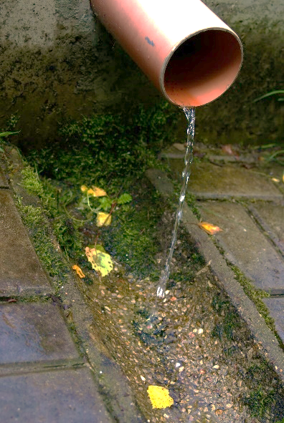
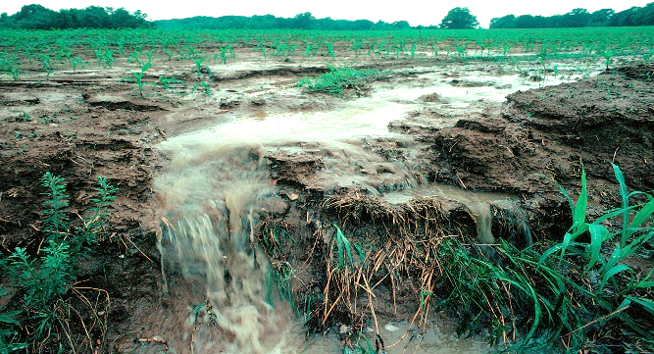
TMDL? A kind of “Pollution Diet”
Water pollution is described by its source. There are two source types,
Point Sources and Non-Point Sources.
Pollution from a point source comes from a direct discharge (ie. effluent discharged to river through an overflow or pipe). Pollution from a non-point source comes from indirect contributions such as stormwater runoff, wind erosion, groundwater seepage, etc.
Pollution Load is the total pollutant from both sources being transported downstream by river flows.
TMDL Endpoint
Pollutant load in the stream currently
Pollutant load the stream can accept and meet WQS

Slide 19

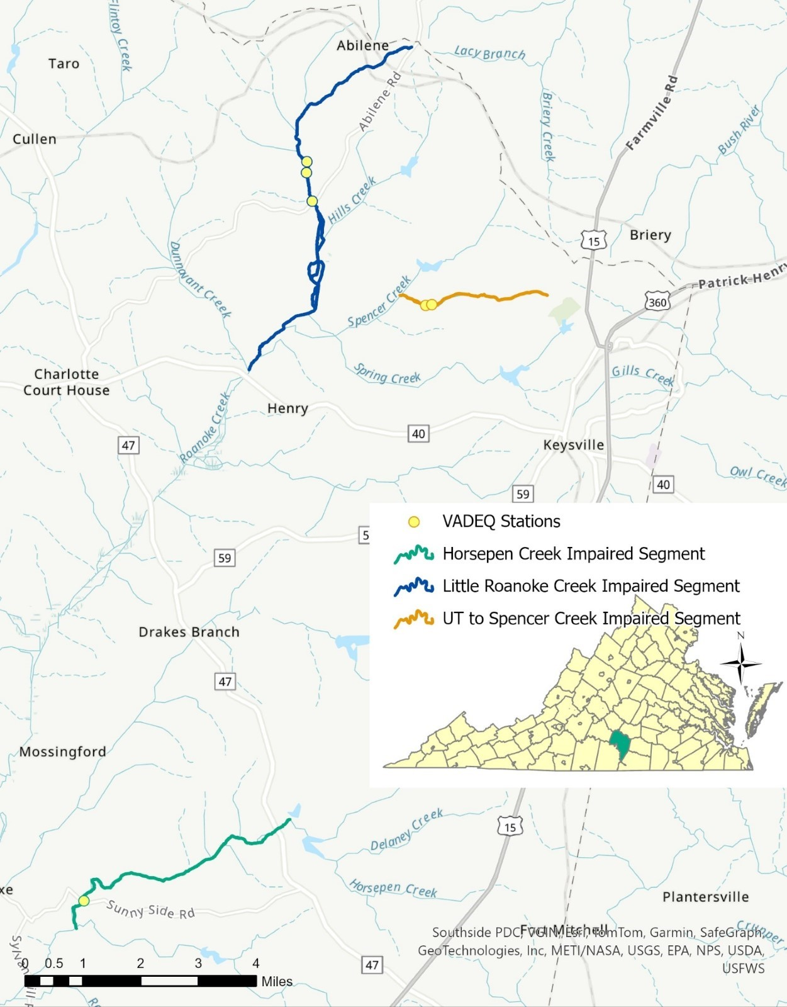
What pollutants may be leading to aquatic life impairments in Horsepen, Little Roanoke, and the unnamed tributary to Spencer Creek?

Slide 20
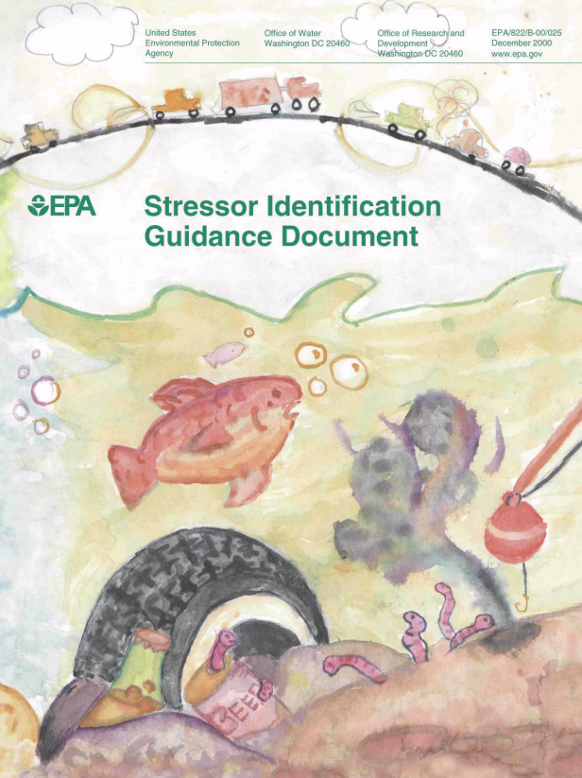
Benthic Stressor Analysis
The goal of the benthic stressor analysis is to identify the pollutant(s) responsible for causing the benthic impairment.
Analysis is done using EPA’s Causal Analysis/Diagnosis Decision Information System (CADDIS) approach.
  Identify potential causes
  Analyze lines of evidence
  Determine the probable cause(s)

Slide 21
Available Data
Stream Name | Station | Benthic Sampling |  | Water Quality Sampling
 |  | Monitoring Period | Samples Collected | Monitoring Period | Samples Collected
Horsepen Creek | 4AHEN004.27 | 2009-2022 | 15 | 2009-2022 | 32
Little Roanoke Creek | 4ALRO010.18 | 2012-2022 | 13 | 2012-2022 | 44
 | 4ALRO010.68 | 2007 | 2
 | 4ALRO010.88 | 2022 | 2 | 2022 | 3
UT Spencer Creek | 4AXVO000.50 | 2012-2022 | 18 | 2012-2022 | 12
 | 4AXVO000.60 |  |  | 2019-2020 | 17
Reference Watershed Station
Reedy Creek | 4ARDD002.09 | 2020-2021 | 4 | 2020-2021 | 4
7 monitoring stations
54 benthic samples collected
95 water quality sampling events
Dataset from 2007-2022, 15 years of monitoring
1 local reference stream

Slide 22
“Stressors” Analyzed
Physical Stressors: sedimentation and physical habitat
Water Chemistry Stressors: temperature, pH, dissolved oxygen, conductivity, total dissolved solids, and dissolved ions (sodium, potassium, chloride, sulfate)
Nutrient Stressors: nitrogen and phosphorus
Dissolved Metals: calcium, magnesium, arsenic, barium, beryllium, cadmium, chromium, copper, iron, lead, manganese, thallium, nickel, silver, zinc, antimony, aluminum, and selenium
Some of these candidates have direct negative effects on aquatic life, metal toxicity for example. Other candidates are factors that are byproducts or precursors of another candidate, low dissolved oxygen levels caused by nutrient enrichments leading to eutrophication for example.

Slide 23

Evidence Examination
8 lines of Evidence were examined
  Ex. biological effect must be observed where the potential stressor is observed
  Ex. biological measurements characteristic of one or a few specific stressors
All the evidence is scored
Future modeling will look at even more evidence to develop the total maximum daily load equation

Slide 24




Causal Analysis/Diagnosis Decision Information System (CADDIS) approach
Probable Stressors
TMDL
ALL available data
Potential Stressors
Evidence Examination
Possible Stressors
Unlikely Stressors

Slide 25
Draft Results
Horsepen Creek:
Phosphorus
Possible Stressors: Sediment, Dissolved Oxygen, Physical Habitat
Little Roanoke Creek:
Sediment and Dissolved Oxygen
Possible Stressors: Phosphorus
Unnamed Tributary to Spencer Creek:
Sediment
Possible Stressors: Physical Habitat and Phosphorus
Probable Stressors
TMDL

Slide 26
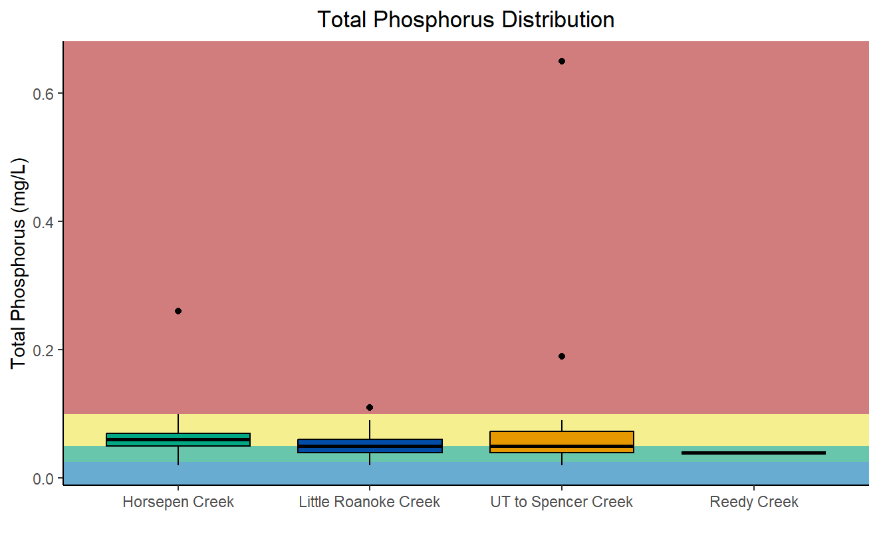
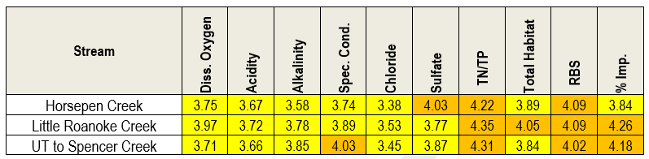
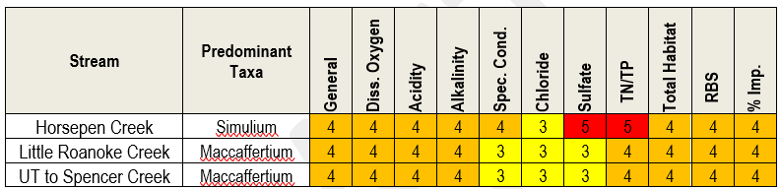
Some Supporting Lines of Evidence – Phosphorus

Slide 27
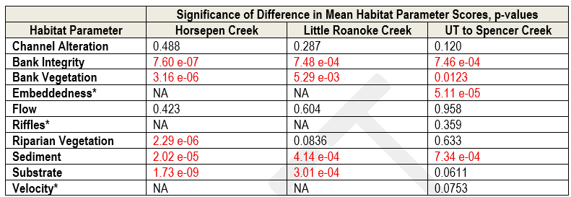
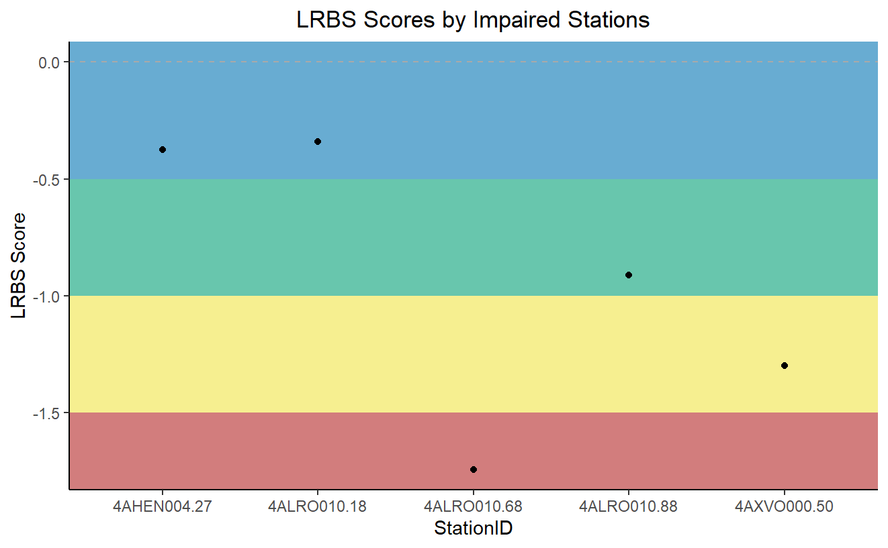
Some Supporting Lines of Evidence – Sediment

Slide 28
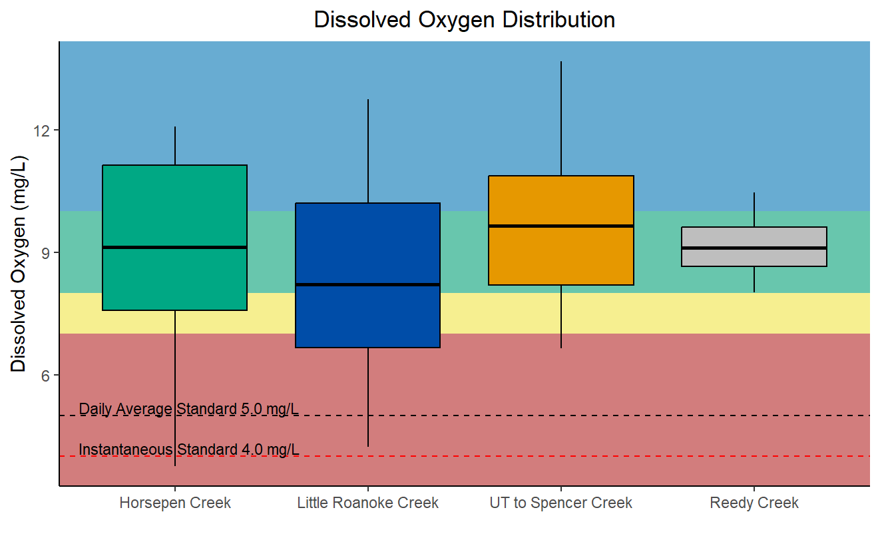
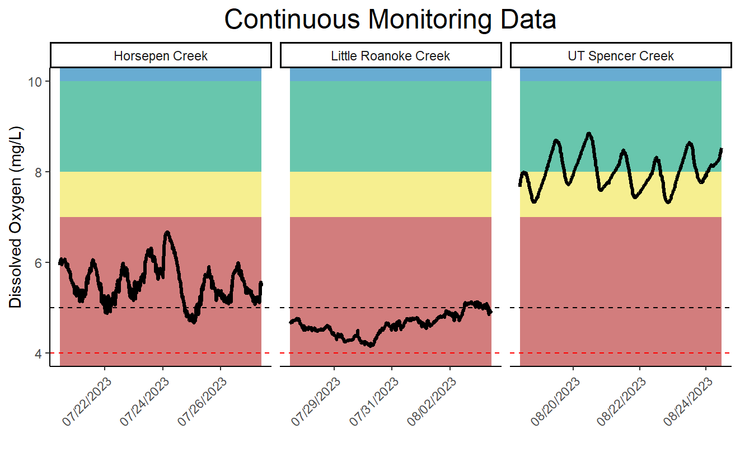
Some Supporting Lines of Evidence – Dissolved Oxygen

Slide 29
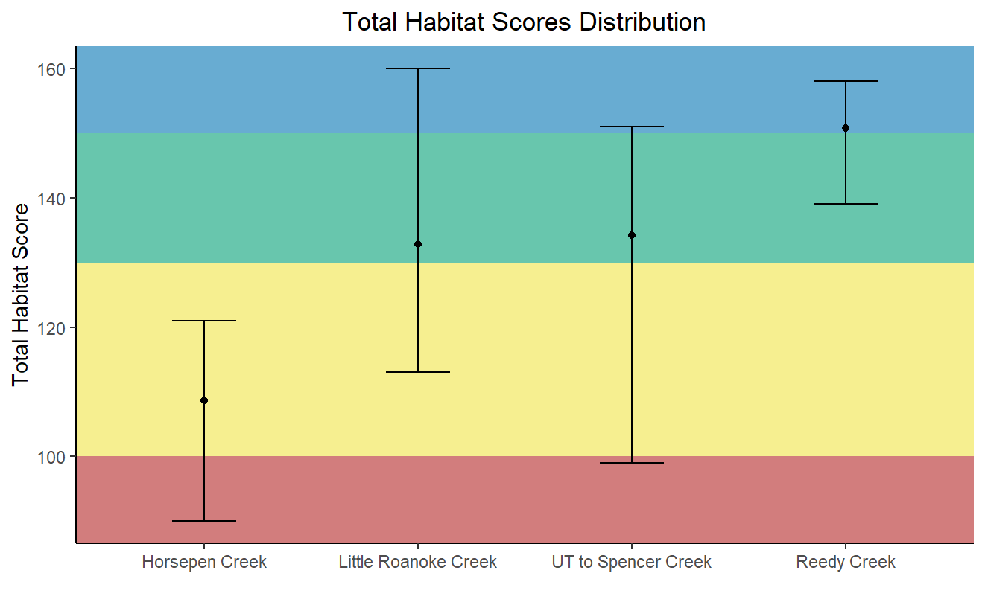
Some Supporting Lines of Evidence – Physical Habitat

Slide 30
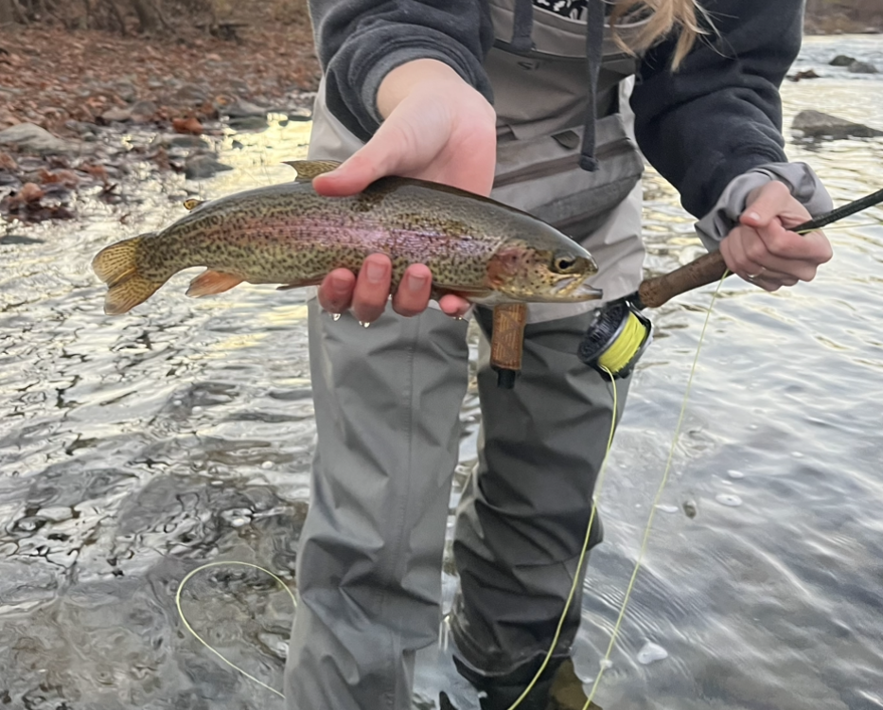
Community Engagement Meeting or
TMDL Advisory Group?
Community Engagement Meetings
  Open to the public
  Anyone in attendance can participate & advise DEQ on TMDL development
TMDL Advisory Group (TAG)
  Set-up upon request
  Replaces community engagement meetings
  Formal panel with approved membership that advises DEQ on TMDL development
    Cross-section of stakeholders
    Members commit to attend multiple meetings
  Open to the public but non-members may only attend as observers

Slide 31



TMDL Development: The Study Continues
Identify Point Sources
  Permitted discharges
  Construction Permits
Identify Non-point Sources
  Land Use
  Natural hydrologic properties of the area

Slide 32


TMDL Development: The Model & Reductions
Adjust
Calibration
Parameters
No
Watershed
Inputs
Model Outputs
Match Observed Data?
Yes
Meet TMDL Endpoints?
Yes
Computer Model
TMDL
Complete
No
Revise Pollutant Reduction
Scenarios Until We Meet
TMDL Endpoints

Slide 33



TMDL Development: The Equation of the Pollution Load
WLA
LA
Wasteload Allocation
Permitted/Point Sources
MOS
TMDL
Load Allocation
Non-point Sources
Margin of Safety
Extra load to account for uncertainty
Total Maximum Daily Load

Slide 34


What happens next…
*****February 14th, 2025*****
https://www.deq.virginia.gov/our-programs/water/water-quality/tmdl-development/tmdls-under-development
January 15, 2024
EPA and SWCB Approval
Completed Benthic Stressor Analysis
First Public Meeting
Public Comment Period
TMDL Development/
Community Engagement Meetings/TAG Meetings
Final Public Meeting
Public Comment Period
30 Days
Opportunity for you to participate

Slide 35

For comments: aerin.doughty@deq.virginia.gov or 901 Russell Drive Salem, VA 24153
The 30-day public comment period ends February 14th, 2025.
To learn more about TMDLs, visit DEQ’s website: https://www.deq.virginia.gov/our-programs/water/water-quality/tmdl-development
To view the Stressor Analysis Document: https://www.deq.virginia.gov/our-programs/water/water-quality/tmdl-development/ tmdls-under-development
Comments, Thoughts, & Questions

