Slide 1
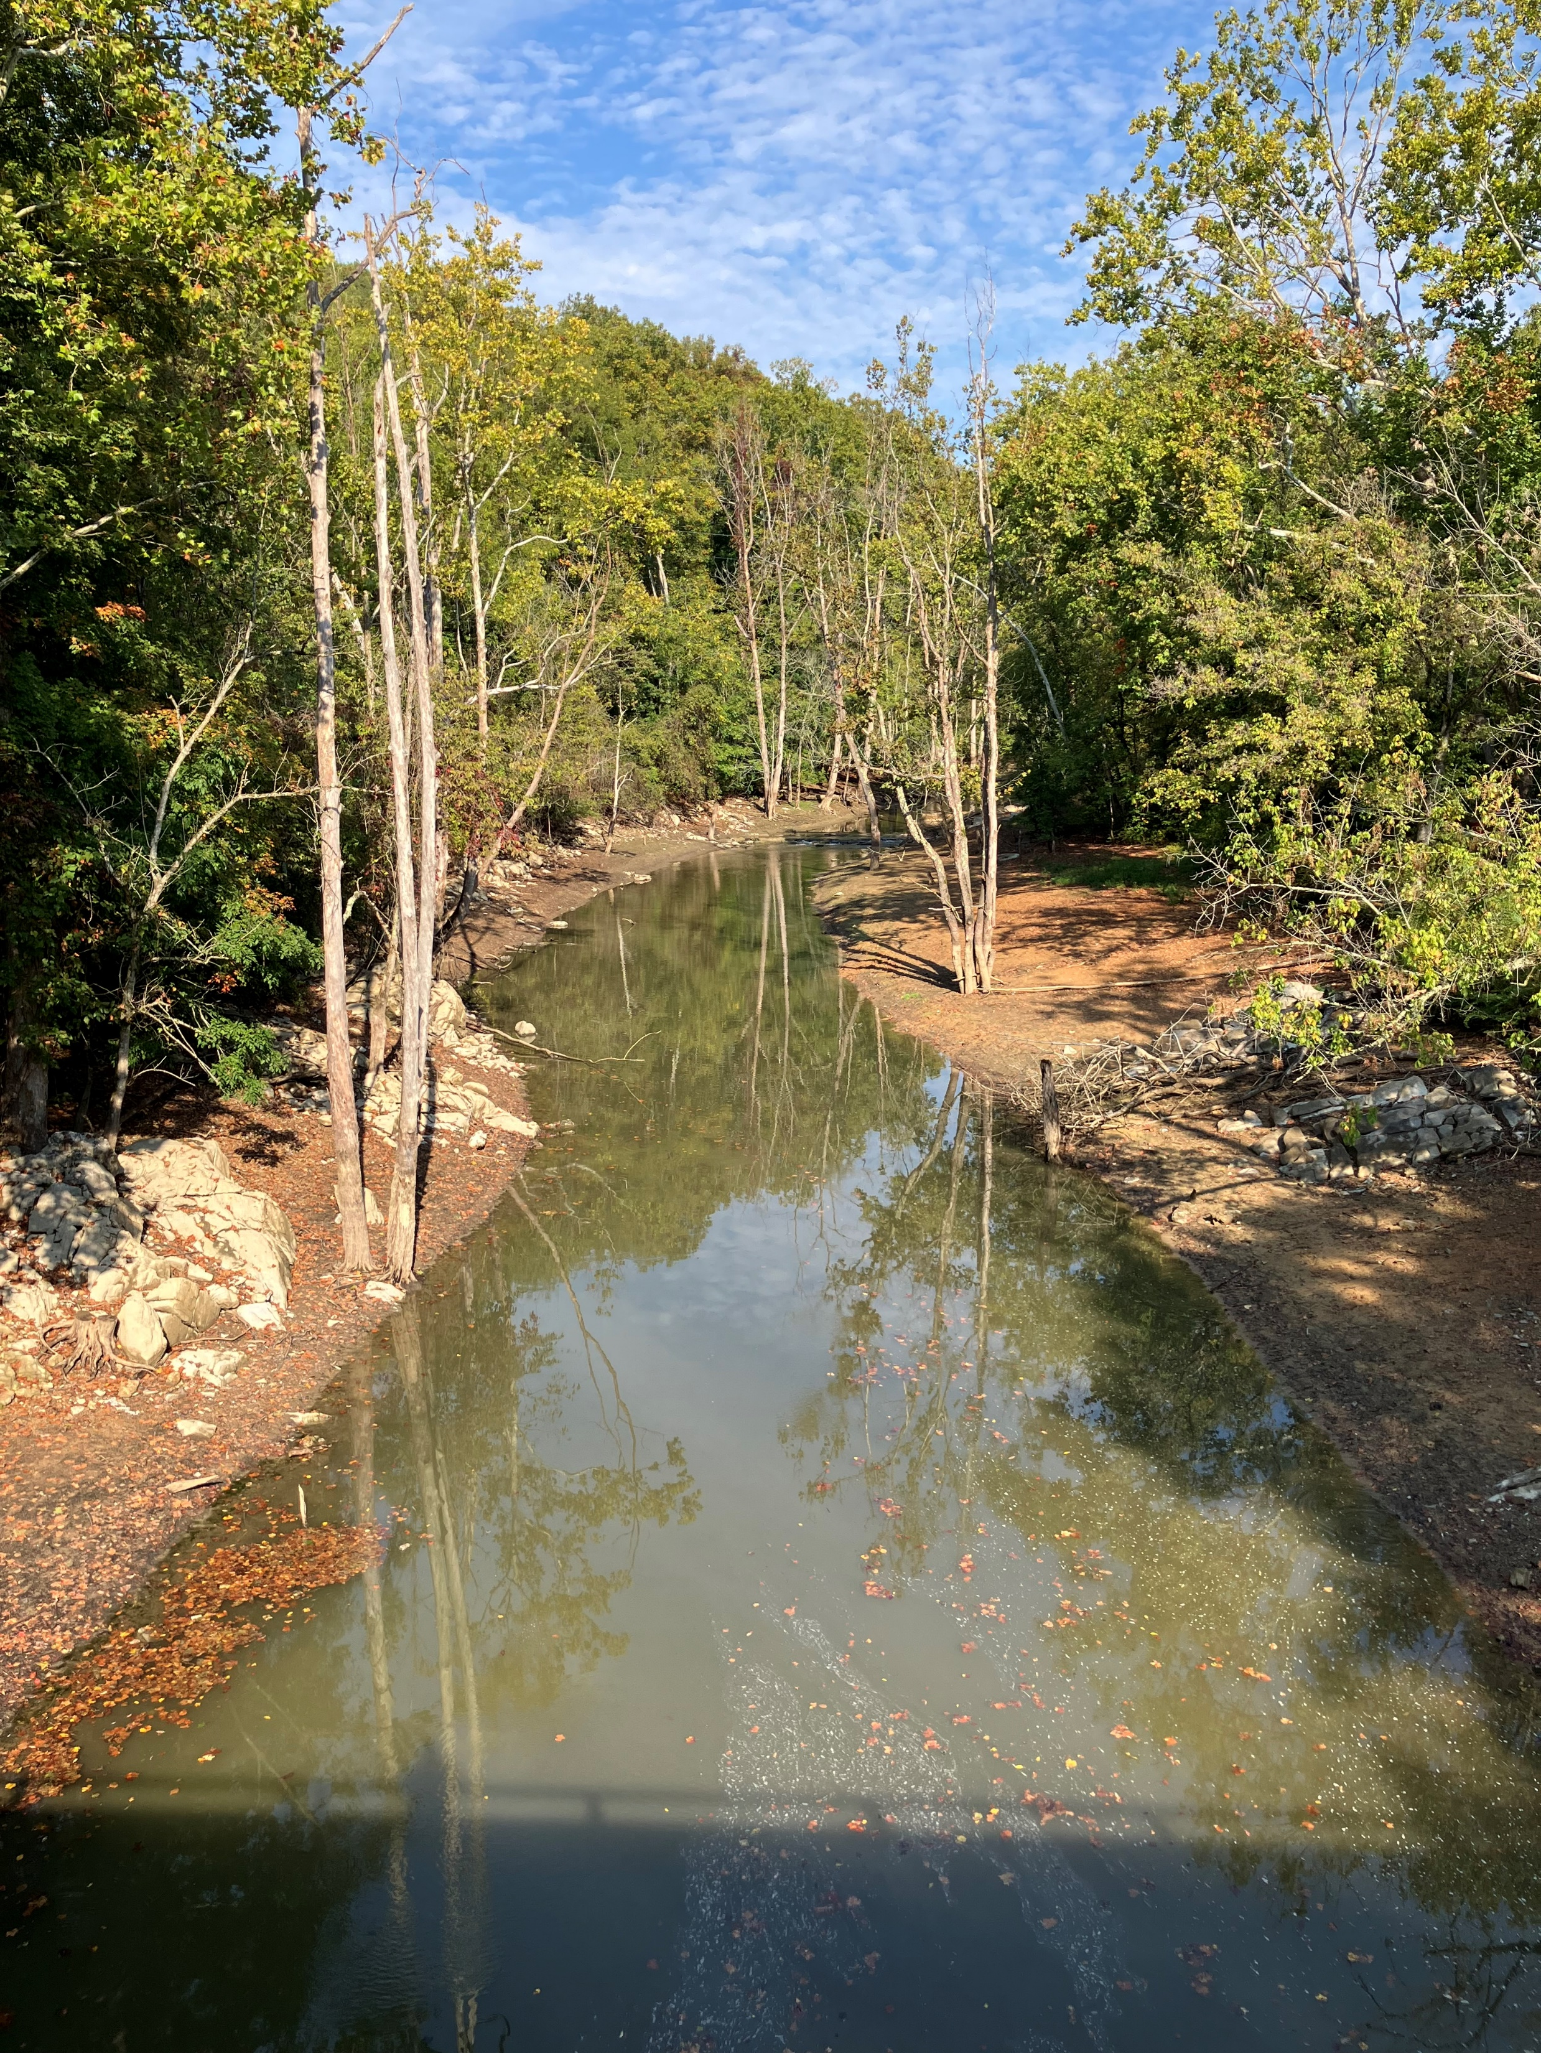
Wolf Creek Watershed Clean Up Study
Initial Public Meeting
Landon Jenkins
TMDL Coordinator, SWRO Regional Office
October 16, 2024

Slide 2
Goals for our meeting
Share what we know about Wolf creek:
Summarize monitoring data, discuss pollutants
Describe process we will use to identify and
address pollution in the streams
Describe how you can get involved in this process
Answer your questions about this effort

Slide 3
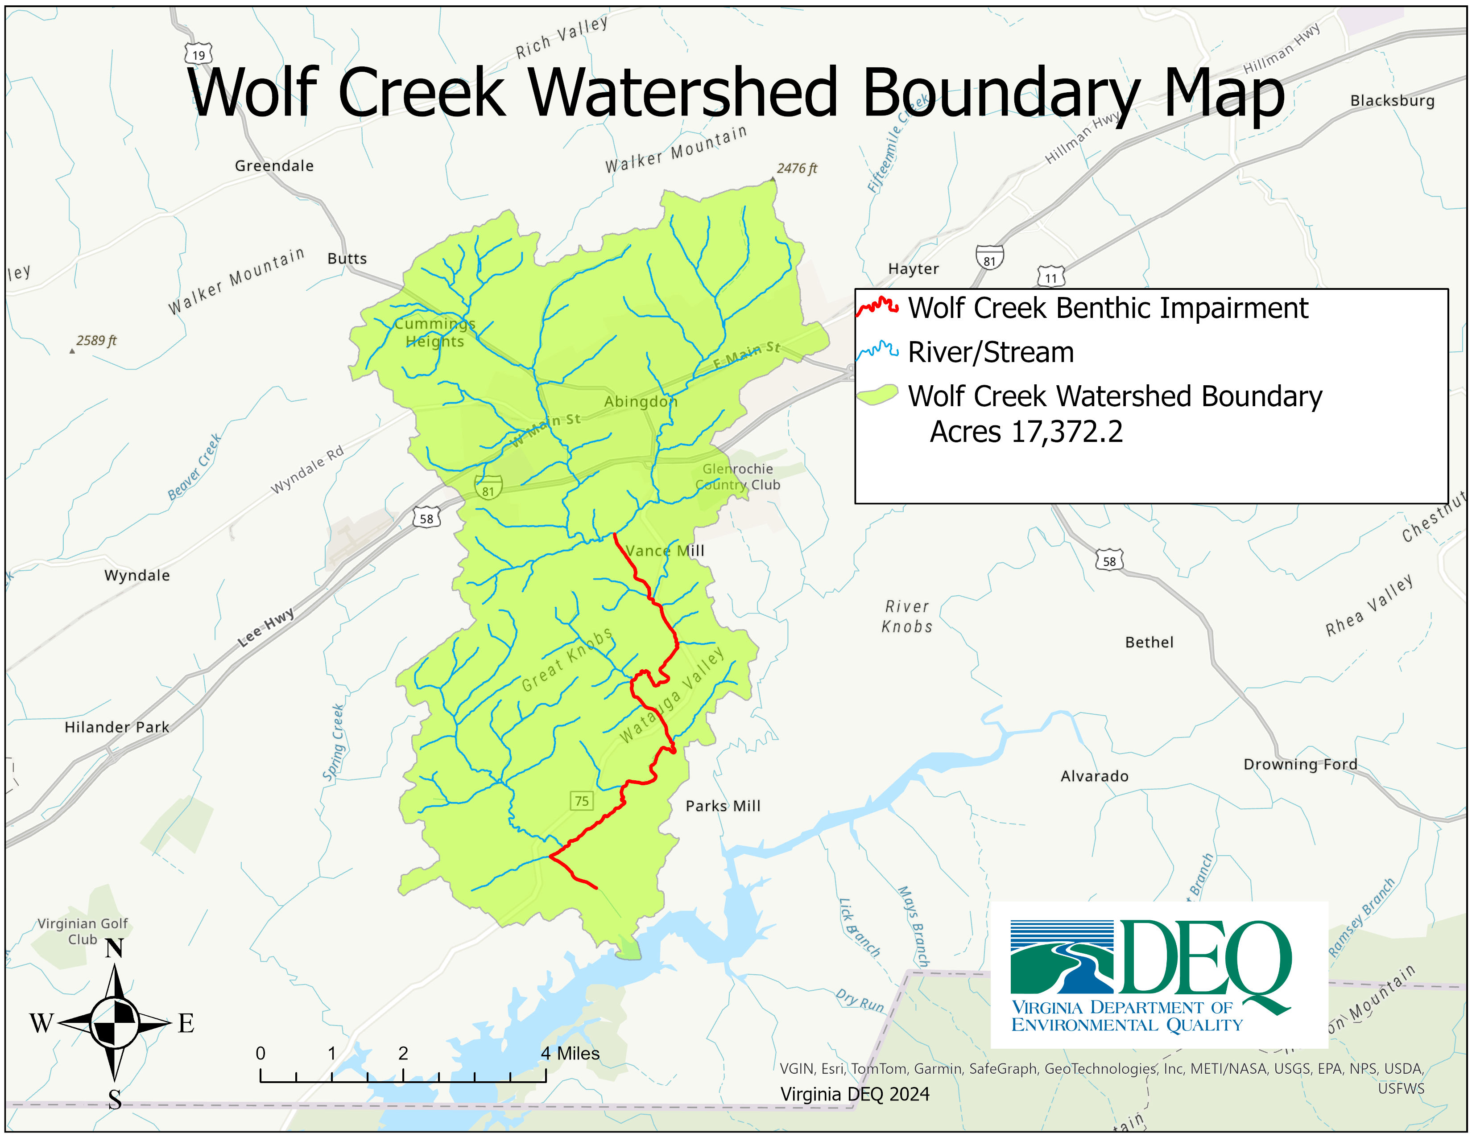

Slide 4

Why a study?
Photo: Jan Hamrsky: lifeinfreshwater.net
Water quality standards designate six uses for surface waters in Virginia. These include:
  Aquatic life
  Fish consumption
  Public water supplies (where applicable)
  Recreation (swimming)
  Shellfishing
  Wildlife

Slide 5
Aquatic Life Designated Use
What does this mean?
All waters should support “the propagation and growth of a balanced, indigenous population of aquatic life”
Benthic impairments, result from violations of the general standard narrative that “waters should be free from substances that are harmful to aquatic life”
Monitor benthic macroinvertebrates (the bugs on the stream bottom) to determine if the standard is met

Slide 6
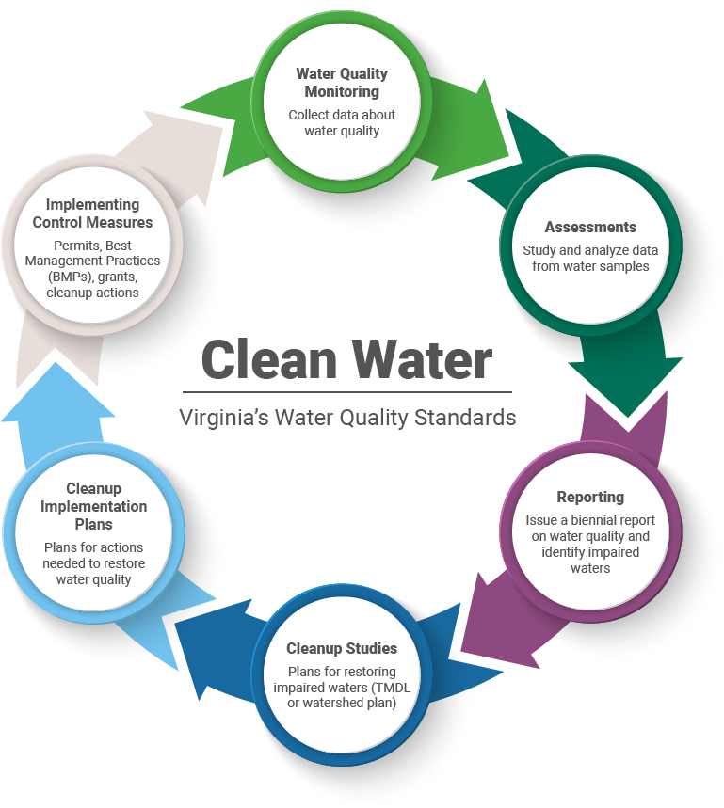

Slide 7
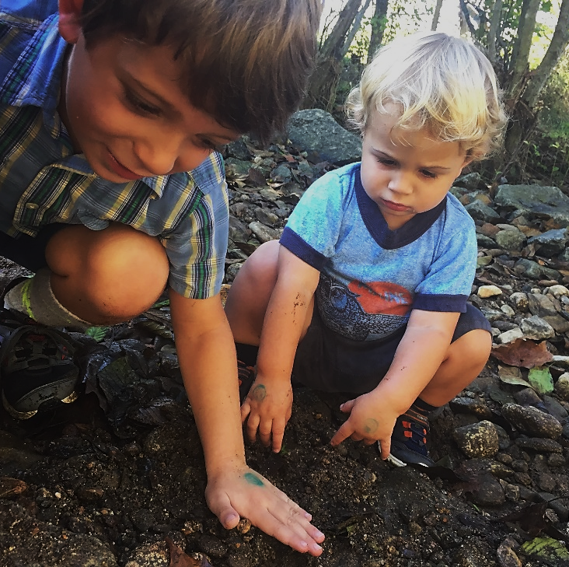
Why should we care about bugs?
Consume algae and organic matter → nutrient cycling
Aquatic food chain
Our “canary in the coal mine”
Chemical monitoring =
a snapshot in time
  Long lived
  Relatively immobile

Slide 8

Determining a biological impairment
DEQ biological monitoring data (spring and fall)
VA Stream Condition Index is our barometer
  Diversity, pollution tolerance, feeding group
  Target score of ≥60

Slide 9

Sensitive to pollution: Mayflies
Sensitive to pollution: Mayflies
Photo: Jan Hamrsky: lifeinfreshwater.net

Slide 10

Caddisflies
Sensitive to pollution: Caddisflies
Photo: Jan Hamrsky: lifeinfreshwater.net

Slide 11
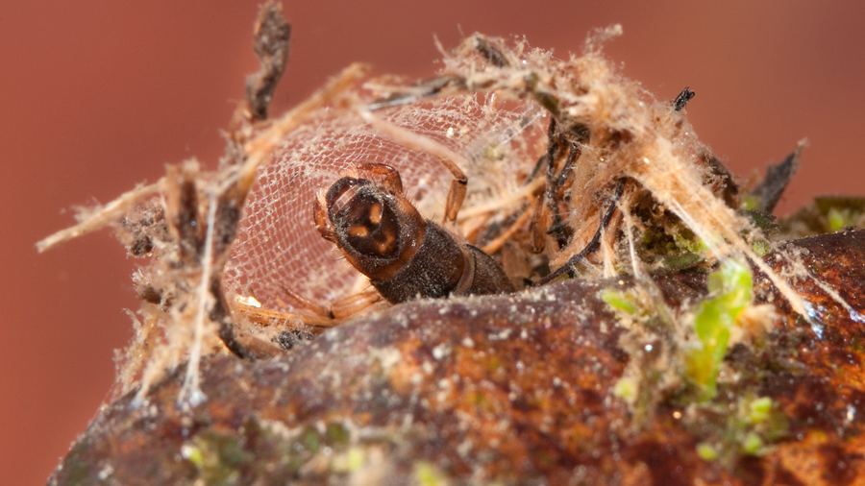
Net spinning caddisfly
Photo: Jan Hamrsky: lifeinfreshwater.net

Slide 12

Moderately Sensitive: Dragonflies
Photo: Jan Hamrsky: lifeinfreshwater.net

Slide 13

Insensitive to Pollution: Blackflies
Photo: Jan Hamrsky: lifeinfreshwater.net

Slide 14




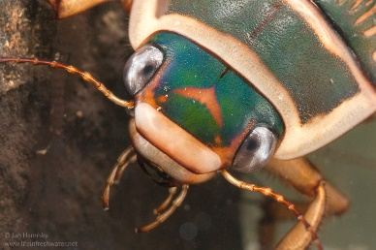
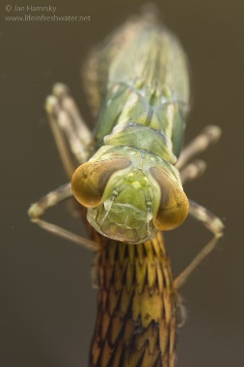

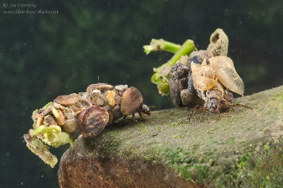
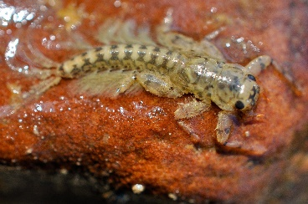
Virginia Stream Condition Index
60
40
20
Photos: Jan Hamrsky: lifeinfreshwater.net

Slide 15
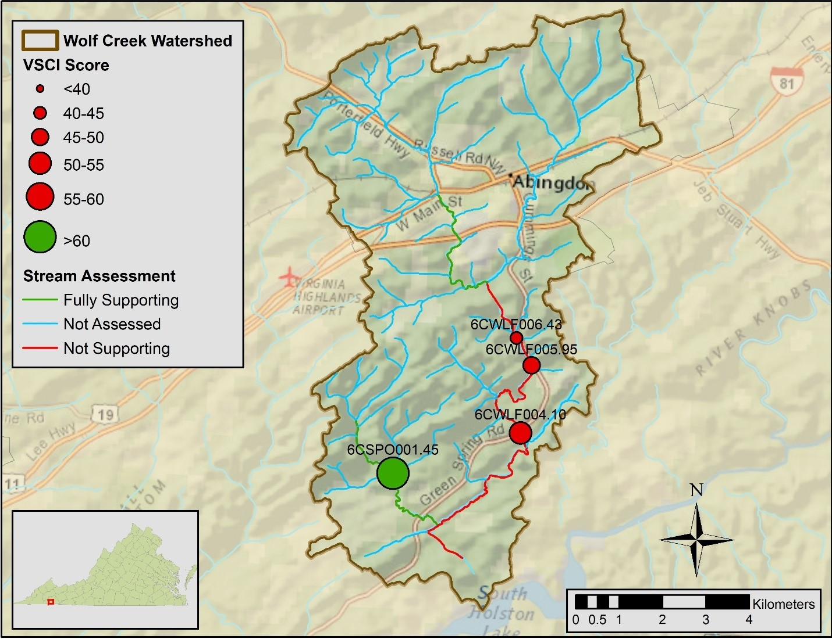
Wolf Creek Benthic Monitoring Stations
Notes:
Extrapolation, assumes due to no land changes the lower segment will also be impaired

Slide 16
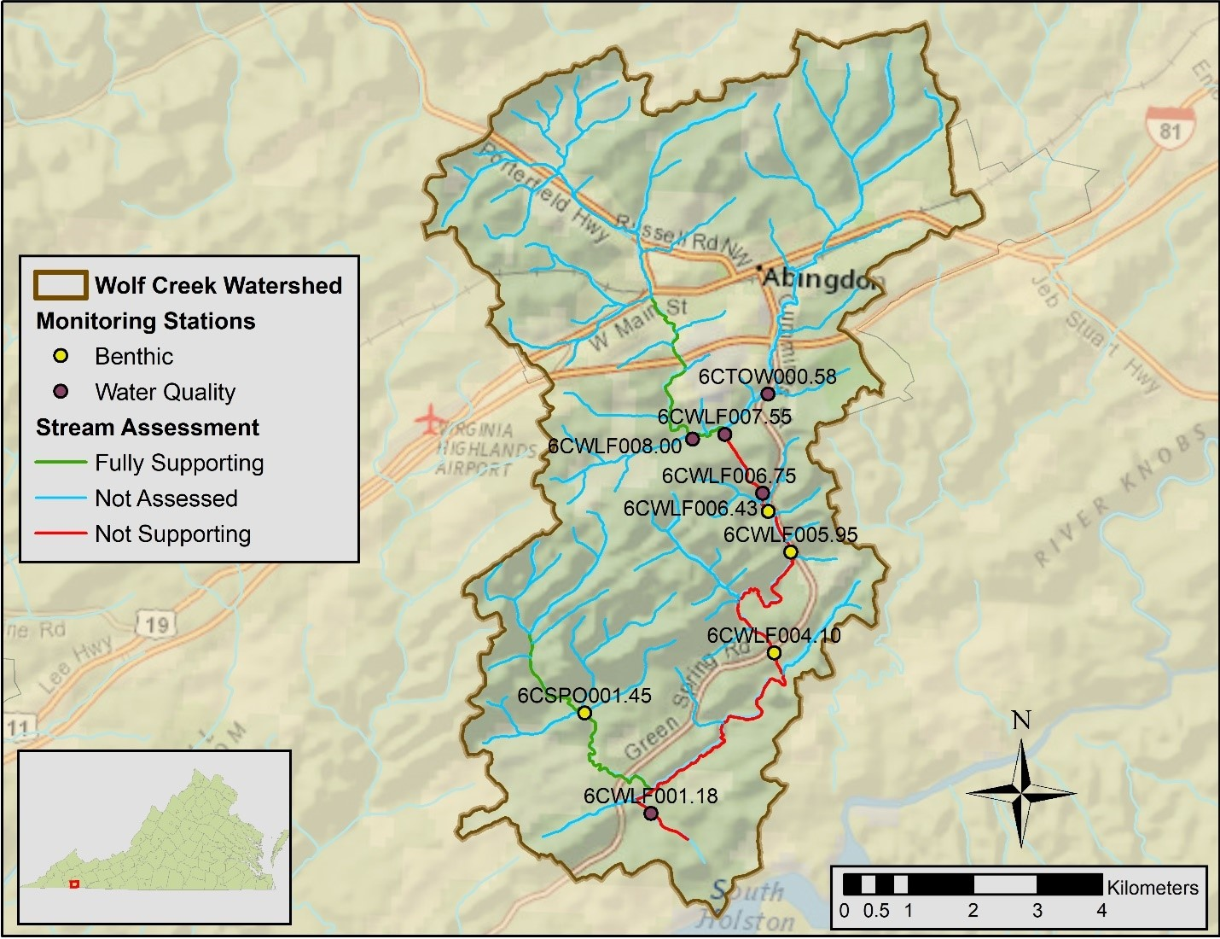
Impairment Units And Impairment Map
Stream Name | NWBD | Impaired Assessment Units | Cause Group Code | First listed | Length (miles) | Impairment Description
Wolf Creek | TH16 | VAS-O06R_WLF01A98 | O06R-01-BEN | 2002 | 3.33 | Lower mainstem from Town Creek confluence through the Great Knobs, downstream to upper Rt. 75 bridge
Wolf Creek | TH16 | VAS-O06R_WLF03A06 | O06R-01-BEN | 2006 | 2.93 | From upper Rt. 75 bridge near Abingdon downstream to lower Rt. 75 bridge near Green Spring
Wolf Creek | TH16 | VAS-O06R_WLF02B06 | O06R-01-BEN | 2006 | 0.41 | From VDOT bridge number 6035 near Green Spring downstream to South Holston Lake backwaters

Slide 17
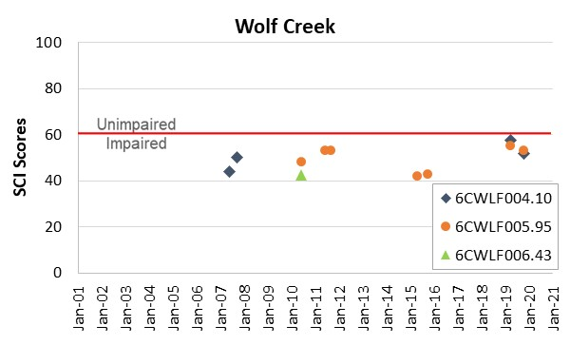
Temporal Trends in Benthic Data For Wolf Creek

Slide 18
The Benthic Stressor Analysis
The Virginia Department of Environmental Quality (VDEQ) contracted Wetland Studies and Solutions, Inc. and James Madison University (JMU) to conduct a stressor identification analysis for benthic impairments in Wolf Creek in Washington County, VA. Wolf Creek drains most of the Town of Abingdon, Virginia, flows south, and empties into South Holston Lake

Slide 19
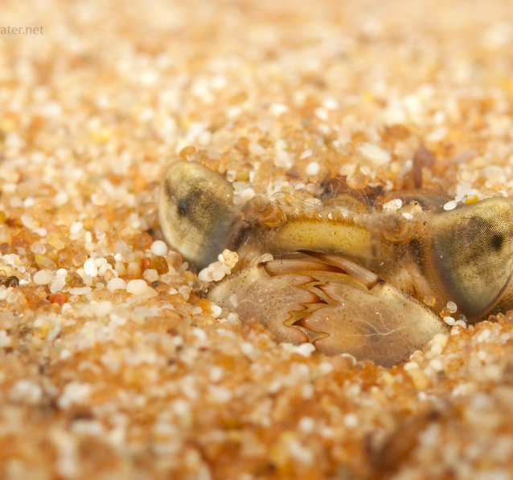
Biological Impairments
Determining the Cause…
How the benthic stressor analysis works
  Evaluation of monitoring data
  Comparison with healthy reference watershed data and stressor thresholds
  Weight of evidence approach-evaluates all data
  Identification of most likely stressor(s)
Photo: Jan Hamsky; www.lifeinfreshwater.net
Notes:
Weight of Evidence approach evaluates all available information on potential candidate stressors by listing potential candidate stressors identified from the listing information, monitoring data, scientific literature and historic information

Slide 20
Candidate Stressors
Suspended solids
Deposited sediment
Dissolved oxygen
Phosphorus
Nitrogen
Ammonia
Total dissolved ions
Dissolved chloride
Dissolved sulfate
Dissolved sodium
Dissolved potassium
Dissolved metals
Temperature
Conductivity
pH
Organic matter
Sediment metals
Sediment toxics
Pesticides
Polycyclic Aromatic Hydrocarbons (PAHs)
Polychlorinated Biphenyls (PCBs)

Slide 21
CADDIS
In this step, James Madison University (JMU) used the Causal Analysis/Diagnosis Decision Information System (CADDIS) (USEPA, 2018a).
The CADDIS approach provides guidance on evaluating various lines of evidence to determine the cause of biological impairments

Slide 22
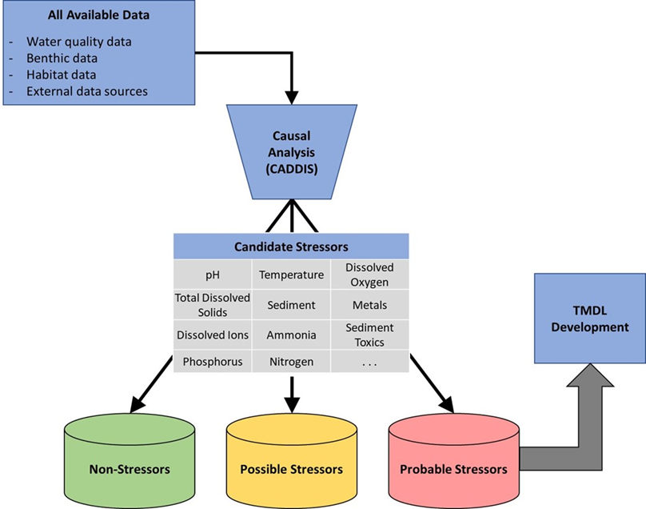
CADDIS APROACH

Slide 23
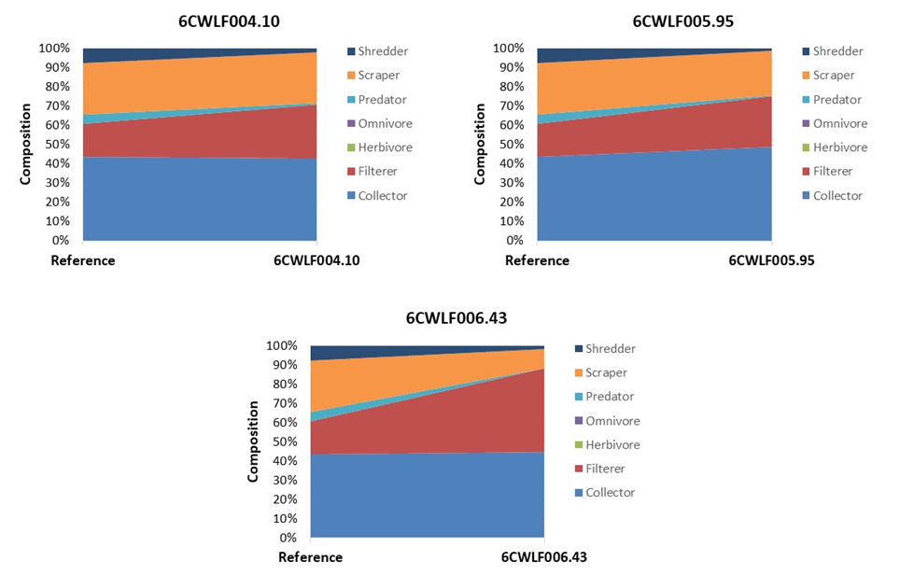
Evidence Of Sediment As A Stressor With an Increase in Filterers
Notes:
This shift in functional feeding group points to an increase in suspended sediment and organic matter. As particulate matter in the water column increases, more food is available for filtering organisms and that feeding niche expands

Slide 24
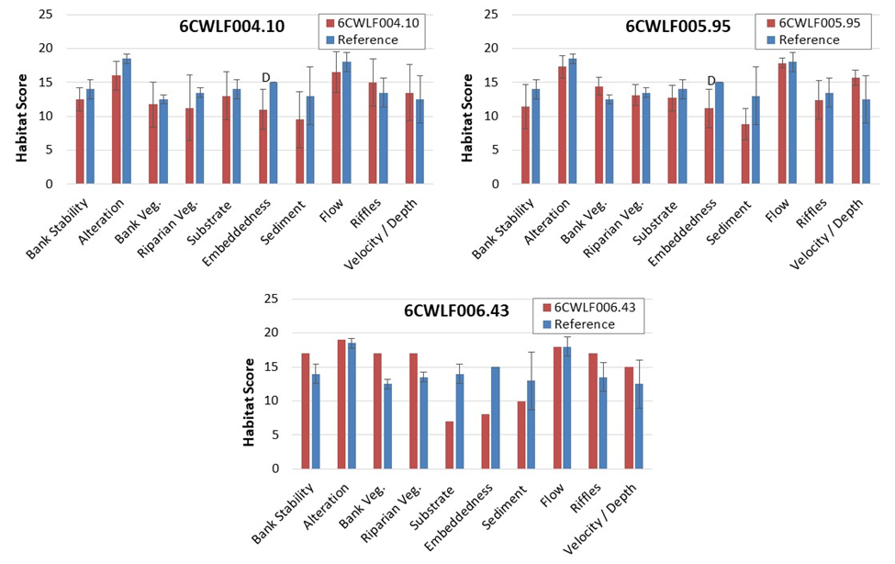
Habitat Measurements

Slide 25






What is a TMDL?
A Total Maximum Daily Load is the maximum amount of a pollutant that a waterbody can receive and still meet water quality standards.

Slide 26
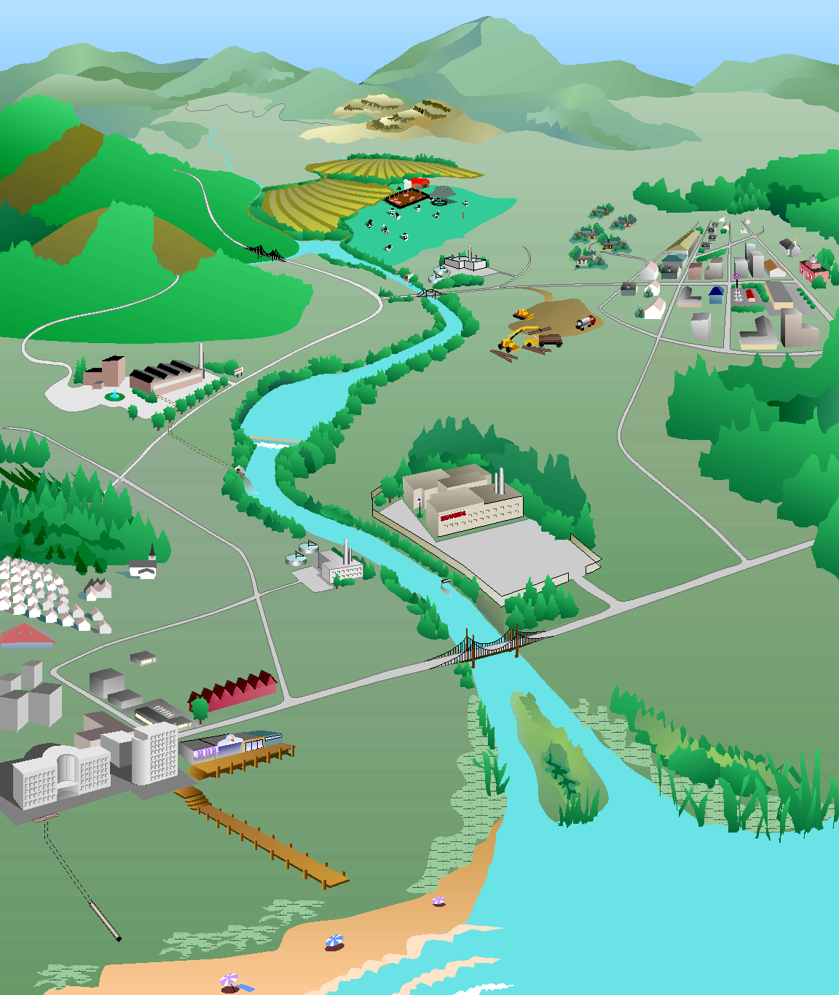
How do we develop a TMDL?
What’s the magic number…
Identify sources of sediment
Model their path to the stream
Determine reductions needed from each source to restore aquatic life
Forest:
0% reduction
Forest:
1 ton/yr
Cropland:
30% reduction
Cropland:
10 tons/yr
Residential:
50% reduction
Residential:
4 tons/yr
Pasture:
40% reduction
Pasture:
12 tons/yr
Urban:
75% reduction
Urban:
8 tons/yr
Impaired stream
Sediment load = 37 tons/yr
TMDL
Sediment load = 19 tons/yr
Point sources:
2 tons/yr
Point sources:
0% reduction
Diagram: Adapted from the Center for TMDL and Watershed Studies at Virginia Tech

Slide 27

This Is More Than Just Numbers
Primary objective is to address pollution in our waterways
TMDL study is the first step
Followed by an implementation plan
Implementation through partnerships with local organizations
Photo: Jan Hamsky; www.lifeinfreshwater.net

Slide 28
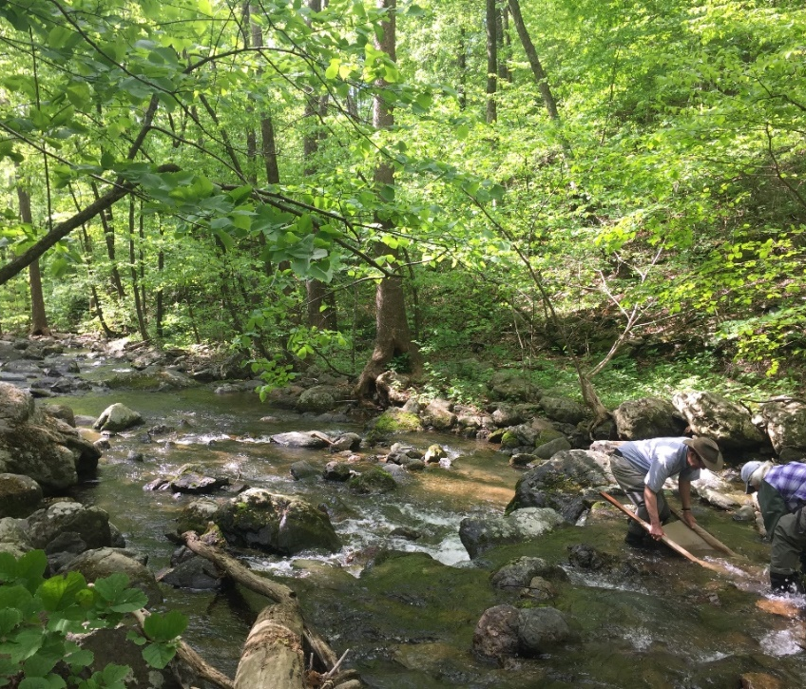
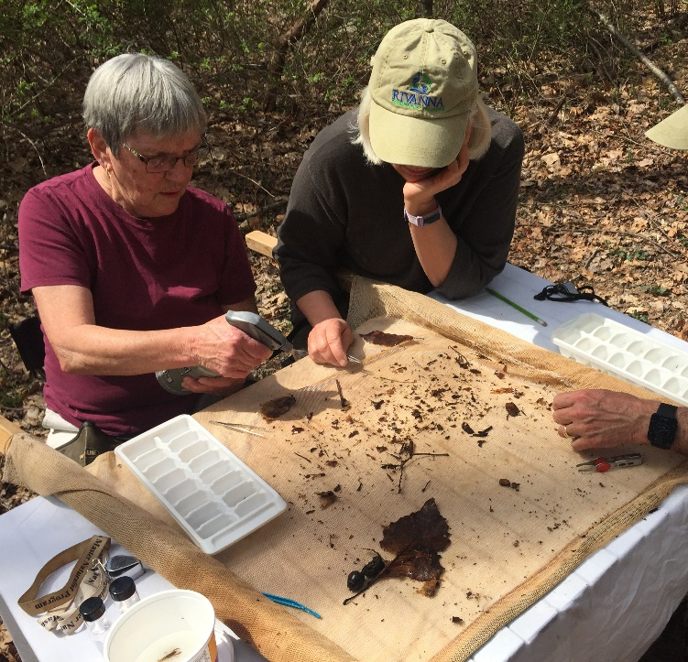
How can you get involved?
We need to hear from you!!!
Participate in Community Engagement Meetings
  Represents the local community
  Provides feedback on
    Land use
    Pollutant sources
    Key stakeholders and community meetings

Slide 29
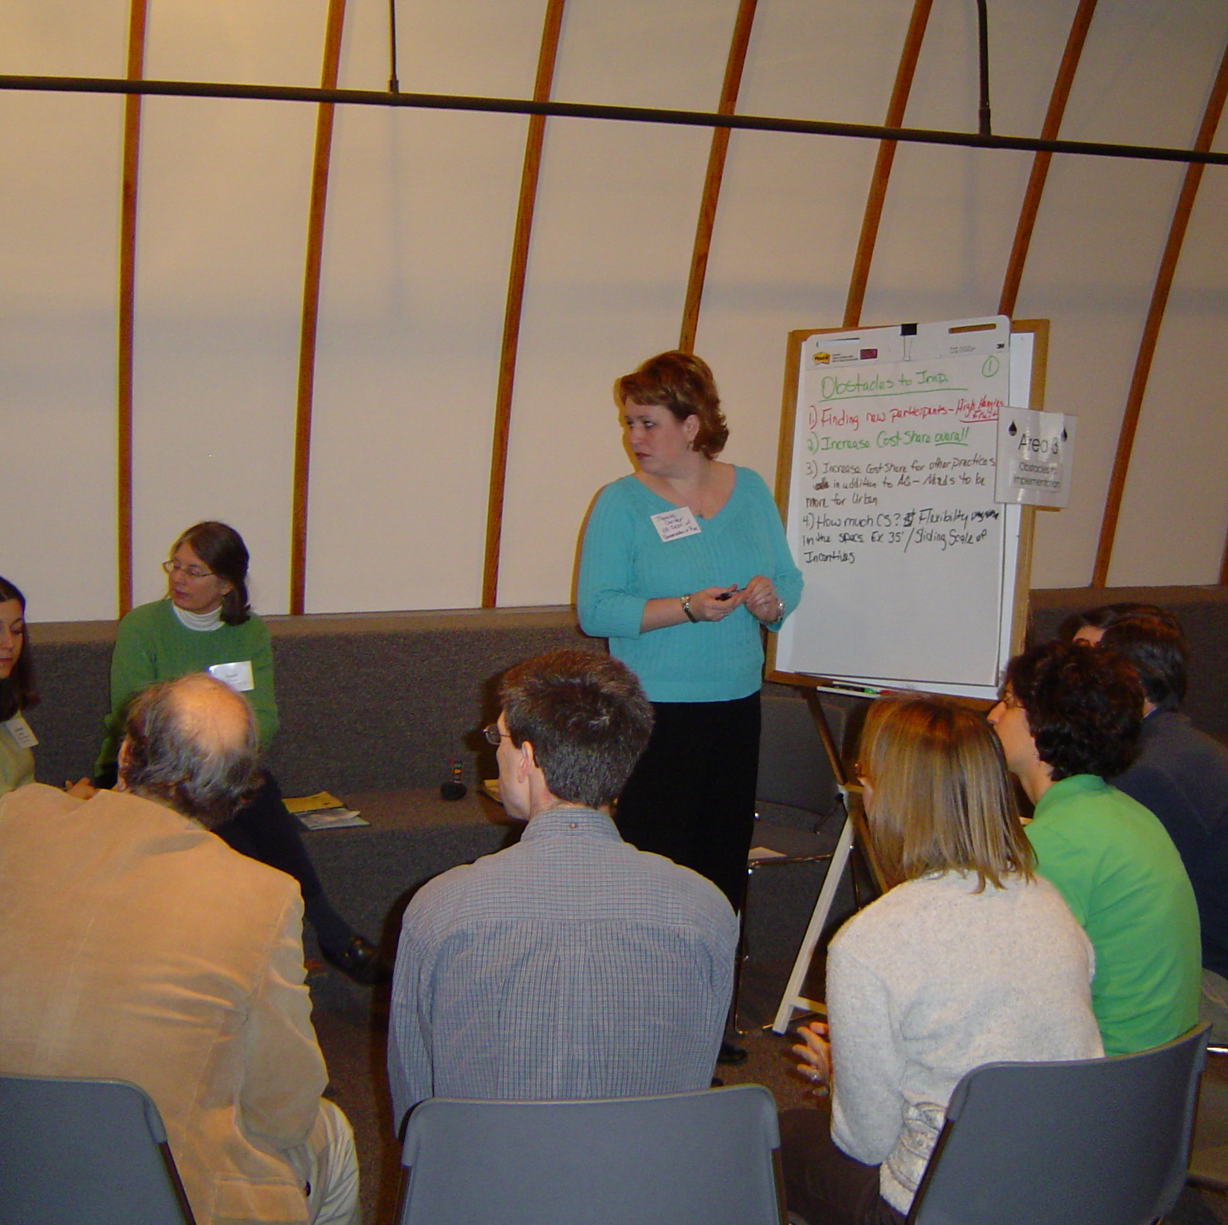
Join us for the first Community Engagement Meeting!
Mid-Late January
Time Preference???
Location Preference???
What’s Next?

Slide 30
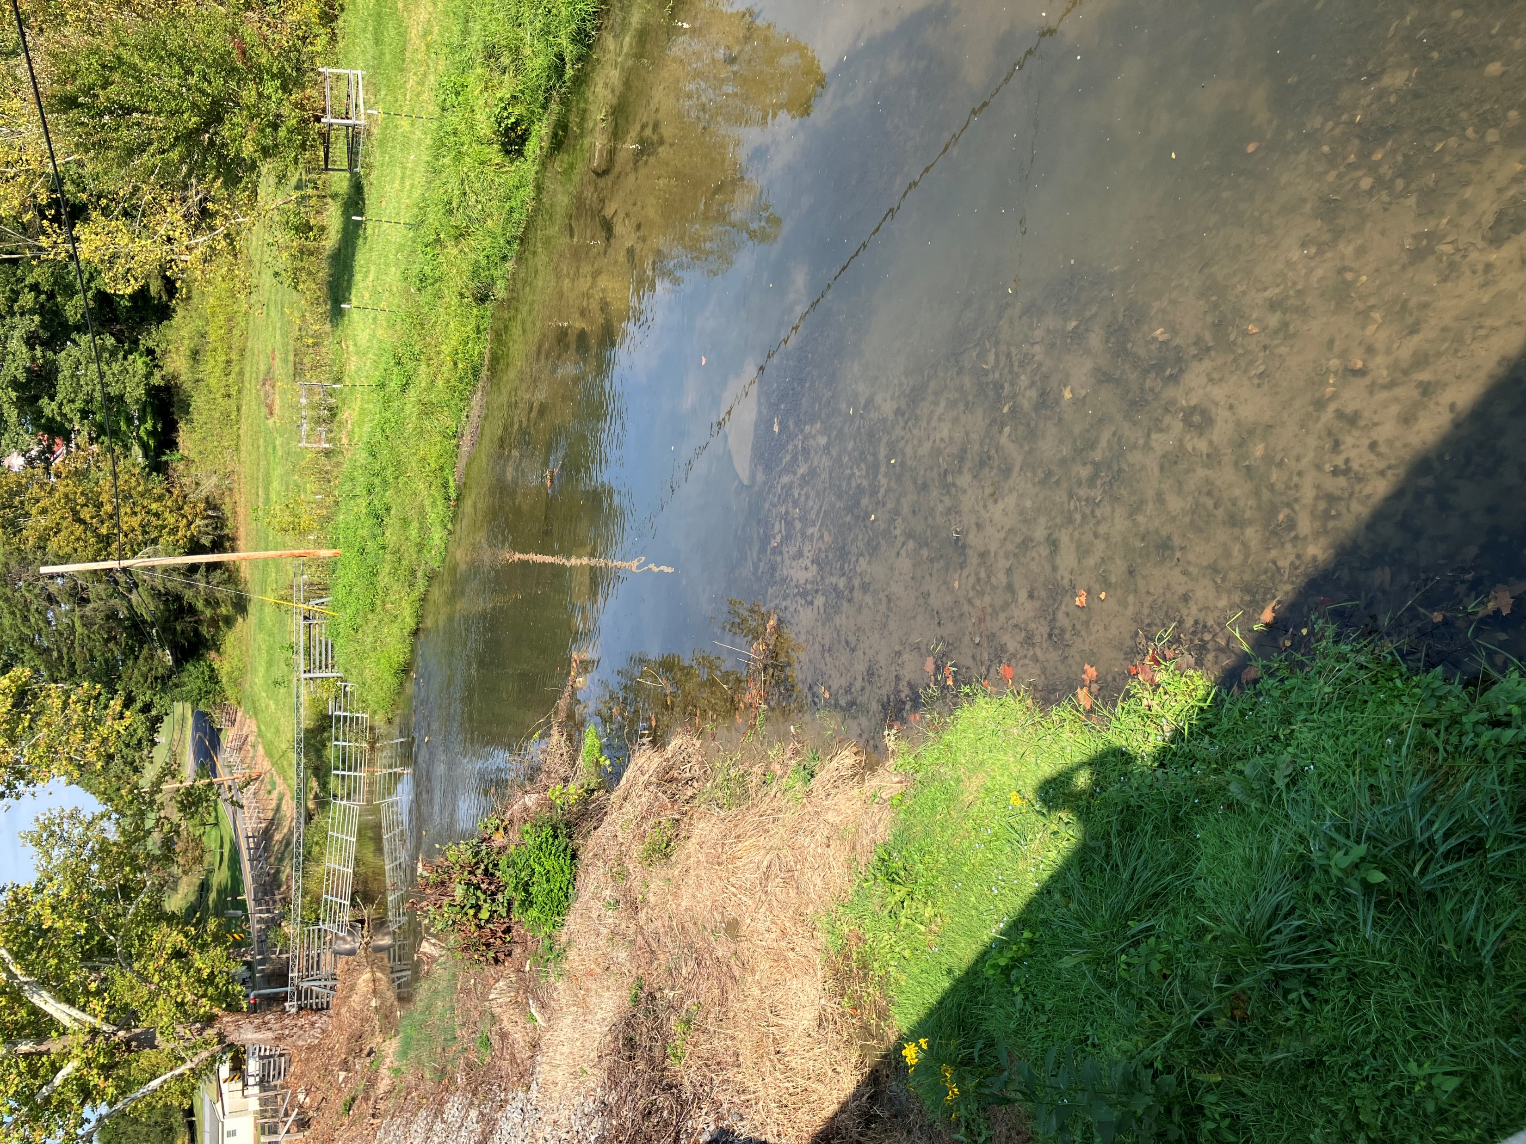
Questions & Comments
30-day public comment period (October 16-November 15)
Send comments to:
Landon Jenkins
355 A Deadmore St SW
Abingdon, VA 24210
landon.jenkins@deq.virginia.gov

