Slide 1
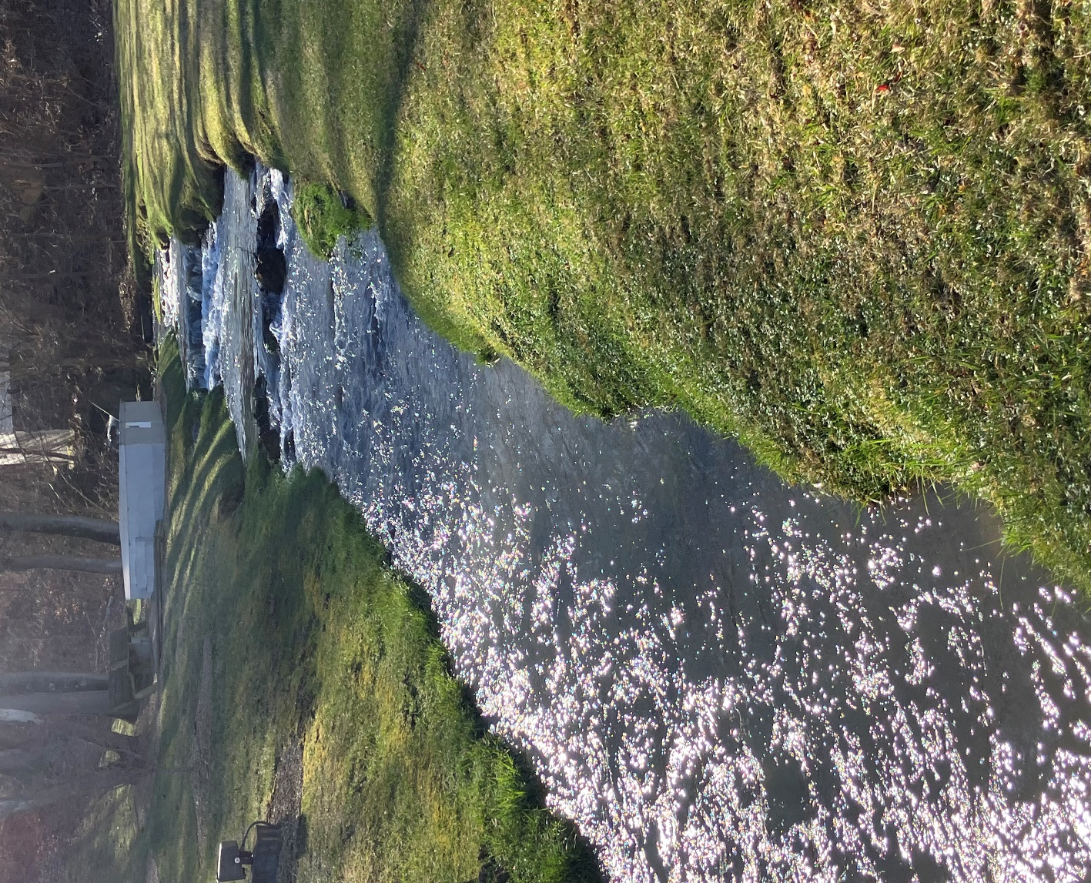
Greendale Creek and Unnamed Tributary to Fleenor Branch Clean Up Study
Final Public Meeting
Landon Jenkins
TMDL Coordinator, SWRO Regional Office
August 13, 2024

Slide 2
Goals for our meeting
Share what we know about both creeks:
Summarize monitoring data, discuss pollutants
Describe process we used to identify and
address pollution in the streams
Describe how you can get involved in this process
Answer your questions about this effort

Slide 3
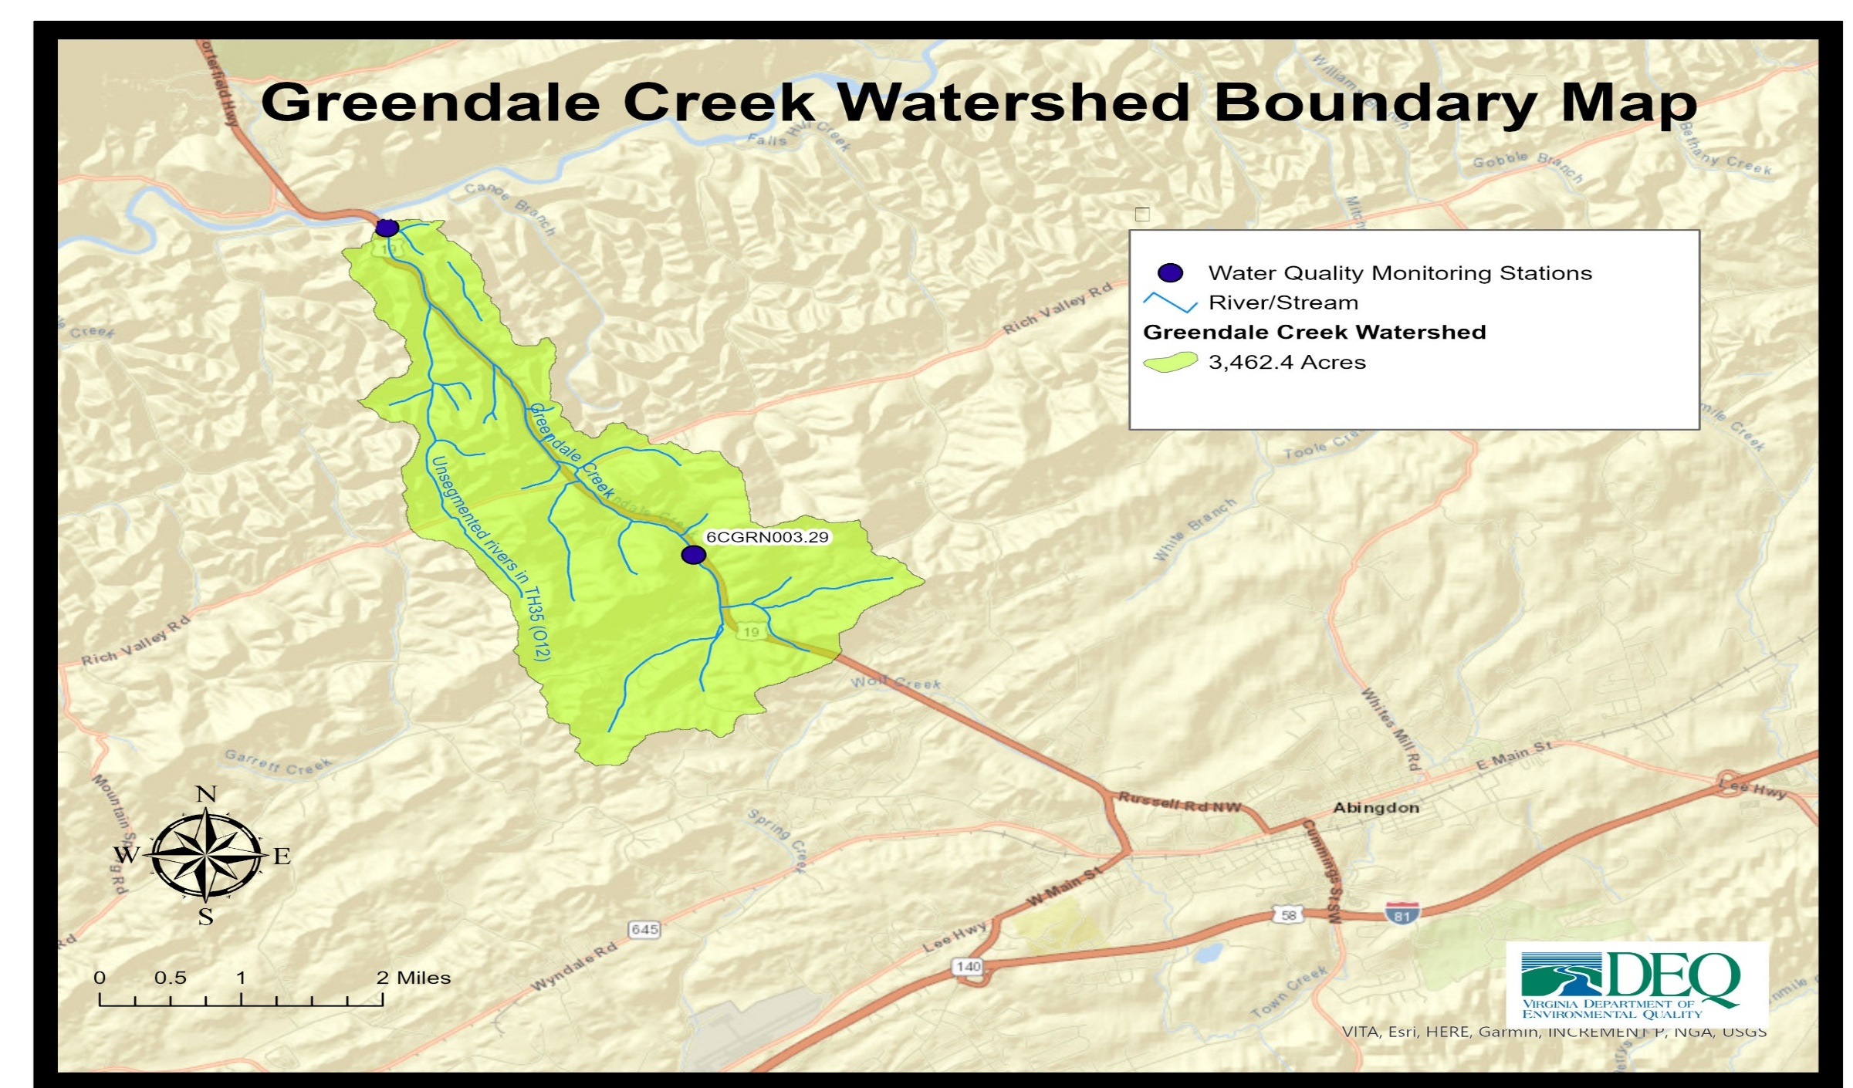

Slide 4
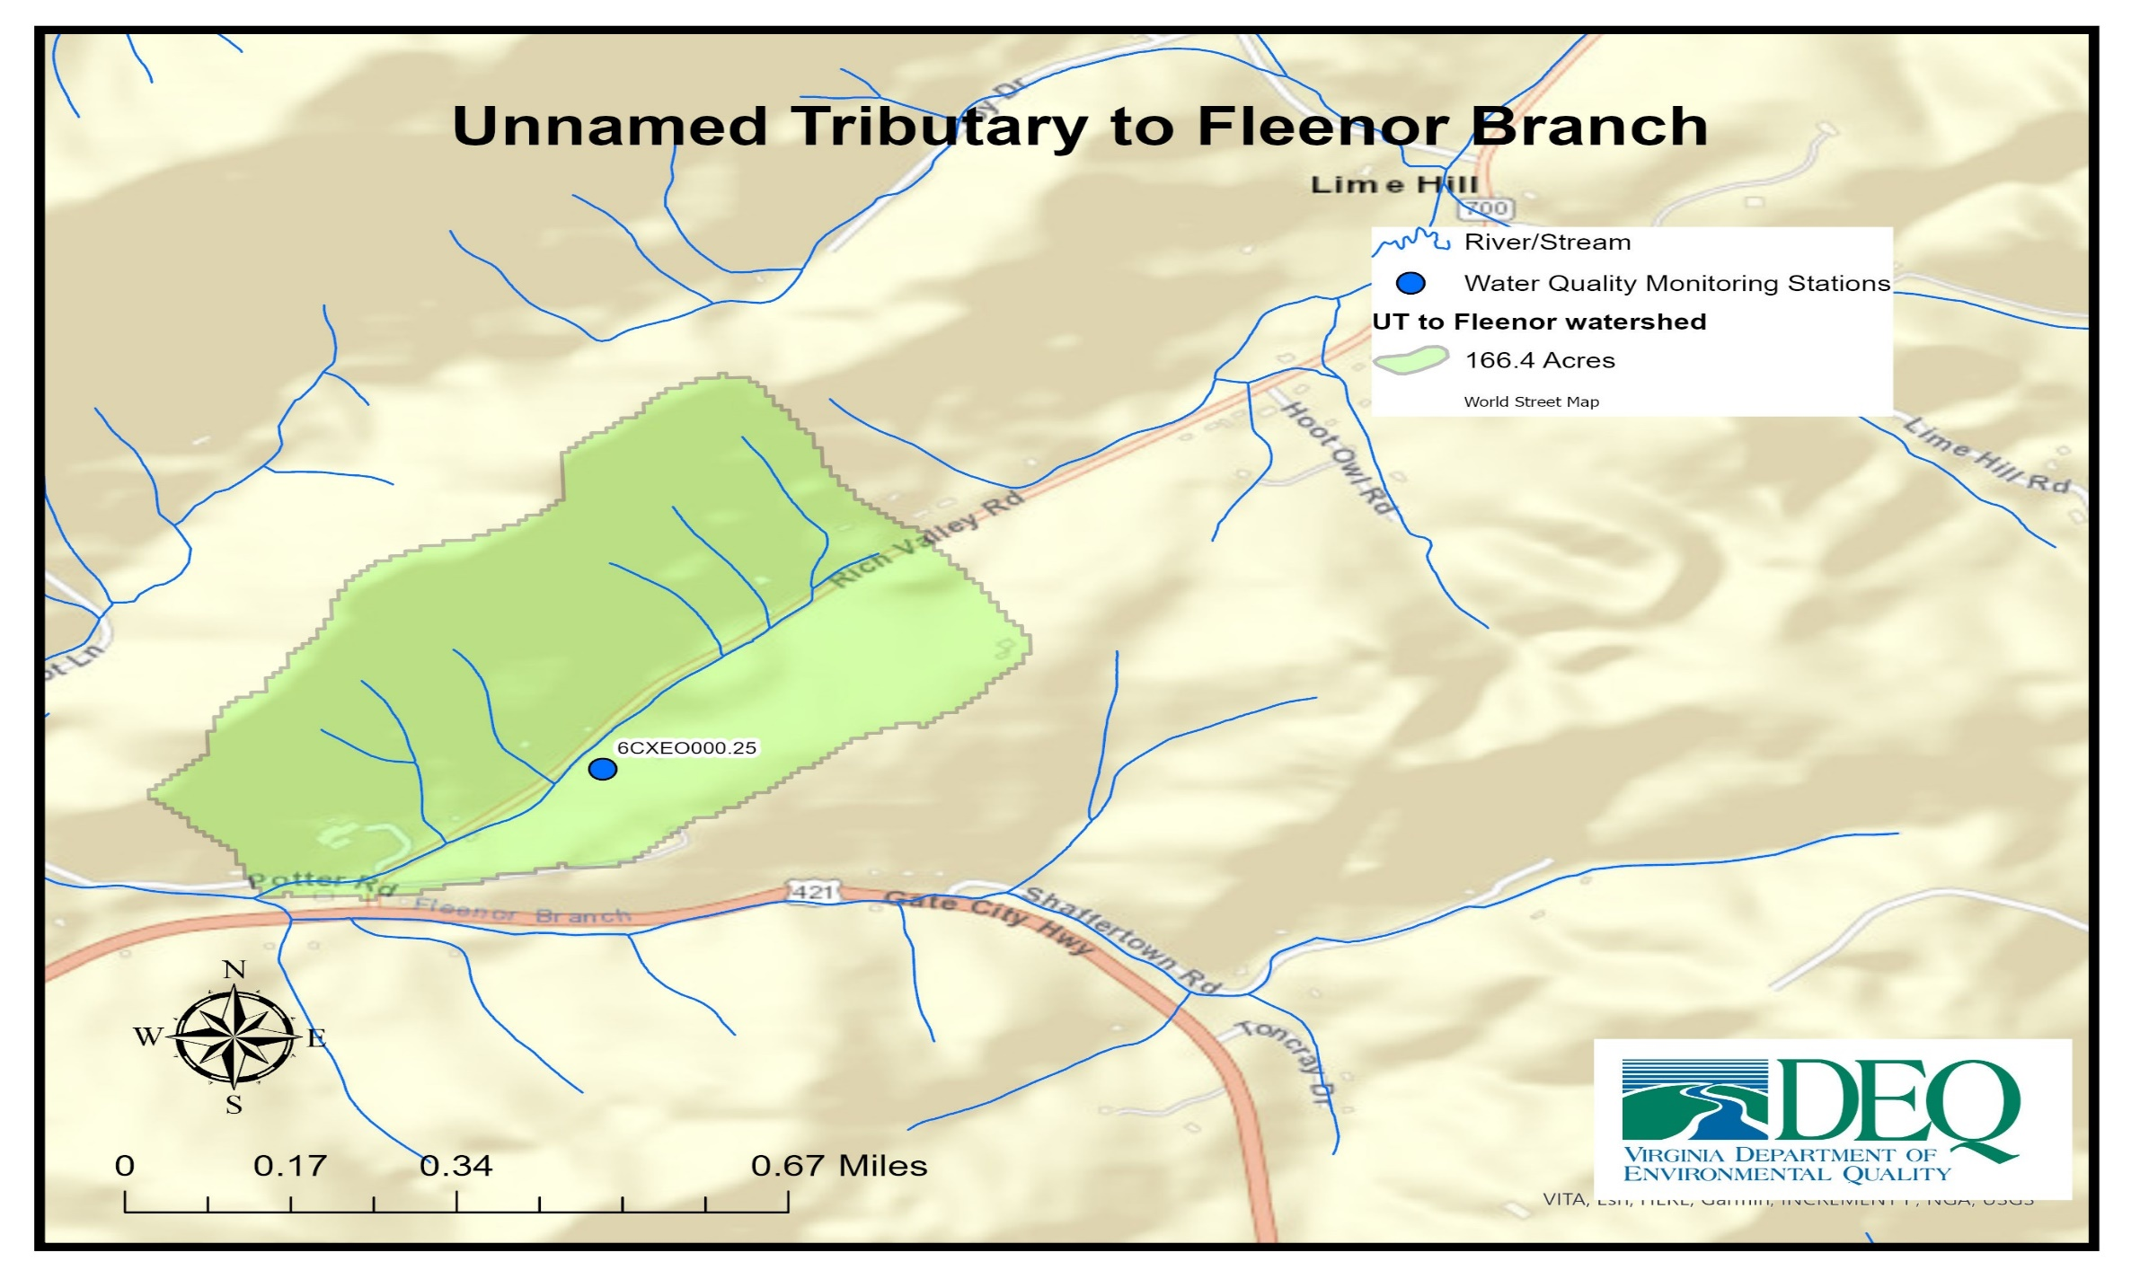

Slide 5

Why a study?
Photo: Jan Hamrsky: lifeinfreshwater.net
Water quality standards in Virginia have designated uses (recreation, aquatic life, wildlife, natural resources)
Aquatic life designated use
  All waters should support “the propagation and growth of a balanced, indigenous population of aquatic life”
What does this mean?
  Waters should be free of substances harmful to aquatic life
Monitor benthic macroinvertebrates (the bugs on the stream bottom) to determine if the standard is met

Slide 6
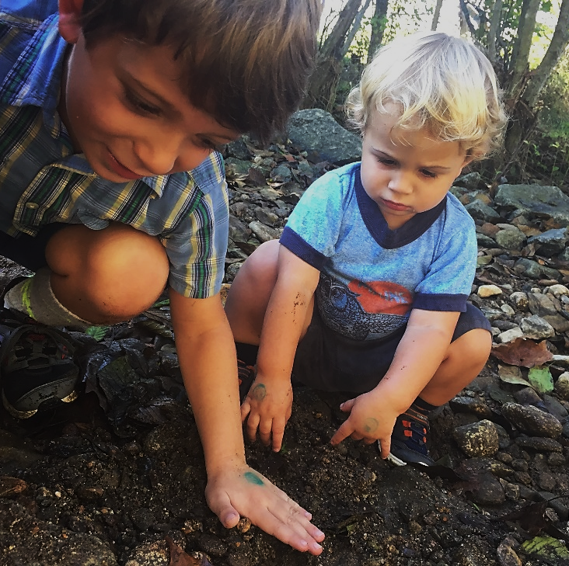
Why should we care about bugs?
Consume algae and organic matter → nutrient cycling
Aquatic food chain
Our “canary in the coal mine”
Chemical monitoring =
a snapshot in time
  Long lived
  Relatively immobile

Slide 7
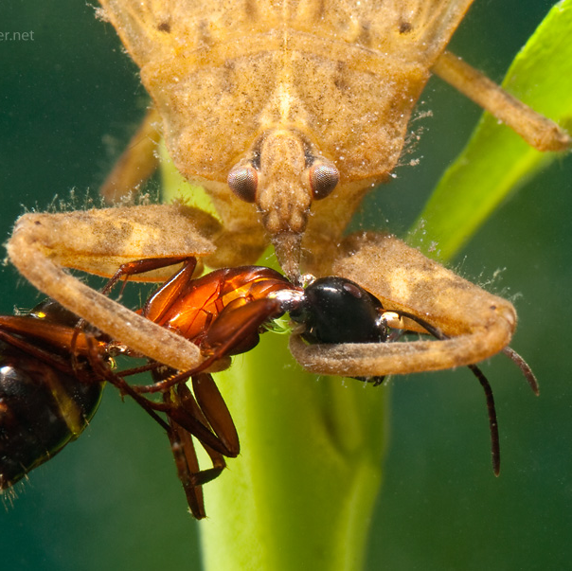
Determining a biological impairment
DEQ biological monitoring data (spring and fall)
VA Stream Condition Index is our barometer
  Diversity, pollution tolerance, feeding group
  Target score of ≥60

Slide 8
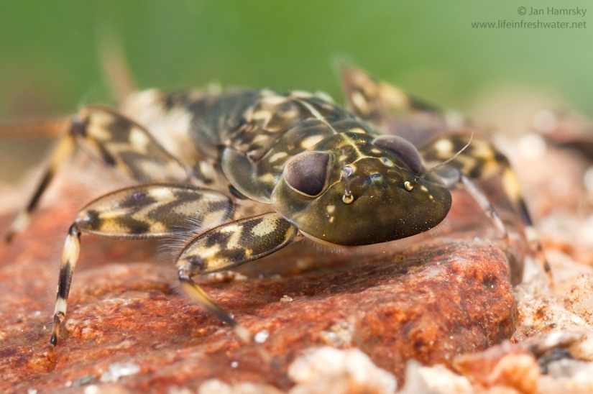
Sensitive to pollution: Mayflies
Sensitive to pollution: Mayflies
Photo: Jan Hamrsky: lifeinfreshwater.net

Slide 9
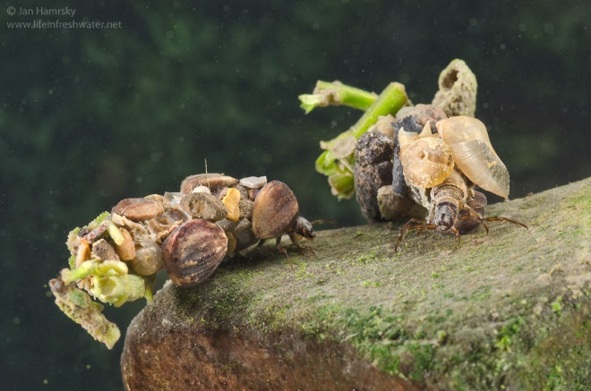
Caddisflies
Sensitive to pollution: Caddisflies
Photo: Jan Hamrsky: lifeinfreshwater.net

Slide 10
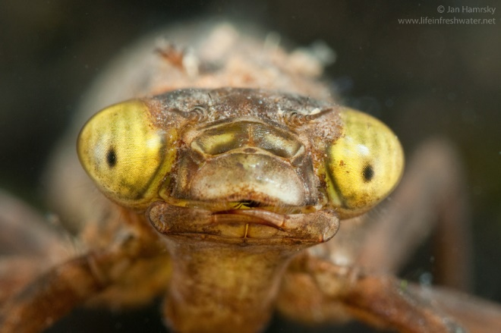
Moderately Sensitive: Dragonflies
Photo: Jan Hamrsky: lifeinfreshwater.net

Slide 11
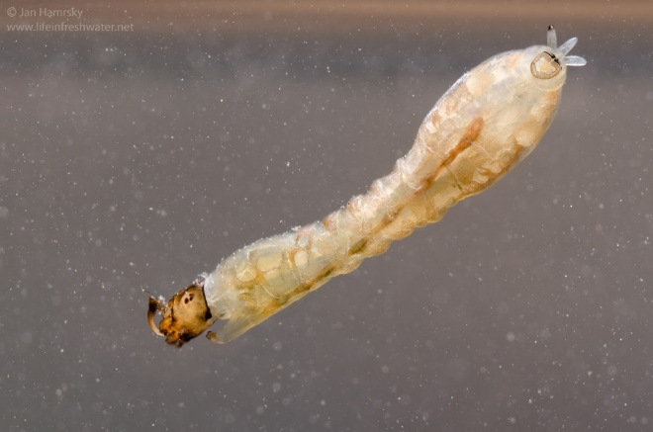
Insensitive to Pollution: Blackflies
Photo: Jan Hamrsky: lifeinfreshwater.net

Slide 12


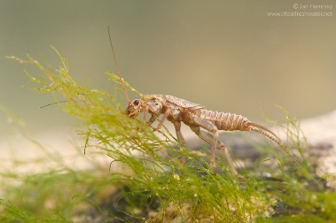

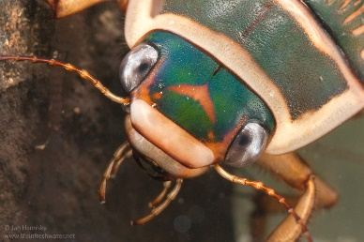
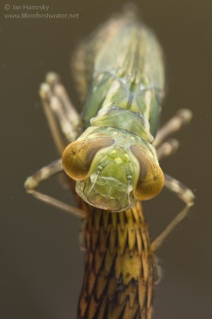
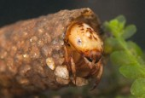
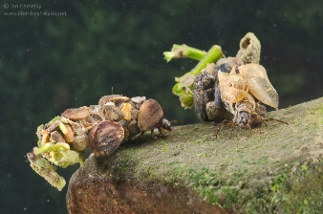
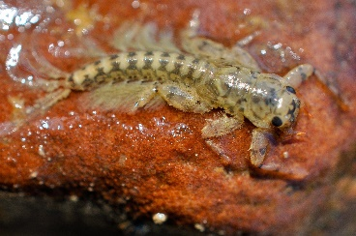
Virginia Stream Condition Index
60
40
20
Photos: Jan Hamrsky: lifeinfreshwater.net

Slide 13
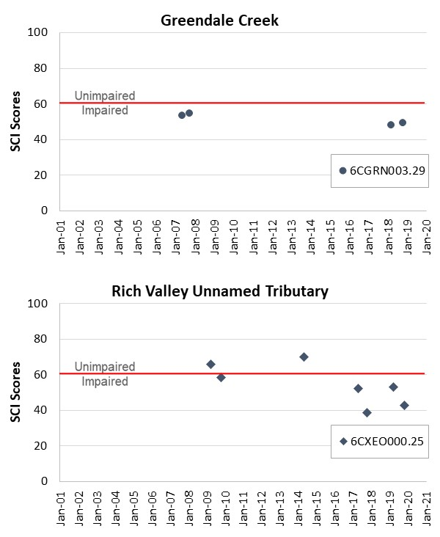
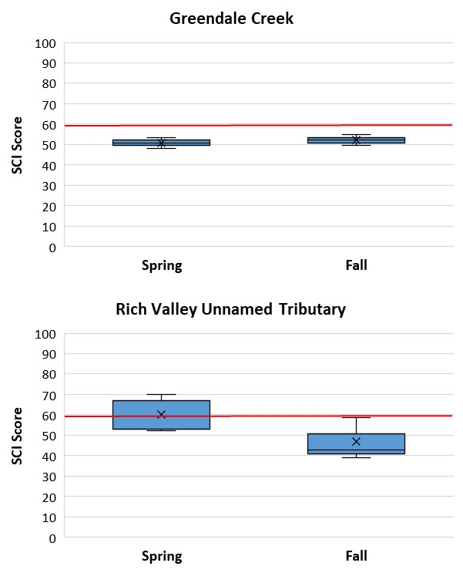
Temporal trends in benthic data for Greendale Creek and Unnamed Tributary to Fleenor Branch

Slide 14
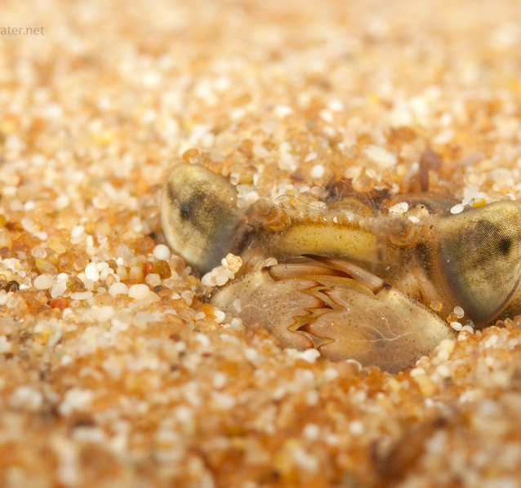
Biological Impairments
Determining the Cause…
Benthic stressor analysis
  Evaluation of monitoring data
  Comparison with healthy reference watershed data and stressor thresholds
  Weight of evidence approach (using multiple pieces of data)
  Identification of most likely stressor(s)
Photo: Jan Hamsky; www.lifeinfreshwater.net

Slide 15
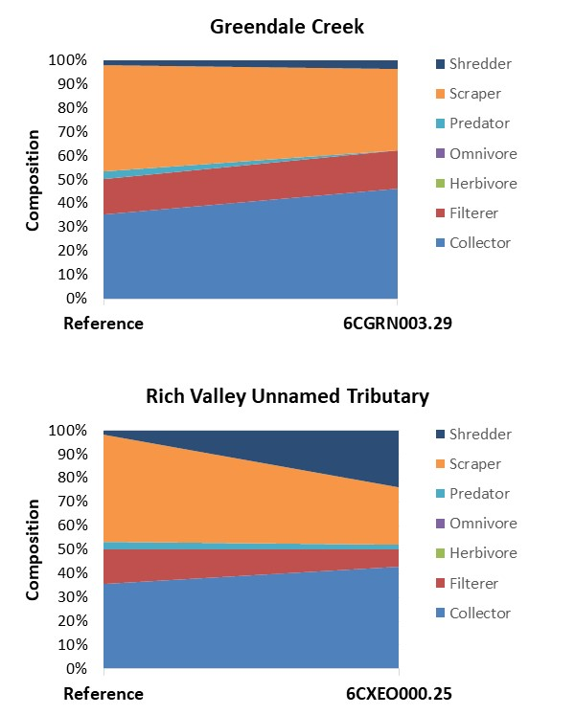
Evidence of Sediment as a Stressor
Increase of Collectors due to their tolerance of sediment

Slide 16
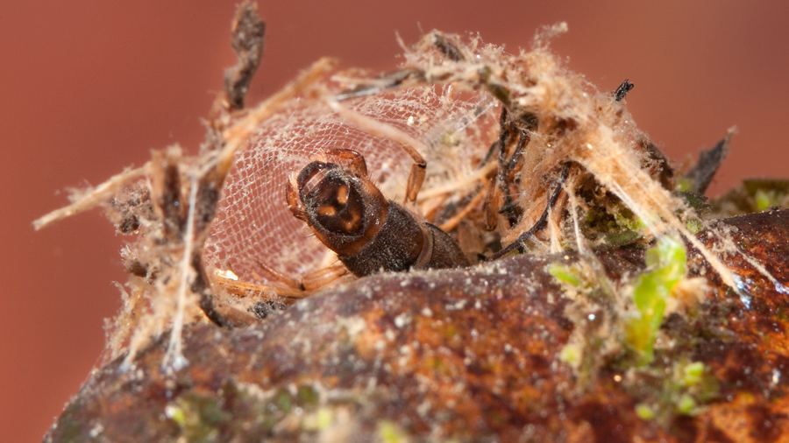
Net spinning caddisfly
Photo: Jan Hamrsky: lifeinfreshwater.net

Slide 17
More evidence for sediment?
Habitat Assessment Scores
Greendale Creek
  Chanel Alteration and Chanel Substrate scored low. These lower metric scores represent both sediment sources from degraded bank habitat and indications of deposited sediment impacts within the stream channel.
  Increased Impervious areas alongside and adjacent to the stream bank
Unnamed Tributary to Fleenor Branch
  In Unnamed Tributary to Fleenor Branch, habitat metrics for substrate, flow, and velocity/depth were significantly scored low. Unnamed Tributary to Fleenor Branch is a very small stream, and flow conditions may decrease dissolved oxygen and limit ecological health during dry periods.

Slide 18
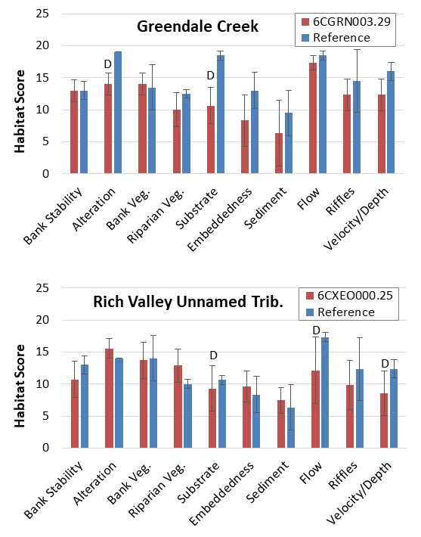
Habitat measurements

Slide 19






What is a TMDL?
A Total Maximum Daily Load is the maximum amount of a pollutant that a waterbody can receive and still meet water quality standards.

Slide 20
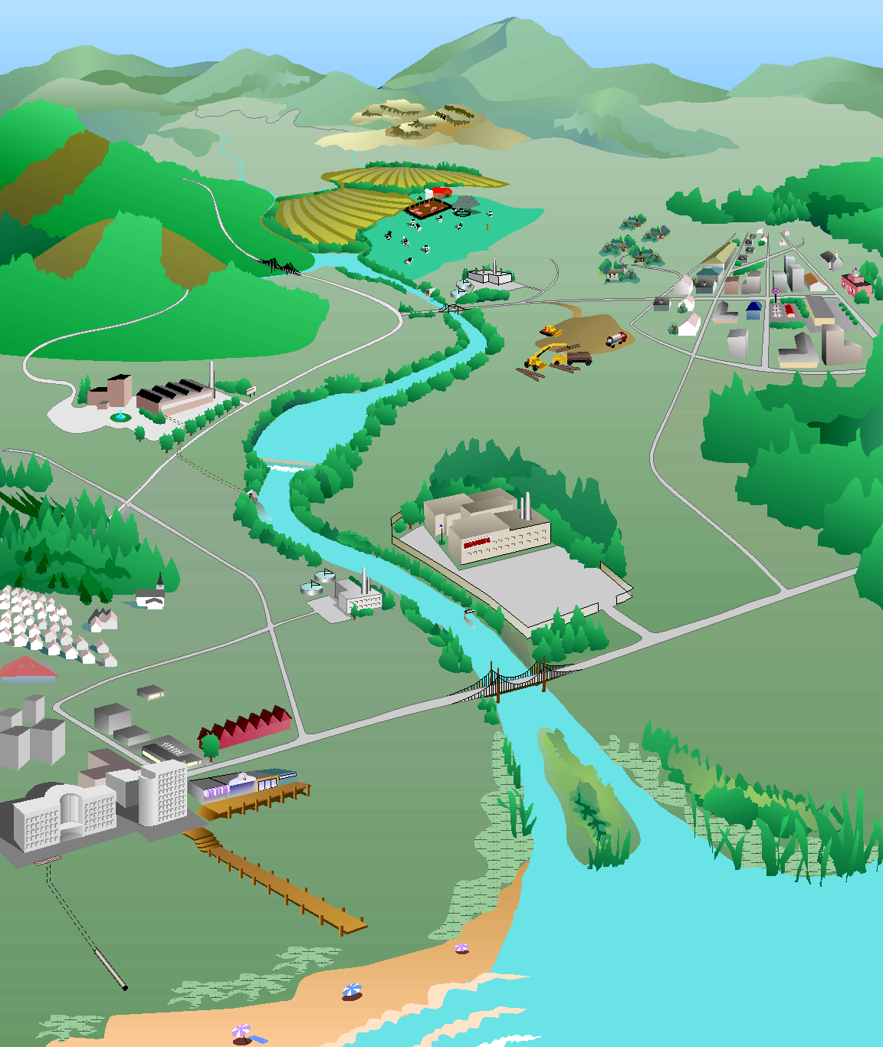
How do we develop a TMDL?
What’s the magic number…
Identify sources of sediment and phosphorus
Model their path to the stream
Determine reductions needed from each source to restore aquatic life
Forest:
0% reduction
Forest:
1 ton/yr
Cropland:
30% reduction
Cropland:
10 tons/yr
Residential:
50% reduction
Residential:
4 tons/yr
Pasture:
40% reduction
Pasture:
12 tons/yr
Urban:
75% reduction
Urban:
8 tons/yr
Impaired stream
Sediment load = 37 tons/yr
TMDL
Sediment load = 19 tons/yr
Point sources:
2 tons/yr
Point sources:
0% reduction
Diagram: Adapted from the Center for TMDL and Watershed Studies at Virginia Tech

Slide 21
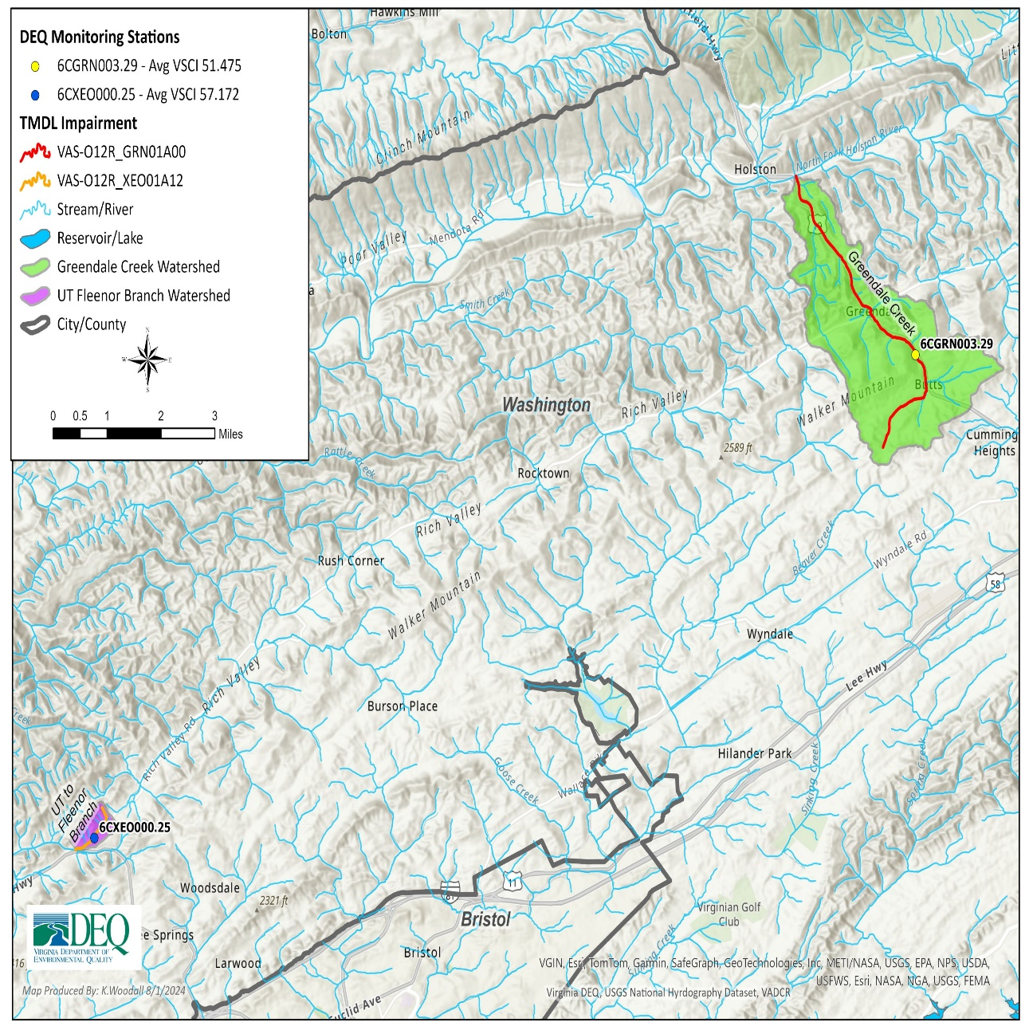
Determining a reduction?
No water quality standard for sediment
Compare Greendale Creek and Unnamed Tributary to Fleenor Branch to nearby reference streams with similar land use patterns and characteristics
Estimate sediment load to these streams to identify “break point” at which impairment occurs
Use this break point to establish target sediment load for impaired streams

Slide 22
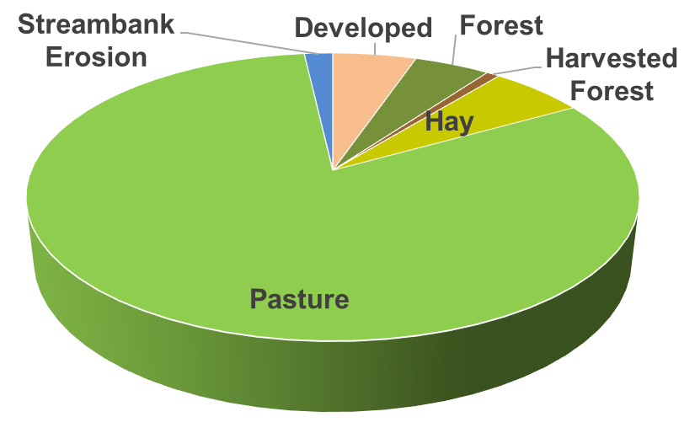
Sediment sources in Greendale Creek
An estimated 38% reduction in sediment is needed to restore aquatic life in Greendale Creek

Slide 23
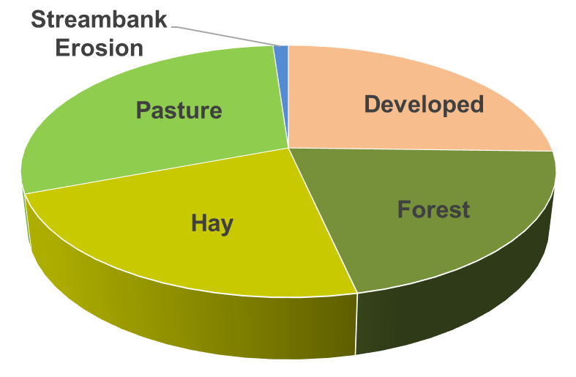
Sediment sources in Unnamed Tributary to Fleenor Branch
An estimated 49% reduction in sediment is needed to restore aquatic life in UT to Fleenor Branch

Slide 24
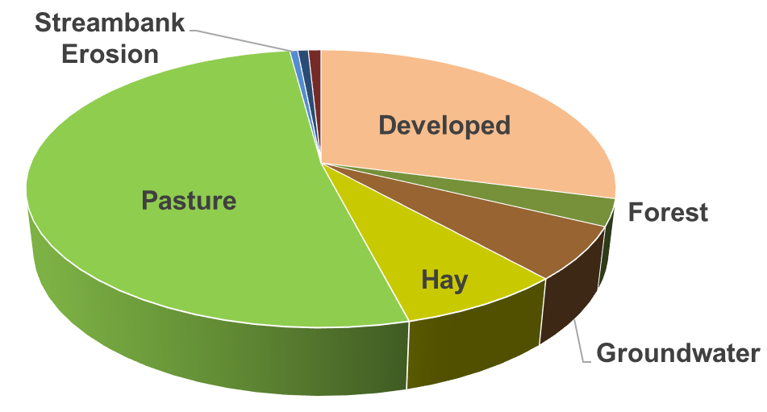
Phosphorus sources in Unnamed Tributary to Fleenor Branch
An estimated 59% reduction in phosphorus is needed to restore aquatic life in UT to Fleenor Branch

Slide 25
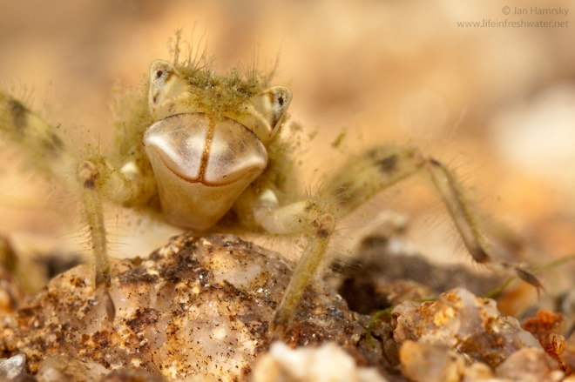
More than just a number?
Primary objective is to address pollution in our waterways
TMDL study is the first step
Followed by an implementation plan
Implementation through partnerships with local organizations
Photo: Jan Hamsky; www.lifeinfreshwater.net

Slide 26
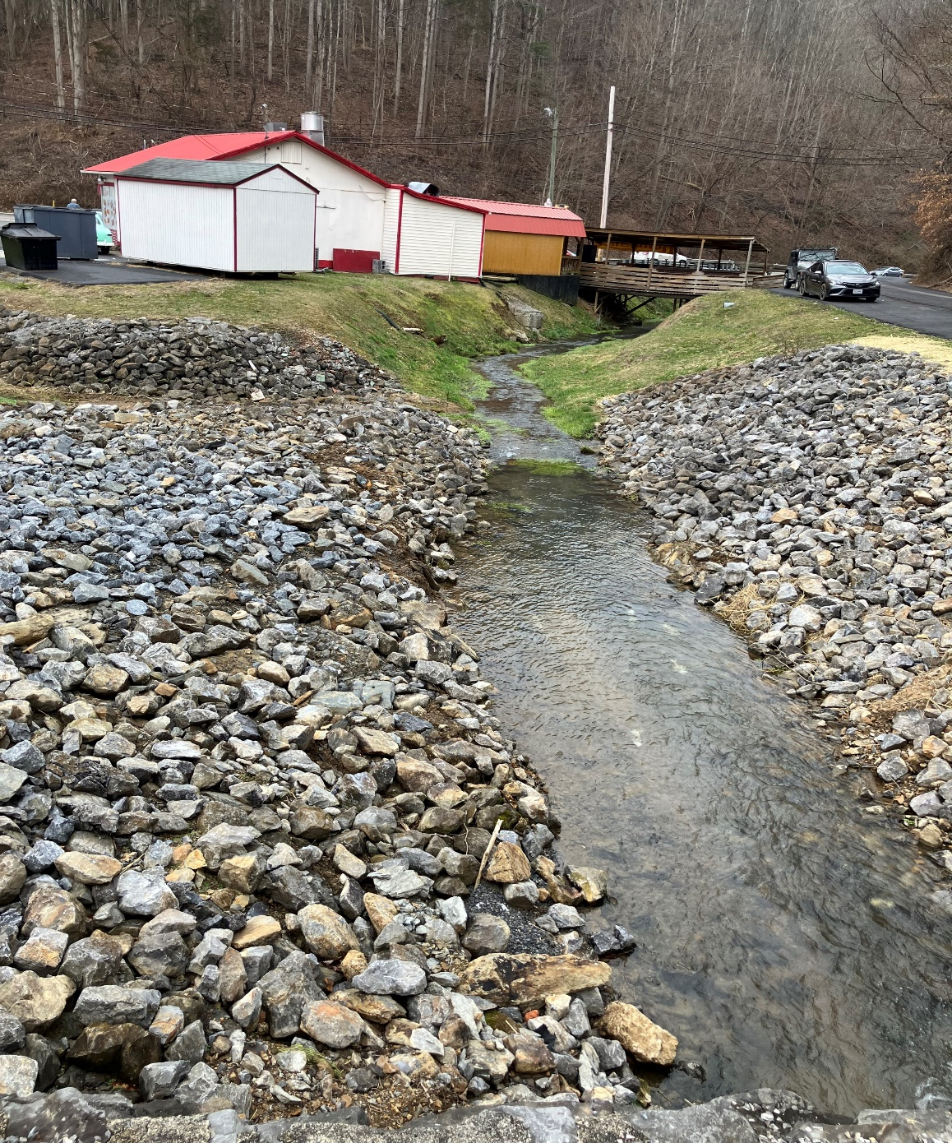
Next Steps
30-day comment period
Allows the public to review the “DRAFT” report and provide comment
Submit study to EPA for approval
Development of implementation plan
Photo: NRCS

Slide 27
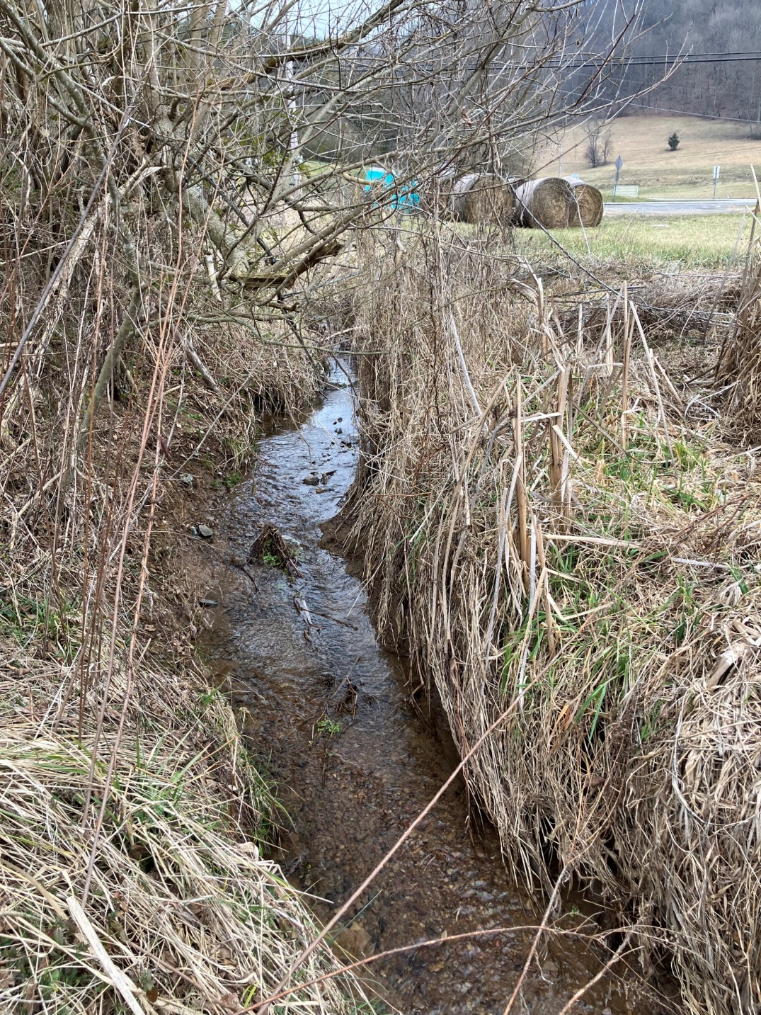
Questions & Comments
30-day public comment period (Aug. 13 – Sept. 12)
Send comments to:
Landon Jenkins
355 A Deadmore St SW
Abingdon, VA 24210
landon.jenkins@deq.virginia.gov

