Slide 1
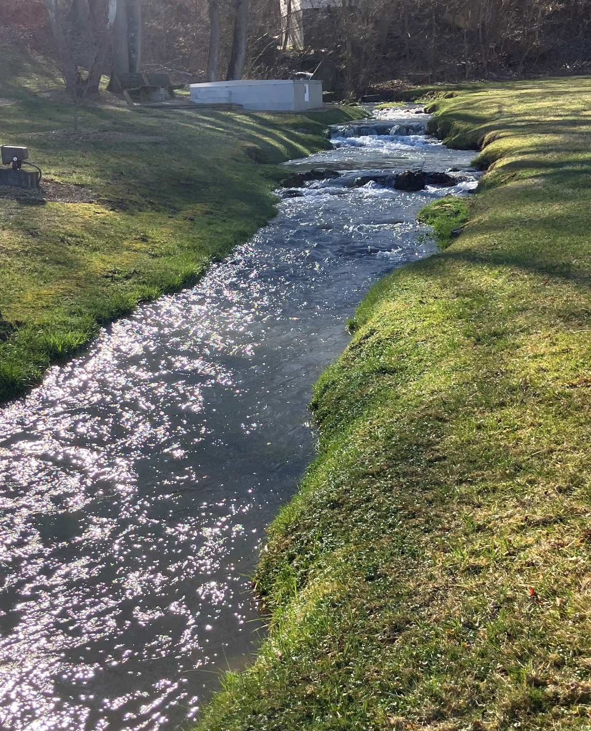
Greendale Creek and Unnamed Tributary to Fleenor Branch Clean Up Study
Final Community Engagement Meeting
Landon Jenkins
TMDL Coordinator, SWRO Regional Office
Karen Kline
Watersheds Modeler
Virginia Department of Environmental Quality
August 13, 2024

Slide 2
Goals for our meeting
Review the Benthic Stressor Analysis and the TMDL process
Describe next steps
Explain the process of developing a watershed model
Explain how goals are set for reducing the pollutants

Slide 3
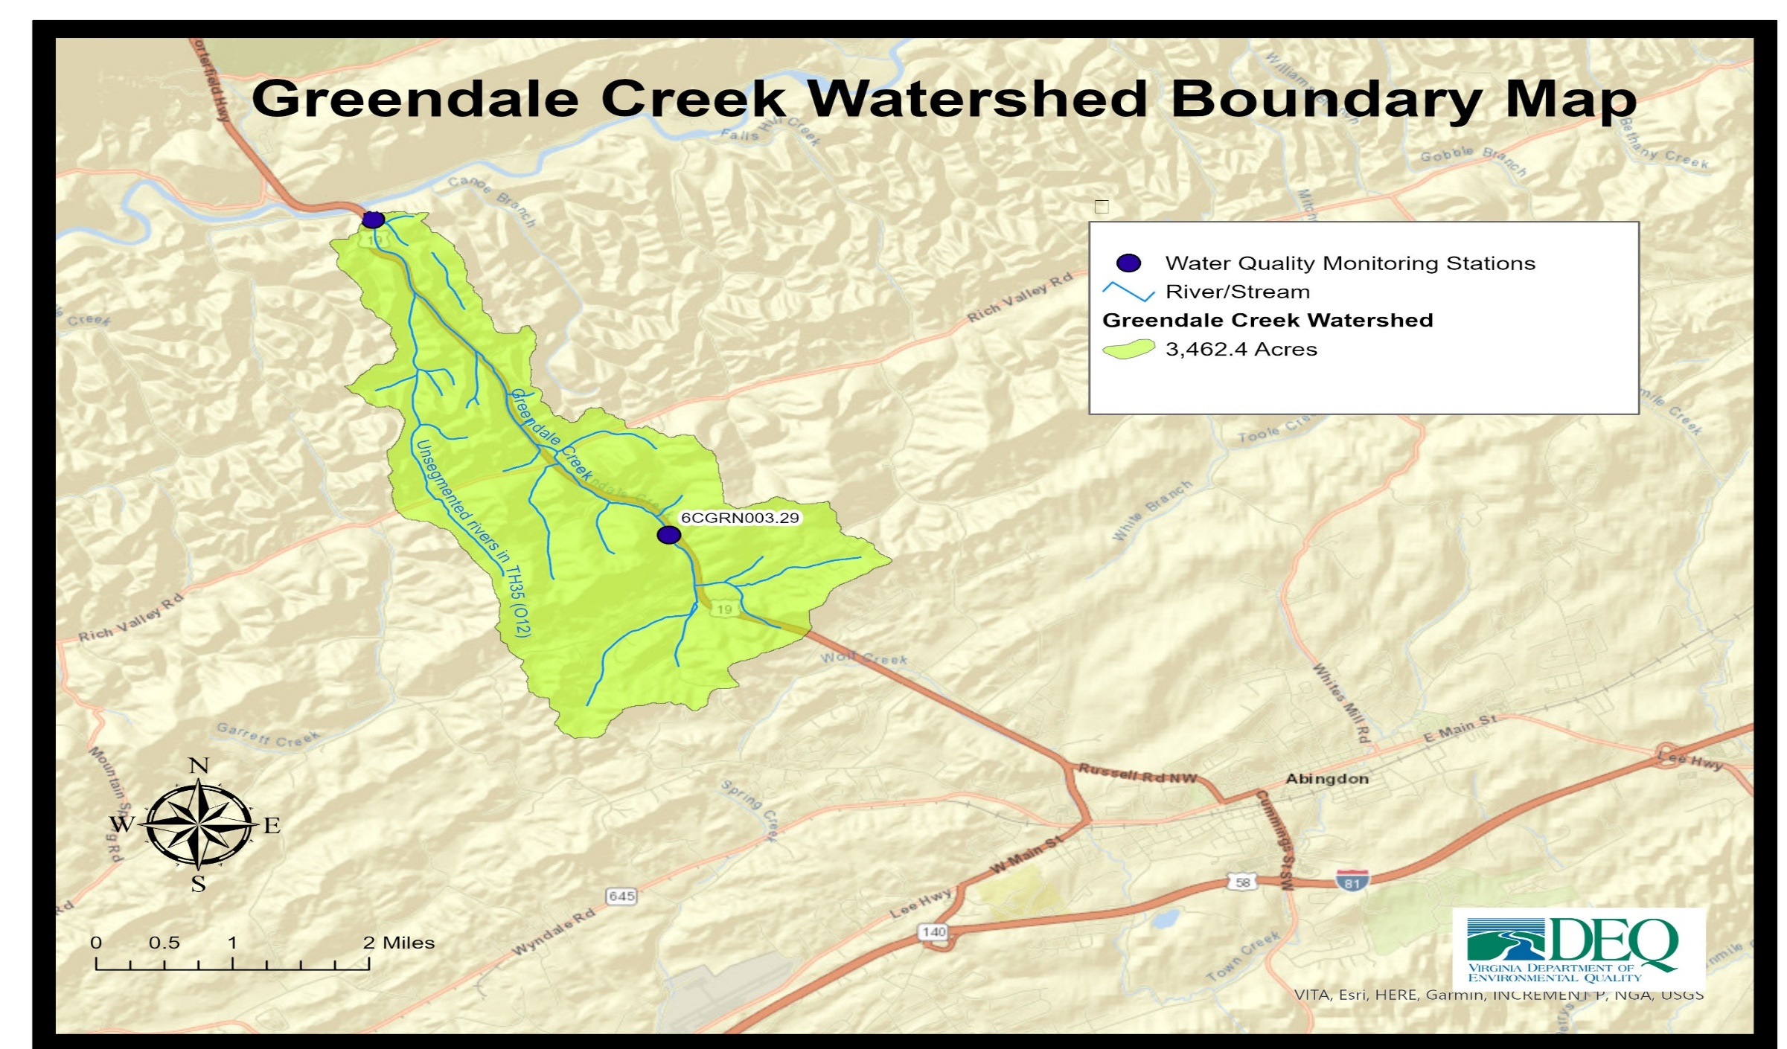

Slide 4
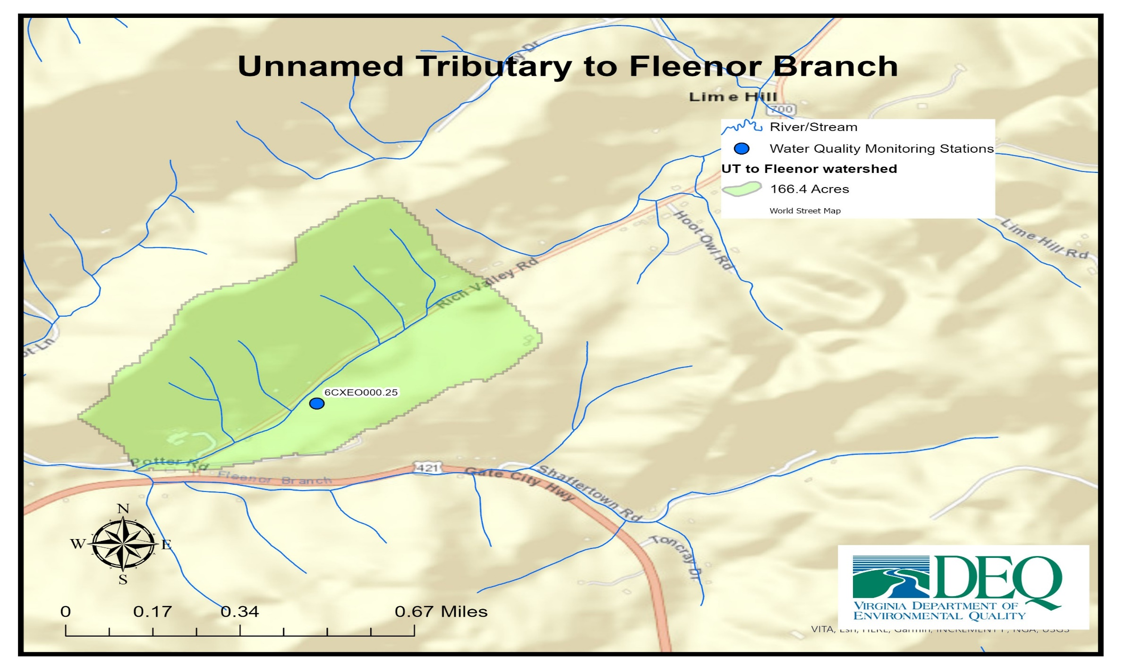

Slide 5

Why a study?
Photo: Jan Hamrsky: lifeinfreshwater.net
Water quality standards in Virginia have designated uses (recreation, aquatic life, wildlife, natural resources)
Aquatic life designated use
  All waters should support “the propagation and growth of a balanced, indigenous population of aquatic life”
What does this mean?
  Waters should be free of substances harmful to aquatic life
Monitor benthic macroinvertebrates (the bugs on the stream bottom) to determine if the standard is met

Slide 6
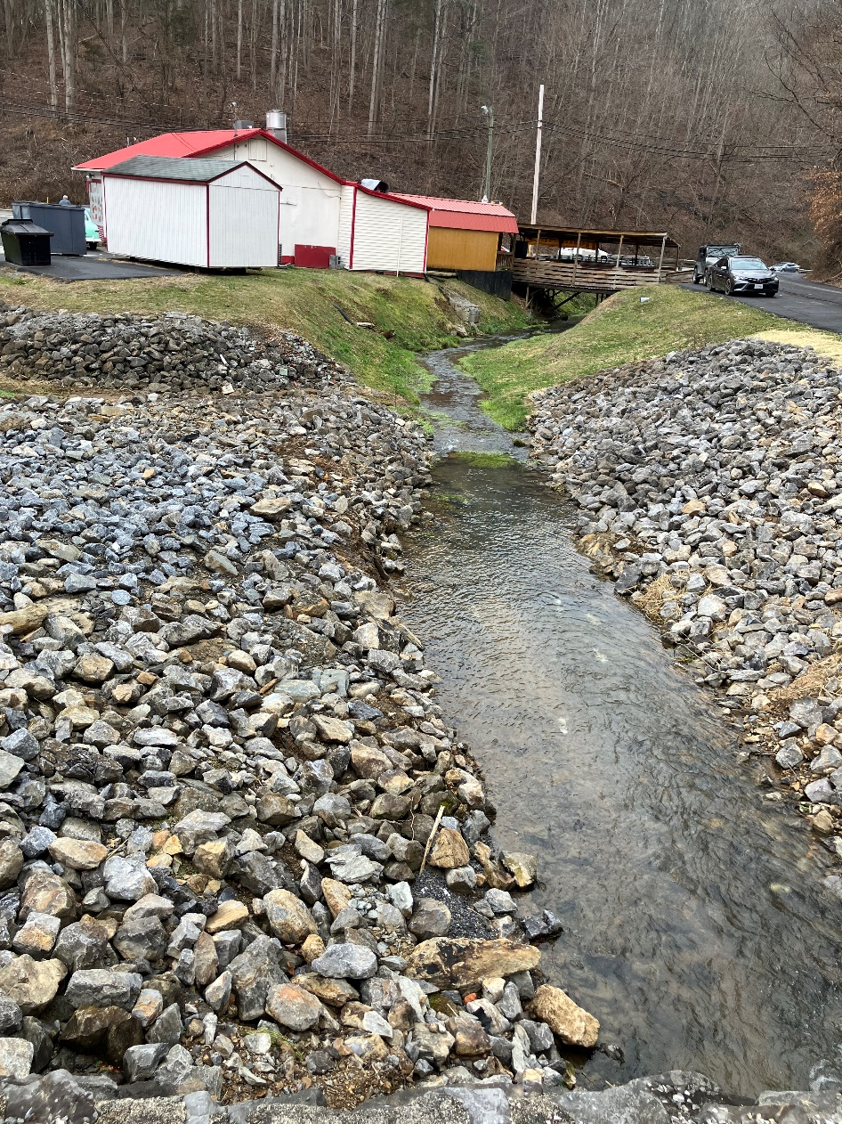
Recap of benthic stressor analysis Greendale Creek
Probable Stressor is Sediment
  High percentage of Collectors
    This functional feeding group thrives on sediment-rich habitat
  Channel Alteration and Channel Substrate scored low.
    These lower metric scores represent both sediment sources from degraded bank habitat and indications of deposited sediment impacts within the stream channel
    Impervious material alongside and adjacent to the stream bank

Slide 7
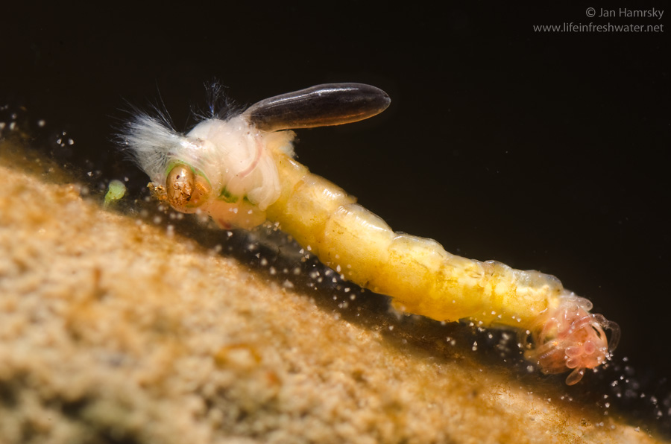
Recap of benthic stressor analysis Unnamed Tributary to Fleenor Branch
Probable Stressors are Sediment and Phosphorus
  High percentage of Collectors
    this functional feeding group thrives on sediment-rich habitat
  Habitat metrics for substrate, flow, and velocity/depth were significantly scored low.
    The Unnamed Tributary is a very small stream, and flow conditions may increase Phosphorus concentrations and limit ecological health during dry periods.
Photo: Jan Hamrsky: lifeinfreshwater.net
Notes:
Non-biting midges (Chironomidae)

Slide 8
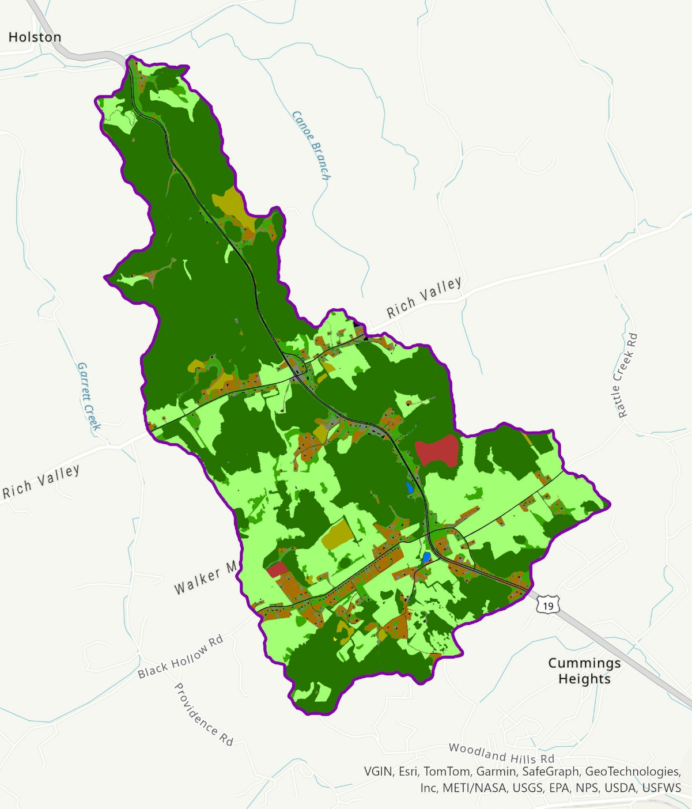

Virginia Tech Biological Systems Engineering (VT BSE) Department modified VA Land Cover Dataset
Estimating Land Cover/Land Use
- Greendale Creek watershed
Land Cover Category | Greendale Creek Watershed
 | Acres | %
Open Water | 2 | <1%
Impervious Extracted | 74 | 2%
Impervious Local Data | 63 | 2%
Forest | 1,832 | 53%
Tree | 233 | 7%
Shrub\Scrub | 61 | 2%
Harvested\Disturbed | 29 | <1%
Turf Grass | 189 | 6%
Pasture | 981 | 28%
NWI\Other | <1 | <1%
Total | 3,465 | 100%

Slide 9
Refining the Land Use Data
- Greendale Creek watershed
Assumptions
‘Impervious’ categories and ‘Turf Grass’ category combined to ‘Developed’ categories
‘Shrub/Scrub’ combined with ‘Forest’
‘NWI\Other’ combined with ‘Water’
‘Pasture’ divided into ‘Hay’, ‘Pasture-fair’, and ‘Pasture-poor’ based on DCR’s 2022 Nonpoint Source Assessment
  36% Hay
  56% Pasture – fair
  8% Pasture - poor
Land Cover Category | Greendale Creek Watershed
 | Acres | %
Developed, impervious | 122 | 4%
Developed, pervious | 204 | 6%
Forest | 1,893 | 55%
Harvested Forest | 29 | <1%
Hay | 353 | 10%
Pasture - fair | 550 | 16%
Pasture - poor | 78 | 2%
Tree | 233 | 7%
Water | 3 | <1%
Total | 3,465 | 100.0%

Slide 10
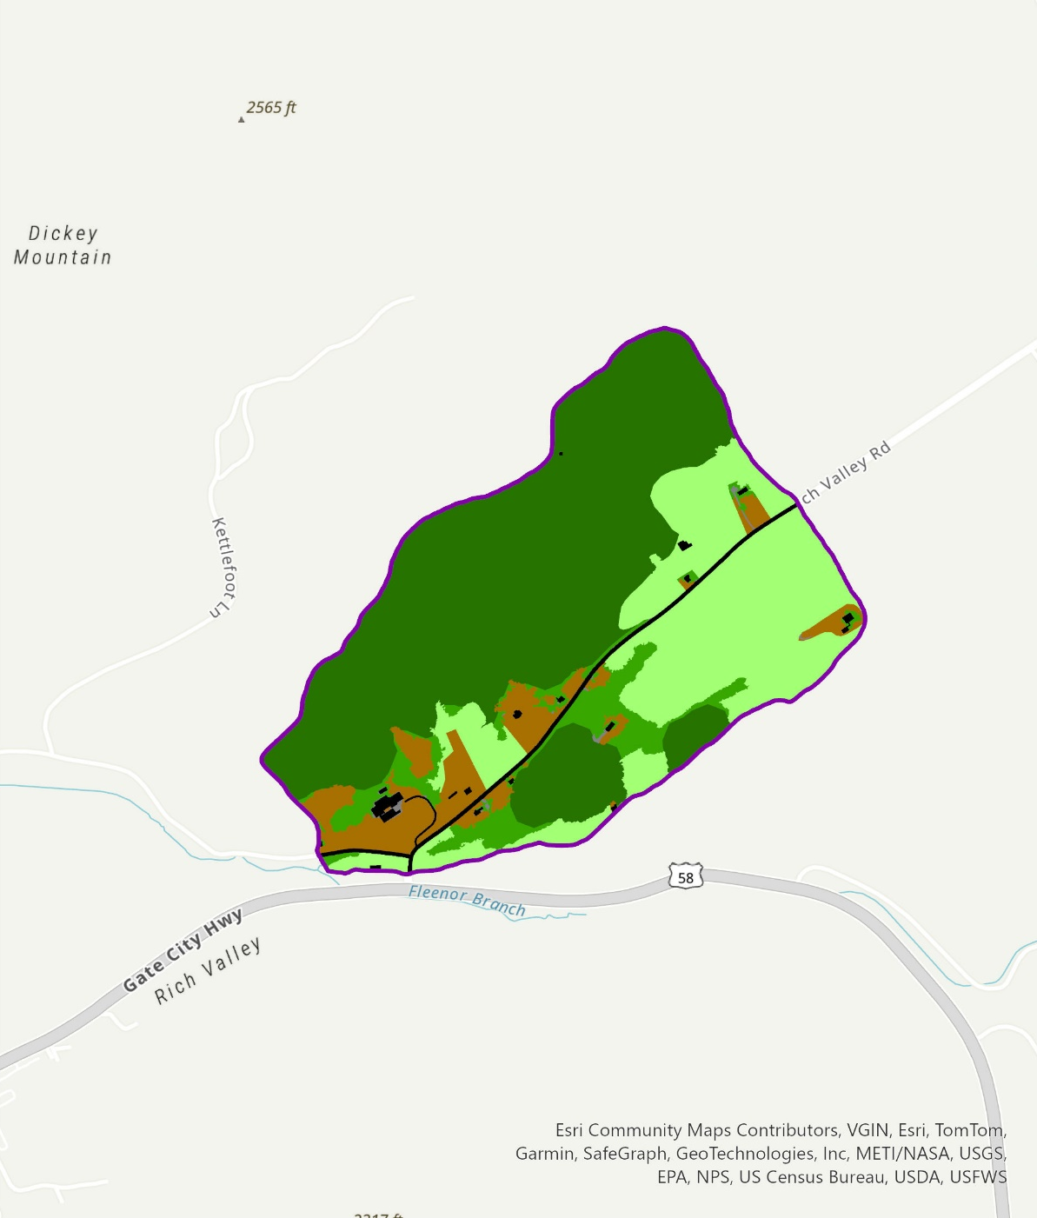

Estimating Land Cover/Land Use
- UT Fleenor Branch
Land Cover Category | UT Fleenor Br Watershed
 | Acres | %
Open Water | - | -
Impervious Extracted | <1 | <1%
Impervious Local Data | 4 | 2%
Forest | 91 | 54%
Tree | 12 | 7%
Shrub\Scrub | - | -
Harvested\Disturbed | - | -
Turf Grass | 14 | 8%
Pasture | 48 | 28%
NWI\Other | - | -
Total | 169 | 100%

Slide 11
Refining the Land Use Data
- UT Fleenor Branch
Assumptions
‘Impervious’ categories and ‘Turf Grass’ category combined to ‘Developed’ categories
‘Pasture’ divided into ‘Hay’, ‘Pasture-fair’, and ‘Pasture-poor’ based on DCR’s 2022 Nonpoint Source Assessment
  38% Hay
  60% Pasture – fair
  2% Pasture - poor
Land Cover Category | UT Fleenor Br Watershed
 | Acres | %
Developed, impervious | 4 | 2%
Developed, pervious | 14 | 8%
Forest | 91 | 54%
Harvested Forest | - | -
Hay | 18 | 11%
Pasture - fair | 29 | 17%
Pasture - poor | 1 | <1%
Tree | 12 | 7%
Water | - | -
Total | 169 | 100.0%

Slide 12

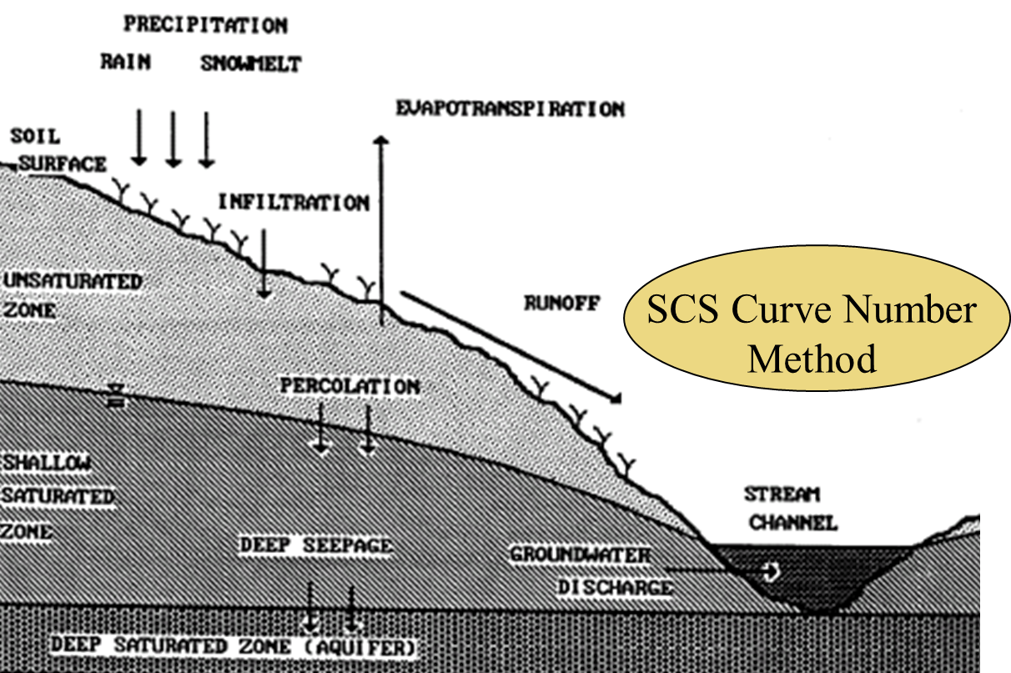
Watershed Computer Model Selection
GWLF (Generalized Watershed Loading Function)
Continuous simulation
Includes surface and groundwater runoff
Simulates runoff, sediment, and nutrients
12

Slide 13
Setting Total Maximum Daily Load (TMDL) Endpoints
Determining the goals for a biological impairment
VA Stream Condition Index is our barometer
  Target score of ≥60
Sediment is a stressor in both Greendale Creek and the UT Fleenor Branch; Phosphorus is a stressor in UT Fleenor Branch
  There is no in-stream water quality standard for sediment or phosphorus
We need a relationship between the pollutants and the local in-stream biology to set the TMDL goals
13

Slide 14
Setting TMDL Endpoints - Methods
Greendale Creek Sediment TMDL
Comparative Watersheds Approach - AllForX method
Unnamed Tributary (UT) to Fleenor Branch Sediment TMDL
Reference Watershed Approach
UT to Fleenor Branch Phosphorus TMDL
Average Annual In-stream Concentration Approach
14

Slide 15
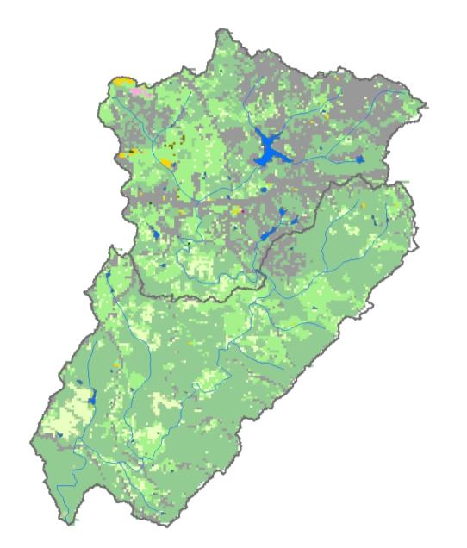
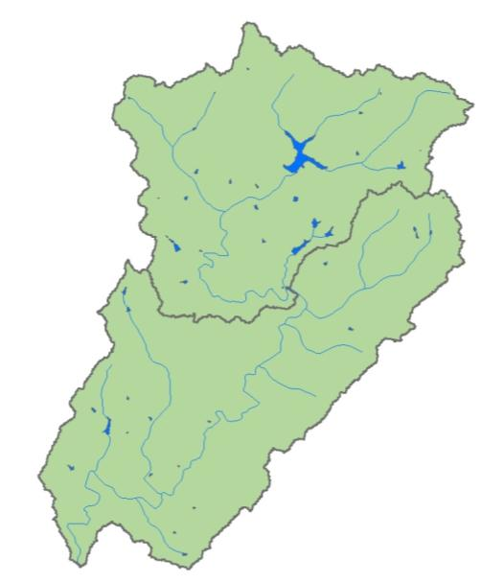
Setting the Greendale Creek Sediment TMDL Endpoint
All-Forest Load Multiplier Approach (AllForX)
Adapted from Maryland Approach to develop sediment TMDLs
(Maryland Dept. of Environment, 2006)
Uses multiple unimpaired (comparison) watersheds
Links biological community health and pollutant loads
$$AllForX Multiplier=\frac{′Existing′ Condition Pollutant Load}{′All−Forested′ Condition Pollutant Load}$$
Existing Condition
All-forested Condition
15
Notes:
Is adapted from the Maryland Approach.
Alternative to RWA
And addresses several of the concerns seen in the RWA:
AllForX compares an impaired watershed to multiple comparison watersheds
AllForX is a value determined for each watershed
This value explains the magnitude of existing sediment loads in the watershed above an all-forested sediment load (or undisturbed condition)
You would expect to see larger AllForX values in watersheds with higher percentages of mixed land use because the existing sediment loads from agriculture and developed land uses are greater than sediment loads in the same watershed considering an all-forested condition. Smaller AllForX values would be seen in watersheds with a higher percentage of forested land use because the existing sediment loads are not much greater than the all-forested condition. The All-forested condition is considered a best possible case scenario where sediment loads are the lowest.

Slide 16
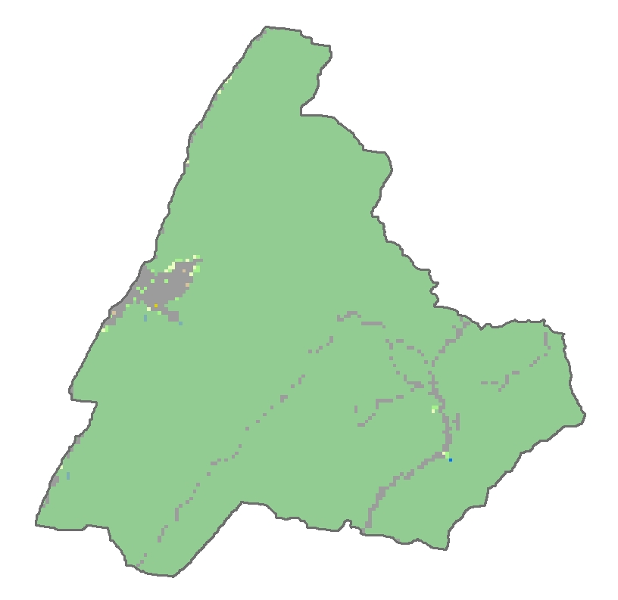
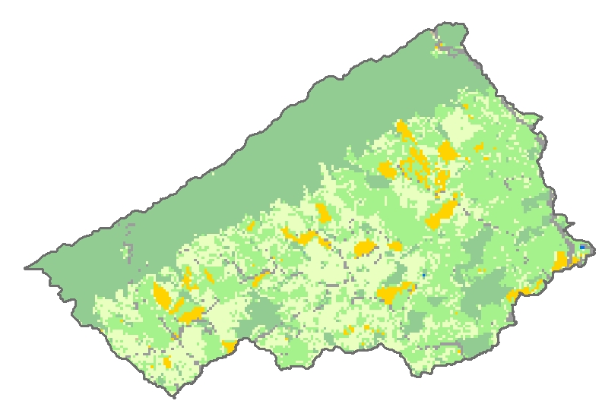
AllForX Multiplier is a function of land use
Mix of Land Uses
Predominantly Forested Land Use
Larger AllForX Multiplier values:
Higher percentage of
non-forest land use
Smaller AllForX Multiplier values:
Higher percentage of forested (undisturbed) land use
16

Slide 17
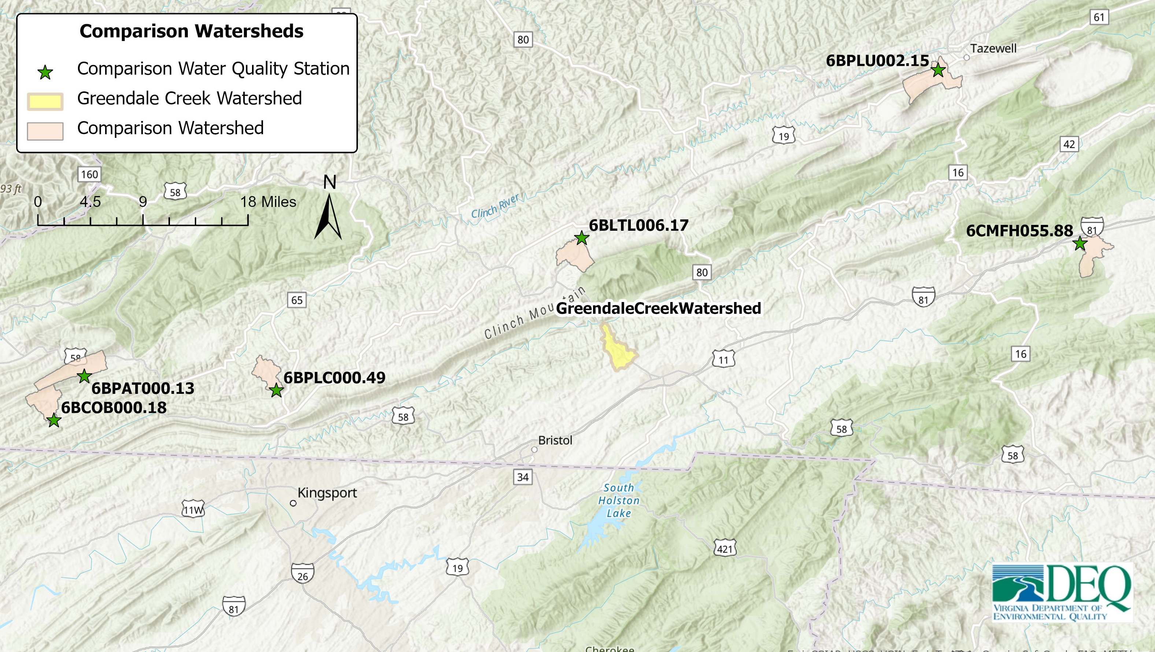
Comparison Watersheds for Greendale Creek Sediment TMDL
Plum Creek
Little Cedar Creek
MF Holston River
Pattonsville Branch
Plank Camp Creek
Cox Branch
17

Slide 18
Comparison Watershed Screening Criteria
size – potential comparison watersheds should be similar in size to the impaired watershed(s)
stream order – comparison watersheds should support 2nd to 4th order streams
proximity/ecoregion similarity – potential comparison watersheds should be within a 30-mile radius of the impaired watershed(s), and, if possible, in the same EPA-defined Level III ecoregion
biological condition/health – potential comparison watersheds should have a minimum of three VSCI samples
data timeliness – data should be relatively current with respect to alterations and development within the watershed
18

Slide 19
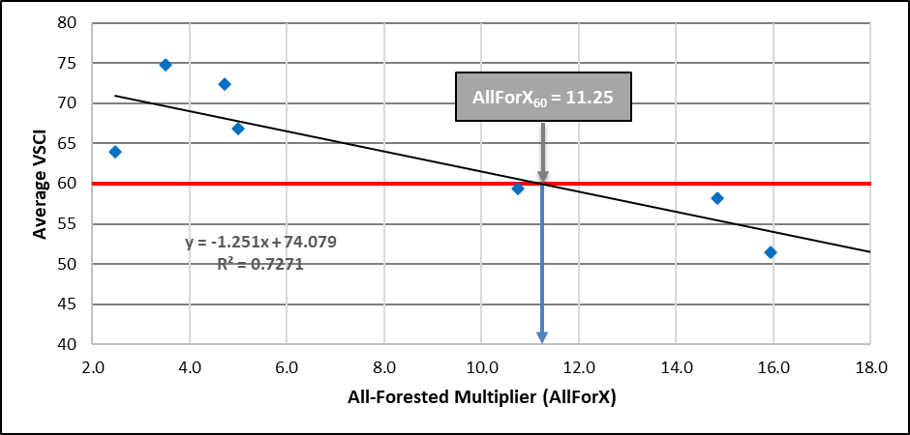
AllForX Approach
AllForX₆₀ = 13.63
Comparison
Impaired
Greendale Creek
AllForX Multiplier
19

Slide 20
Greendale Creek Sediment Reductions
Allocation Scenarios
Land Use/Source Group | Area (acres) | Existing Sediment Load (tons/yr) | Scenario 1 |  | Scenario 2
 |  |  | % Reduction | Allocation Load (tons/yr) | % Reduction | Allocation Load (tons/yr)
Row Crops | - | - | - | - | - | -
Pasture/Hay | 981 | 854 | 39.9% | 514 | 42.6% | 491
Forest | 1,892 | 46 | 0.0% | 46 | 0.0% | 46
Harvested Forest | 29 | 8 | 39.9% | 5 | 0.0% | 8
Developed | 560 | 51 | 39.9% | 31 | 0.0% | 51
Transitional | - | - | - | - | - | -
Streambank Erosion | - | 18 | 39.9% | 10 | 42.6% | 10
Permitted WLA | - | - | - | - | - | -
Total Load |  | 977 |  | 606 |  | 606
TMDL-MOS*-FG** = 606 (tons/yr)
Needed Reduction = 370 (tons/yr)
% Reduction Needed = 38%
*MOS – Margin of Safety (10%)
**Future Growth (2%)

Slide 21
Setting the UT Fleenor Branch Sediment TMDL Endpoint
Reference Watershed Approach
Impaired
TMDL Target Load
Load
Non-impaired
Impaired Watershed
TMDL Reference Watershed
Reducing load in the impaired watershed to the target TMDL load is expected to restore the benthic community
Notes:
To identify practical scenarios to meet water quality standards

Slide 22
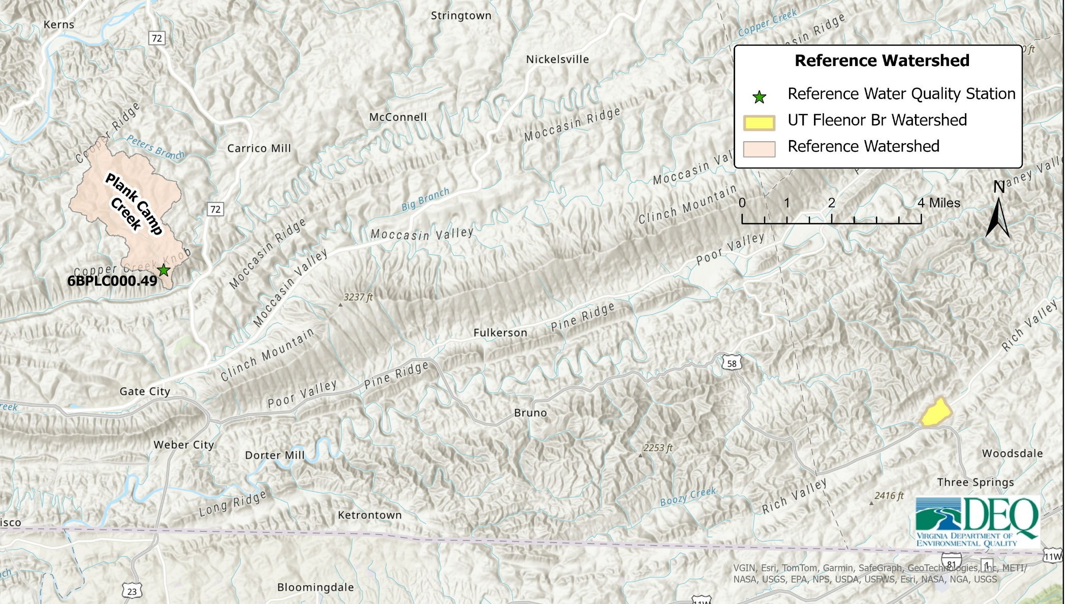
Impaired and Reference Watershed
Healthy VSCI Score
Land use distribution
Size
Slope
Elevation
Physiographic region
River basin
Soil erodibility
UT Fleenor Branch

Slide 23
Reference Watershed Area-adjustment Example
HYSadj
4,252 ha
HYS
20,789 ha
TMB
4,252 ha

Slide 24
UT Fleenor Branch Sediment Reductions
Allocation Scenarios
Land Use/Source Group | Area (acres) | Existing Sediment Load (tons/yr) | Scenario 1 |  | Scenario 2
 |  |  | % Reduction | Allocation Load (tons/yr) | % Reduction | Allocation Load (tons/yr)
Row Crops | - | - | - | - | - | -
Pasture/Hay | 48 | 10.00 | 62.4% | 3.75 | 72.7% | 2.73
Forest | 91 | 4.04 | 0.0% | 4.04 | 0.0% | 4.04
Harvested Forest | - | - | - | - | - | -
Developed | 30 | 4.86 | 62.4% | 1.83 | 40.0% | 2.91
Transitional | - | - | - | - | - | -
Streambank Erosion | - | 0.21 | 62.4% | 0.08 | 89.1% | 0.02
Permitted WLA | - | - | - | - | - | -
Total Load |  | 19.11 |  | 9.70 |  | 9.70
TMDL-MOS-FG = 9.70 (tons/yr)
Needed Reduction = 9.40 (tons/yr)
% Reduction Needed = 49%

Slide 25
Setting the UT Fleenor Branch Phosphorus TMDL Endpoint
A Concentration Approach
The total phosphorus (TP) TMDL load was calculated as the average annual load corresponding to an average annual in-stream concentration
The endpoint was based on the 90th percentile concentration of a neighboring non-impaired watershed
  Water quality data from Cove Creek, station 6CCOV002.44, was used to set the TP TMDL endpoint
    Cove Creek was used as the unimpaired reference stream for the Greendale Creek and UT Fleenor Branch benthic stressor analysis
    UT Fleenor Branch is a tributary to Cove Creek, by means of Fleenor Branch
The TP endpoint was set at an average annual in-stream concentration of
  0.05 mg/L
  based on the 90th percentile concentration at the Cove Creek station 6CCOV002.44
25

Slide 26
UT Fleenor Branch Phosphorus Reductions
Allocation Scenarios
Land Use/Source Group | Area (acres) | Existing Phosphorus Load (lbs/yr) | Scenario 1 |  | Scenario 2
 |  |  | % Reduction | Allocation Load (lbs/yr) | % Reduction | Allocation Load (lbs/yr)
Row Crops | - | - | - | - | - | -
Pasture/Hay | 48 | 90.2 | 65.7% | 31.0 | 77.7% | 20.1
Forest | 91 | 4.7 | 0.0% | 4.7 | 0.0% | 4.7
Harvested Forest | - | - | - | - | - | -
Developed | 30 | 44.1 | 65.7% | 15.1 | 40.0% | 26.4
Transitional | - | - | - | - | - | -
Streambank Erosion | - | 0.8 | 65.7% | 0.3 | 89.1% | 0.1
Groundwater | - | 9.4 | 0% | 9.4 | 0% | 9.4
Septic Systems | - | 1.0 | 65.7% | 0.3 | 77.7% | 0.2
Livestock Direct Deposition | - | 1.3 | 65.7% | 0.4 | 77.7% | 0.3
Permitted WLA | - | - | - | - | - | -
Total Load |  | 151.5 |  | 61.2 |  | 61.2
TMDL-MOS-FG = 61.3 (tons/yr)
Needed Reduction = 90.2 (tons/yr)
% Reduction Needed = 59%

Slide 27
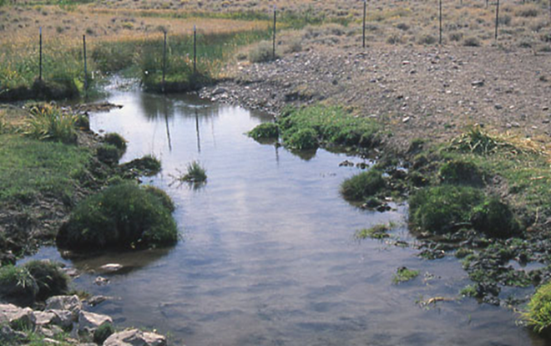
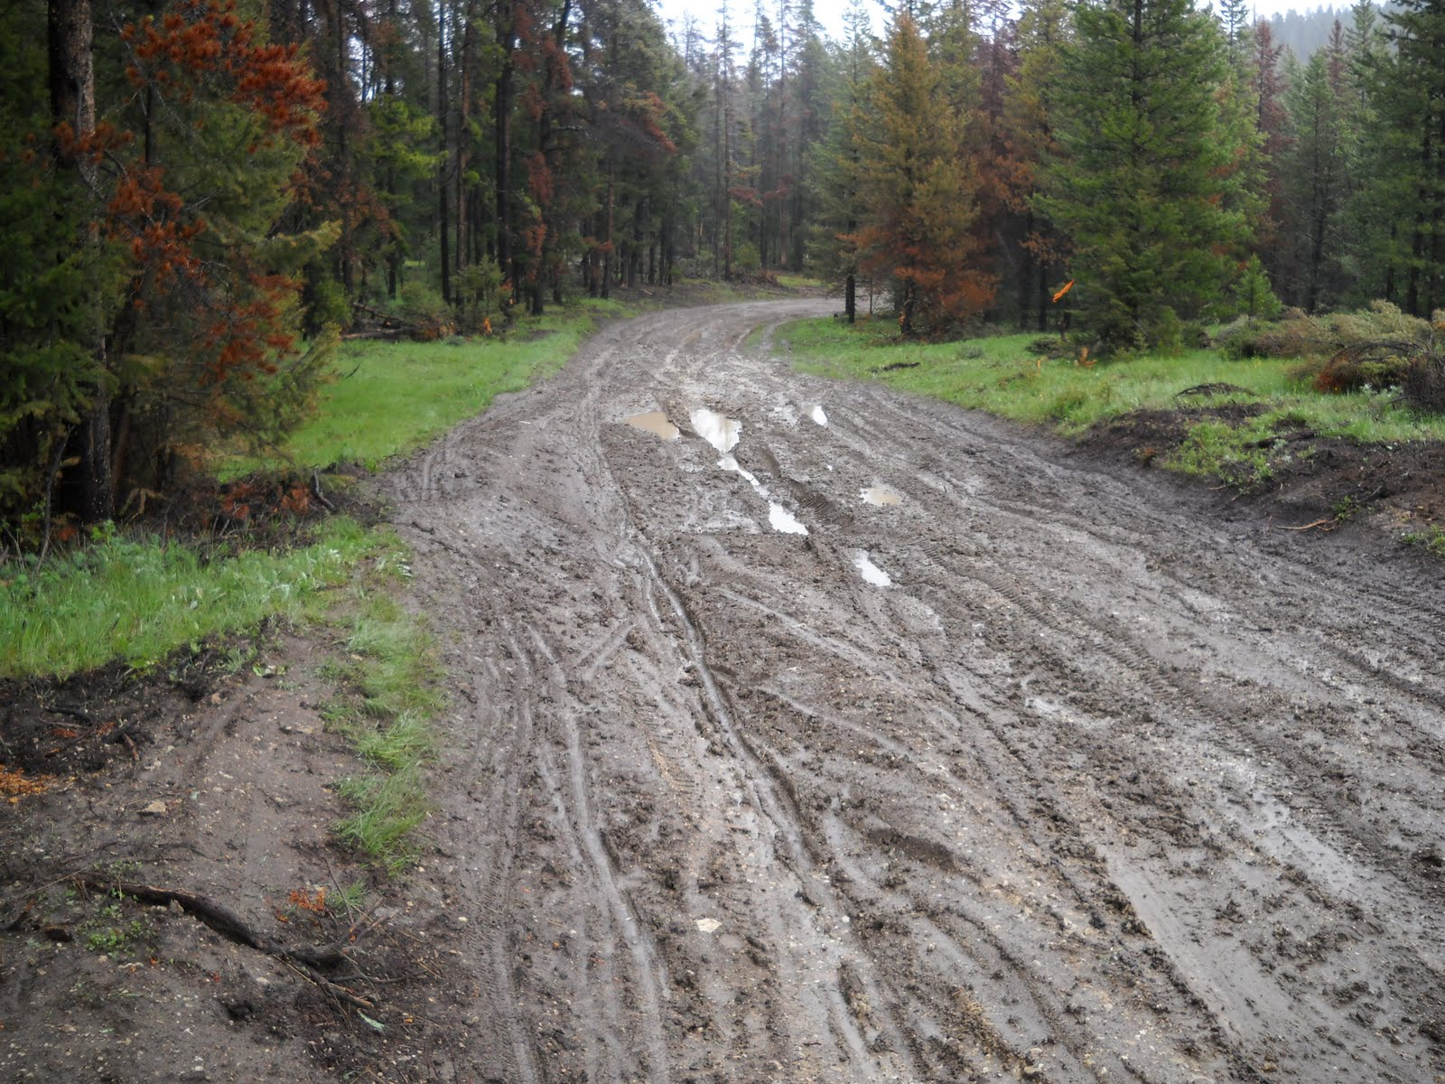
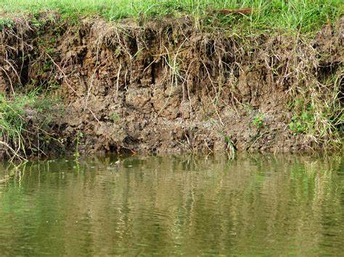
Potential Pollutant Reduction Targets
Pastures with stream access
Pastures with fair or poor conditions
Eroding field roads
Localized disturbed areas
Stormwater along public roadways
27

Slide 28
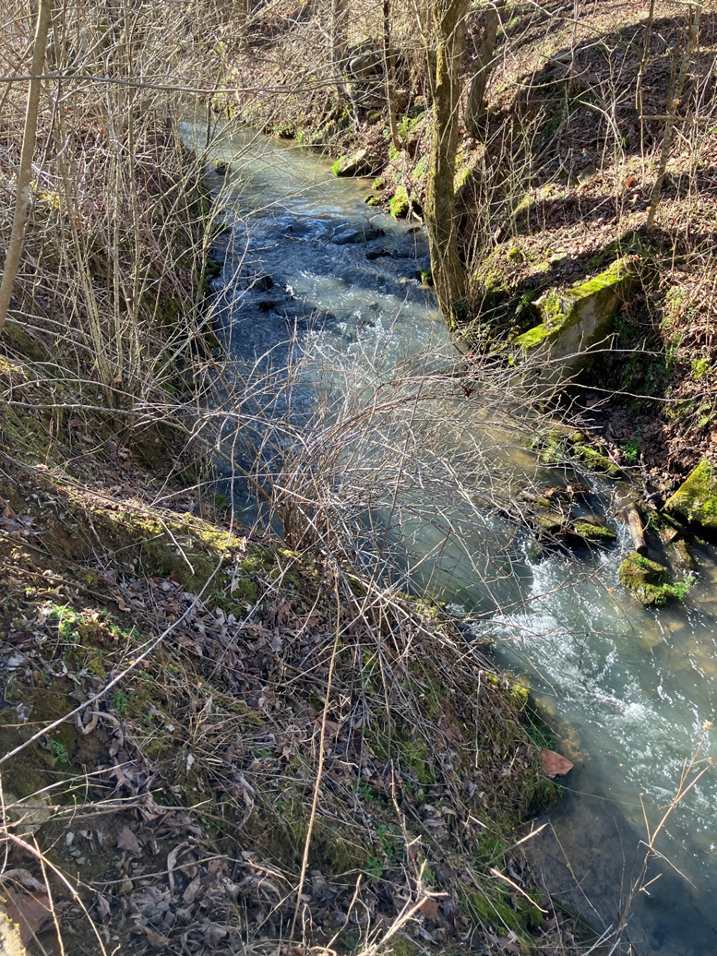
Contact Information:
Landon Jenkins
355 A Deadmore St SW
Abingdon, VA 24210
landon.jenkins@deq.virginia.gov
28

