Slide 1
Roanoke River, Tinker Creek, and
Wolf Creek TMDL Study
A water quality study for watersheds in the City of Roanoke, Roanoke County, and Botetourt County
Aerin Doughty
TMDL Coordinator
April 10, 2024

Slide 2
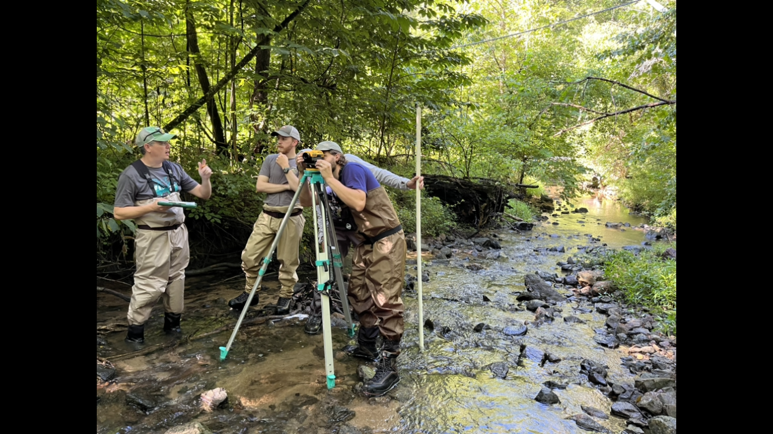
Our goals for today…
Share DEQ’s water quality improvement process
  Provide information on the streams of interest
  Define Total Maximum Daily Loads (TMDL)
  Discuss stressor identification process
  Explore next steps and opportunities for engagement
Receive community feedback – we want to hear from you!

Slide 3
Agenda
Background and TMDL Development
  Virginia Stream Condition Index
  Impairments
  TMDL
Benthic Stressor Analysis Overview - Dr. R. Brent
  Monitoring/Data
  Approach
  Conclusions
Wrap-up and Next Steps by DEQ Staff
  Public Comment Period
  Community Engagement vs. TMDL Advisory Group
  Study/Modeling/Implementation
Questions

Slide 4
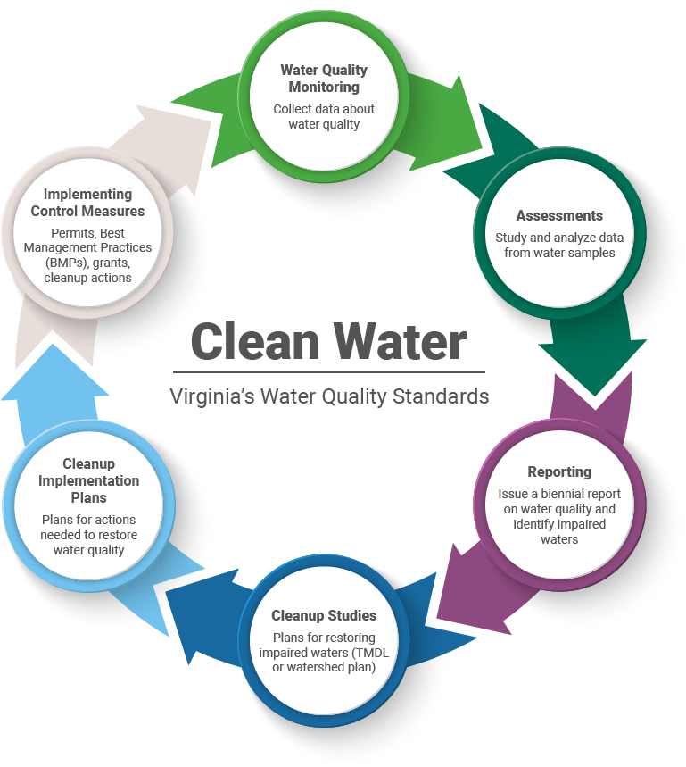
Virginia’s Water Quality Process

Slide 5
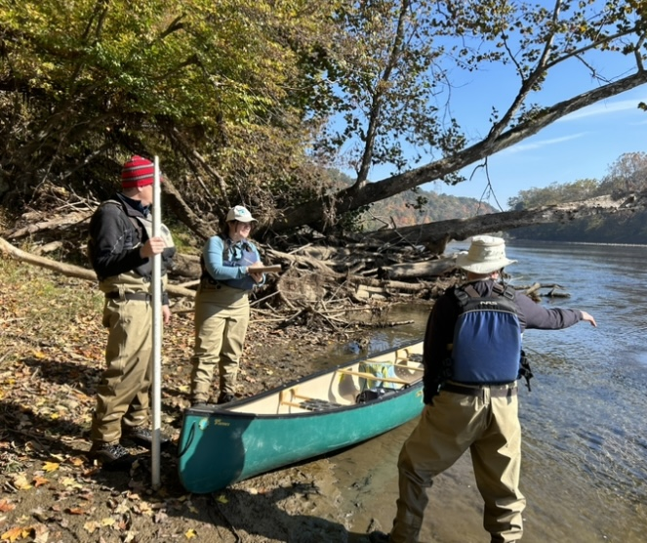
Background: Clean Water Act
The Clean Water Act requires that all waters meet water quality standards that promote healthy water use.
To meet the goals of the Clean Water Act, Virginia established water quality standards.

Slide 6
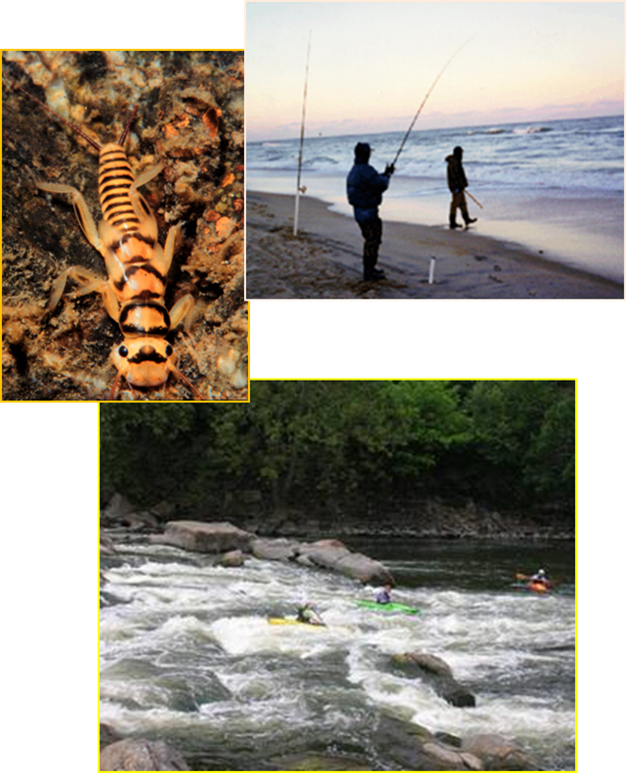
Virginia’s Water Quality Standards
Water quality standards protect these six designated uses:
  aquatic life
  wildlife
  fishing
  shellfish
  swimming
  drinking water

Slide 7
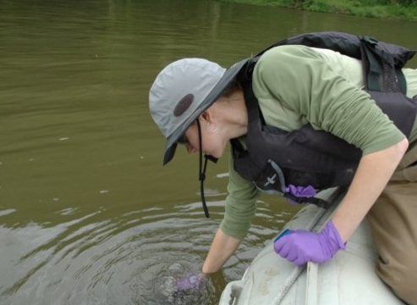
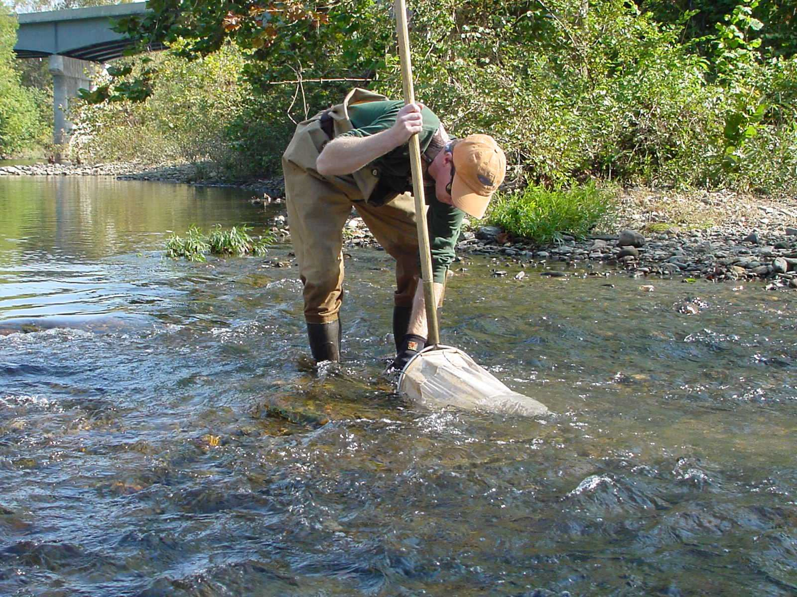
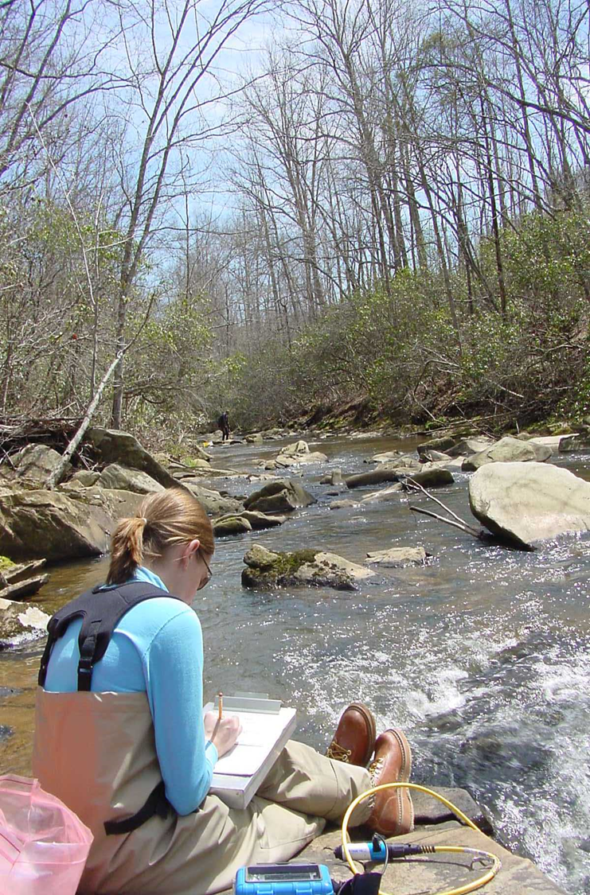
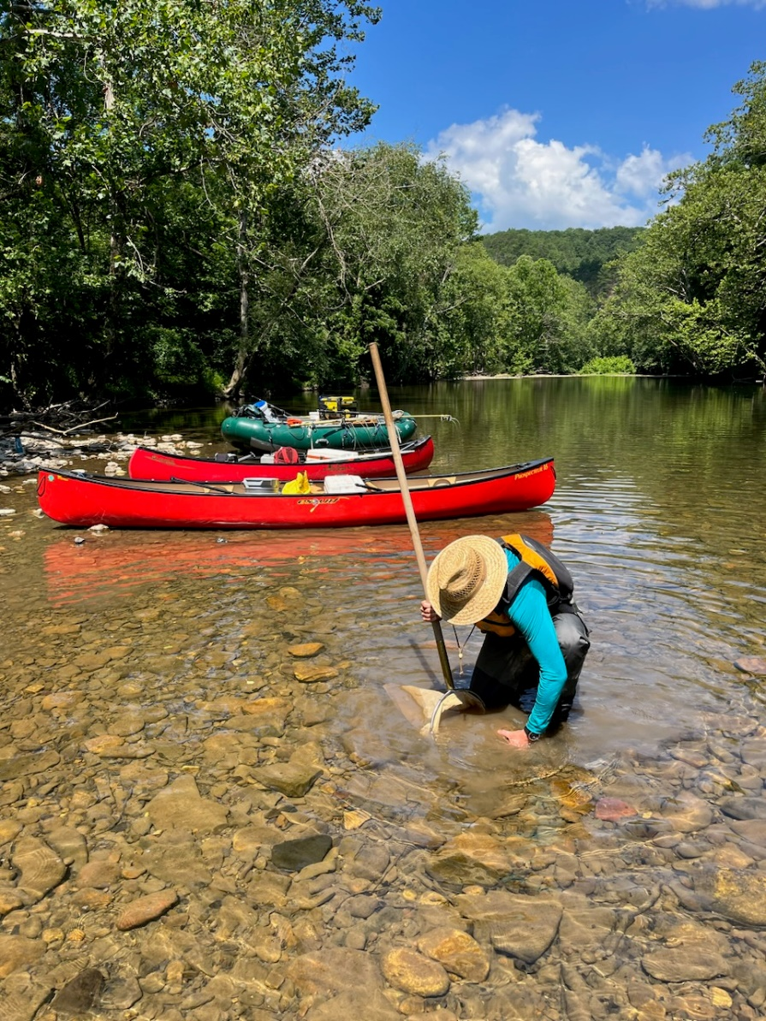
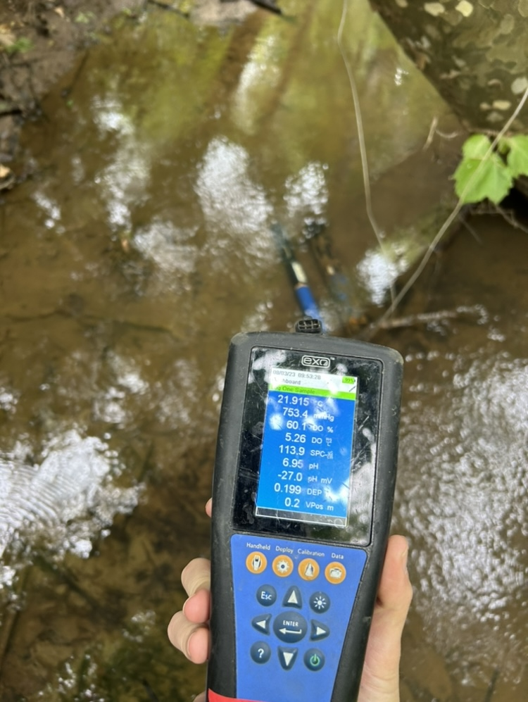

Slide 8
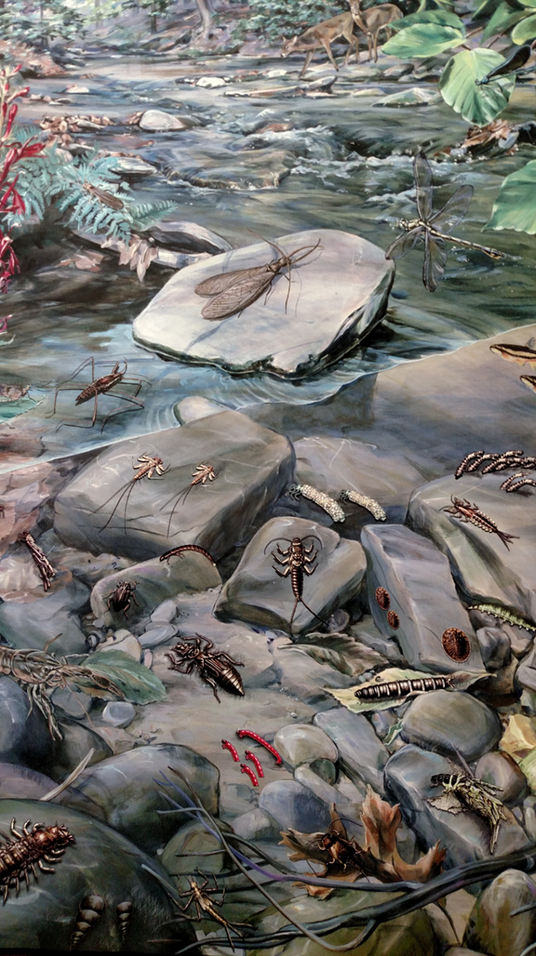
Why Benthic Macroinvertebrates?
Biological Indicators
Vary in their sensitivity to or tolerance of pollution
  Known pollution tolerance values (0-10)
  Respond to changes in water quality
Widespread, found in all aquatic environments
Limited mobility; spend 1-3 years in the water as larvae or nymphs
Biological monitoring gives a longer-term picture of water quality

Slide 9
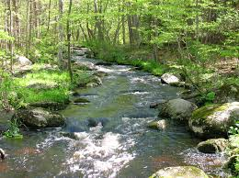

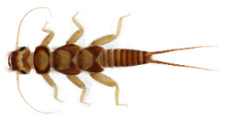
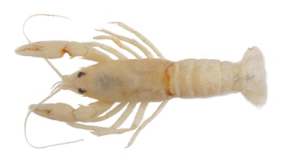
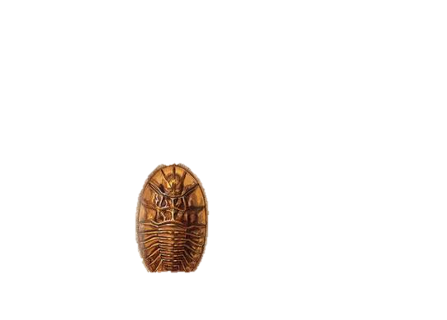


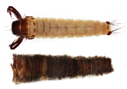
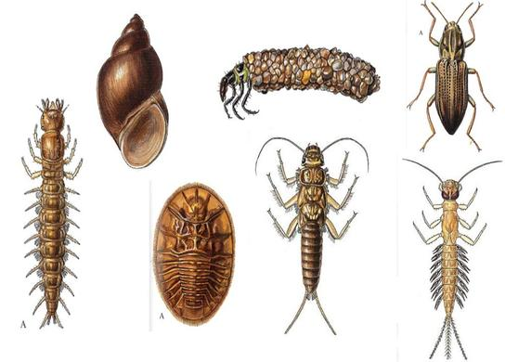

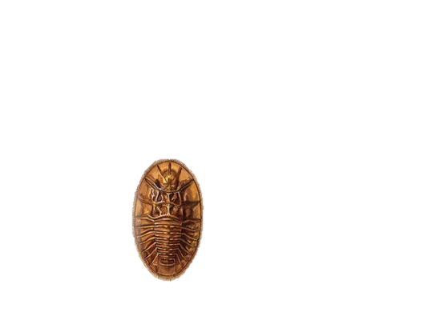
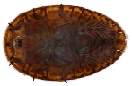
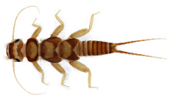
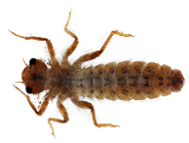


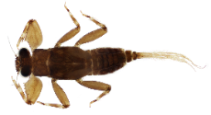

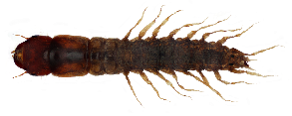

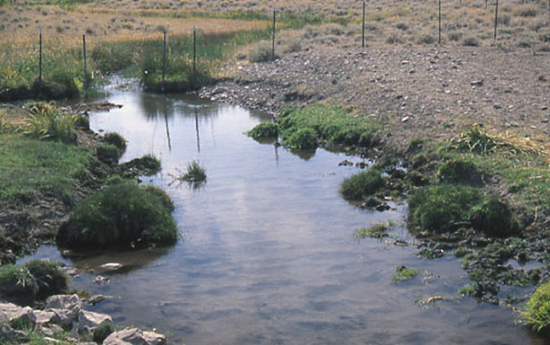






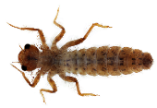


Aquatic life impairments are visible and quantifiable.

Slide 10
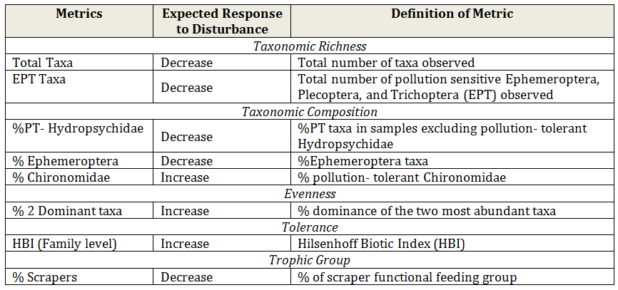
Virginia Stream Condition Index (VSCI)
Benthic macroinvertebrates are collected, sorted, and identified
Each sample produces a score that is driven primarily by the types and diversity of organisms found
Pollution sensitivity affects the score

Slide 11
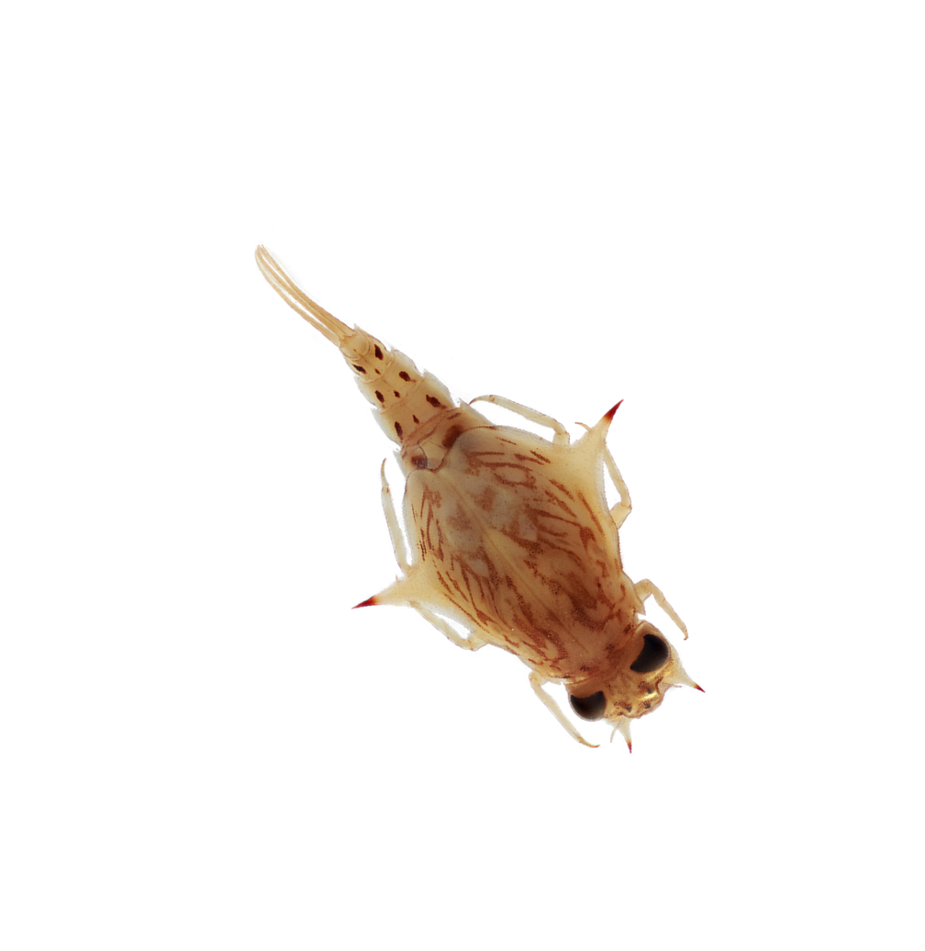
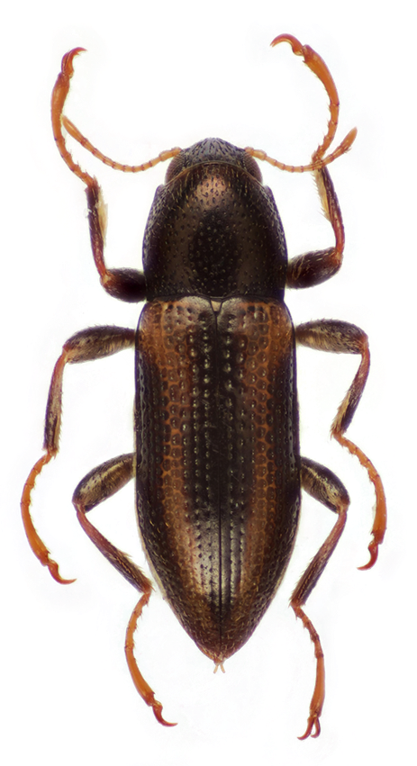
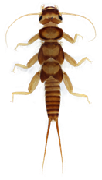
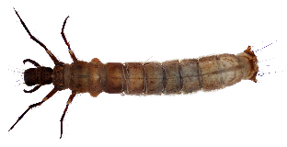
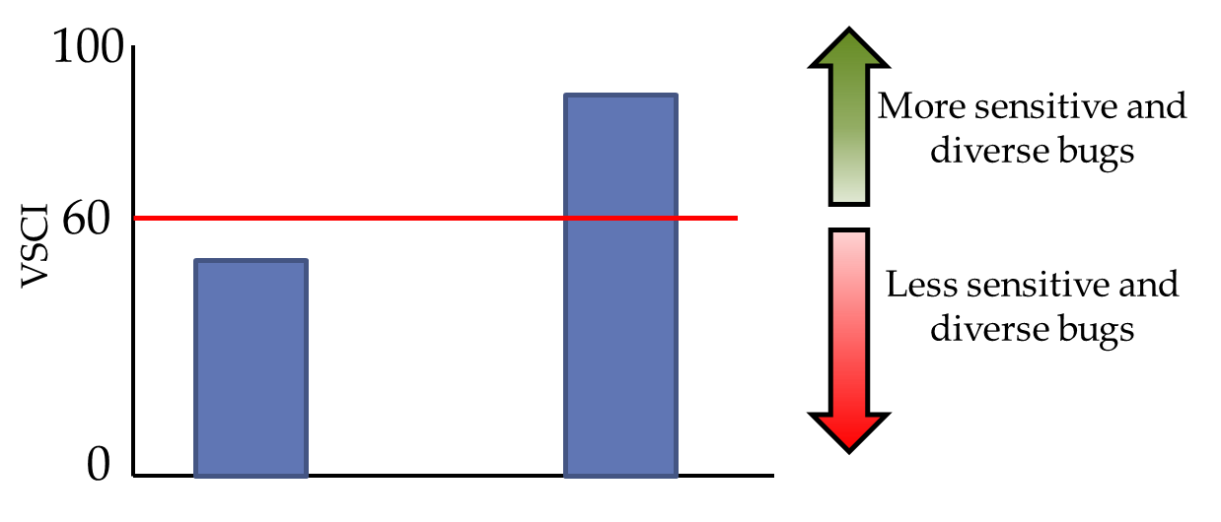
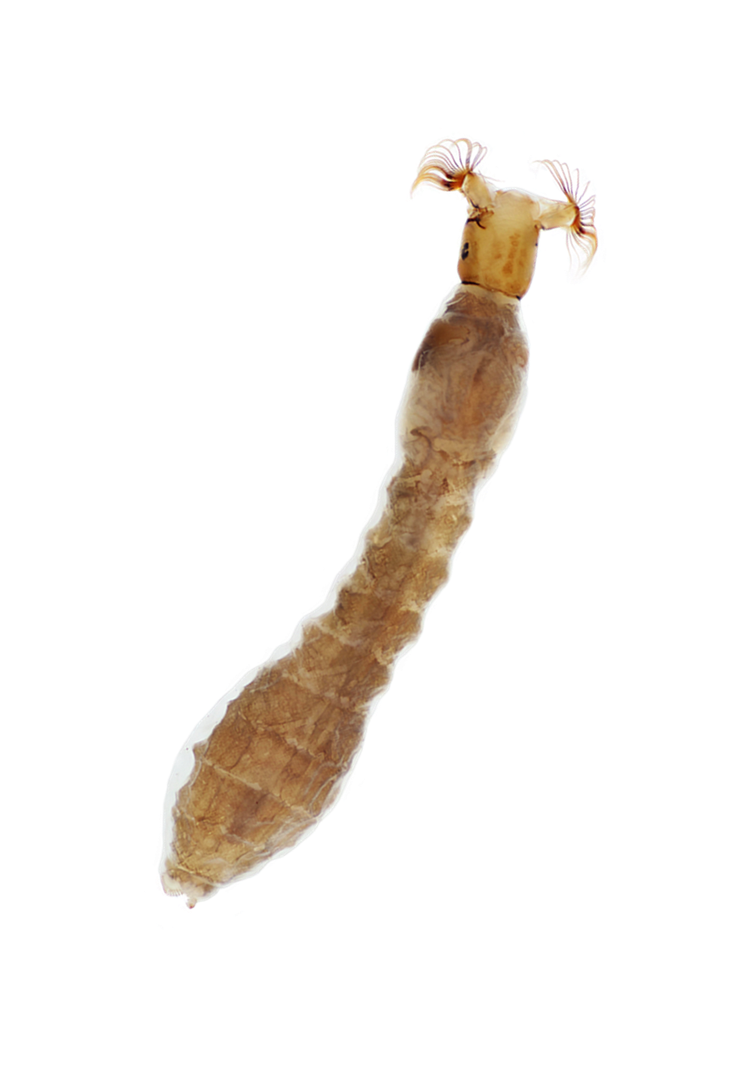
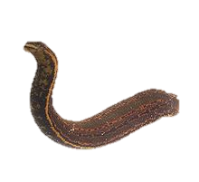
Virginia Stream Condition Index (cont.)
VSCI scores tell us that there is an impairment but not what the pollutant is…

Slide 12
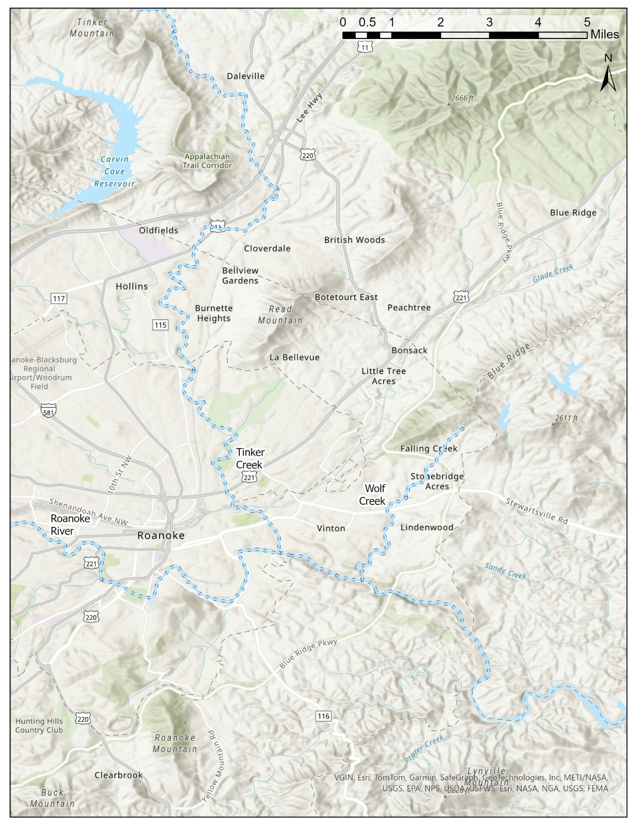
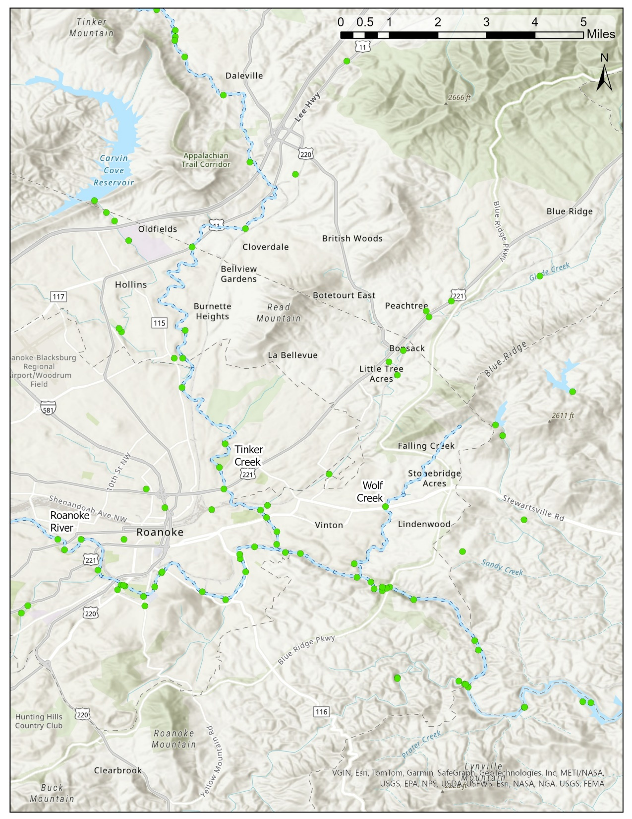
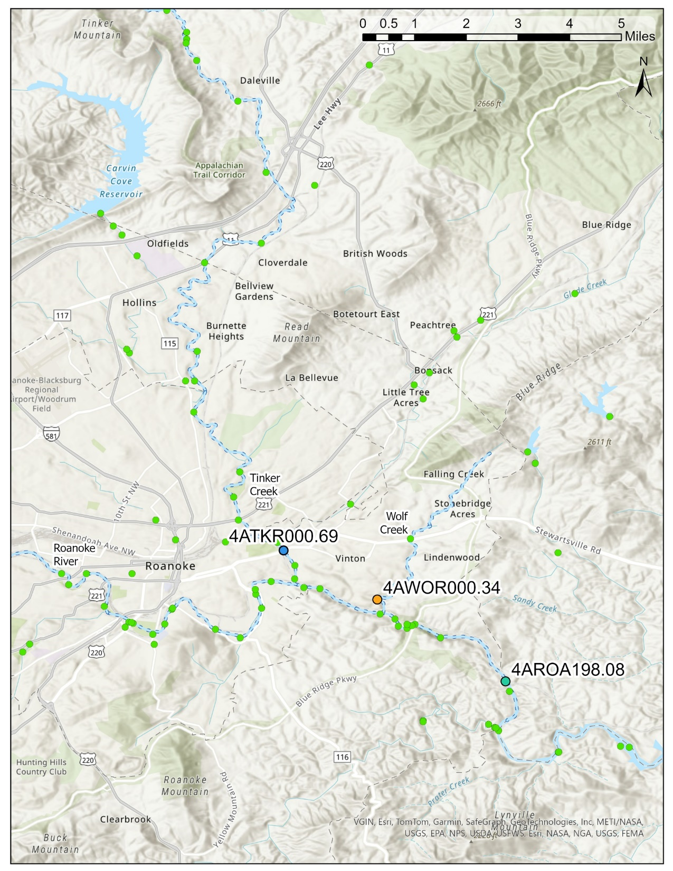
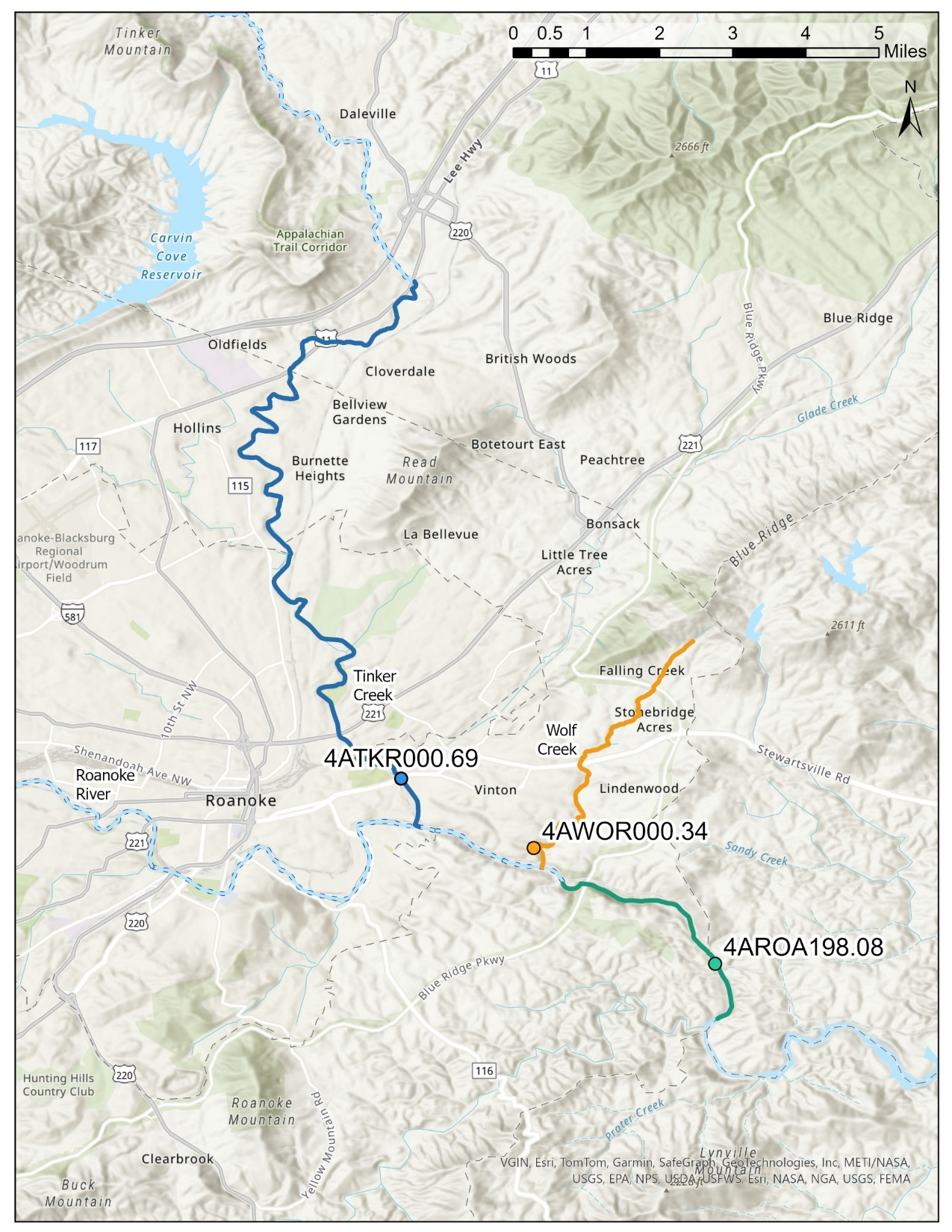
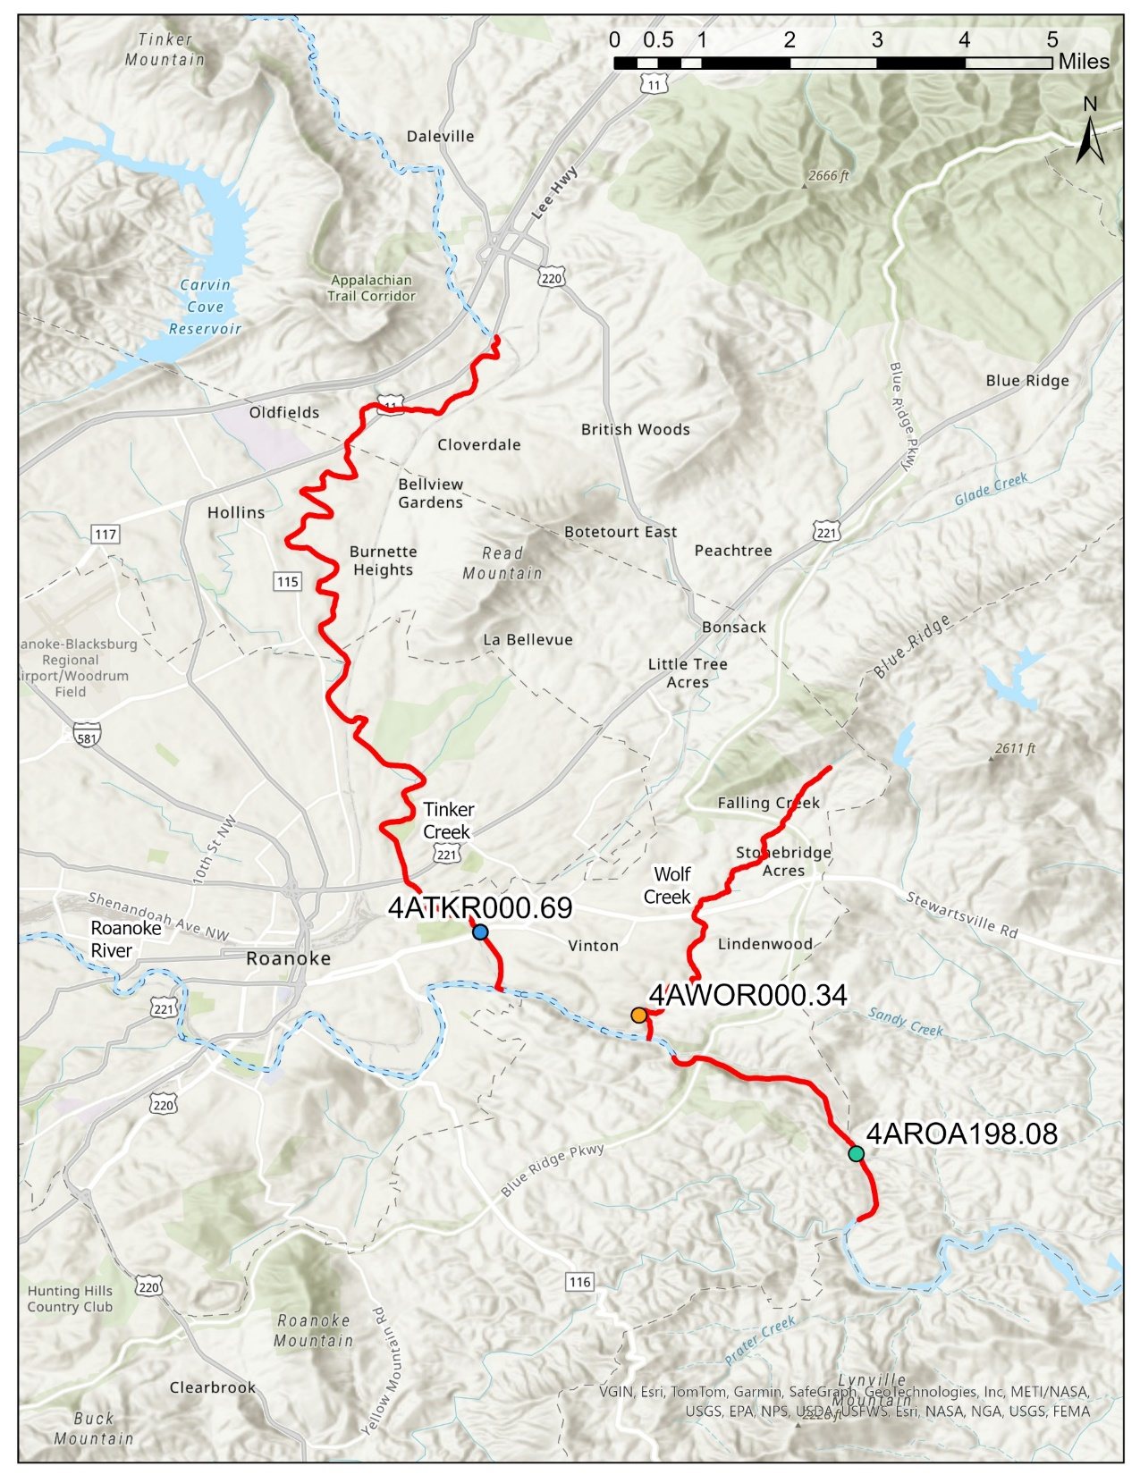

Slide 13
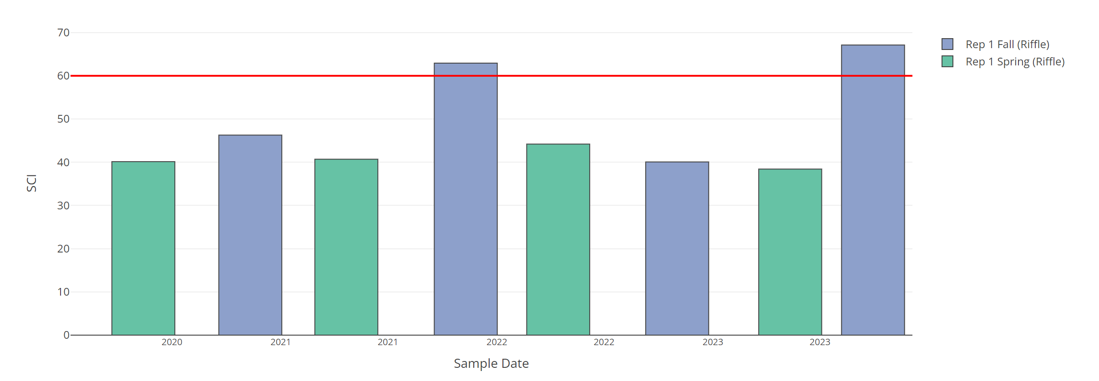
Roanoke River Biomonitoring Data
Station: 4AROA198.08
VSCI
2020
2021
2022
2023
Sample Year
Low VSCI scores are driven by % Mayflies, % Stoneflies and Caddisflies, and % Scrapers

Slide 14
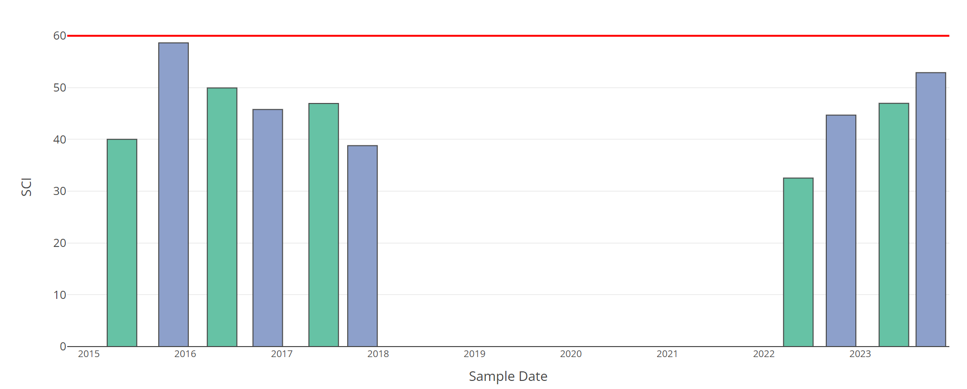

Tinker Creek Biomonitoring Data
Station: 4ATKR000.69
VSCI
2015
2016
2017
2018
2019
2020
2021
2022
2023
Sample Year
Low VSCI scores are driven by % Mayflies, % Stoneflies and Caddisflies, and % Scrapers

Slide 15
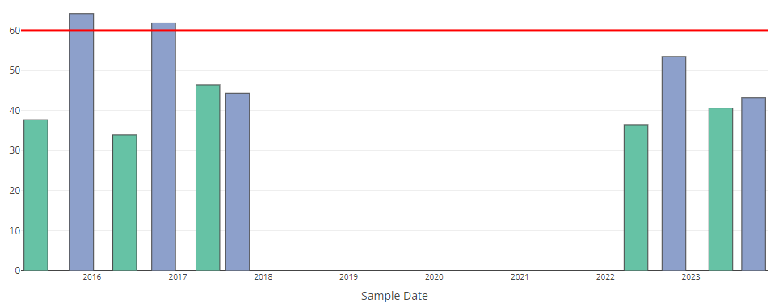
Wolf Creek Biomonitoring Data
Station: 4AWOR000.34
VSCI
2015
2016
2017
2018
2019
2020
2021
2022
2023
Sample Year
Low VSCI scores are driven by % Mayflies, % Stoneflies and Caddisflies, and % Scrapers

Slide 16
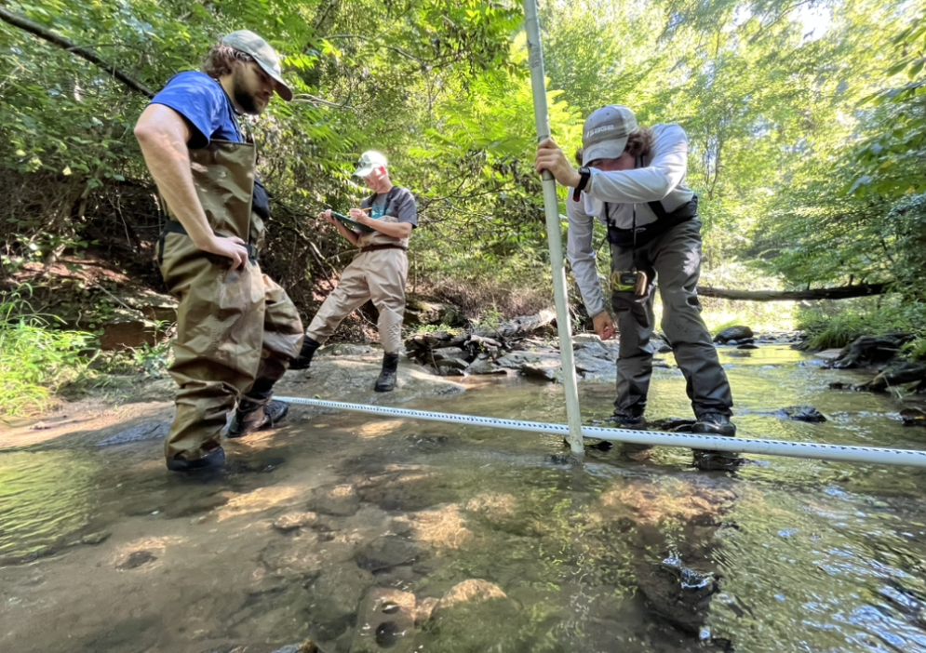
What is a TMDL?
A Total Maximum Daily Load (TMDL) is the maximum amount of a pollutant that a waterbody can receive and still meet water quality standards.
A TMDL includes:
  Identifying sources of pollution causing impairments
    Aquatic Life Impairment
  Modeling their path to the stream
  Determining the reductions needed from each source to meet the standard

Slide 17
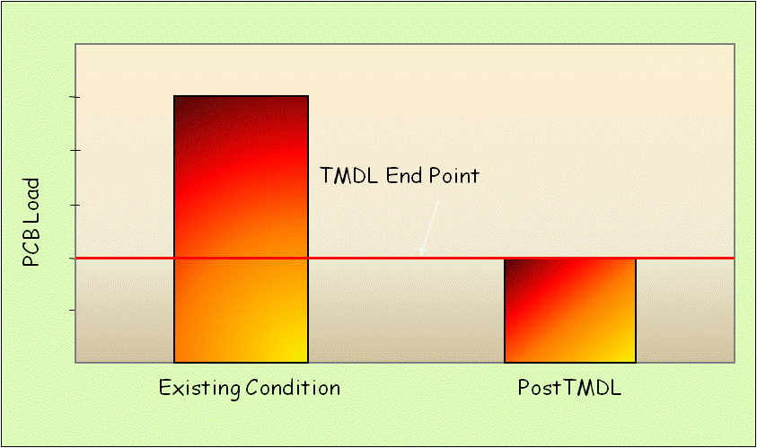
TMDL? A kind of “Pollution Diet”
TMDL Endpoint
Pollutant load in the stream currently
Pollutant load the stream can accept and meet WQS

Slide 18
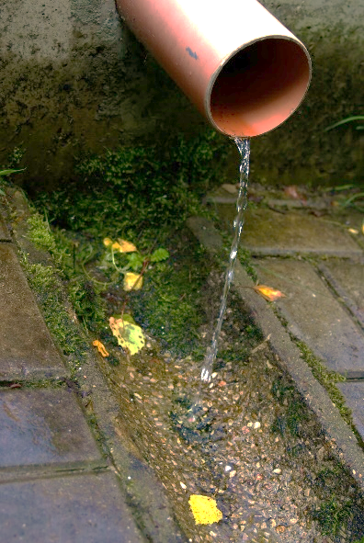
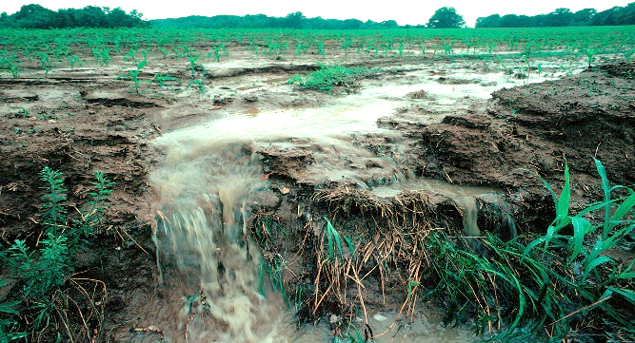
TMDL? A kind of “Pollution Diet”
Water pollution is described by its source. There are two source types,
Point Sources and Non-Point Sources.
Pollution from a point source comes from a direct discharge (ie. effluent discharged to river through an overflow or pipe). Pollution from a non-point source comes from indirect contributions such as stormwater runoff, wind erosion, groundwater seepage, etc.
Pollution Load is the total pollutant from both sources being transported downstream by river flows.
TMDL Endpoint
Pollutant load in the stream currently
Pollutant load the stream can accept and meet WQS

Slide 19
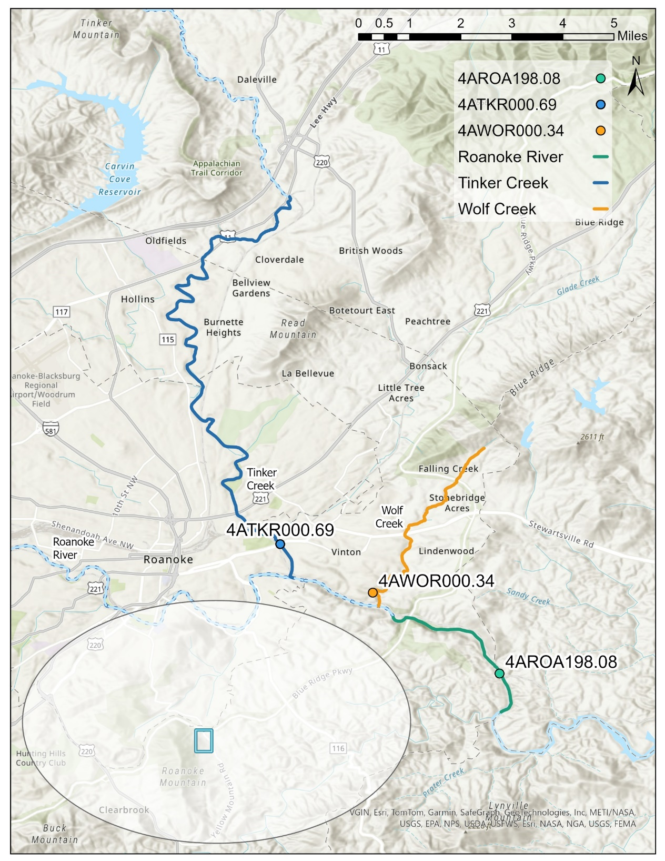
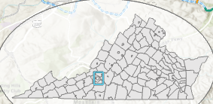
What pollutants may be leading to aquatic life impairments in the Roanoke River,
Tinker Creek, and Wolf Creek?

Slide 20
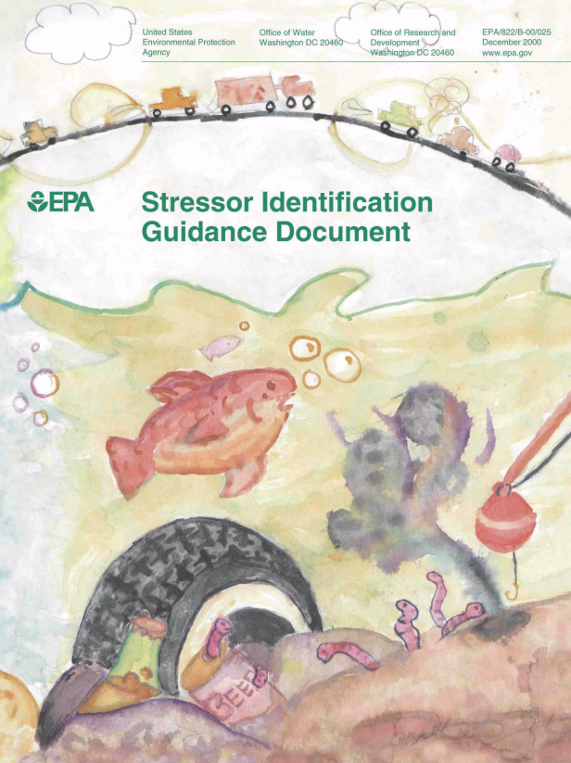

Benthic Stressor Analysis
Goal – identify the pollutant(s) responsible for causing the benthic impairment
Process – EPA’s CADDIS approach (Causal Analysis/Diagnosis Decision Information System)
  Identify potential causes
  Analyze lines of evidence
  Determine the probable cause(s)
Like a medical diagnosis

Slide 21
Potential Causes and Available Data
General List of Potential Causes
Available Data Included
  Nearly 400 different water quality parameters
  67 stations
  > 20 years (2000 – 2023)
  > 72,000 data points
  Additional data from
    Western Viriginia Water Authority
    Biological Monitoring, Inc.
    Brown and Caldwell
    Federal Energy Regulatory Commission
    US Geological Survey
Large Dataset

Slide 22
Lines of Evidence
For each potential cause, up to 18 different lines of evidence were evaluated
Example Lines of Evidence

Slide 23
Scoring Lines of Evidence
Each potential cause is then scored for each line of evidence on a -3 to +3 scale

Slide 24
Example Scoring
Scores for each stream and potential cause are summed
  >0 = non-stressors
  1-3 = possible stressors
  >3 = probable stressors
Non-Stressors
Possible Stressors
Probable Stressors

Slide 25
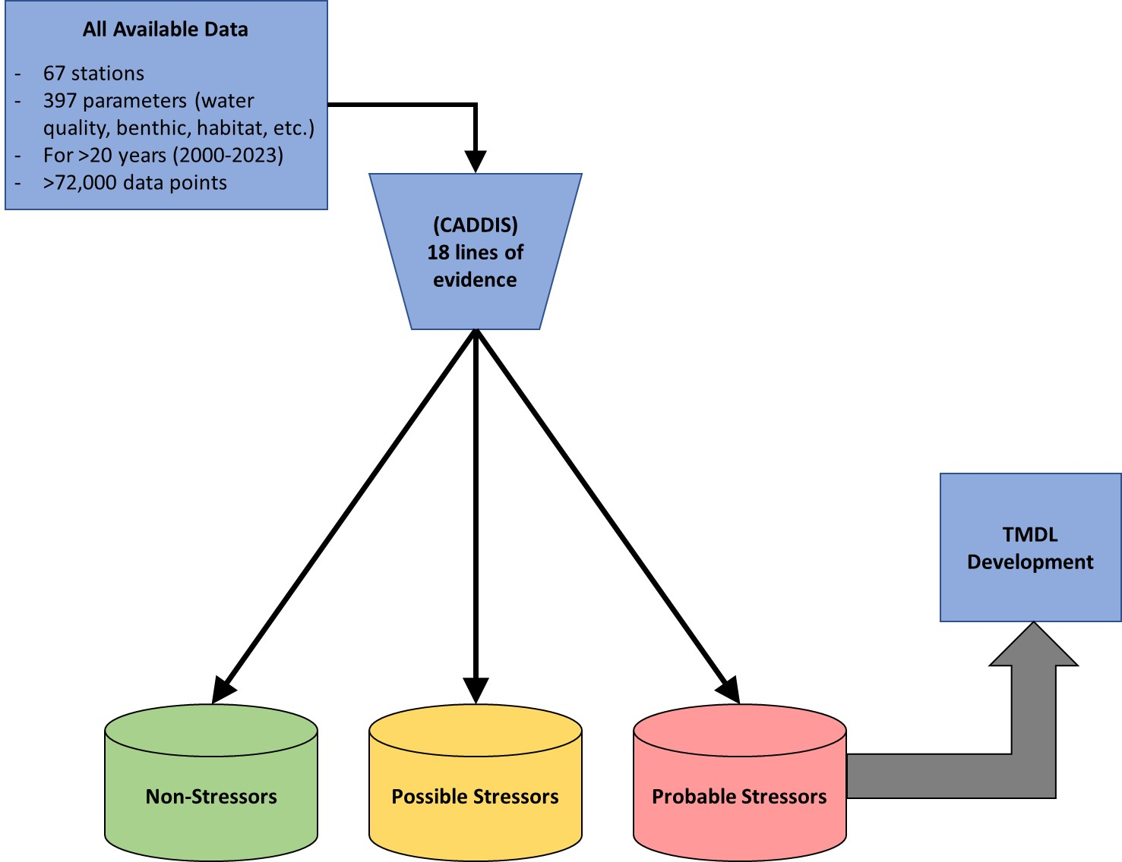
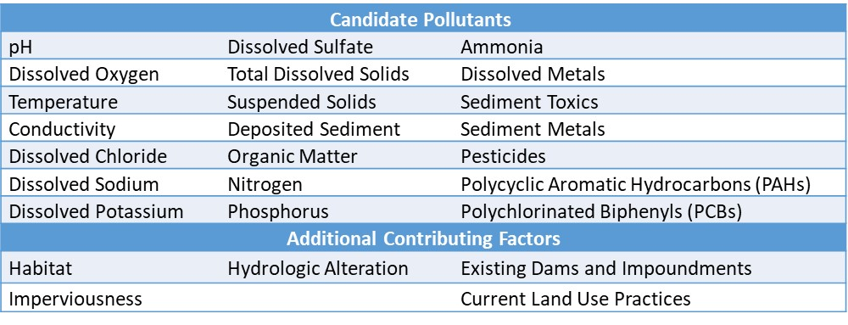
CADDIS Overview

Slide 26
Results
Probable Stressors
  Wolf Creek
    Sediment
  Tinker Creek
    Sediment
    Sediment PCBs
  Roanoke River (202.20)
    Sediment
    Phosphorus
  Roanoke River (198.08)
    Phosphorus
    Nitrogen
    Niagara Dam
Non-Stressors
Possible Stressors
Probable Stressors

Slide 27
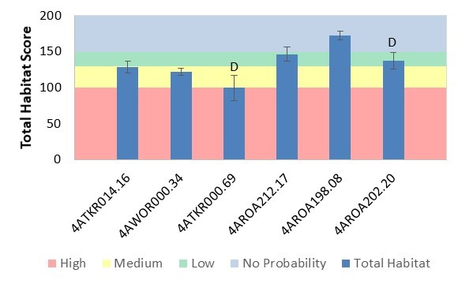
Some Supporting Lines of Evidence – Sediment
(Wolf, Tinker, Upper Roanoke)
Total habitat assessment scores
Statistically lower than the reference
Medium probability range for stressor effects

Slide 28

Some Supporting Lines of Evidence – Sediment
(Wolf, Tinker, Upper Roanoke)
Individual habitat metrics

Slide 29

Some Supporting Lines of Evidence – Sediment
(Wolf, Tinker, Upper Roanoke)
Functional feeding group analysis – increase in collectors and filterers

Slide 30
Some Supporting Lines of Evidence – Nutrients (Roanoke)
Functional feeding group analysis – increase in scrapers

Slide 31

Some Supporting Lines of Evidence – Nutrients (Roanoke)
Statistically significant regressions between nutrient levels and benthic scores across Roanoke River sites

Slide 32

Some Supporting Lines of Evidence – Nutrients (Roanoke)
Excess algae growth that increases moving downstream

Slide 33
Some Supporting Lines of Evidence – Nutrients (Roanoke)
Biological condition gradient attribute analysis showed nutrients as the highest ranked stressor

Slide 34

Some Supporting Lines of Evidence – Nutrients (Roanoke)
High nitrogen levels – statistically significantly higher than the reference and in the high probability range for stressor effects

Slide 35
The Controlling Nutrient – Phosphorus or Nitrogen?
Algal growth is typically controlled by the limiting nutrient
Because both phosphorus and nitrogen were identified as probable stressors, both will be carried into the model development phase
At a later point, phosphorus or nitrogen could be removed based on subsequent modeling
Rationale
  CADDIS scores were in the probable stressor range
  Currently don’t have definitive nutrient limitation evidence
  Nutrient limitation may vary spatially and temporally
  Phosphorus controls alone may be inadequate for controlling algae

Slide 36
Impact of the Niagara Dam
Station 4AROA198.08 is only approximately a mile downstream from the Niagara Dam
Dams are known to cause physical, chemical, and ecological changes that result in immediate downstream benthic impairment
In addition, the dam is likely exacerbating the nutrient impairment by:
  increasing nutrient retention
  reducing the frequency of scouring event and allowing algal communities to proliferate
However, TMDL program is designed to address pollutants only

Slide 37
Benthic Stressor Analysis Summary
Stream | Probable Stressors | TMDL Target
Wolf Creek | Sediment | Sediment
Tinker Creek | Sediment Sediment PCBs | Sediment
Roanoke River | Phosphorus Nitrogen Sediment Niagara Dam | Phosphorus Nitrogen
Red strikethrough = TMDL already developed
Blue strikethrough = TMDL can only be developed for pollutants

Slide 38


What happens next…
*****May 10th, 2024*****
https://www.deq.virginia.gov/our-programs/water/water-quality/tmdl-development/tmdls-under-development
April 10, 2024
EPA and SWCB Approval
Completed Benthic Stressor Analysis
First Public Meeting
Public Comment Period
TMDL Development/
Community Engagement Meetings/TAG Meetings
Final Public Meeting
Public Comment Period
30 Days
Opportunity for you to participate

Slide 39

Community Engagement Meeting or
TMDL Advisory Group?
Community Engagement Meetings
  Open to the public
  Anyone in attendance can participate & advise DEQ on TMDL development
TMDL Advisory Group (TAG)
  Set-up upon request
  Replaces community engagement meetings
  Formal panel with approved membership that advises DEQ on TMDL development
    Cross-section of stakeholders
    Members commit to attend multiple meetings
  Open to the public but non-members may only attend as observers

Slide 40



TMDL Development: The Study Continues
Identity Point Sources
  Permitted discharges
  Construction Permits
Identify Non-point Sources
  Land Use
  Natural hydrologic properties of the area

Slide 41


TMDL Development: The Model & Reductions
Adjust
Calibration
Parameters
No
Watershed
Inputs
Model Outputs
Match Observed Data?
Yes
Meet TMDL Endpoints?
Yes
Computer Model
TMDL
Complete
No
Revise Pollutant Reduction
Scenarios Until We Meet
TMDL Endpoints

Slide 42



TMDL Development: The Equation of the Pollution Load
WLA
LA
Wasteload Allocation
Permitted/Point Sources
MOS
TMDL
Load Allocation
Non-point Sources
Margin of Safety
Extra load to account for uncertainty
Total Maximum Daily Load

Slide 43
What happens next…
April 10, 2024
EPA and SWCB Approval
Completed Benthic Stressor Analysis
First Public Meeting
Public Comment Period
TMDL Development/
Community Engagement Meetings/TAG Meetings
Final Public Meeting
Public Comment Period
30 Days
Opportunity for you to participate

Slide 44

For comments: aerin.doughty@deq.virginia.gov or 901 Russell Drive Salem, VA 24153
The 30-day public comment period ends May 10
To learn more about TMDLs, visit DEQ’s website: https://www.deq.virginia.gov/our-programs/water/water-quality/tmdl-development
To view the Stressor Analysis Document: https://www.deq.virginia.gov/our-programs/water/water-quality/tmdl-development/ tmdls-under-development
Comments, Thoughts, & Questions

