Slide 1
Pigg River, Poplar Branch, Fryingpan Creek, and Beaverdam Creek
TMDL Implementation Plan
First Public Meeting
Kimberly Romero
Nonpoint Source Coordinator, Blue Ridge Regional Office
February 29th, 2024
1
Notes:
It’s about 4:30 so I would like to go ahead and get started. I just wanted to make sure that everyone had a chance to sign in, pick up some of the documents and get some cookies if you’d like
Welcome
Hi thank you all for taking the time to come today to the first public meeting for Pigg…..
My name is Kim Romero and I am the NPS Coordinator for the BRRO and parts of VRO

Slide 2
Welcome and Introductions
  DEQ Staff
  Meeting Attendees
2
Notes:
Before we begin, I would like to go around the room and have everyone introduce themselves (name,job title, or if you’re a member of the community

Slide 3
What do we hope to accomplish today?
  Remind ourselves of Virginia’s water quality process
    TMDL
    Discuss how to reduce bacteria/benthic impairments in the watershed
  Overview of the Implementation Plan (Clean Up Plan)
  Next steps
Notes:
we’re here to discuss the beginning stages of a clean up study also known as an implementation plan for the Pigg River, Poplar Branch, Fryingpan Creek and Beaverdam Creek. This project includes a focus on benthic impairments within the project area and one segment of bacteria impairment on Beaverdam Creek
now to do get a better understanding of this, we’ll need to review:
Water process, TMDL
Which includes the various components of the TMDL and the finding
Once we complete the overview of the TMDL we will then move on to
Overview of the Implementation Plan
Next Steps
By the end of this meeting I hope everyone is able to leave with a better understanding of the impairments we would like to address in the Implementation Plan as well as a general understanding of what the IP process looks like.

Slide 4
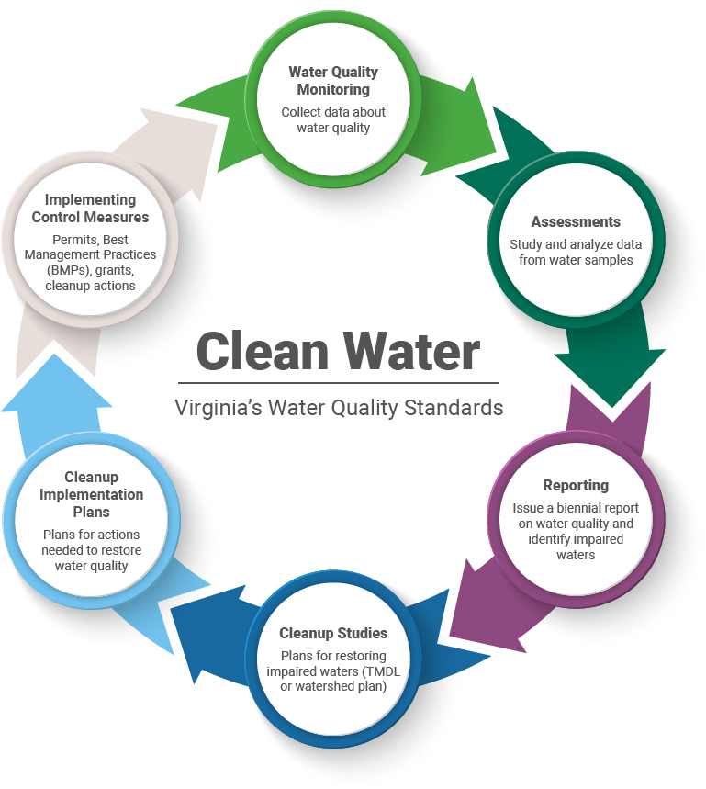
Virginia’s Water Quality Process
Notes:
Starting off we’ll look at this water wheel. Before diving deeper into these steps, it’s important to understand a bit of the background and how the clean water act ties into it.
The Clean Water Act became law in 1972 requires that all U.S. streams, rivers, and lakes meet certain water quality standards. In doing so, states began monitoring various bodies of water. Through this process Virginia found many stream segments which do not meet the state standards for protection of the six beneficial uses including the need to support aquatic life, wildlife, fishing, shellfish, recreation and drinking water
Wheel outlines our steps in monitoring and assessing these waters to find the impaired areas and from there determining ways in which can help bring it back to meet the state’s water quality standards established by the clean water act
Going back to the wheel we start with WQM
This is where our field staff go out throughout Virginia in designated sampling areas to collect water quality samples like E.coli, DO, pH, etc.
These samples are then sent to a lab to be analyzed. ​
During the assessment phase all of the data from the samples becomes compiled, studied, and analyzed.
​ To determine what the data is saying
Reporting: This is where The streams that do not meet Virginia’s water quality standards/ are identified as impaired are listed in a biennial report called the Water Quality Assessment 305(b)/303(d) Integrated Report.
From this, we are able to use the data that is listed in the reports and develop a TMDL (total maximum daily load) Report which is a plan for restoring impaired waters. The stream which fails to meet the standards that we list in the TMDL come from the 303 (d) list in the integrated report that we mentioned in the reporting section. The term "303(d) list" aka “dirty water list” is short for a state’s list of impaired and threatened waters (e.g. stream/river segments, lakes). We will touch more on the background of a TMDL in the next slide but basically it dives deeper into identifying the point sources and nonpoint sources that would need to be reduced to obtain and meet the water quality standard​
Clean Up/IP: Once a TMDL is developed and approved by EPA, measures must be taken to reduce non point source pollution levels in the stream as stated by Virginia’s Water Quality Monitoring, Information, and Restoration Act (WQMIRA). For IPs to be approved by the Commonwealth, they must meet the requirements outlined by WQMIRA. ​
Through this process, states establish water-quality-based controls to reduce pollution and meet water quality standards. Upon approval of an IP, Virginia may provide funding for implementation of these plans through 319(h) funding.

Slide 5
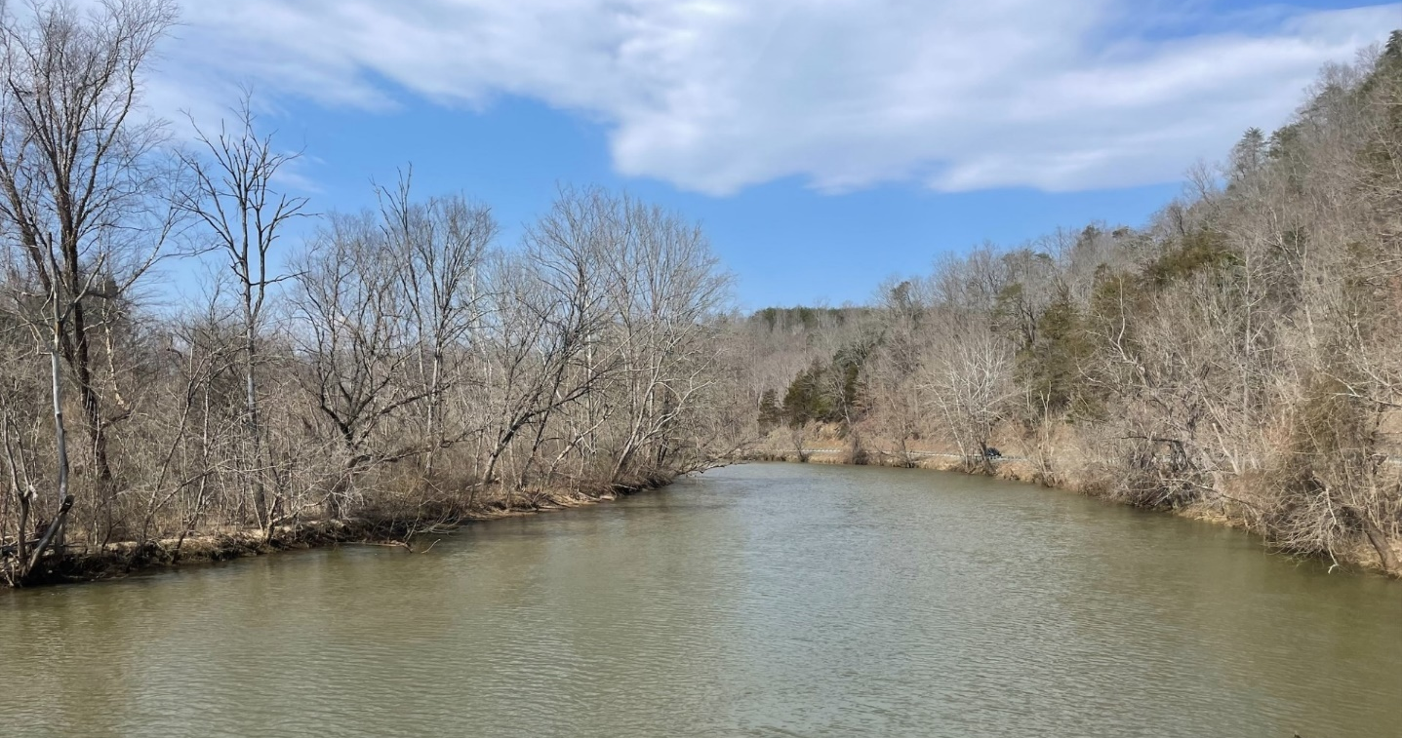
What is a TMDL?
Total Maximum Daily Load is the maximum amount of a pollutant that a waterbody can receive and still meet water quality standards.
A TMDL includes:
  Identifying sources of pollution
    Bacteria
    Benthic
  Modeling their path to the stream
  Determining the reductions needed from each source to meet the standard.
TMDL= Waste Load Allocation (point source) + Load Allocation (nonpoint source) + Margin of Safety
5
Notes:
TMDLs which stands for Total Maximum Daily Load is set limit on the amount of pollution that a waterbody can tolerate and still maintain water quality standards plus support healthy aquatic life.
A TMDL serves as the starting point or planning tool for restoring water quality.​
A TMDL includes identifying source of pollution In this case the TMDLs we will be reviewing for this study come from the 2022 Benthic Impairments from Pigg, Pop, Fry and Beav and the 2006 TMDL Study that focuses on the bacteria impairment in the one segment on Beaverdam Creek.
The TMDL also model the path of pollutants to the stream whether that be point sources (wastewater plants, straight pipes, etc.. ) or nonpoint sources (urban and agricultural runoff, failing septic systems) and we see that in the TMDL equation below.
An essential component of a TMDL is the calculation of the maximum amount of a pollutant that can occur in waterbody and still meet WQS. Within the TMDL the state allocates this loading capacity among the various point sources and non-point sources. Permits for point sources are issued through EPA’s National Pollutant Discharge Elimination System, or NPDES program.​
Waste Load Allocations- portion of a receiving water's loading capacity that is attributed to point sources, these are permitted sources ​
Load Allocation (LA)- portion of a receiving water's loading capacity that is attributed to nonpoint sources or to natural background sources, these are non permitted sources, and this is where an IP comes in to address. ​
Margin of Safety- to account for uncertainty in modeled output, to ensure that the modeled loads do not underestimate the actual loadings that exist in the watershed​
TMDLs also determine the reductions needed from each source to meet the water quality standard which we will review more in a couple slides. ​

Slide 6
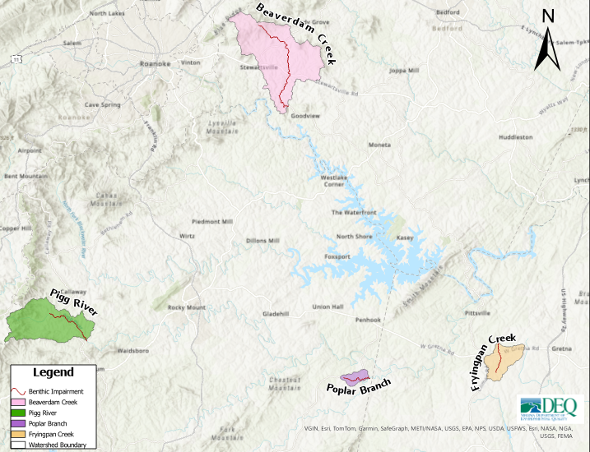
Benthic Impairments as of 2022 Integrated Report
Impairment Name | Initial Listing Year | Impairment Miles
Pigg River #1 | 2012 | 1.48
Pigg River #2 | 2012 | 1.01
Pigg River #3 | 2012 | 1.94
Poplar Branch | 2010 | 2.56
Fryingpan Creek | 2010 | 2.56
Beaverdam Creek #1 | 2008 | 4.98
Beaverdam Creek #2 | 2006 | 5. 58
6
Notes:
Now, the 2022 Integrated Report listed 7 segments of benthic impairments that are not meeting the water quality standards which were addressed in the TMDL.
​
Describe map and table: Color corresponds. you will also see the information regarding specifics to the length of impairment miles.​
​
These stream impairments all have different years of when they were initially listed as impaired because we have collected more data overtime and they have been nested into the existing TMDLs.​
​
You will also see that for Pigg River and Beaverdam Creek they have numbers beside them. This is indicating the stream segments from upstream to downstream.
In addition to these, we have an additional segment that overlaps with the benthic Beaverdam creek impairment.

Slide 7
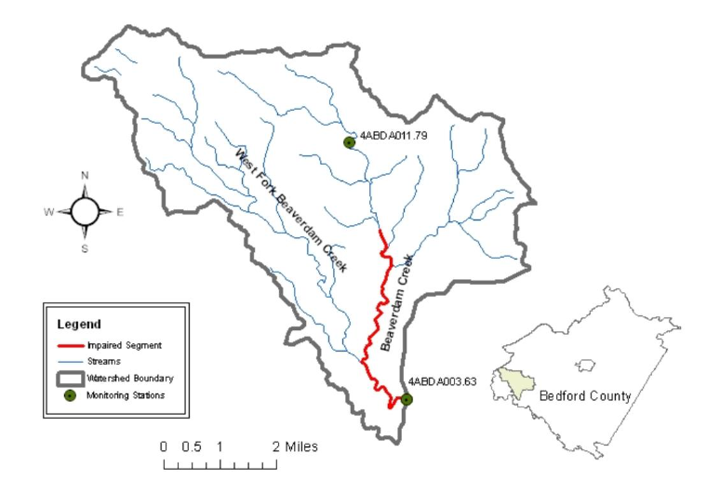
Bacteria Impairment from 2006 TMDL
Impairment Name | Initial Listing Year | Impairment Miles
Beaverdam Creek #2 | 2006 | 5.58
Notes:
VADEQ’s biological monitoring program is used to evaluate compliance with the above standard. This program monitors the assemblage of benthic (bottom-dwelling) macro (large enough to see) invertebrates (insects, mollusks, crustaceans, and annelid worms) in streams to determine the biological health of the stream. Benthic macroinvertebrates are sensitive to water quality conditions, important links in aquatic food chains, major contributors to energy and nutrient cycling in aquatic habitats, relatively immobile, and easy to collect. These characteristics make them excellent indicators of aquatic health. Changes in water quality are reflected in changes in the structure and diversity of the benthic macroinvertebrate community. Currently, VADEQ assesses the health of the benthic macroinvertebrate community using the Virginia Stream Condition Index (VSCI).

Slide 8
Benthic and Bacteria Sources
Benthic:
  Benthic Stressor Analysis study conducted 2021 determined the impairment was caused by too much sediment
    Nonpoint Source
      Streambank erosion
      Surface runoff
    Point Source
      VPDES Individual Permit
      Domestic Sewage Permits
      Construction Stormwater General Permits
Bacteria:
  Bacteria Stressor Analysis study from 2006 TMDL Report determined the impairment was caused by fecal coliform bacteria.
    15% by human
    21% by pet
    27% by livestock
    37% by wildlife
Notes:
Ultimately what the benthic stressor analysis found was that Excess sediment was identified as the primary stressor in all TMDL watersheds
For instance if you have freshly plowed field or construction site, and rain. The rain will carry the loose sediment down the body of water. When that soil gets into nearby streams, it falls to the bottom as sediment and can smother certain aquatic insects that live on the bottom of the stream, limiting the diversity of aquatic life.
So these streams are considered impaired for failure to support aquatic life use (i.e., a benthic impairment). It is important to note that all study streams are also considered impaired for recreational use (i.e., bacteria); however, previous TMDL studies address those impairments.
Essentially The reason why we’re adding the 2006 bacteria impairment is to 1. Help address the impairment 2. Provide control measures and funding to help with the issues presented in the 2006 TMDL
Fecal bacteria levels are used to assess the Recreational Use water quality standard. .
***Another important thing to note about these figures is that we Will revisit land use and source assessment for bacteria in the next meeting and will provide any updates that we find.
The health and diversity of these bugs are assessed using the Virginia Stream Condition Index (VSCI), which is measured on a scale from 0 to 100, with scores greater than 60 being acceptable. Figure 12 shows the various monitoring stations throughout the watershed, color-coded by the average score at each site. Red and yellow icons indicate that the streams do not support a healthy and diverse community of bugs and fish. This shows that the various impaired streams in this study fail the aquatic life standard, and pollutants within the watershed need to be identified and reduced.
Excess sediment was identified as the primary stressor in all TMDL watersheds. When it rains, sediment is washed off the land surface into nearby creeks and rivers. The amount of soil that is washed off depends upon how much it rains and the type of land that the rain falls on. Some land types, like a freshly plowed farm field or a construction site, can yield large amounts of sediment when it rains, while other land types, like forests and well-maintained pasture, yield only a small amount. When that soil gets into nearby streams, it falls to the bottom as sediment and can smother certain aquatic insects that live on the bottom of the stream, limiting the diversity of aquatic life.
Monitoring was used to determine how much sediment is in the streams at any given time and how aquatic life conditions have changed over time. The computer model was used to estimate where the sediment is coming from and make predictions about how stream conditions would change if those sources were reduced.
For this purpose, a computer model, the Generalized Watershed Loading Function model (or GWLF)
GWLF considers the slope, soils type, land cover, soil erodibility, and runoff to estimate the amount of soil eroded from the watershed and deposited in the stream. The model was calibrated against real-world flow measurements taken from the stream to ensure that it was producing accurate results.
The stressor analysis study used a formal causal analysis approach developed by USEPA, known as CADDIS (Causal Analysis Diagnosis Decision Information System). The CADDIS approach evaluates 14 lines of evidence that support or refute each candidate stressor as the cause of impairment. In each stream, each candidate stressor was scored from -3 to +3 based on each line of evidence. Total scores across all lines of evidence were then summed to produce a stressor score that reflects the likelihood of that stressor being responsible for the impairment. The study found that sediment (measured as total suspended solids or TSS) was a probable stressor in all the impaired study watersheds. For Poplar Branch impairment, the stressor identification analysis also identified hydrologic modification (via small farm ponds) as a probable stressor.
Sediment can be delivered to streams by either point or nonpoint sources. Point sources include permitted sources such as water treatment facilities. Nonpoint sources encompass all other sources in the watersheds. Nonpoint sediment is primarily from surface runoff (anywhere not captured and converted to point sources) and erosion happening within and on the banks of streams.
NPS
Additionally, impacts to riparian (streambank) vegetation from livestock access and other management practices weaken the stability of the streambanks themselves as root system matrices break down. Weakened streambanks are more easily eroded by storm flows and can lead to excessive channel migration and eventual channel over-widening. Increasing channel width decreases stream depth which can lead to increased sediment deposition and increased water temperatures, which both negatively impact aquatic life.
PS
Fecal bacteria levels are used to assess the Recreational Use water quality standard.
Fecal bacteria organisms originate in the feces of warm-blooded animals. Fecal bacteria, parasites, and viruses can cause both acute (diarrhea and infections) and chronic (ulcers and arthritis) effects in humans
How are excessive fecal bacteria levels determined?
DEQ collects and sends water sample to laboratory
Results compared to water quality standard for recreation in fresh water
We use fecal bacteria levels in streams to assess the recreational use water quality standard. To determine excessive fecal bacteria levels DEQ collects and sends water samples to the labs and results are compared to the water quality standard to determine if it is up to standard for recreational use in fresh water
***Will revisit land use and source assessment for bacteria

Slide 9
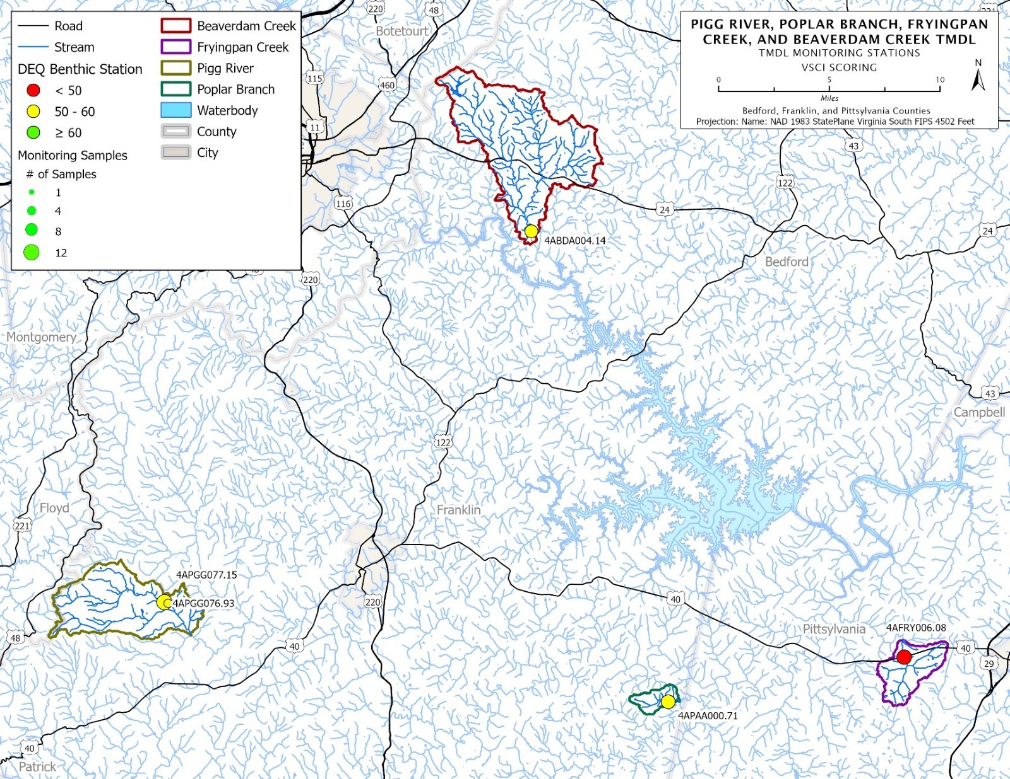
Notes:
Biological, physical, and chemical data from 5 monitoring stations within the TMDL watersheds were used in developing the stressor analysis study.
Monitoring was used to determine how much sediment is in the streams at any given time and how aquatic life conditions have changed over time.
Here we’ll see the water monitoring stations that were used to collect data on these streams. The data from these stations is what helped them to be determined as impaired for benthic and bacteria. This map is using data as recent as the 2022 Integrated Report​

Slide 10
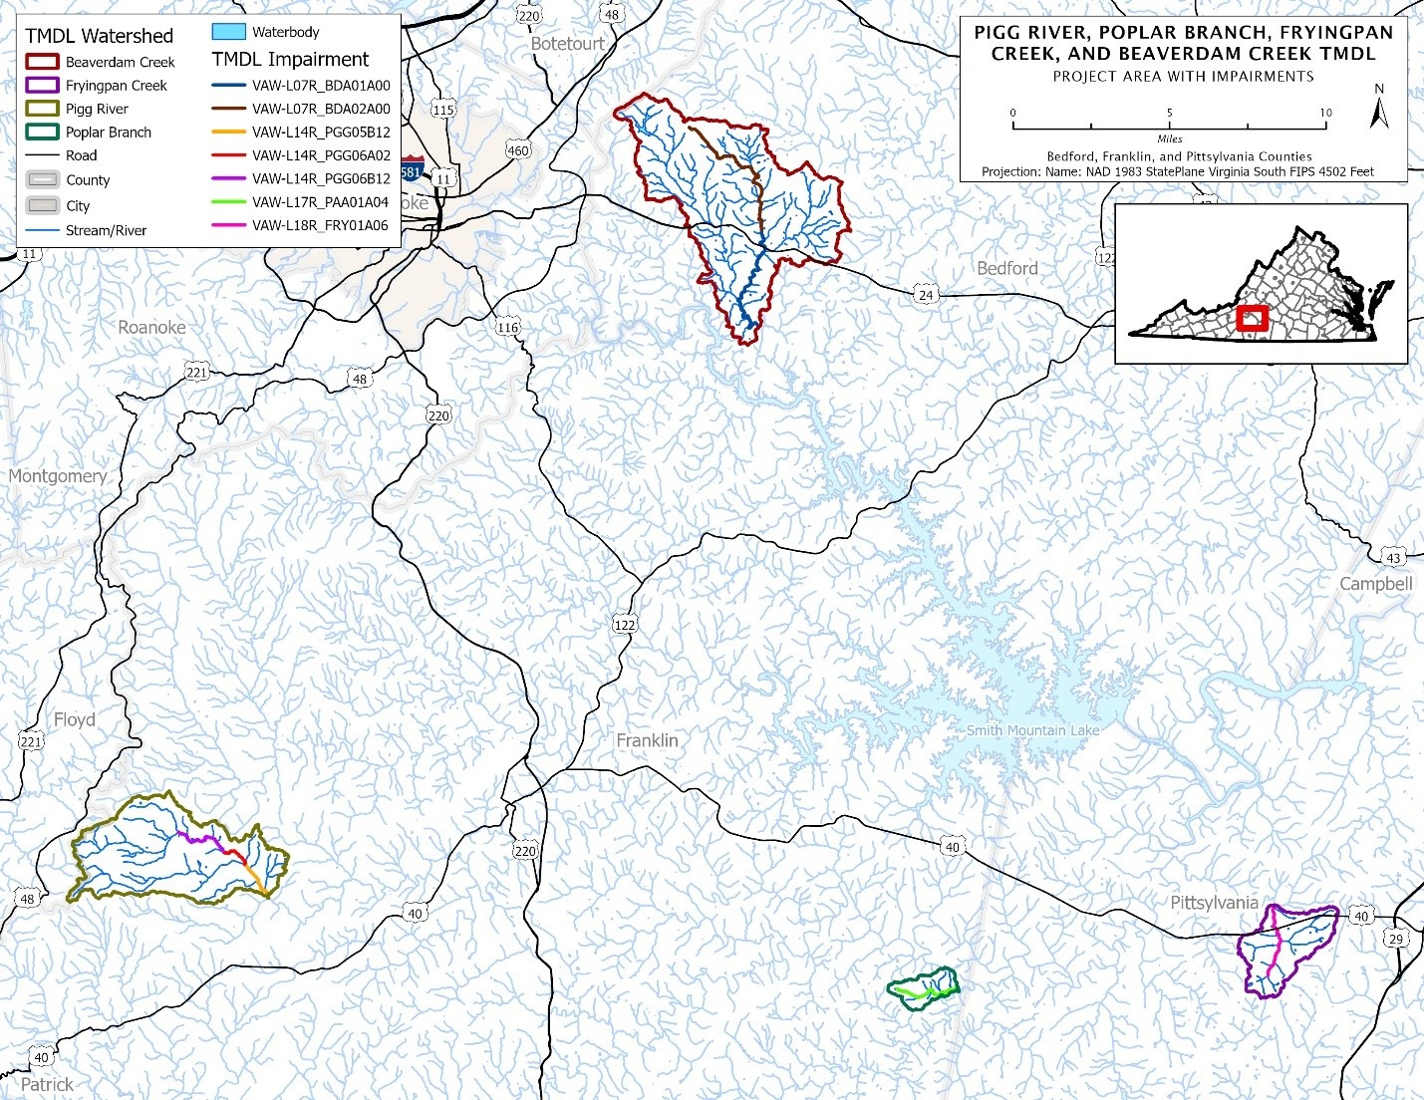
Notes:
This slide further breaks down the segments of impairments

Slide 11
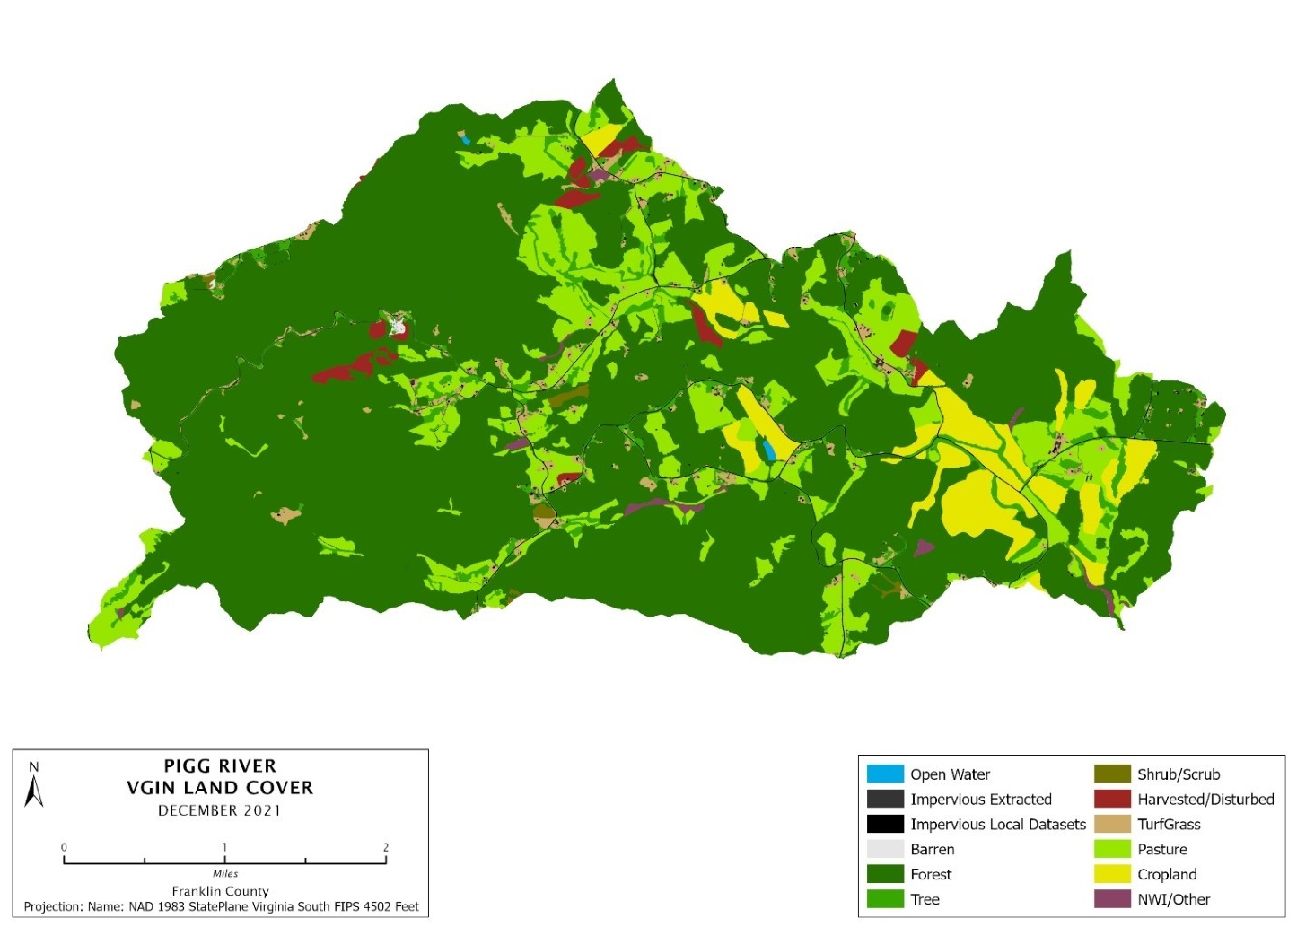
Pigg River VGIN Land Cover 2021
Land Use Categories | Percent of Acreage
Cropland | 5.0%
Hay | 6.0%
Pasture | 8.7%
Forest | 70.9%
Trees | 4.5%
Shrub | 0.2%
Harvested/Disturbed | 1.1%
Water | 0.0%
Wetland | 0.4%
Barren | 0.0%
Turfgrass | 1.9%
Developed, pervious | 0.1%
Developed, impervious | 1.2%
11
Notes:
- The TMDL also takes in land use into account in order to be able to identify and target sediment/bacterial sources
- These land cover maps were part of the 2022 TMDL Benthic report. Great way of breaking down the land use categories in each watershed
- The (VGIN) VA Geographic Information Network Virginia Land Cover Dataset (VLCD) was used to determine the land cover distribution throughout the watershed
- In all four of these TMDL watersheds, pasture or cropland were the primary sources of sediment.
**Again, important to note that these will be revisited and possible updated for the next meeting.

Slide 12
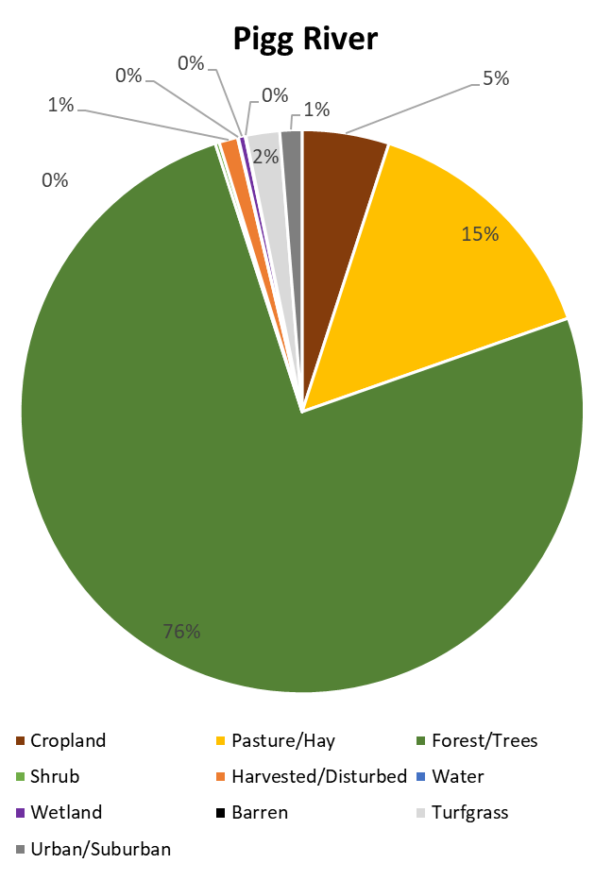
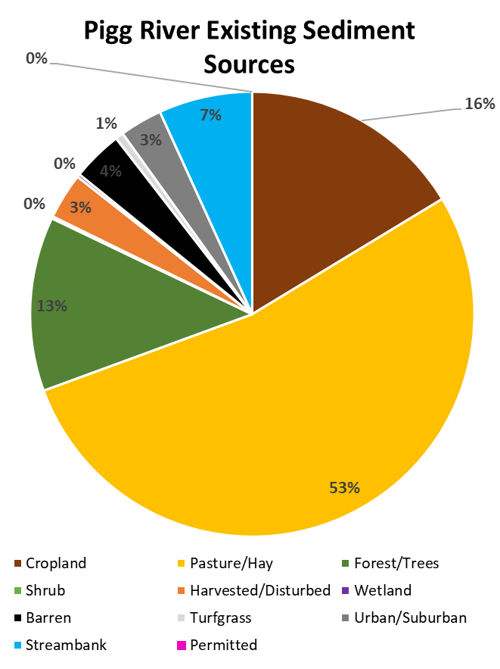
Land Use

Slide 13
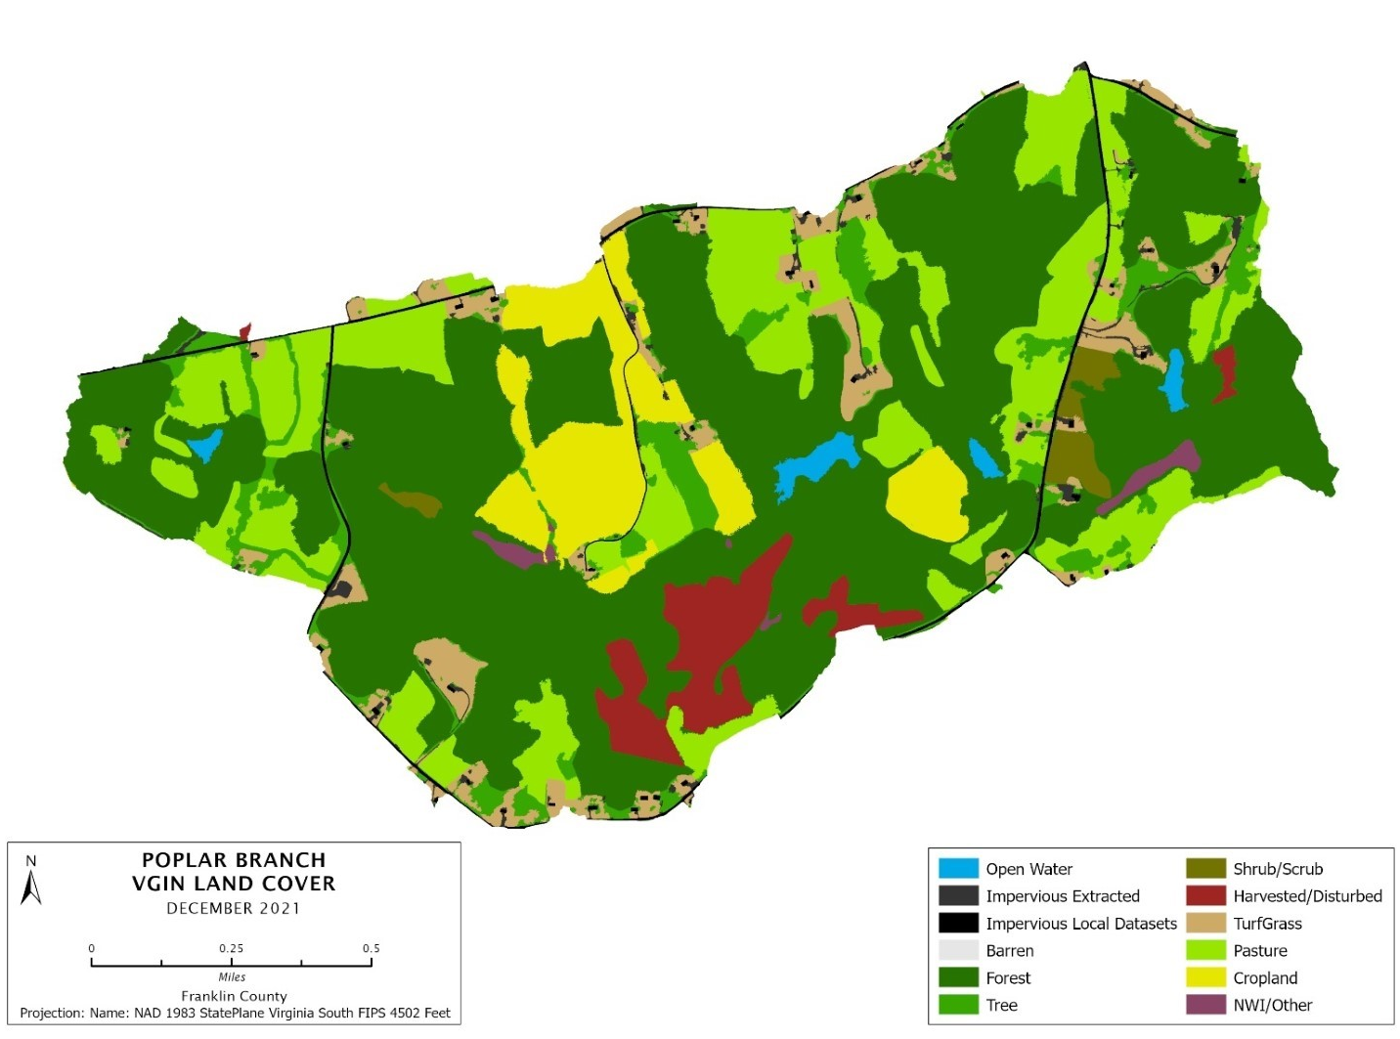
Poplar Branch VGIN Land Cover 2021
Land Use Categories | Percent of Acreage
Cropland | 7.5%
Hay | 12.2%
Pasture | 6.7%
Forest | 53.4%
Trees | 6.1%
Shrub | 1.1%
Harvested/Disturbed | 4.0%
Water | 0.8%
Wetland | 0.6%
Barren | 0.0%
Turfgrass | 5.1%
Developed, pervious | 0.2%
Developed, impervious | 2.3%
13

Slide 14
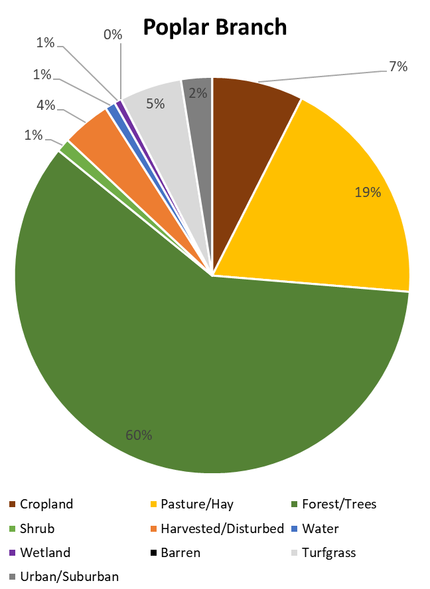
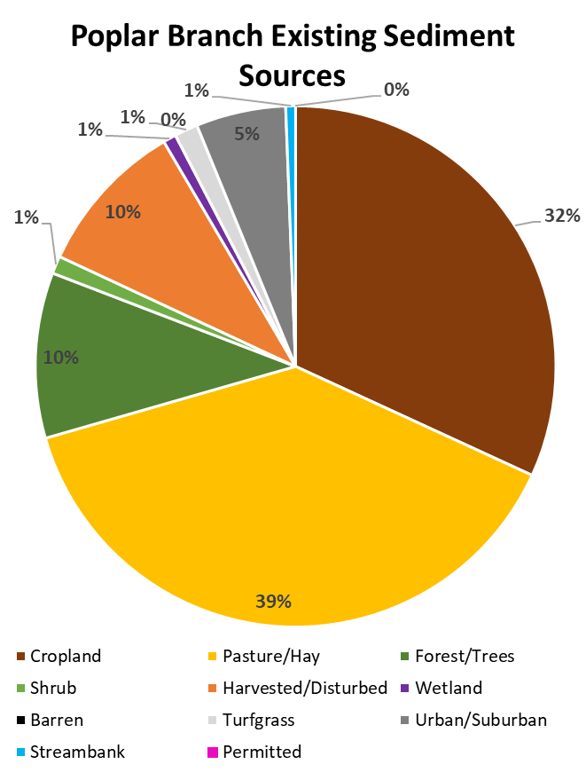
Land Use

Slide 15
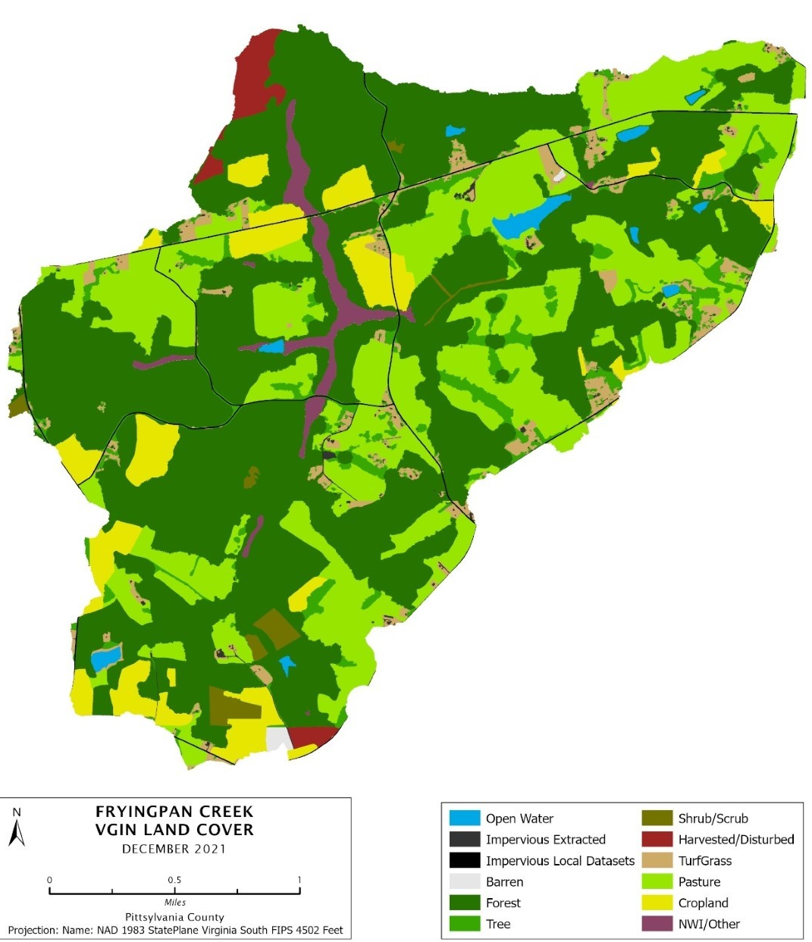
Fryingpan Creek VGIN Land Cover 2021
Land Use Categories | Percent of Acreage
Cropland | 6.7%
Hay | 15.7%
Pasture | 10.8%
Forest | 51.8%
Trees | 4.9%
Shrub | 1.0%
Harvested/Disturbed | 1.3%
Water | 0.9%
Wetland | 1.8%
Barren | 0.2%
Turfgrass | 3.5%
Developed, pervious | 0.1%
Developed, impervious | 1.3%
15
Notes:
Data from 2019 NLCD
Most recent
UPDATE FOR Pigg

Slide 16
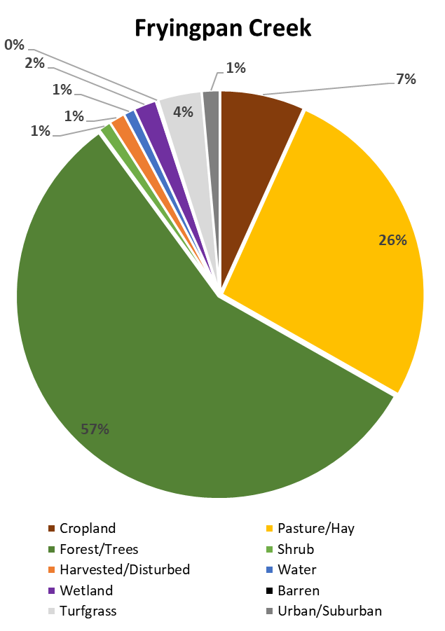
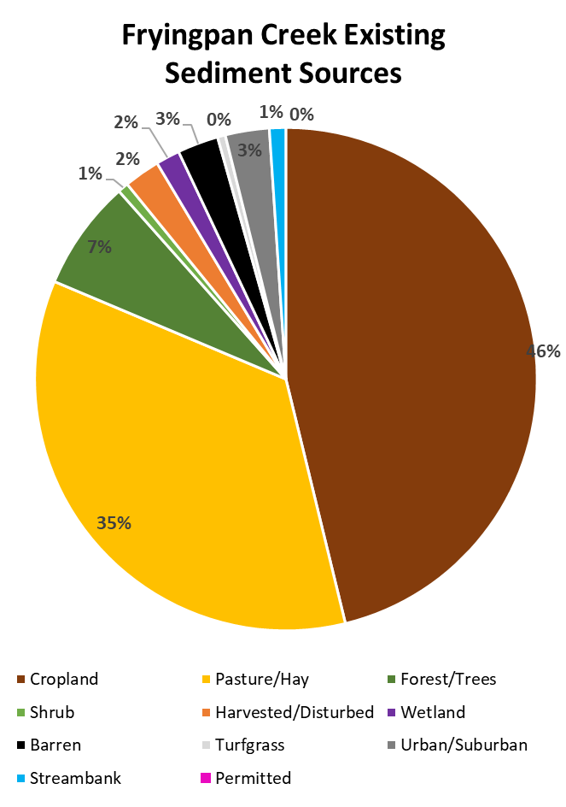
Land Use

Slide 17
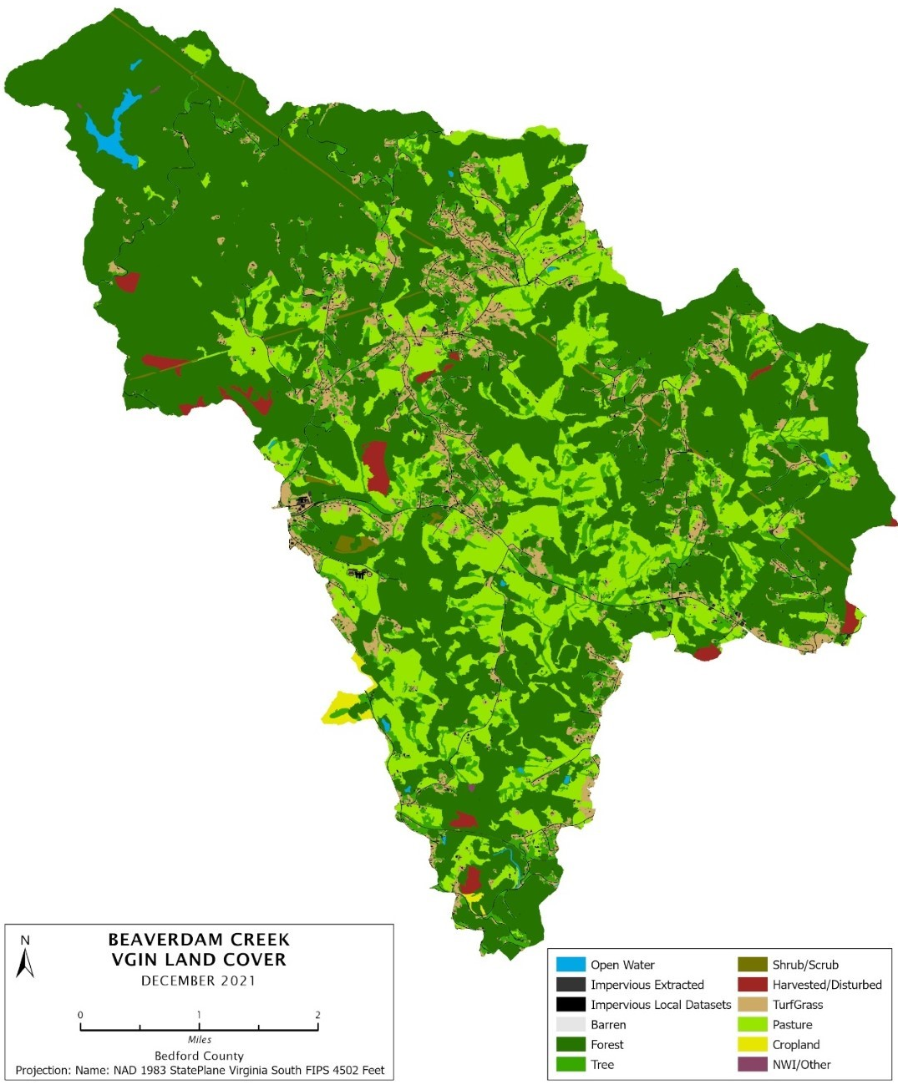
Beaverdam Creek VGIN Land Cover 2021
Land Use Categories | Percent of Acreage
Cropland | 0.2%
Hay | 10.3%
Pasture | 8.3%
Forest | 60.3%
Trees | 10.1%
Shrub | 0.5%
Harvested/Disturbed | 1.1%
Water | 0.4%
Wetland | 0.0%
Barren | 0.0%
Turfgrass | 6.0%
Developed, pervious | 0.2%
Developed, impervious | 2.6%
17
Notes:
Data from 2019 NLCD
Most recent
UPDATE FOR Pigg Virginia Land Cover Dataset
he 2016 VGIN Virginia Land Cover Dataset (VLCD) was used to determine the land cover distribution throughout the watershed (Figure 33 through Figure 36). Table 31 through Table 34 summarize the land cover distributions for each of the impaired watersheds.
The VGIN dataset contains two different types of impervious land cover: extracted and local datasets. The local datasets impervious land cover is based on locally-developed datasets covering specifically building footprints, roads, and other known impervious areas. This land cover type is included in the computer model as entirely impervious. VGIN’s extracted impervious land cover layer was developed using computer algorithms to extract additional areas that are likely impervious, beyond those areas identified in local datasets. When compared with aerial imagery, the extracted land cover set includes some areas that are not impervious. Based on visual comparisons, the extracted impervious land cover layer from VGIN was treated in the model as 80% developed impervious and 20% developed pervious.
The ‘NWI/other’ land cover type in the VGIN dataset is based on the combined National Wetlands Inventory and Tidal Marsh Inventory datasets and represents all identified wetland areas in those datasets.

Slide 18
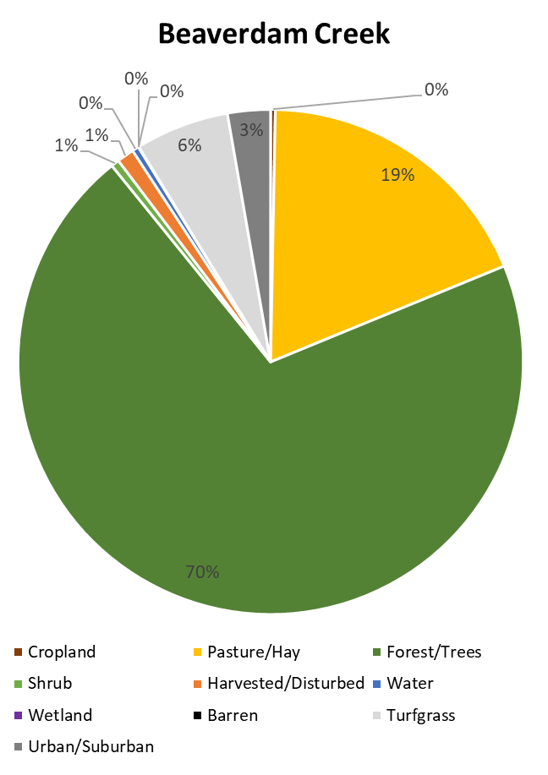
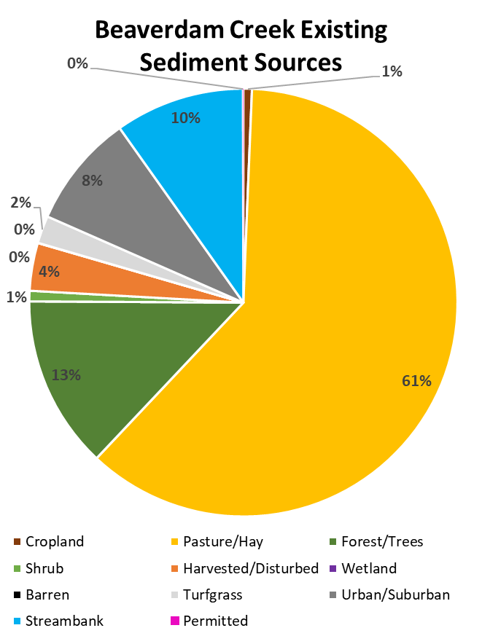
Land Use
Notes:
Now this is something we will be revisiting with any updates during our first community engagement meeting.
Most of the land cover in all study watersheds is forest, ranging from 57 to 76%, followed by pasture, ranging from 15 to 26%. Except for Beaverdam creek, cropland is the third most common land cover type, ranging from 5 to 7%. None of the watersheds are significantly developed.

Slide 19
Review of TMDL Study: Benthic Load Reductions​
IP Area​ | Crop, Pasture, Hay (%) | Forest, Trees, Shrubs, Wetland (%) | Developed Pervious and Impervious Areas, Barren, Turfgrass​ (%) | Streambank Erosion (%) | Permitted Sources (%)
Pigg River | 31.5% | 0%​ | 31.5% | 31.5%​ | 0%​
Poplar Branch | 56.1% | 0%​ | 56.1%​ | 56.1%​ | 0%​
Fryingpan Creek​ | 76.1%​ | 0%​ | 76.1% | 76.1%​ | 0%​
Beaverdam Creek | 30.4%​ | 0%​ | 30.4%​ | 30.4%​ | 0%​
Notes:
After determining the source of sediment in the impaired stream, a computer model was used to determine the amount that sediment loads need to be reduced to promote healthy aquatic life in each stream. The goal for these reductions is for the impaired streams to have sediment levels that allow for diverse and abundant aquatic life. The reductions in sediment needed to meet these goals are shown in TMDL includes margin of safety
Here in this table we have broken up into each subwatershed for the benthic load reductions that the TMDLs are requiring. We have it organized Crop/pasture/hay, forest/trees/shrubs/wetlands, developed pervious and impervious areas/barren/ turfgrass, streambank erosion, and permitted sources.
significant reductions are needed from several sediment sources. Sediment loads from agricultural and urban/suburban land covers within Beaverdam Creek, Fryingpan Creek, Pigg River, and Poplar Branch need to be reduced by 30.4%, 76.1%, 31.5%, and 56.1%, respectively. The total amount of sediment per year that would be entering each of these streams after the recommended reductions are made represent the total maximum daily load of sediment for each stream (Table 13 through Table 16). This load includes permitted sources as well as future growth to account for potential future permitted sources. These annual loads are converted to daily maximum loads as well, as described in Section 6.3 (Table 17 and Table 110). If sediment loads are reduced to these amounts, healthy aquatic life is expected to be restored in these streams
Keeping in mind again these reduction numbers could potentially shift based on the most recent data we are able to model from

Slide 20
Average annual load distribution, reduction, and allowable load by source-
Beaverdam Creek
Percent Reduction in Bacteria Loads Needed
 | Total | Human @ 15% | Pet @ 21% | Livestock @ 27% | Wildlife @ 37%
Reduction | 94% | 99% | 99% | 99% | 85.5%
20
Notes:
Bacteria- Table shows the distribution of the average annual E. coli load among sources, the reduction applied to each source, and the allowable loading for each source
Any questions?
In order to apply the reduction calculated above, the average annual E. coli load had to be allocated to each of the four non-point sources identified in the BST analysis. Table shows the distribution of the average annual E. coli load among sources, the reduction applied to each source, and the allowable loading for each source
This requirement is intended to add a level of safety to account for any inherent uncertainty in the TMDL development process and the data used in the development. The MOS may be either implicit or explicit. An implicit margin of safety relies on the conservative nature of the assumptions, values, and methods used to calculate a TMDL whereas an explicit margin of safety is a value (typically a percentage) applied at some point during the TMDL calculation.
In the Beaverdam Creek TMDL, an implicit MOS was incorporated through the use of conservative analytical assumptions. These include: (1) the use of the single-most extreme water quality violation event which was used to develop maximum exceedance curve over the entire range of flow conditions, and (2) the computation of average annual load using the average flow conditions. In addition, the load duration method of TMDL development has been evaluated against TMDLs that were developed using computer modeling. The results showed the load duration method to be slightly more conservative.

Slide 21
Virginia’s Water Quality Process
We are here
Notes:
Now that we discussed the results of the TMDL we can begin discussing the components of an implementation plan which brings us to here on the water wheel

Slide 22

What is a Clean Up Plan/Implementation Plan (IP)?
What the plan is….
- a document that details actions/strategies to achieve load reductions for nonpoint source pollutants as defined by the TMDL
    Reviews TMDL
    Actions to improve water quality (corrective actions)
      BMPs, education & outreach, incentives, etc…
    Cost-Benefit Analysis
    Measurable goals
    Timeline to achieve water quality goals/objectives
    Public participation (Voluntary)
Tells us “how” to improve water quality
for nonpoint sources
22
Notes:
While not a federal requirement, Virginia’s 1997 Water Quality Monitoring, Information and Restoration Act (WQMIRA)​ requires the development of an IP that should be designed to address multiple water quality problems within a waterbody or TMDLs in a watershed
A TMDL Implementation Plan is a document that details the actions and strategies needed to achieve load reductions for nonpoint source pollutants that the TMDL identified. Aspects of an IP include:​ A review of the TMDL and any updates that are necessary​
Corrective actions needed to improve water quality. This could be seen through the implementation of best management practices (BMPs), education and outreach, incentives, etc.… things to help us reach our goals​
A cost–benefit analysis to assess the cost of implementation. To compare the cost-effectiveness of various practices and evaluate their environmental benefits to determine the best practices needed to reach our goals.​
Measurable goals and timeline: Implementation works best with a targeted, staged approach. What we see work best is directing initial efforts where the biggest impacts can be made with the least effort so that money, time, and resources are spent efficiently.
Initial implementation efforts will focus on these more cost-effective BMPs and educational programs. Once the first phase is completed, water quality will be re-assessed to determine if water quality standards were attained. If these standards are still not being met, we move onto phase 2 where additional actions, usually more expensive and extensive, are taken. The purpose of this phased approach is to define a clear set of output and outcome goals, as well as used to set a realistic schedule for the restoration of a watershed.
These phased approaches are usually on a 5 -15 year timeframe.​
Achieving the goals of IP plans are dependent on strong participation by many environmental conservation organizations, area landowners, and community members. It is a vital part in the development and continuation of an IP.
I would like to stress that this is a completely voluntary practice
Not a static document, something that changes and caters to the need of the community

Slide 23
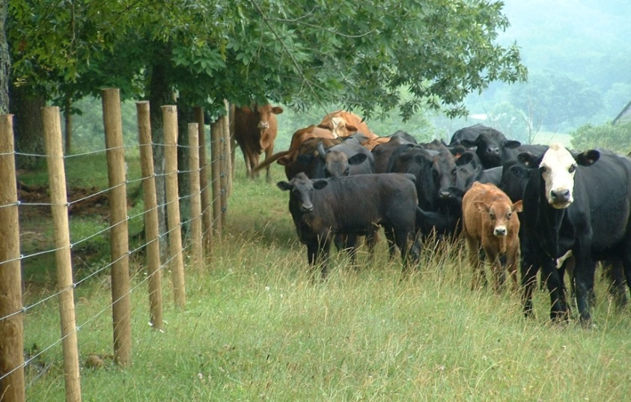
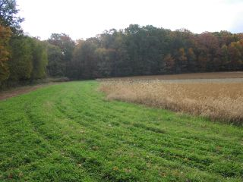
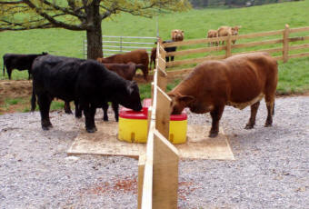
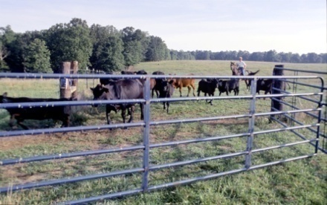
Potential Agricultural Control Measures
Livestock Exclusion Fencing
Vegetation Cover
23
Water Trough
Rotational Grazing
Notes:
Fence out cattle from streams and provide alternative water sources
Implement conservation tillage practices on cropland
Conduct stream bank restoration projects in areas where banks are actively eroding
Leave a band of 35 – 100 ft along the stream natural so that it buffers or filters out sediment from farm or residential land (a riparian buffer)
Expand street sweeping programs in urban areas
Reduce runoff by increasing green spaces and reducing hardened spaces (asphalt or concrete)

Slide 24
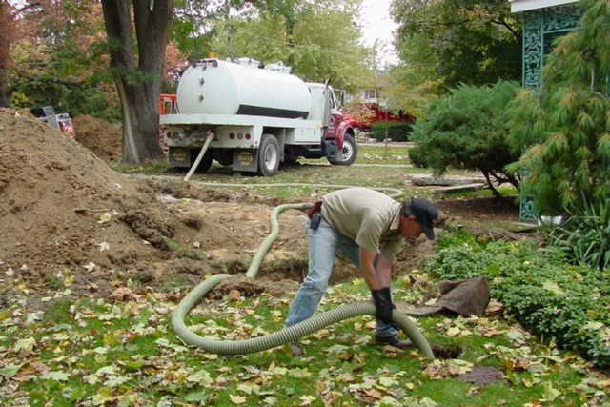
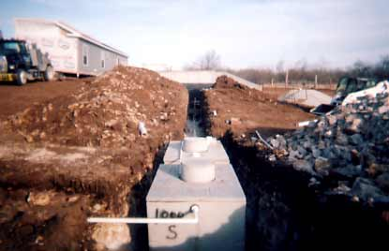
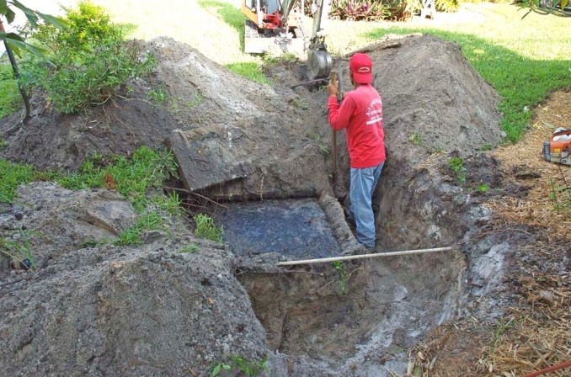
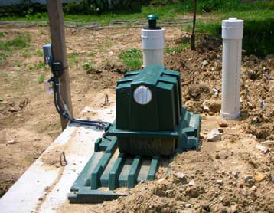
Potential Residential Control Measures
Septic System Replacement
Septic System Pump out
Conventional Septic System Replacement
Septic System Pump-out
Septic System Repair
Alternative On-site Sewage
Disposal System
Alternative On-site Sewage Disposal System
24
Septic System Repair
Notes:
Fence out cattle from streams and provide alternative water sources
Implement conservation tillage practices on cropland
Conduct stream bank restoration projects in areas where banks are actively eroding
Leave a band of 35 – 100 ft along the stream natural so that it buffers or filters out sediment from farm or residential land (a riparian buffer)
Expand street sweeping programs in urban areas
Reduce runoff by increasing green spaces and reducing hardened spaces (asphalt or concrete)

Slide 25
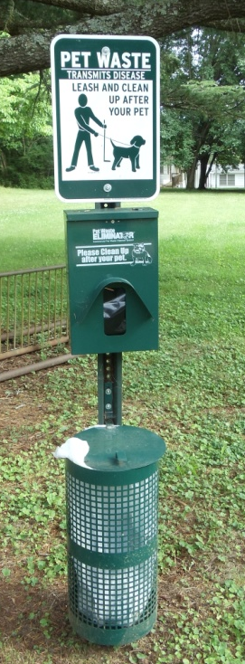
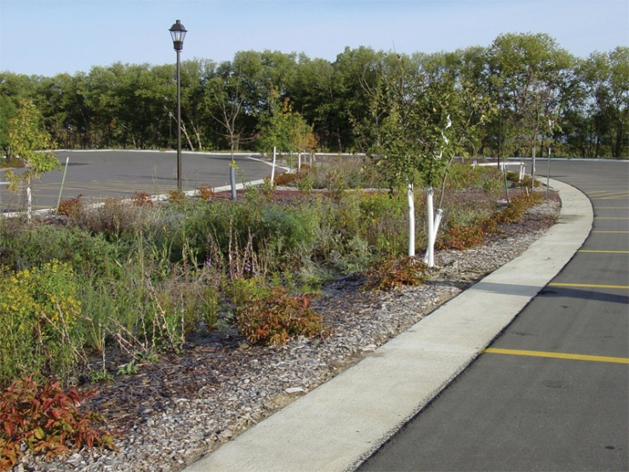
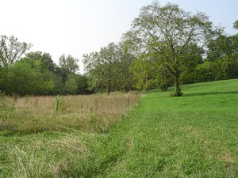
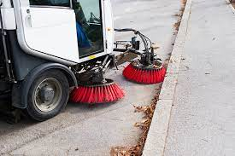
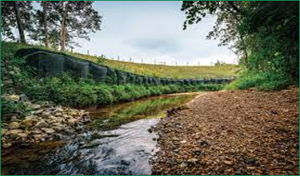
Pet Waste and Stormwater Control Measures
Pet Waste
Composters
Vegetated Buffers
Bio Retention (Rain Garden)
Vegetated Buffer
Pet Waste Station
Pet Waste Station
Street Sweeping
Streambank Stabilization
25
Bioretention (rain garden)
Notes:
Not exclusive list but we will touch more on suggested practices based on your needs

Slide 26
How to Implement a TMDL Implementation Plan​
Section 319(h) NPS Implementation Program Request for Applications (RFA)​
  What is 319(h) funding?​
    EPA awards 319(h) funds (Clean Water Act) to states, territories, and tribes to implement TMDL Implementation Plans.​
  Who can apply?​
    Local governments, county health departments, SWCDs, Virginia institutes of higher education, Planning District Commissions, Regional Commissions, nonprofits, and other agencies/departments of the Commonwealth.​
  What can you apply for?​
    BMPs (agricultural, residential septic, pet waste, urban)​
    Education and Outreach​
    Water Quality Monitoring​
  Where can you work?​
    In an approved TMDL Implementation Plan​

Slide 27
What is your role in developing the Plan?
IPs are only as good as the information received/assessed
What are the needs/interests in the area?
Is it realistic?
Provide comments/feedback on:
  Land use practices
  Failing septic systems and straight pipes
  Livestock, wildlife and pet population estimates
  Are there particular management strategies that will work well in this area?
  Are there strategies that should be avoided?
  Recommend outreach activities & funding sources
  Identify potential partner organizations
27
Notes:
Join the Planning Process! (Time commitment: 1-2 meetings and review draft plan)
Provide input based on local interest/need
Share ideas to maximize landowner participation
Review draft of the Clean Up Plan
Plan for the final public meeting

Slide 28
Timeline/Next Steps for the Clean Up Plan process
 | Tentative Date
First Public Meeting | February 29th, 2024 (Public comment period February 29th, 2024 – April 1, 2024)
Community Engagement Meetings
# 1 | Late March or April 2024
# 2 | June or July 2024
Final Public Meeting | August/September 2024 (Public comment period 30 days after Final Public Meeting)
EPA Acceptance | Winter 2024/Spring 2025 Eligible for DEQ 319 funding in 2025
28
Notes:
This is the tentative timeline that may change throughout this development process​
Preference on mornings or afternoons or certain dates to avoid​
For CE those will typically be during the hours of 9am-5pm and the final public meeting will likely start sometime between 5-7​
Explain what there is to expect at the first CE meeting​
Goal to have ready for next years RFA with funding available in 2026

Slide 29
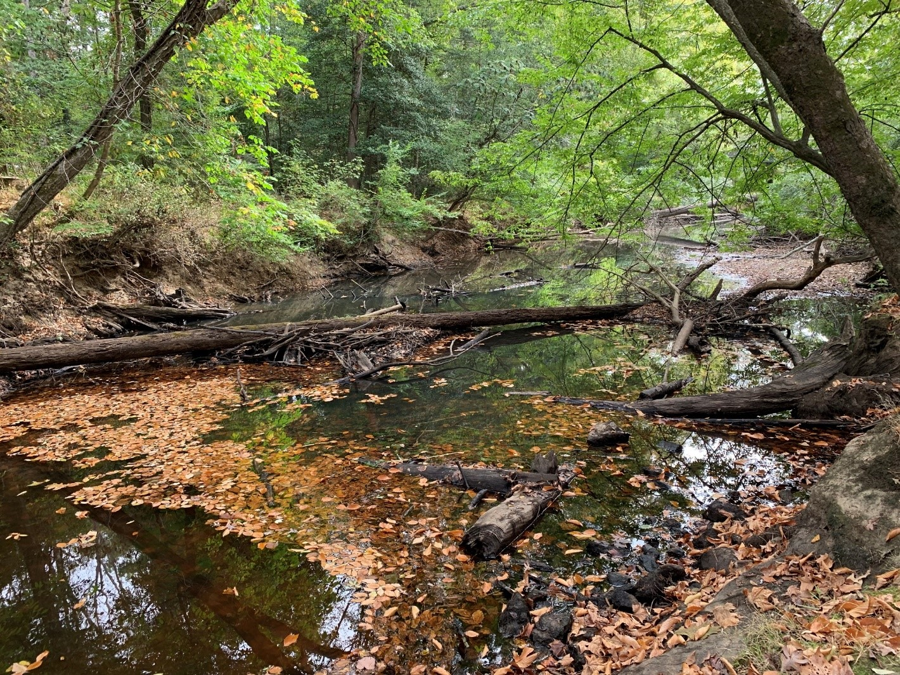
Contact me with any other thoughts, questions, and/or comments!
Kimberly Romero
VDEQ –Blue Ridge Regional Office
901 Russell Drive,
Salem, VA 24153
kimberly.romero@deq.virginia.gov
(540) 759-9075
Notes:
- That concludes my presentation

Slide 30
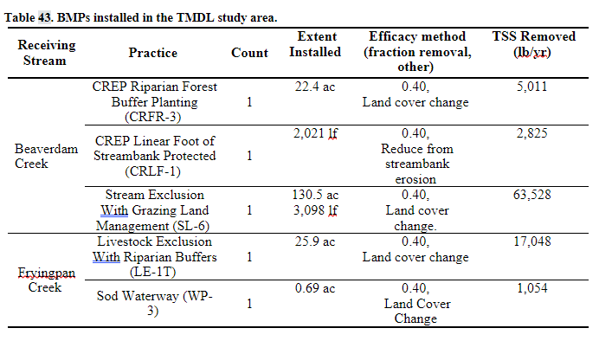
Current BMPs in the Area

