Slide 1
Community Pollution Reduction
Planning Webinar
Department of Environmental Quality
December 2023
Tom Ballou
Air Quality Planning Manager
Virginia Department of Environmental Quality
January 9, 2024

Slide 2
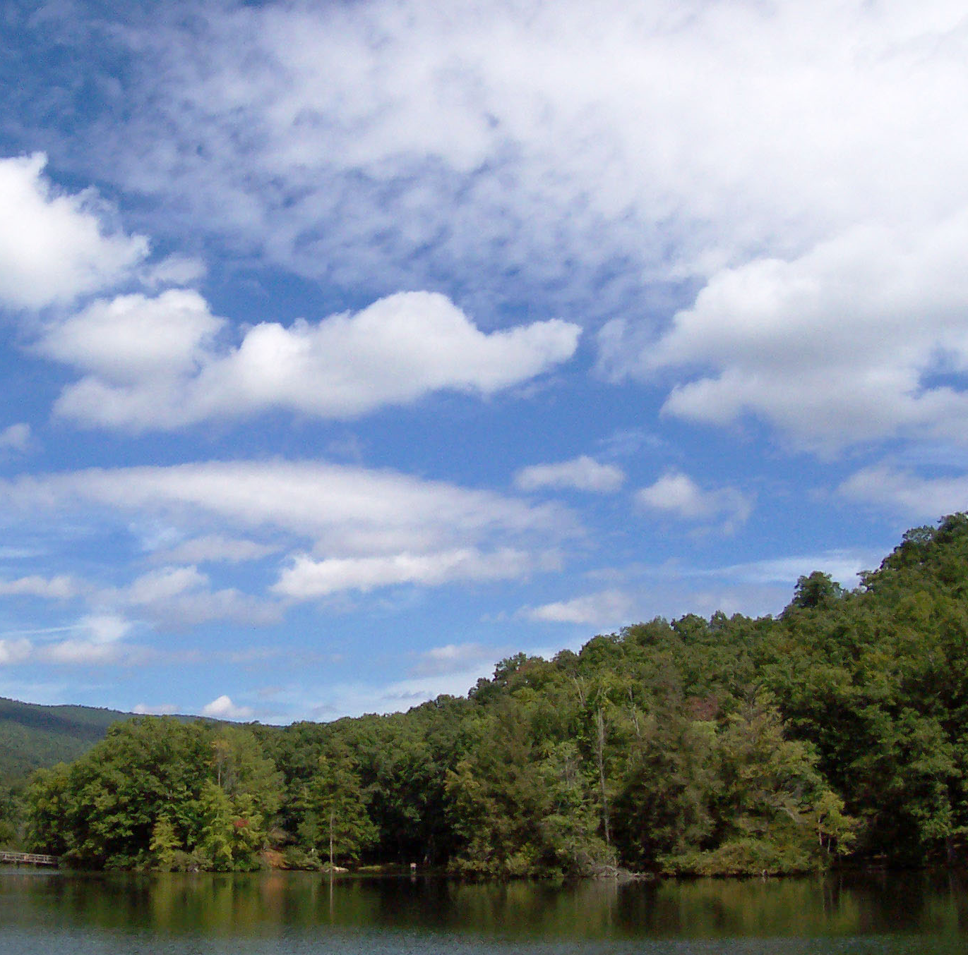

Agenda
DEQ introduction
Benefits of cleaner air
  Good for everyone
  Fewer poor health outcomes
  Overall better quality of life
  Healthier environment
Community input - What do you think your local priorities should be?
  Online survey
  Interactive participant input

Slide 3
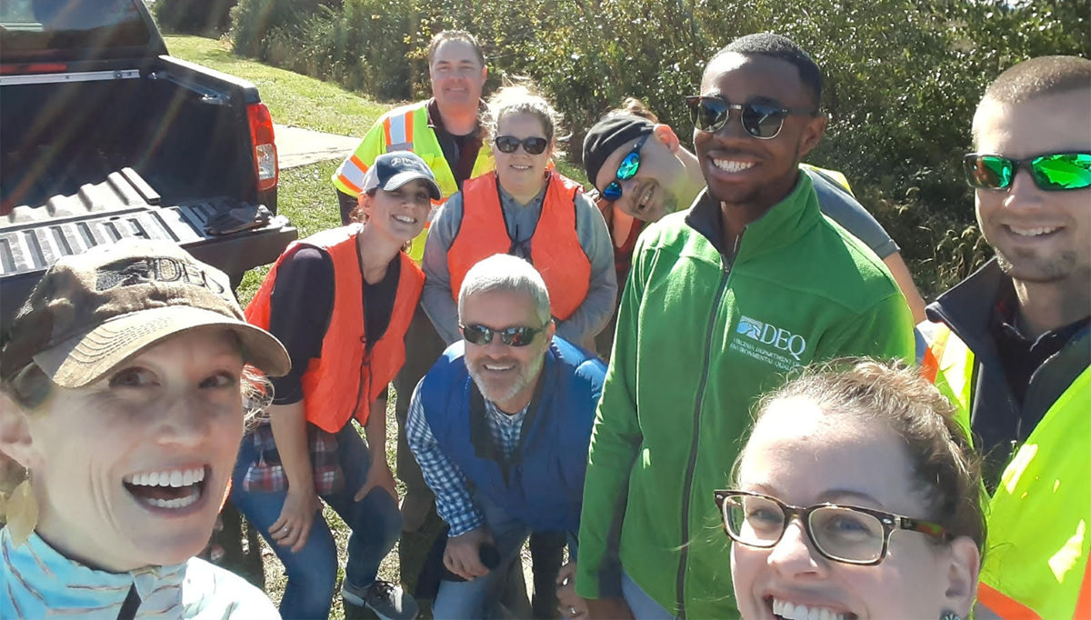
Who We Are
We are 800+ professionals who apply science and law to enhance Virginia's environment
Air Quality & Renewable Energy
Water Planning & Permitting
Land Protection & Revitalization
Regulatory Affairs & Outreach
Notes:
DEQ has a vision for Virginia’s environment that Virginians will enjoy:
Cleaner water available for all uses.
Improved air quality that supports communities and ecosystems.
Productive re-use of contaminated land.

Slide 4
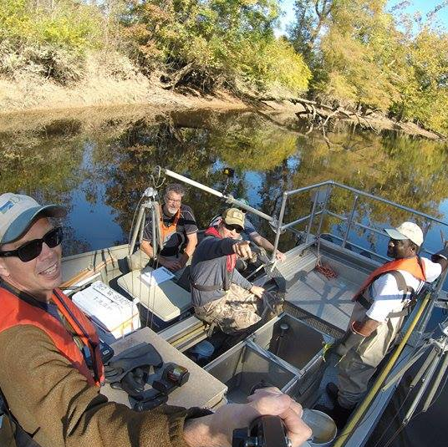
Our Mission
DEQ's Mission is to protect and enhance the environment of Virginia in order to promote the health and well-being of the Commonwealth's citizens, residents, and visitors in accordance with applicable laws and regulations.

Slide 5

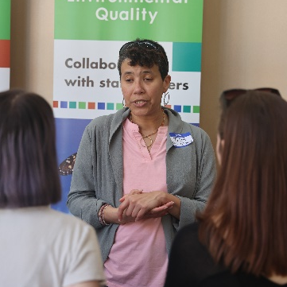
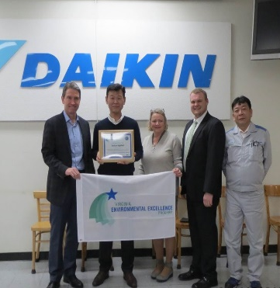
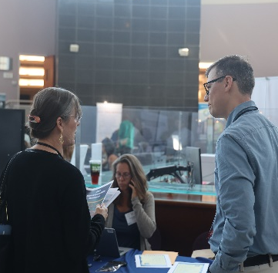
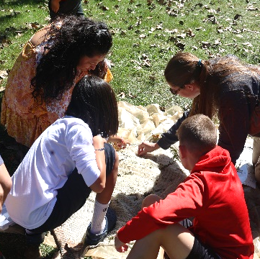
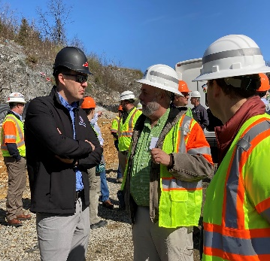
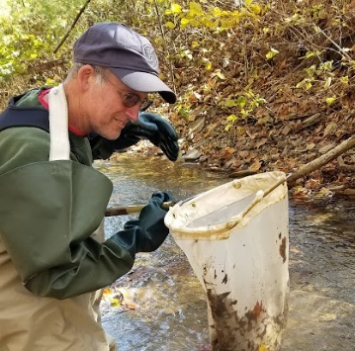
What We Stand For
A healthy environment and a healthy economy are integrally related; balanced economic development and the protection of our environment go hand in hand to contribute to Virginians' quality of life.

Slide 6
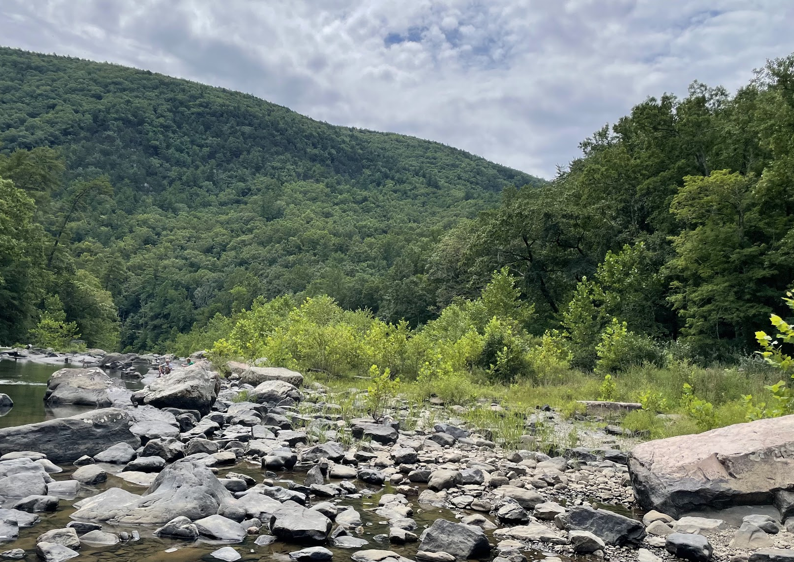
Climate Action Planning
DEQ has been awarded an EPA grant for climate action planning in two steps
Short-term (5 year) priority plan with potential ready-to-go, innovative, high-impact projects to reduce greenhouse gases and other pollutant emissions.
Long-term (20+ years) to reduce overall statewide climate pollution from all source sectors

Slide 7
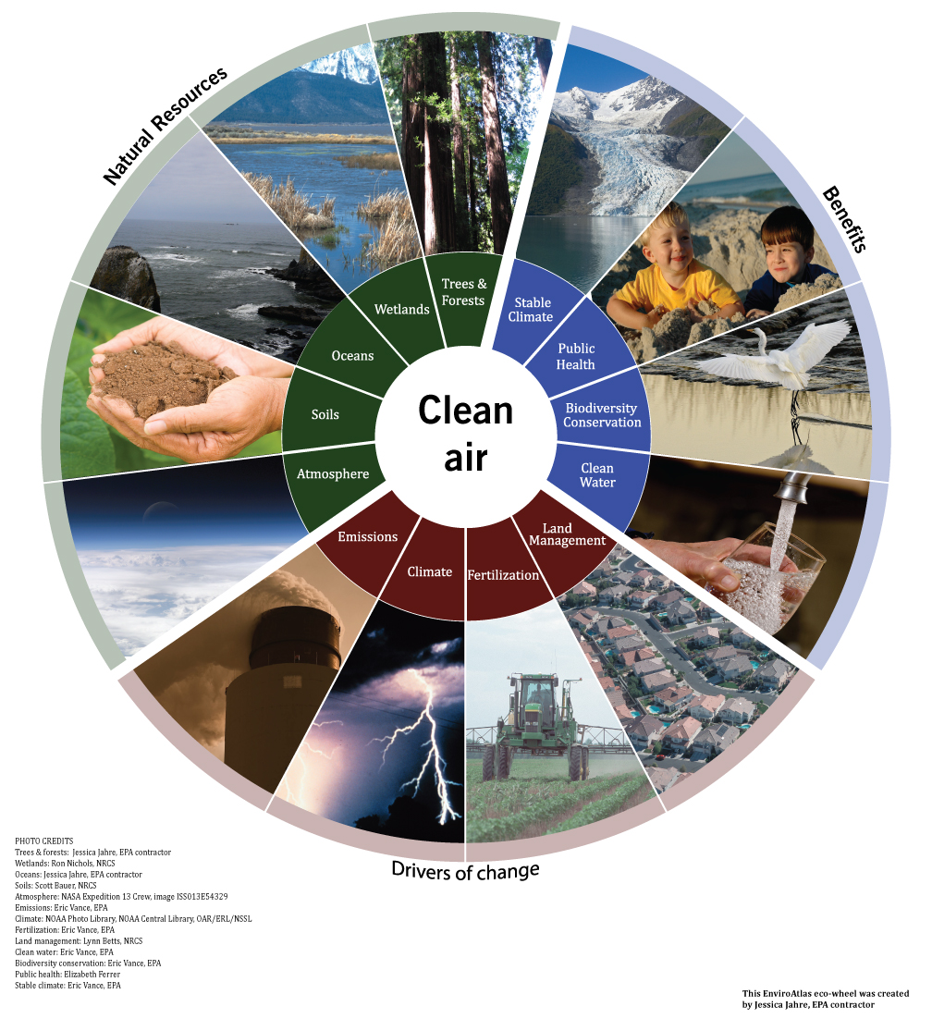
Air Quality Interconnections
Source: EPA EnviroAtlas

Slide 8
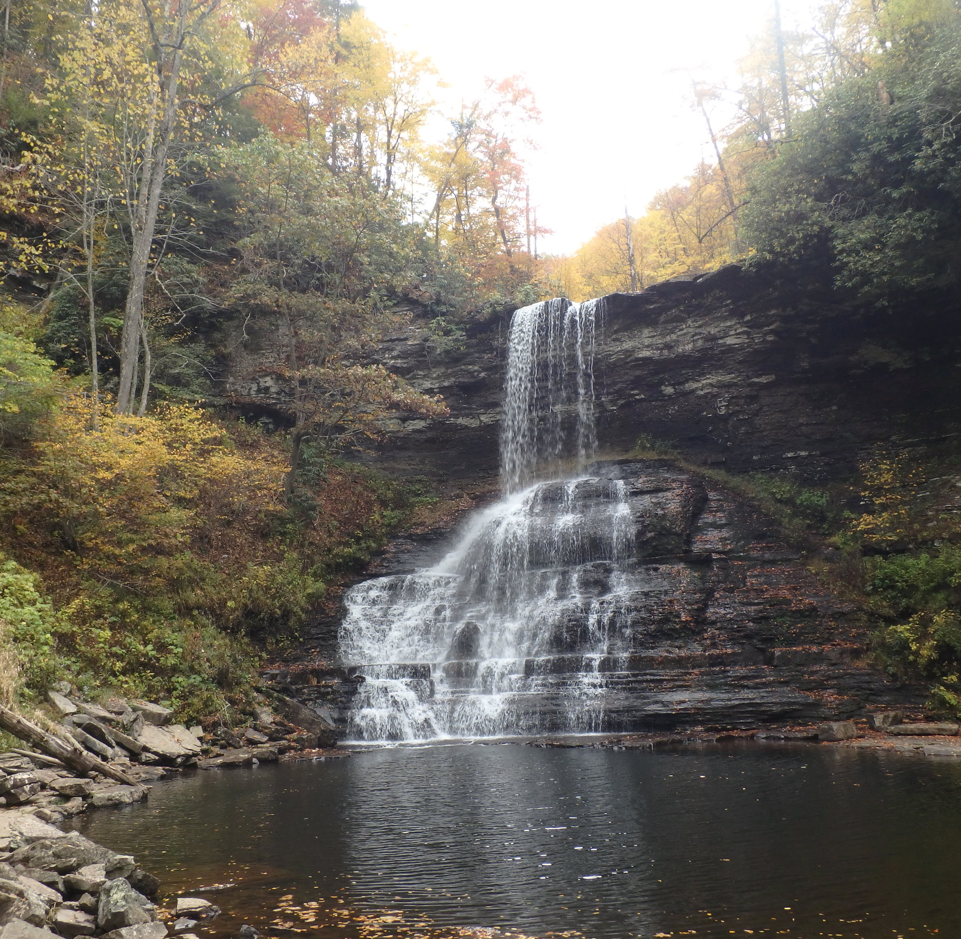
What We Want to Know…
What are the air quality concerns in your community?
What are some possible short- and long-term solutions?
What should be the priorities to address air pollution in your community?
What are the challenges?

Slide 9
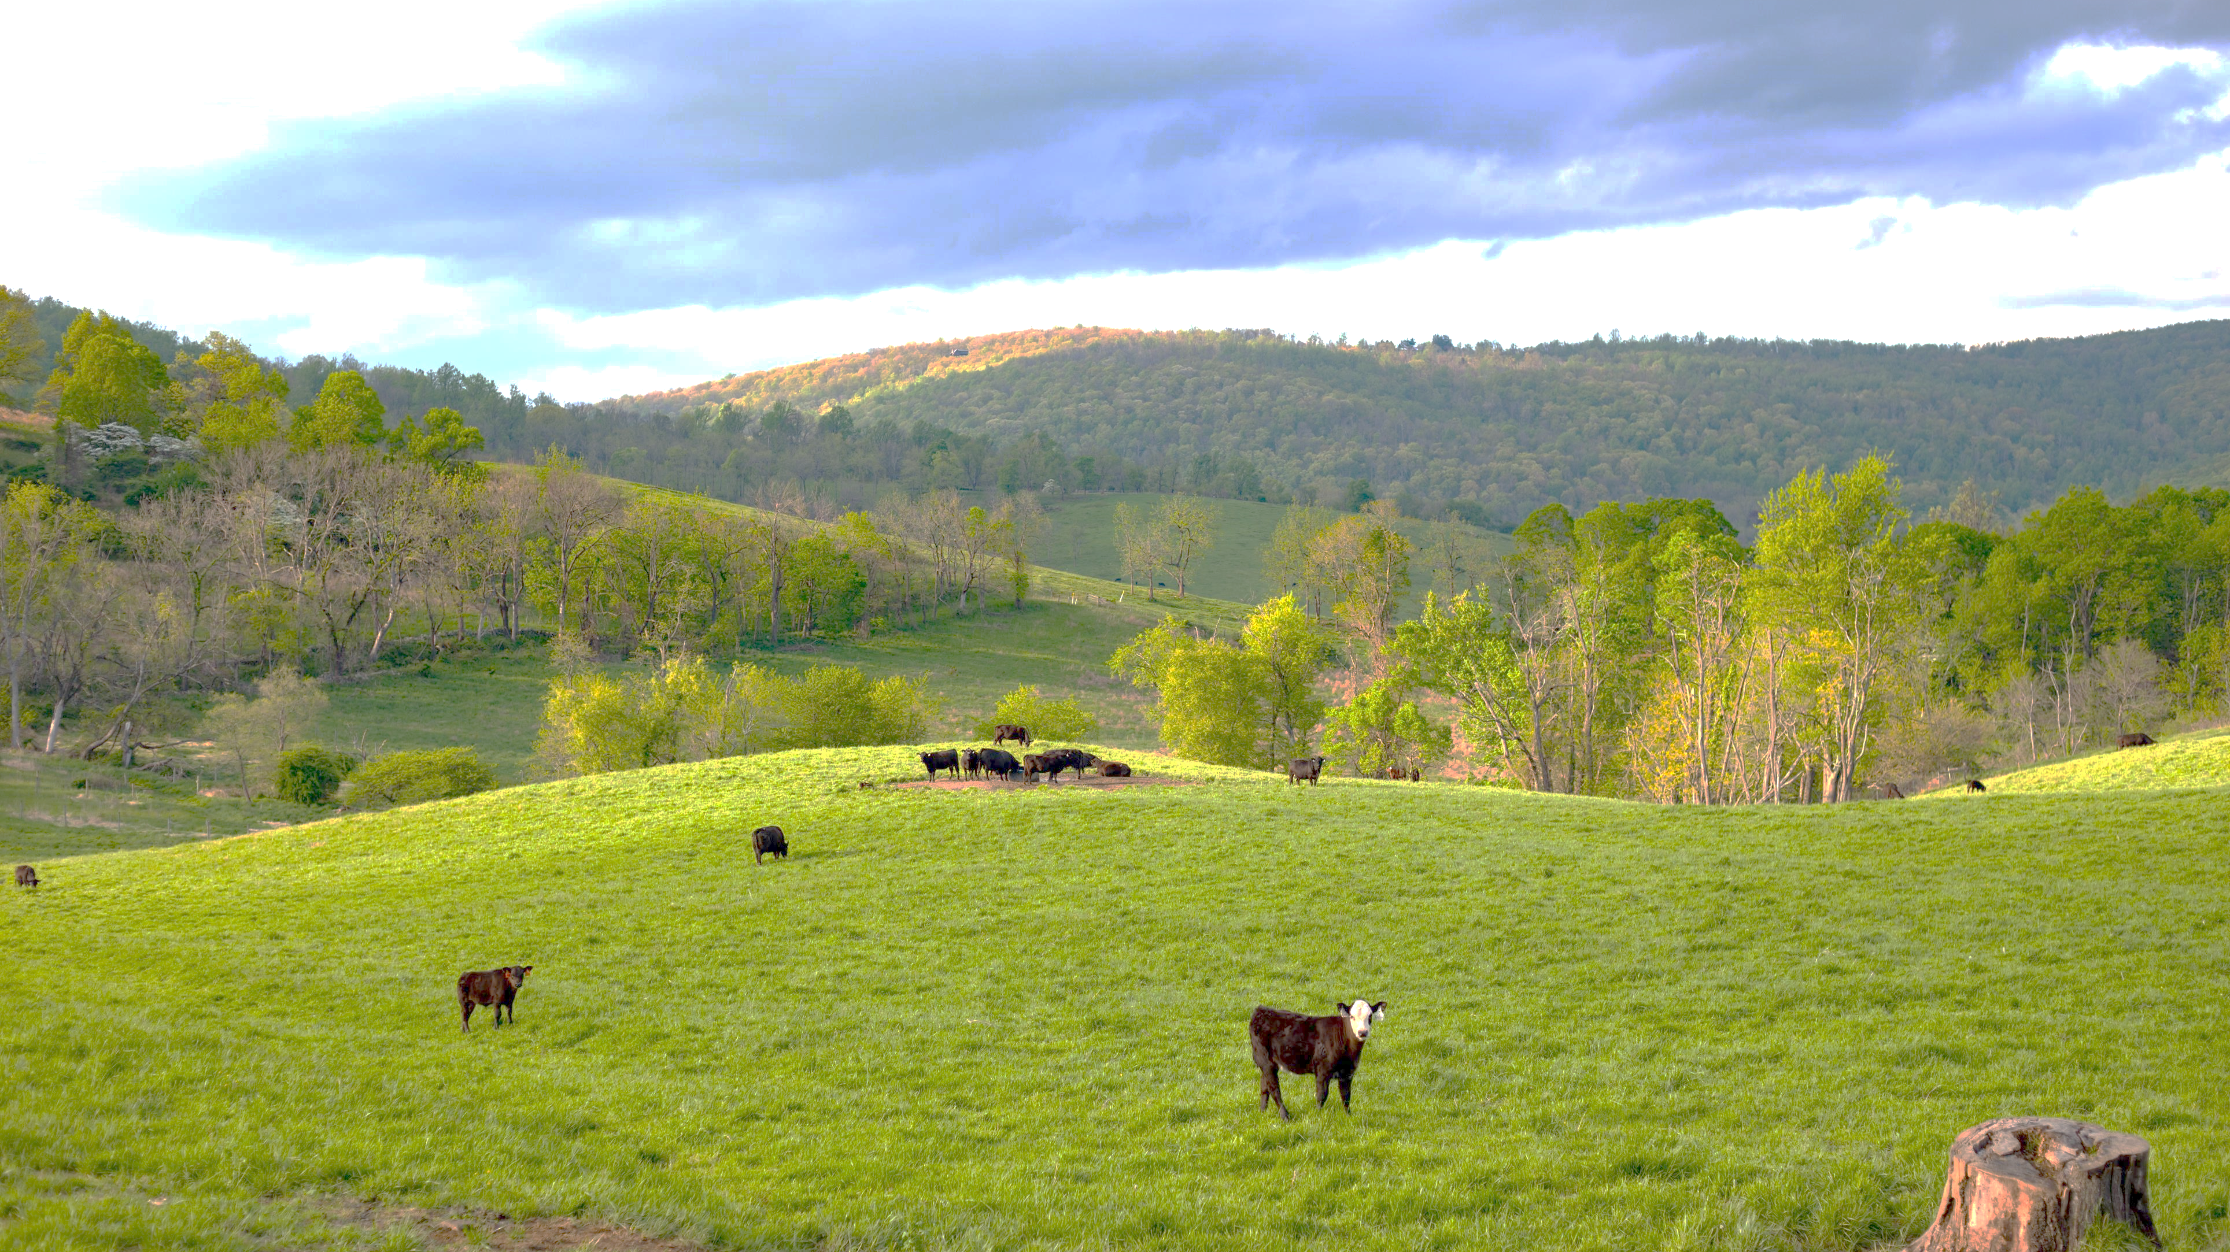
What Could Be Done…
Transportation: Increase the share of electric vehicles and to expand electric vehicle charging infrastructure.
Electric Power: Streamline permitting for renewable energy projects.
Industrial: Reduce energy demand of industrial facilities.
Waste Management: Reduce methane emissions from landfills and wastewater treatment facilities.
Agriculture: Promote green farming practices including anaerobic digesters for methane reduction
Carbon Removal: Restoration of degraded and forested lands to enhance carbon sequestration.
Other: Promote weatherization of homes and energy efficient appliances. Promote food waste reduction programs.

Slide 10
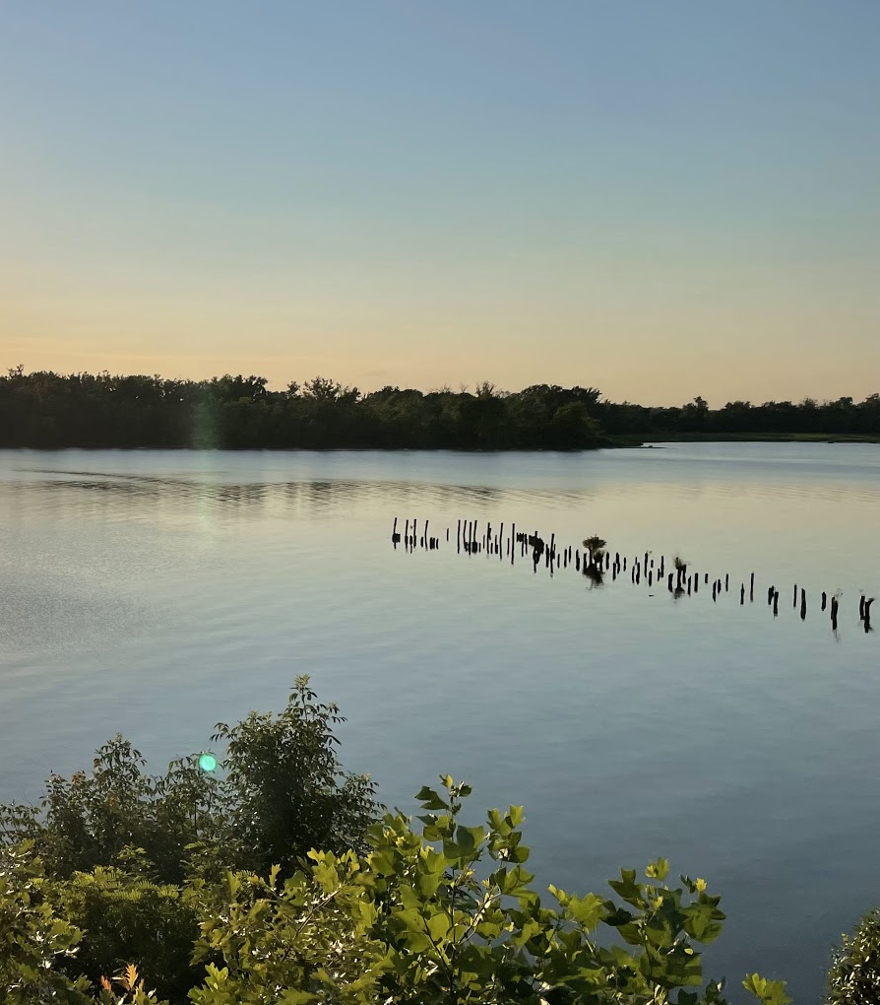
Your Input Matters!
Your input will be provided to state and local governments to help them identify community goals for projects across the Commonwealth to inform the short-term plan. It will also be considered holistically when developing the more comprehensive long-term climate plan.

Slide 11
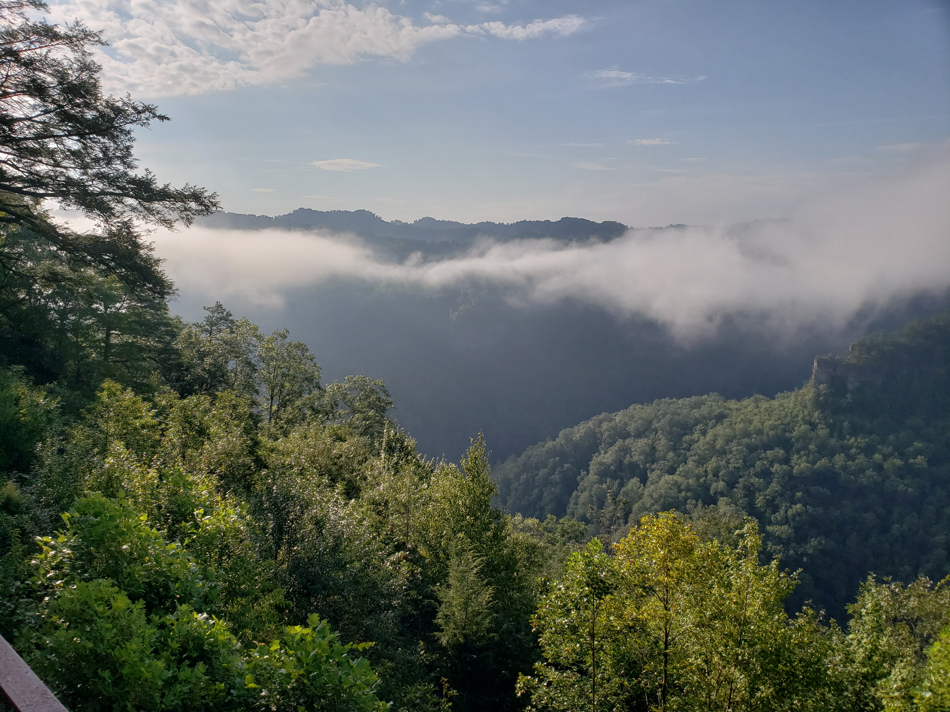
What’s Next
In-person outreach in Hampton Roads, Richmond, NOVA (week of Jan 22)
Draft short-term plan available in late January
Informal public comment Period (Feb)
Final plan to EPA by March 1
Then the long-term planning process begins

Slide 12
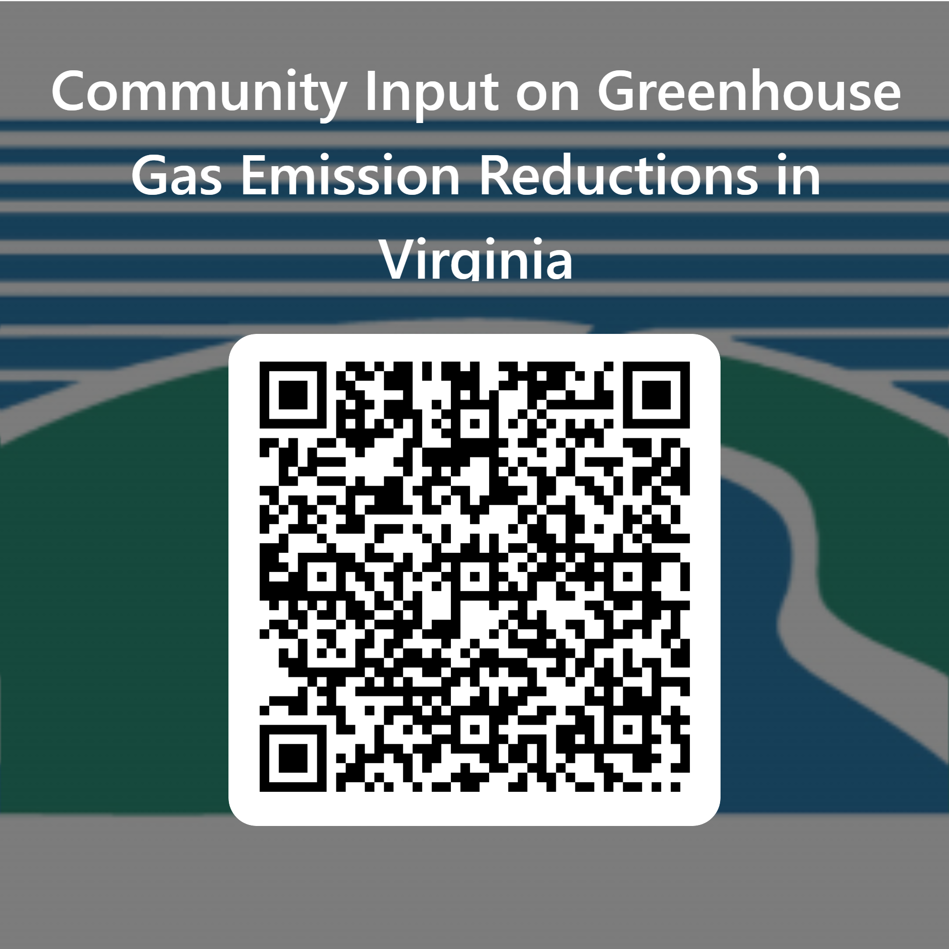

Stay Involved…
DEQ dedicated CPRG webpage is online
  https://www.deq.virginia.gov/CPRG
Contains planning process, outreach, and resource link information
Dedicated email address for questions, comments, ideas – CPRG@deq.virginia.gov
Online community survey (see QR code above)

Slide 13
Community Input Survey – List of Questions
Which source categories are most important to you to reduce air emissions?
What are you already doing to help reduce emissions?
What barriers are preventing you from taking next steps?
What specific actions do you wish were in place in your community?
What would make it easier for you to take additional actions to reduce emissions?
Which of the following benefits from emissions reduction projects are most important to you?

Slide 14

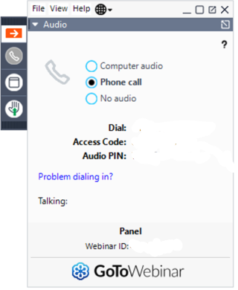

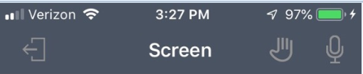

PC/Laptop View
Climate Pollution Reduction Grant
Mobile Devices View
Android
Minimize the control panel➔
or maximize the panel
Raise or lower your hand ➔
Raise ⬆ Lower Hand
⬆ Click 3 dots to open Audio Options
Select audio method
*Phone call provides better quality audio
Raise ⬇ Lower Hand
iPhone
Audio Options ⬆

Slide 15
Webinar Attendee Engagement
Webinar attendees will each be allotted 2 minutes to ask questions or provide comments to DEQ on the CPRG planning grant process. Please use the hand raise icon to indicate that you would like to speak.
Attendees can also drop questions and/or comments in the chat for DEQ.
If the same organization has multiple attendees, we ask that one person ask question and/or provide comments on behalf of the organization.

Slide 16
Virginia 2020 GHG Emissions Inventory
Sector | Emissions in MMT CO2e
Transportation | 45.70
Electric power | 28.87
Industry | 21.13
Residential | 6.72
Commercial | 5.68
Agriculture & Forestry | 4.02
Waste & Wastewater | 3.75
Gross Total | 115.87
Carbon Removal | -51.25
Net Total | 64.62

