Slide 1

State Programmatic general permit
22-SPGP-LT and 22-SPGP-RCIR
Corps & DEQ JoINT TRAINING
Anna Lawston
Section 106/Tribal SME - NAD TEC
19 April 2023

Slide 2
Initial review
Two SPGP permits
Acreage threshold only
All federal coordination now completed by the COE
Preliminary Screenings – completed by the COE
Separate VDOT SOP

Slide 3
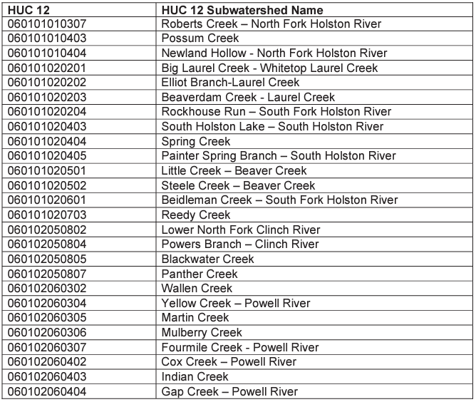

Excluded basins
The 22-SPGP-RCIR and 22-SPGP-LT can not be used in subwatersheds shared with Tennessee.

Slide 4
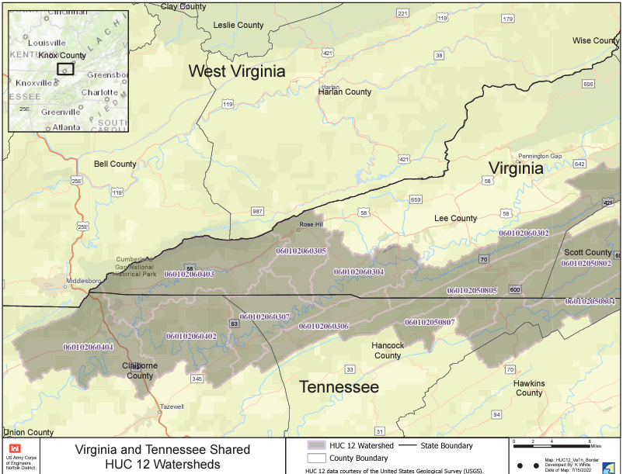
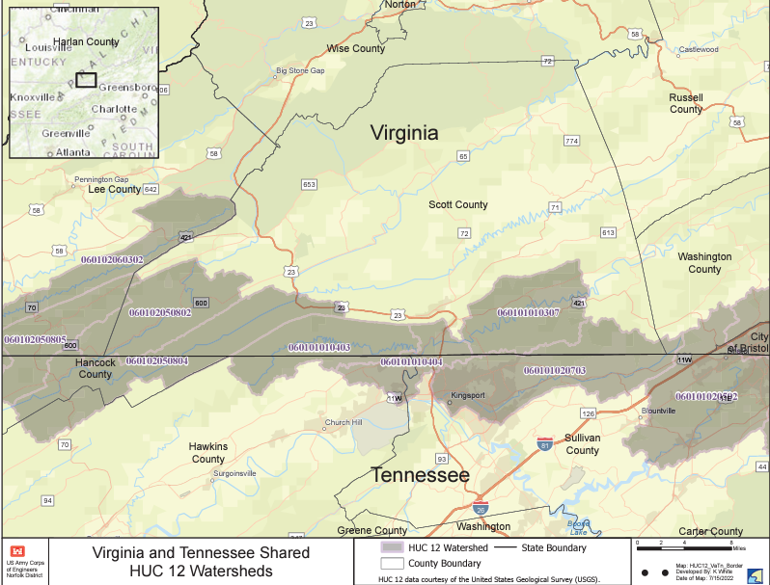

Slide 5
22-SPGP-RCIR
Authorized Activities
Residential, Commercial, Institutional and Recreational
The discharge must not cause the loss of greater than 1 acre (wetlands, streams and open waters)
Must have no more than minimal individual and cumulative impacts
Must have avoided and minimized to maximum extent practicable.
Exemptions: may not be used for stand alone utilities, substations, regional stormwater, mining and Total Maximum Daily Load projects.
Notes:
Definitions of residential, commercial, institutional, recreational and stormwater are all located in the RCIR permit.
If a project does not fall within these definitions, then the SPGP should not be used. If you are unsure, please contact the project manager or myself.
Please notice there is no linear foot threshold. This was done to mirror the impacts as they are listed in the NWPs.

Slide 6
22-SPGP-LT
Linear Transportation – road, rail, trail and air
The discharge must not cause the loss of greater than 1/2 acre (wetlands, streams and open waters)
Must have no more that minimal individual and cumulative impacts
Must have avoided and minimized to maximum extent practicable.
Exemptions: may not be used for stand alone utilities, substations, regional stormwater, mining and Totals Maximum Daily Load projects.
Separate SOP for VDOT and FHWA projects.
Amended December 2022
Notes:
The definition of linear transportation is located in the LT permit.
Again please notice there is not linear foot threshold. However, stream impacts and mitigation must still be reported in linear feet.

Slide 7
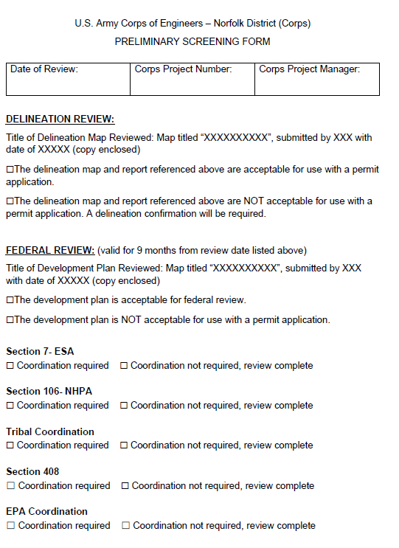

Confirmations and Preliminary Federal Screening
Must have one of the following:
Preliminary Screening (PSF)
Preliminary jurisdiction determination (PJD)
Approved jurisdictional determination (AJD)

Slide 8
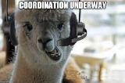
Complete application for COE coordination
The application must have:
A valid PSF, PJD or AJD
A development plan that is acceptable for permitting
Must account for all types of impacts (e.g. fill, dredging, temporary, etc.)
Notes:
A development plan that accurately accounts for all impacts to WOTUS, including secondary impacts, and is acceptable for permitting.
A development plan that clearly identifies all impact types (e.g., fill, dredging, temporary, conversion, permanent, etc.) and is acceptable for permitting.

Slide 9
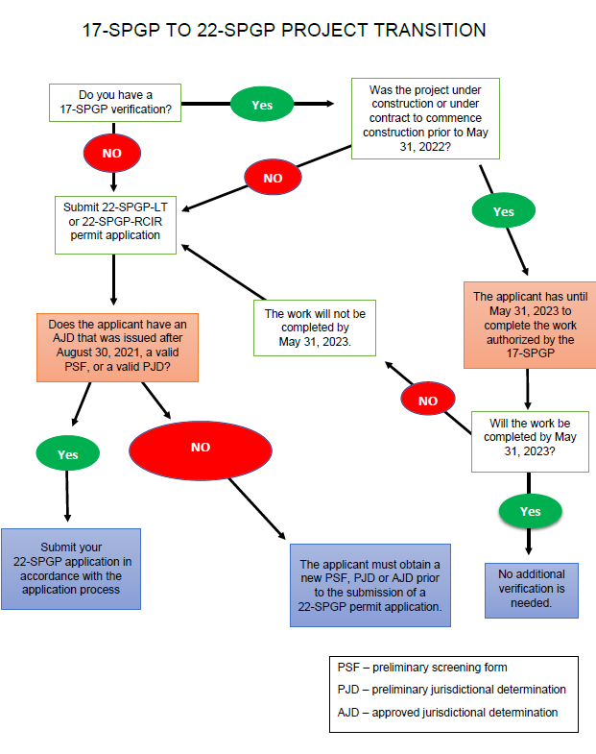
DELINEATIONS
Notes:
Do not send applicants to get a PSF during the application process. This is done before application.
If there are isolated features, they want considered non-jurisdictional they will need an AJD.

Slide 10
How do I know if a preliminary screening form (psf) is valid?
Matching delineations and approved for use with permit application
Matching development plans and approved for use with a permit application
Federal review: ONLY VALID FOR 9 MONTHS FROM DATE OF REVIEW (date of review listed on form)
Signature not required but highly recommended.
Notes:
This is a process to help expedite those projects that are close to application, have all their stuff together, do not really have any outstanding issues or concerns.
Not meant to be an all-encompassing process.
Do not send applicants to get a PSF during the application process. This is done before application.

Slide 11
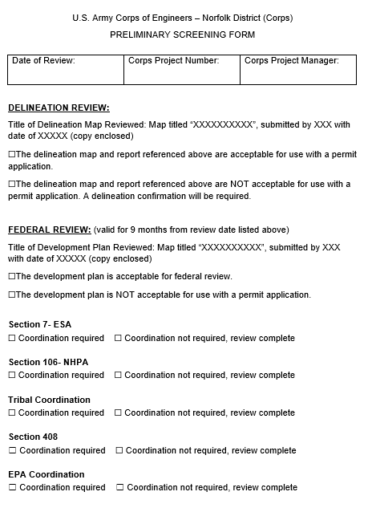


Slide 12
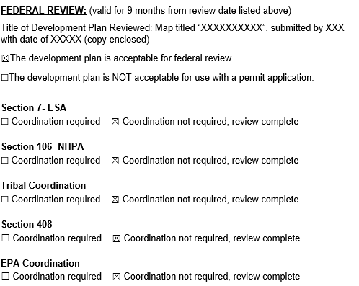
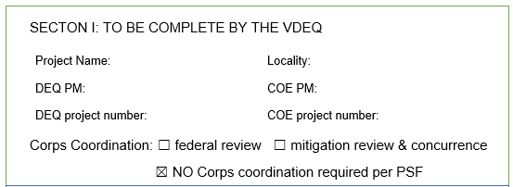
Corps notification only and no coordination required
The delineation matches the PSF/ they have a confirmed PJD/AJD
The development plan is acceptable for permitting and matches the PSF
The PSF states no federal coordination is required for ALL federal responsibilities.
Send SPGP coordination form
Notes:
Do not send applicants to get a PSF during the application process. This is done before application.
If there are isolated features, they want considered non-jurisdictional they will need an AJD.

Slide 13
Corps coordination required
When ANY of the following occur:
A PSF has not been completed. You only have a PJD or AJD.
When the PSF indicates federal coordination is required.
When the PSF delineation does not match the application.
When the PSF development plan does not match the application.
What if?
What if the delineation is acceptable but the development plan is different?
What if the delineation is different but the development plan is acceptable?

Slide 14
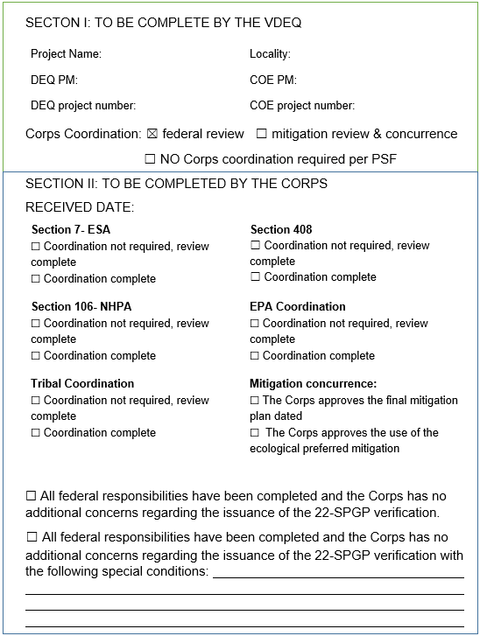
How do we coordinate?
Section 1 – completed by the DEQ
Section II – completed by the Corps
Must be completed for verification
COE PM should be signing
Notes:
A SPGP verification can not be issued until you receive a completed SPGP coordination form.
The COE PM will note any special conditions at the bottom of the form.
All federal review documentation and file recordation will be held at the COE
COE PMS – You will communicate directly with the application for federal review. You should notify applicant when coordination is initiated and of the suspense date.
COE PMS – you should be copying the DEQ PM on coordination and suspense date notices that are sent to applicant

Slide 15
Mitigation coordination required when?
PRM is proposed
Does not follow the Corps-EPA Compensatory Mitigation Rule Hierarchy
Notes:
Please remember to check the GSA for all bank/ILF that are proposed for use. If the bank is outside of the GSA it can not be used.
DEQ must receive approval of the mitigation for PRM and if the project does not follow the heirarchy
If they change the mitigation proposal to meet the rule or purchase credits, then notify the Corps and proceed with issuance.

Slide 16

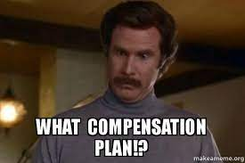
Speaking of mitigation
Compensation for permanent conversion of forested wetlands will generally be required at a 1:1 ratio.
Compensation for the permanent loss of open waters will generally be required at a 0.5:1 ratio.

Slide 17
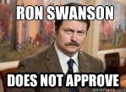
Permit decisions – VDEQ responsibilities
Review permit application for completeness for issuance.
Address issues regarding incomplete applications.
Verification Issuance written on “22-SPGP Verification Letter”
If the project does not qualify for a 22-SPGP verification the applicant should:
  Revise permit application to meet terms
  Submit application to Corps for processing under different permit.

Slide 18
New permit verifications corps coordination required
YOU CAN NOT MODIFY A SPGP VERIFICATION
ALL projects that have special conditions.
ALL project proposing new impacts.
ALL project proposing impacts in new locations even when there is an overall decrease.
A new permit request and application are required.
A new verification letter must be issued.
Notes:
DEQ must issue a new verification letter
They may use the original application however it needs to be complete so if there was add info it needs to contain that information and justification for new impacts, including A&M statement.
If the new impacts exceed the thresholds of the SPGP, revise or submit directly to the Corps

Slide 19
New permit verifications corps coordination NOT required
YOU CAN NOT MODIFY A SPGP VERIFICATION
Change in ownership
Modified plan but no change in impacts or only a decrease
Change in the bank/ILF proposed for use.
Clerical revisions.
A new permit request is required.
A new verification letter must be issued.
Notes:
You must issue a new verification letter
Temporary, conversion, permanent, same location but large, etc.
They may use the original application however it needs to be complete so if there was add info it needs to contain that information and justification for new impacts, including A&M statement.

Slide 20
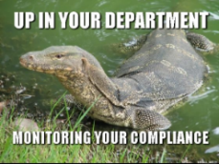
Compliance review and resolution
YOU CAN NOT MODIFY A SPGP VERIFICATION
Must be coordinated with Corps in accordance with New Verification Procedures as listed in the SOP.
If the projects exceed 1 acre (RCIR) or ½ acre (LT) must be sent to Corps for processing under a different permit.
A new permit request and application are required.
A new verification letter must be issued.
Notes:
You must issue a new verification letter
They may use the original application however it needs to be complete so if there was add info it needs to contain that information and justification for new impacts, including A&M statement.

Slide 21
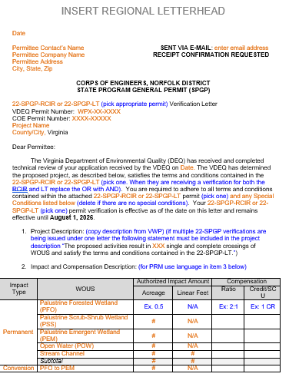
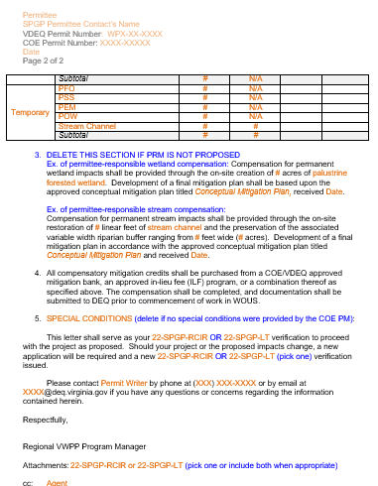
What does the verification look like?
Notes:
The verification has to reference the Corps permitted impacts not the DEQ. So if there are isolated impacts those should not be included on the verification.
One form for both SPGP permits.
Structured like DEQ templated with orange and blue

Slide 22
Common questions and issues
All requests for a delineation concurrence or confirmation need to be submitted by the applicant/consultant and directly to the Corps via the ROD email.
If the delineation maps approved do not match the delineation maps provided in the permit application, the applicant does not have a complete application and needs to contact the Corps.
Approved jurisdictional determinations issued prior to August 30, 2021, are not valid and can not be used for permitting.
Notes:
All requests for a delineation concurrence or confirmation need to be submitted by the applicant/consultant and directly to the Corps via the ROD email.
DEQ PMs should not be coordinating delineation requests with the Corps.
AJD prior to August 30, 2021 can not be used, this is not optional and can not be waved by the COE Pm

Slide 23
Common questions and issues
PJDs are valid for 5 years from the date of the letter. If the PJD is expired, then they need to contact the Corps to determine the most efficient JD confirmation avenue.
All SPGP coordination requests need to be sent to the Corps regulator of the day email for project assignment. No coordination should be sent directly to Corps project managers.
Do applicant’s have to revise their projects and/or mitigation to meet the 22-SPGP permit conditions? The answer is YES!
Notes:
Once a Corps project manager has been assigned, they should be notifying the DEQ PM that they have been assigned the project. After assignment the Corps PM can move forward with direct communication and coordination of any additional materials.
New applications must be in compliance with the 22-SPGP terms and conditions, including mitigation requirements. If there are concerns with this I recommend the applicant meet with the Corps and DEQ pms to discuss the project and potential options for processing under 22-SPGP or another Corps permit.

Slide 24

I don’t know what to do!
FLOWCHART
FAQS
SOP
PERMIT
CALL/EMAIL ANNA
Anna.r.Lawston@usace.army.mil
540-764-4459

Slide 25
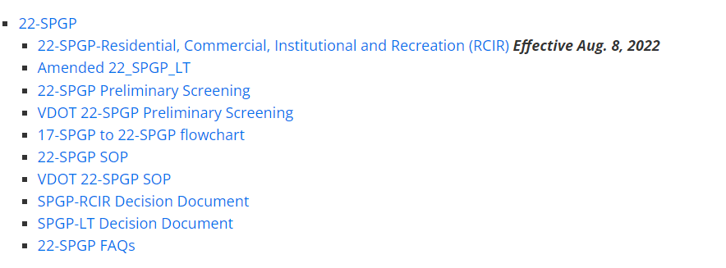
USACE Norfolk Regulatory
Regional Permits

Slide 26

questions

