Slide 1
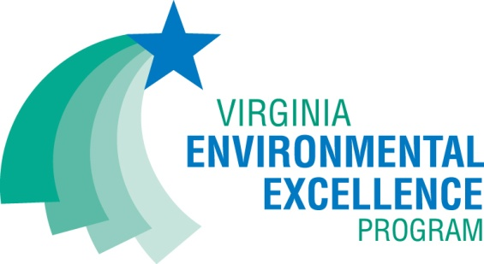
Office of Pollution Prevention
Promoting P2 in the Commonwealth
Meghann Quinn
Manager, Office of Pollution Prevention

Slide 2
§ 10.1-1183. Creation of Department of Environmental Quality; statement of policy.
It is the policy of the Department of Environmental Quality to protect and enhance the environment of Virginia in order to promote the health and well-being of the Commonwealth's citizens, residents, and visitors in accordance with applicable laws and regulations.
The purposes of the Department are:
Notes:
Code of Virginia that creates DEQ, list 13 purposes of the agency

Slide 3
§ 10.1-1183. Creation of Department of Environmental Quality; statement of policy.
It is the policy of the Department of Environmental Quality to protect and enhance the environment of Virginia in order to promote the health and well-being of the Commonwealth's citizens, residents, and visitors in accordance with applicable laws and regulations. The purposes of the Department are:
1. To assist in the effective implementation of the Constitution of Virginia by carrying out state policies aimed at conserving the Commonwealth's natural resources and protecting its atmosphere, land, and waters from pollution.
2. To address climate change by developing and implementing policy and regulatory approaches to reducing climate pollution and promoting climate resilience in the Commonwealth and by ensuring that climate impacts and climate resilience are taken into account across all programs and permitting processes.
3. To coordinate permit review and issuance procedures to protect all aspects of Virginia's environment.
4. To further environmental justice and enhance public participation in the regulatory and permitting processes.
5. To establish and effectively implement a pollution prevention program to reduce the impact of pollutants on Virginia's natural resources.
6. To establish procedures for, and undertake, long-range environmental program planning and policy analysis, including assessments of emerging environmental challenges.
7. To conduct comprehensive evaluations of the Commonwealth's environmental protection programs.
8. To develop uniform administrative systems to ensure coherent environmental policies.
9. To coordinate state reviews with federal agencies on environmental issues, such as environmental impact statements.
10. To promote environmental quality through public hearings and expeditious and comprehensive permitting, inspection, monitoring, and enforcement programs, and provide effective service delivery to the regulated community.
11. To advise the Governor and General Assembly, and, on request, assist other officers, employees, and public bodies of the Commonwealth, on matters relating to environmental quality and the effectiveness of actions and programs designed to enhance that quality.
12. To ensure that there is consistency in the enforcement of the laws, regulations, and policies as they apply to holders of permits or certificates issued by the Department, whether the owners or operators of such regulated facilities are public sector or private sector entities, including the development of electronic recordkeeping and document transmittal systems that encourage the use of electronic methods in performing the Department's business as a means of furthering both resource conservation and transaction efficiency.
13. To ensure the fair treatment and meaningful involvement of all people regardless of race, color, national origin, faith, disability, or income with respect to the administration of environmental laws, regulations, and policies.

Slide 4
§ 10.1-1183. Creation of Department of Environmental Quality; statement of policy.
It is the policy of the Department of Environmental Quality to protect and enhance the environment of Virginia in order to promote the health and well-being of the Commonwealth's citizens, residents, and visitors in accordance with applicable laws and regulations. The purposes of the Department are:
1. To assist in the effective implementation of the Constitution of Virginia by carrying out state policies aimed at conserving the Commonwealth's natural resources and protecting its atmosphere, land, and waters from pollution.
2. To address climate change by developing and implementing policy and regulatory approaches to reducing climate pollution and promoting climate resilience in the Commonwealth and by ensuring that climate impacts and climate resilience are taken into account across all programs and permitting processes.
3. To coordinate permit review and issuance procedures to protect all aspects of Virginia's environment.
4. To further environmental justice and enhance public participation in the regulatory and permitting processes.
5. To establish and effectively implement a pollution prevention program to reduce the impact of pollutants on Virginia's natural resources.
6. To establish procedures for, and undertake, long-range environmental program planning and policy analysis, including assessments of emerging environmental challenges.
7. To conduct comprehensive evaluations of the Commonwealth's environmental protection programs.
8. To develop uniform administrative systems to ensure coherent environmental policies.
9. To coordinate state reviews with federal agencies on environmental issues, such as environmental impact statements.
10. To promote environmental quality through public hearings and expeditious and comprehensive permitting, inspection, monitoring, and enforcement programs, and provide effective service delivery to the regulated community.
11. To advise the Governor and General Assembly, and, on request, assist other officers, employees, and public bodies of the Commonwealth, on matters relating to environmental quality and the effectiveness of actions and programs designed to enhance that quality.
12. To ensure that there is consistency in the enforcement of the laws, regulations, and policies as they apply to holders of permits or certificates issued by the Department, whether the owners or operators of such regulated facilities are public sector or private sector entities, including the development of electronic recordkeeping and document transmittal systems that encourage the use of electronic methods in performing the Department's business as a means of furthering both resource conservation and transaction efficiency.
13. To ensure the fair treatment and meaningful involvement of all people regardless of race, color, national origin, faith, disability, or income with respect to the administration of environmental laws, regulations, and policies.
5. To establish and effectively implement a pollution prevention program to reduce the impact of pollutants on Virginia's natural resources.

Slide 5
§ 10.1-1183. Creation of Department of Environmental Quality; statement of policy.
It is the policy of the Department of Environmental Quality to protect and enhance the environment of Virginia in order to promote the health and well-being of the Commonwealth's citizens, residents, and visitors in accordance with applicable laws and regulations. The purposes of the Department are:
1. To assist in the effective implementation of the Constitution of Virginia by carrying out state policies aimed at conserving the Commonwealth's natural resources and protecting its atmosphere, land, and waters from pollution.
2. To address climate change by developing and implementing policy and regulatory approaches to reducing climate pollution and promoting climate resilience in the Commonwealth and by ensuring that climate impacts and climate resilience are taken into account across all programs and permitting processes.
3. To coordinate permit review and issuance procedures to protect all aspects of Virginia's environment.
4. To further environmental justice and enhance public participation in the regulatory and permitting processes.
5. To establish and effectively implement a pollution prevention program to reduce the impact of pollutants on Virginia's natural resources.
6. To establish procedures for, and undertake, long-range environmental program planning and policy analysis, including assessments of emerging environmental challenges.
7. To conduct comprehensive evaluations of the Commonwealth's environmental protection programs.
8. To develop uniform administrative systems to ensure coherent environmental policies.
9. To coordinate state reviews with federal agencies on environmental issues, such as environmental impact statements.
10. To promote environmental quality through public hearings and expeditious and comprehensive permitting, inspection, monitoring, and enforcement programs, and provide effective service delivery to the regulated community.
11. To advise the Governor and General Assembly, and, on request, assist other officers, employees, and public bodies of the Commonwealth, on matters relating to environmental quality and the effectiveness of actions and programs designed to enhance that quality.
12. To ensure that there is consistency in the enforcement of the laws, regulations, and policies as they apply to holders of permits or certificates issued by the Department, whether the owners or operators of such regulated facilities are public sector or private sector entities, including the development of electronic recordkeeping and document transmittal systems that encourage the use of electronic methods in performing the Department's business as a means of furthering both resource conservation and transaction efficiency.
13. To ensure the fair treatment and meaningful involvement of all people regardless of race, color, national origin, faith, disability, or income with respect to the administration of environmental laws, regulations, and policies.
2. To address climate change by developing and implementing policy and regulatory approaches to reducing climate pollution and promoting climate resilience in the Commonwealth and by ensuring that climate impacts and climate resilience are taken into account across all programs and permitting processes.

Slide 6
§ 10.1-1183. Creation of Department of Environmental Quality; statement of policy.
It is the policy of the Department of Environmental Quality to protect and enhance the environment of Virginia in order to promote the health and well-being of the Commonwealth's citizens, residents, and visitors in accordance with applicable laws and regulations. The purposes of the Department are:
1. To assist in the effective implementation of the Constitution of Virginia by carrying out state policies aimed at conserving the Commonwealth's natural resources and protecting its atmosphere, land, and waters from pollution.
2. To address climate change by developing and implementing policy and regulatory approaches to reducing climate pollution and promoting climate resilience in the Commonwealth and by ensuring that climate impacts and climate resilience are taken into account across all programs and permitting processes.
3. To coordinate permit review and issuance procedures to protect all aspects of Virginia's environment.
4. To further environmental justice and enhance public participation in the regulatory and permitting processes.
5. To establish and effectively implement a pollution prevention program to reduce the impact of pollutants on Virginia's natural resources.
6. To establish procedures for, and undertake, long-range environmental program planning and policy analysis, including assessments of emerging environmental challenges.
7. To conduct comprehensive evaluations of the Commonwealth's environmental protection programs.
8. To develop uniform administrative systems to ensure coherent environmental policies.
9. To coordinate state reviews with federal agencies on environmental issues, such as environmental impact statements.
10. To promote environmental quality through public hearings and expeditious and comprehensive permitting, inspection, monitoring, and enforcement programs, and provide effective service delivery to the regulated community.
11. To advise the Governor and General Assembly, and, on request, assist other officers, employees, and public bodies of the Commonwealth, on matters relating to environmental quality and the effectiveness of actions and programs designed to enhance that quality.
12. To ensure that there is consistency in the enforcement of the laws, regulations, and policies as they apply to holders of permits or certificates issued by the Department, whether the owners or operators of such regulated facilities are public sector or private sector entities, including the development of electronic recordkeeping and document transmittal systems that encourage the use of electronic methods in performing the Department's business as a means of furthering both resource conservation and transaction efficiency.
13. To ensure the fair treatment and meaningful involvement of all people regardless of race, color, national origin, faith, disability, or income with respect to the administration of environmental laws, regulations, and policies.
4. To further environmental justice and enhance public participation in the regulatory and permitting processes.

Slide 7
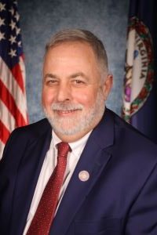
Virginia DEQ Structure
Boards & Citizen Advisory Groups
DEQ Director Michael Rolband
Chief Stormwater Policy Assistant
Chief Deputy
Division of Administration
Operations
Central Operation
Regulatory Affairs & Outreach Division
Division of Policy
OneDEQ Coordination & Process Improvement
Regional Operations
Security
Notes:
Director Mike Rolband joined DEQ in January 2022.
He founded Wetland Studies and Solutions Inc. (WSSI) in 1991, and grew his company into a multidisciplinary natural and cultural resources consulting firm with a staff of more than 200. His firm constructed the first LEED Gold facility in Virginia and utilized multiple Low Impact Development practices for stormwater management in 2005.

Slide 8

BIG Initiatives | Progress
OneDEQ (cultural and procedural) | In Place
2. Permitting Enhancement & Evaluation Platform (PEEP) | In Progress
3. One Stormwater Management (SWM), Best Management Practice (BMP), and Erosion & Sediment Control (ESC) Handbook | In Progress
4. Commodity Trading Platform for Mitigation (water-related commodities) | CY 2024 Start

Slide 9
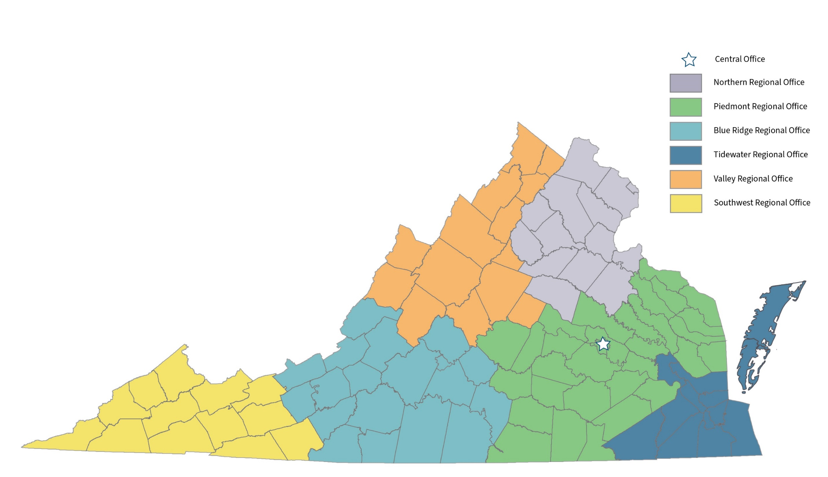
One DEQ – In Place – Cultural Change
DEQ employees are working collaboratively to ensure responsive customer service and timely actions for all DEQ customers
  Emerging Leaders Program project – Strengthen “OneDEQ” Collaboration Culture
  Ombudsman Positions
Workload Evaluation & Distribution (WED) process manages distribution of workload on real-time basis and establishes uniform performance expectations to maximize staff resources
  Coordinated with PEEP roll-out for permitting programs
  Implemented in Virginia Water Protection Permitting, Stormwater Plan Review, and Enforcement programs to date

Slide 10
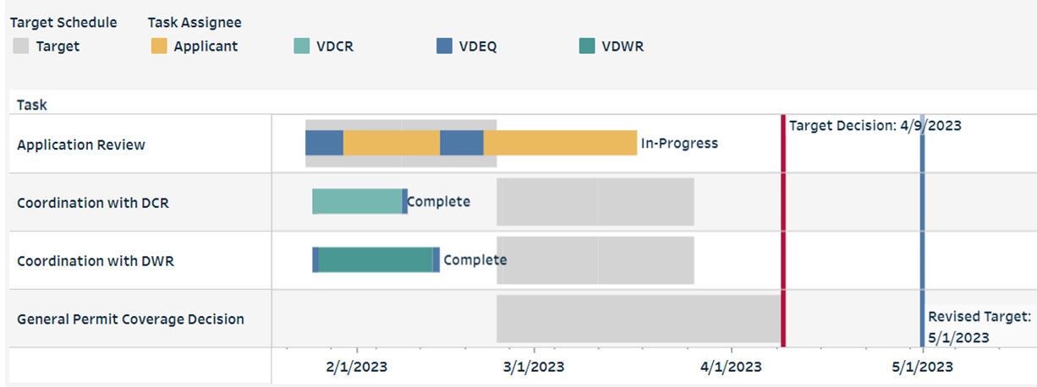
Permitting Enhancement & Evaluation Platform (PEEP)
Public schedule to track permit review process
Transparency
Project management tool
10
Notes:
Critical steps of interest to the public and applicants
DEQ review
Coordination
Agency decision
Displays target and actual timeframes for each step
Identifies Responsible Party
Sends notifications
Visible to everyone
Workload management tool

Slide 11
Permitting Enhancement & Evaluation Platform (PEEP)
The PEEP release schedule for the 11 DEQ Programs is as follows:
Virginia Water Protection Permit (VWPP) Program – December 1, 2022
Wetland and Stream Channel Mitigation Banking – March 13, 2023
Air Permitting – June 2, 2023
Surface Water Withdrawal - June 12, 2023
Nutrient Banking – June 23, 2023
Municipal Separate Storm Sewer System (MS4) Permitting – July 3, 2023
Stormwater and Erosion and Sediment Control Plan Review – July 3, 2023
Virginia Pollution Abatement (VPA) Permitting - July 3, 2023
Virginia Pollutant Discharge Elimination System (VPDES) - July 3, 2023
Renewable Energy Permitting – July 21, 2023
Land Protection / Waste Permitting – September 11, 2023
Groundwater Withdrawal Permitting – April 1, 2024
11

Slide 12
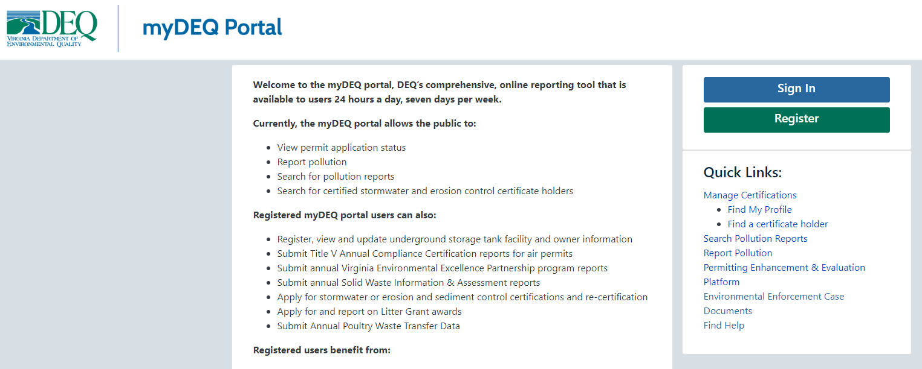
Enforcement Transparency

Slide 13
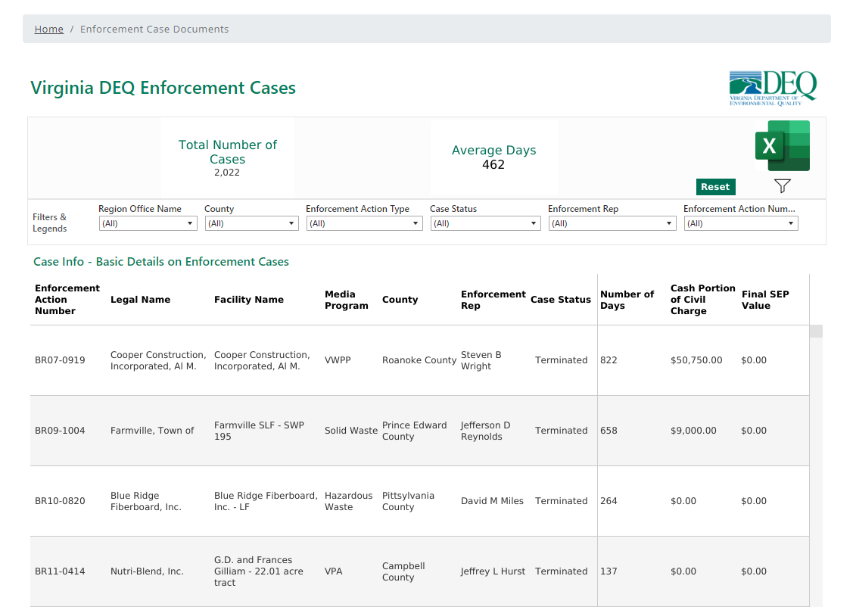

Slide 14
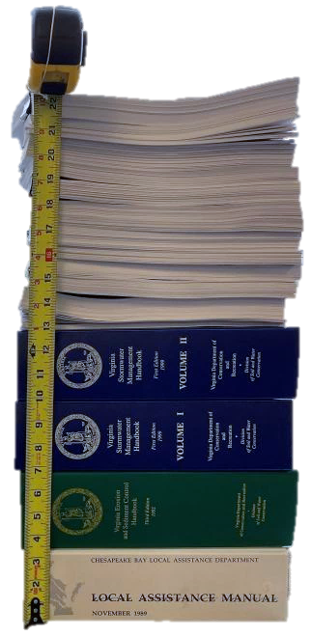

One Stormwater Handbook
Produce Best In Class Stormwater Handbook
Update & Consolidate Stormwater Information
VRRM Update
ESC/SWM Regulation Consolidation
2024 Construction General Permit (CGP) Reissuance
2024
Virginia Stormwater Handbook
to
deq.virginia.gov/permits-regulations/permits/water/stormwater-construction
Notes:
DEQ’s goal begins with this image.
Nearly two feet of stacked statutes, regulations, handbooks, manuals, guidance documents, technical bulletins, information bulletins, and design specifications apply to land-disturbing activities in Virginia.
This content applies to both construction-phase erosion and sediment control and post-development water quality and quantity compliance.
Recently, for the first time, DEQ made all of these materials available on its website in one location.
DEQ’s goal is to update and consolidate stormwater reference information into one handbook.
Some of the benefits of a new stormwater handbook will include easier and faster access to key information for design professionals and DEQ staff. In addition, updated best management specifications will reduce the need to prepare and approve annual standards and specifications documents including variances.
The contractor will play a critical role in realizing DEQ’s goal. Our expectations for a contractor include
By performing these activities, our goal is to produce the “best in class” stormwater handbook.

Slide 15

Commodity Trading Platform
Develop trading platform for water-related commodities to provide transparency for permittees with regard to prices and supply and demand
Assist market in meeting demands of a strong economy
Coming in 2024!

Slide 16
Virginia DEQ Structure
DEQ Director Michael Rolband
Chief Stormwater Policy Assistant
Chief Deputy
Division of Administration
Operations
Regulatory Affairs & Outreach Division
Division of Policy
Security
Communications, PREP & Permitting Assistance
Environmental Justice
Enforcement
Environmental Enhancement

Slide 17
Virginia DEQ Structure
DEQ Director Michael Rolband
Chief Stormwater Policy Assistant
Chief Deputy
Division of Administration
Operations
Regulatory Affairs & Outreach Division
Division of Policy
Security
Communications, PREP & Permitting Assistance
Environmental Justice
Enforcement
Environmental Enhancement

Slide 18
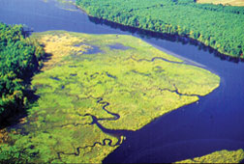
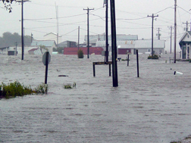
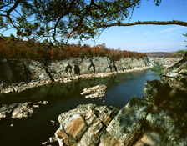
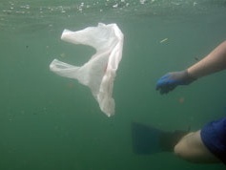
Division of Environmental Enhancement
Coastal Zone Management Program
Office of Environmental Impact Review & Long Range Planning
Office of Pollution Prevention
Notes:
CZM:
Network of Virginia state agencies and local governments (coastal zone is basically east of 95)
DEQ is the lead agency
Receives funding from NOAA, much of which is given out to other agencies to implement projects
EIR:
State lead for NEPA environmental impact reviews (federal projects or programs)
Coordinates reviews of major state projects as well as airport, power, drilling and mineral extraction projects
Federal consistency reviews
High profile projects include pipeline reviews, airport expansions, transmission lines
Long Range Priorities:
Address issues that pose long-term risk for the Commonwealth (e.g., water Supply, coastal resiliency, urban stormwater)

Slide 19
Office of Pollution Prevention
Motivate Virginians to minimize their environmental footprint through actions that exceed what is required while enhancing their bottom line.
Non-regulatory programs
  Public recognition
Technical assistance
  Web-based information
  resources
  Training & workshops

Slide 20
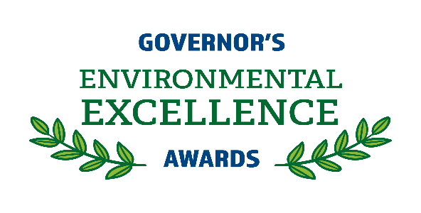



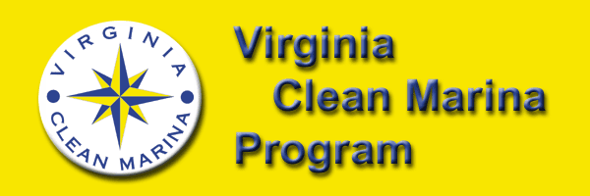



What is P2?
Pollution Prevention means eliminating or reducing the use, generation or release at the source of environmental waste.

Slide 22
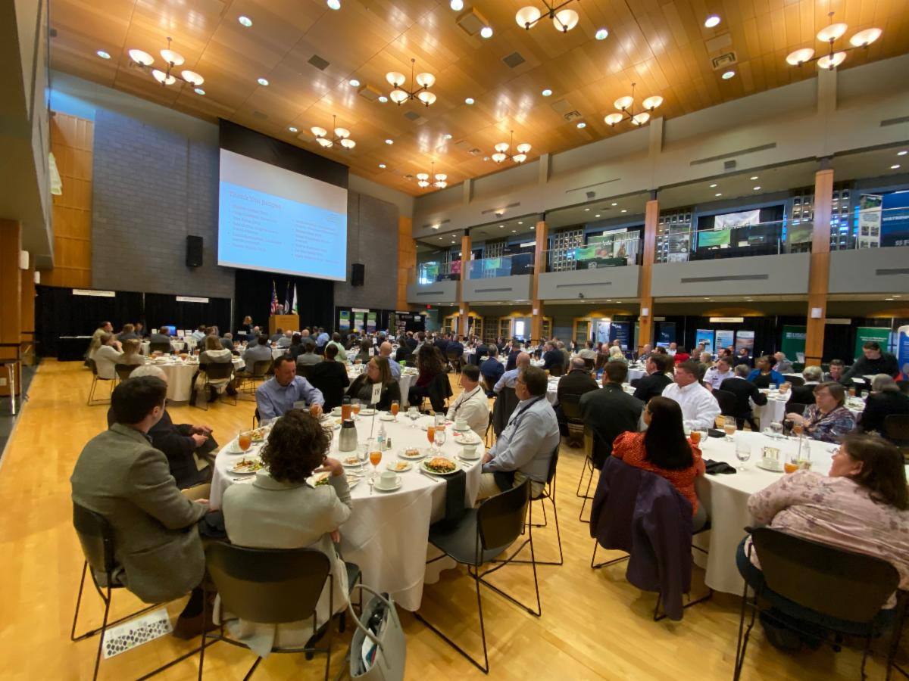
Governor’s Environmental
Excellence Awards
Award categories
  Environmental & Sustainability Program
  Environmental & Sustainability Project
  Land Conservation Program
  Virginia Outdoors Plan
  Commonwealth Green Government
Winners selected by a panel of
independent judges
Applications received from non-profits,
manufacturers, small businesses and
government

Slide 23

Applications are now available!

Slide 24
Virginia Information Source for Energy
Energy conservation and renewable energy technologies are important to Virginia's environmental and economic health as well as to the health of Virginians.
  Financial Incentives
  Renewable Energy
  Energy and the Environment
Notes:
A list of financial incentives and programs available in Virginia is maintained. This includes loans, rebates, tax incentives, etc.
Renewable energy also known as green power options are explained. Links to purchase certified green power and certified carbon offsets are available.
Energy and the environment discusses the air, waste and water impacts of using fossil fuel

Slide 25



Virginia Green Travel
Green certification for the tourism industry
All sectors of tourism
Environmental benefits and cost savings
Ask Virginia Green
Find members at Virginia.org/green
Partnership
Notes:
Virginia Green consists of a network of tourism-related organizations that are committed to protecting the environment while promoting responsible tourism. The statewide program works to reduce the environmental impacts of the Commonwealth's tourism industry and raises awareness about green tourism.
Virginia Green’s in person annual conference and award returned in 2022.
Frequenting Virginia Green certified facilities supports environmental efforts in the hospitality industry.

Slide 26
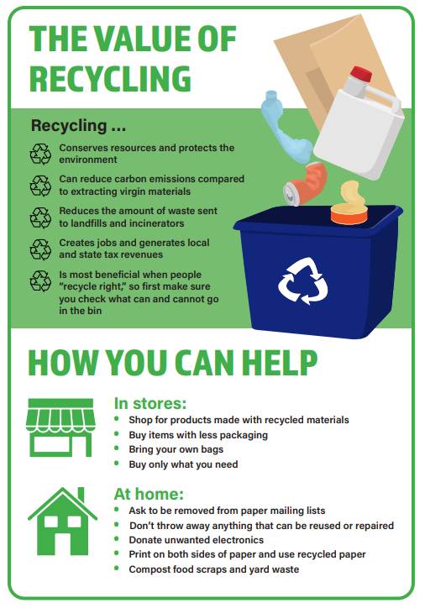
Greening of Government
Waste Reduction
Environmentally Preferable Purchasing
Energy Conservation
Executive Order 17- Recognizing the Value of Recycling and Waste Reduction
  State Agency Recycling
  Stopping Food Waste
Notes:
EO 17 Increase efforts for state agency recycling, raising awareness, improved signage, etc.
Reducing food waste - work in partnership with large-scale suppliers of food such as food manufacturers, grocery retailers, sports arenas, schools, hotels and banquet facilities to identify appropriate strategies to reduce food waste in their respective sectors by encouraging donations to needy individuals, food for animals or for composting purposes.

Slide 27


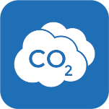
VEEP is…
DEQ’s voluntary recognition and incentive program
Facilities in the program have committed to:
  Complying with environmental regulations
  Striving for continuous environmental improvement
Notes:
VEEP is DEQ’s voluntary recognition and incentive program. Facilities in the program have committed not only to be in compliance with environmental regulations but also to strive for continuous environmental improvement, which requires innovative thinking, leadership and partnerships.

Slide 28

Partnerships
VEEP in and of itself is an example of a successful partnership.
Notes:
VEEP in and of itself is an example of a successful partnership.
Part of DEQ’s mission is to improve environmental results through a better engaged community.
We want to help your facility be recognized by the local community and Virginia industry as an environmental leader.
Your facility is now a resource for DEQ and an environmental asset to the local community.

Slide 29




Virginia Environmental Excellence Program (VEEP)
Sustainability Partners Track
  Annual renewal with numerical reporting
  Compliance requirements
  Identified sustainability projects
  Public recognition
Environmental Management System Track
  Three year renewal with annual reporting
  Compliance requirements
  Requires an environmental management system
  Public recognition
  Permit fee discounts

Slide 30


VEEP by the Numbers
350+ Participants
20+ years
250,000+ employees under the umbrella of VEEP
Notes:
VEEP has been around for over 20 years.
Started July, 2000; codified July, 2005
There are over 250,000 employees that work for VEEP members
Membership ranges from government to private industry, from dentist offices to NASA, from facilities that handle nuclear material to universities
More E3 than E2
Only 20% of VEEP members participate at our highest level – E4 – It’s a select group of an already select group.

Slide 31
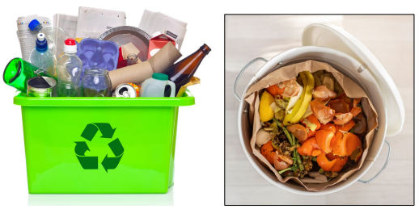
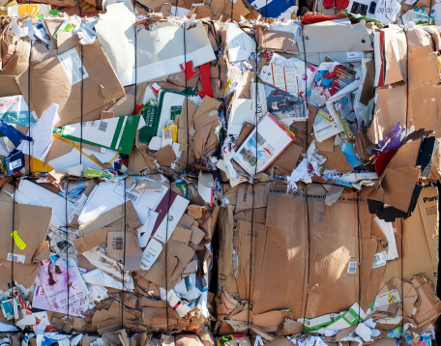
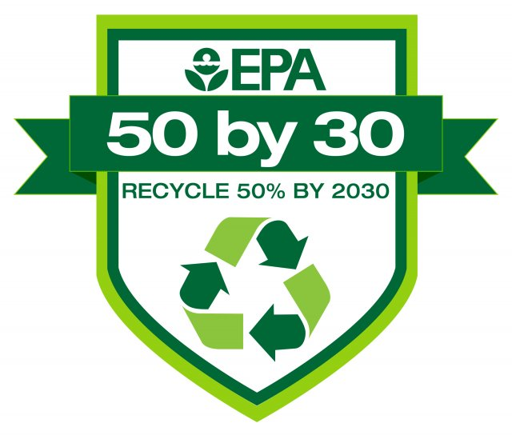
Solid Waste Infrastructure for Recycling Grant
EPA funding for states to improve post-consumer materials management programs
Funding possibilities for DEQ:
  Update statewide solid waste management plan
  Improve data collection
  Implement plans to advance post-consumer materials management
Notes:
DEQ has submitted its notice of intent to participate and EPA indicated DEQ will be receiving $531K. DEQ is drafting our workplan for the funding areas.
Develop or update plans to advance post-consumer materials management
Develop, strengthen, and/or implement comprehensive data collection efforts that demonstrate progress towards the National Recycling Goal & Food Loss & Waste Reduction Goals
Support state-led implementation of plans (Not considering this area)
Final workplans due by end of this month.

Slide 32
Solid Waste Infrastructure for Recycling (SWIFR) Grant
Grant Period:
Oct. 1, 2023, to Sept. 30, 2026​
Data Collection & Measurement
State-led Plan Implementation
Solid Waste Management Planning
32
Notes:
NEW Solid Waste Infrastructure for Recycling (or SWIFR) grant program authorized by the Save Our Seas 2.0 Act and funded through the Bipartisan Infrastructure Legislation (BIL).
Develop or update plans to advance post-consumer materials management. Plans can be for Title 40 of the Code of Federal Regulations Part 256 solid waste management plans or other planning documents (e.g., circular economy plans).
Develop, strengthen, and/or implement comprehensive data collection efforts that demonstrate progress toward the National Recycling Goal and Food Loss and Waste Reduction Goal. Data collection and measurement efforts should be designed to improve the state’s ability to track progress towards national and state recycling and/or circular economy goals. Data collection efforts could include state-wide or other targeted waste characterization studies. EPA’s goal is 50% reduction in food waste & 50% recycling rate by 2030.
Support the state-led implementation of plans to advance post-consumer materials management.

Slide 33
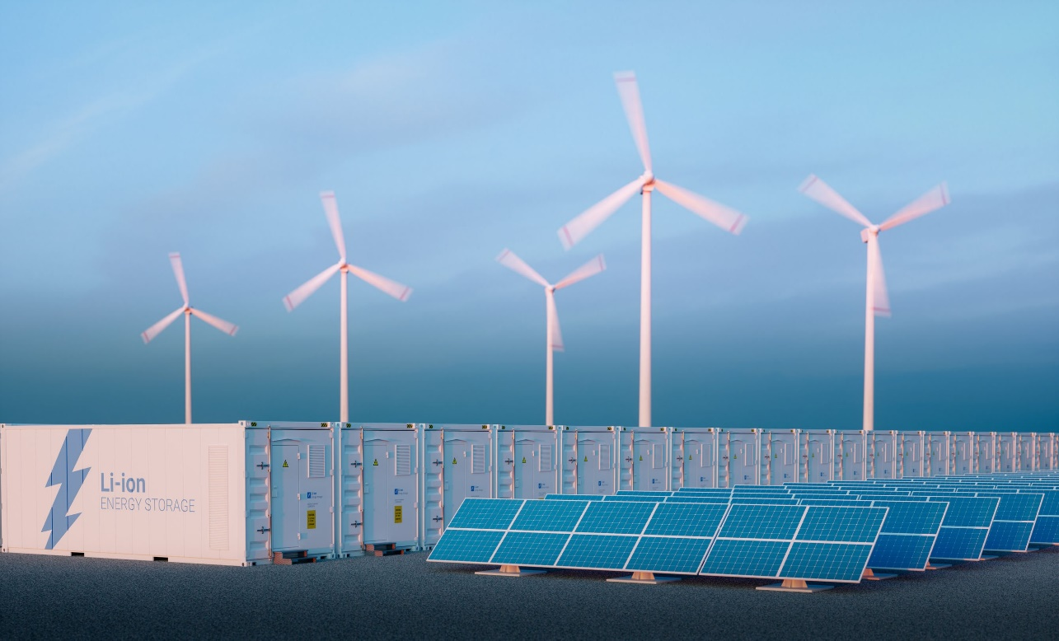
Climate Pollution Reduction Grant (CPRG)
CPRG grant program administered by the EPA Air Office
CPRG has two elements
  Climate Action Planning ($250 million)
  CPRG Project Implementation ($4.6 billion)
DEQ (Air Division) designated agency lead

Slide 34
CRPG’s Two Elements
Climate Action Planning
  $3 million non-competitive award to each state that submitted Climate Action Workplan by March 1 deadline
    Large MSAs also eligible for $1 million climate planning grants
  Funding to be used to develop and implement a Comprehensive Climate Action Plan (CCAP) by late summer 2025
    A Preliminary Climate Action Plan (PCAP) due by March 1, 2024
CPRG Project Implementation Grants totaling $4.6 billion will be awarded by EPA on a competitive basis
  EPA guidance this September
  Eligible projects must be included in state or SMA PCAP
  Application due on or about April 1, 2024

Slide 35

Upcoming Tanks Program Brown Bag Webinars
Webinar Topic | Date
Tank Owner Online Registration Tools | Sept 27th
Geophysical Site Characterization Tools | Oct 19th
Most Common Errors on AAFs and Claims | Nov 15th
The ABCs of Overfill Prevention Testing | Dec 13th
Carbon Filtration on Petroleum Contaminated Sites | Jan 17th
Private Insurance and the VPSTF | Mar 20th
Musts for USTs (translated by EPA)
Procedimientos de Cumplimiento de los Tanques Subterráneos de Almacenaje
UST के लिए अनिवार्य
35
Notes:
AAF = Activity Authorization Form
"Musts for USTs" summarizes federal UST requirements for installation, reporting, spill and overfill prevention, corrosion protection, release detection, walkthrough inspections, compatibility, operator training, repairs, financial responsibility, release response, and closure, an in-depth summary of the regulatory requirements for Underground Storage Tanks.

Slide 36
Want to Lean More
About Clean Air Regulation?
Announcing Air Permitting Workshop & More!
Co-Sponsored by DEQ and VMA
Coming in 2024, Stay Tuned!
Topical input is welcome via email: ewilliamson@williamsmullen.com

Slide 37
Questions?
Meghann Quinn
Meghann.Quinn@deq.virginia.gov
804-698-4021
Manager, Office of Pollution Prevention

