Slide 2
Virginia Department of Environmental Quality
Office of Environmental Justice
Virginia Environmental Excellence Program (VEEP)
Workshop
Kate D. Miller
Regional Environmental Justice Coordinator - Valley, Southwest & Blue Ridge
October 24, 2023
Notes:
TY for the intro.
My name is KD, I’m DEQ’s EJ Coordinator for the Valley, Southwest & Blue Ridge regions.
Want to thank you all for letting the OEJ have a few minutes this morning to go over DEQ’s EJ program.

Slide 3
Presentation Overview:
Virginia EJScreen+ Tool
Draft EJ Permitting Guidance
Grants Webinar
Citizen Water Quality Monitoring and Air Quality Monitoring Programs

Slide 4
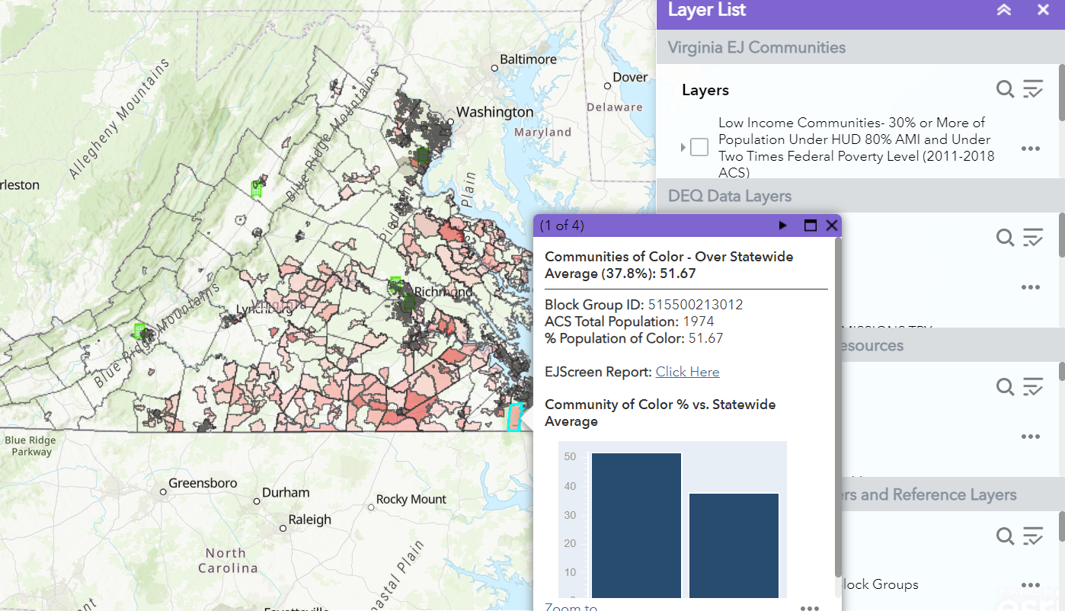
Virginia EJScreen+
Virginia EJScreen+ Mapping Tool
Developed to increase access to and enhance awareness of Environmental Justice-related data and information throughout the Commonwealth.
Two major EJ Indicators.
Notes:
This is an image of the Virginia EJScreen+ Tool developed by DEQ, with the purpose of:
increasing access to and enhancing awareness of
EJ-related data and info throughout the Commonwealth.
-mapped census blocks
-different layers
-data
At this point I do want to emphasize that DEQ’s Virginia EJScreen+ Tool is just that – it is only a screening tool designed to help identify Environmental Justice Communities in the Commonwealth.
It is not an absolute.
The Virginia EJScreen Tool focus on two major indicators, which will go over in the next few slides…

Slide 5
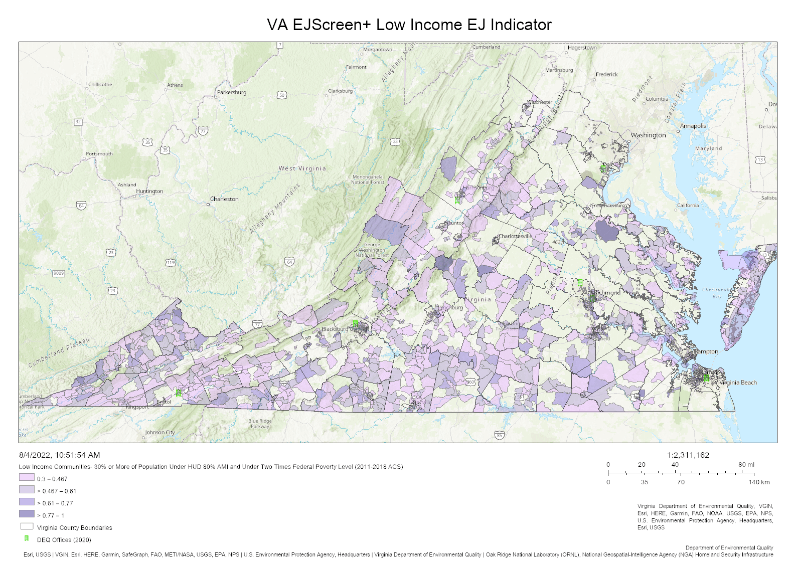
Low Income Communities
30% or more of the population in a census block group are:
under HUD 80% AMI
…and…
under 2x federal poverty level
Notes:
HUD → U.S. Dept. of Housing & Urban Development
AMI → Area Median Income

Slide 6
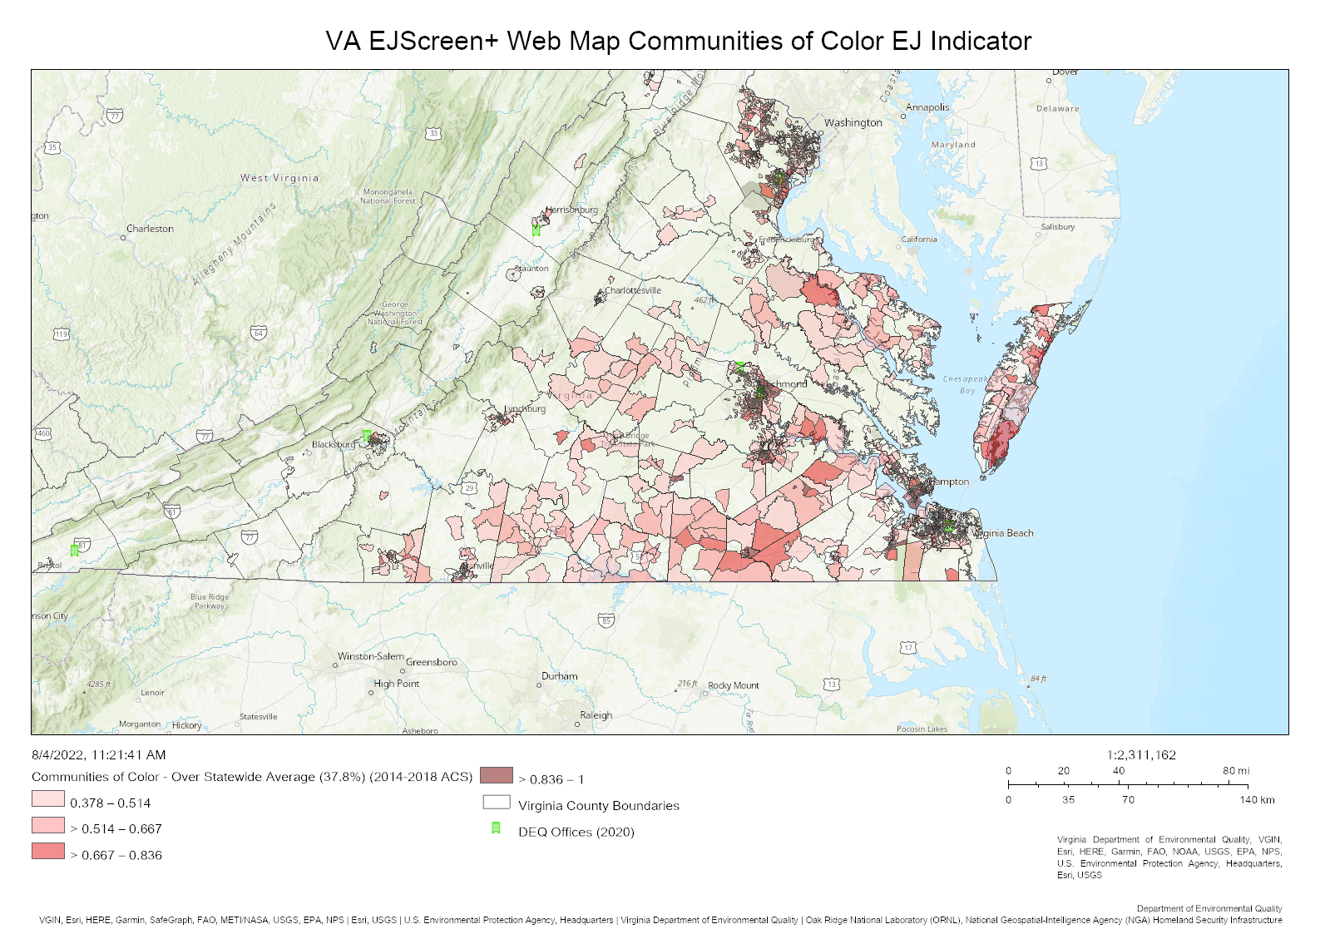
Communities of Color
Population made up of individuals who identify as belonging to 1+ of the following groups:
Black, African American, Asian, Pacific Islander, Native American, other non-white race, mixed race, Hispanic, Latino;
or linguistically isolated;
over the statewide average of 37.8%

Slide 7
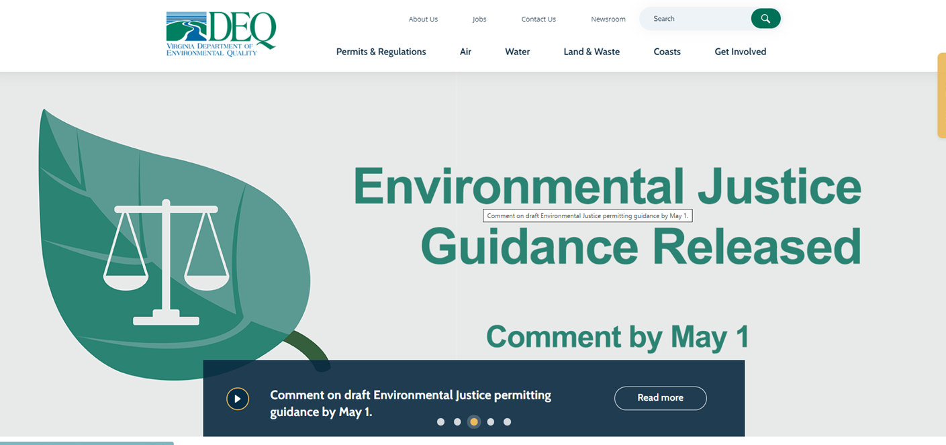
Environmental Justice Draft Guidance: Overview
Creates procedures to ensure fair treatment and meaningful involvement throughout DEQ’s permitting processes
Informal public comments collected until May 1, 2023
Environmental Justice in the Permitting Process – Link to Draft Guidance
Notes:
The draft guidance creates procedures to ensure fair treatment and meaningful involvement throughout DEQ’s permitting processes.
It outlines a permit evaluation process for permitting actions at DEQ, as well as establishes processes for further evaluation of permits of particular concern to EJ Communities.
The informal public comment period for this draft Environmental Justice Permitting Guidance was open from mid-March until May 1st, 2023.
DEQ has reviewed and all comments and submitted a revised guidance document to the Governor’s Office.
Once the Governor’s Office approves the revisions, DEQ will make the revised guidance document available to the public and open a formal Public Comment period.

Slide 8
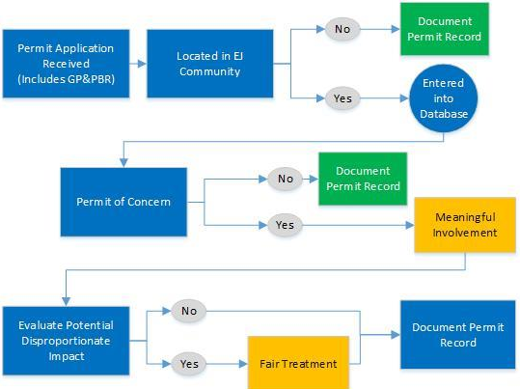
Environmental Justice Draft Guidance
Permit Evaluation Process – Flow chart
Notes:
The guidance outlines the following procedures to ensure permits located within EJ Communities:
Do not cause a disproportionate share of any negative environmental consequences.
Provide affected community residents with access and opportunities to participate in the full cycle of the decision-making process for a proposed permit that will affect their environment or health.
Inform decision makers on seeking out and pursuing public participation, allowing the views and perspectives of community residents to shape and influence the decision.
The flowchart on this slide provides a visualization of how that process is outlined. We’ll walk through these steps over the next few slide.
Step 1: Once a permit application is received, VA EJScreen+ EJ layers will be used to evaluate whether or not permits are located within an environmental justice community. If yes, this is entered into DEQ’s database.
Step 2: Evaluate whether or not permit is a “permit of concern” → we’ll take a look at what qualifies as a “permit of concern” later in the presentation.
Step 3: If permit is considered a “permit of concern,” the Office of Environmental Justice shall conduct additional meaningful involvement outreach such as informational meetings, tours/site visits, facilitate ongoing communication, etc.
Step 4: Evaluate disproportionate impact by media/type (air, water, land).
Step 5: If the permit is determined to have a disproportionate impact, DEQ will actively engage permit applicants to voluntarily take additional measures to minimize or mitigate any potential disproportionate share of impacts from the proposed permit action to the fullest extent possible.

Slide 9
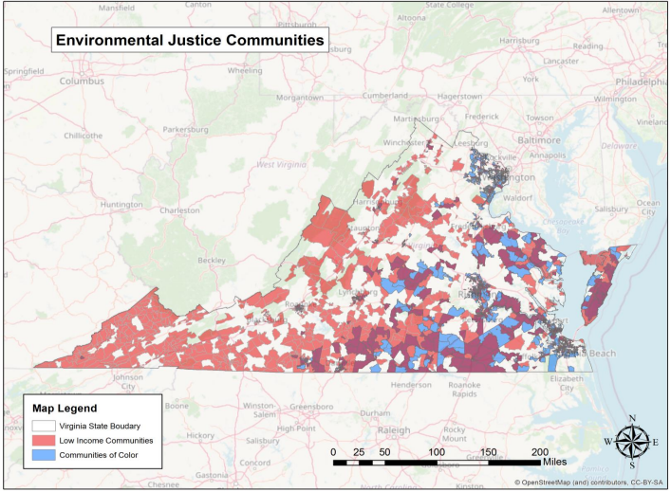
Environmental Justice Draft Guidance: Map
Notes:
So, Step 1:
Once a permit application is received, VA EJScreen+ EJ layers will be used to evaluate whether or not permits are located within an environmental justice community. If yes, this is entered into DEQ’s database.
Here’s where DEQ’s Virginia EJScreen+ Tool comes into play…
-Permits would be evaluated on whether or not they are in an EJ community.
-This is a map of EJ communities in the Commonwealth as defined by the Virginia EJ Act, generated by the Virginia EJScreen+ Tool. The communities are shown by census block.
-This map shows both Low Income Communities and Communities of Color. While some census blocks may meet the threshold for both of these community definitions, keep in mind that a census block only needs to meet one of these two thresholds to be considered an EJ Community.
Step 1: Once a permit application is received, VA EJScreen+ EJ layers will be used to evaluate whether or not permits are located within an environmental justice community. If yes, this is entered into DEQ’s database.
Step 2: Evaluate whether or not permit is a “permit of concern” → we’ll take a look at what qualifies as a “permit of concern” later in the presentation.

Slide 10
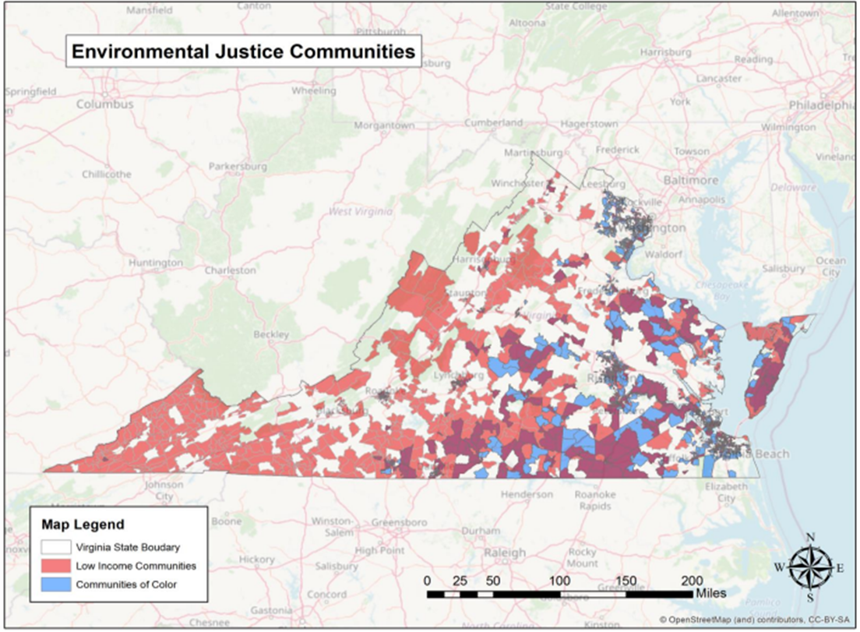
Environmental Justice Draft Guidance: EJ Communities
Low Income Communities
Census block groups in which 30% or more of the population is composed of people having an annual household income equal to or less than the greater of:
An amount equal to 80% of the median income of the area in which the household is located (as reported by the U.S. Department of Housing & Urban Development), and
200% of the Federal Poverty Level (2011-2018 ACS)
Notes:
We saw this earlier – but, again, here is the threshold for Low Income Communities to quality as EJ Communities…

Slide 11

Environmental Justice Draft Guidance: EJ Communities
Communities of Color
Any geographically distinct area where the population of color, expressed as a percentage of the total population of such area, is higher than the population of color in the Commonwealth expressed as a percentage of the total population of the Commonwealth (37.8%; 2014-2018 American Community Survey [ACS]).
Notes:
…and here is the threshold for Communities of Color to be considered EJ Communities.

Slide 12
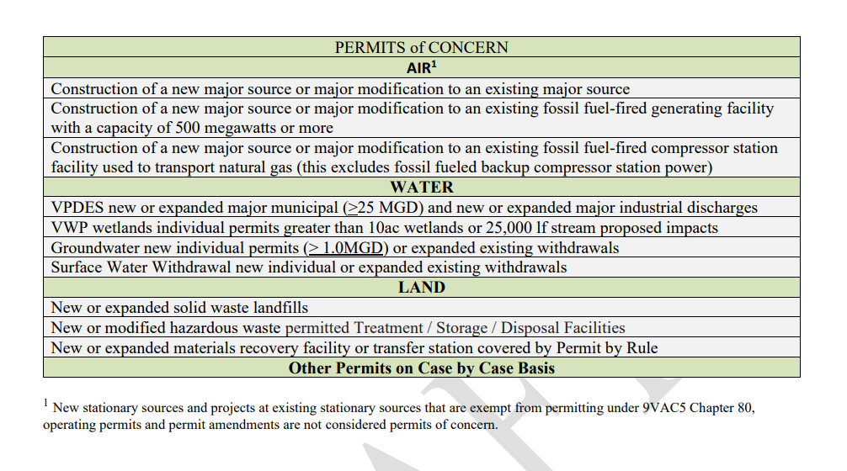
Environmental Justice Draft Guidance
Permits of Concern
Notes:
Here’s where we pick up on “permits of concern,” which is the next step in the Permit Evaluation Process flow chart.
If a permit is proposed in an EJ Community, then:
Step 2: Evaluate whether or not permit is a “permit of concern”
This table summarized DEQ’s parameters for “permits of concern,” and is based on agency experience working with applicants, Citizen Boards and stakeholders.
It should be noted that none of the procedures in this guidance supersede or change existing law or regulatory requirements regarding issuance or denial of permits.

Slide 13
Environmental Justice Draft Guidance
Permit Evaluation Process – Flow chart
Notes:
Back to the Permit Evaluation Process Flow Chart,
If a Permit of Concern is located in an EJ Community, then:
Step 3: If permit is a “permit of concern,” the Office of Environmental Justice shall conduct additional meaningful involvement outreach such as informational meetings, tours/site visits, facilitate ongoing communication, etc.
Step 4: Evaluate disproportionate impact by media/type
Air permits of concern: cumulative air modeling of New Source Review pollutant is equal or exceeds 90% of the NAAQS within EJ community, maximum air quality impact resulting from the new stationary source or project is equal to or exceeds impact threshold for the pollutant, and the difference between the cumulative air modeled maximum impact in the EJ community and the cumulative air modeled maximum impact in the closest non-EJ community is equal to or exceeds impact thresholds.
-Looking at thresholds for nitrogen dioxide, carbon monoxide, sulfur dioxide, PM-2.5, PM-10, ozone
-Thresholds for Air Pollution Control = Table 1 in the draft Guidance Memo
Water permits of concern: whether or not location of impact census block group intersects within a watershed with 5 or more impairments.
Land permits of concern: whether or not the proposed land permit action is within a 5-mile radius of an existing permitted municipal solid waste or coal combustion residuals landfill.
Step 5: If the permit is determined to have a disproportionate impact, DEQ will actively engage permit applicants to voluntarily take additional measures to minimize or mitigate any potential disproportionate share of impacts from the proposed permit action to the fullest extent possible such as engaging the permit applicant to:
evaluate additional treatment and operational actions to reduce pollutants or impacts beyond regulatory requirements.
consider engaging the community to identify potential community projects or initiatives for reduction of any negative environmental consequences that could result from the proposed permit action, or other community projects.
DEQ will evaluate:
the need for any additional ambient air, receiving stream or other, environmental monitoring to further evaluate potential impacts.
the appropriateness of enhanced compliance scrutiny under the Risk Based Inspection Strategy (http://www.deq.virginia.gov/RiskBasedAssessment) for the proposed facility and surrounding permitted facilities as appropriate.

Slide 14
Grants, Water Quality Monitoring, Air Quality Monitoring
Grant webinar – March 2023
Nominate water bodies for monitoring – March/April 2023
Citizen Water Quality Monitoring
Air Quality Monitoring – Tidewater Air Monitoring Evaluation Project
Notes:
On March 1, we held a stakeholder engagement call to share available funding opportunities at DEQ, EPA’s environmental justice funding opportunities, and an overview of how to apply for federal funding. More than 130 stakeholders were in attendance from across the state, ranging from grassroots community leaders, local and federal government officials, and industry representatives.
In late March/early April, we shared information with EJ Communities, Tribal leaders and community leaders about the opportunity to nominate a water body for water quality monitoring by DEQ agency staff.
Upcoming: Citizen Water Quality Monitoring Grant Program – looking to engage more EJ communities on that opportunity in the future
Regarding Air quality monitoring, we have a project called the Tidewater Air Monitoring Evaluation (TAME) project which is a federally funded project that will utilize air quality monitors and sensors to measure and analyze toxic metals and particulates in the air in two study areas:
-Lambert's Point area in Norfolk, and
-the Southeast area in Newport News.
Information collected will be used to conduct area health risk assessments. Community members have also volunteered to host purple air sensors in their home to measure PM2.5

Slide 15
Thank you!
Any questions?

