Slide 1
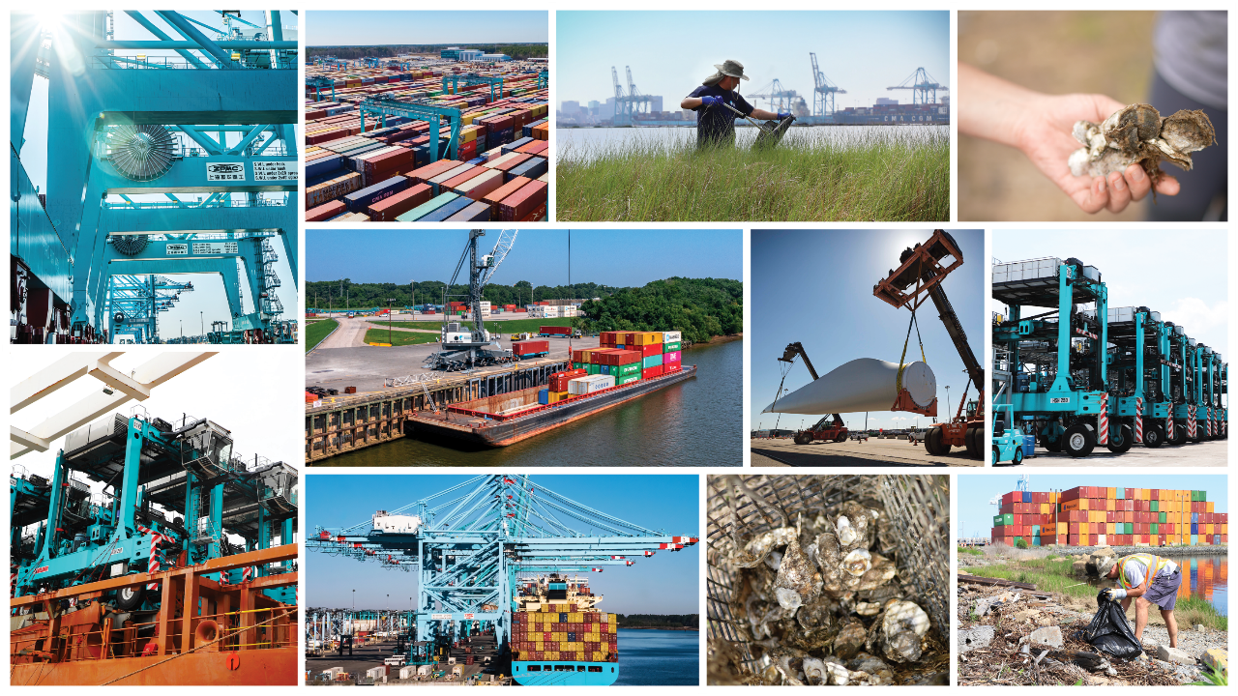

Getting the Port to Net-Zero by 2040
Billy Goodson,
Environmental Manager
October 24, 2023
Notes:
Sustainability Cover Slide
Please reach out to salesenablement@vit.org if you need a specific theme focused cover page that is not in Templafy)
Do’s
Change Title
Add Name
Add Job Title
Drop in Presentation Date
Don’t’s
Do not resize logo
Do not change the color of rectangles
Do not resize background image
Do not change the color of the text
Do not change the color of the text
Do not add any other text box elements

Slide 2
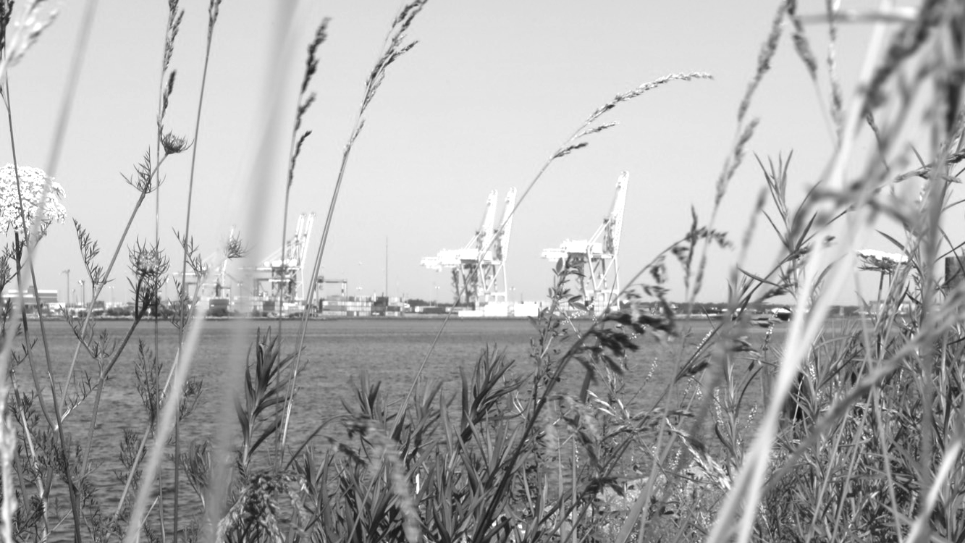
• Truck Reservation System implementation
• Hybrid shuttle truck commitment
• NIT North Gate complete
• Mandatory Truck Reservations expands
• PMT volume migration
• VIG Expansion complete
• PMT closes
2017
70,247
MTCO2e
Emissions
2018
73,613
• NIT Optimization complete
• Port commits to decarbonization goals
2019
68,590
2020
59,531
2021
58,478
2024
65% absolute emission reduction from 2017 and powered by 100% renewable energy
The Port of Virginia will operate with net-zero carbon emissions by 2040
2040
Net-zero
*Net-zero for scope 1 and 2 emissions
Notes:
Net Zero by 2040
Updated as of 06/26/2022
Please reach out to marketing@portofvirginia.com if you need anything adjusted, or a new slide to be designed/branded.
Do’s
Change Title to better fit your message
Don’t’s
Do not adjust the Title position
Do not change the color of the text
Do not add any additional images
Do not change the text

Slide 3

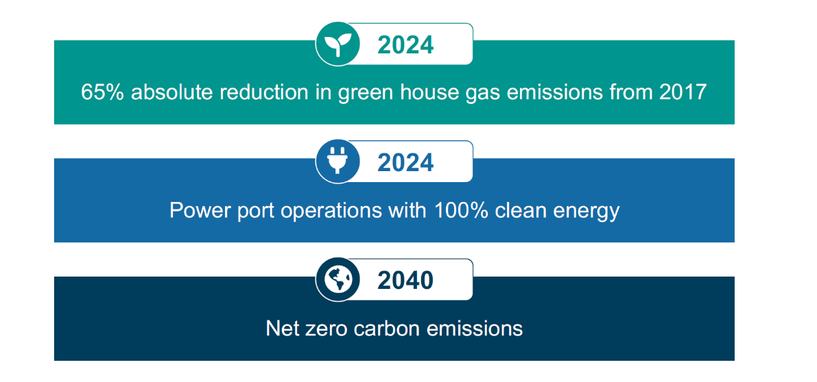
Decarbonization Commitments
2024
65% absolute reduction in green house gas emissions from 2017
2024
Power port operations with 100% clean energy
2040
Net-zero carbon emissions
Notes:
Decarbonization Commitments – POV
Updated as of 06/26/2022
Please reach out to marketing@portofvirginia.com if you need anything adjusted, or a new slide to be designed/branded.
Do’s
Change Title to better fit your message
Don’t’s
Do not adjust the Title position
Do not change the color of the text
Do not add any additional images
Do not change the text

Slide 4

For The Port of Virginia
Scope 1
Scope 2
Scope 3
Direct emissions from port owned or operated assets (tailpipe emissions
Indirect emissions that occur in the value chain of the company, both upstream & downstream
Direct emissions from port owned or operated assets (tailpipe emissions)
Indirect emissions that occur in the value chain of the company, both upstream & downstream
Indirect emissions from the generation of purchased energy from a utility provider (emissions from electricity purchased from power grid)
  Trucks
  Rail
  Marine vessels
  Tenant and stevedore equipment
  Water/Sewage treatment
  Employee commuting
  Business Travel
  Purchased goods
  Buildings
  Shuttle and straddle carriers
  Yard tractors
  Forklifts
  Fleet vehicles
  Sequestration Projects
Notes:
Chart to Compare Info
Updated as of 08/23/2022
Please reach out to salesenablement@vit.org if you need anything adjusted, or a new slide to be designed/branded.
Do’s
Change Title to better fit your message
Change the icons (icon ppt in Templafy)
Change the outline color of the boxes to one of our brand colors.
Change the text: Header, and info here
Don’t’s
Do not adjust the Title position

Slide 5
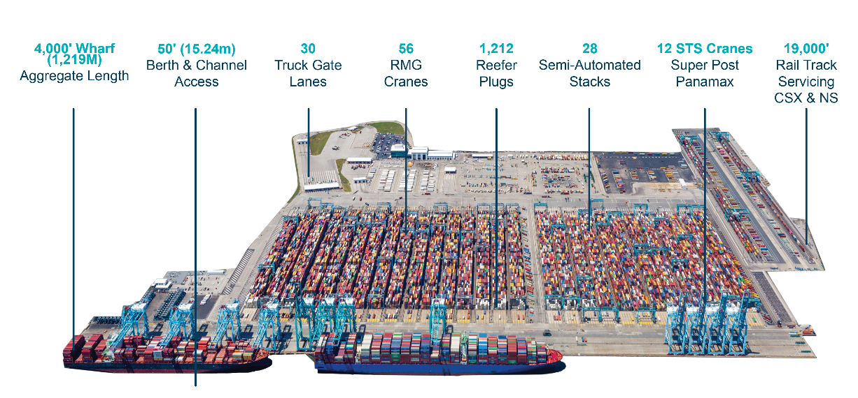
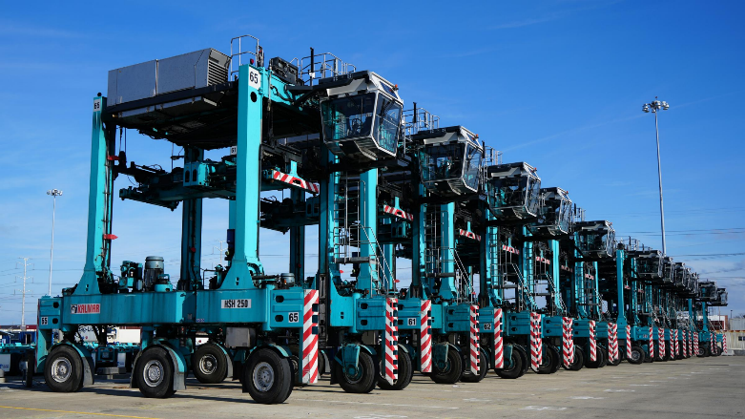
Electrification of Container Yard
The port started replacing diesel straddle carriers with hybrid shuttle carriers in 2015
We currently have 100 hybrid shuttle carriers in operation
Hybrid shuttle carriers provide a 90% reduction in NOX and a 50% reduction in diesel
Notes:
Presentation Slide
Please reach out to salesenablement@vit.org if you need anything adjusted, or a new slide to be designed/branded.
Do’s
Change Title
Add in your own bullet points
Add an image to the slide if you like ( Approved and quality images in the Frontify tab)
Don’t’s
Do not change the Title text size
Do not adjust the Title position
Do not overlap images or text on top of the rectangle template
Do not change the color of the text

Slide 6
Hybrid Shuttle Carriers
The port started replacing diesel straddle carriers with hybrid shuttle carriers in 2015
We currently have 100 hybrid shuttle carriers in operation
Hybrid shuttle carriers provide a 90% reduction in NOX and a 50% reduction in diesel
Notes:
Presentation Slide
Please reach out to salesenablement@vit.org if you need anything adjusted, or a new slide to be designed/branded.
Do’s
Change Title
Add in your own bullet points
Add an image to the slide if you like ( Approved and quality images in the Frontify tab)
Don’t’s
Do not change the Title text size
Do not adjust the Title position
Do not overlap images or text on top of the rectangle template
Do not change the color of the text

Slide 7
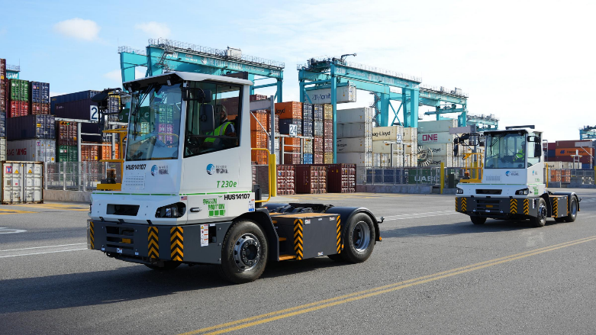
Electric Yard Hustlers
The port received four new Mafi T30e electric yard hustlers in December 2022 which are currently in operation at NIT
Each unit is currently in operation for 12 hours/day
Notes:
Presentation Slide
Please reach out to salesenablement@vit.org if you need anything adjusted, or a new slide to be designed/branded.
Do’s
Change Title
Add in your own bullet points
Add an image to the slide if you like ( Approved and quality images in the Frontify tab)
Don’t’s
Do not change the Title text size
Do not adjust the Title position
Do not overlap images or text on top of the rectangle template
Do not change the color of the text

Slide 8
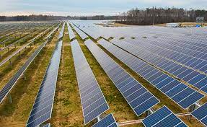
Power Purchase Agreements
Currently operating on 69% clean power
Power Purchase Agreement with Dominion Energy to supplement their renewable portfolio standard projects with 5 dedicated solar projects across the Commonwealth
100% Renewable Energy Rider for the Virginia Inland Port (VIP) through Rappahannock Electric Cooperative powered by Virginia based solar facilities owned by Old Dominion Electric Cooperative.
Notes:
Presentation Slide
Please reach out to salesenablement@vit.org if you need anything adjusted, or a new slide to be designed/branded.
Do’s
Change Title
Add in your own bullet points
Add an image to the slide if you like ( Approved and quality images in the Frontify tab)
Don’t’s
Do not change the Title text size
Do not adjust the Title position
Do not overlap images or text on top of the rectangle template
Do not change the color of the text

Slide 9
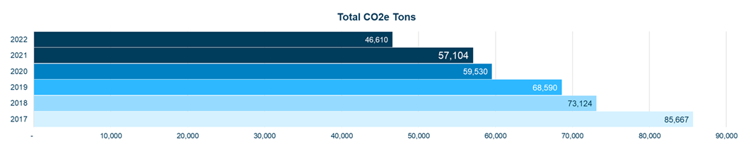
POV Total CO2e Emissions
58% reduction of scope 1 & 2 emissions since 2017
Notes:
Presentation Slide
Please reach out to salesenablement@vit.org if you need anything adjusted, or a new slide to be designed/branded.
Do’s
Change Title
Add in your own bullet points
Add an image to the slide if you like ( Approved and quality images in the Frontify tab)
Don’t’s
Do not change the Title text size
Do not adjust the Title position
Do not overlap images or text on top of the rectangle template
Do not change the color of the text

Slide 10
Truck Reservation System & Green Operator Program
Improved turn times from our truck reservation system have reduced over 160,000 truck idling hours on our terminals
Our longstanding Green Operator Program has reduced emissions by incenting the replacement of over 400 older model diesel trucks in 2022.
Updating the program to include new Zero-Emission engines this fall.
Notes:
Dray study/scope 3 – We used RSTP? funding to provide an Electric Dray Truck Study that informs future and current viability for alternatively fueled dray trucks. The study included an evaluation of what it would take scope 3 partner sites to provide the infrastructure required to operate a zero or reduced emissions fleet of dray trucks.

Slide 11
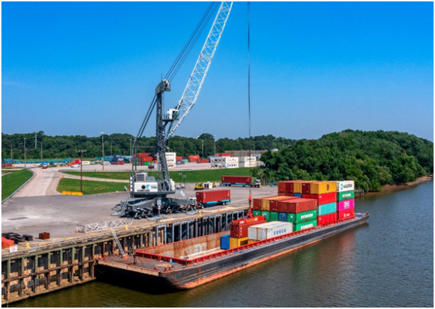
Barge Service to Richmond Marine Terminal
Since 2017, the port has increased container moves by barge by 67%.
Each barge trip saves more than 10,000 truck miles on Virginia’s highways.
Using barges results in 35% less oxides of nitrogen and 60% less CO2 emissions as compared to moving freight by truck.
660,000 truck trips since we started this service.
Notes:
Presentation Slide
Please reach out to salesenablement@vit.org if you need anything adjusted, or a new slide to be designed/branded.
Do’s
Change Title
Add in your own bullet points
Add an image to the slide if you like ( Approved and quality images in the Frontify tab)
Don’t’s
Do not change the Title text size
Do not adjust the Title position
Do not overlap images or text on top of the rectangle template
Do not change the color of the text

Slide 12
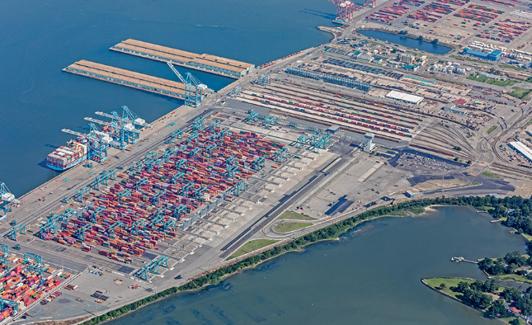
Living Shoreline
The Port of Virginia has completed the design of its NIT Living Shoreline Project
Construction to restore 3600 linear feet of native wetland grasses, oyster reefs, and native plantings will begin in 2023
Notes:
Presentation Slide
Please reach out to salesenablement@vit.org if you need anything adjusted, or a new slide to be designed/branded.
Do’s
Change Title
Add in your own bullet points
Add an image to the slide if you like ( Approved and quality images in the Frontify tab)
Don’t’s
Do not change the Title text size
Do not adjust the Title position
Do not overlap images or text on top of the rectangle template
Do not change the color of the text

Slide 13
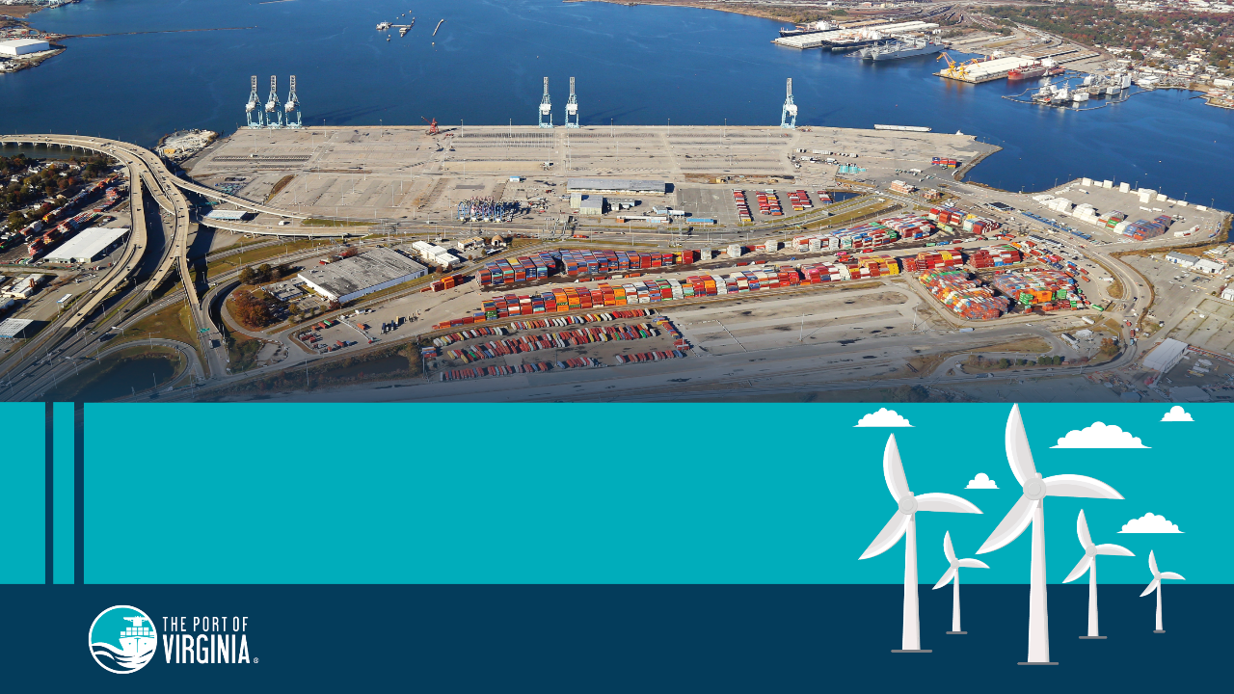
Portsmouth Marine Terminal
The Wind Energy Hub of the Future
Notes:
PMT The Wind Energy Hub of the Future
Updated as of 1/06/2023
Please reach out to marketing@portofvirginia.com if you need anything adjusted, or a new slide to be designed/branded.
Don’t’s
Do not add an image
Do not change the color of the text
Do not adjust the title

Slide 14


Alignment of Port Actions to Sustainability Goals
Climate Action
Increase use of clean energy
Facilitate offshore wind hub development
Reduce fossil fuel consumption
Expand use of alternative technology
Life Below Water
Build and monitor oyster reefs
Design & build a shoreline restoration project
Industry, Innovation, and Infrastructure
Create gate efficiencies
Expand use of alternative technology
Barge and rail service to inland ports
Beneficial reuse of dredged materials
Notes:
Port Committed to UN Sustainability Goals 9, 13, and 14

