Slide 1
Toray Plastics (America), Inc.
TPA-VA
PEF Division
Chris Thomlison
Safety and Environmental Manager

Slide 2
Corporate Data
Toray Corporation
Head Office
Tokyo
Established
1926
Toray Group
Number of Employees
48,682
Number of Countries/
Regions Toray Operation in
Revenue
18 billion USD
29
As of March 31, 2023

Slide 3
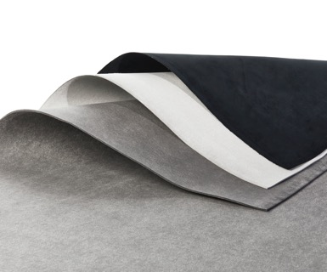
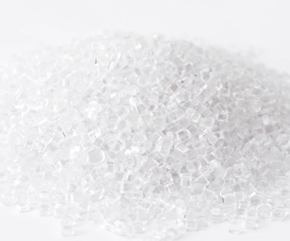
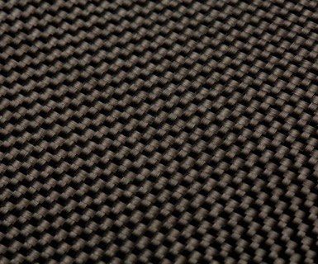


Business Segments
Fibers and
Textiles
Fibers/Textiles/Apparel
Performance
Chemicals
Resins/Chemicals/Films/
Electronics and Information Materials
Carbon Fiber
Composite Materials
Carbon Fiber Composite Materials
Environment and
Engineering
Water Treatment and Environment/
Housing and Engineering
Life Science
Pharmaceuticals,
medical devices, etc.

Slide 4
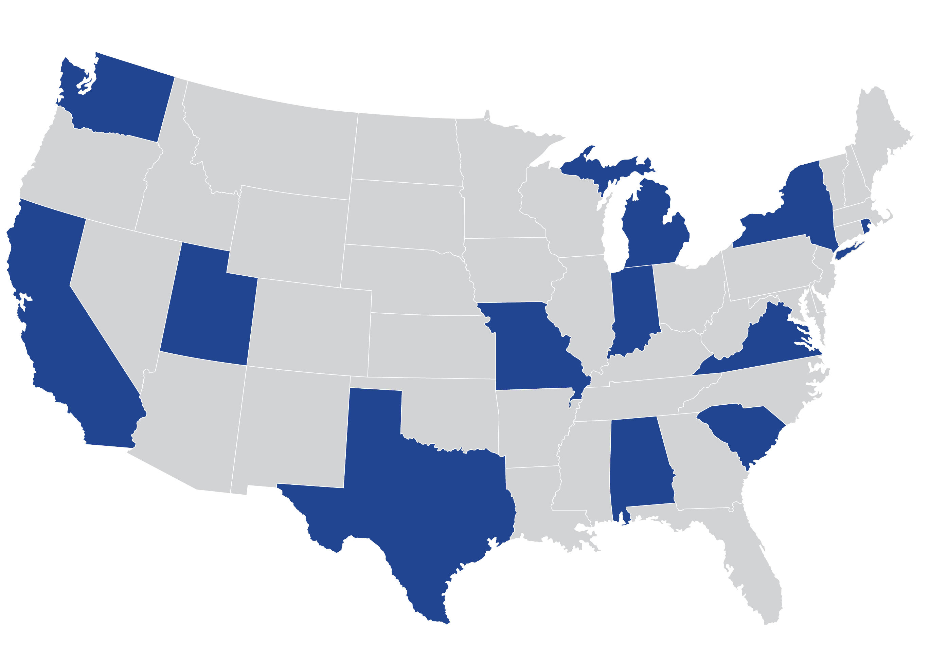
Toray US Locations
ENTEC
(UT)
Zoltek
(MO)
TREC
(IN)
CMA
(WA)
TIAM
(MI)
TAM
TIAM
(NY)
TIAM
(CA)
CMA
(CA)
TAC
(CA)
TPA
(VA & RI)
TMUS
(CA)
Performance Chemicals
Revenue in Excess of $2B
Over 3k Employees
CMA
(SC)
Fiber & Textiles (Toray Trading)
CMA
Zoltek
(TX)
15 facilities
Carbon Fiber & Composites
Environment & Engineering
CMA
TFA
(AL)
TIAM
(TX)
Notes:
Toray locations across the US of all business segments represents $1.88B in revenue, 7 companies with over 15 locations and 2,835 employees
TAM = Toray US HQ
TIAM = Toray International America – trading companies (Ultrasuede office – CA, Resins – MI, Carbon Fiber – TX, All – NY)
CMA = Toray Composite Materials America – high end carbon fiber manufacturer for aerospace applications
TAC = Formerly Tencate, high end carbon fiber for aerospace, automotive, space and consumer products
TMUS = Toray Membrane – water filtration, desalination, etc.
Zoltek = Carbon Fiber; all other markets other than aerospace – most of a affordable CF option
TFA = Toray Fluorofibers – knit, woven felts, fibers and fabrics; highly chemical resistant
TPA = Toray Plastics America (Films/Foams)
TREC = Toray Resin Company
ENTEC = Engineering Technology Corporation to support fiber manufacture (machinery manufacturer)

Slide 5
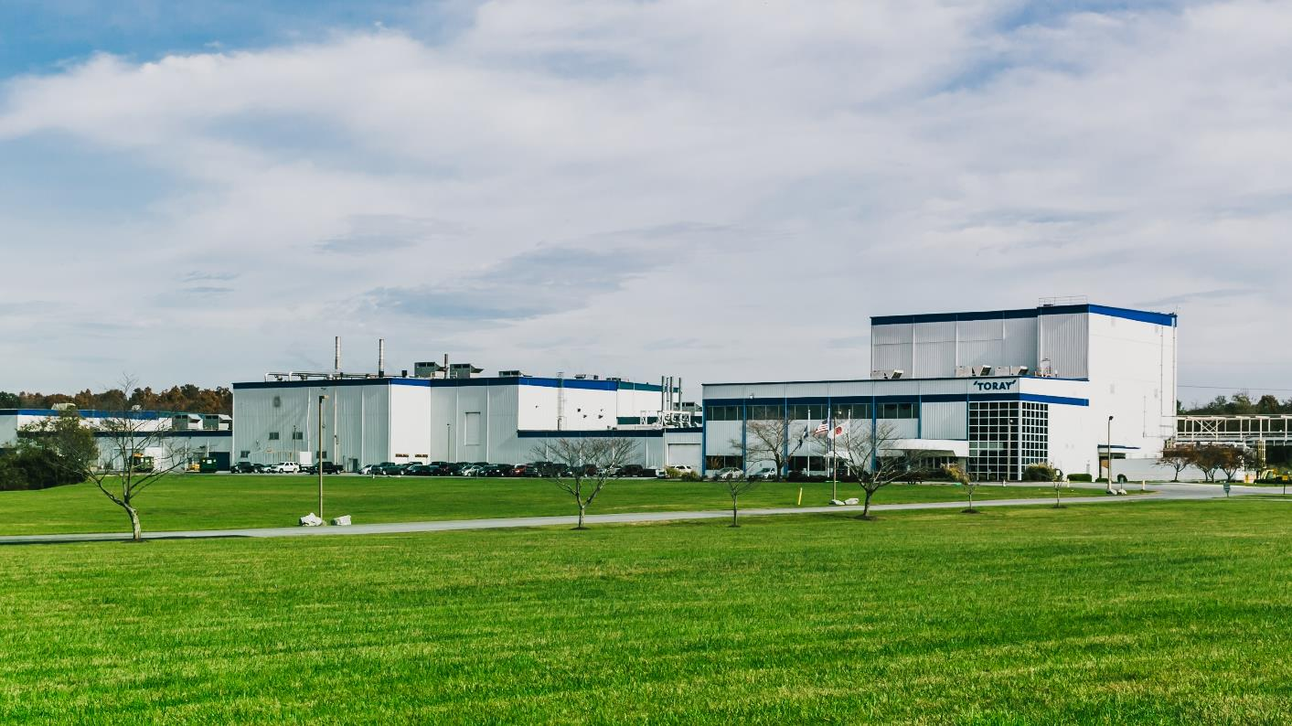
Toray Plastics (America), Inc.
135 Employees
PP & PE Foams
60% US market share
~ $100M Capital Invested
- $75 M Sales
Front Royal, Virginia
Established in 1996
Notes:
Foams facility in VA
Recent expansion in 2017

Slide 6

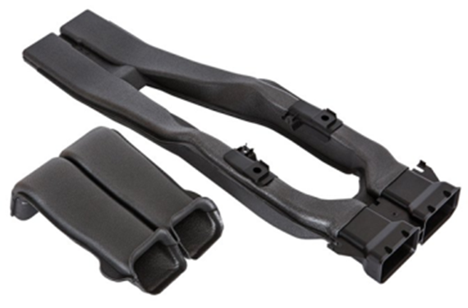
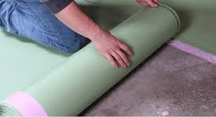
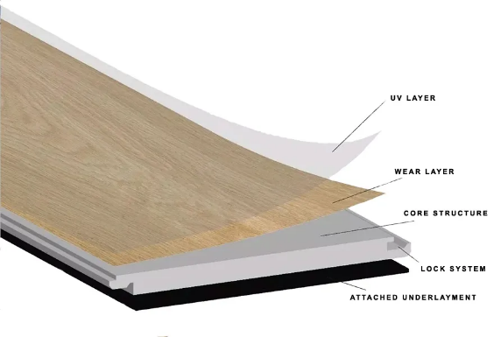
Common Applications
Interior Trim
Molded Components
Rollout Underlayment
Pre-attached Pad
Notes:
Diverse applications
Both industrial and food grade type applications
Thickness range of BOPP 45G – 300G
Capabilities of white and metallized
Food packaging is form fill seal or pre-made
Labels are decorative for containers

Slide 7
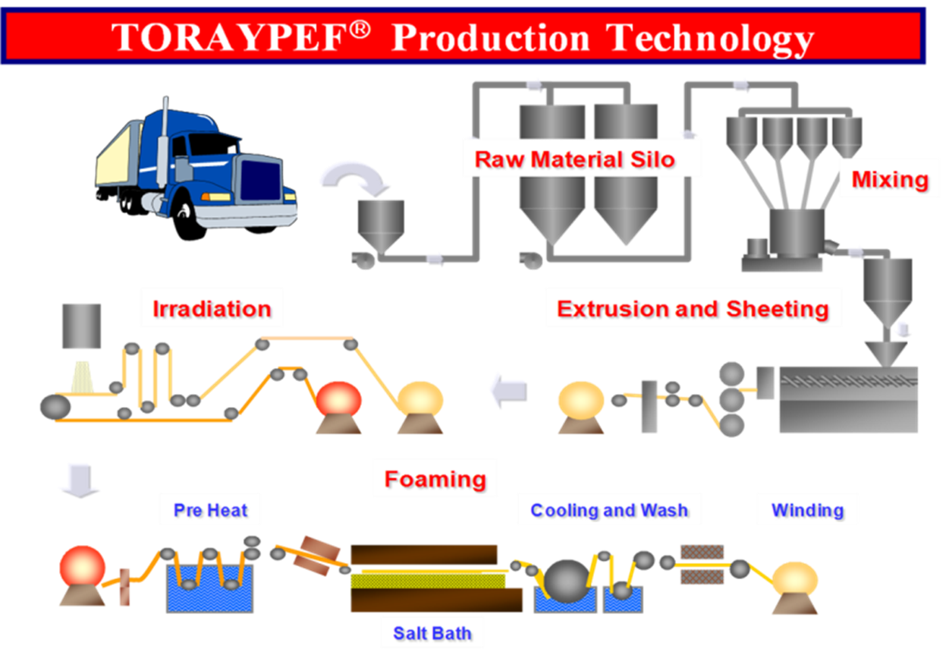
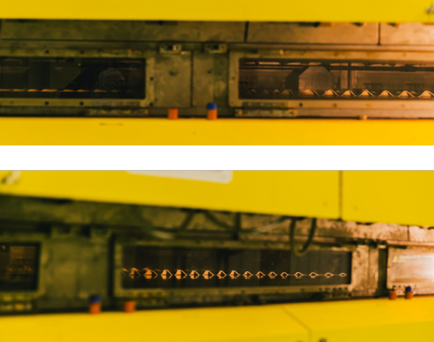
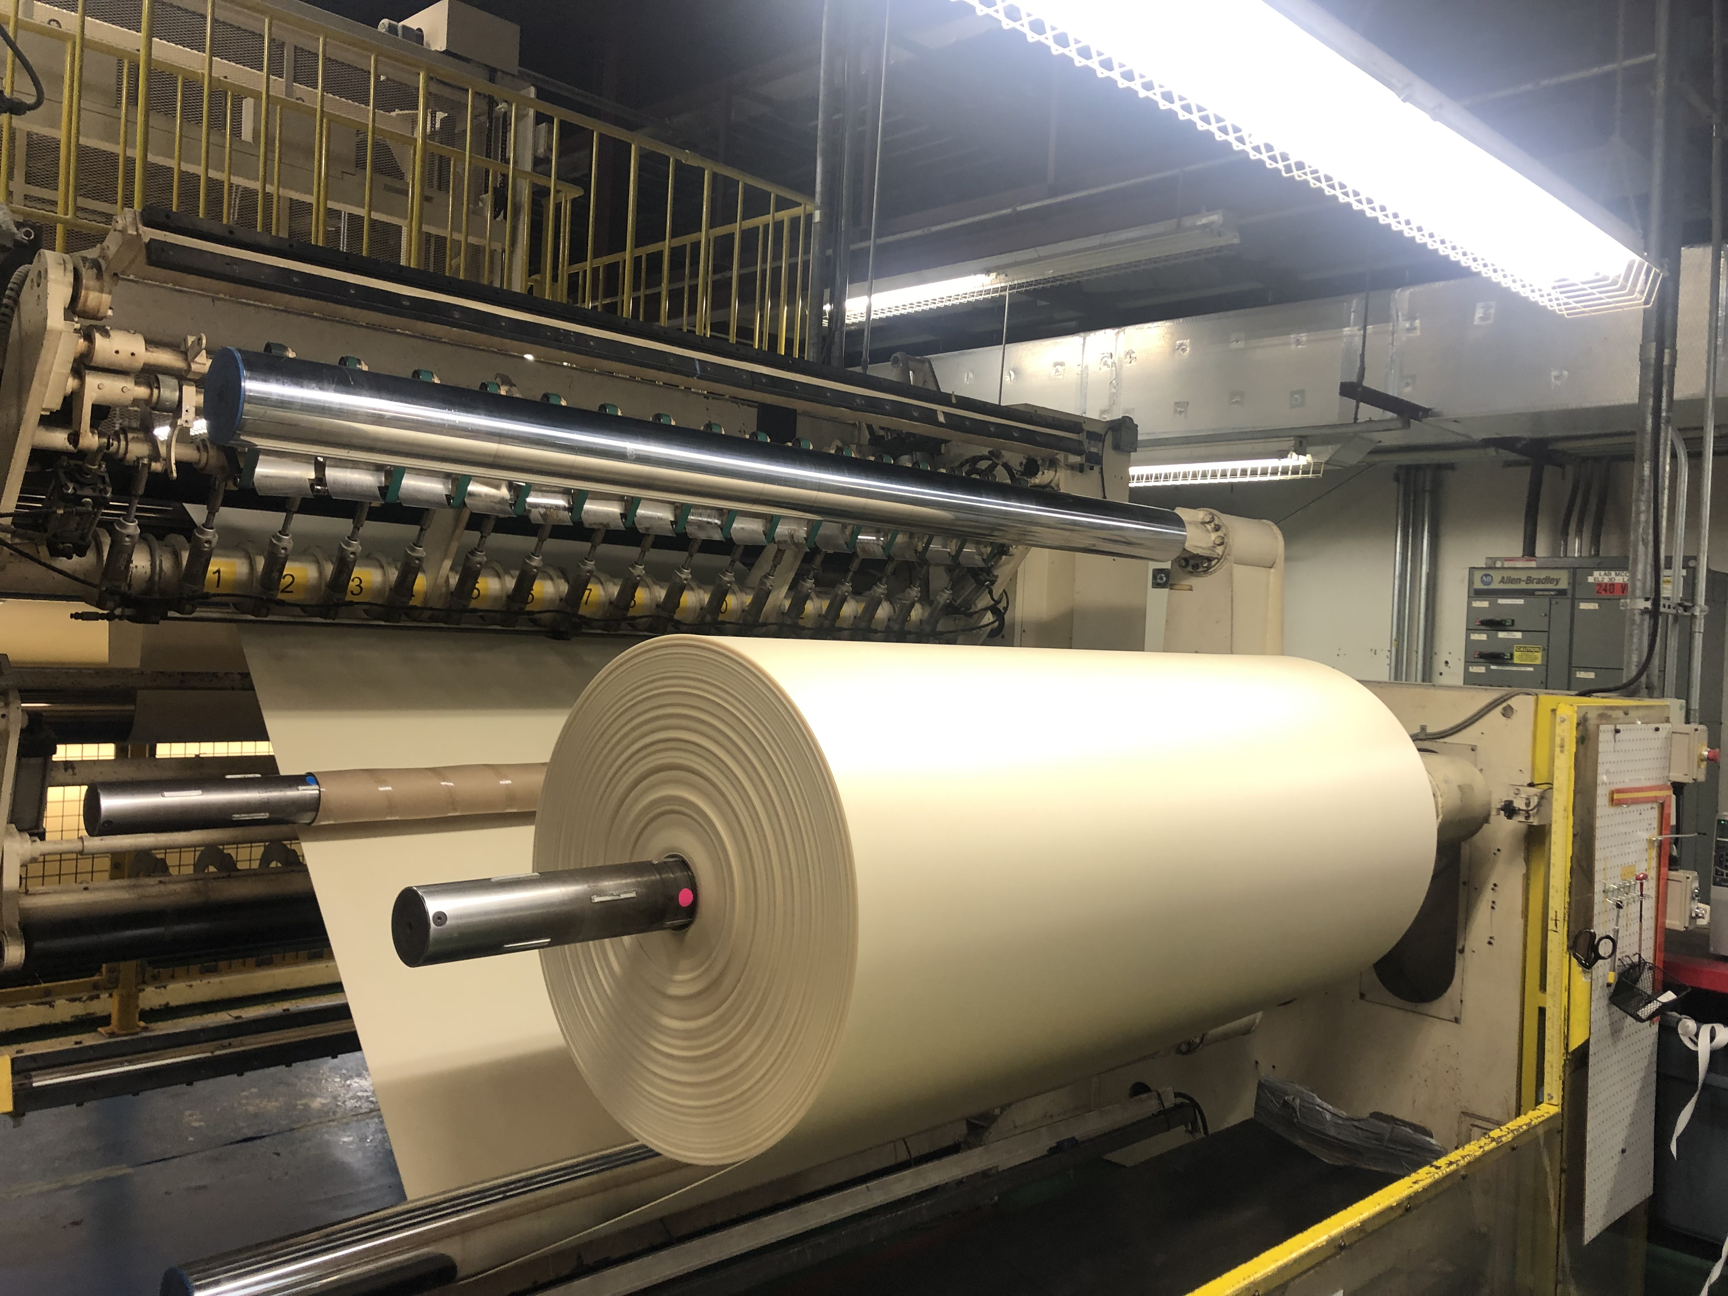
Proprietary salt-bath foaming process delivers:
Wide-web capability
High dimensional stability
Tight tolerance performance across web
Salt-side of foam has higher surface energy
Foam Expansion
Finished Product
Notes:
Diverse applications
Both industrial and food grade type applications
Thickness range of BOPP 45G – 300G
Capabilities of white and metallized
Food packaging is form fill seal or pre-made
Labels are decorative for containers

Slide 8
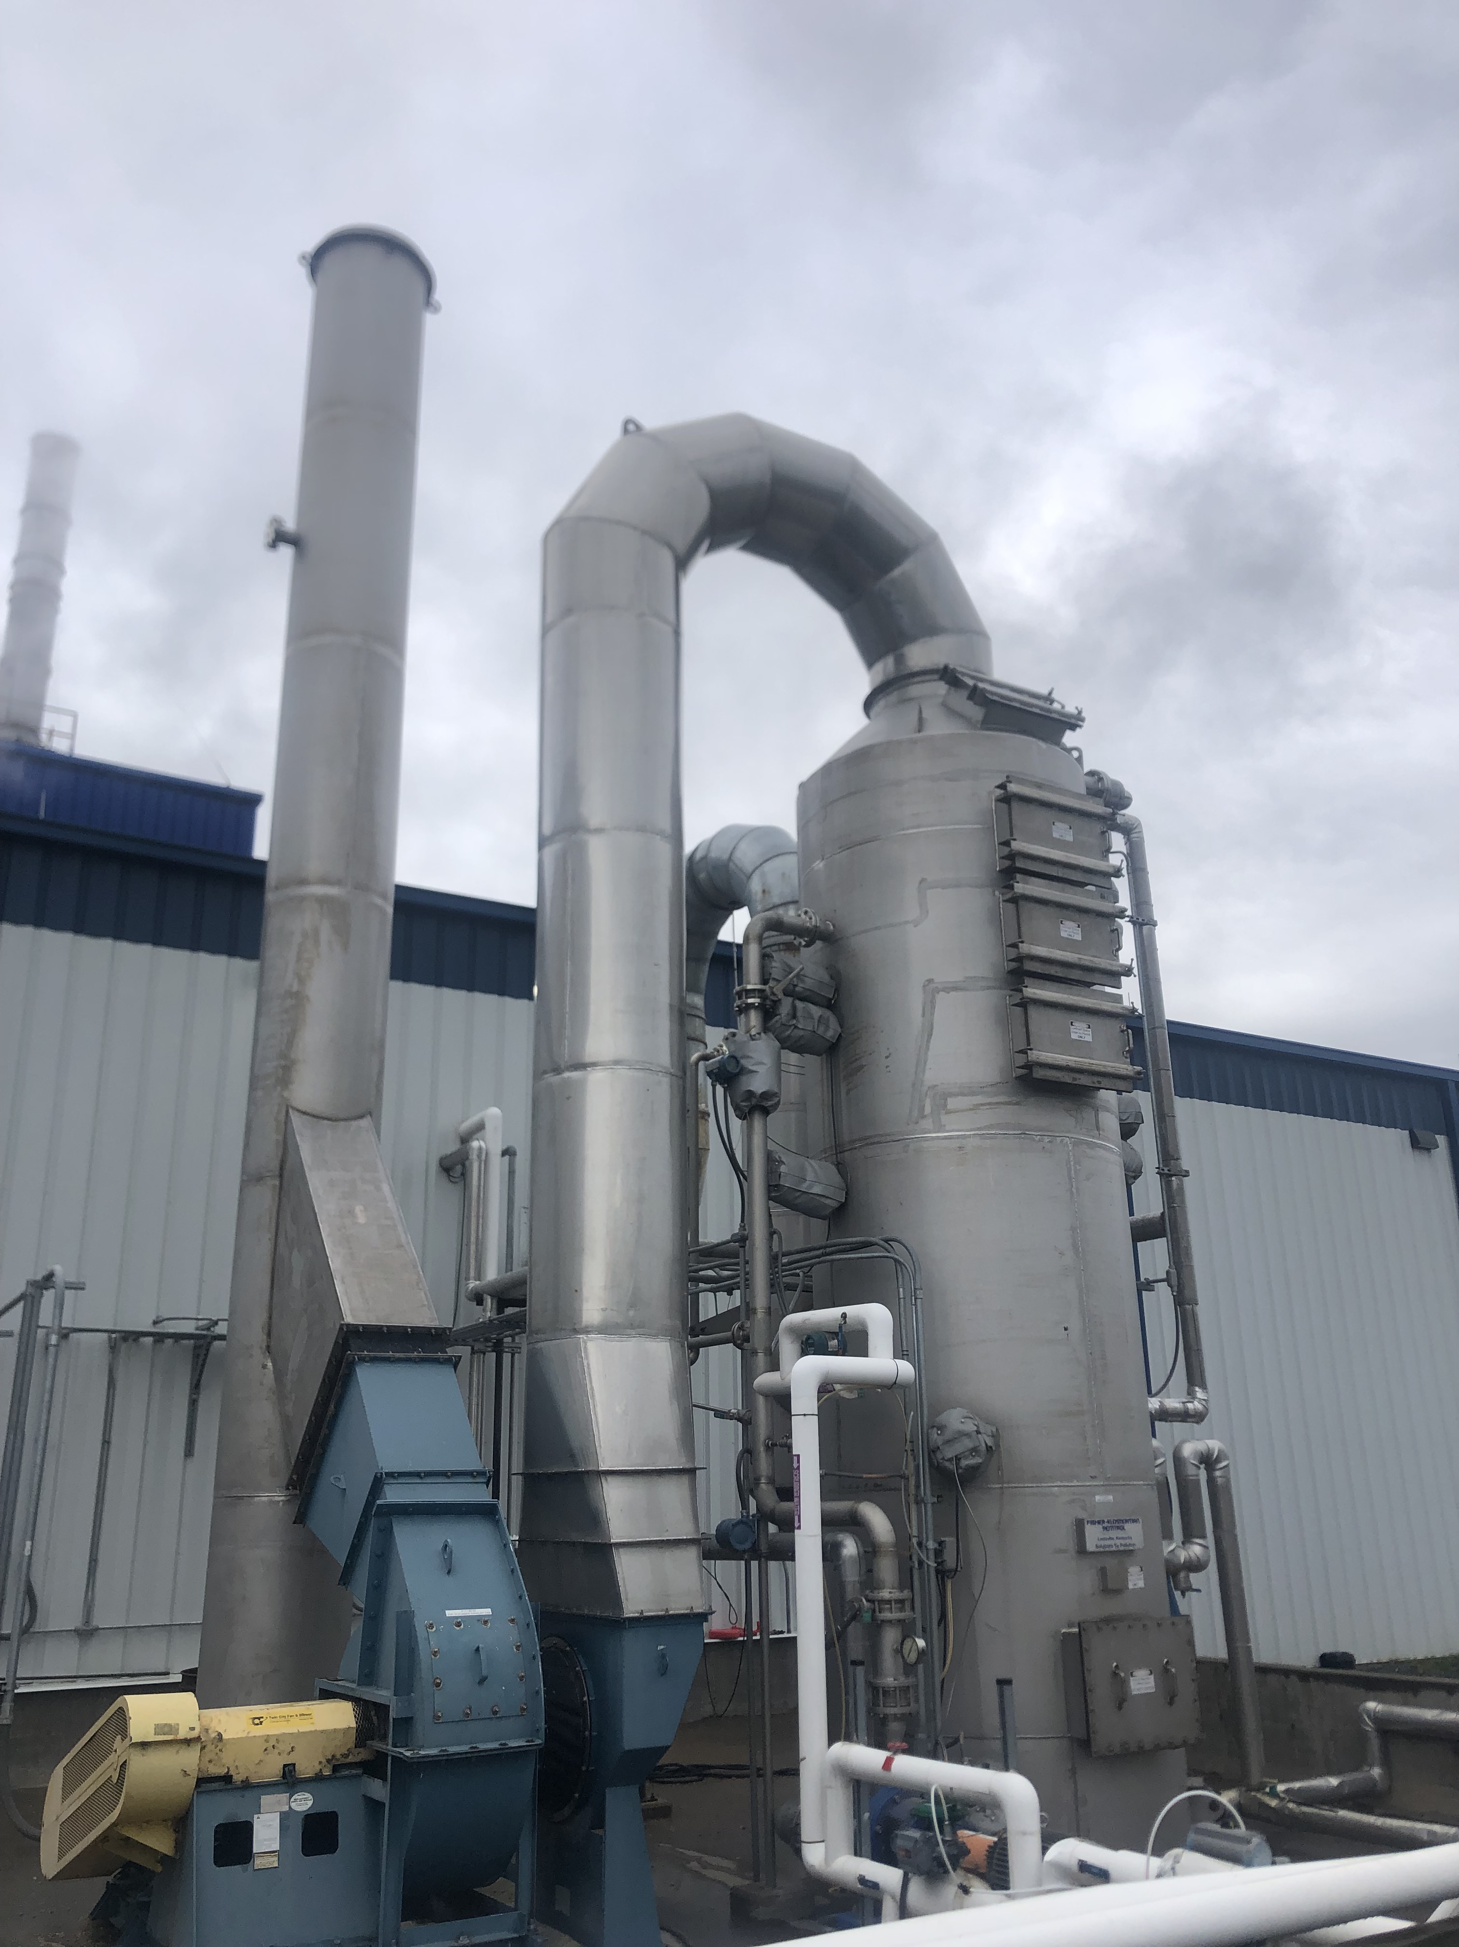
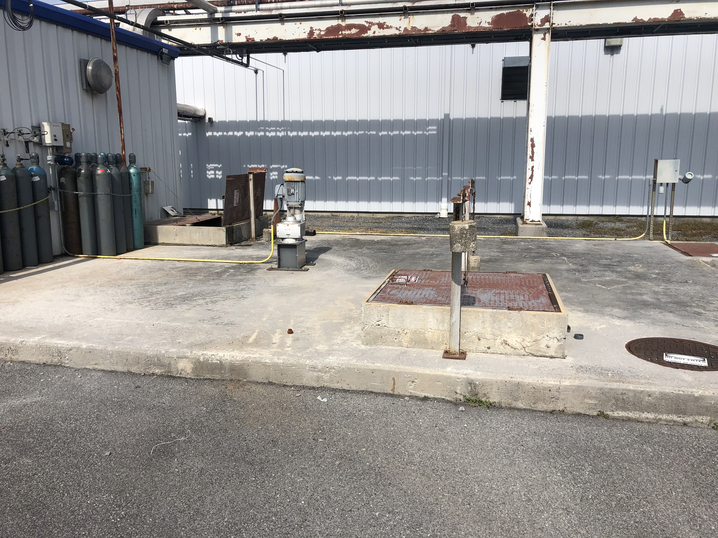
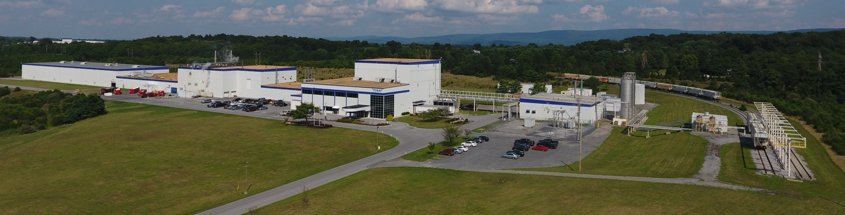
Environmental Aspects and Reduction Points
Foaming emissions
Sheeting emissions
Water discharge
89 acres total
27 acres of industrial activity
Notes:
Diverse applications
Both industrial and food grade type applications
Thickness range of BOPP 45G – 300G
Capabilities of white and metallized
Food packaging is form fill seal or pre-made
Labels are decorative for containers

Slide 9
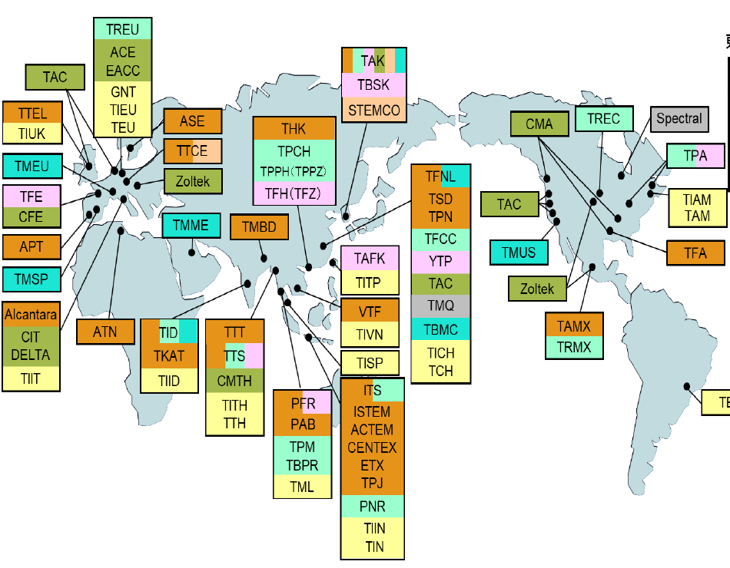
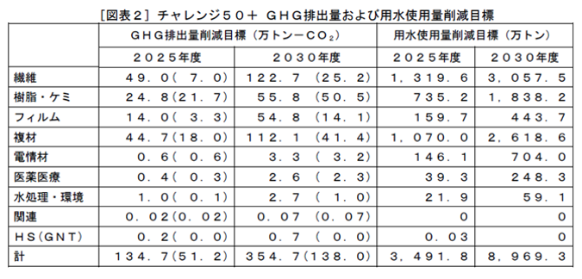
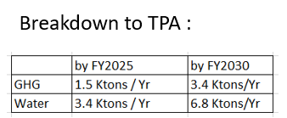
Challenge 30 and 50 Projects
Reduce total Greenhouse Gas Emissions and Water Consumption by 50% by 2030 Toray Worldwide
3.54 million tons of CO2 by 2025 worldwide
3.1 million gallons of water worldwide
Notes:
Diverse applications
Both industrial and food grade type applications
Thickness range of BOPP 45G – 300G
Capabilities of white and metallized
Food packaging is form fill seal or pre-made
Labels are decorative for containers

Slide 10
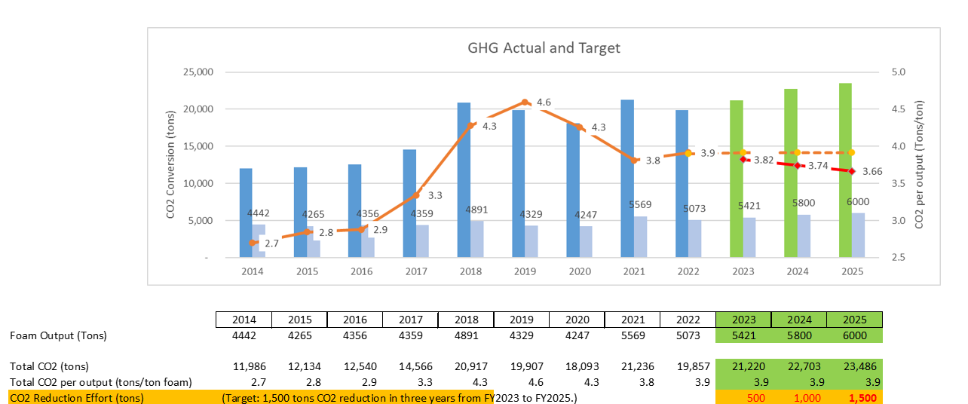
Challenge 30 and 50 Projects
Reduce total Greenhouse Gas Emissions and Water Consumption by 50% by 2030 Toray Worldwide
Notes:
Diverse applications
Both industrial and food grade type applications
Thickness range of BOPP 45G – 300G
Capabilities of white and metallized
Food packaging is form fill seal or pre-made
Labels are decorative for containers

Slide 11
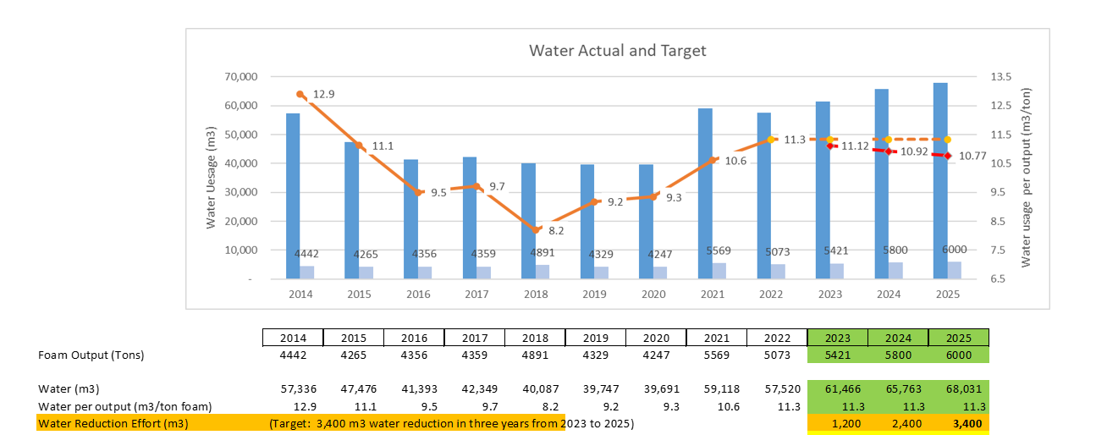
Challenge 30 and 50 Projects
Reduce total Greenhouse Gas Emissions and Water Consumption by 50% by 2030 Toray Worldwide
Notes:
Diverse applications
Both industrial and food grade type applications
Thickness range of BOPP 45G – 300G
Capabilities of white and metallized
Food packaging is form fill seal or pre-made
Labels are decorative for containers

Slide 12
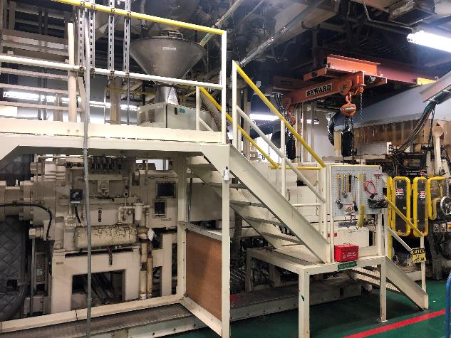
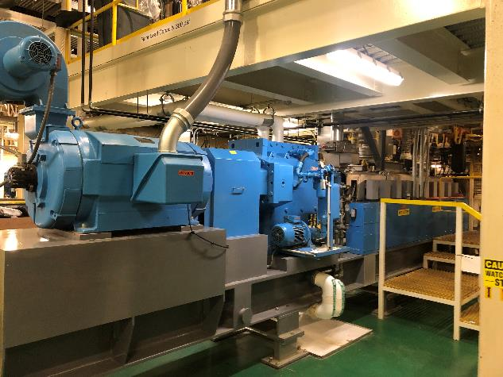
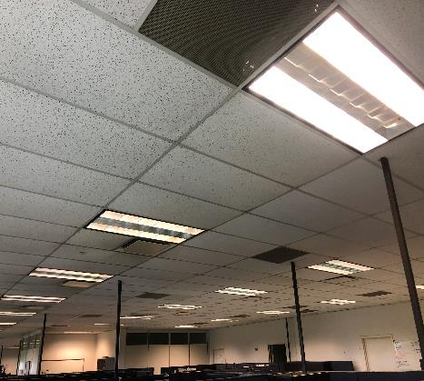
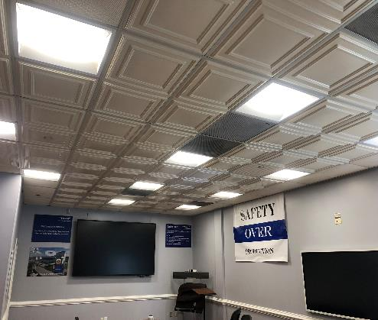
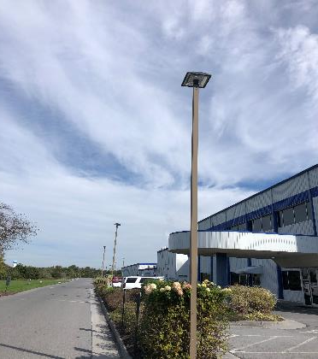
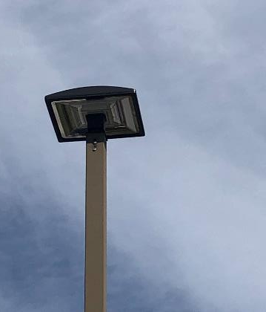
Challenge 30 and 50 Projects
Challenge 30 and 50:
Electricity reduction
Water usage reduction
Other environmental efforts:
Gas usage reduction
Hazardous waste reduction
Hitachi Extruder to Leistritz Extruder- High Efficiency Motor
Lighting replacement- T8 to LED and T5 to LED
Lighting replacement- HPS to LED
Notes:
Diverse applications
Both industrial and food grade type applications
Thickness range of BOPP 45G – 300G
Capabilities of white and metallized
Food packaging is form fill seal or pre-made
Labels are decorative for containers

Slide 13
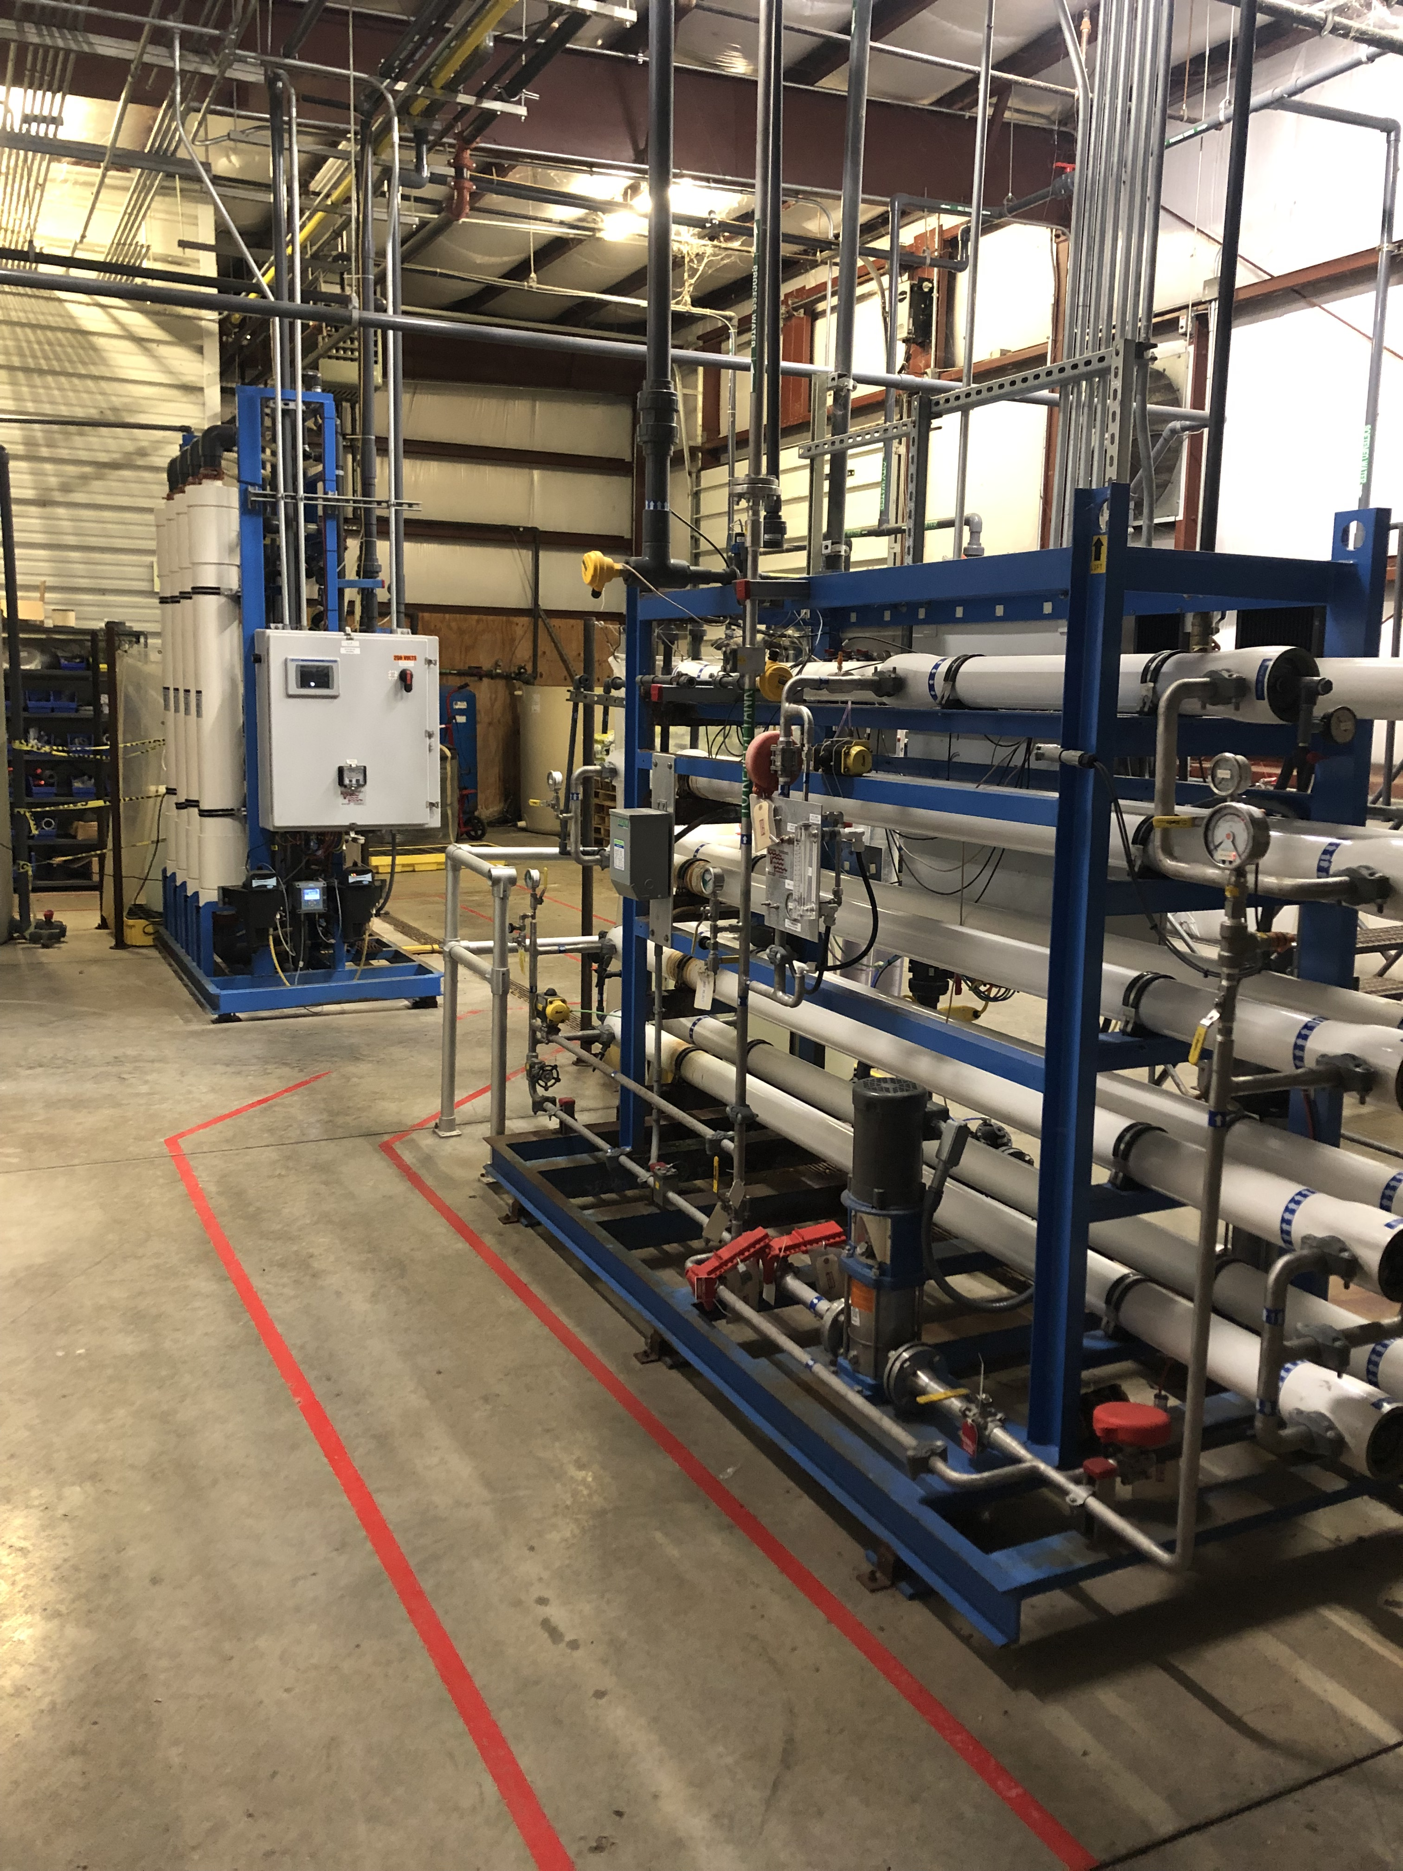
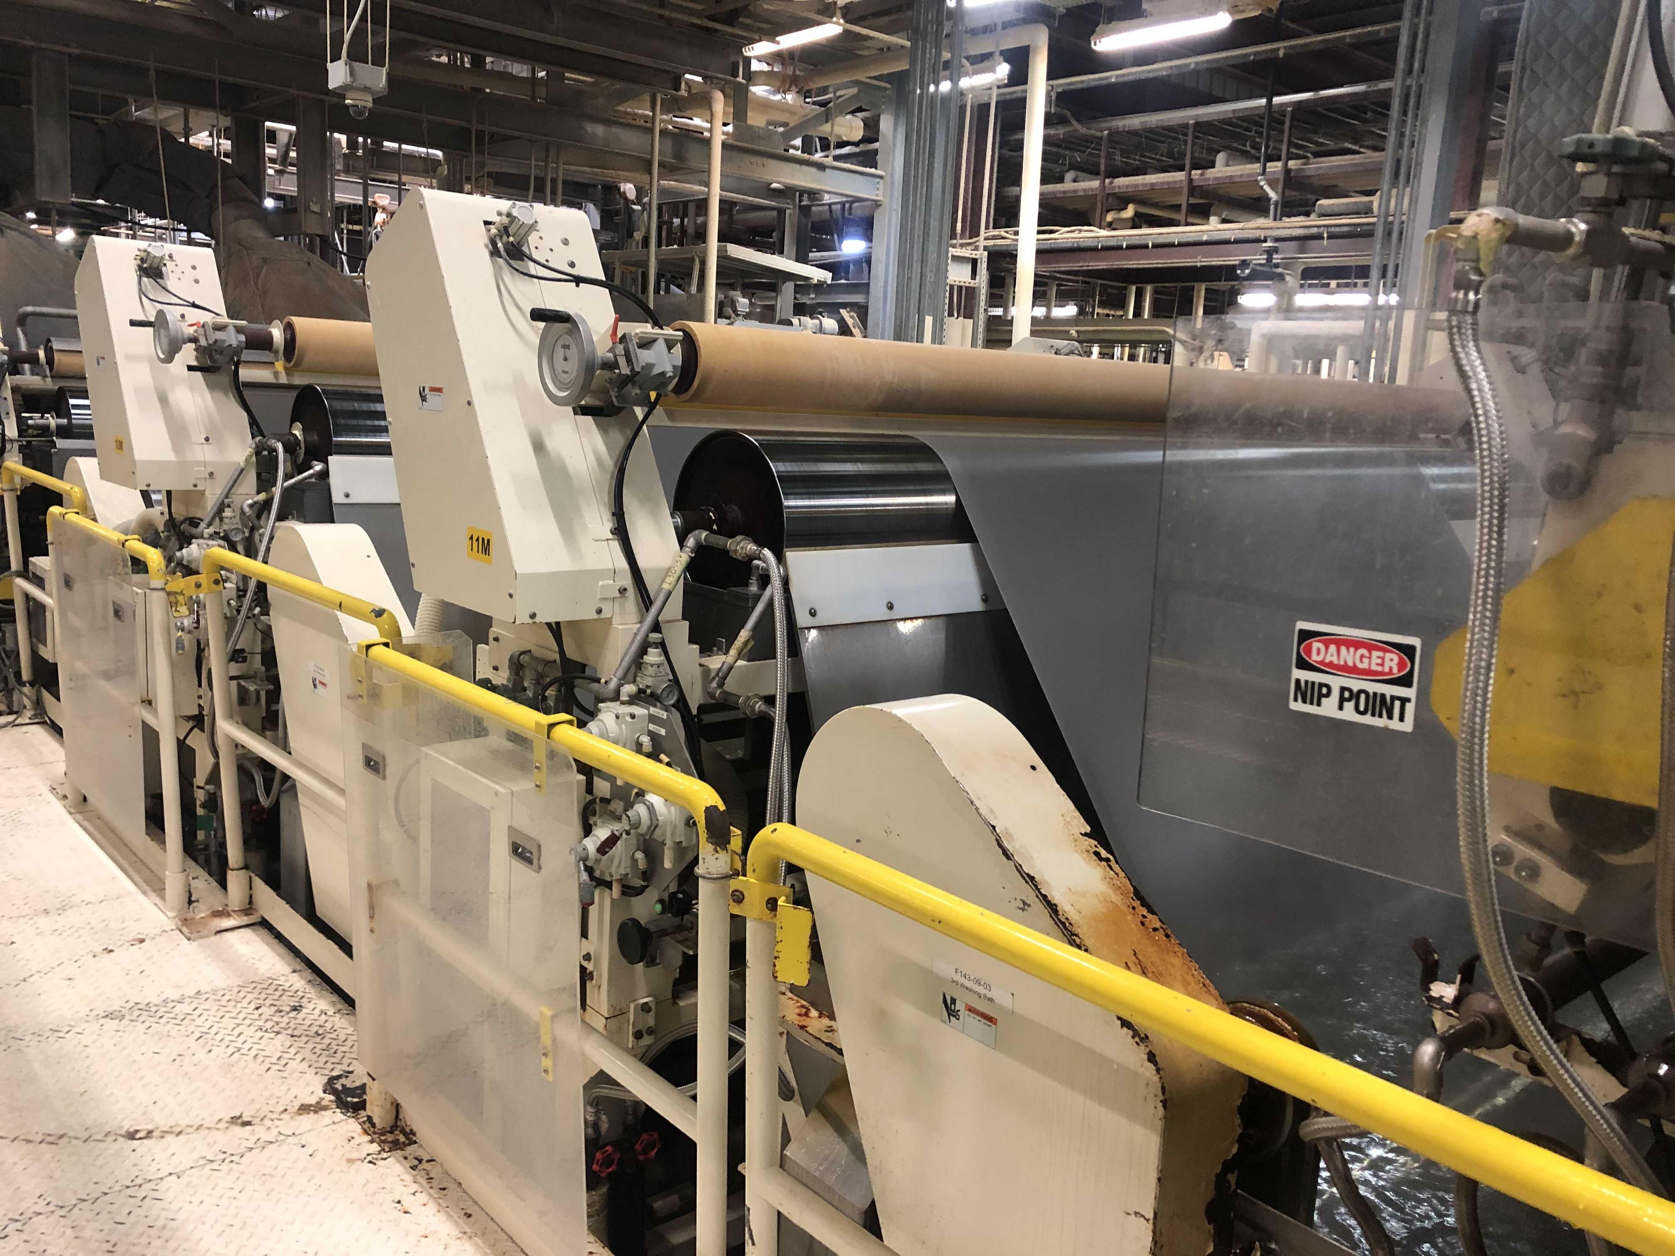
Challenge 30 and 50 Projects
24% reduction in wastewater
discharge
Challenge 30 and 50:
Electricity reduction
Water usage reduction
Gas usage reduction
RO system installation to reuse process water
18% reduction in water use in the facility
Specific gravity control of recovery water
Notes:
Diverse applications
Both industrial and food grade type applications
Thickness range of BOPP 45G – 300G
Capabilities of white and metallized
Food packaging is form fill seal or pre-made
Labels are decorative for containers

Slide 14
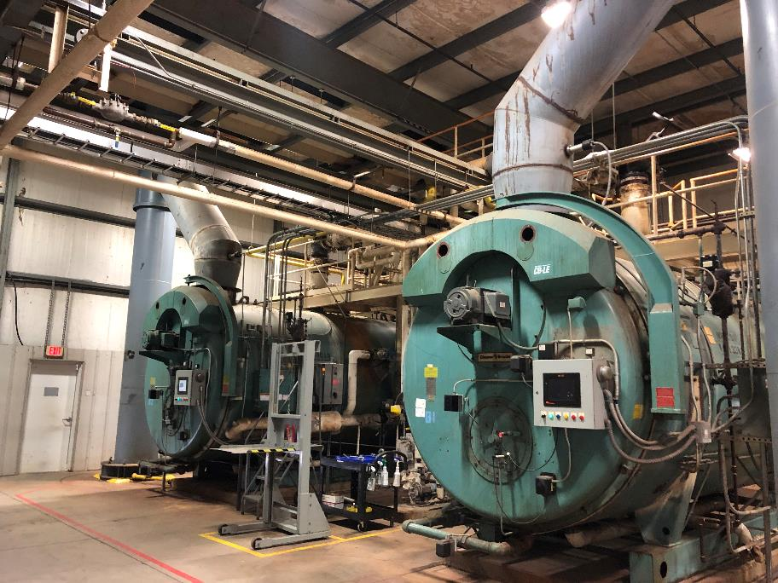
Challenge 30 and 50 Projects
Challenge 30 and 50:
Electricity reduction
Water usage reduction
Gas usage reduction
Optimization of boilers and steam system to reduce demand and control wasted energy
Notes:
Diverse applications
Both industrial and food grade type applications
Thickness range of BOPP 45G – 300G
Capabilities of white and metallized
Food packaging is form fill seal or pre-made
Labels are decorative for containers

Slide 15
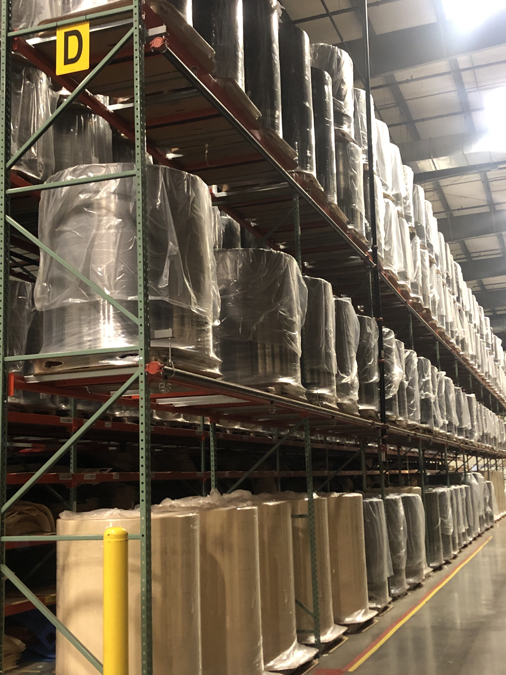
Management buy in and difficulties
Influenced management with cost savings
As always pressure to produce and expand while reducing GHG is not easy.
Think outside the box. Look for small reductions that can accumulate into large impactful reductions
Notes:
Diverse applications
Both industrial and food grade type applications
Thickness range of BOPP 45G – 300G
Capabilities of white and metallized
Food packaging is form fill seal or pre-made
Labels are decorative for containers

