Slide 1
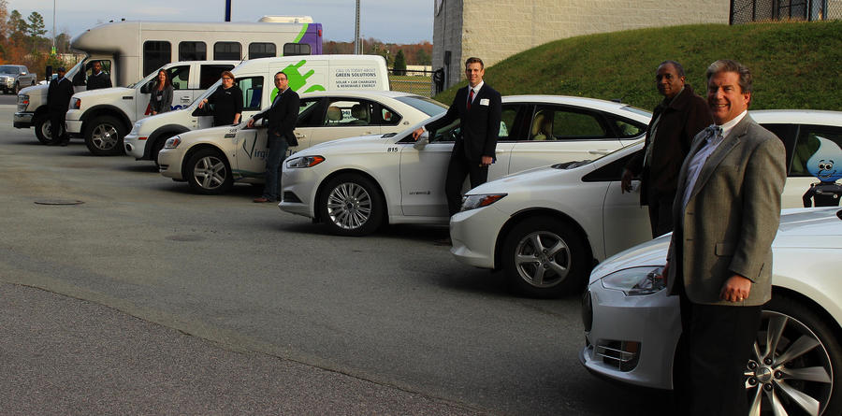
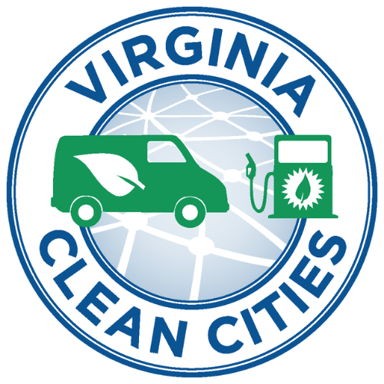
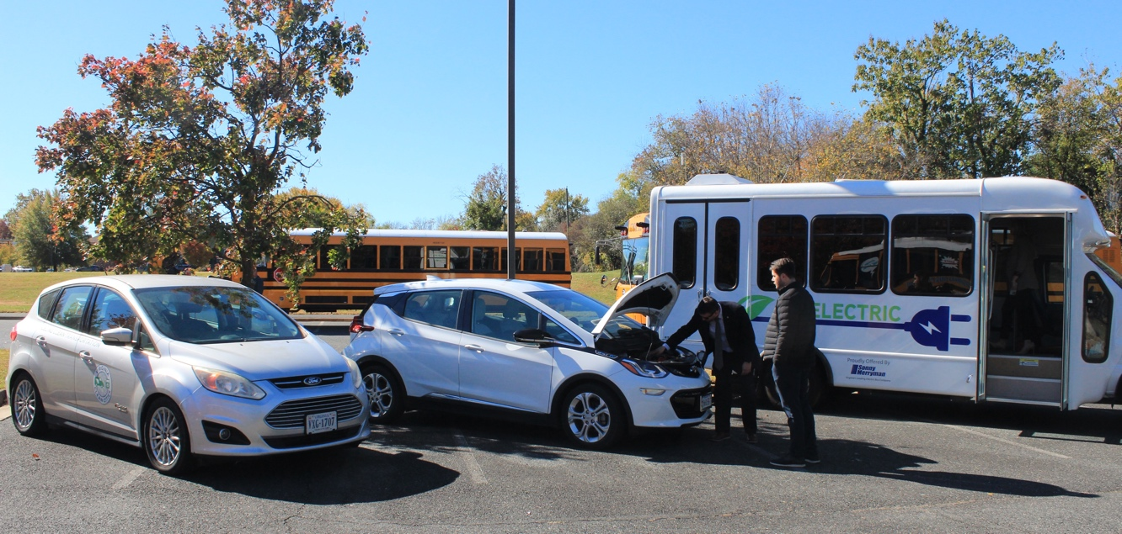
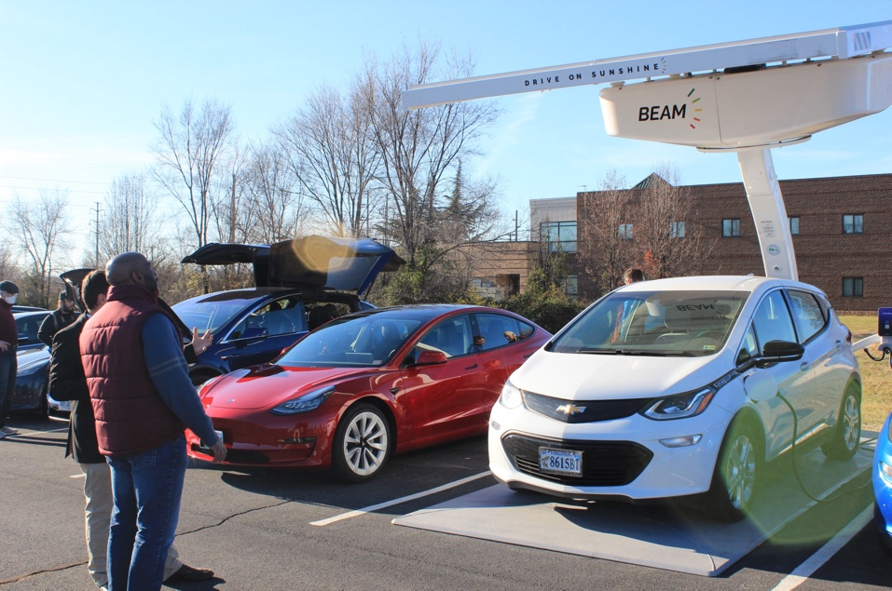
Climate Case Studies
Alleyn Harned
Virginia Clean Cities
Calendly.com/alleyn
804 539 9425

Slide 2
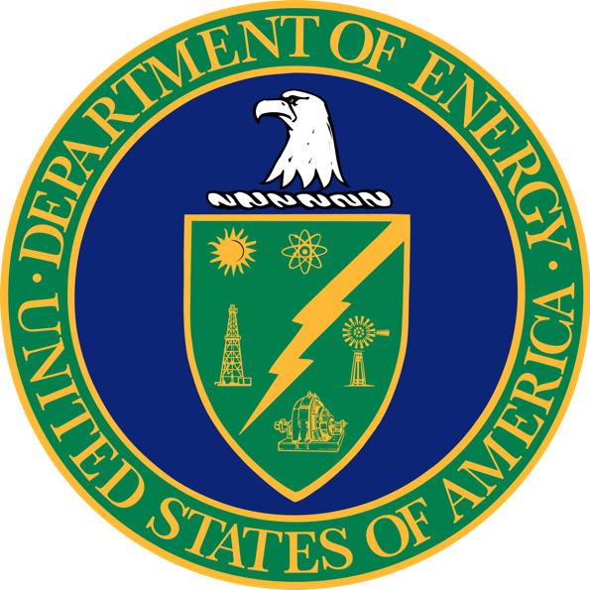
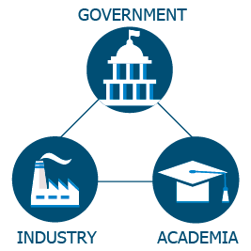

Why/What Clean Cities?
Reduced petroleum consumption
Clean Cities advances the energy, economic, and environmental security of the United States by supporting local actions to cut petroleum use in transportation.
Reduced greenhouse gas (GHG) emissions
Reduced dependence on imported petroleum
Notes:
Clean Cities is a program within the U.S. Department of Energy’s (or DOE) Vehicle Technologies Office.
DOE’s mission is to ensure the United States’ security and prosperity by addressing its energy, environmental, and nuclear challenges through transformative science and technology solutions.
Clean Cities is a community-based program that creates partnerships in the public and private sectors. Its mission is to advance the energy, economic, and environmental security of the United States by supporting local actions to cut petroleum use in transportation.
The benefits of the program include reduced petroleum consumption, reduced greenhouse gas, or GHG, emissions, and reduced dependence on imported petroleum. I will delve into these in more detail on the following slides.

Slide 3
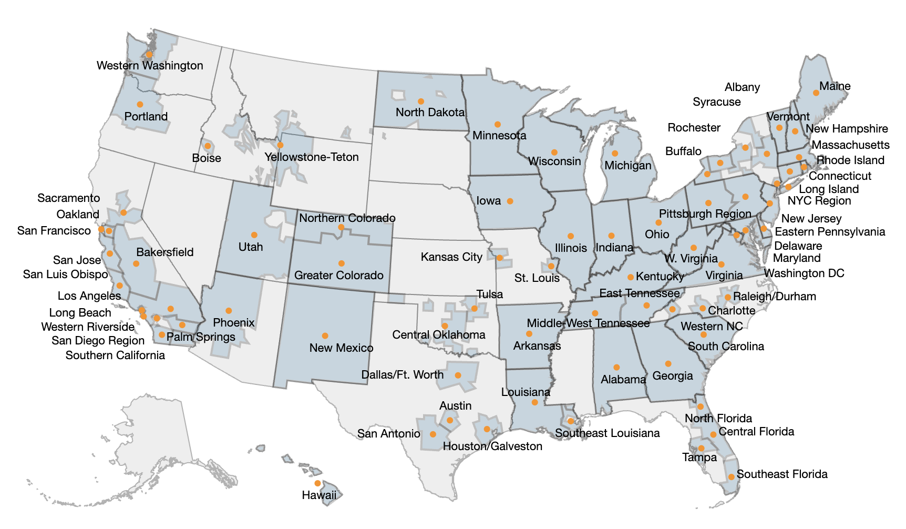
Local Partnerships:
Clean Cities Coalitions
National network of nearly 75 local coalitions
82% of the total U.S. population lives inside coalition boundaries
500,000 alternative fuel vehicles (AFVs)
VA Coalition large team additional federal support and also available for contracting / members
Notes:
Coordinator may choose to add a slide after this one to outline their own coalition.
Coordinator should be sure to include the most recent map, available at: https://cleancities.energy.gov/toolbox/logos-graphics-photographs/
So, let’s talk more about the first node in the web that I showed you earlier in the presentation—about partnerships—but specifically local partnerships. Nearly 100 local coalitions serve as the foundation of the Clean Cities program by working to cut petroleum use in communities across the country. About 82% of the total U.S. population lives inside Clean Cities coalition boundaries. Additionally, Clean Cities is responsible for helping to place nearly 500,000 alternative fuel vehicles (also known as AFVs) on the road as of 2014.
Each coalition is led by an on-the-ground Clean Cities coordinator [like me] who tailors projects and activities to capitalize on the unique opportunities in their region.
Coordinators serve as both educators and problem solvers for their stakeholders.

Slide 4
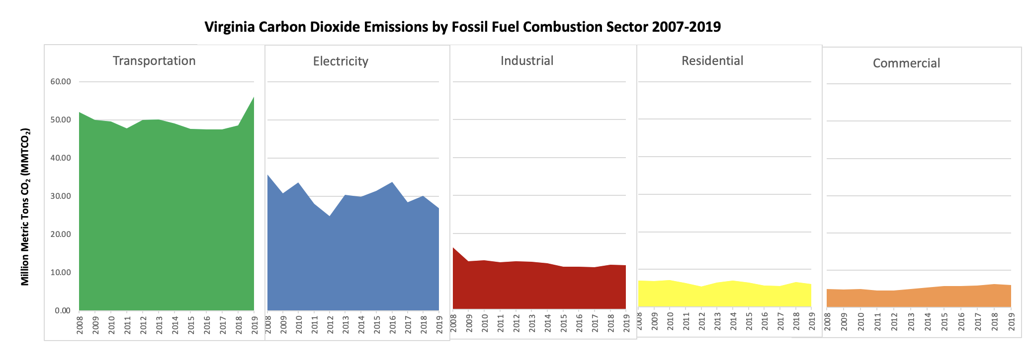
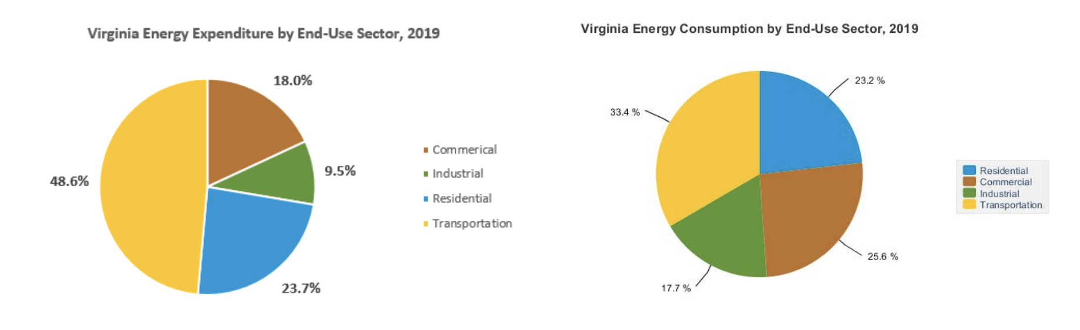
Transportation Emissions
👎
👎
👎
Notes:
Clean Cities is a program within the U.S. Department of Energy’s (or DOE) Vehicle Technologies Office.
DOE’s mission is to ensure the United States’ security and prosperity by addressing its energy, environmental, and nuclear challenges through transformative science and technology solutions.
Clean Cities is a community-based program that creates partnerships in the public and private sectors. Its mission is to advance the energy, economic, and environmental security of the United States by supporting local actions to cut petroleum use in transportation.
The benefits of the program include reduced petroleum consumption, reduced greenhouse gas, or GHG, emissions, and reduced dependence on imported petroleum. I will delve into these in more detail on the following slides.

Slide 5
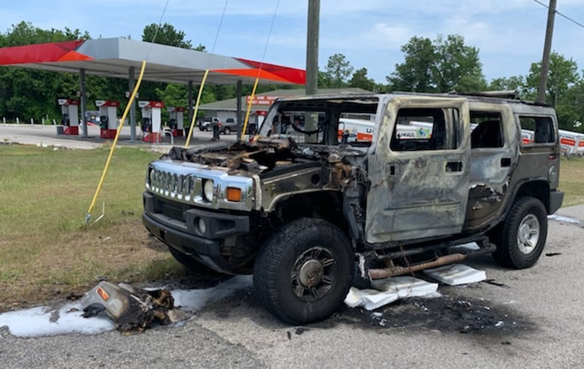
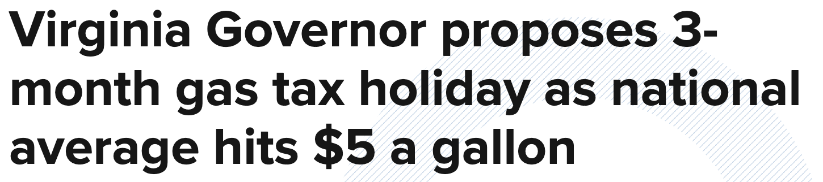


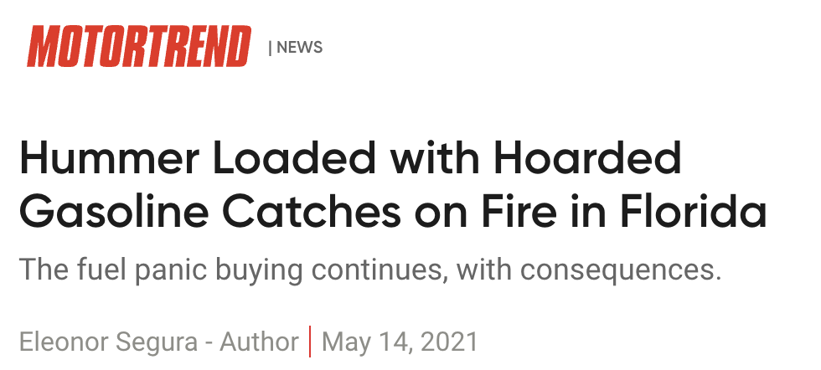

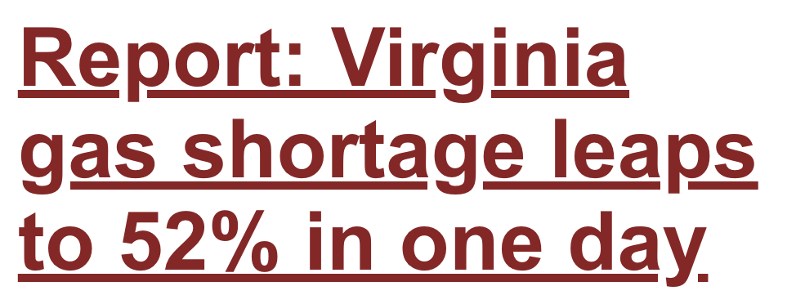
Supply Chain Issues

Slide 6
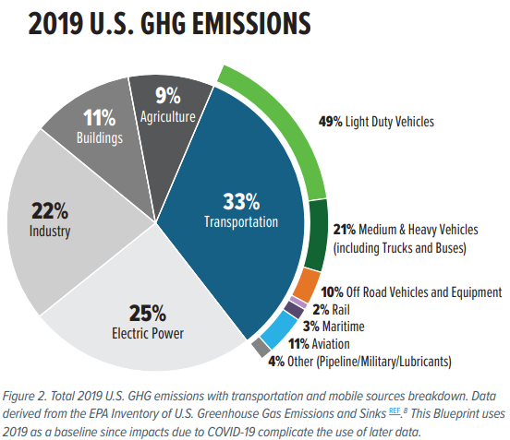

Slide 7
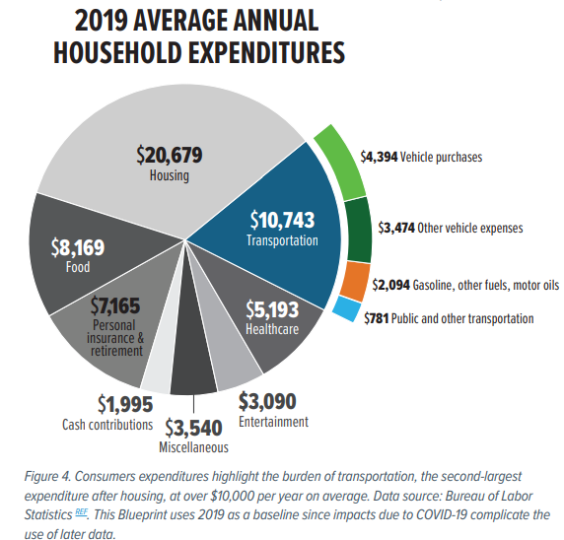

Slide 8
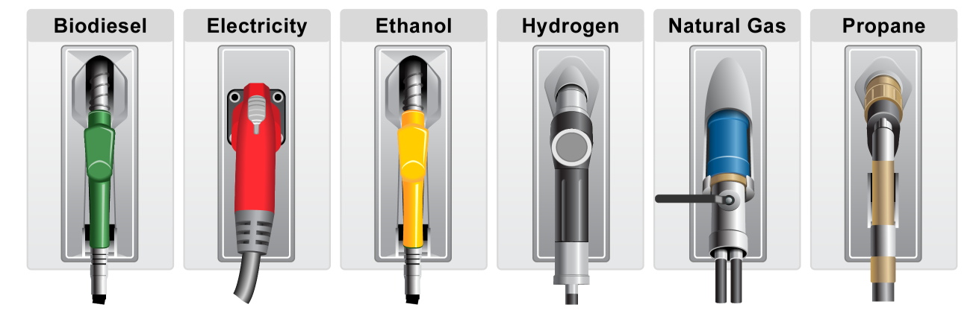
Virginia Clean Cities at JMU
Vehicles and Driver Choices that Increase Fuel Economy
  Right-size, Idle Reduction – Bikes, Land Use, Transit
Advanced (e.g., HEVs, PHEVs) Alternative Fuels & Vehicles
Lower fuel use Incentives for Change
Lower cost fuels at scale $3.50 Gasoline to $1 NetZero Fuel
Fuel our economy Alternative Fuel Data Center
Notes:
8

Slide 9


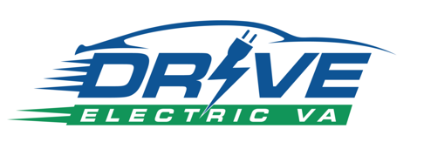

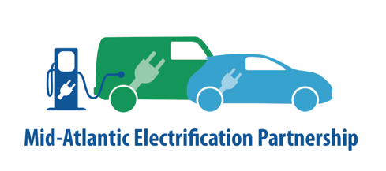


Active Projects
Events, Information, Dept Energy Designated 1996
24-7 Clean Transportation Transition Animals (@JMU)
Technical Support Free to VA – Technology Neutral
Rural AFV Transition, Demonstrations
Planning assistance to rural clusters
Statewide EV Education Initiative
Working groups, Data Dashboard
More free planning technical assistance

Slide 10
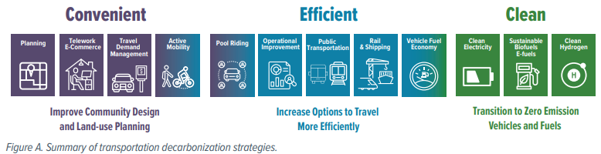
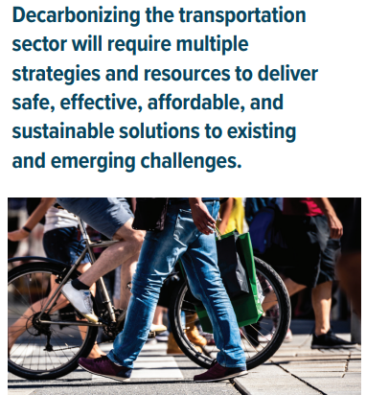
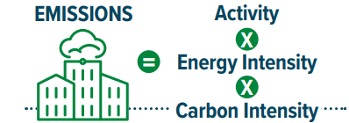

Slide 11
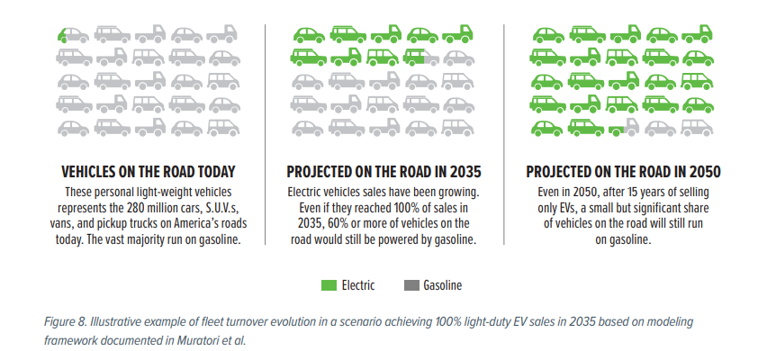

Slide 12

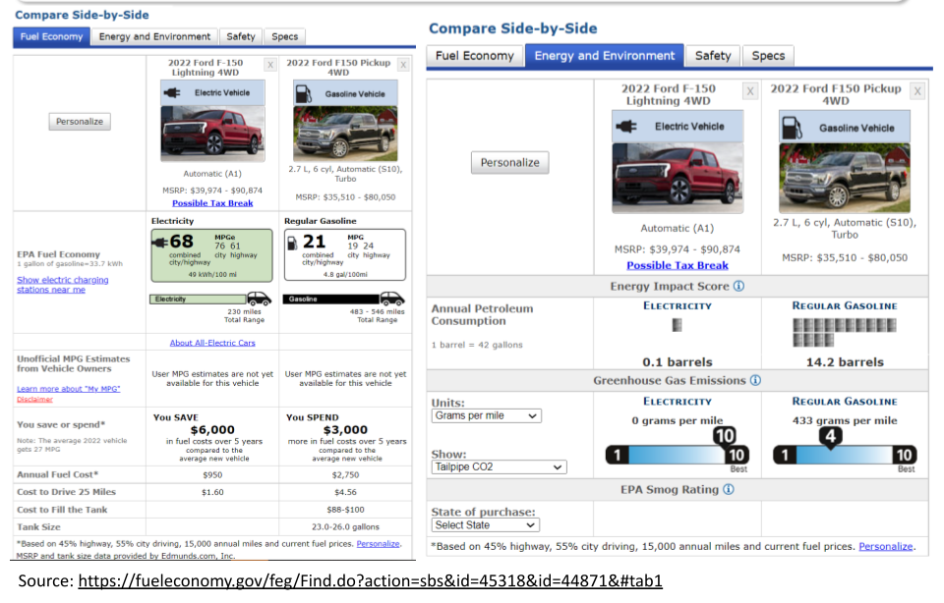

Slide 13
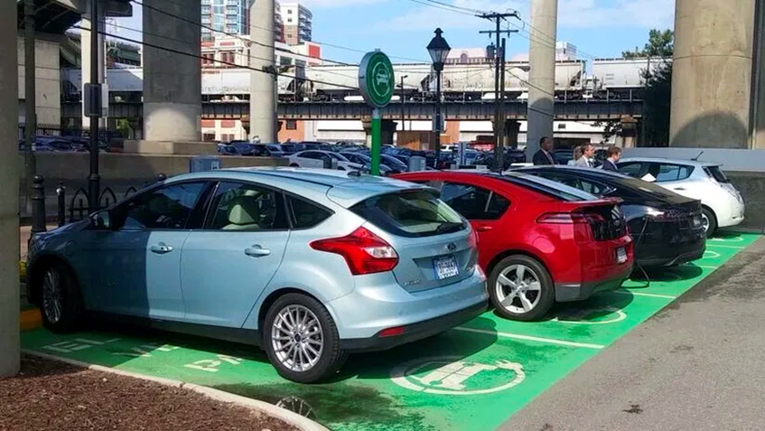
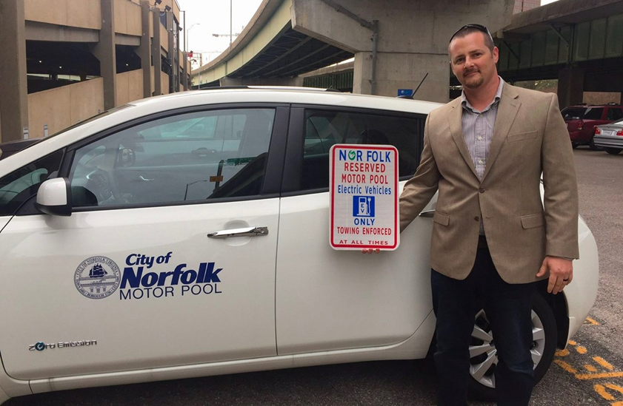
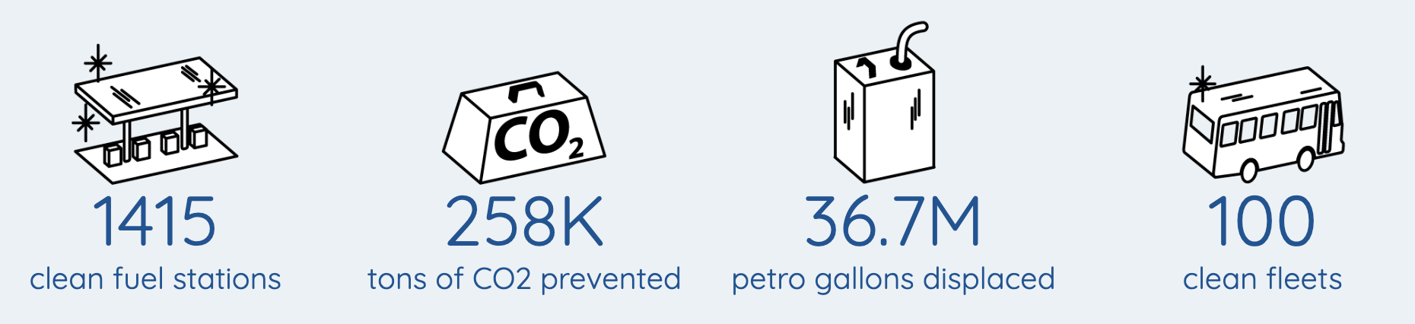
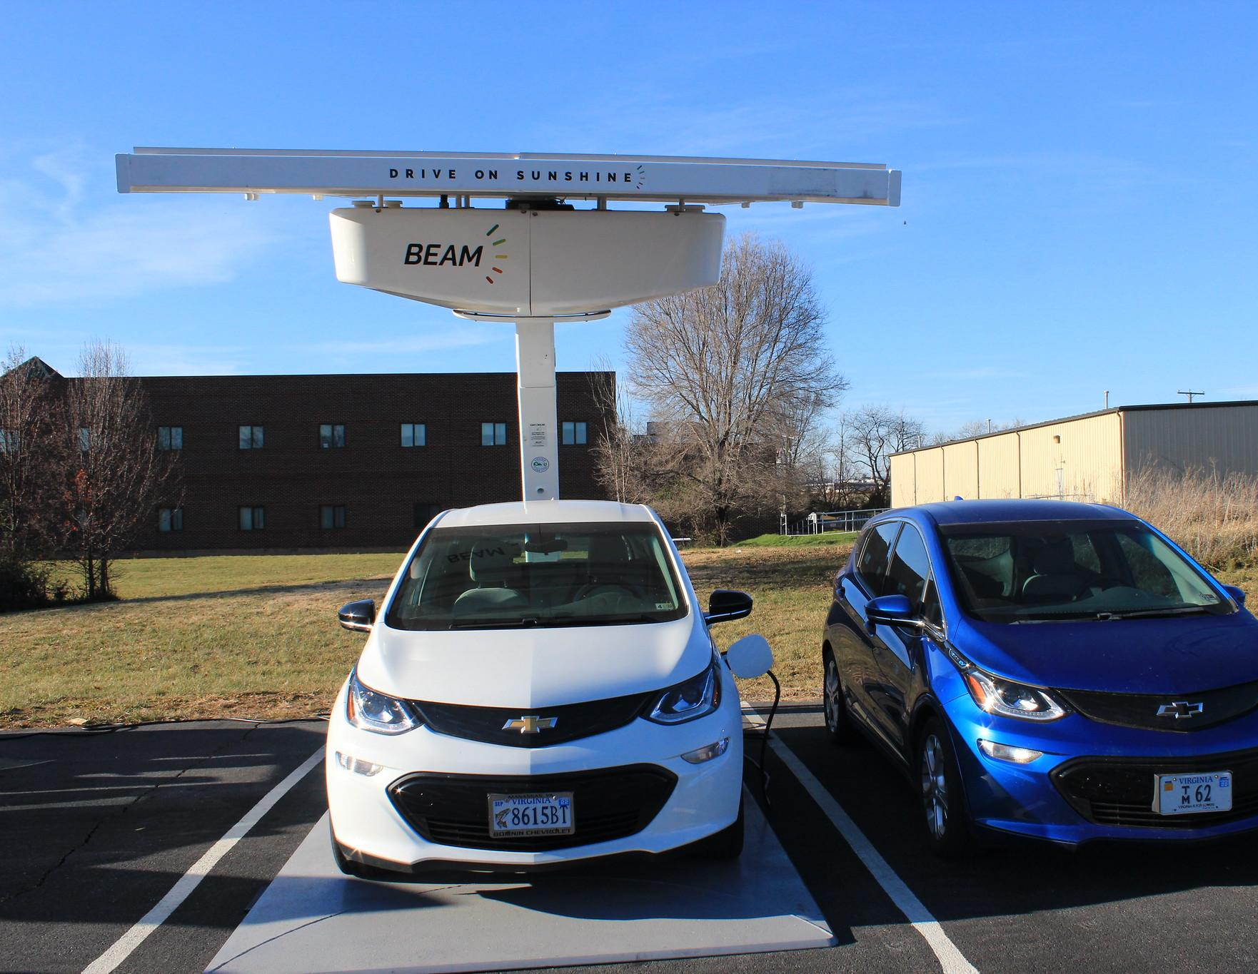
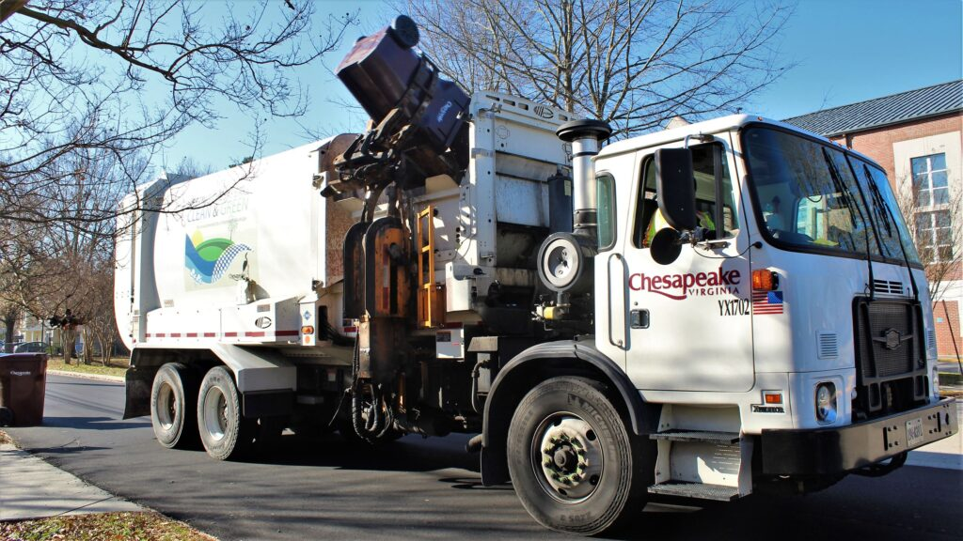
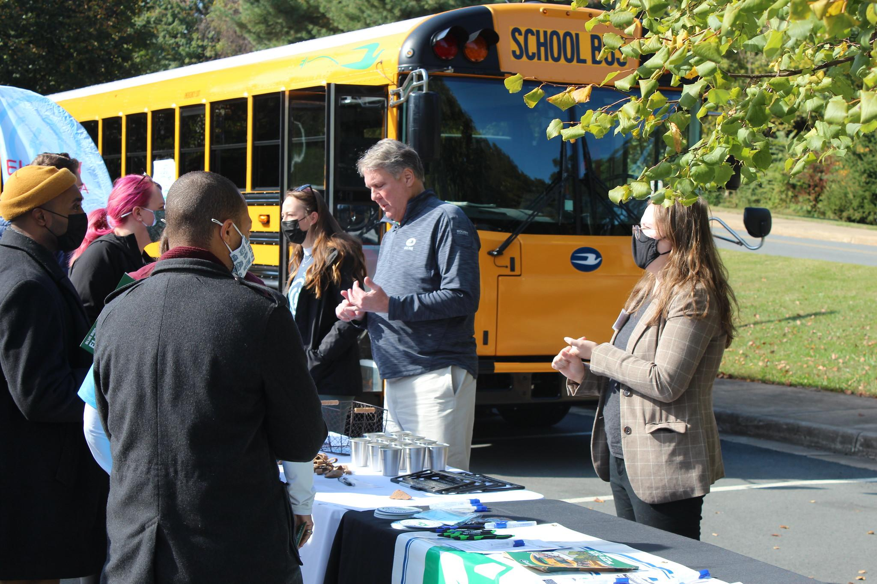
Progress in Virginia

Slide 14
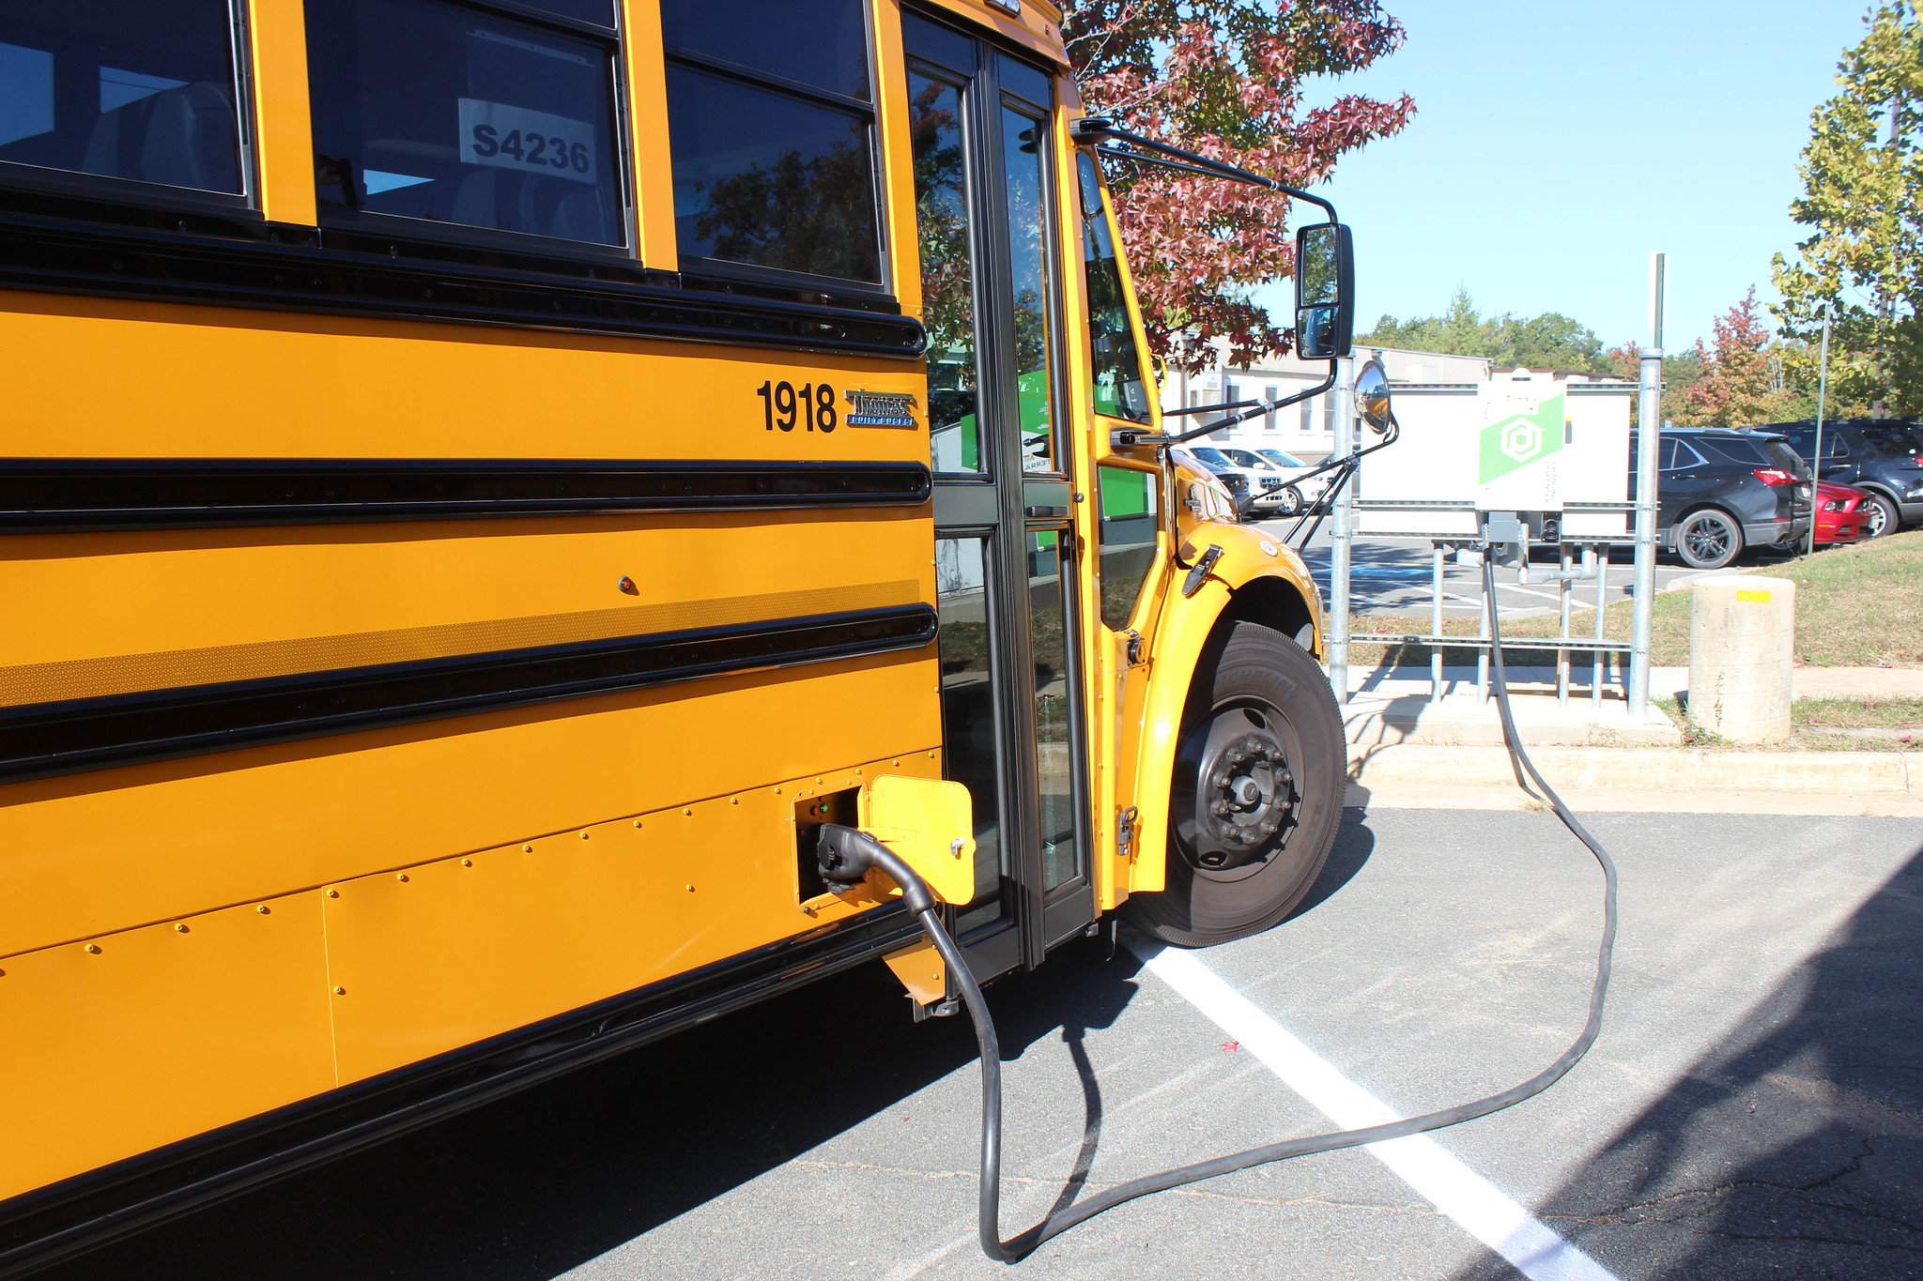
262 EV School Buses, 45 Districts

Slide 15
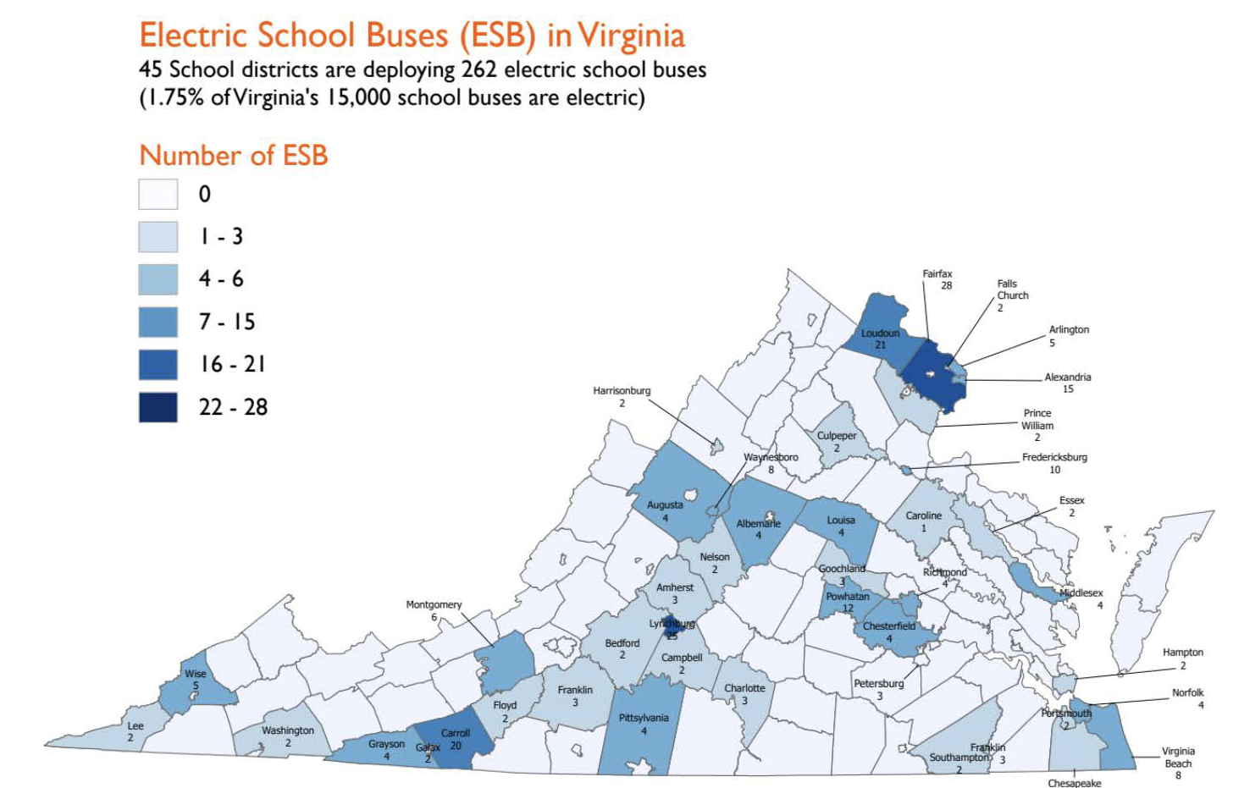

Slide 16

Alleyn Harned
Virginia Clean Cities
Executive Director
www.calendly.com/alleyn
aharned@vacleancities.org
(540) 568-8896 Desk
(804) 539 9425 Cell

