Slide 1

Solvent Reclaim
How Cabinetworks Group has reduced VOC emissions, reduced waste, and increased cost savings

Slide 2

Who We Are
Cabinetworks Group (CWG) specializes in kitchen and bathroom cabinet manufacturing
  20 brands of cabinetry under the CWG umbrella
Eighteen plants nationwide
Cabinet components are manufactured, assembled, and shipped to distributors such as Home Depot and Lowes.

Slide 3
Mount Jackson, VA Facility
Over 1 million cabinet components are produced and transported to an assembly plant every year.
The facility uses over 250,000 gallons of paint and solvents every year.
The facility is classified as a large quantity generator (LQG) of hazardous waste
  Produces over 100,000 gallons of hazardous waste every year.
The facility operates under the Title V Air Permit
  VOC emissions limit: 463 tons

Slide 4
VOC Emissions and Hazardous Waste Generation
Growing business Increase in VOC emissions and hazardous waste
In late 2019, the management team discussed concerns on increase in VOC emissions
  The facility was at risk of exceeding the VOC emissions limit
  The facility was utilizing 2000 gallons of finishing belt cleaning solvent every week, which contained 100% VOCs
  The management team was looking into purchase additional pollution control devices (i.e., scrubbers)
CWG met with Blue Ridge Solvents and Coatings (BRSC) to discuss solutions

Slide 5

Blue Ridge Solvents and Coatings
Specializes in distributing chemical industrial products and recycling
CWG met with BRSC to offer the following solutions
  Adjust the composition of the finishing line belt cleaning solvent to contain only 75% VOCs
  Solvent Reclaim/Recycling Program
    Convert hazardous waste to reclaimed solvent

Slide 6
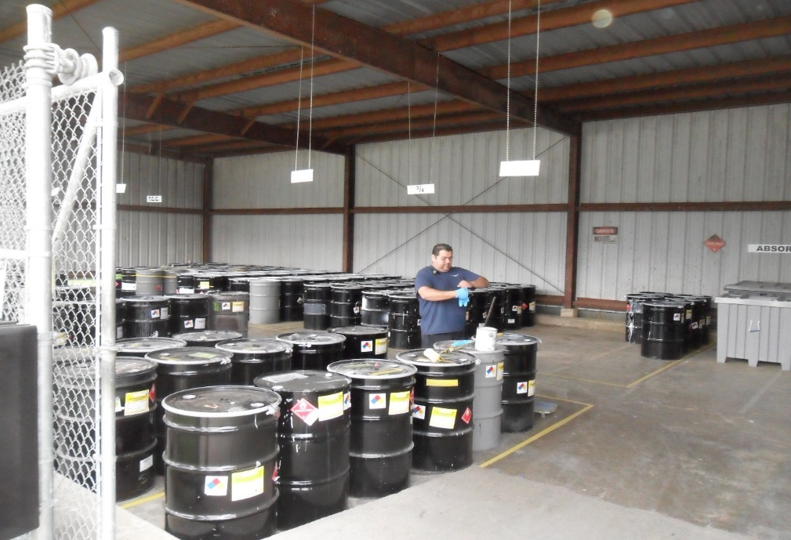
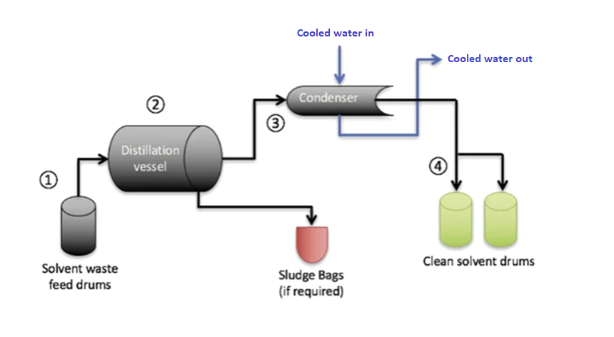
Solvent Reclaim Program
BRSC’s solvent reclaim program consisted of having hazardous waste containing spent solvent undergo a distillation process.
  During the distillation process, drums of waste are fed into a distillation vessel.
  The material is then brought to a boiling point.
  Once the waste is separate, vapors of the recovered solvent are channel to a water-cooled condenser to cool into a liquid form.
Five waste streams generated from the facility can be turned into reusable solvent

Slide 7
Benefits of Continuing Solvent Reclaim Program
69% of waste had been converted to reclaimed solvent over the last 3.5 years
Reduction of VOC Emissions
  Belt cleaning solvent contains 25% less VOCs
  Earn VOC credit for disposing hazardous waste
Cost savings
  Reduction in purchasing virgin material
  Reduction in hazardous waste disposal costs
  Reduction in VDEQ emissions fees
Reduction of hazardous waste being incinerated
Year | Waste (lbs.) | Reclaimed (lbs.)
2020 | 52,511 | 33,100
2021 | 461,201 | 319,890
2022 | 453,789 | 295,097
2023 | 344,953 | 257,176
Total | 1,312,454 | 905,263

Slide 9
Solvent Reclaim Program Expansion
BRSC had reached out to the Thompsontown (TT), PA facility in the past for an opportunity to partake in the solvent reclaim
  It is an assembly plant with an operational finishing department.
  Accumulates approximately 50,000 gallons of hazardous waste every month
February 2023: MTJ had proposed the idea of having TT’s waste transported to BRSC to be distilled into reclaimed solvent for MTJ’s belt cleaner
April/May 2023: BRSC visited the TT facility to pull samples from several waste streams to have analyzed for ability of obtain reclaim.
June 2023: Results of the analysis determined several waste streams to be reclaimable
August 2023: BRSC picked up 80 drums of waste from TT to convert to reclaimed solvent
  64% of waste converted to reclaimed belt cleaner
September/October 2023: MTJ retrieved 18 drums of the TT reclaimed material to test on the finishing line

Slide 10
Benefits of Expansion of Solvent Reclaim Program
Mount Jackson, VA
  Reduction in purchasing of virgin material
    Cost of reclaimed material 60% less than virgin
    Obtain up to 1300 more gallons of reclaim
    Cost savings of up to $10,000/month
Thompsontown, PA
  Reduction in disposal costs
    Previous disposal cost: $118/drum
    Current disposal cost:$65/drum
    Accumulate up to 40 drums every month
    Cost savings of up to $2100/month
  Reduction in waste going to the incinerator

Slide 11
Thank You!

