Slide 1
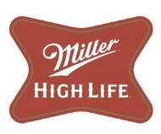
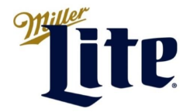
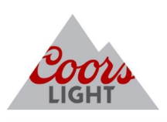
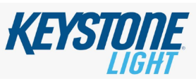
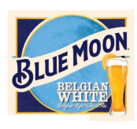
Our Imprint
Strategy
Molson Coors - Shenandoah Brewery
Elkton, Virginia

Slide 2
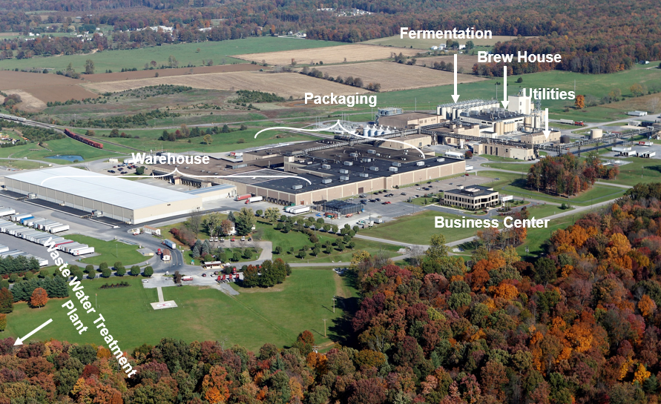
Shenandoah Brewery at a Glance
Opened in 1987
530+ Employees
Volume: 7M+ bbls
1,800 acres bordering Shenandoah National Park
Complete wastewater treatment with direct discharge to South Fork Shenandoah River
We produce, package and ship Coors Light, Miller Lite, Blue Moon, Miller High Life, and Keystone Light

Slide 3

Our Environmental Visions, Values and Beliefs
At the Shenandoah Brewery, we will:
• Conduct our business in compliance with all environmental laws, regulations, and our Environmental, Health and Safety Management Systems requirements.
• Continuously and innovatively improve our Environmental, Health, and Safety Management System and processes by evaluating our activities and measuring our performance against established objectives.
• Aggressively pursue waste reduction, resource management, and emission reduction through feasible pollution prevention measures.
• Incorporate environmental considerations into all business decisions, including expansion, renovation, and process modifications.
• Create cooperative relationships with the neighboring community and local agencies.

Slide 4
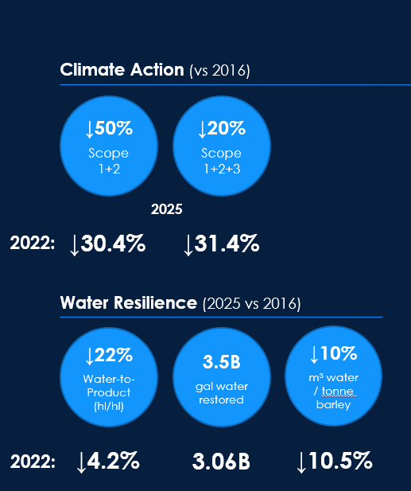
Corporate Targets for Emissions and Water
Molson Coors is committed to sustainability and has external
commitments to improve emissions and water consumption
Scope 1 – emissions are direct emissions from owned or controlled sources (e.g., natural gas combustion in boilers for heating or process uses; fuels for owned vehicles).
Scope 2 – emissions are indirect emissions from the generation of purchased energy (i.e., electricity used at owned facilities).
Scope 3 – emissions are all indirect emissions (not included in Scope 2) that occur in the value chain of the reporting company, including both upstream and downstream emissions

Slide 5

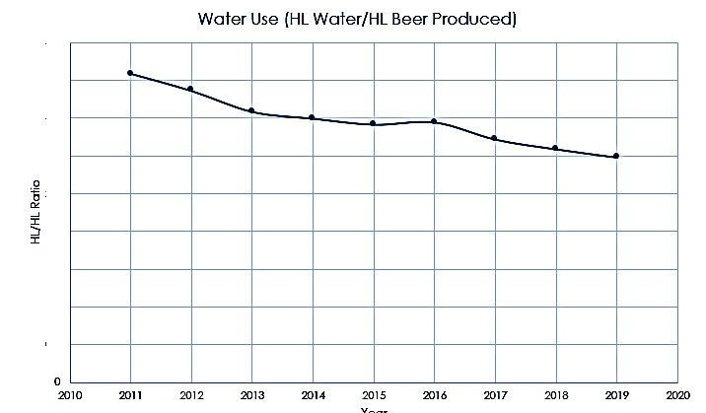
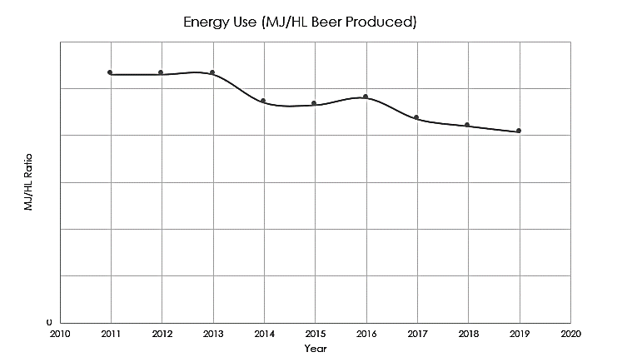
VEEP
Virginia Environmental Excellence Program (VEEP)
E3 facility
Water and energy are our KPIs
Targeted improvement process
Sustainability goals tighten up each year in order to keep continuous improvement a priority
Robust monitoring and reporting infrastructure to generate swift responses to deviations
Improvement planning includes technology as well as people/process changes

Slide 6
Initiatives to improve sustainability
Department | Actions
BREWING | Optimize steam consumption in pound/brewed bbl Optimize CO₂ consumption in pound/blended bbl Optimize tank recharges following CIPs Focus to eliminate leaks – water, compressed air, CO₂
PACKAGING | Optimize cleaning sequences to reduce steam or water and escalate cleaning sequences when not done right-the-first-time (RTFT) Ensure robust shutdowns are followed when shutdown Optimize warmer set points to achieve dew point temps of warehouse Leverage blowers rather than compressed air to dry containers or conveyors Focus to eliminate leaks – water, compressed air, CO₂
DISTRIBUTION | Ensure robust shutdowns are followed when shutdown At planned stops (e.g., maintenance days) stop equipment, conveyors Focus to eliminate leaks – water and compressed air Ensure Keg Cooler Door remains closed
TS | Optimize condensate return, escalate condensate contamination Optimize boiler efficiency Optimize CO₂ inventory management Optimize all utilities temperatures and pressures as per process needs
SUPPORT FUNCTIONS | Perform waste walks during no meeting zone Escalate water, compressed air, CO₂ leaks when seen Assist with or build capability with Process Verifications
Everyone in the brewery can help reduce emissions and resource consumption!

