Slide 1

Emily Irvine
Climate Program Manager
City of Charlottesville
irvinees@charlottesville.gov
Gabe Dayley
Climate Protection Program Manager
Albemarle County
gdayley2@albemarle.org

Slide 2





Agenda
Welcome
Project Introduction
Hazards and Risks
Resilient Together
Q & A
Notes:
Emily

Slide 3

  Project Summary
Resilient Together is a joint planning and community engagement process to help our community prepare for the more intense and frequent severe weather events that we face.
Albemarle County the City of Charlottesville, and the University of Virginia have partnered in this work. The project will engage staff, partner institutions, community-based organizations, and the public.
Goals:
  Enhanced quality of life
  Reliable systems
  Economic vitality
  Healthy ecosystem
Outcomes:
  Climate adaptation and resilience plans
  Framework for community investments
  Increased resilience through community engagement
a strong, safe, and healthy future for all
Notes:
Emily

Slide 4
  Why Work Together?
Shared Context:
  Same region, climate, weather patterns
  Jurisdictional boundaries don’t matter to the weather
  Knowing your neighbors is good emergency preparedness
Partnership between City and County:
  Stronger plans; better outcomes
  More efficient use of human and financial resources
  For many residents, it’s all one community
UVA:
  Major influence on local economy, infrastructure, etc.
  Subject matter experts
  Research and funding support
Notes:
Emily

Slide 5


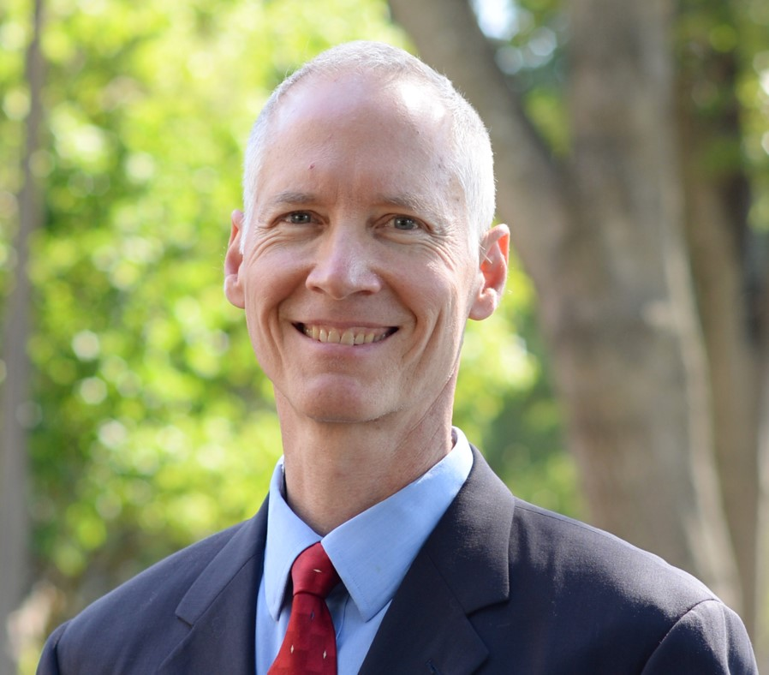
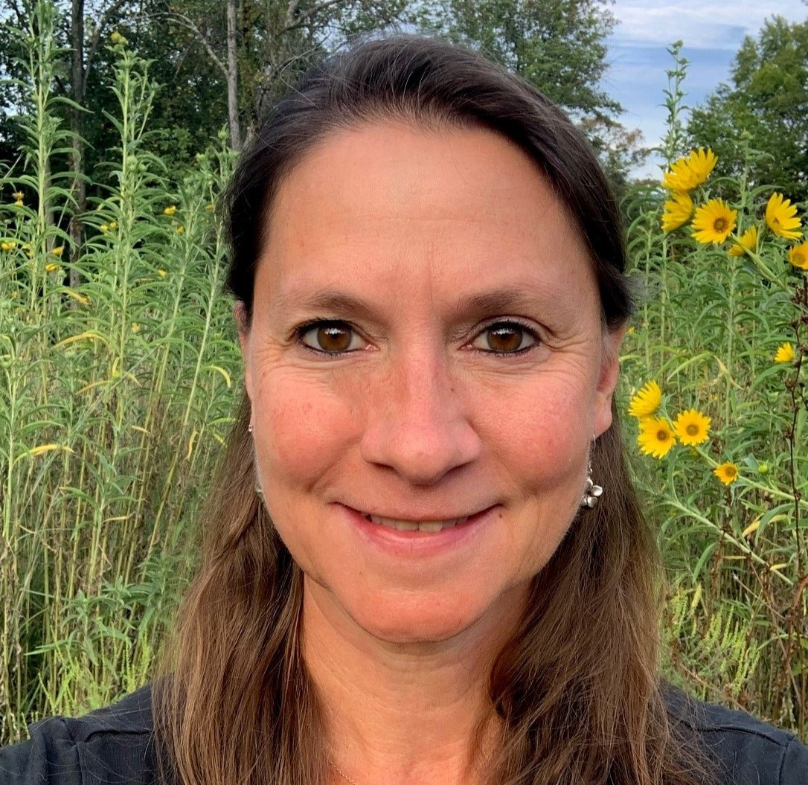
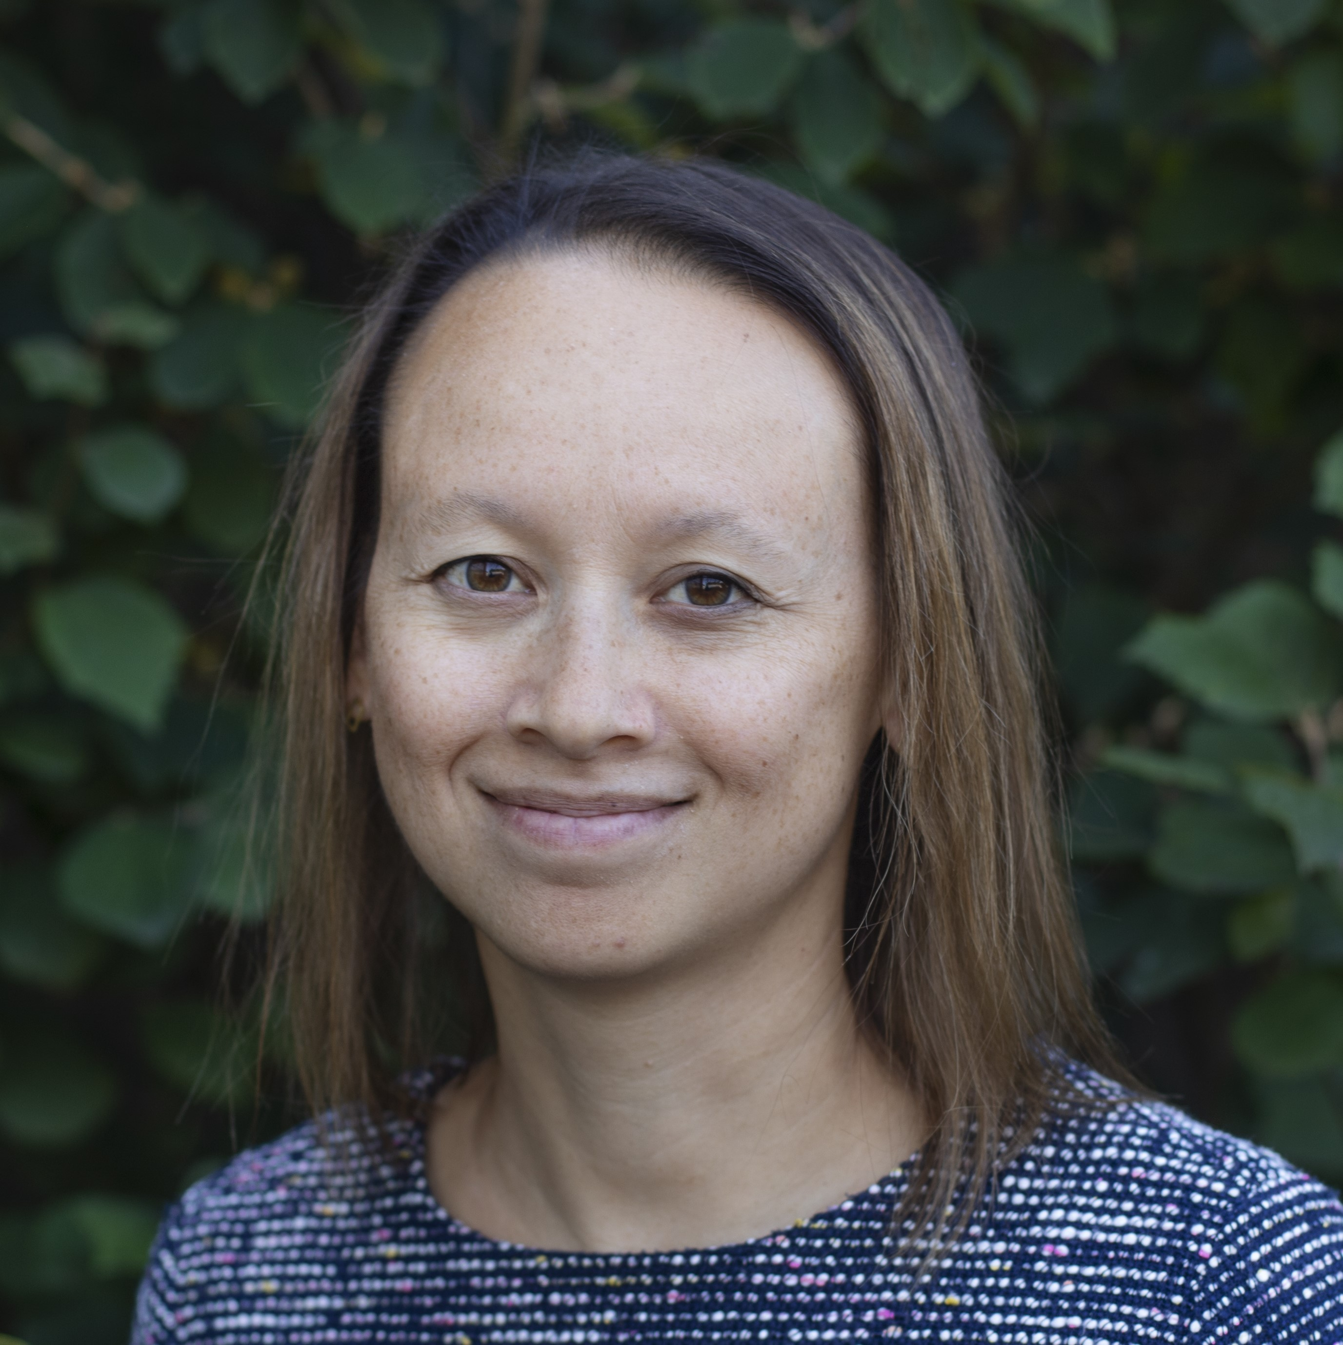
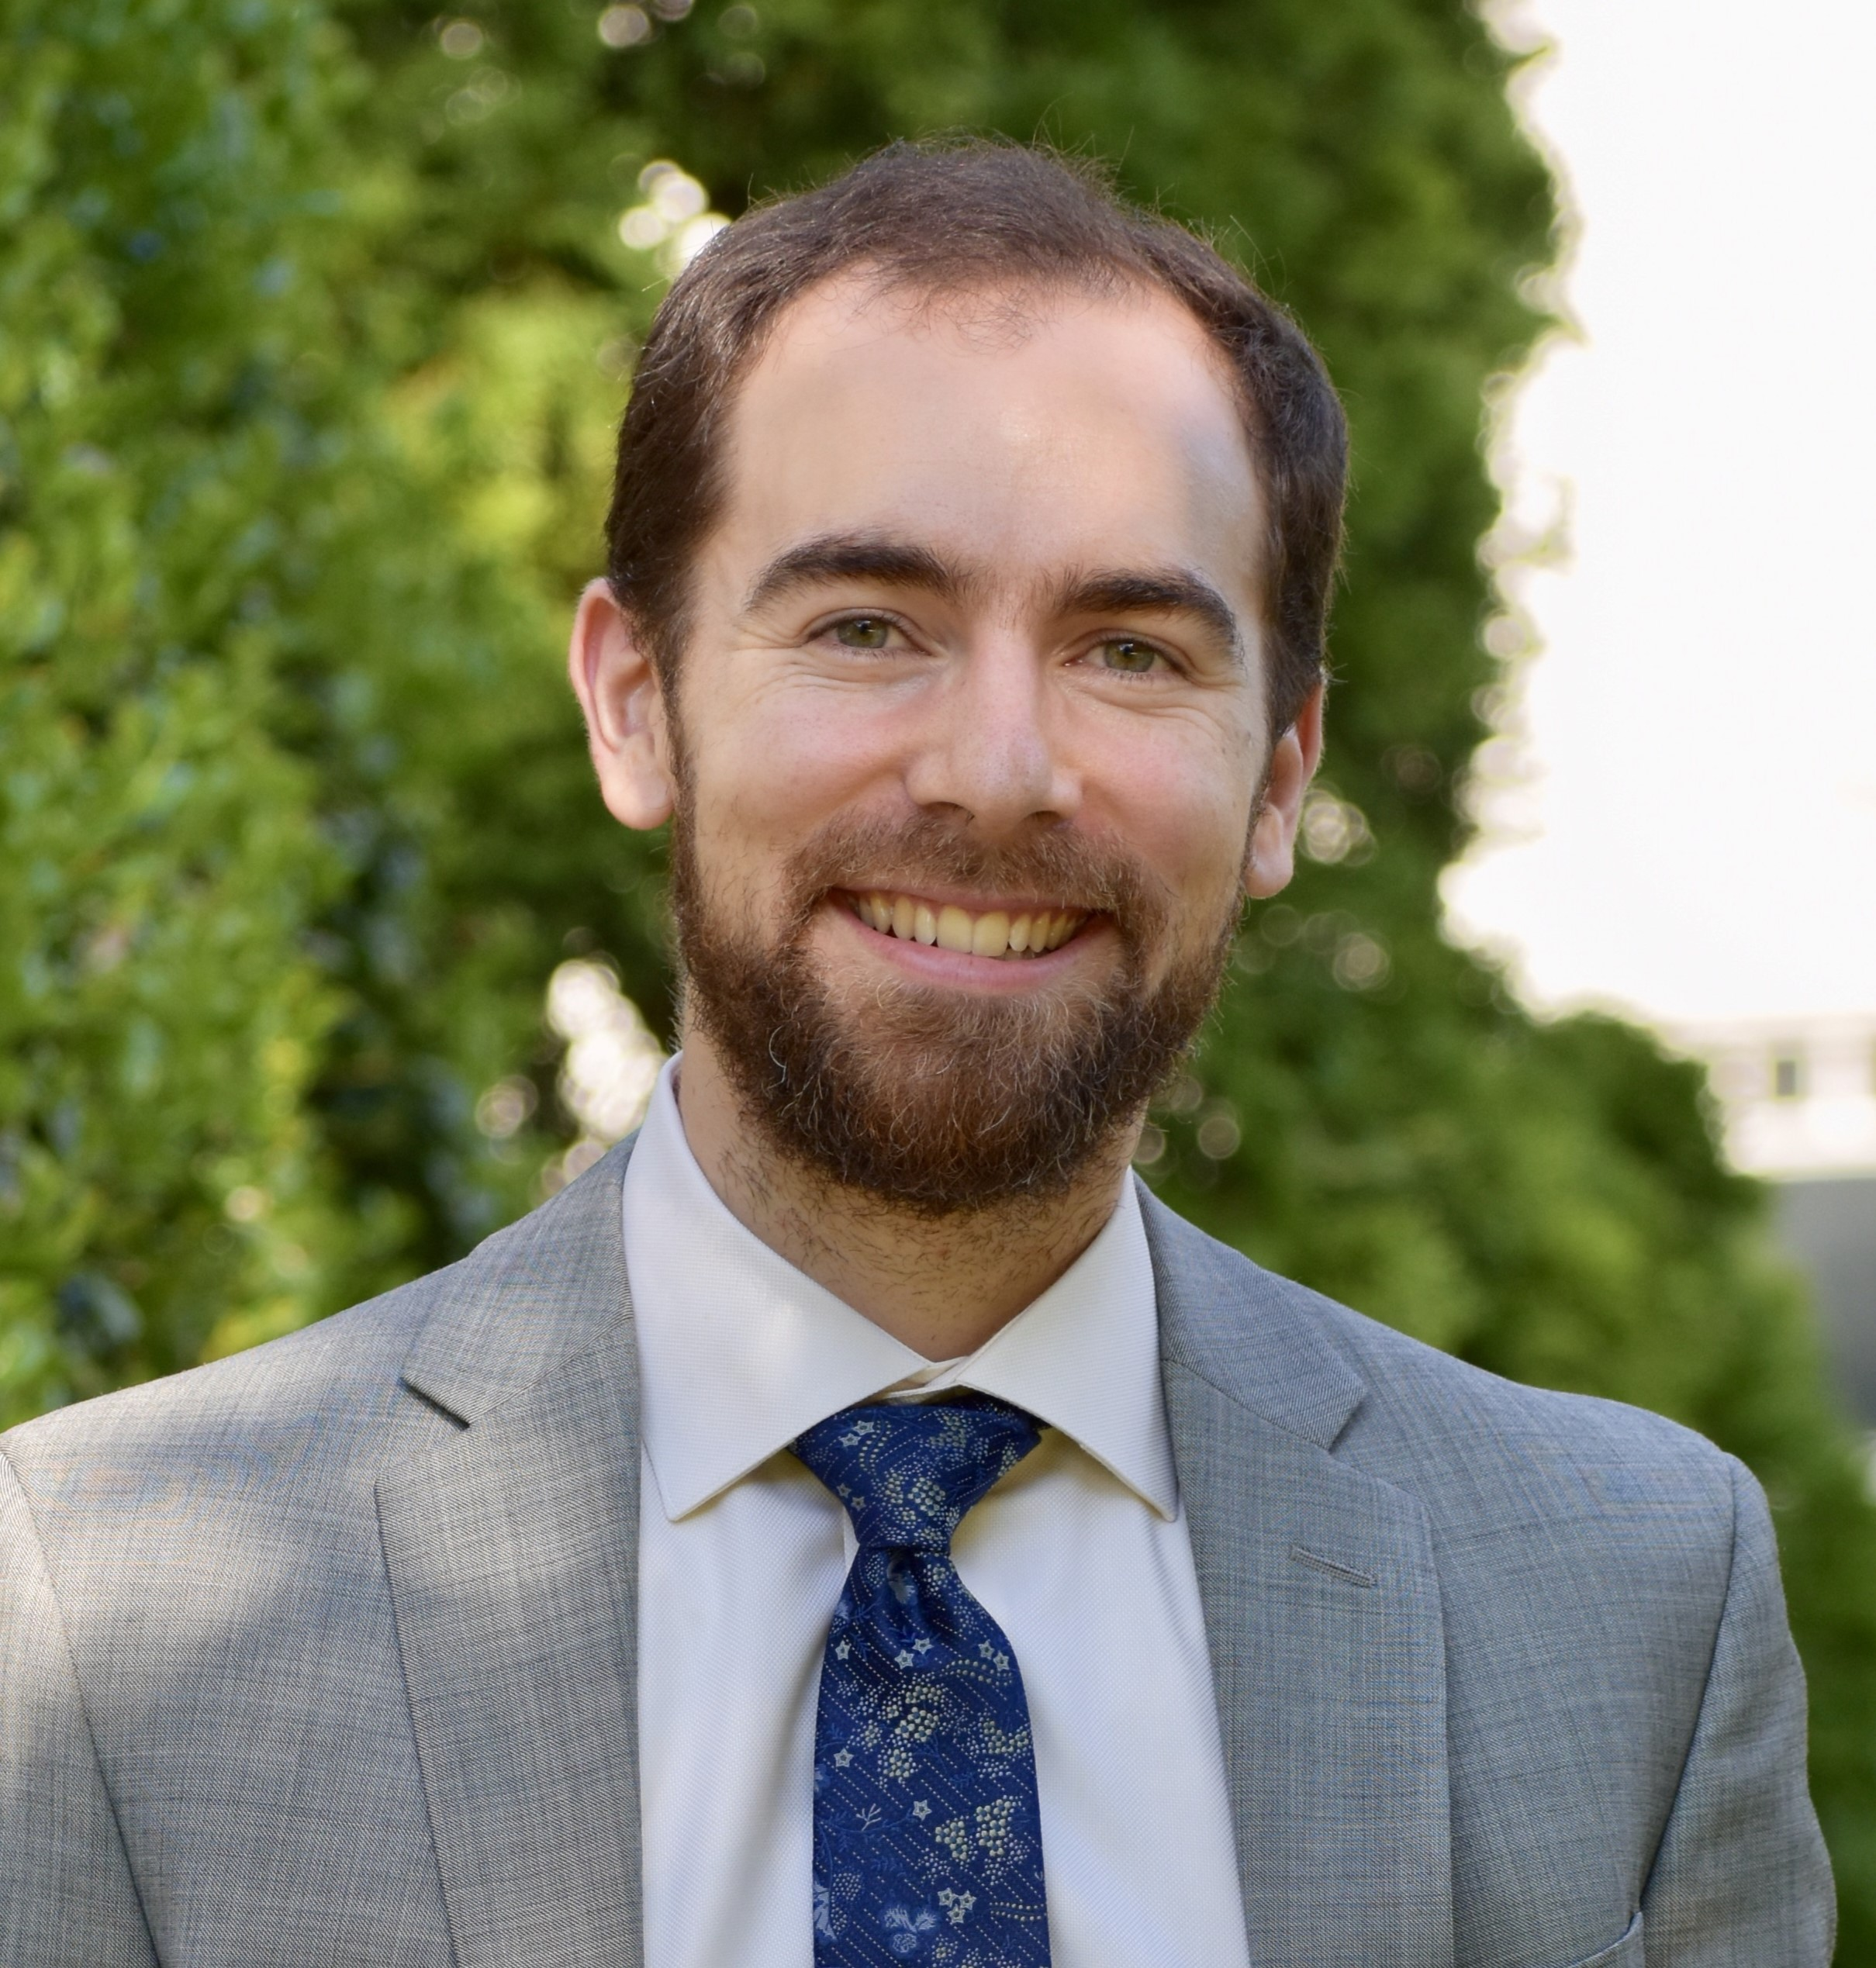
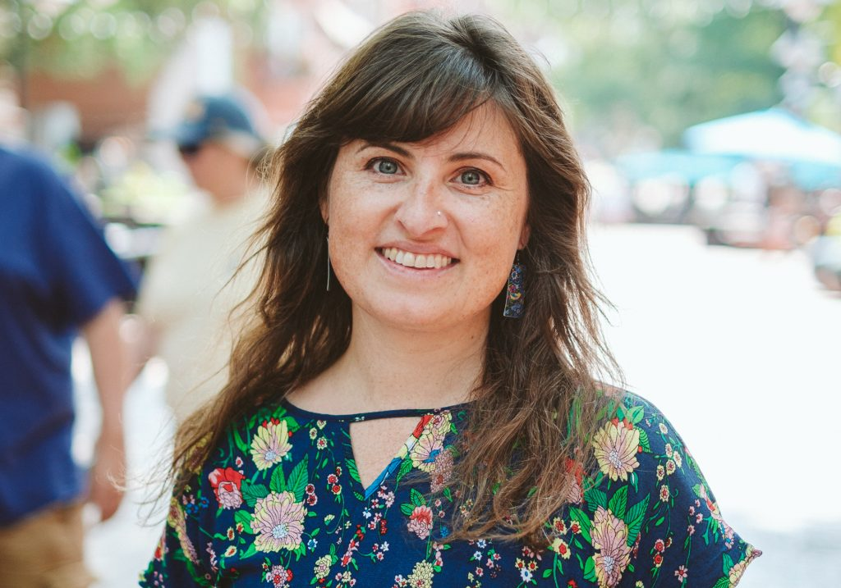
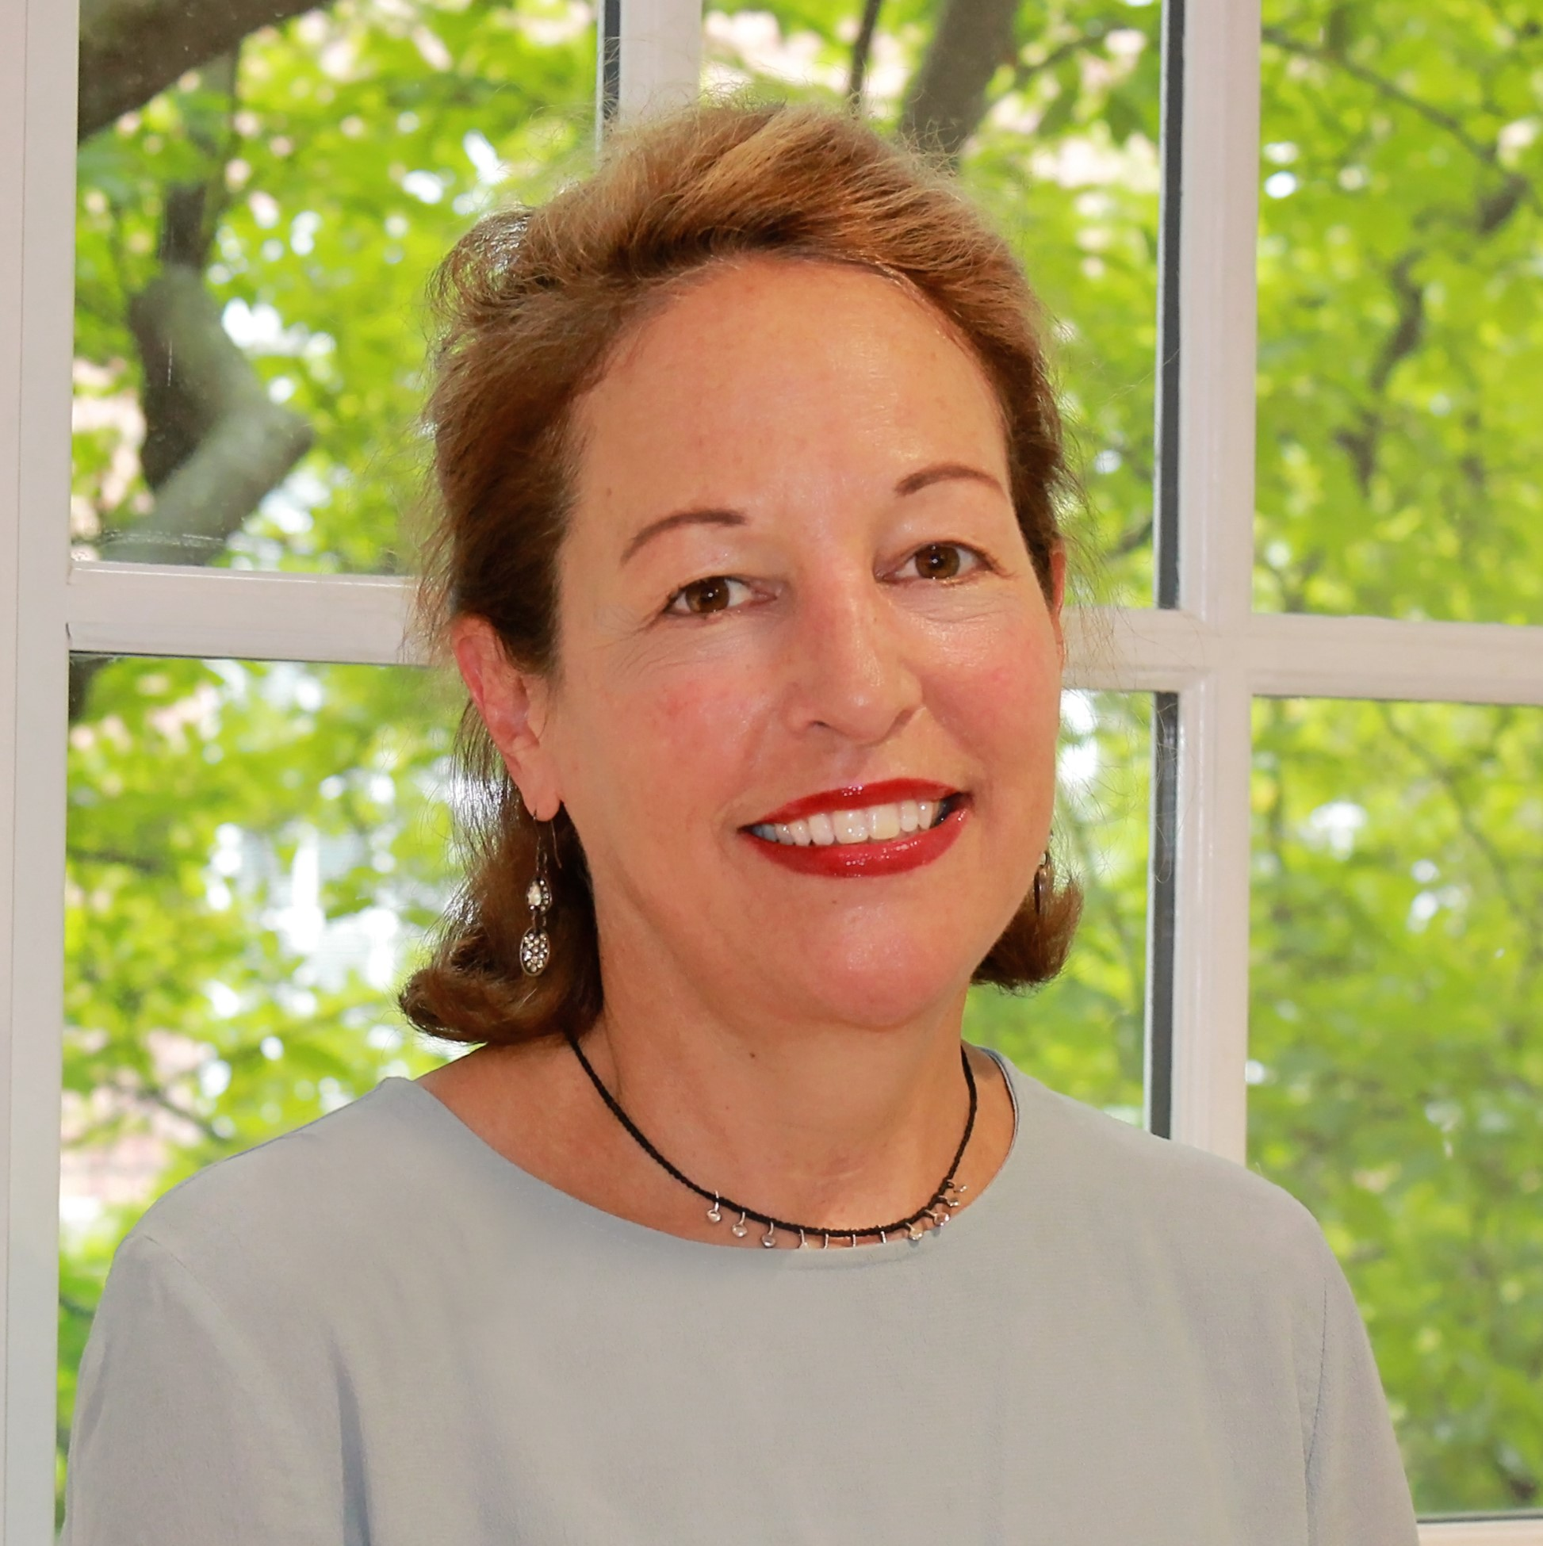
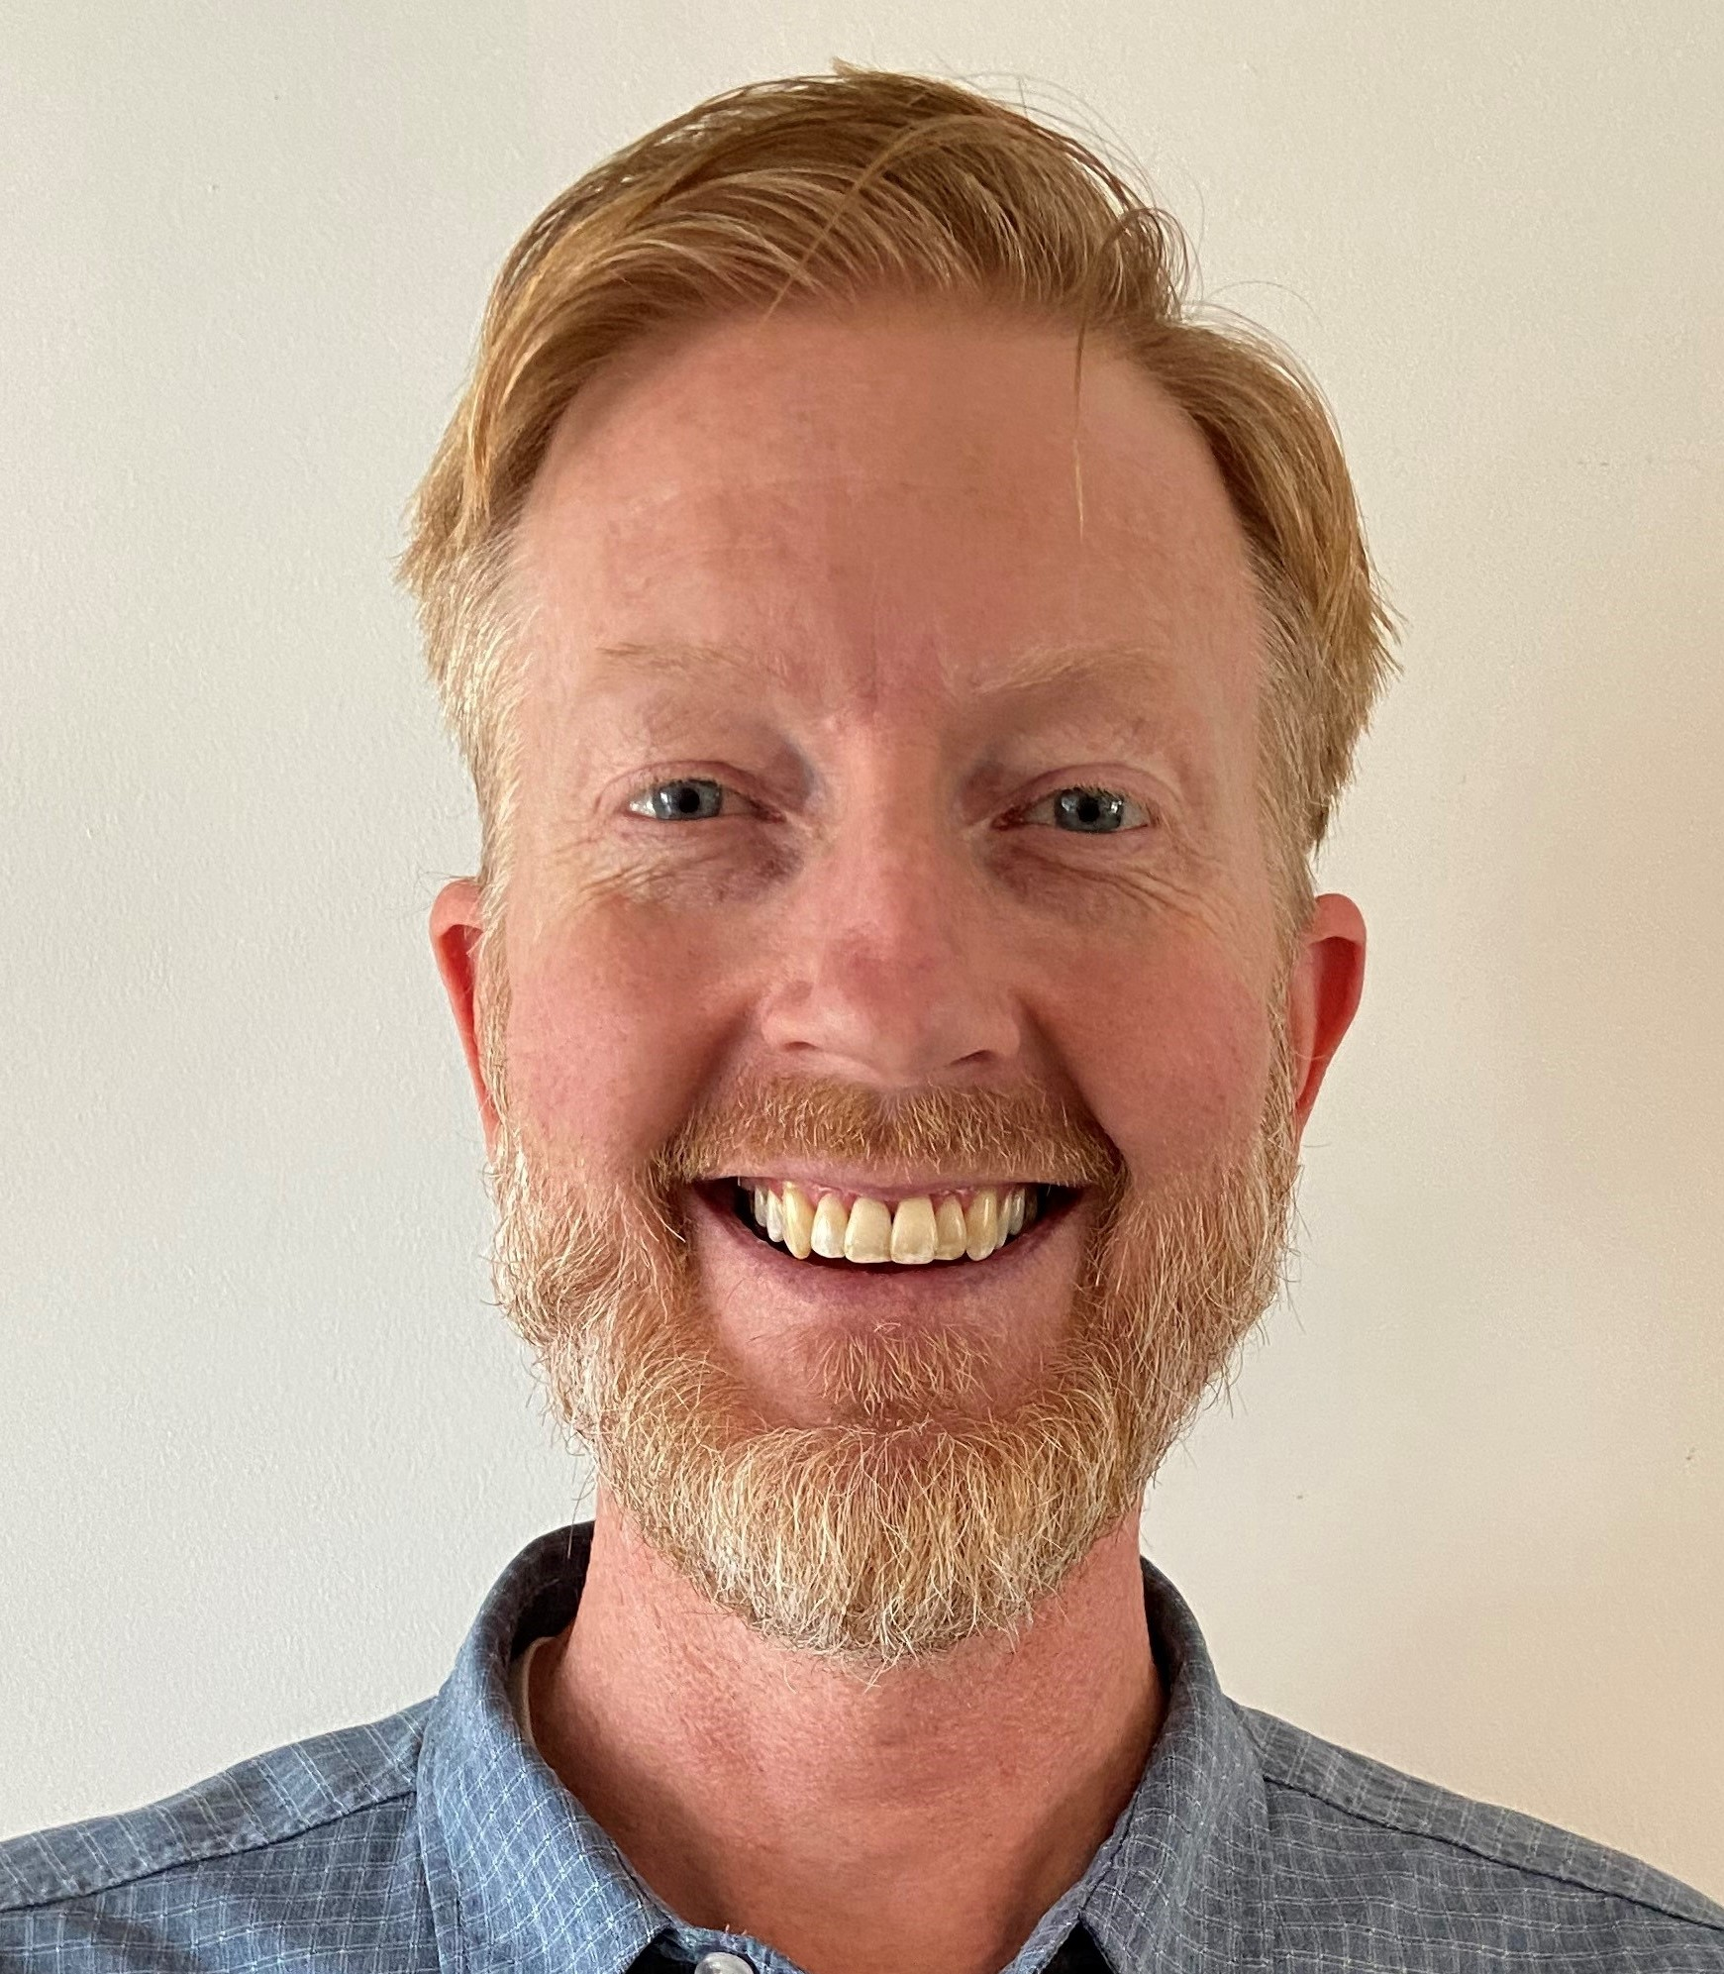
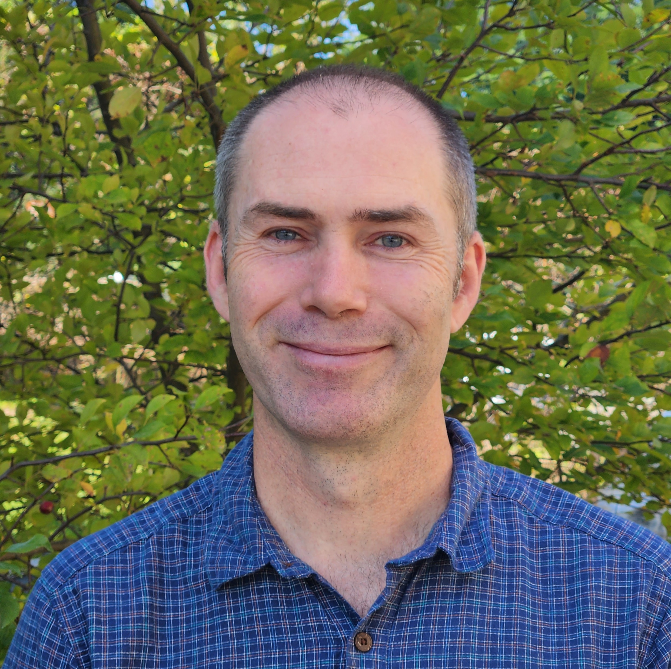

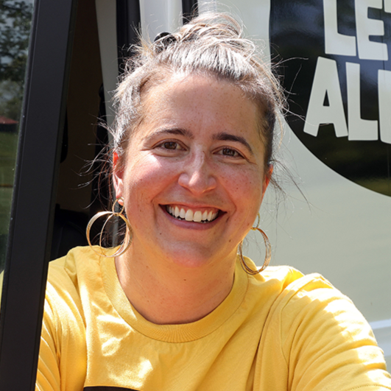
  Project Team
County
City
UVA
Greg Harper
Kristel Riddervold
Andrea Trimble
Gabe Dayley
Emily Irvine
Julia Monteith
Jamie Powers
Tray Biasiolli
Serena Gruia
Notes:
Emily

Slide 6
  Hazards & Risks: Overview
Extreme Heat
Wildfire Smoke
Drought
Local Hazards & Risks
Shifting Seasons & Pests
Heavy Rainfall & Flooding
Notes:
Emily

Slide 7
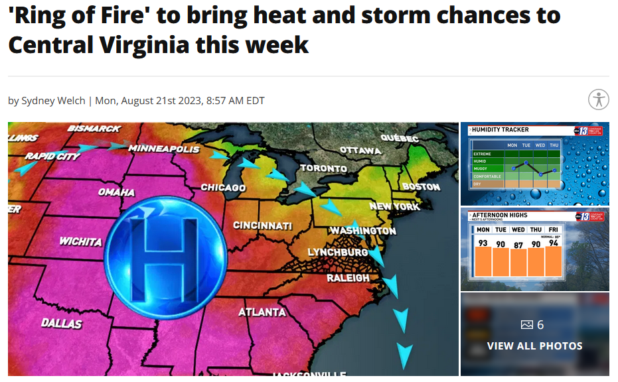
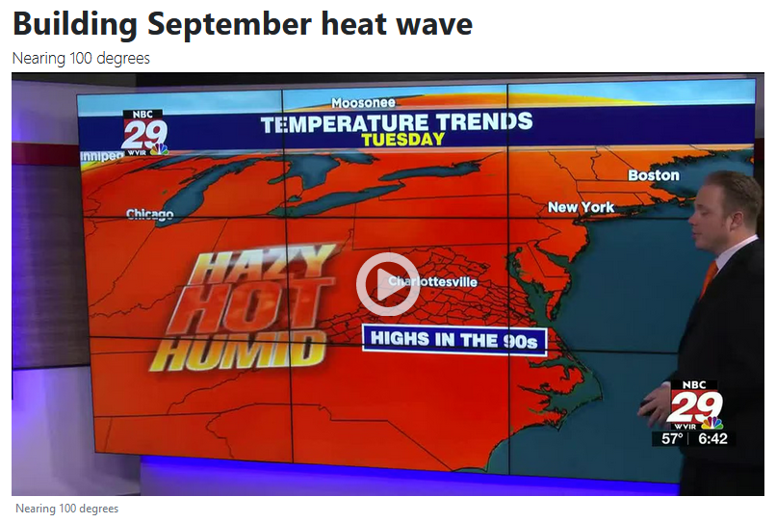
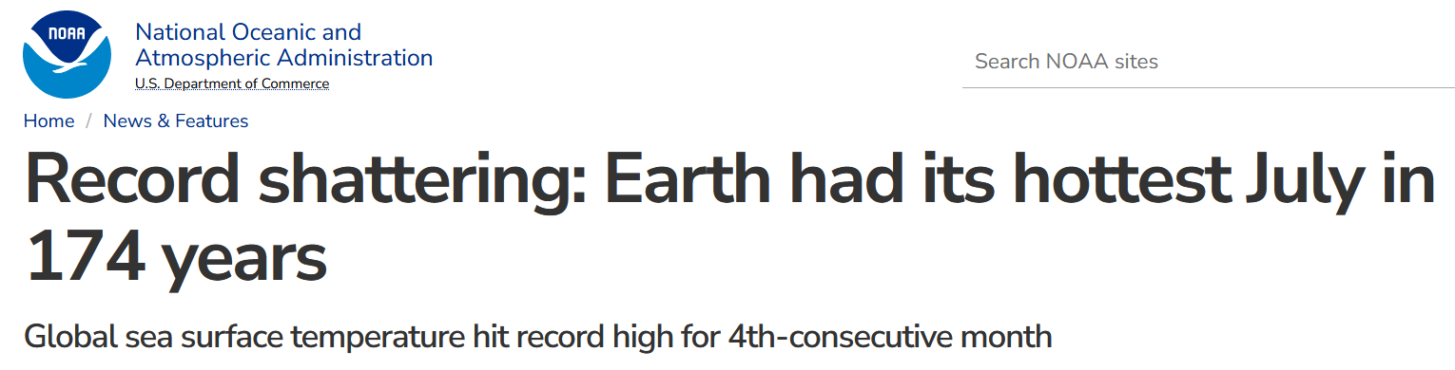
  Hazards & Risks: Extreme Heat
NBC29 News, Charlottesville 09/02/23
ABC13 News, Lynchburg, VA 08/21/23
NOAA News 08/14/23
Notes:
Emily

Slide 8
  Hazards & Risks: Extreme Heat
Number of Days per Year above 95°F
Current Climate
2050
2075
1 | 2 | 3 | 4 | 5 | 6 | 7
8 | 9 | 10 | 11 | 12 | 13 | 14
15 | 16 | 17 | 18 | 19 | 20 | 21
22 | 23 | 24 | 25 | 26 | 27 | 28
29 | 30 | 1 | 2 | 3 | 4 | 5
6​ | 7​ | 8 | 9​ | 10​ | 11 | 12
13 | 14​ | 15​ | 16 | 17​ | 18 | 19
20​ | 21​ | 22​ | 23​ | 24​ | 25 | 26
​27 | 28​ | 29​ | 30​ | 31​
1 | 2 | 3 | 4 | 5 | 6 | 7
8 | 9 | 10 | 11 | 12 | 13 | 14
15 | 16 | 17 | 18 | 19 | 20 | 21
22 | 23 | 24 | 25 | 26 | 27 | 28
29 | 30 | 1 | 2 | 3 | 4 | 5
6​ | 7​ | 8 | 9​ | 10​ | 11 | 12
13 | 14​ | 15​ | 16 | 17​ | 18 | 19
20​ | 21​ | 22​ | 23​ | 24​ | 25 | 26
​27 | 28​ | 29​ | 30​ | 31​
1 | 2 | 3 | 4 | 5 | 6 | 7
8 | 9 | 10 | 11 | 12 | 13 | 14
15 | 16 | 17 | 18 | 19 | 20 | 21
22 | 23 | 24 | 25 | 26 | 27 | 28
29 | 30 | 1 | 2 | 3 | 4 | 5
6​ | 7​ | 8 | 9​ | 10​ | 11 | 12
13 | 14​ | 15​ | 16 | 17​ | 18 | 19
20​ | 21​ | 22​ | 23​ | 24​ | 25 | 26
​27 | 28​ | 29​ | 30​ | 31​
5 Days
25-35 Days
32-56 Days
Observed 30 Year Average (1990-2020), Monticello Station
Lower Emission Scenario
(steep emission reductions)
Higher Emission Scenario
(business as usual)
Data from Albemarle’s Climate Vulnerability & Risk Assessment (2022)

Slide 9
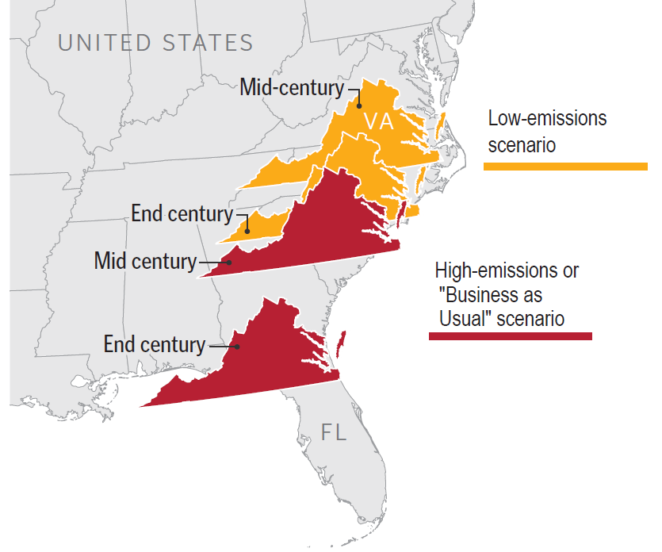
  Hazards & Risks: Extreme Heat
“Virginia Climate Fever”, The Roanoke Times 2014
Notes:
Emily

Slide 10
  Hazards & Risks: Drought
Dry periods are predicted to increase
Data from Albemarle County Climate Vulnerability and Risk Assessment (2022)
Notes:
Gabe

Slide 11
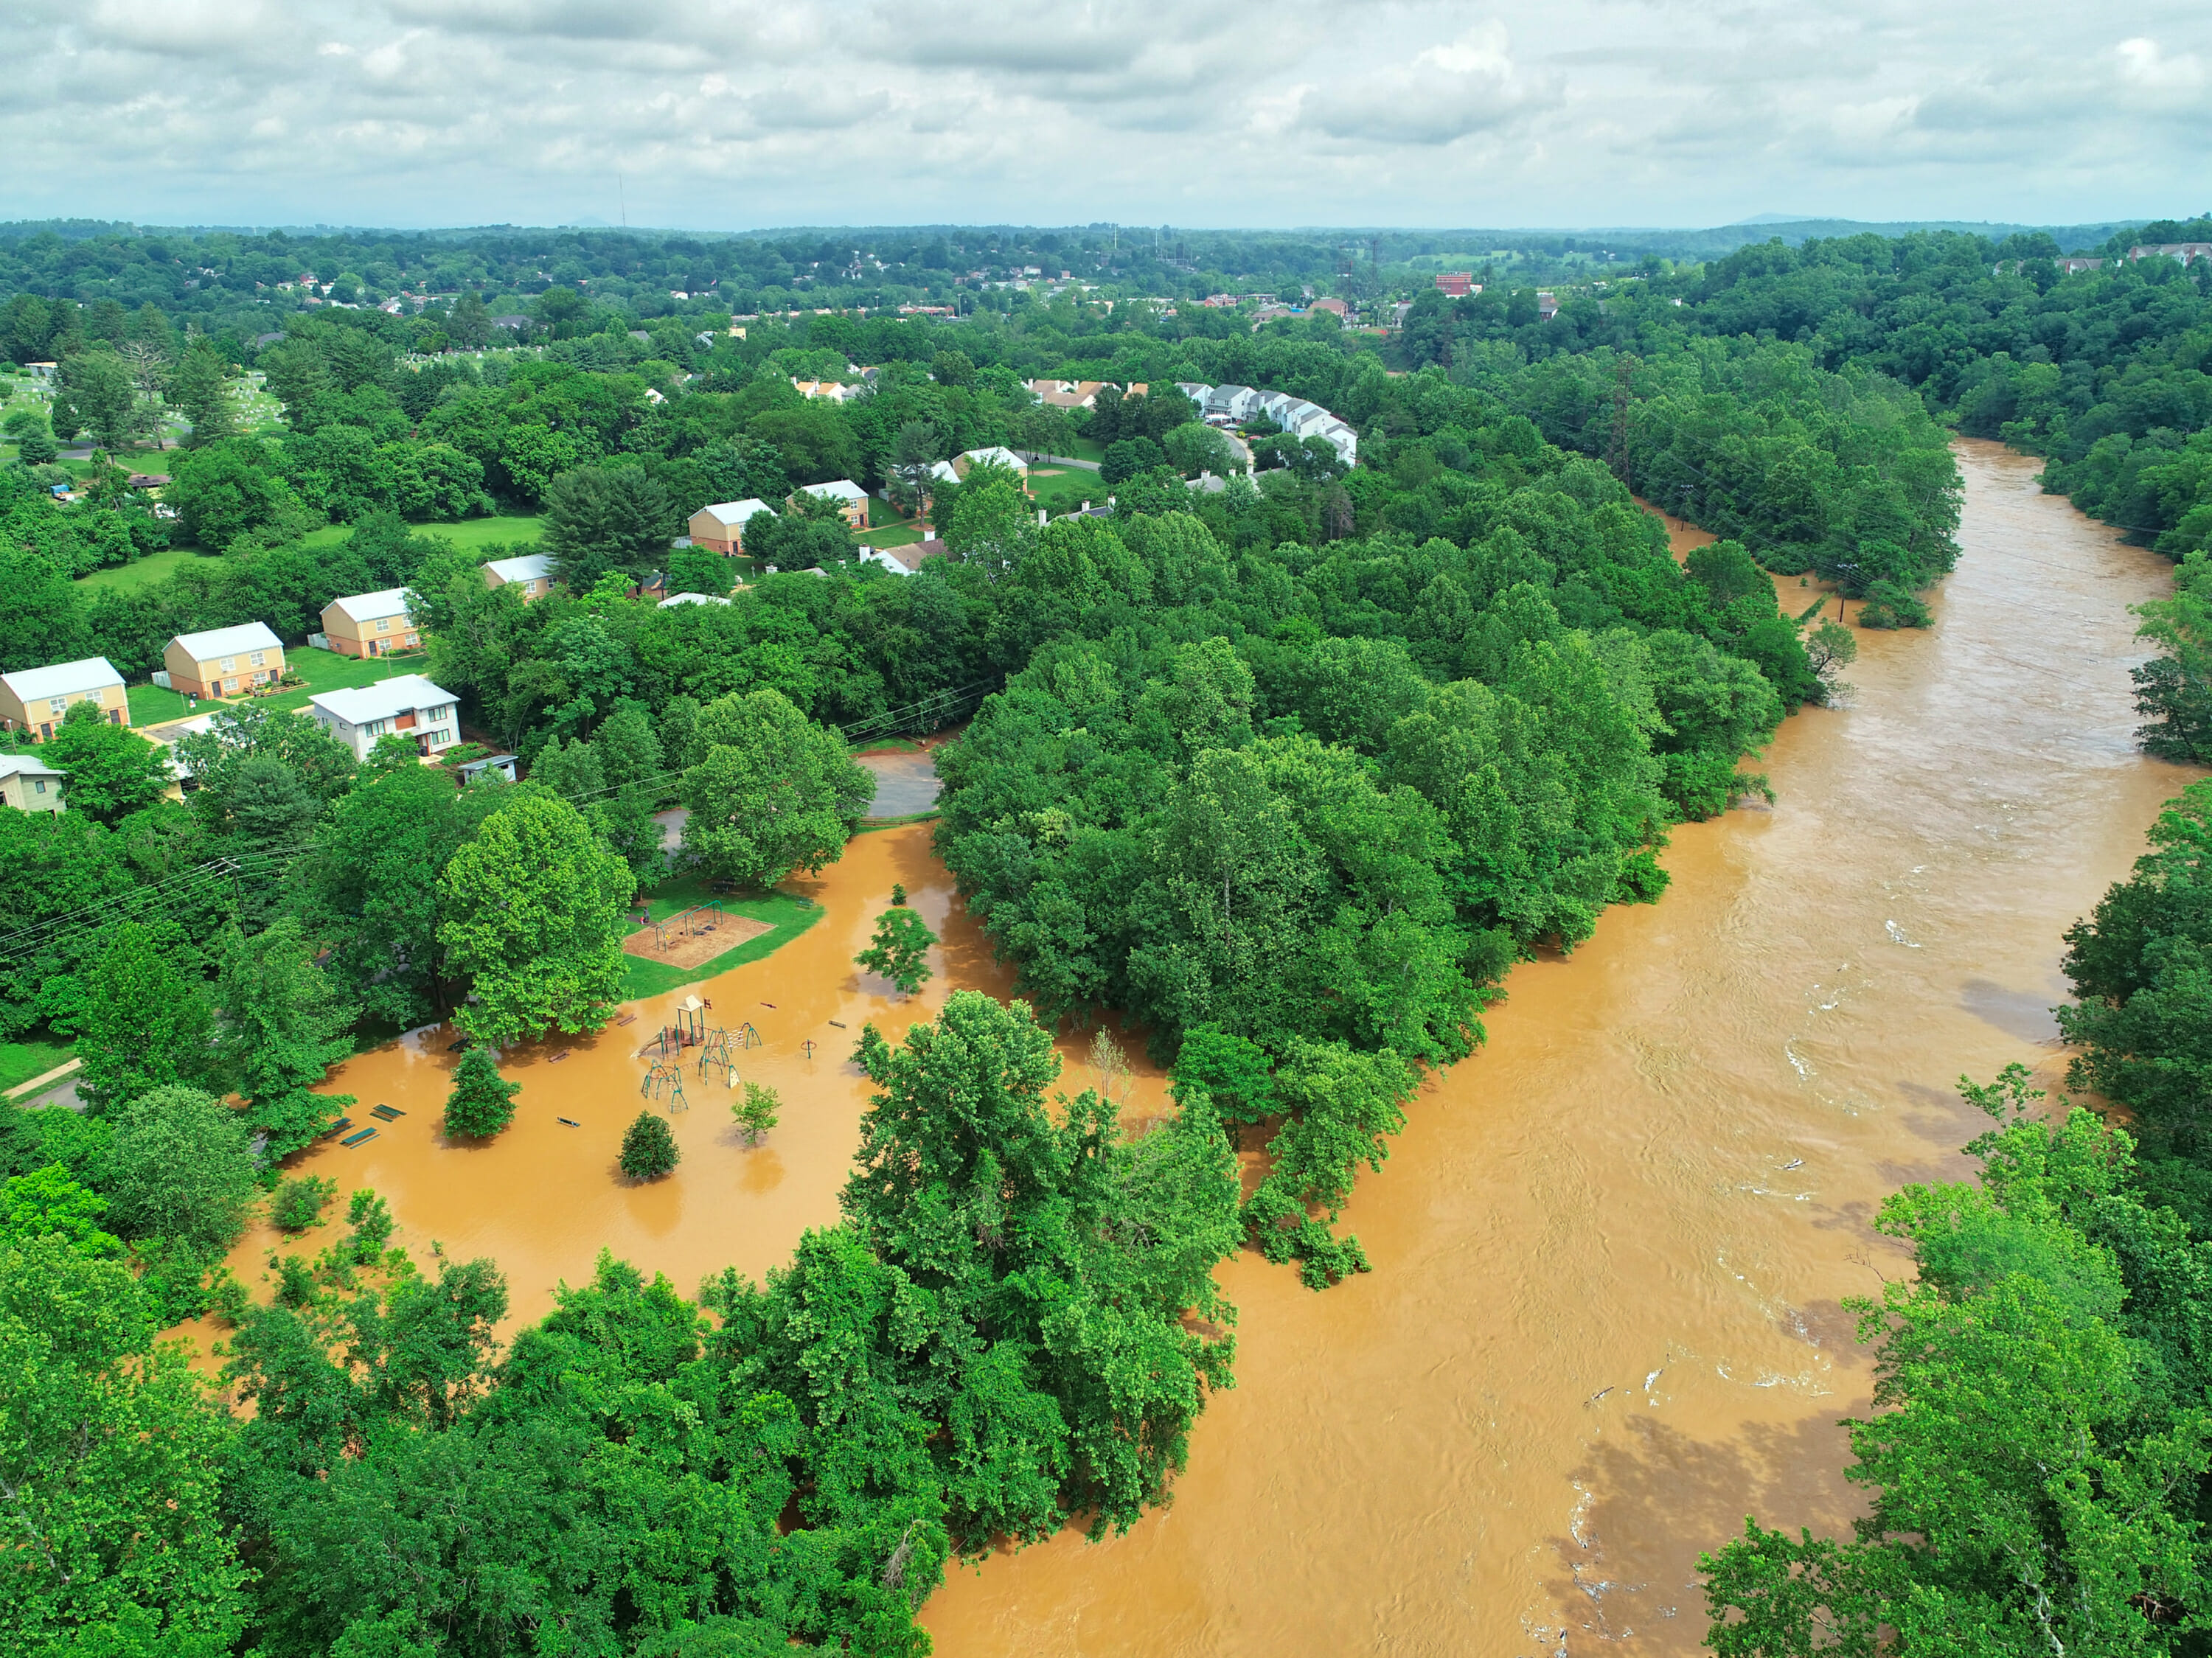
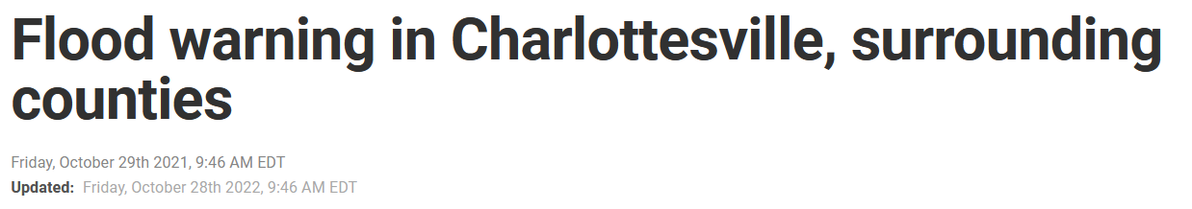
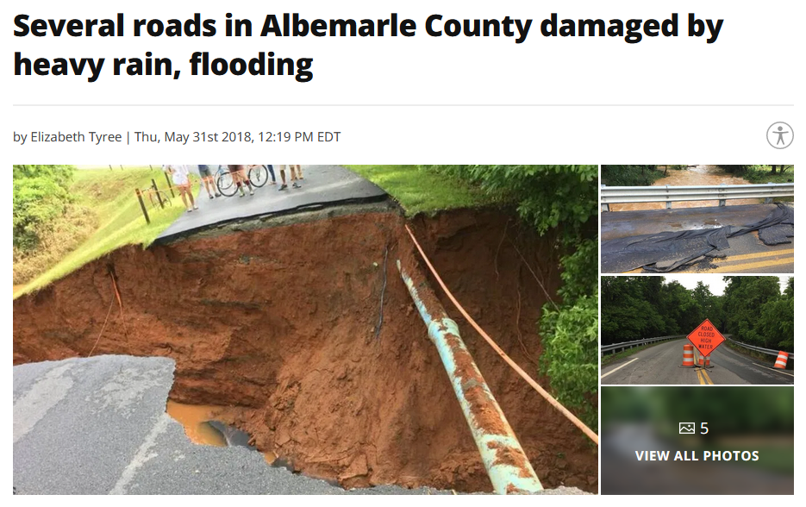
  Hazards & Risks: Increased Flooding
CBS19 News 10/29/21
C’ville Weekly 06/05/2018
ABC13 News 05/31/18
Notes:
Gabe

Slide 12
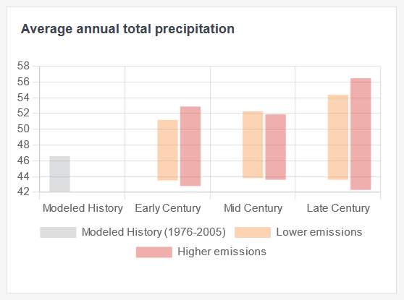
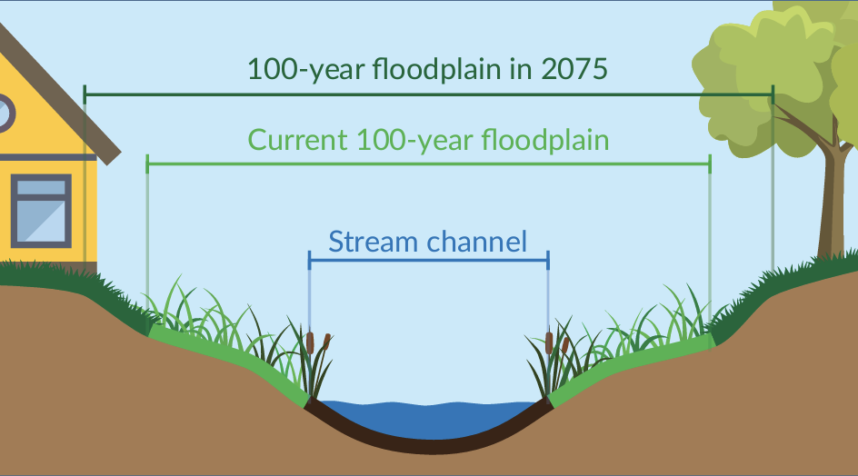
  Hazards & Risks: Increased Flooding
Precipitation is increasing…
…and our floodplains are growing.
Data for Albemarle County, Climate Mapping for Resilience and Adaptation Tool (CMRA)
Note: Illustrative graphic; not an actual local stream channel
Notes:
Gabe

Slide 13
  Hazards & Risks: Changing Seasons
Frost Days: Number of Days per Year with Minimum Temperature below 32°F
Current Climate
2050
2100
1 | 2 | 3 | 4 | 5 | 6 | 7
8 | 9 | 10 | 11 | 12 | 13 | 14
15 | 16 | 17 | 18 | 19 | 20 | 21
22 | 23 | 24 | 25 | 26 | 27 | 28
29 | 30 | 1 | 2 | 3 | 4 | 5
6​ | 7​ | 8 | 9​ | 10​ | 11 | 12
13 | 14​ | 15​ | 16 | 17​ | 18 | 19
20​ | 21​ | 22​ | 23​ | 24​ | 25 | 26
​27 | 28​ | 29​ | 30​ | 31​ | 1 | 3
1 | 2 | 3 | 4 | 5 | 6 | 7
8 | 9 | 10 | 11 | 12 | 13 | 14
15 | 16 | 17 | 18 | 19 | 20 | 21
22 | 23 | 24 | 25 | 26 | 27 | 28
29 | 30 | 1 | 2 | 3 | 4 | 5
6​ | 7​ | 8 | 9​ | 10​ | 11 | 12
13 | 14​ | 15​ | 16 | 17​ | 18 | 19
20​ | 21​ | 22​ | 23​ | 24​ | 25 | 26
​27 | 28​ | 29​ | 30​ | 31​
1 | 2 | 3 | 4 | 5 | 6 | 7
8 | 9 | 10 | 11 | 12 | 13 | 14
15 | 16 | 17 | 18 | 19 | 20 | 21
22 | 23 | 24 | 25 | 26 | 27 | 28
29 | 30 | 1 | 2 | 3 | 4 | 5
6​ | 7​ | 8 | 9​ | 10​ | 11 | 12
13 | 14​ | 15​ | 16 | 17​ | 18 | 19
20​ | 21​ | 22​ | 23​ | 24​ | 25 | 26
​27 | 28​ | 29​ | 30​ | 31​
63 Days
49 Days
29 Days
Observed 30 Year Average (1990-2020), Charlottesville
Higher Emission Scenario
(business as usual)
Data from Charlottesville’s Climate Risk and Vulnerability Assessment 2022

Slide 14
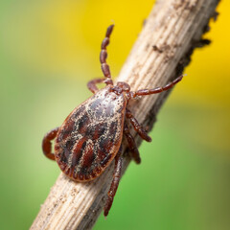
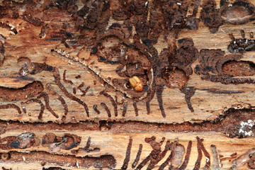
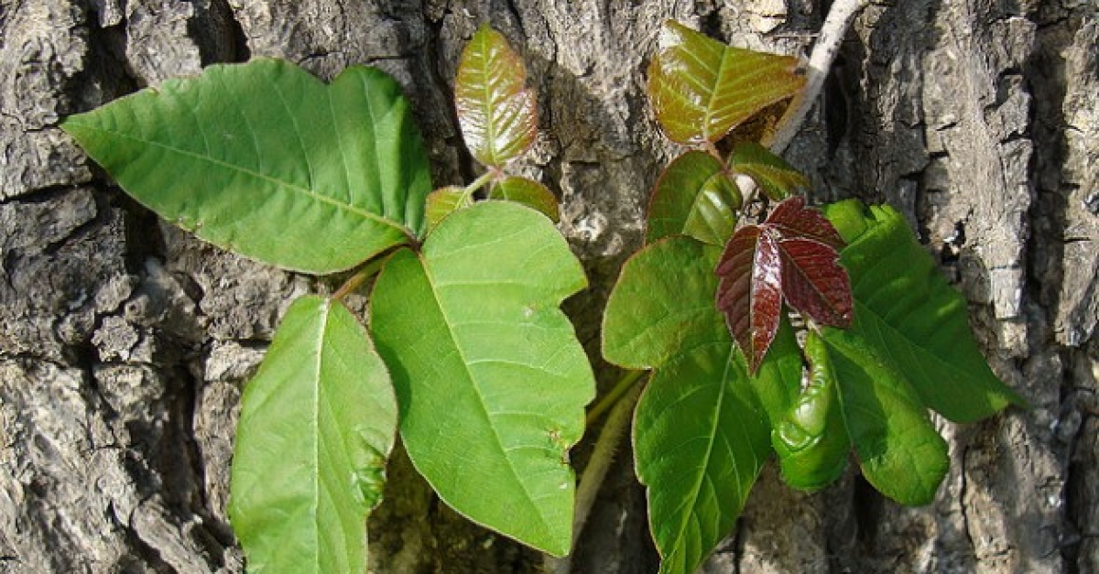
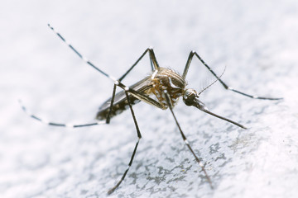
  Hazards & Risks: Changing Seasons
By 2050, we expect:
1 additional month of mosquito activity each year
3 additional weeks of tick activity each year
More cases of tick-borne illness
Increased risk of pests and disease affecting trees
Increased risk of agricultural loss due to pests
Data from Albemarle County Climate Vulnerability and Risk Assessment 2022
Notes:
Emily
Gabe: reduce prediction section; add line about how other hazards compound these

Slide 15
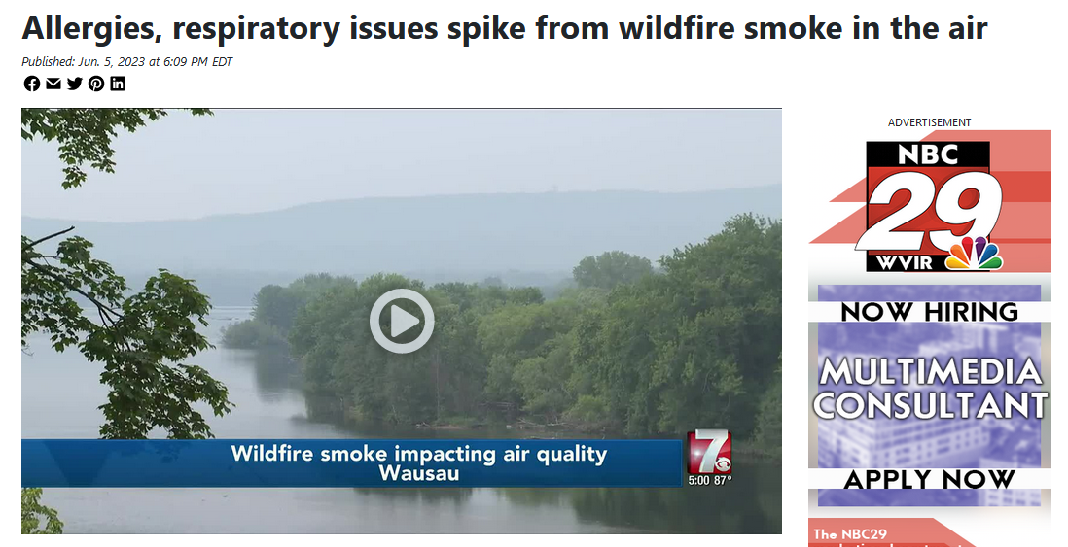
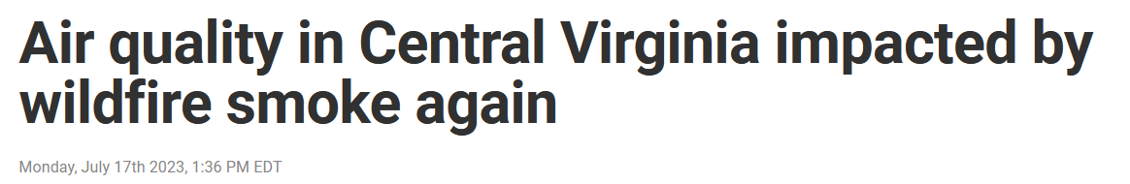
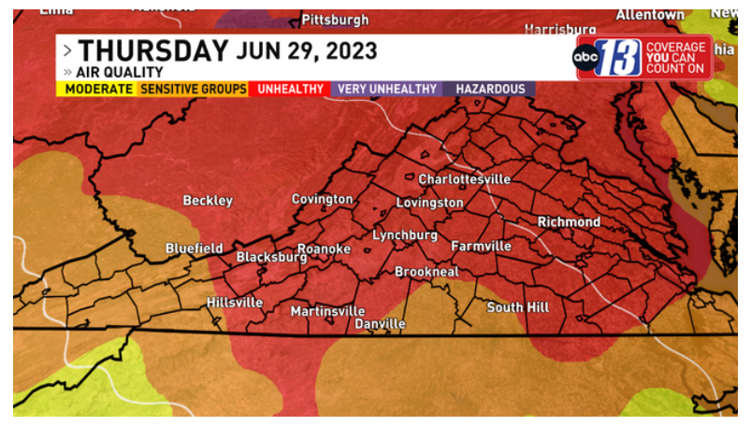

  Hazards & Risks: Wildfire Smoke
CBS19 News 07/17/23
NBC29 News 06/05/23
UVA Today 06/09/23
ABC13 News 06/29/23
Notes:
Emily

Slide 16
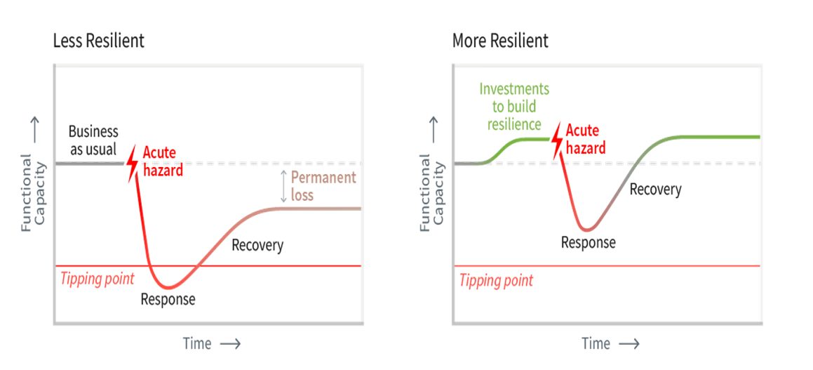
  Resilient Together: The Goal
How is building resilience different from emergency response?
Notes:
Gabe

Slide 17



  Community Systems
Our
Community
Public Health & Wellness
Natural Environment
Built Environment
Infrastructure
Economy & Livelihoods
Transportation
Energy
Resilient Together aims to strengthen existing community systems.
How does your work fit in?
Notes:
Emily

Slide 18
  Resilient Together: Why You’re Here
Department | Potential Issue of Concern | Example prediction
Fire/Rescue | Extreme Heat | Ambulance calls – 2x today in 2050
Social Services | Extreme Heat | Increased need to provide cooling for unhoused or those without A/C
Emergency Management | Flooding/Increased Storm Intensity | Extended loss of power/service, Inaccessible locations
Utilities/Regional Services | Drought | Extended dry periods necessitate water conservation measures
Facilities/Public Works | Flooding/Increased Storm Intensity | Infrastructure damage
Parks & Rec | Poor Air Quality | Pests | Not safe for children/elderly/other vulnerable groups to be outside Tree stress and die-off
Economic Development | Ag. Pests | Extreme Heat | Loss of productivity, worker safety
Police | Extreme Heat | Violence goes up in extremely hot weather
Notes:
Gabe

Slide 19
  Resilient Together: Project Timeline
Prep
Discover
Define
Design
Decide
Do
Prepare for successful process
Foster shared knowledge of the challenge
Define goals
Design strategies for adaptation and resilience
Draft plan, adopt
Implement
January – August 2023
Sept 2023 – Feb 2024
March – May 2024
June – Nov 2024
Dec 2024 – March 2025
March 2025 onward!
Notes:
Gabe

Slide 20

1. January 2022 Winter Storm
  Preceded by 70°F weather
  Heavy, wet snow downed trees and power lines
  Extended power outages
How was your work impacted?
What would you do differently?
2. June 2023 Wildfire Smoke
  Wildfires in Canada
  Smoke across much of eastern US
  Poor air quality for days
How was your work impacted?
What would you do differently?

Slide 21
Comments or Questions?

Slide 22
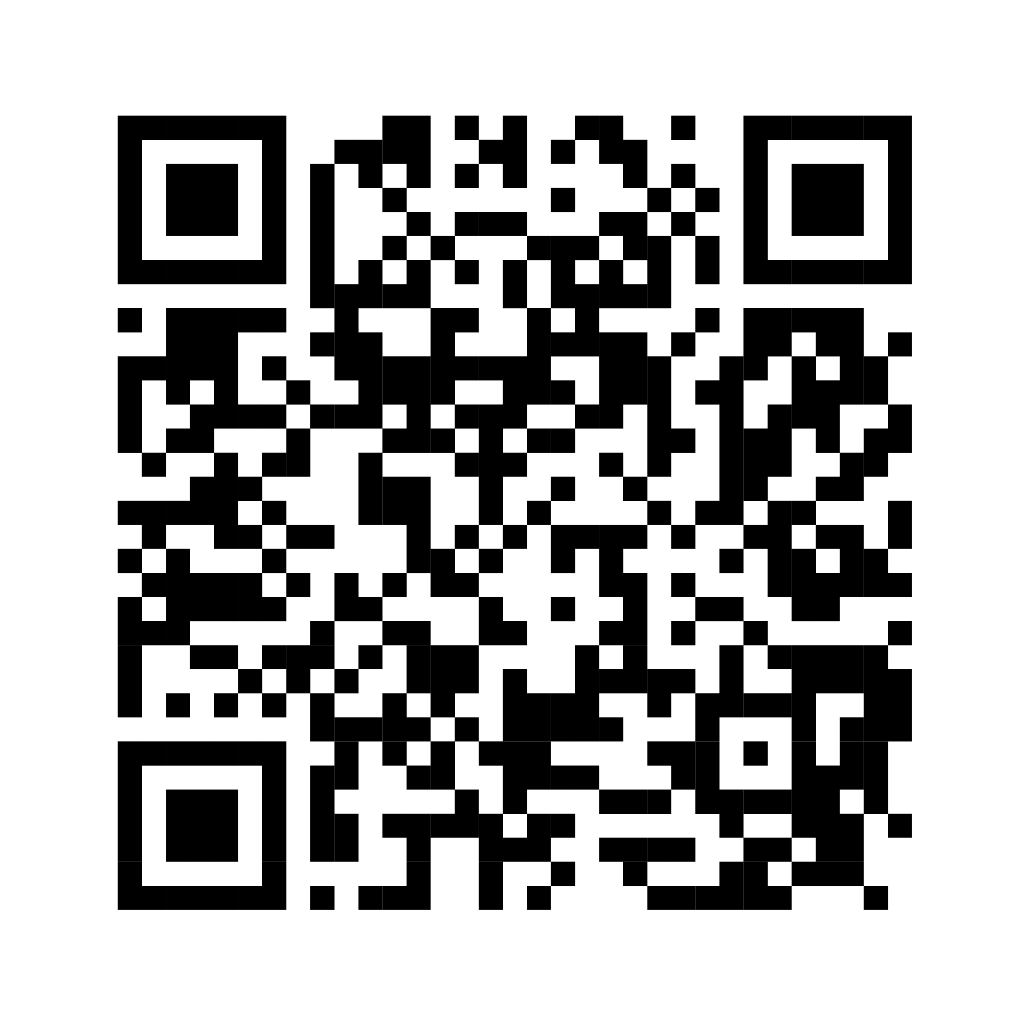
RESILIENT TOGETHER WEBSITE

