Slide 1
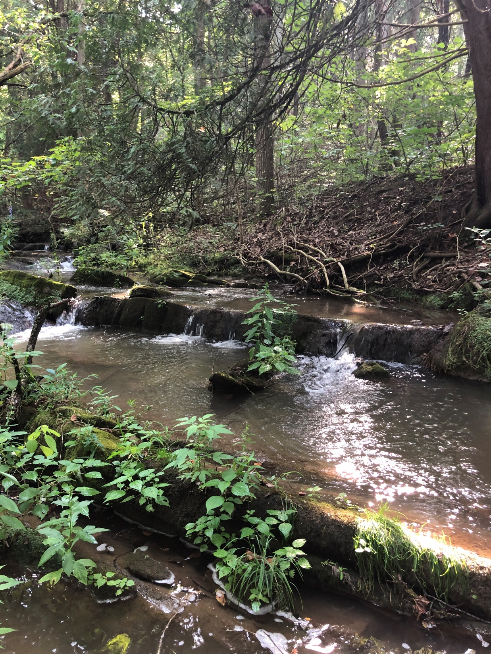
Moores and Mill Creek Clean Up Study
Community Kick Off Meeting
Nesha McRae
TMDL Coordinator, Valley Regional Office
October 19, 2021

Slide 2
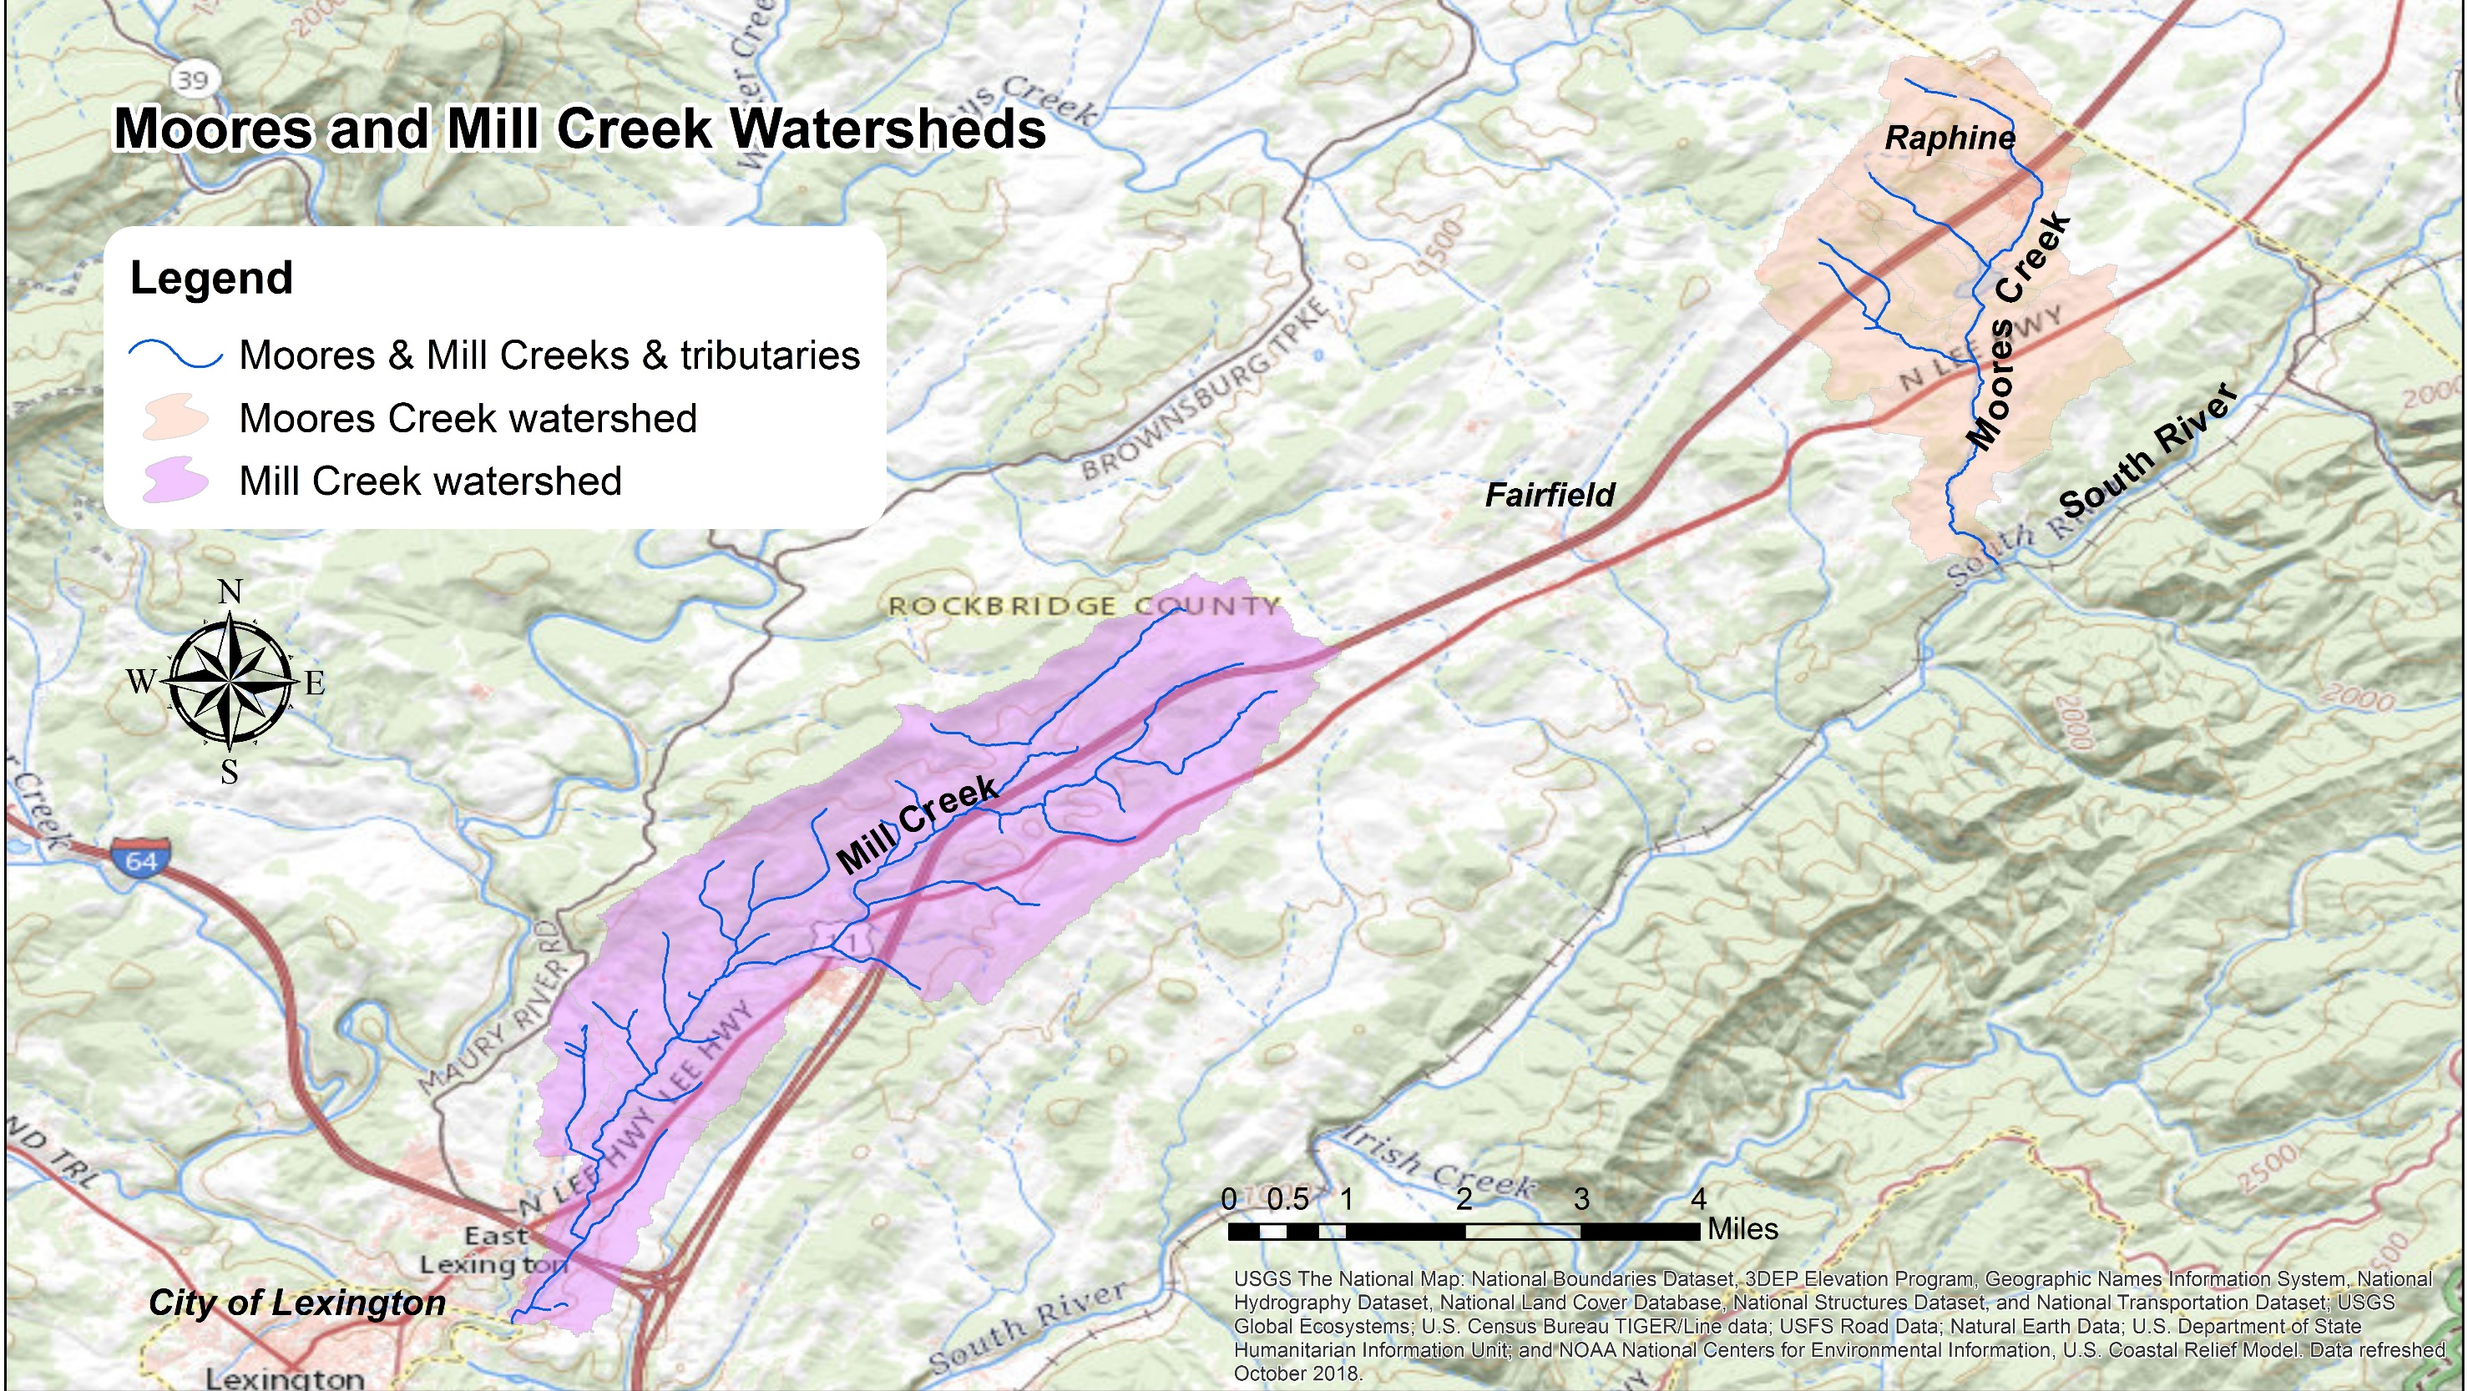
Moores and Mill Creek Watersheds
3,830 acres
7,390 acres

Slide 3

Why a study?
Photo: Jan Hamrsky: lifeinfreshwater.net
Aquatic life designated use
  All waters should support “the propagation and growth of a balanced, indigenous population of aquatic life”
What does this mean?
  Waters should be free of substances harmful to aquatic life
Monitor aquatic macroinvertebrates (the bugs) to determine if the standard is met

Slide 4
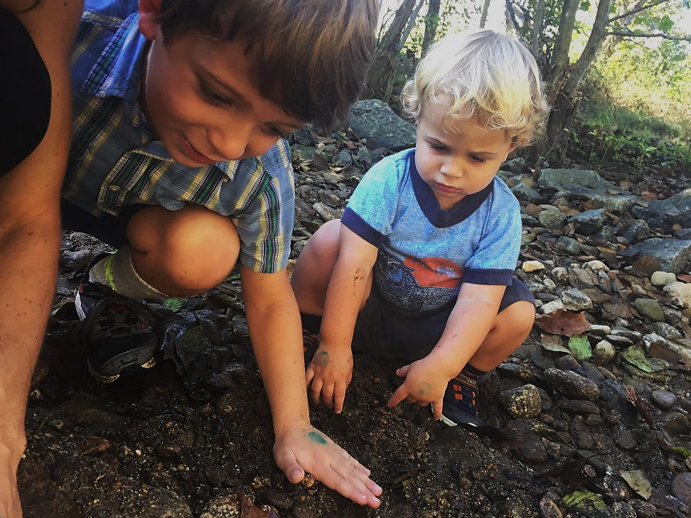
Why should we care about bugs?
Consume algae and organic matter → nutrient cycling
Aquatic food chain
Our “canary in the coal mine”
Chemical monitoring = a snapshot in time

Slide 5
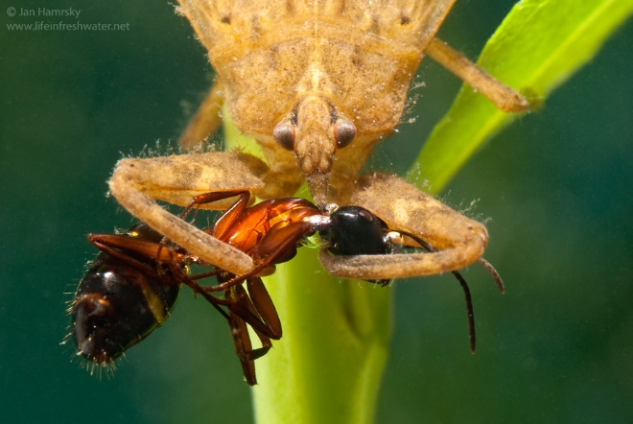
Determining a “biological impairment”
DEQ biological monitoring data (spring and fall)
VA Stream Condition Index is our barometer
  Diversity, pollution tolerance, feeding group
  Target score of ≥60
Photo: Jan Hamrsky: lifeinfreshwater.net

Slide 6
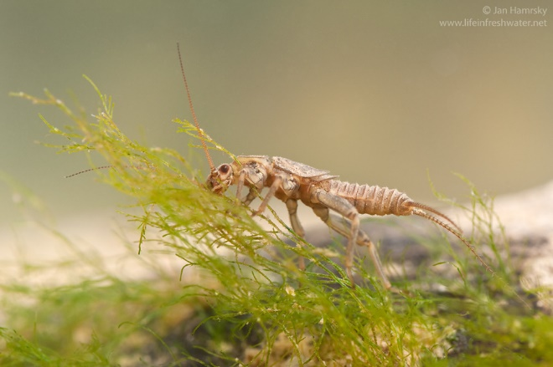
Sensitive to pollution: Stoneflies
Photo: Jan Hamrsky: lifeinfreshwater.net

Slide 7
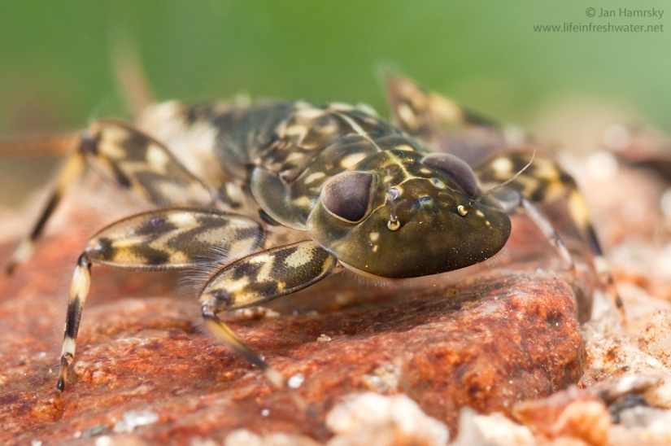
Sensitive to pollution: Mayflies
Sensitive to pollution: Mayflies
Photo: Jan Hamrsky: lifeinfreshwater.net

Slide 8
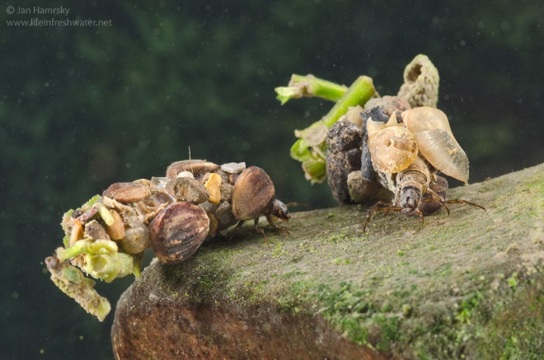
Caddisflies
Sensitive to pollution: Caddisflies
Photo: Jan Hamrsky: lifeinfreshwater.net

Slide 9
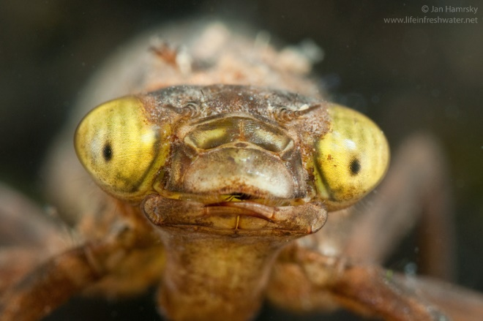
Moderately Sensitive: Dragonflies
Photo: Jan Hamrsky: lifeinfreshwater.net

Slide 10

Insensitive to Pollution: Blackflies
Photo: Jan Hamrsky: lifeinfreshwater.net

Slide 11

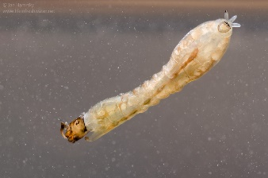


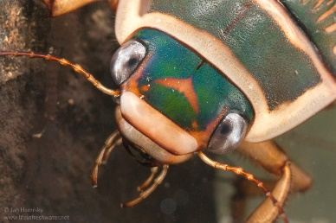
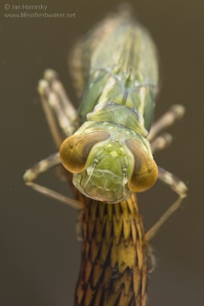
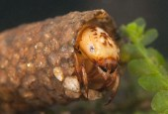
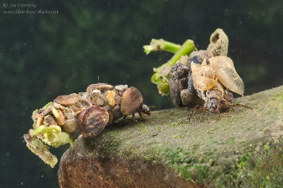
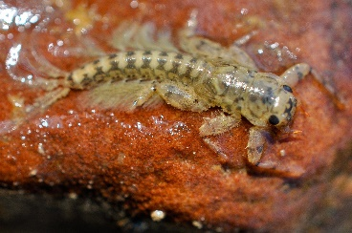
Virginia Stream Condition Index
60
40
20
Photos: Jan Hamrsky: lifeinfreshwater.net

Slide 12
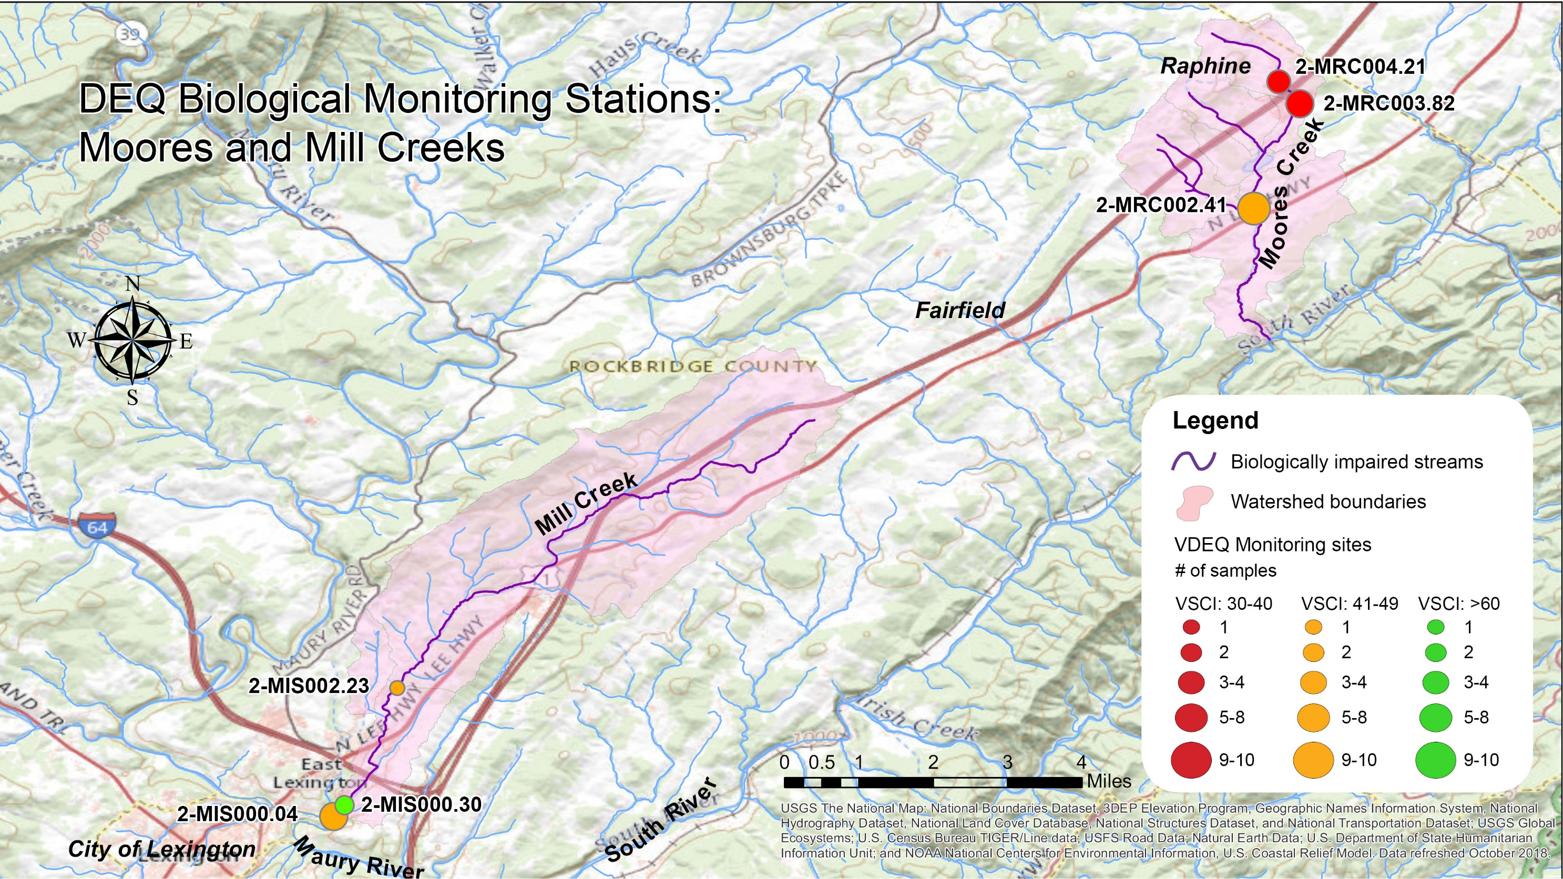
DEQ Biological Monitoring Stations

Slide 13
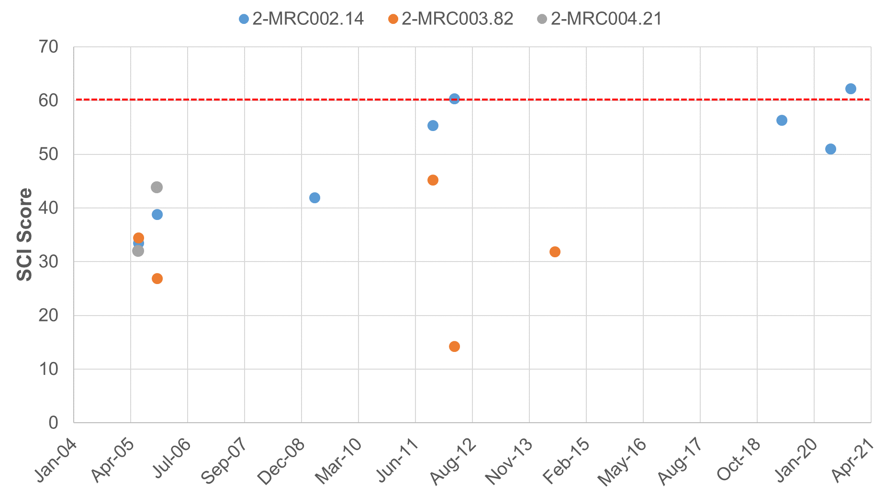
Moores Creek VSCI Scores

Slide 14
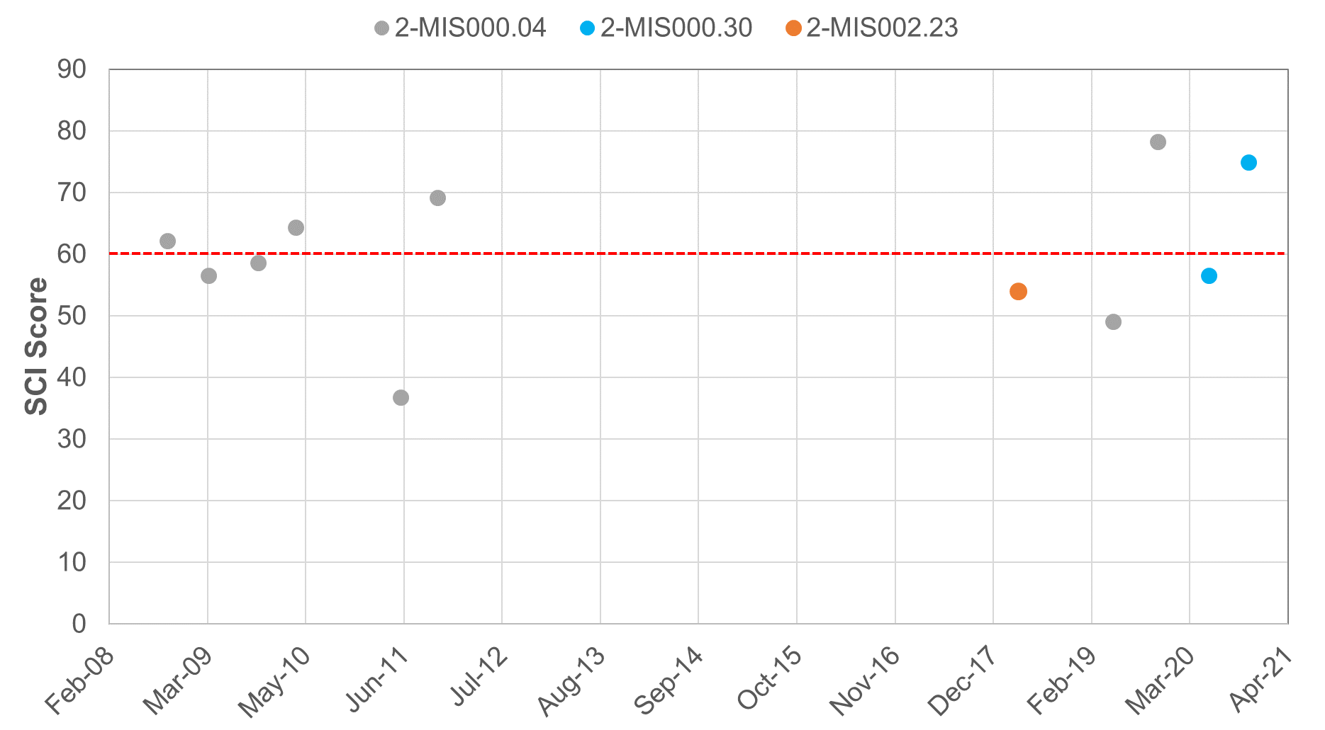
Mill Creek VSCI Scores

Slide 15






What is a TMDL?
A Total Maximum Daily Load is the maximum amount of a pollutant that a waterbody can receive and still meet water quality standards.

Slide 16
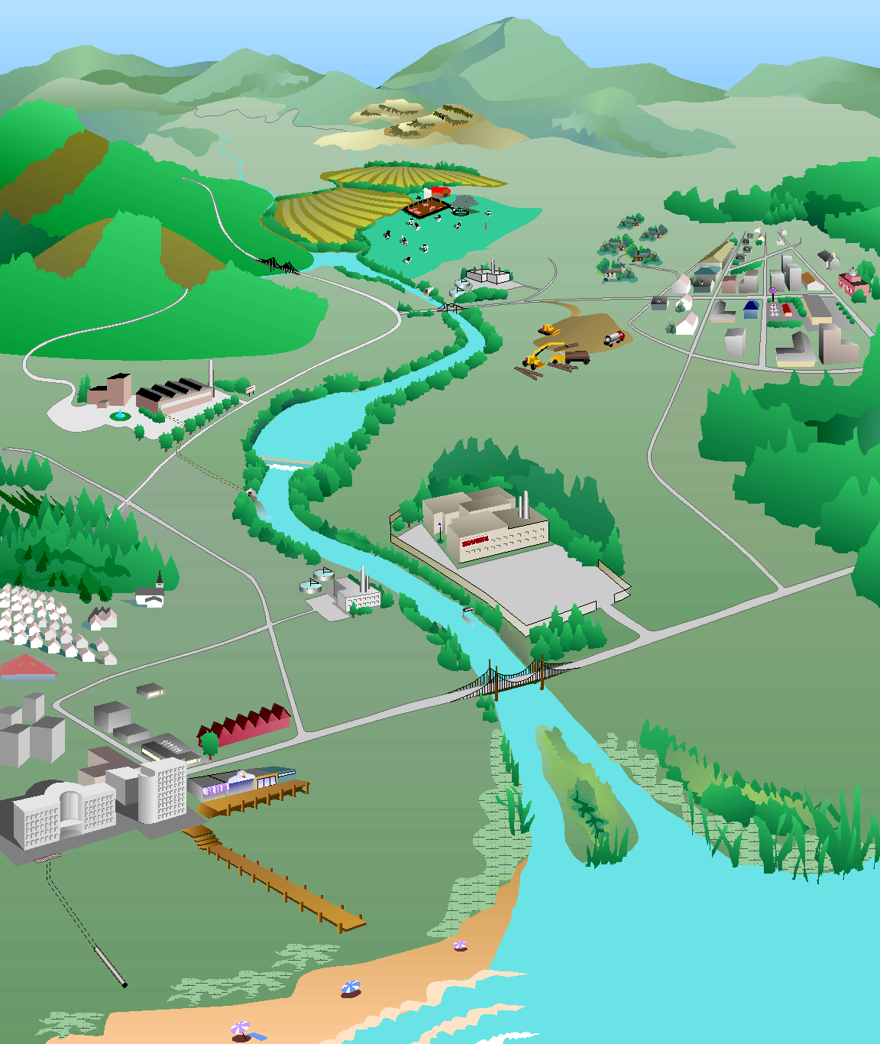
How do we develop a TMDL?
What’s the magic number…
Identify sources of the pollutant
Model their path to the stream
Determine reductions needed from each source to meet standard
Forest:
0% reduction
Forest:
1 ton/yr
Cropland:
30% reduction
Cropland:
10 tons/yr
Residential:
50% reduction
Residential:
4 tons/yr
Pasture:
12 tons/yr
Pasture:
40% reduction
Urban:
75% reduction
Urban:
8 tons/yr
Impaired stream
Sediment load = 37 tons/yr
TMDL
Sediment load = 19 tons/yr
Point sources:
2 tons/yr
Point sources:
0% reduction
Diagram: Adapted from the Center for TMDL and Watershed Studies at Virginia Tech

Slide 17
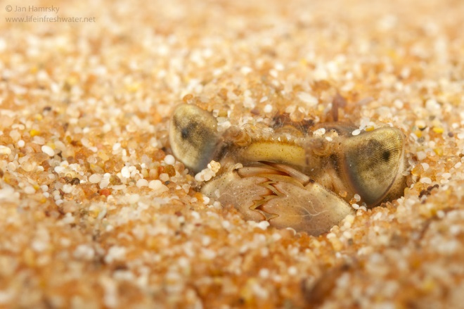
Biological Impairments:
Determining the cause…
Benthic stressor analysis
  Evaluation of monitoring data
  Comparison with reference watershed data
  Weight of evidence approach
  Identification of most likely stressor(s)
TMDL development for most likely stressor(s)
Photo: Jan Hamsky; www.lifeinfreshwater.net

Slide 18
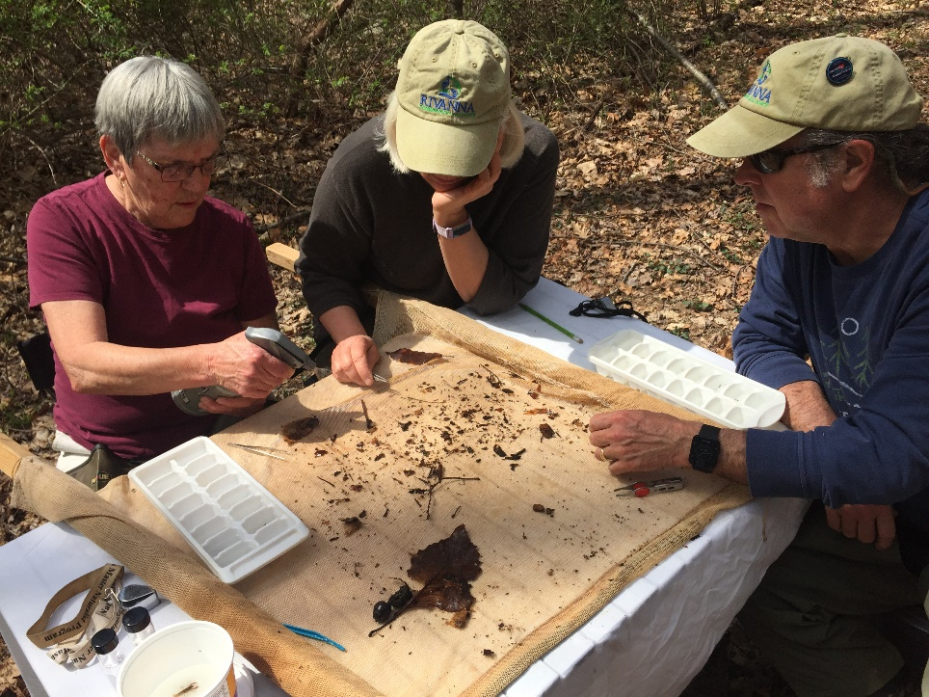
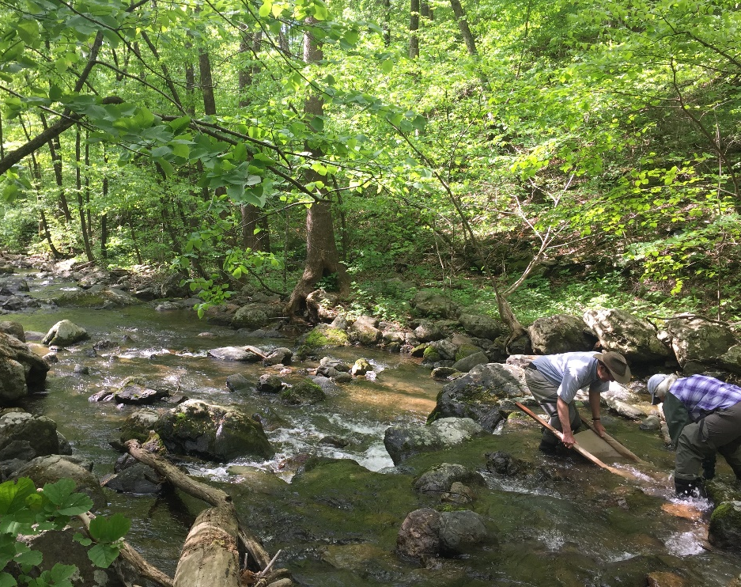
How can you get involved?
We need to hear from you!!!
Join the Technical Advisory Committee
  Represents the local community
  Provides feedback on
    Stressors to the benthic community
    Land use
    Pollutant sources
    Key stakeholders and community meetings
Become a volunteer monitor
  Get trained by the Rockbridge Water Monitors
  Contact Sandra Stuart for more information (sws.watershed@gmail.com)

Slide 19
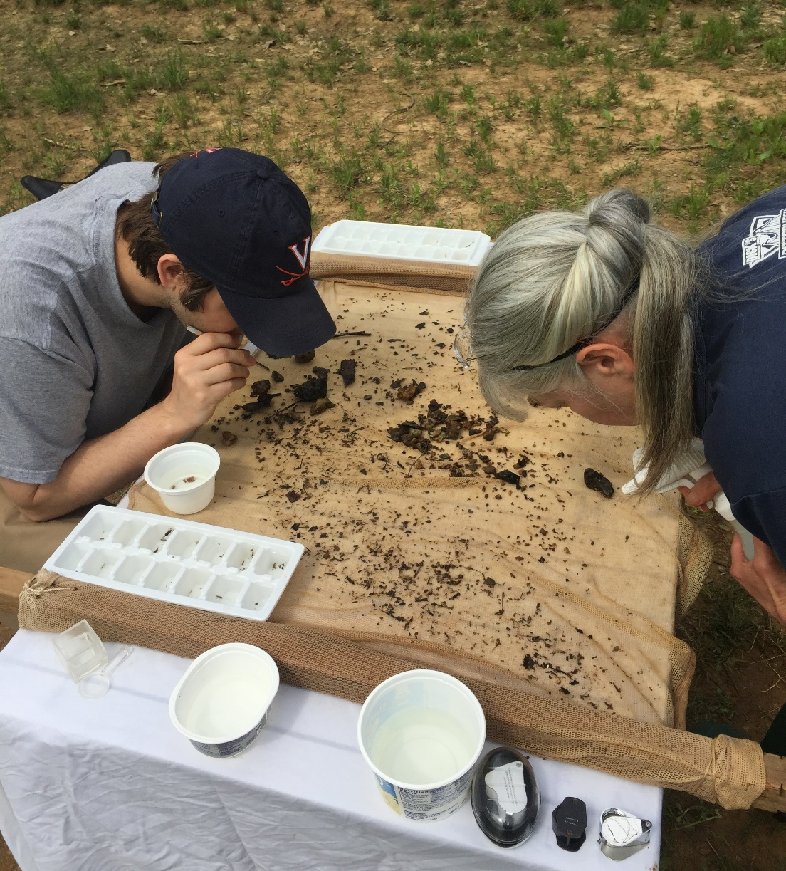
Join us for the first Technical Advisory Committee Meeting!
Jordans Point Park Picnic Pavilion
November 3, 2021
2:00 p.m. – 4:00 p.m.
What’s Next?

Slide 20
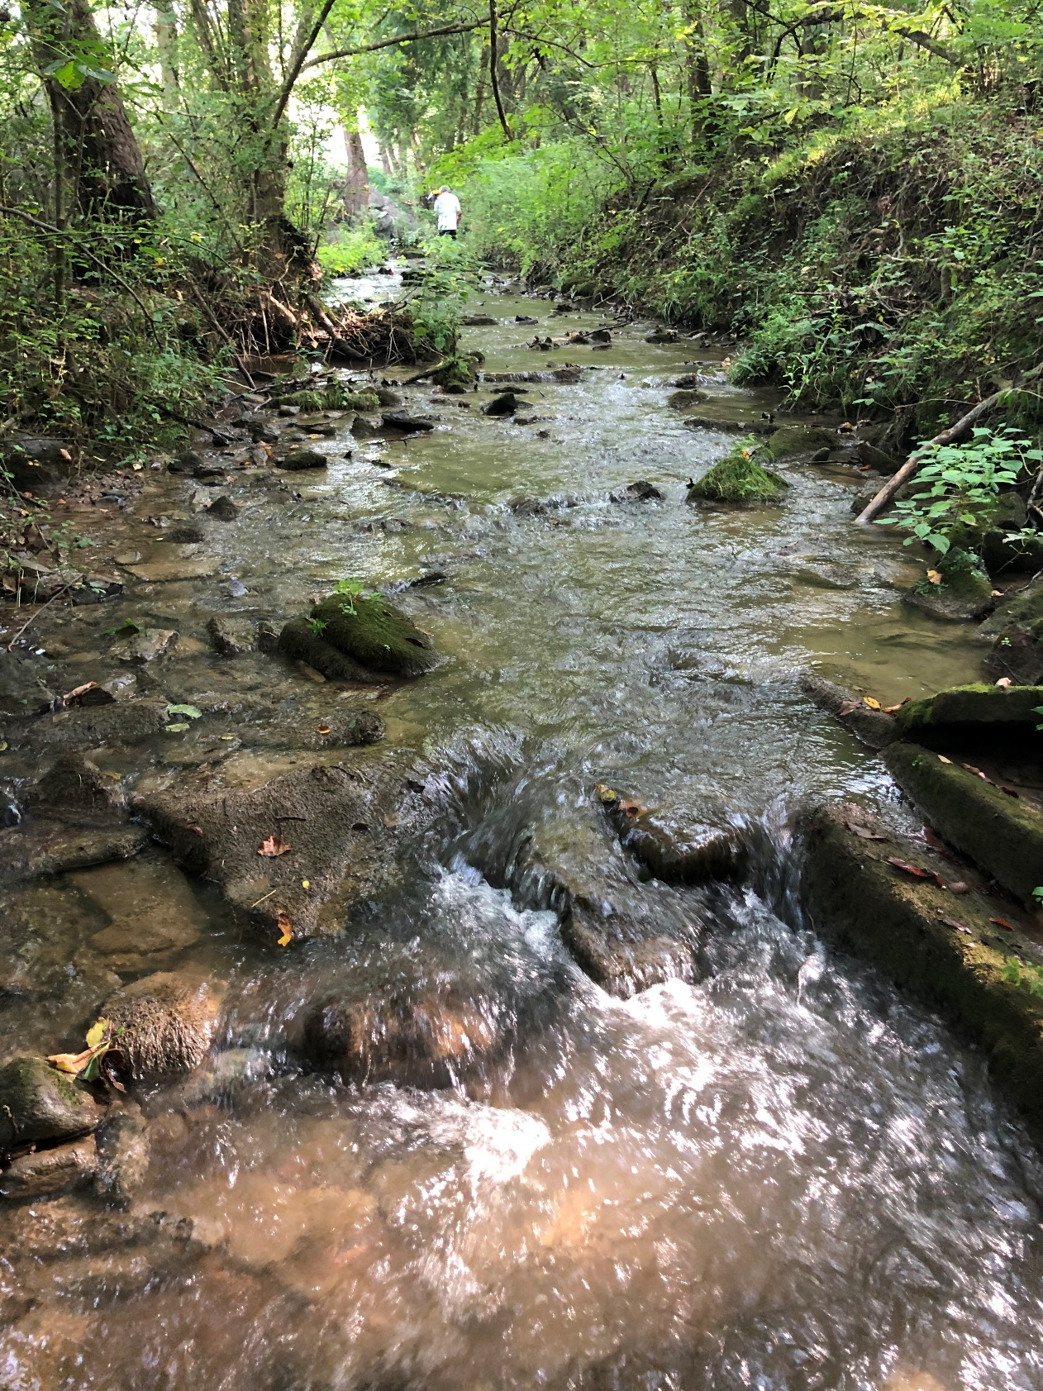
Questions & Comments
30-day public comment period (Oct. 20 – Nov. 18, 2021)
Send comments to:
Nesha McRae
PO Box 3000
Harrisonburg, VA 22801
Nesha.mcrae@deq.virginia.gov

